Slide 1
C7081 Lab 01 data warmup
Course introduction
Dr. Ed Harris

Slide 2
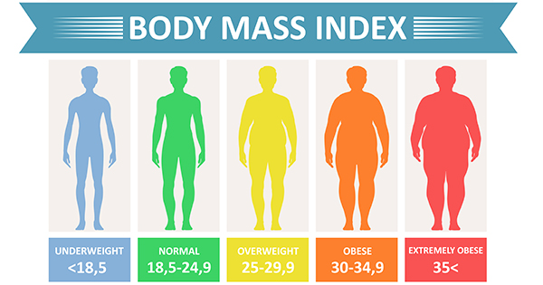
Activity 01: BMI data

Slide 3
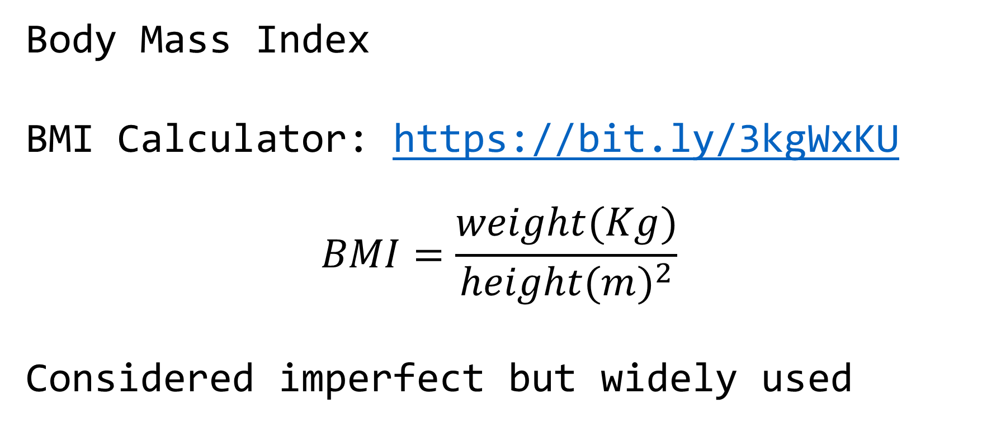
Activity 01: BMI data
Body Mass Index
BMI Calculator: https://bit.ly/3kgWxKU
$$BMI=\frac{weight(Kg)}{height(m)^{2}}$$
Considered imperfect but widely used

Slide 4

Activity 01: BMI data
Tidy data concept

Slide 5
Activity 01: BMI data
Data dictionary present
Simple variable names, first row
Simple data structure, 1 row per obs.
No extraneous info embedded
E.g. Excel: 1st tab data, 2nd tab data dictionary

Slide 6
Activity 01: BMI data
Files:
bmi_f.txt, bmi_m.txt (tab delimited text)
“ID”, subject ID within each file
“steps”, # steps / wk past 16 weeks
“bmi”, bmi measure
Also, gender is indicated (obviously)

Slide 7
Activity 01: BMI data
Your task:
Convert the data to a tidy data format in a single .xlsx file
~15 minutes + scrutiny
We will scrutinize and discuss
Go!

Slide 8
Activity 02 - analyse BMI data
Receive individual “instructions”
Plain reproducible R script (template)
Perform analysis ~30 mins
Do not discuss with others
Discussion of findings (~30 mins)
Go!

Slide 9
Activity 02 - analyse BMI data
What did you find?
Ed script
Discuss (~15 mins)
Yanai paper

Slide 10
Activity 03: BMI data report
Formated “dynamic” reports using R Markdown
Markdown is a language
Rmd is “R flavoured Markdown”

Slide 11
Activity 03: BMI data report
Go for “document”, HTML output (NB pdf, word options): Demonstration
A report should usually be structured with the “seen” sections: Title, Summary, Background, Results, Bibliography
NB there may be “unseen” sections

Slide 12
Activity 03: BMI data report
Title + details - descriptive title
Set in the YAML (“YAML ain’t Markup Language”: recursive acronym…) header
Summary
Summary of major findings - written LAST

Slide 13
Activity 03: BMI data report
Background
Functions like and introduction section in a scientific paper. The most important part is the list of OBJECTIVES
Results Graphs, stats results, terse, clear, technical style

Slide 14
Activity 03: BMI data report
Bibliography
If relevant, mostly cited in Background, or possibly in Results if there are methods citations
NB a markdown document is “freeform” ; the structure I suggest here is a minimal example for good practice

Slide 15
Activity 03: BMI data report
Make your own report (~45 mins)
https://dsgarage.netlify.app/bootcamp/3.2-m3-rmarkdown/
Discuss and critique resulting reports and code (~45 mins)

