Slide 1








- note about "lecture capture" announcement
- Note about progress
- Website updates
- HARUG
- bird tables problem
- Q & A

Slide 2





Priorities
- Stay on schedule
- Lectures & Labs > Exercises & Text
- Survey of topics versus mastery

Slide 3
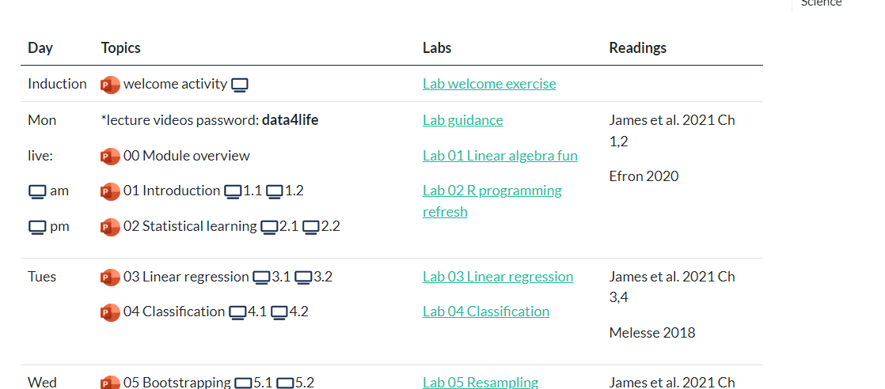













Slide 4





















