Slide 1
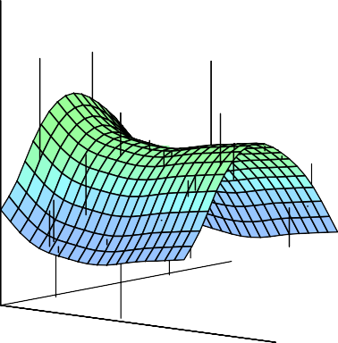
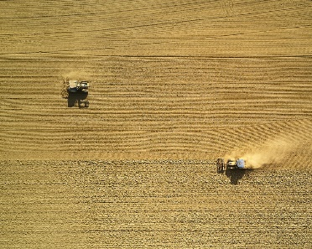

Statistical Analysis for Data Science C7081
Ed Harris
•
•
•
•
•
•
•• • •• • •• •
• ••••
•
•
• • •
••
• ••
•
••
•
•
•
•
•
•
•
•
• •
•
•

Slide 2
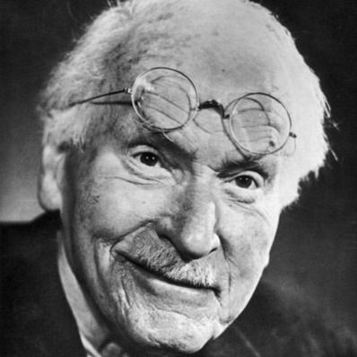
09: Support vector machines
“Every individual is an exception to the rule”
-Carl Jung

Slide 3
Support Vector Machines
Here we approach the two-class classification problem in a direct way:
We try and find a geometric plane that separates the classes in feature space.
If we cannot, we get creative in two ways:
We soften what we mean by “separates”, and
We enrich and enlarge the feature space so that separation is possible.
3 / 21

Slide 4

What is a Hyperplane?
A hyperplane in p dimensions is a flat affine subspace of dimensions p − 1.
In general the equation for a hyperplane has the form
β₀ + β₁X₁ + β₂X₂ + . . . + β_{p}X_{p} = 0
In p = 2 dimensions a hyperplane is a line.
If β₀ = 0, the hyperplane goes through the origin, otherwise not.
The vector β = (β₁, β₂, · · · , β_{p}) is called the normal vector
— it points in a direction orthogonal to the surface of a hyperplane.
4 / 21

Slide 5
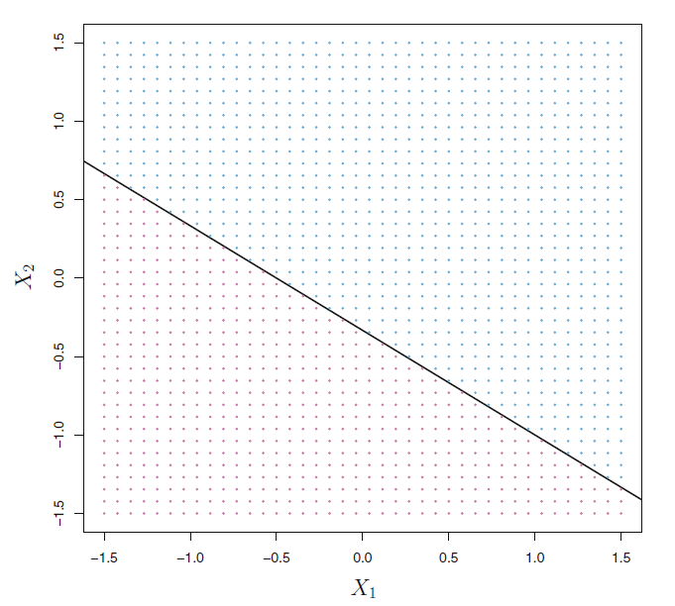
The hyperplane 1 + 2X1 + 3X2 = 0 is shown. The blue region is
the set of points for which 1+2X1 +3X2 > 0, and the purple region is the set of points for which 1 + 2X1 +3X2 < 0.

Slide 6
Hyperplane in 2 Dimensions
10
8
β=(β₁,β₂)
●
●
6
β₁X₁+β₂X₂−6=1.6
β₁X₁+β₂X₂−6=0
●
X₂
4
●
β₁X₁+β₂X₂−6=−4
2
●
●
0
−2
β₁ = 0.8
β₂ = 0.6
−2
0
2
4
6
8
10
X₁
6 / 21

Slide 7
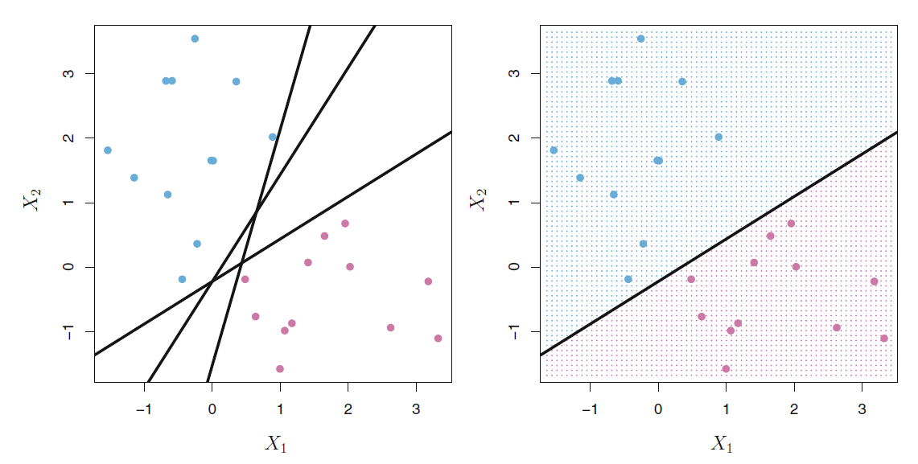
Separating Hyperplanes
Left: There are two classes of observations, shown in blue and in purple; each has measurements on two variables (X₁, X₂). Three separating hyperplanes, out of many possible, are shown in black.
Right: A separating hyperplane is shown in black. The blue and purple grid indicates the decision rule made by a classifier based on this separating hyperplane: a test observation that falls in the blue portion of the grid will be assigned to the blue class, and a test observation that falls into the purple portion of the grid will be assigned to the purple class.
7 / 21

Slide 8
Separating Hyperplanes
If f (X) = β₀ + β₁X₁ + · · · + β_{p}X_{p}, then f (X) > 0 for points on one side of the hyperplane, and f (X) < 0 for points on the other.
If we code the colored points as Y_{i} = +1 for blue, say, and Y_{i} = −1 for mauve, then if Y_{i} · f (X_{i}) > 0 for all i, f (X) = 0 defines a separating hyperplane.
8 / 21

Slide 9
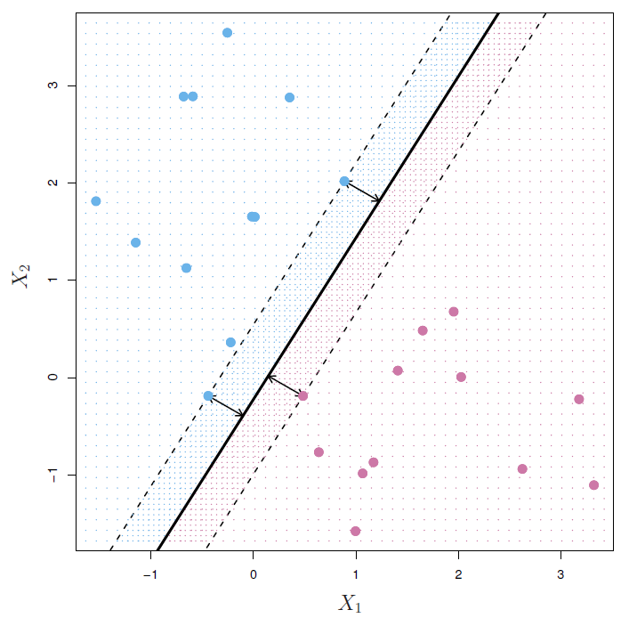
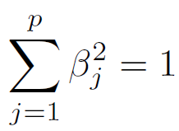
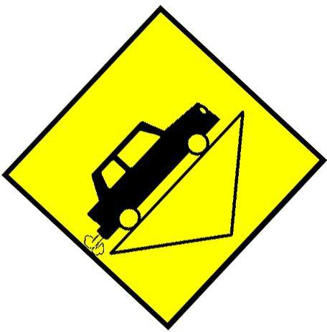
Maximal Margin Classifier
Among all separating hyperplanes, find the one that makes the biggest gap or margin between the two classes.
Constrained optimization problem
maximize M
β0 ,β1 ,...,βp
subject to
y_{i}(β₀ + β₁x_{i1} + . . . + β_{p}x_{ip}) ≥ M
for all i = 1, . . . , N.
This can be rephrased as a convex quadratic program, and solved efficiently. The function svm() in package e1071 solves
this problem efficiently
5 / 21

Slide 10
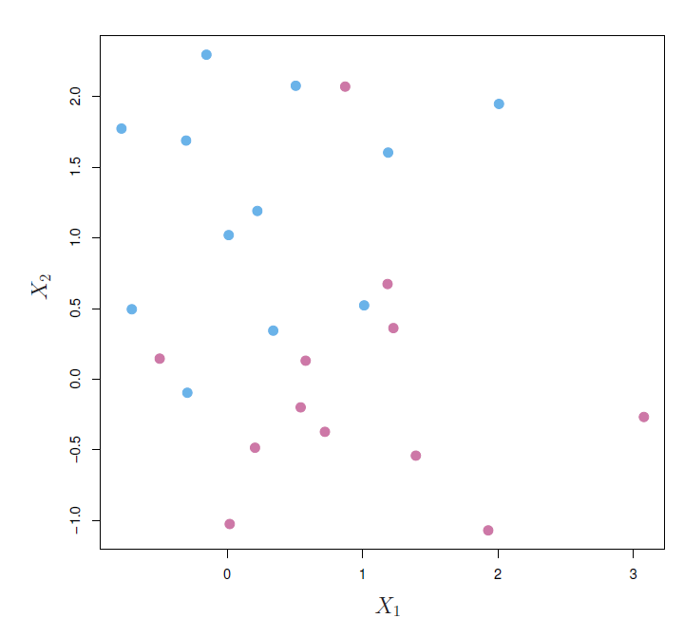
Non-separable Data
The data on the left are not possible to separate by a linear boundary.
This is often the case, unless N < p.
10 / 21

Slide 11
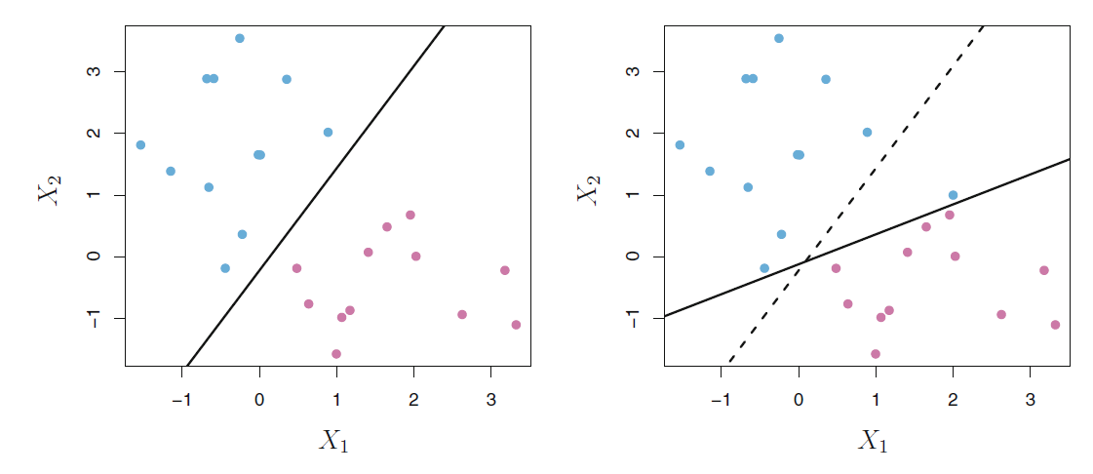
Noisy Data
Left: Two classes of observations are shown in blue and in
purple, along with the maximal margin hyperplane.
Right: An additional blue observation has been added, leading to a dramatic shift in the maximal margin hyperplane shown as a solid line. The dashed line indicates the maximal margin hyperplane that was obtained in the absence of this additional point.
11 / 21

Slide 12
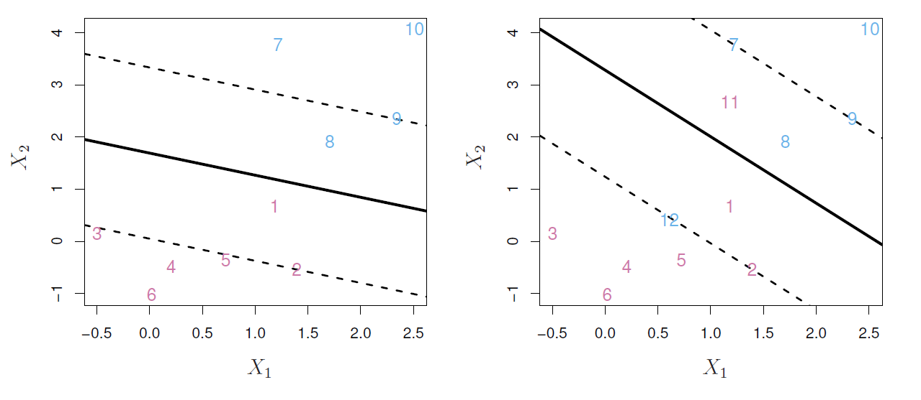
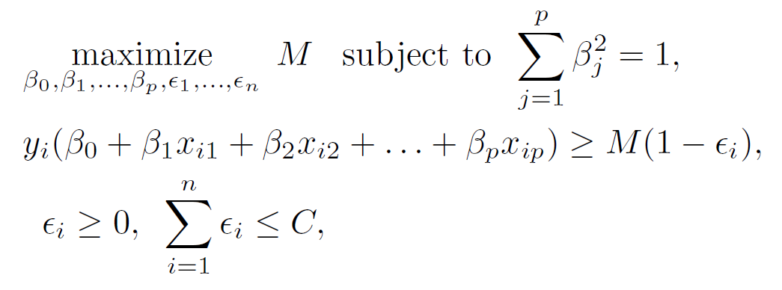
Support Vector Classifier
12 / 21

Slide 13
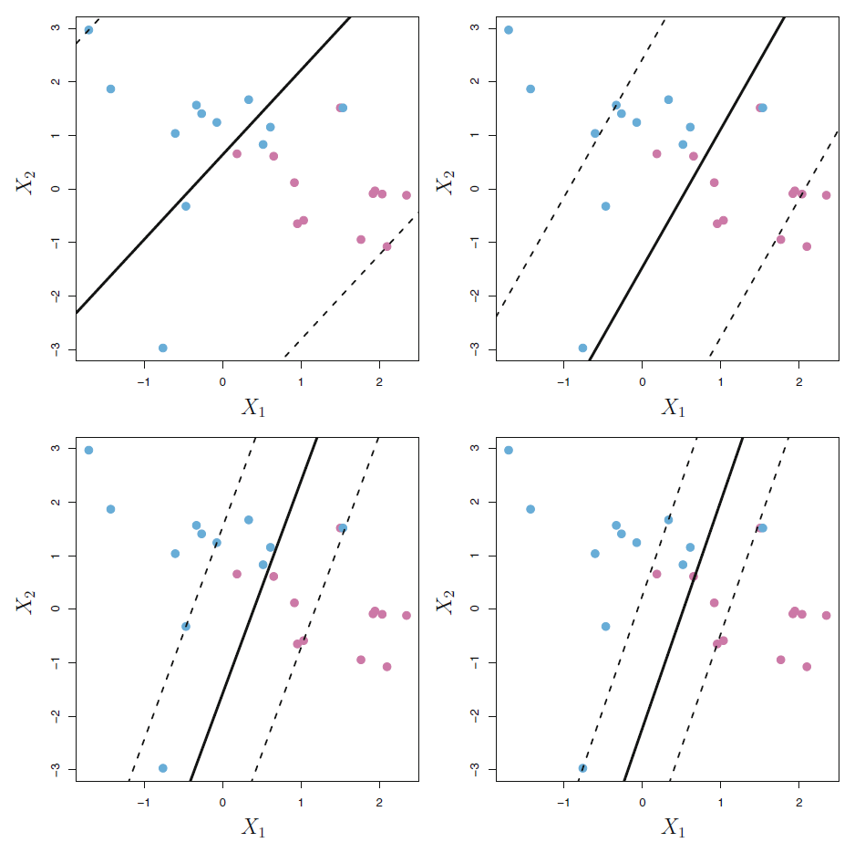
C is a regularization parameter
A support vector classifier was fit using four different values of the tuning parameter C.
The largest value of C was used in the top left panel, and smaller values were used in the top right, bottom left, and bottom right panels. When C is large, then there is a high tolerance for observations being on the wrong side of the margin, and so the margin will be large. As C decreases, the tolerance for observations being on the wrong side of the margin decreases, and the margin narrows.

Slide 14
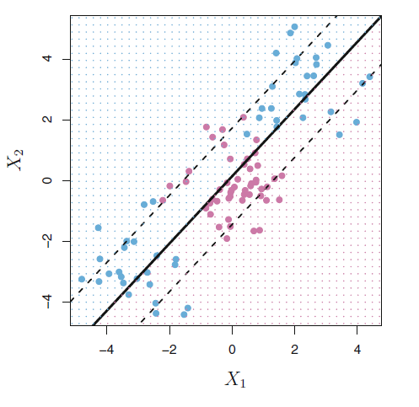

Linear boundary can fail
Sometime a linear boundary simply won’t work, no matter what value of C.
The example here is such a case.
What to do?

Slide 15
Feature Expansion
Enlarge the space of features by including transformations;
e.g. X², X³, X₁X₂, X₁X²,. . .. Hence go from a
1 1 2
p-dimensional space to a M > p dimensional space.
Fit a support-vector classifier in the enlarged space.
This results in non-linear decision boundaries in the original space.

Slide 16
Feature Expansion
Example: Suppose we use (X₁, X₂, X², X², X₁X₂) instead of
1 2
just (X₁, X₂). Then the decision boundary would be of the form
β₀ + β₁X₁ + β₂X₂ + β₃X² + β₄X² + β₅X₁X₂ = 0
1 2
This leads to nonlinear decision boundaries in the original space (quadratic conic sections).

Slide 17
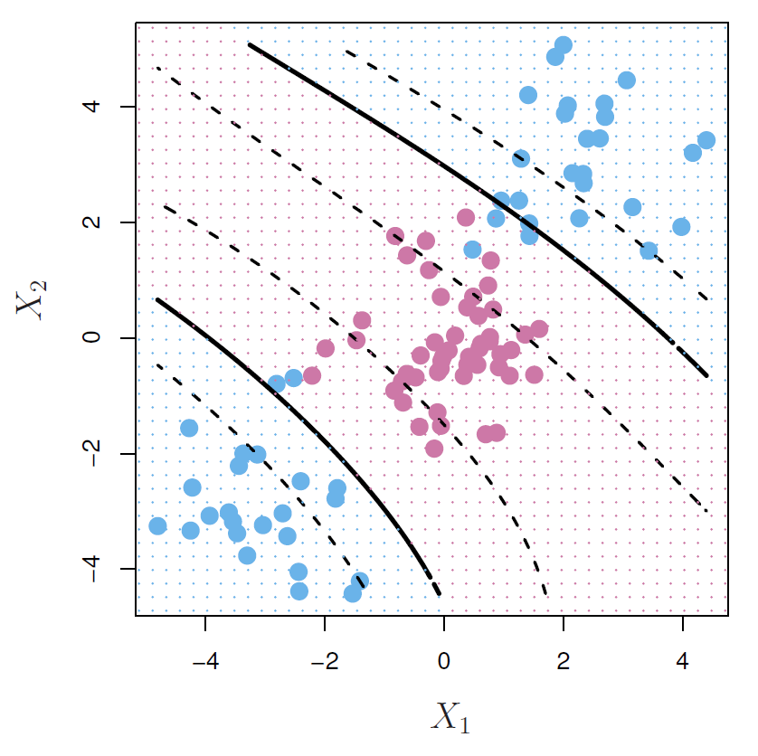
Cubic Polynomials
Here we use a basis expansion of cubic polynomials.
From 2 variables to 9 the support-vector classifier in the enlarged space solves the problem in the lower-dimensional space.
β0 +β1X1 +β2X2 +β3X² +β4X² +β5X1X2 +β6X³ +β7X³ +β8X1X² +β9X²X2 = 0
1 2 1 2 2 1

Slide 18

Nonlinearities and Kernels
Polynomials (especially high-dimensional ones) get wild rather fast.
There is a more elegant and controlled way to introduce nonlinearities in support-vector classifiers — through the use of kernels.
Before we discuss these, we must understand the role of inner products in support-vector classifiers.

Slide 19
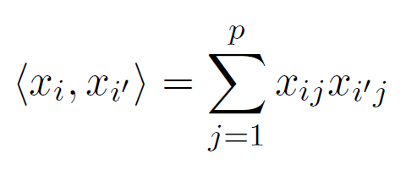
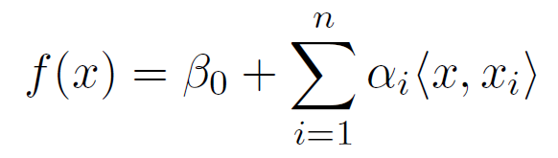
Inner products and support vectors
— inner product between vectors
The linear support vector classifier can be represented as
— n parameters
14 / 21

Slide 20
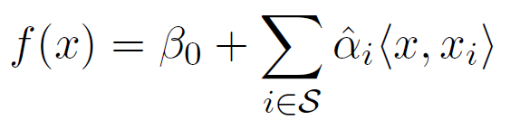
Inner products and support vectors
To estimate the parameters α₁, . . . , α_{n} and β₀, all we need
n
are the inner products
x
between all pairs of
2
training observations.
It turns out that most of the αˆ_{i} can be zero:
S is the support set of indices i such that αˆ_{i} > 0.
14 / 21

Slide 21
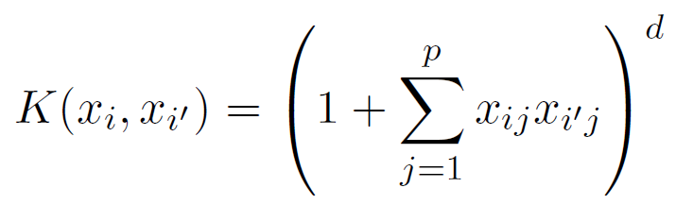
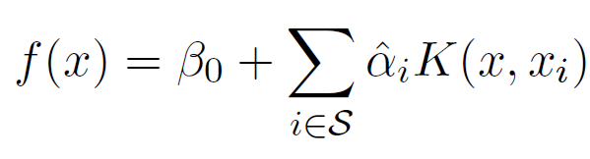
Kernels and Support Vector Machines
If we can compute inner-products between observations, we can fit a SV classifier. Can be quite abstract!
Some special kernel functions can do this for us. E.g.
computes the inner-products needed for d dimensional
polynomials
P +d
basis functions!
d
Try it for p = 2 and d = 2.
The solution has the form
15 / 21

Slide 22
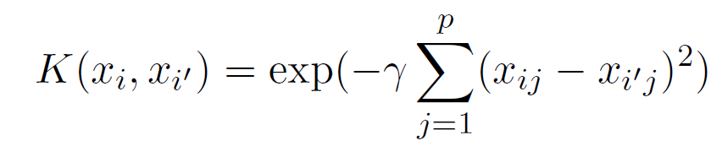
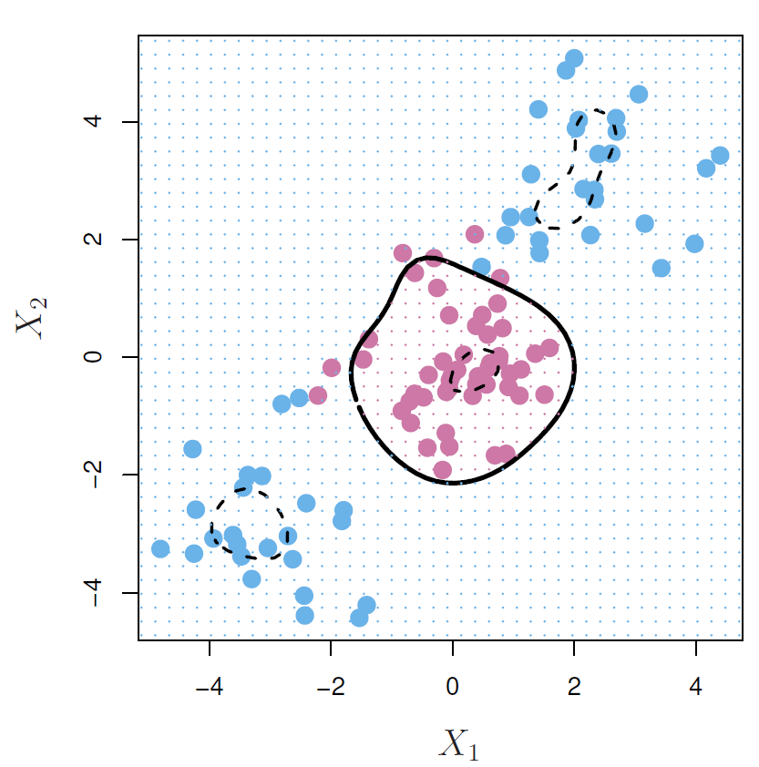
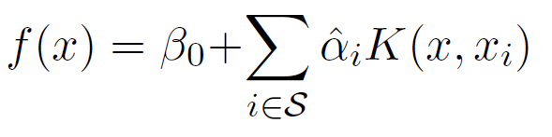
Radial Kernel
Implicit feature space; very high dimensional.
Controls variance by squashing down most dimensions severely
16 / 21

Slide 23
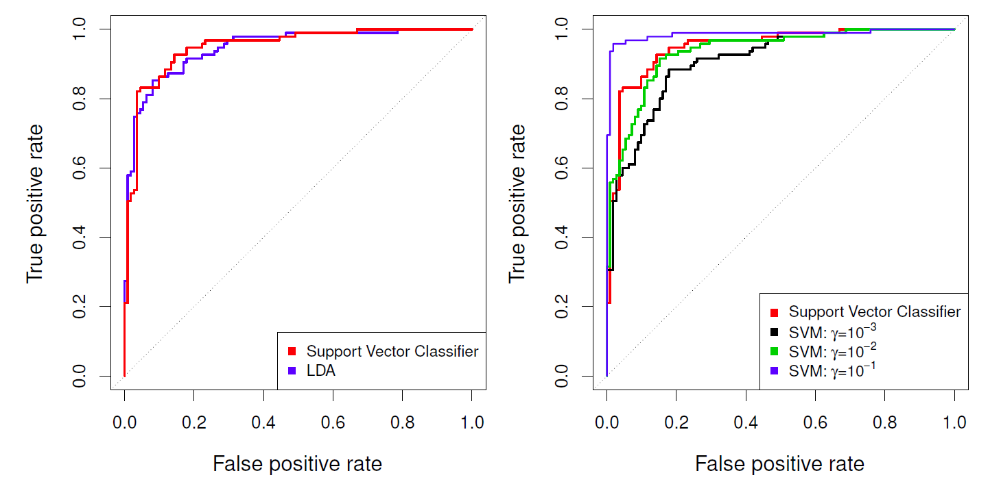
Example: Heart Data
ROC curves for the Heart data training set. Left: The support vector classifier and LDA are compared. Right: The support vector classifier is
compared to an SVM using a radial basis kernel with γ = 10⁻³, 10⁻², and 10⁻¹

Slide 24
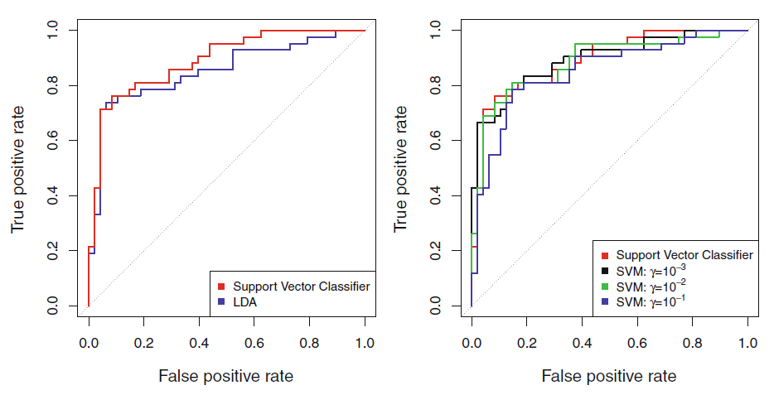
Example continued: Heart Test Data
ROC curves for the test set of the Heart data. Left: The support
vector classifier and LDA are compared. Right: The support vector classifier is compared to an SVM using a radial basis kernel with γ = 10⁻³, 10⁻², and 10⁻¹

Slide 25
SVMs: more than 2 classes?
The SVM as defined works for K = 2 classes. What do we do if we have K > 2 classes?
OVA One versus All. Fit K different 2-class SVM classifiers f^{ˆ}_{k}(x), k = 1, . . . , K; each class versus the rest. Classify x∗ to the class for which f^{ˆ}_{k}(x∗) is largest.
K
OVO One versus One. Fit all pairwise classifiers
2
f^{ˆ}_{kl}(x). Classify x∗ to the class that wins the most pairwise competitions.
Which to choose? If K is not too large, use OVO.

Slide 26
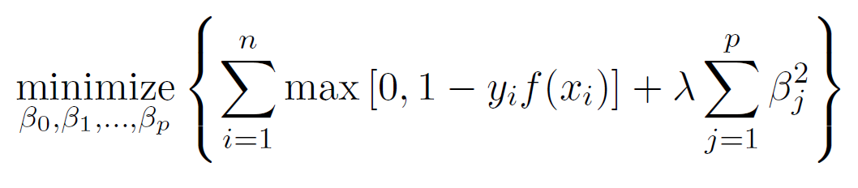
Support Vector versus Logistic Regression?
With f (X) = β₀ + β₁X₁ + . . . + β_{p}X_{p} can rephrase support-vector classifier optimization as
8
SVM Loss
Logistic Regression Loss
This has the form loss plus penalty.
The loss is known as the hinge loss.
Very similar to “loss” in logistic regression (negative log-likelihood).
6
Loss
4
2
0
−6
−4 −2 0 2
yi(β0 + β1xi1 + . . . + βpxip)

Slide 27
Which to use: SVM or Logistic Regression
When classes are (nearly) separable, SVM does better than LR. So does LDA.
When not, LR (with ridge penalty) and SVM perform similarly.
If you wish to estimate probabilities, LR is the choice.
For nonlinear boundaries, kernel SVMs are popular. Can use kernels with LR and LDA as well, but computations are more expensive.

