Slide 1
MSc in Data Science for Global Agriculture, Food & Environment
Course introduction
Dr. Ed Harris

Slide 2

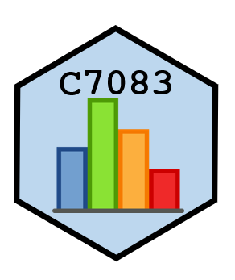

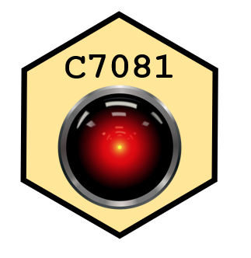



Slide 3
Ed Contact
Twitter: @EdHarris9000, @adams_data
email: eharris@harper-adams.ac.uk
Google scholar: research record

Slide 4
Ed Bio
Ed Harris
PhD Statistics, BSc genetics
15 years biostatistical research and consulting

Slide 5
Ed Bio
Research:
Conservation ecology, machine learning, experimental design, animal welfare, agri-tech, crop yield

Slide 6
Ed Bio
Current interests:
-Deep learning applications, Data Science applications, Automation of biodiversity data capture, Ag Engineering applications
(and sheep, cats, motorcycles, and acoustic guitar)

Slide 7
Community
Slack:
Join with Harper email address!
Harper Adams MSc Slack
Harper Adams R Users Slack

Slide 8
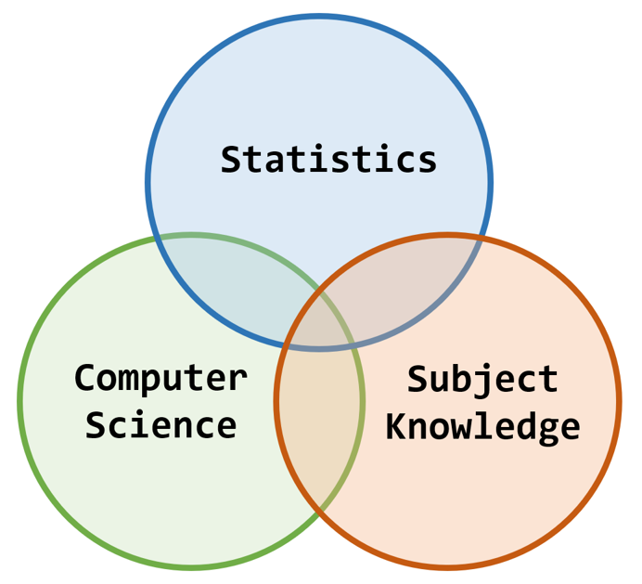
Why are we here?
Venn mania: https://bit.ly/3kiXy5s

Slide 9
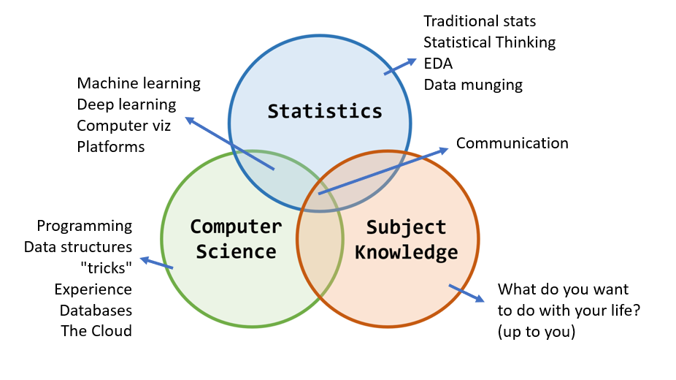
Why are we here?

Slide 10
# Why are we here?
Course schedule (timetable)
Mention Moodle (the Hub)

Slide 11
# Why are we here?
Hardware or software questions, resources?
(do) We need to talk about Kevin Python
Norm Matloff on R vs Python

Slide 12
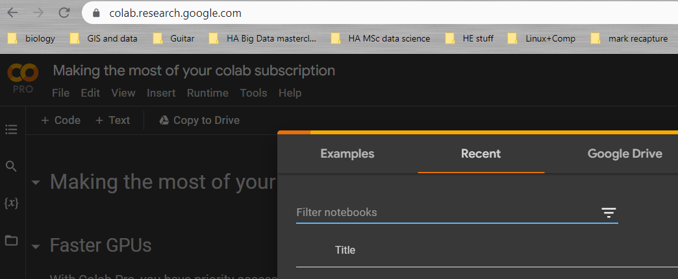
Some things to do after today
Google account

Slide 13
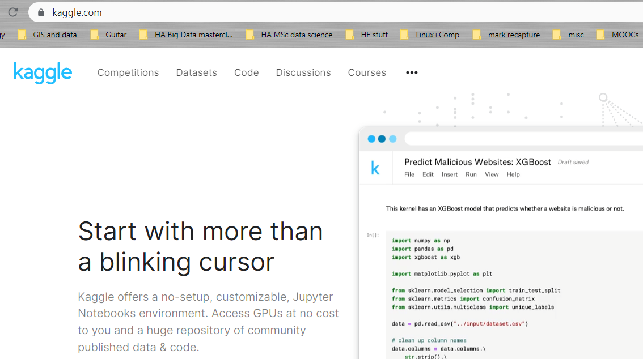
Some things to do after today
Kaggle account

Slide 14
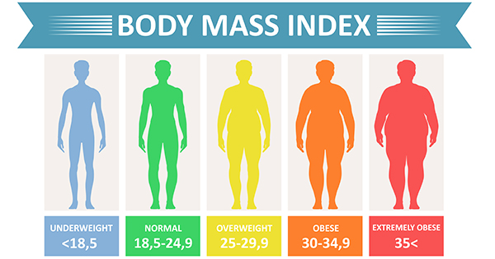
Activity 01: BMI data

Slide 15
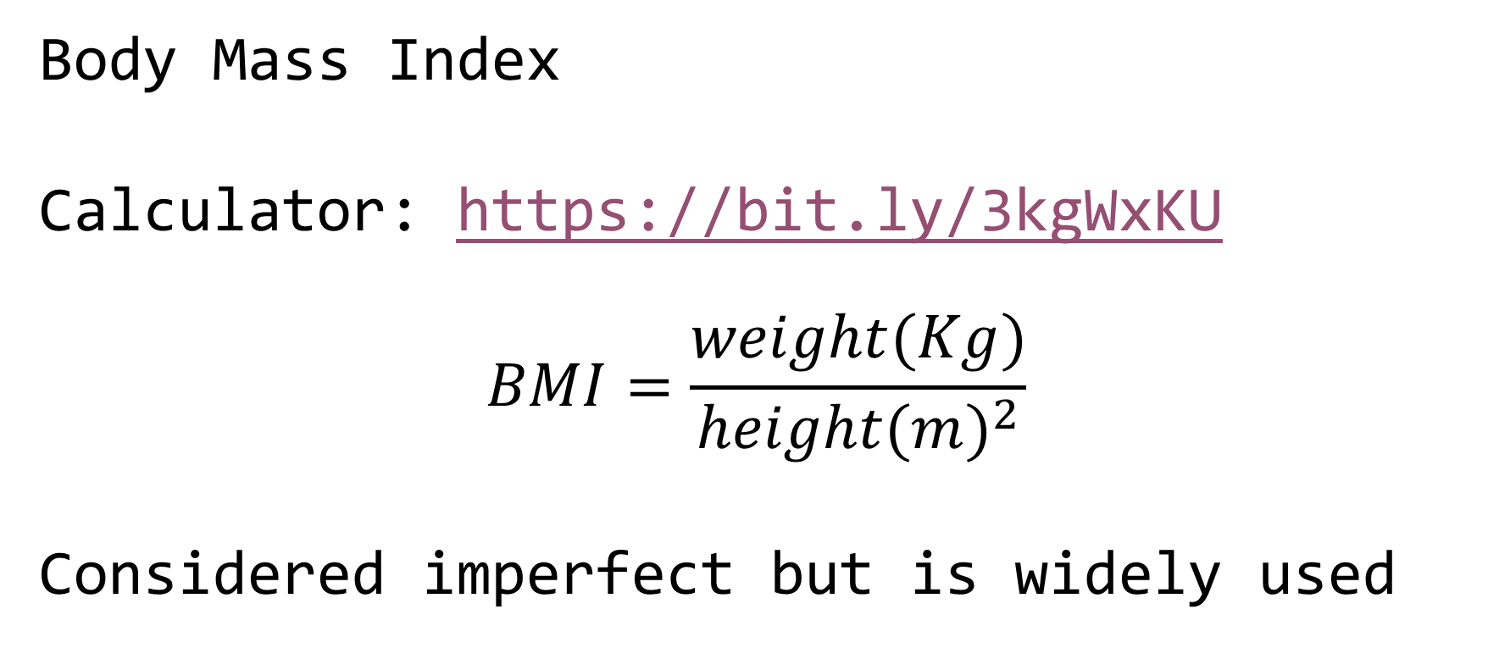
Activity 01: BMI data
Body Mass Index
Calculator: https://bit.ly/3kgWxKU
$$BMI=\frac{weight(Kg)}{height(m)^{2}}$$
Considered imperfect but is widely used

Slide 16

Activity 01: BMI data
Concept of tidy data

Slide 17
Activity 01: BMI data
Data dictionary present
Simple variable names, first row
Simple data structure, 1 row per obs.
No extraneous info embedded
E.g. Excel: 1st tab data, 2nd tab data dictionary

Slide 18
Activity 01: BMI data
Files:
bmi_f.txt, bmi_m.txt (tab delimited text)
“ID”, subject ID within each file
“steps”, # steps / wk past 16 weeks
“bmi”, bmi measure
Also, gender is indicated (obviously)

Slide 19
Activity 01: BMI data
Your task:
Convert the data to a tidy data format in a single .xlsx file
Do this using only R code
~15 minutes + scrutiny
We will scrutinize and discuss
Go!

Slide 20
Activity 02 - analyse BMI data
Receive individual “instructions”
Perform analysis ~30 mins
Do not speak to others
Discussion of findings (~30 mins)
Go!

Slide 21
Activity 02 - analyse BMI data
What did you find?
Ed script
Discuss (~15 mins)
Yanai paper

Slide 22
Activity 03: BMI data report
Formated “dynamic” reports using R Markdown
Markdown is a language
Rmd is “R flavoured Markdown”

Slide 23
Activity 03: BMI data report
Go for “document”, HTML output (NB pdf, word options): Demonstration
A report should usually be structured with the “seen” sections: Title, Summary, Background, Results, Bibliography
NB there are usually several “unseen” sections

Slide 24
Activity 03: BMI data report
Title + details - descriptive title
Set in the YAML (“YAML ain’t Markup Language”: recursive acronym…) header
Summary
Summary of major findings - written LAST

Slide 25
Activity 03: BMI data report
Background
Functions like and introduction section in a scientific paper. The most important part is the list of OBJECTIVES
Results Graphs, stats results, terse, clear, technical style

Slide 26
Activity 03: BMI data report
Bibliography
If relevant, mostly cited in Background, or possibly in Results if there are methods citations
NB a markdown document is “freeform” ; the structure I suggest here is a minimal example for good practice

Slide 27
Activity 03: BMI data report
Make your own report (~45 mins)
https://dsgarage.netlify.app/bootcamp/3.2-m3-rmarkdown/
Discuss and critique resulting reports and code (~45 mins)

