Slide 1
MSc in Data Science for Global Agriculture, Food & Environment
Course introduction
Dr. Ed Harris

Slide 2

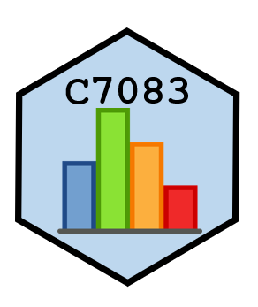

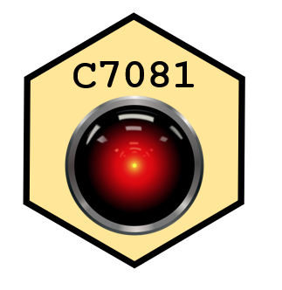



Slide 3
Ed Contact
Twitter: @EdHarris9000, @adams_data
email: eharris@harper-adams.ac.uk
Google scholar: research record

Slide 4
Ed Bio
Ed Harris
PhD Statistics, BSc genetics
15 years biostatistical research and consulting

Slide 5
Ed Bio
Research:
Conservation ecology, machine learning, experimental design, animal welfare, agri-tech, crop yield

Slide 6
Ed Bio
Current interests:
-Deep learning applications, Data Science applications, Automation of biodiversity data capture, Ag Engineering applications
(and sheep, cats, motorcycles, and acoustic guitar)

Slide 7
Community
Slack:
Join with Harper email address!
Harper Adams MSc Slack
Harper Adams R Users Slack

Slide 8
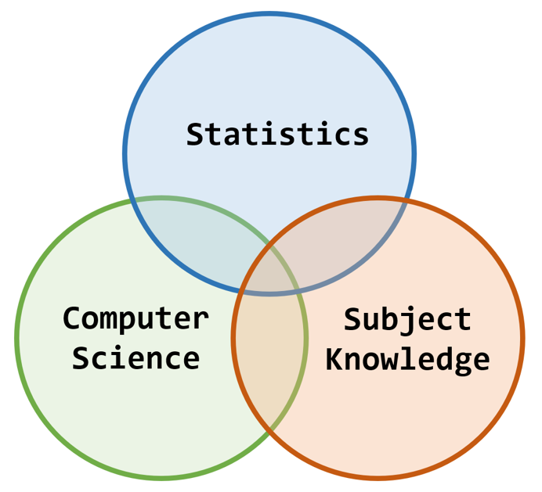
Why are we here?
Venn mania: https://bit.ly/3kiXy5s

Slide 9
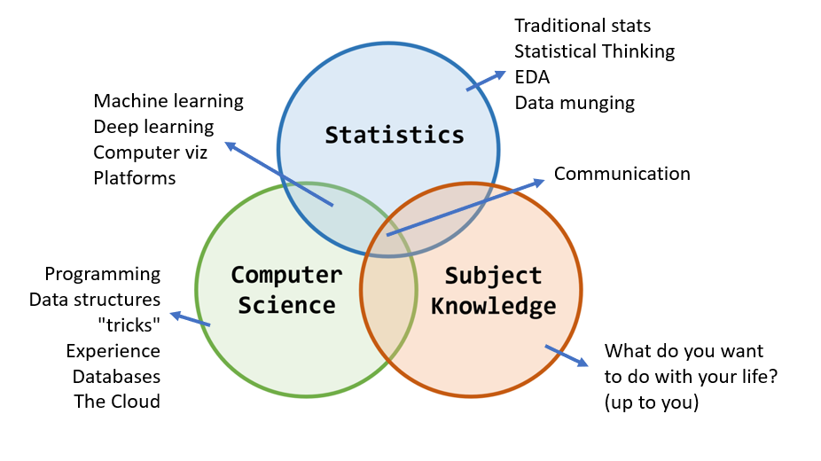
Why are we here?

Slide 10
# Why are we here?
Course schedule (timetable)
Mention Moodle (the Hub)

Slide 11
# Why are we here?
Hardware or software questions, resources?
(do) We need to talk about Kevin Python
Norm Matloff on R vs Python

Slide 12
Computer recommendations
All work we can or will do can be accomplished in "the cloud", making your local hardware and software less important.
Rstudio cloud (free time each month)
Google Colab (free)
Kaggle (free)
Amazon Sagemaker, etc. (free*)
Rough guidelines:
8 GB RAM (16 better)
Intel i7 (or better)
500GB HD or SSD (or more)
Windows (Mac or linux fine)

Slide 13









Software and computing

Slide 14
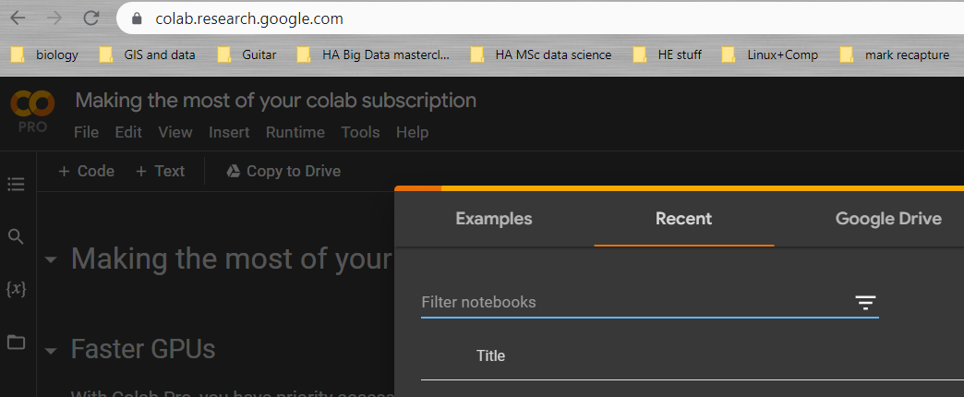
Some things to do after today
Google account

Slide 15
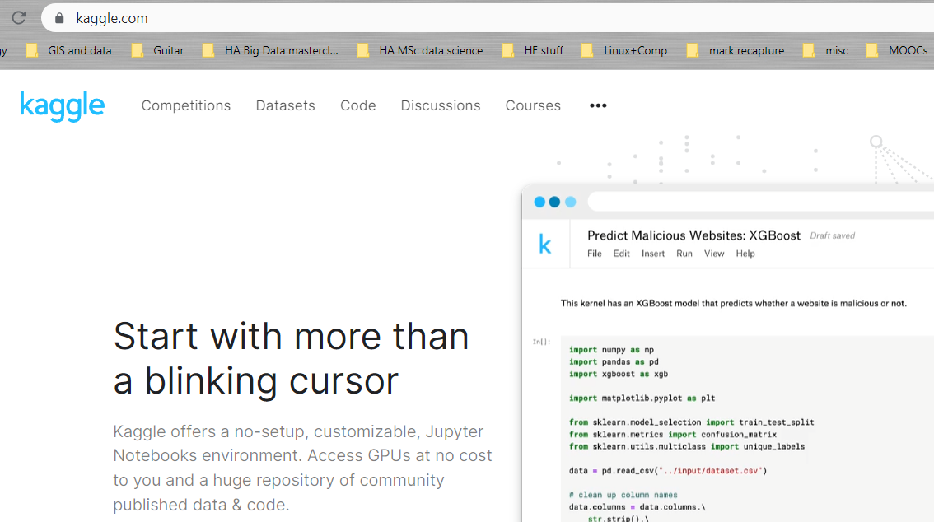
Some things to do after today
Kaggle account

Slide 16
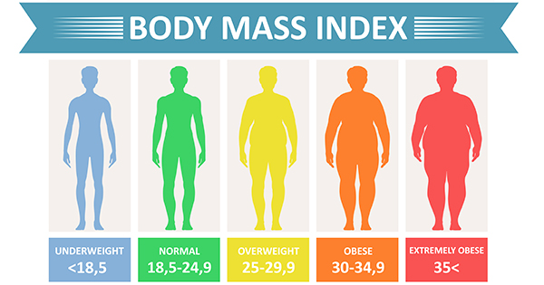
Activity 01: BMI data

Slide 17
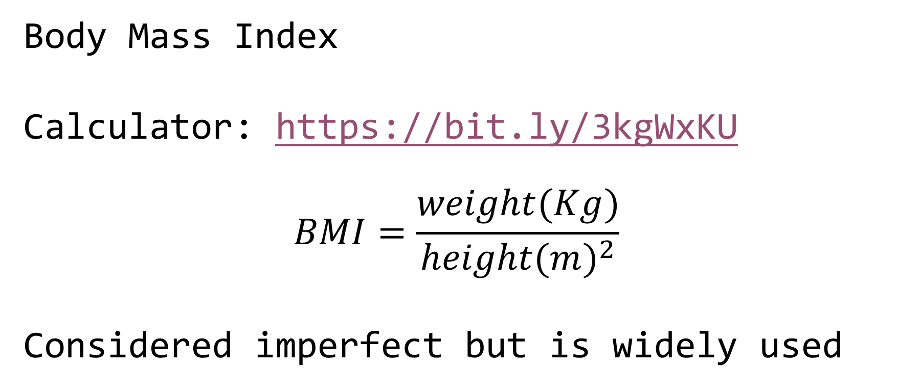
Activity 01: BMI data
Body Mass Index
Calculator: https://bit.ly/3kgWxKU
$$BMI=\frac{weight(Kg)}{height(m)^{2}}$$
Considered imperfect but is widely used

Slide 18

Activity 01: BMI data
Concept of tidy data

Slide 19
Activity 01: BMI data
Data dictionary present
Simple variable names, first row
Simple data structure, 1 row per obs.
No extraneous info embedded
E.g. Excel: 1st tab data, 2nd tab data dictionary

Slide 20
Activity 01: BMI data
Files:
bmi_f.txt, bmi_m.txt (tab delimited text)
“ID”, subject ID within each file
“steps”, # steps / wk past 16 weeks
“bmi”, bmi measure
Also, gender is indicated (obviously)

Slide 21
Activity 01: BMI data
Your task:
Convert the data to a tidy data format in a single .xlsx file
Do this using only R code
~15 minutes + scrutiny
We will scrutinize and discuss
Go!

Slide 22
Activity 02 - analyse BMI data
Receive individual “instructions”
Perform analysis ~30 mins
Do not speak to others
Discussion of findings (~30 mins)
Go!

Slide 23
Activity 02 - analyse BMI data
What did you find?
Ed script
Discuss (~15 mins)
Yanai paper

Slide 24
Activity 03: BMI data report
Formated “dynamic” reports using R Markdown
Markdown is a language
Rmd is “R flavoured Markdown”

Slide 25
Activity 03: BMI data report
Go for “document”, HTML output (NB pdf, word options): Demonstration
A report should usually be structured with the “seen” sections: Title, Summary, Background, Results, Bibliography
NB there are usually several “unseen” sections

Slide 26
Activity 03: BMI data report
Title + details - descriptive title
Set in the YAML (“YAML ain’t Markup Language”: recursive acronym…) header
Summary
Summary of major findings - written LAST

Slide 27
Activity 03: BMI data report
Background
Functions like and introduction section in a scientific paper. The most important part is the list of OBJECTIVES
Results Graphs, stats results, terse, clear, technical style

Slide 28
Activity 03: BMI data report
Bibliography
If relevant, mostly cited in Background, or possibly in Results if there are methods citations
NB a markdown document is “freeform” ; the structure I suggest here is a minimal example for good practice

Slide 29
Activity 03: BMI data report
Make your own report (~45 mins)
https://dsgarage.netlify.app/bootcamp/3.2-m3-rmarkdown/
Discuss and critique resulting reports and code (~45 mins)

