Slide 1
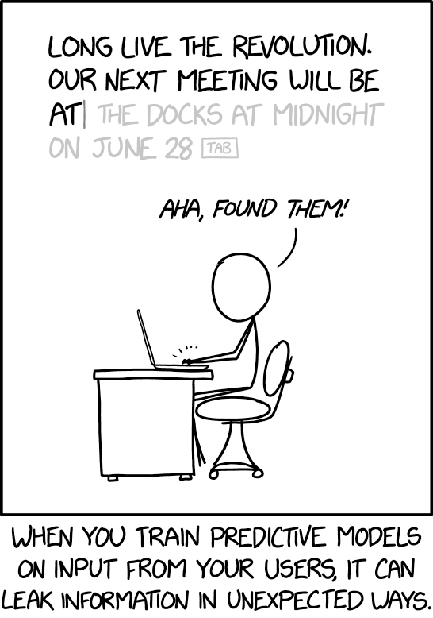
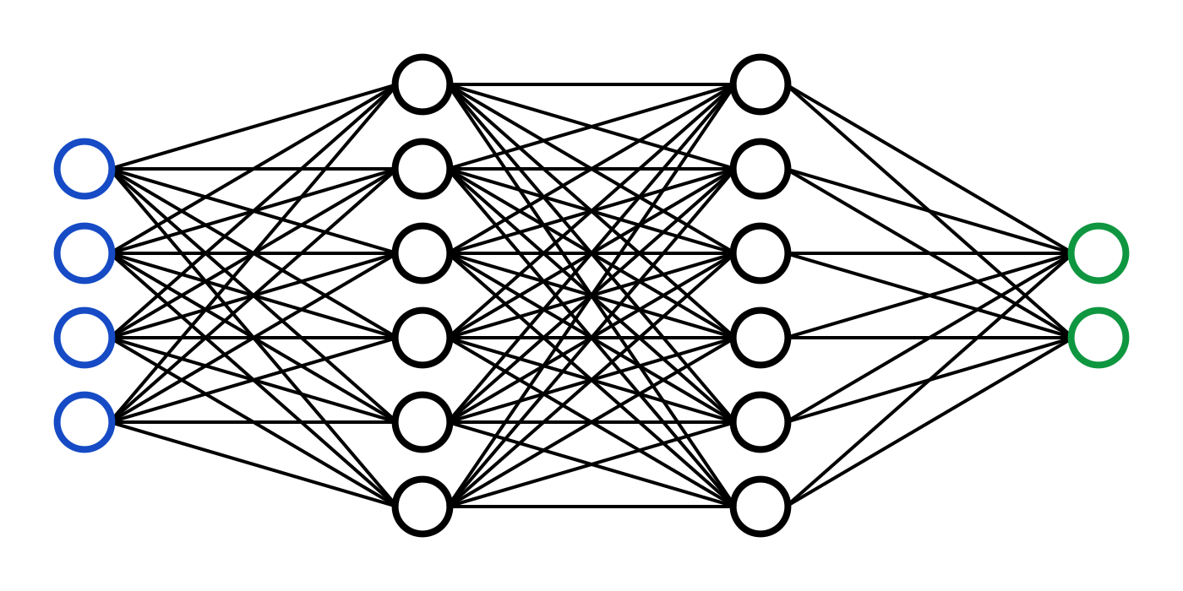
C7082 Techniques in Machine Learning and AI
Ed Harris

Slide 2
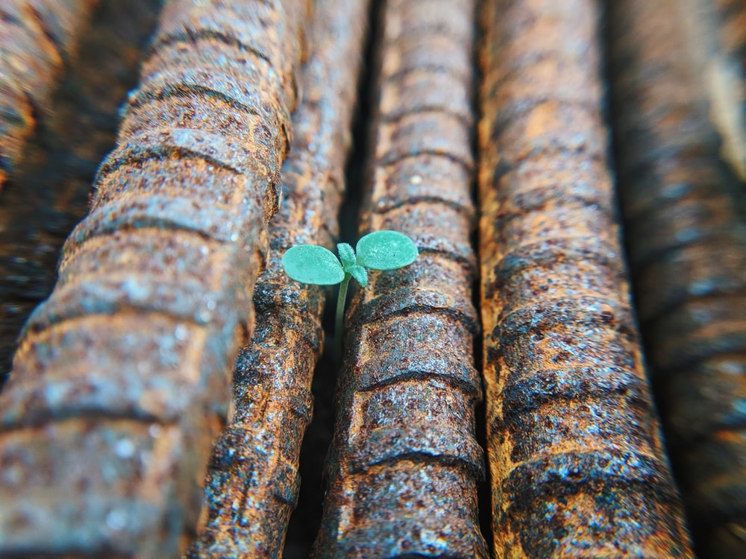
01 Introduction
How the module will work
How the labs will work
Overview of Deep learning and lectures

Slide 3
How the module will work
Meetings daily ~9:30a and 4p
- recorded lectures
- readings
- labs
Choose Python or R….
- some setup will be required
Lecture function
- Theory “taste”
Labs
- hacking, practical bits
- get idea of what is possible and how

Slide 4

Machine Learning and AI
Deep learning
Example: MLPs
Example: Shallow autoencoders
Example: Logistic regression
Example: Knowledge bases
Representation learning
Machine learning
AI

Slide 5
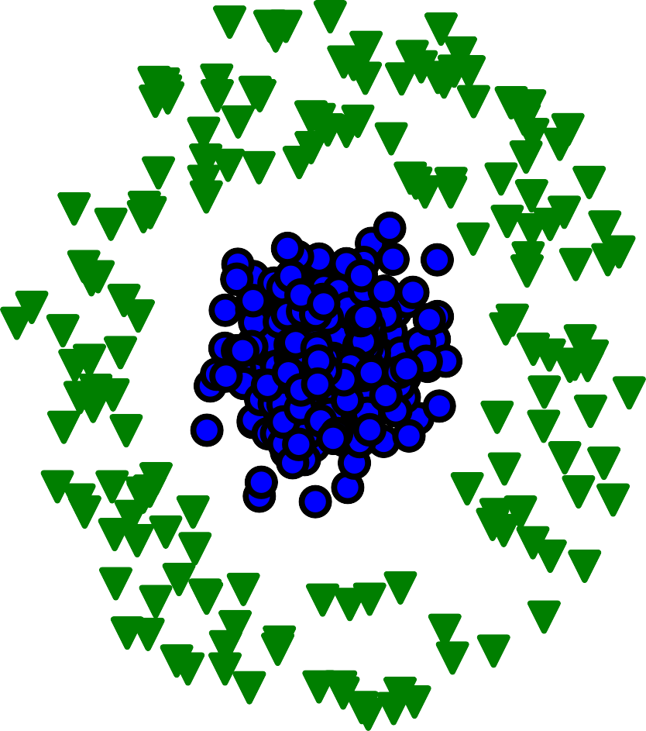
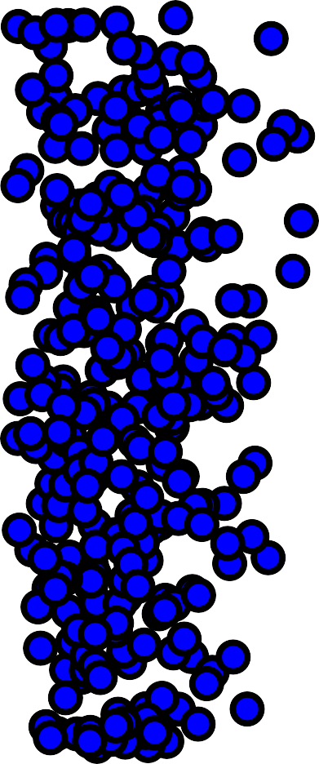
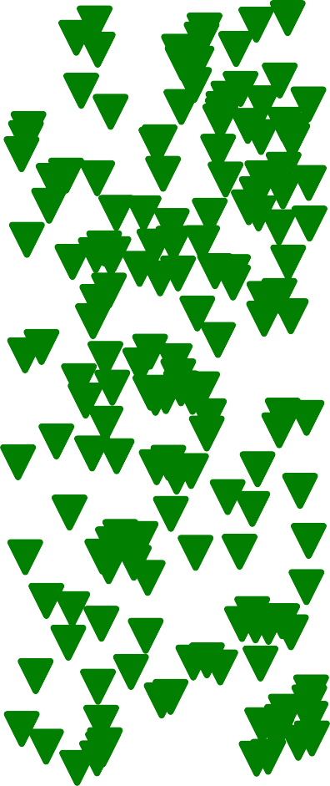
Representations Matter
Cartesian coordinates Polar coordinates
y
θ
x
r

Slide 6

























Depth: Repeated Composition
CAR
PERSON
ANIMAL
Output (object identity)
3rd hidden layer (object parts)
2nd hidden layer (corners and contours)
1st hidden layer (edges)
Visible layer (input pixels)

Slide 7
Computational Graphs
Element Set
+
Element Set
Logistic Regression
+
Logistic Regression
w₁
x₁
w₂
x₂

Slide 8
Learning Multiple Components
Output
Output
Output
Mapping from features
Output
Mapping from features
Mapping from features
Additional layers of more abstract features
Hand- designed program
Hand- designed features
Features
Simple features
Input
Input
Input
Input
Classic machine learning
Deep learning
Rule-based systems
Representation learning

Slide 9
Lecture topics
1. Introduction
Part I: Applied Math and Machine Learning Basics
2. Linear Algebra
3. Probability and Information Theory
4. Numerical Computation
5. Machine Learning Basics
Part II: Deep Networks: Modern Practices
6. Deep Feedforward Networks
7. Regularization
8. Optimization
9. CNNs
10. RNNs
11. Practical Methodology
12. Applications
Part III: Deep Learning Research 13. Linear Factor _{14. Autoencoders} 15. Representation Models Learning 16. Structured 17. Monte Carlo Probabilistic Models Methods _{19. Inference} 18. Partition Function
 | 20. Deep Generative Models

Slide 10
Historical Waves
0.000250
0.000200
0.000150
0.000100
0.000050
Frequency of Word or Phrase
 | cybernetics (connectionism + neural networks)
0.000000
1970
Year
1940
1950
1960
1980
1990
2000

Slide 11






Historical Trends: Growing Datasets
10⁹
10⁸
10⁷
10⁶
10⁵
10⁴
10³
10²
10¹
10⁰
Dataset size (number examples)
Canadian Hansard
WMT
Sports-1M
ImageNet10k
Public SVHN
Criminals
ImageNet
ILSVRC 2014
MNIST
CIFAR-10
T vs. G vs. F
Rotated T vs. C
Iris
1900
1950
1985 2000 2015

Slide 12
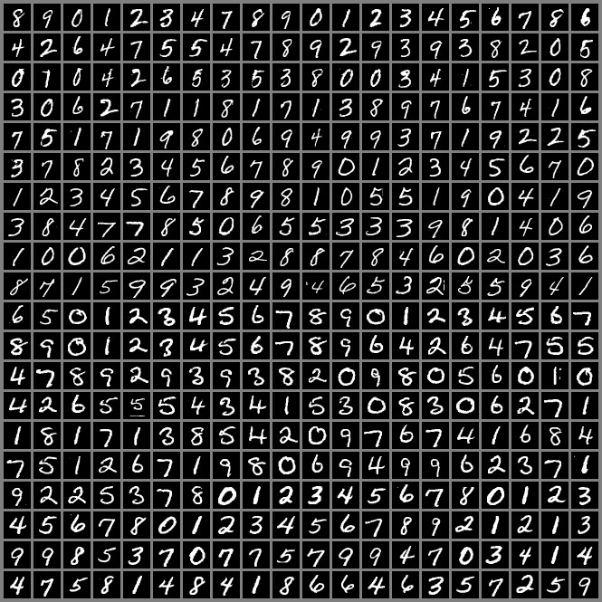
The MNIST Dataset

Slide 13







Connections per Neuron
10⁴
Human
Connections per neuron
6
7
Cat
9
4
10³
Mouse
2
5
10
8
10²
3
Fruit fly
1
10¹
1950
1985
2000
2015

Slide 14








Number of Neurons
Number of neurons (logarithmic scale)
₁₀11
₁₀10
10⁹
10⁸
10⁷
10⁶
10⁵
10⁴
10³
10²
₁₀1
₁₀0 ₁₀ 1 ₁₀ 2
Human
17
16 19
20
18
Octopus
14
11
Frog
8
3
Bee
Ant
13
Leech
1
2
12
10
6
9
7
15
Roundworm
5
4
Sponge
1950
1985 2000 2015
2056

Slide 15
Solving Object Recognition
0.30
0.25
0.20
0.15
0.10
0.05
0.00
ILSVRC classification error rate
2010
2011
2012
2013
2014
2015

