Slide 1
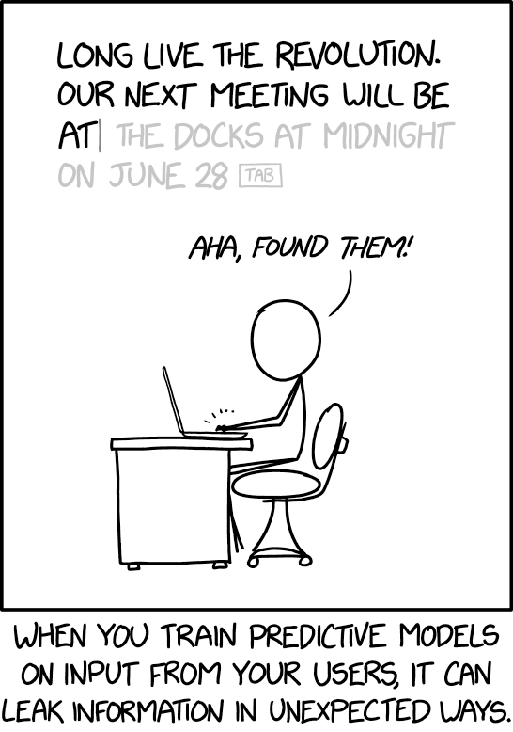
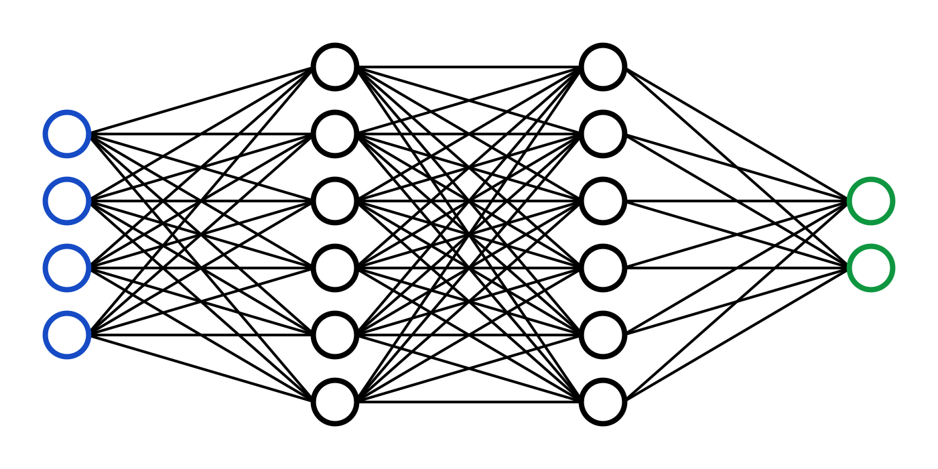
C7082 Techniques in Machine Learning and AI
Ed Harris

Slide 2
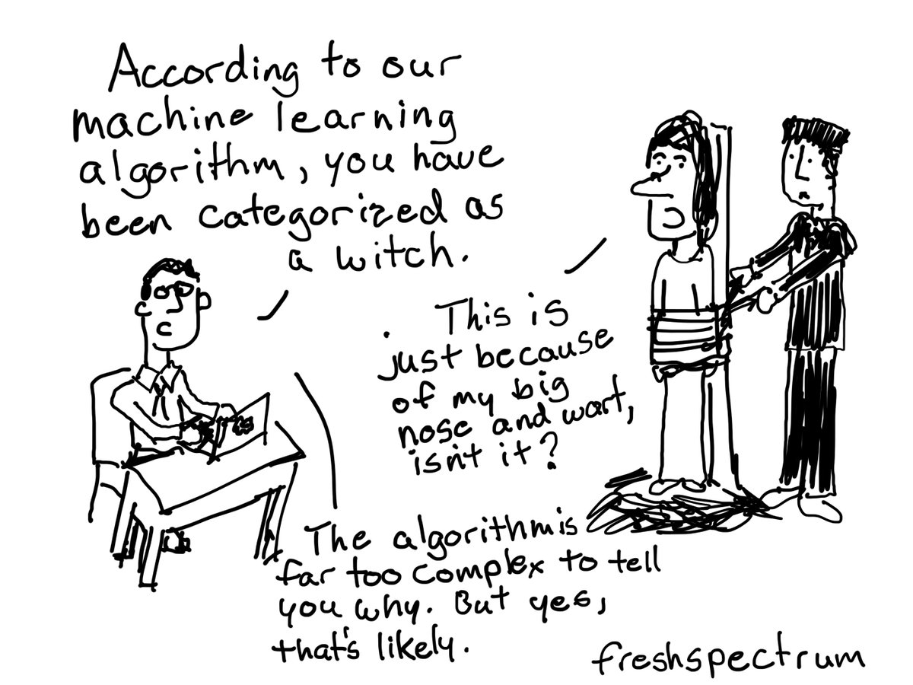
05 Machine Learning Basics
A review of some of the C7081 techniques
+ some new ideas

Slide 3
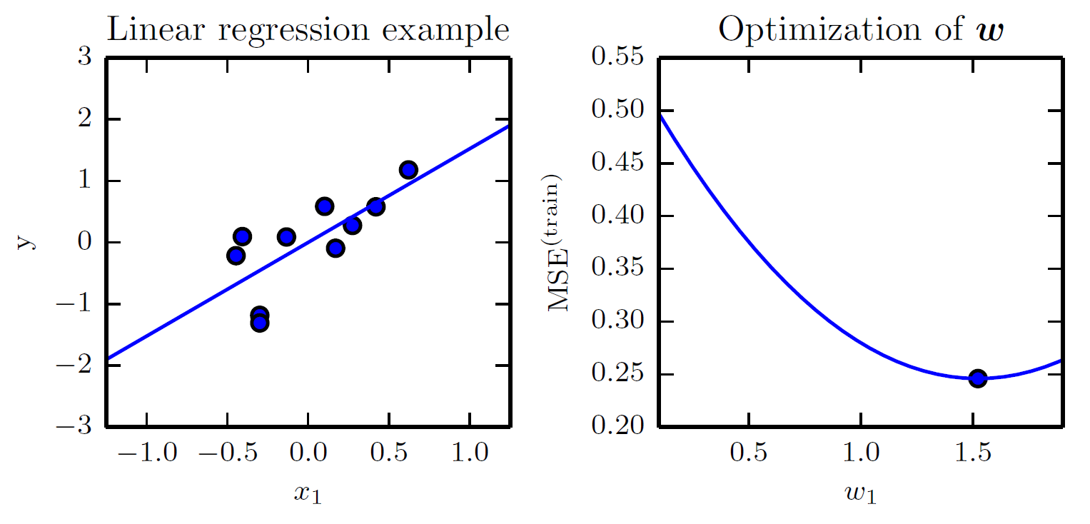
Linear Regression

Slide 4
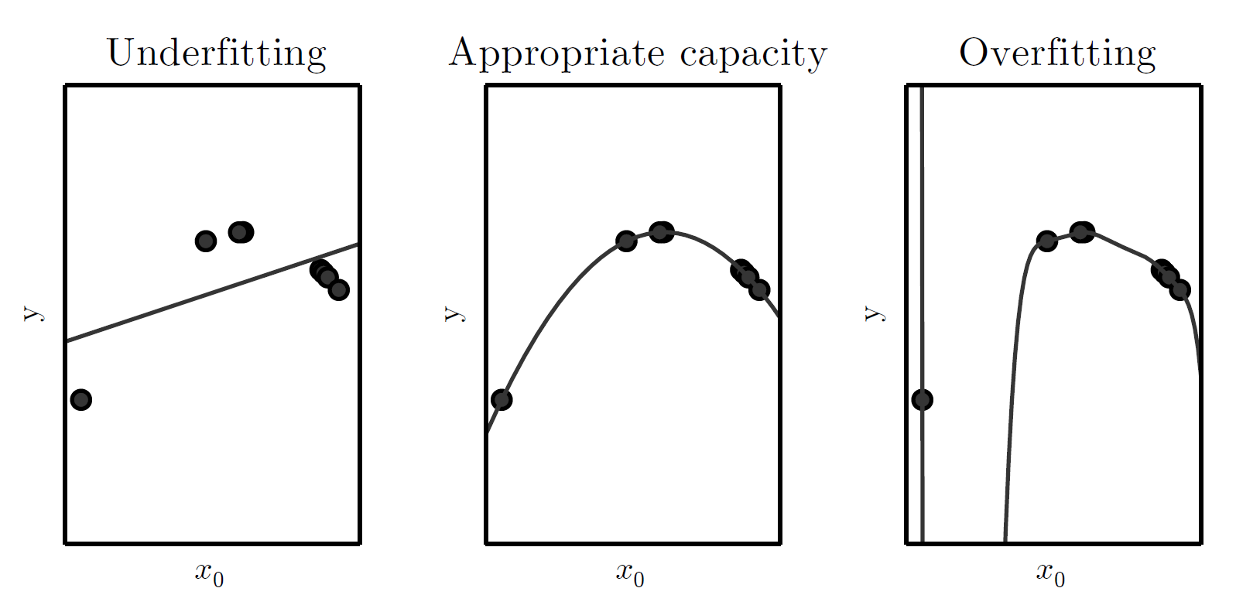
Underfitting and Overfitting in Polynomial Estimation

Slide 5
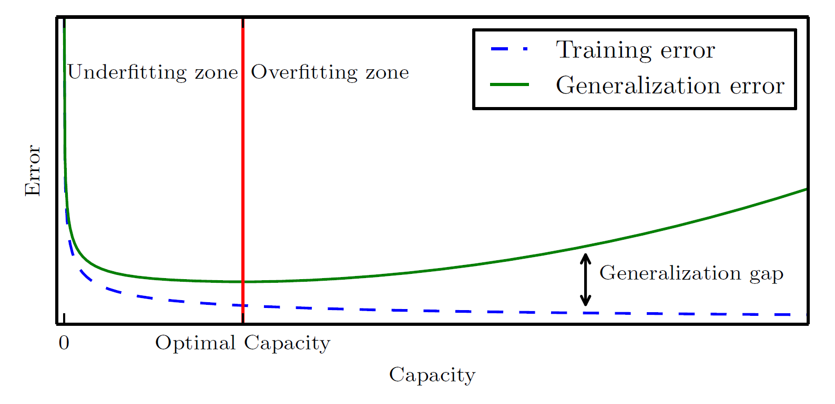
Generalization and Capacity

Slide 6
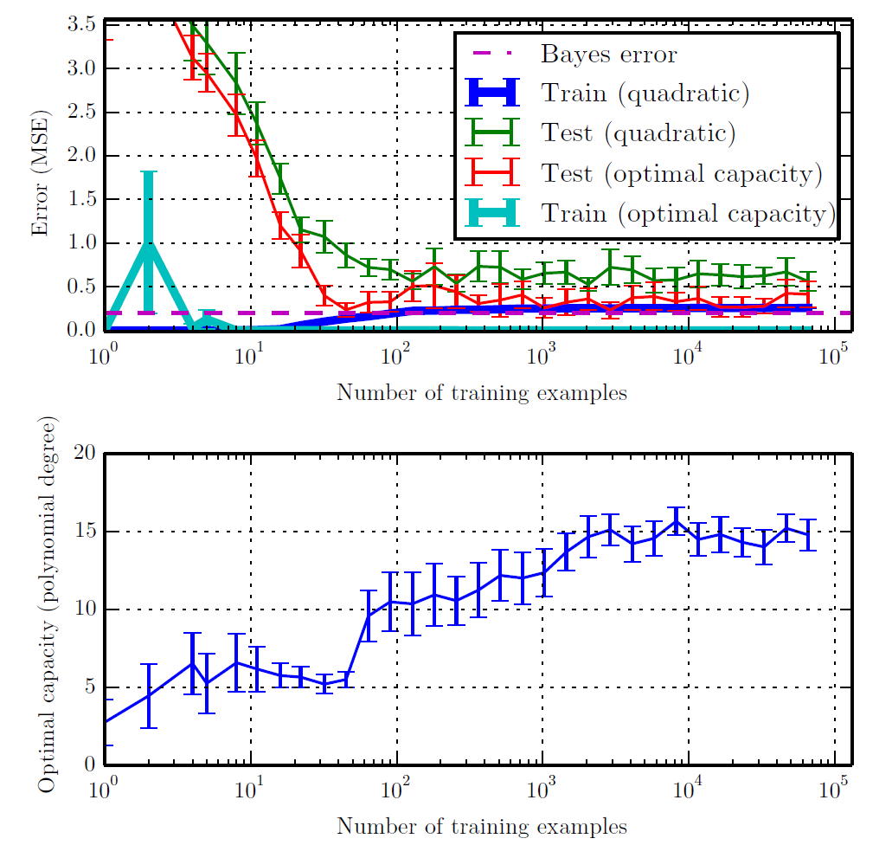
Training Set Size

Slide 7
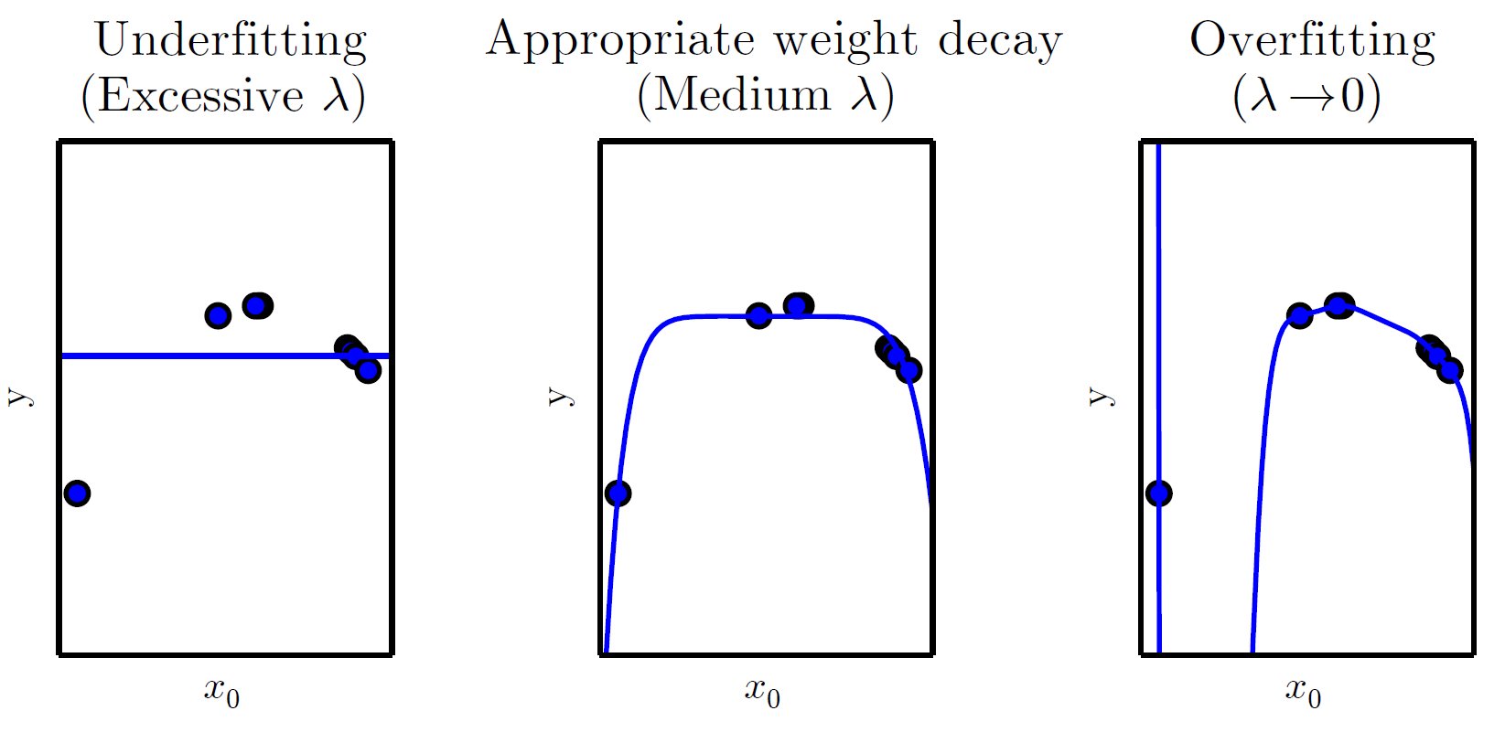
Weight Decay

Slide 8
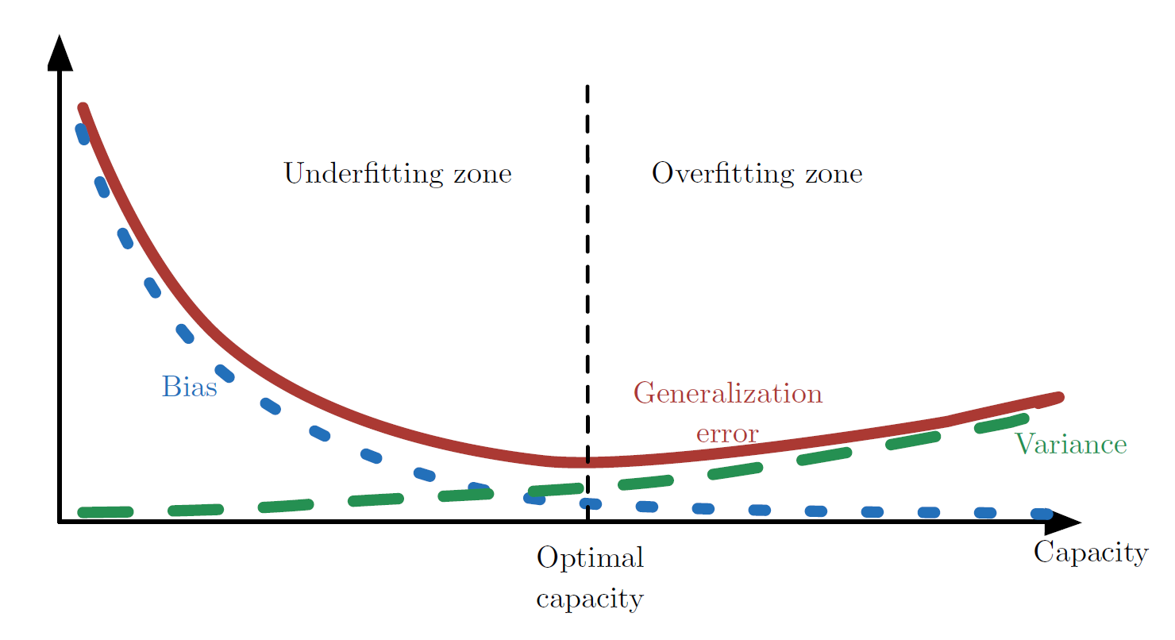
Bias and Variance

Slide 9
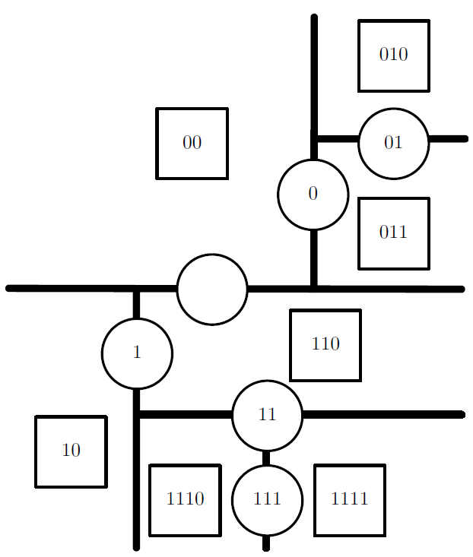
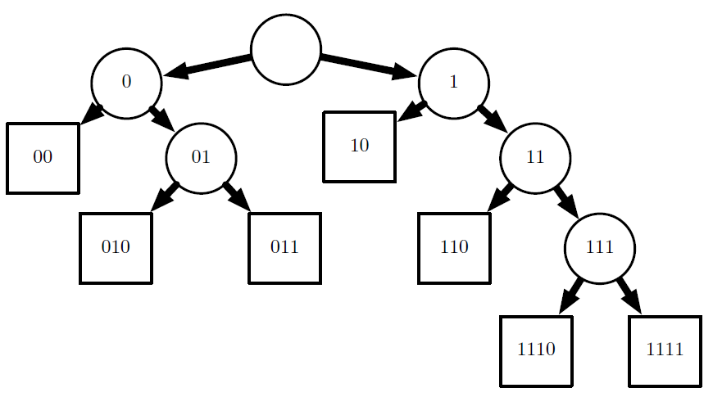
Decision Trees

Slide 10
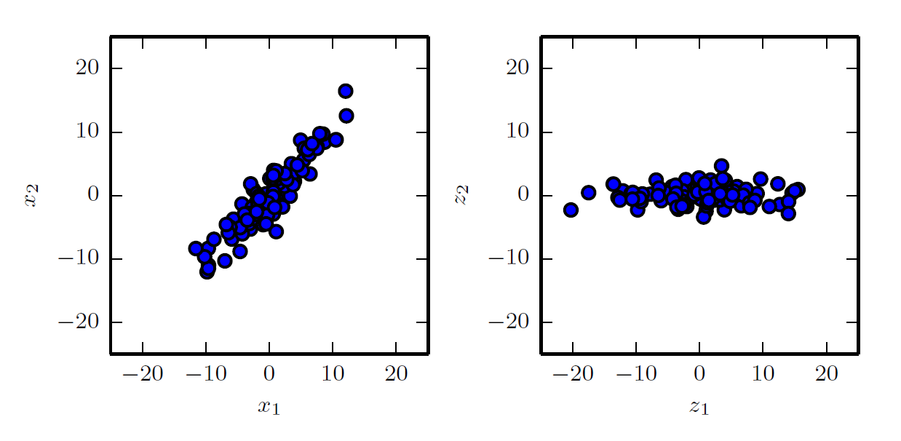
Principal Components Analysis

Slide 11
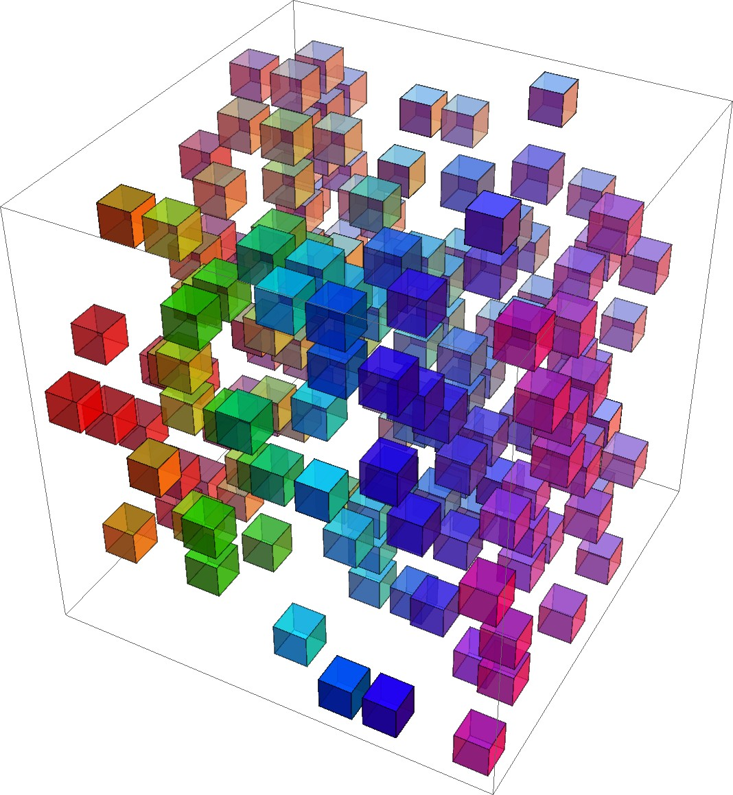
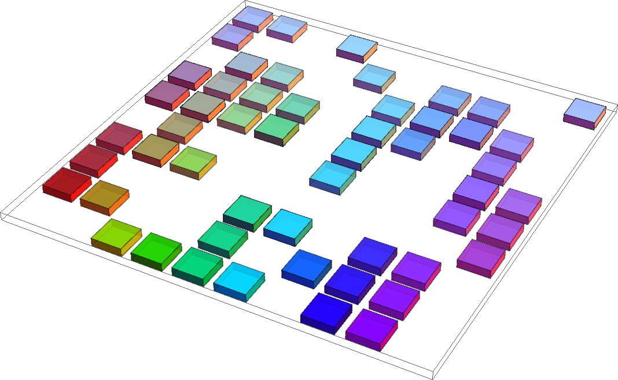
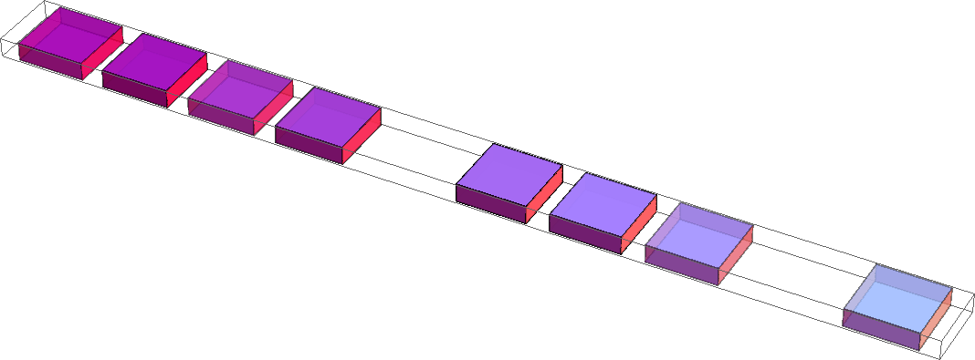
Curse of Dimensionality

Slide 12
Nearest Neighbor

Slide 13
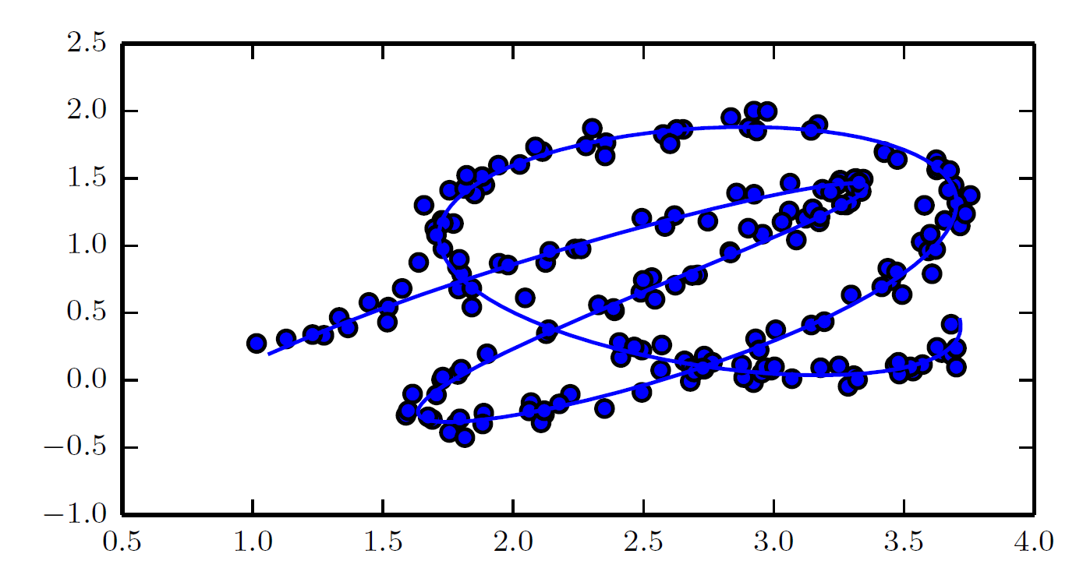
Manifold Learning

Slide 14
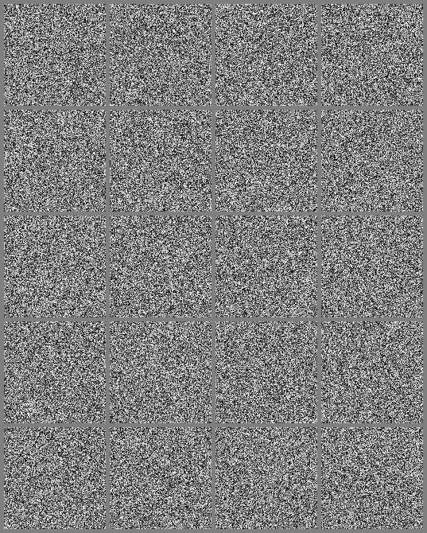
Uniformly Sampled Images

Slide 15
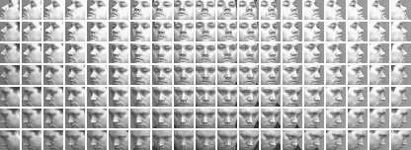
QMUL Dataset

