Slide 1

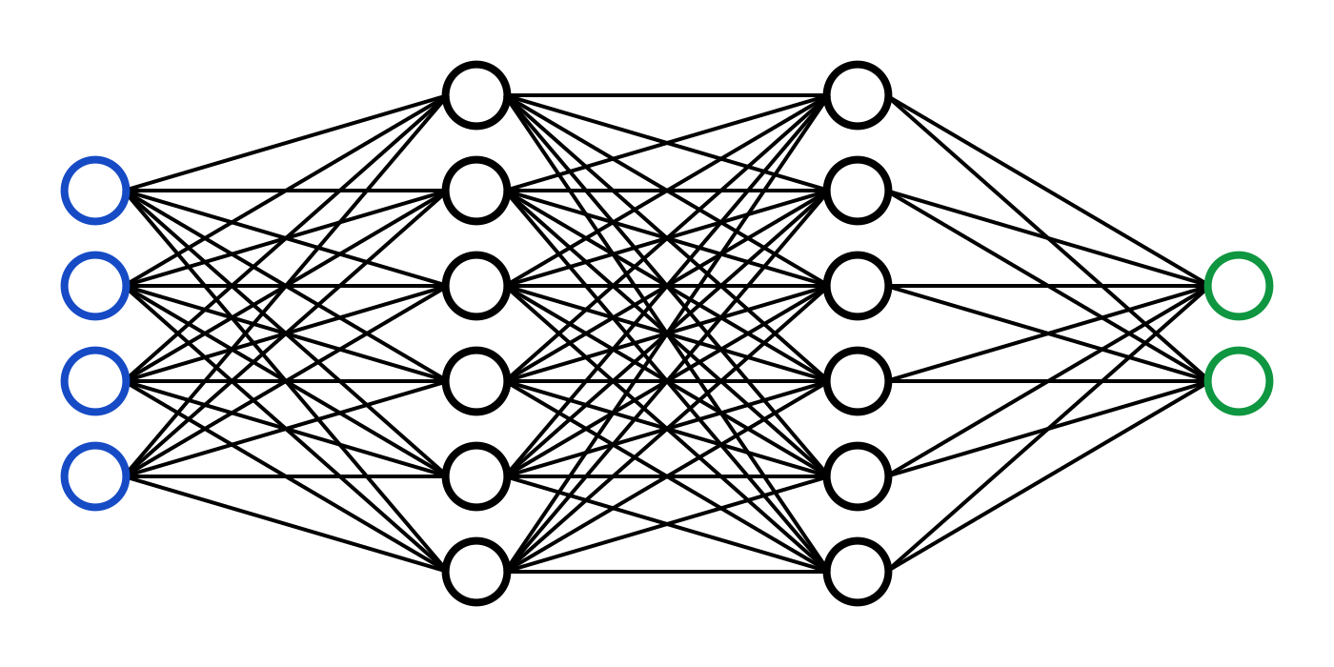
C7082 Techniques in Machine Learning and AI
Ed Harris

Slide 2
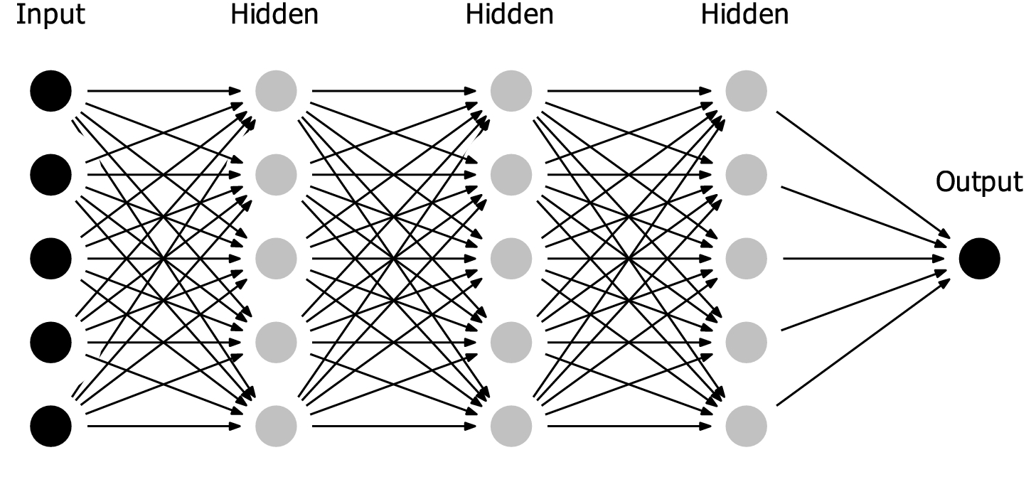
06 Deep Feedforward Networks

Slide 3
Roadmap
Example: Learning XOR
Gradient-Based Learning
Hidden Units
Architecture Design
Back-Propagation

Slide 4
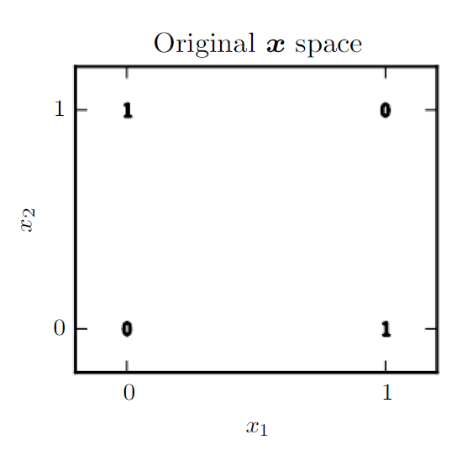
“Exclusive or” (XOR) function

Slide 5
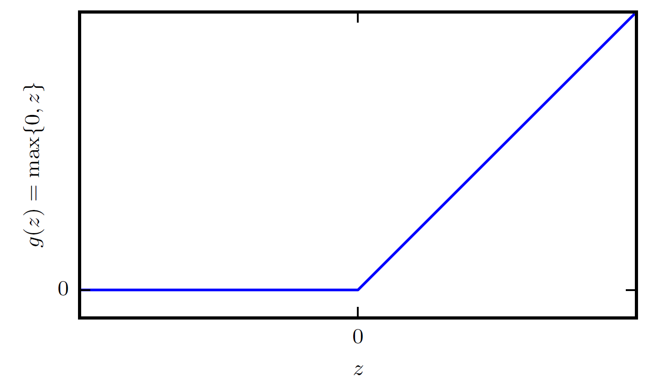
Rectified Linear Activation
“ReLU” – Rectified Linear Unit

Slide 6
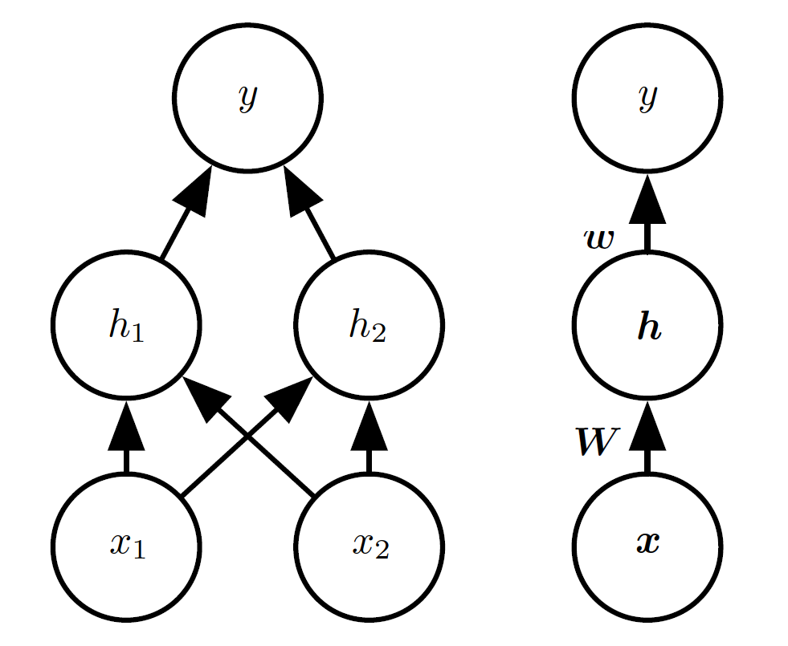
Network Diagrams

Slide 7
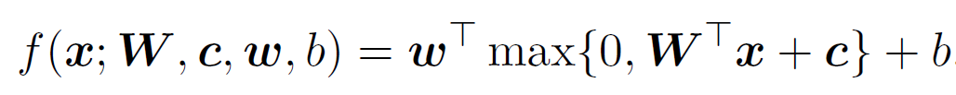
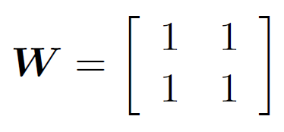
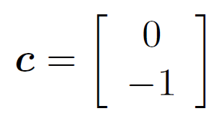
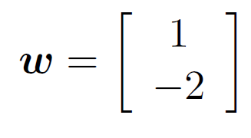
Solving XOR

Slide 8
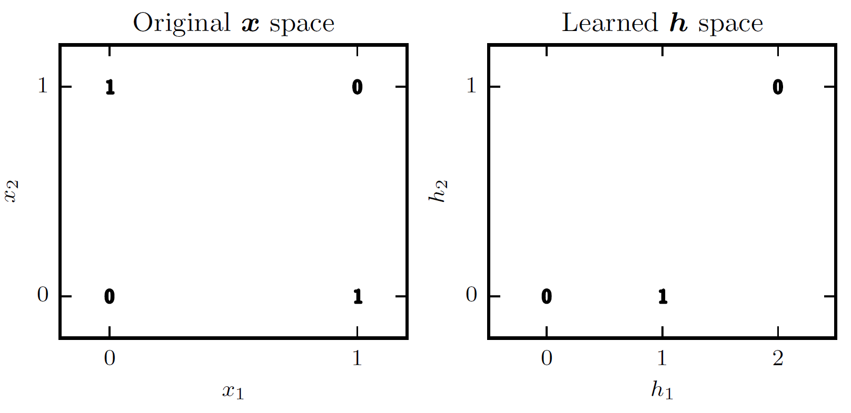
Solving XOR

Slide 9
Roadmap
Example: Learning XOR
Gradient-Based Learning
Hidden Units
Architecture Design
Back-Propagation

Slide 10
Gradient-Based Learning
Specify
Model
Cost
Design model and cost so cost is smooth
Minimize cost using gradient descent or related techniques

Slide 11
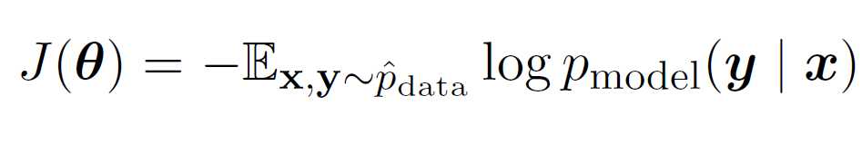
Conditional Distributions and Cross-Entropy
This is a way to compare the variation explained between the training data and the model distribution. Using maximum likelihood in a “cost function”

Slide 12
Output Types
_{Output Type} Output Output Cost Distribution Layer Function
Binary | Bernoulli | Sigmoid | Binary cross- entropy
Discrete | Multinoulli | Softmax | Discrete cross- entropy
Continuous | Gaussian | Linear | Gaussian cross- entropy (MSE)
Continuous | Mixture of Gaussian | Mixture Density | Cross-entropy
Continuous | Arbitrary | E.g.: GAN, VAE, FVBN | Various

Slide 13
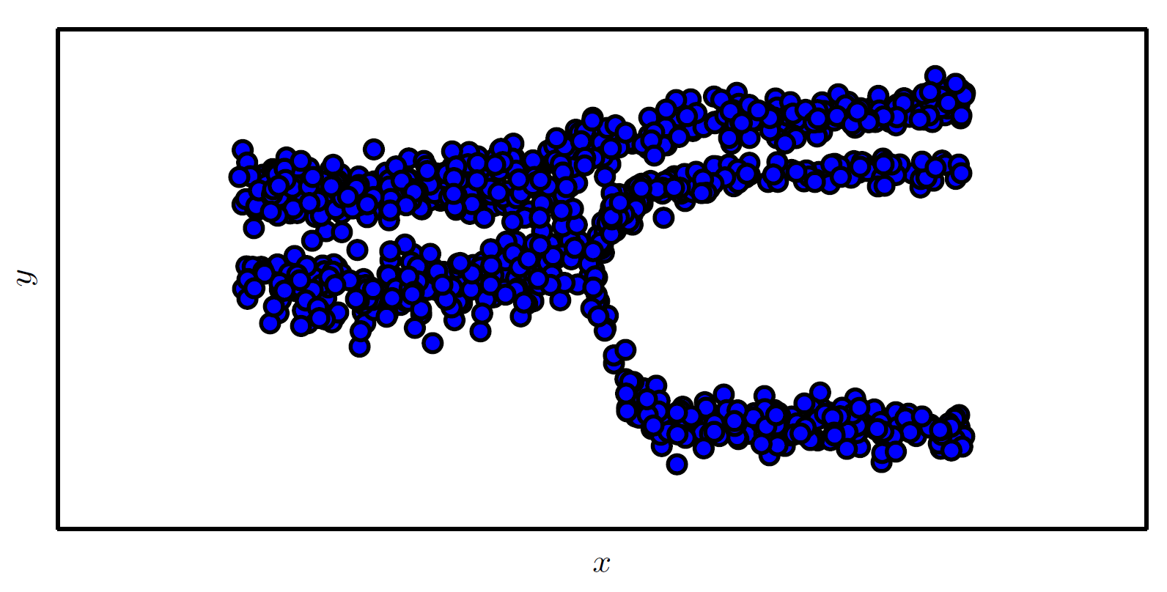
Mixture Density Outputs
Samples drawn from a neural network with a mixture density output layer. The input x is sampled from a uniform distribution and the output y is sampled from p_{model} (y | x)

Slide 14
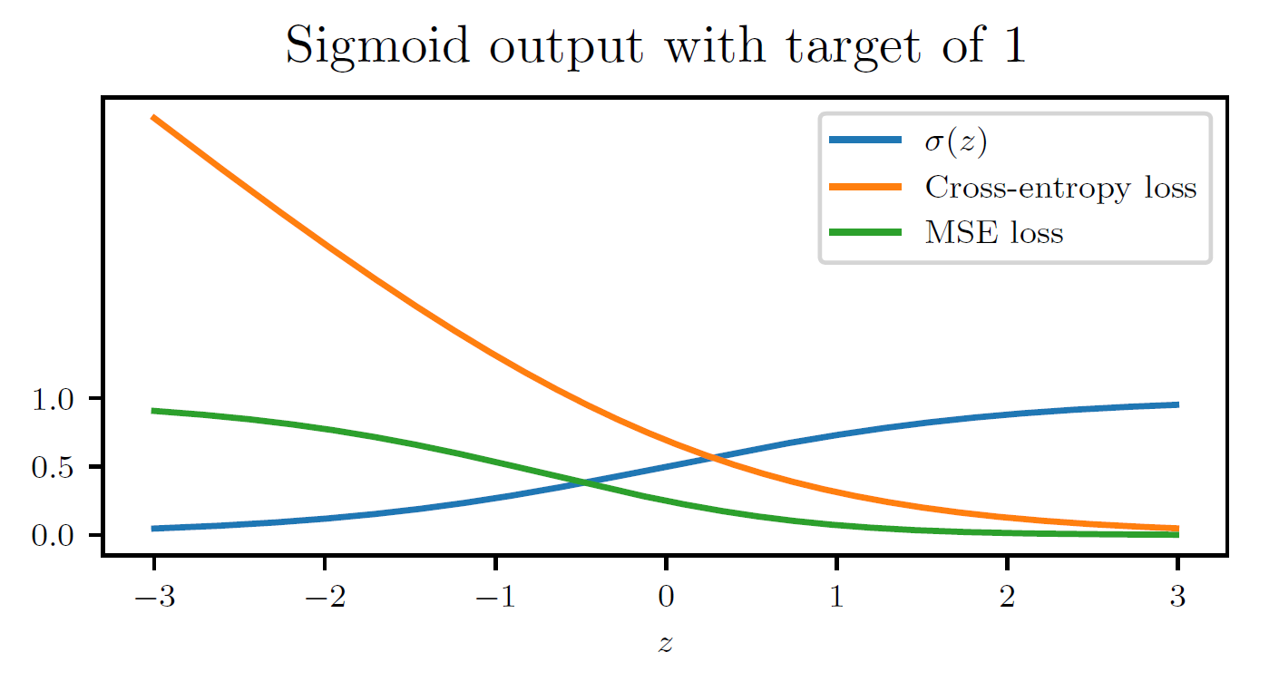
Don’t mix and match

Slide 15
Roadmap
Example: Learning XOR
Gradient-Based Learning
Hidden Units
Architecture Design
Back-Propagation

Slide 16
Hidden units
Use ReLUs mostly, e.g. ~90% of the time (we will unpack this)
For RNNs… (future lecture)
For some research projects, people get creative
Many hidden units perform comparably to ReLUs. New hidden units that perform comparably are rarely interesting (if it ain’t broke…)

Slide 17
Roadmap
Example: Learning XOR
Gradient-Based Learning
Hidden Units
Architecture Design
Back-Propagation

Slide 18
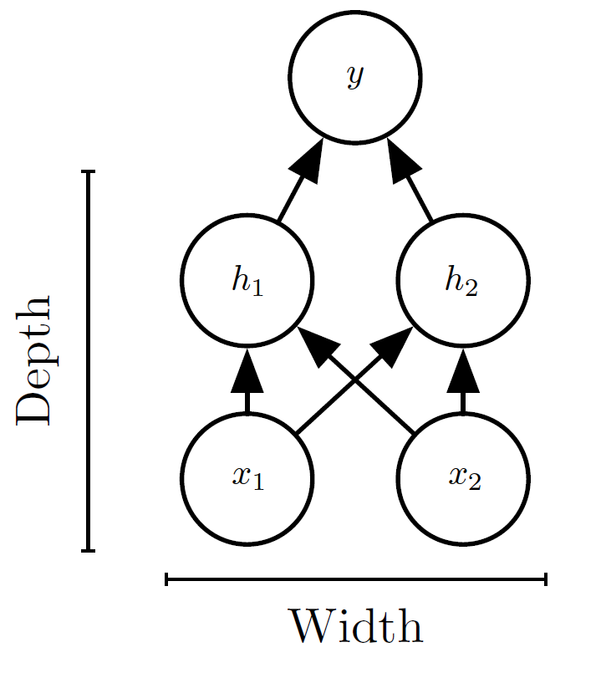
Architecture Basics
Predictions
Input features

Slide 19
Universal Approximator Theorem
One hidden layer is enough to represent (not learn) an approximation of any function to an arbitrary degree of accuracy
So why go deeper?
Shallow net may need (exponentially) more width
Shallow net may overfit more

Slide 20
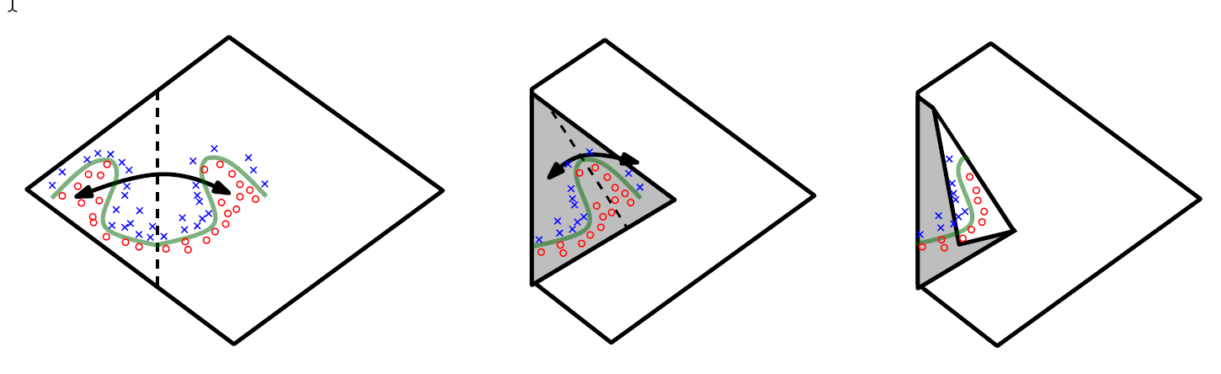
Exponential Representation Advantage of Depth
Convolutional cartoon

Slide 21
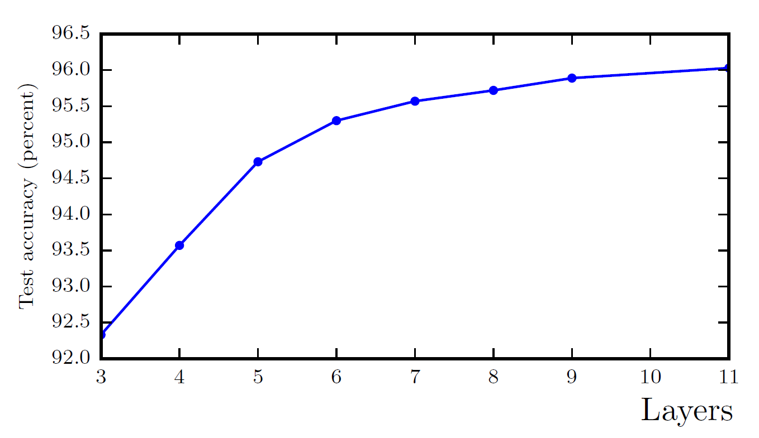
Better Generalization with Greater Depth

Slide 22
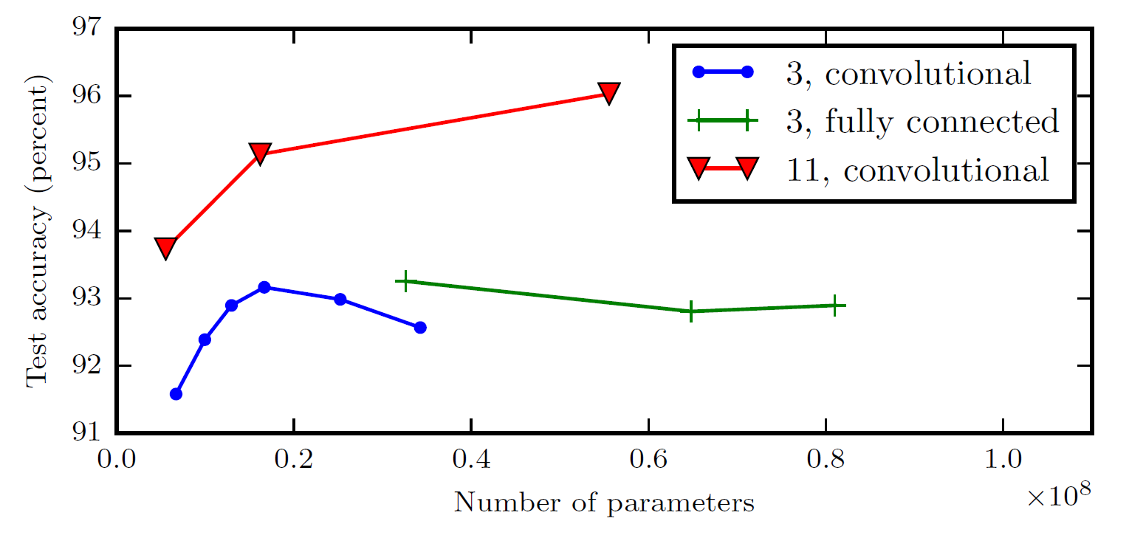
Large, Shallow Models Overfit More

Slide 23
Roadmap
Example: Learning XOR
Gradient-Based Learning
Hidden Units
Architecture Design
Back-Propagation

Slide 24
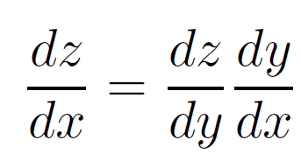
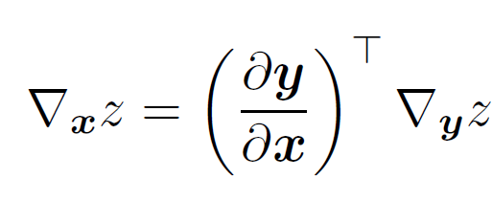
Back-Propagation
The chain rule is a formula for calculating the derivatives of composite functions. Composite functions are functions composed of functions inside other function(s).
Back-propagation is “just the chain rule” of calculus
But it’s a particular implementation of the chain rule
Uses dynamic programming (table filling)
Avoids recomputing repeated subexpressions
Speed vs memory tradeoﬀ

Slide 25
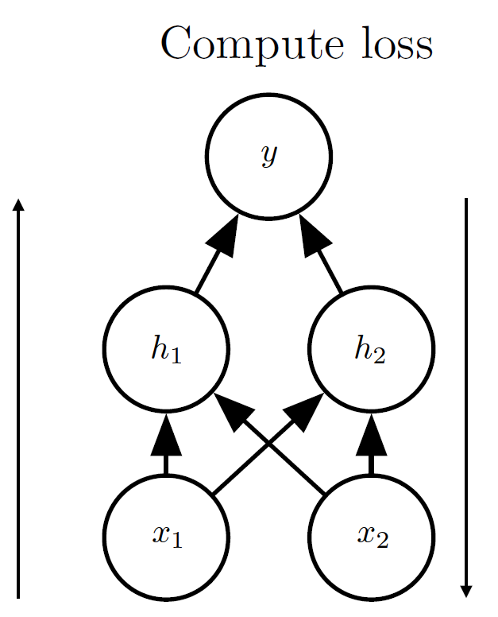
Simple Back-Prop Example
Compute
activations
Compute
derivatives
Forward propagation
Backwards
propagation

Slide 26
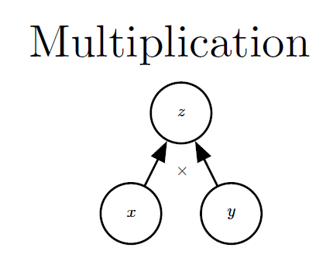
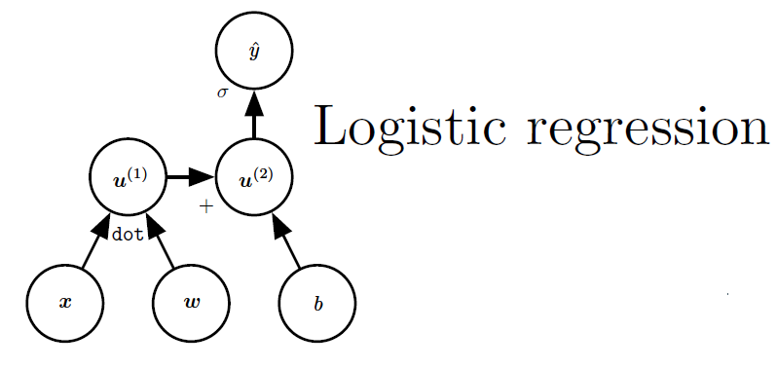
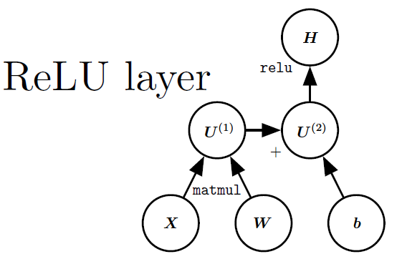
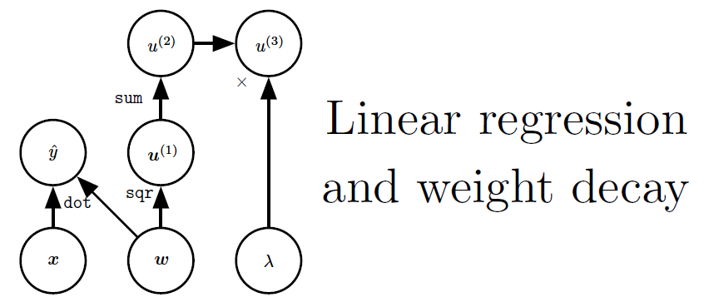
Computation Graphs

Slide 27
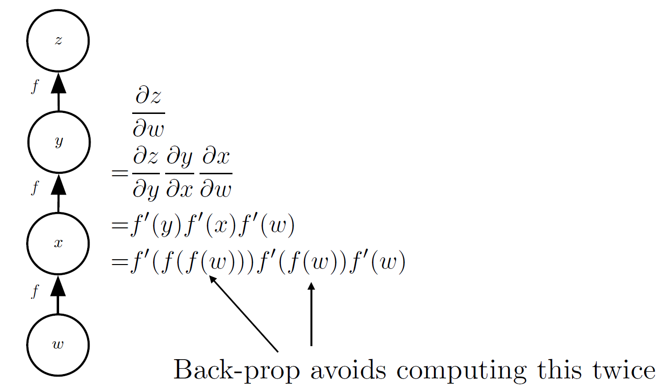
Repeated Subexpressions

Slide 28
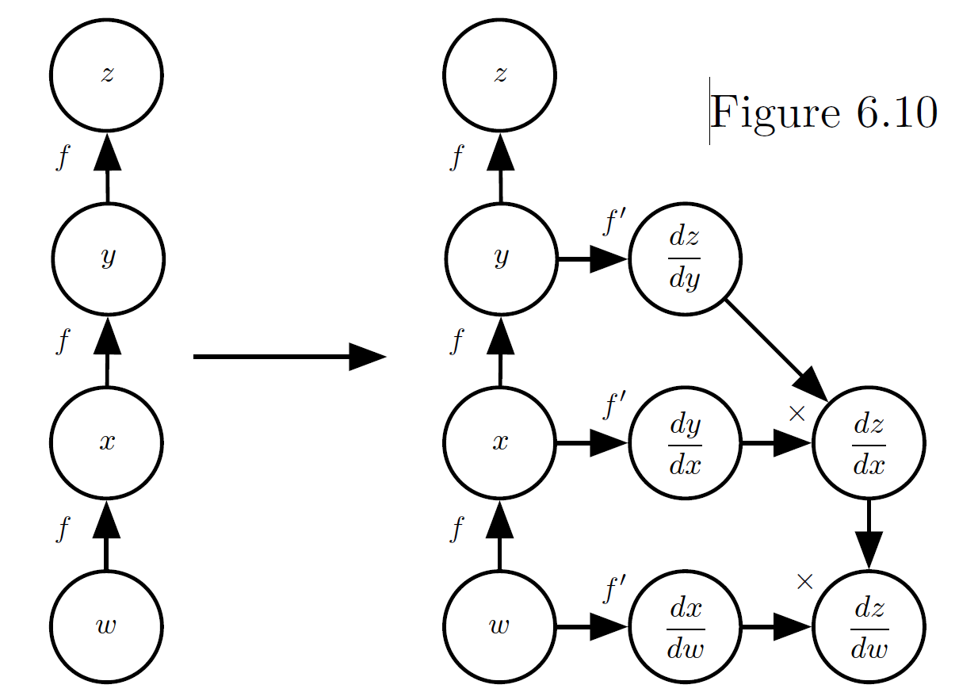
Symbol-to-Symbol Diﬀerentiation
The computational graph is extended to include gradient calculations and relationships between gradients

Slide 29
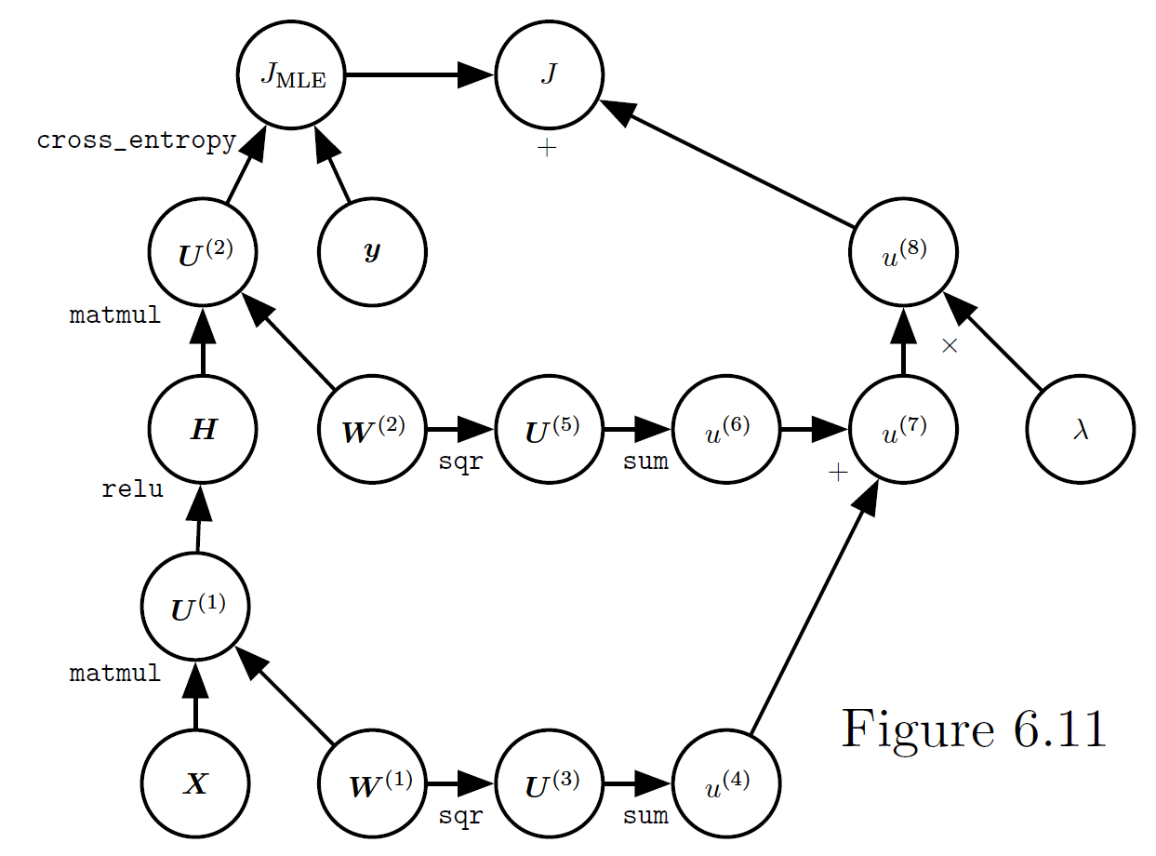
Neural Network Loss Function
The computational graph used to compute the cost used to train an example
of a single-layer MLP using the cross-entropy loss and weight decay

