Slide 1

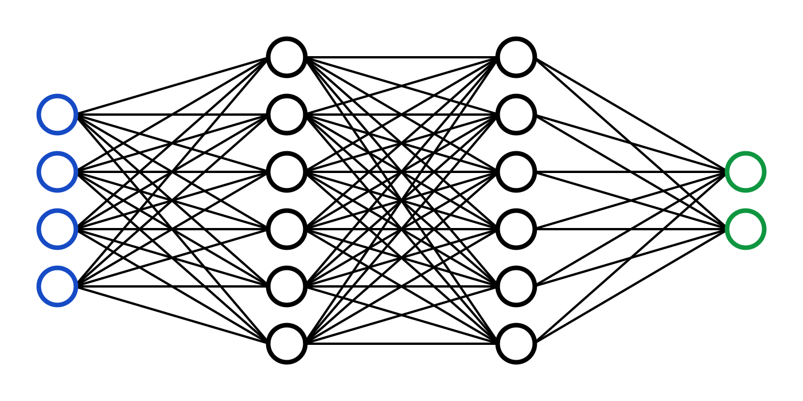
C7082 Techniques in Machine Learning and AI
Ed Harris

Slide 2
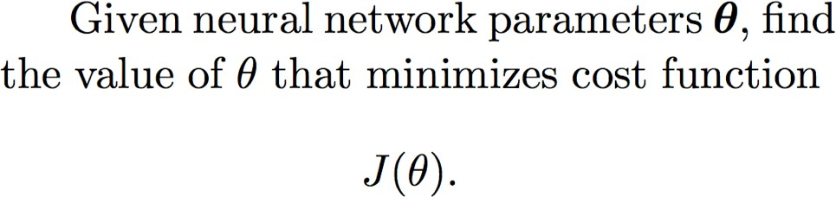
08 Optimization
-Exhaustive search
-Random search (genetic algorithms)
-Analytical solution
-Model-based search (e.g. Bayesian optimization)
-Neural nets usually use gradient-based search

Slide 3
Key literature
Choromanska, A., Henaff, M., Mathieu, M., Arous, G.B., LeCun, Y., 2015. The Loss Surfaces of Multilayer Networks. arXiv:1412.0233 [cs].
Dauphin, Y., Pascanu, R., Gulcehre, C., Cho, K., Ganguli, S., Bengio, Y., 2014. Identifying and attacking the saddle point problem in high-dimensional non-convex optimization. arXiv:1406.2572 [cs, math, stat].
Goodfellow, I.J., Vinyals, O., Saxe, A.M., 2015. Qualitatively characterizing neural network optimization problems. arXiv:1412.6544 [cs, stat].
Saxe, A.M., McClelland, J.L., Ganguli, S., 2014. Exact solutions to the nonlinear dynamics of learning in deep linear neural networks. arXiv:1312.6120 [cond-mat, q-bio, stat].

Slide 4
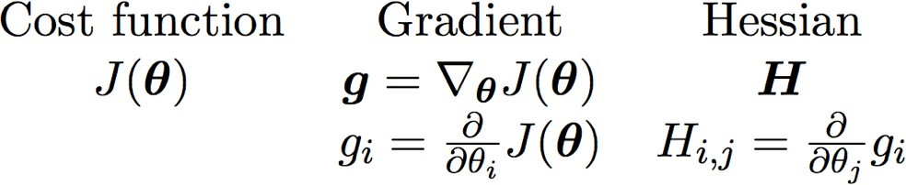
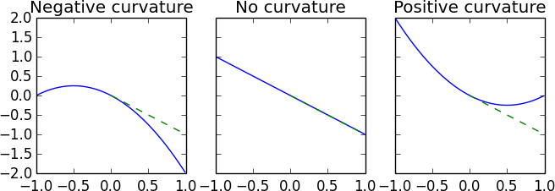
Derivatives and Second Derivatives

Slide 5
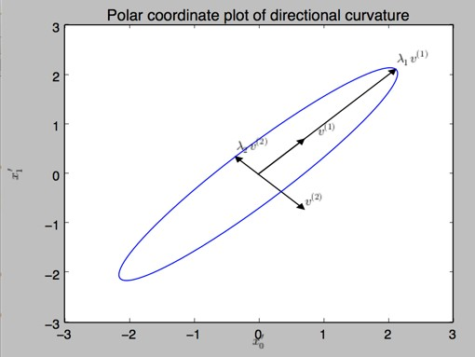
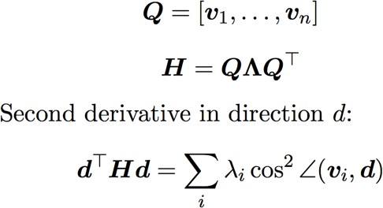
Directional Curvature

Slide 6
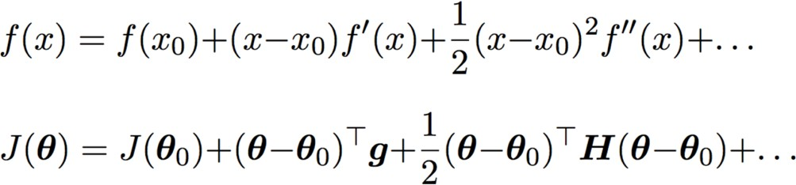
Taylor series approximation
Linear change due to gradient
Correction from directional curvature
Baseline

Slide 7
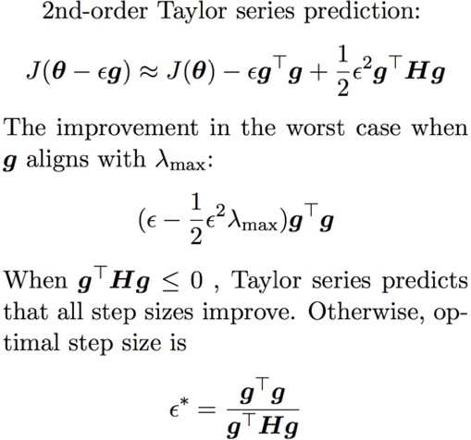
How much does a gradient step reduce the cost?

Slide 8
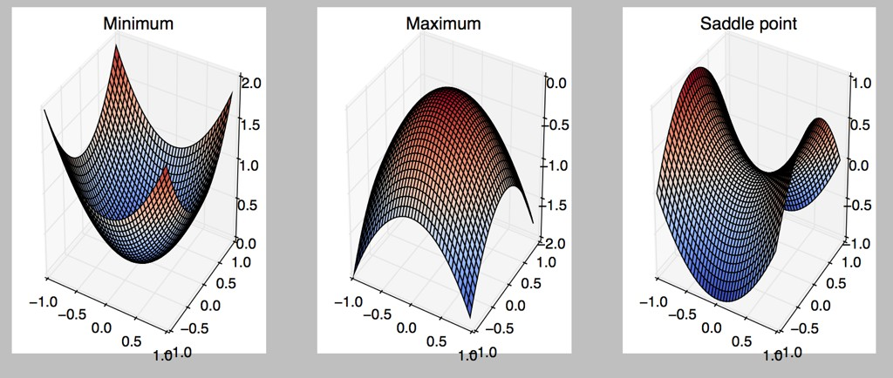
Critical points
Zero gradient, and Hessian with…
All pos eigenvalues
All neg eigenvalues
Mix of pos and neg

Slide 9
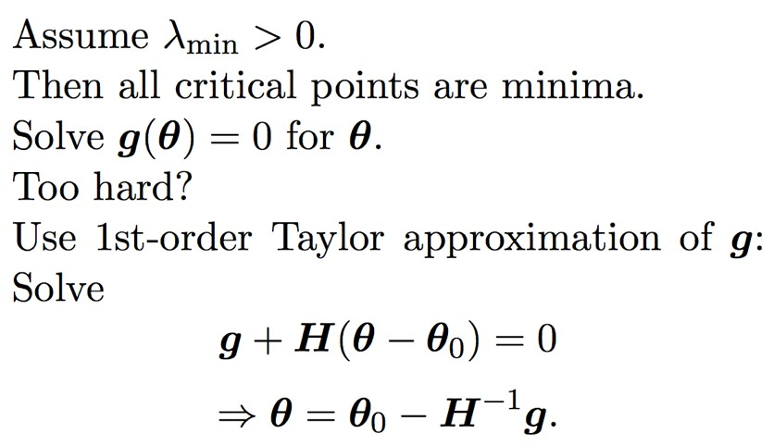
Newton’s method

Slide 10
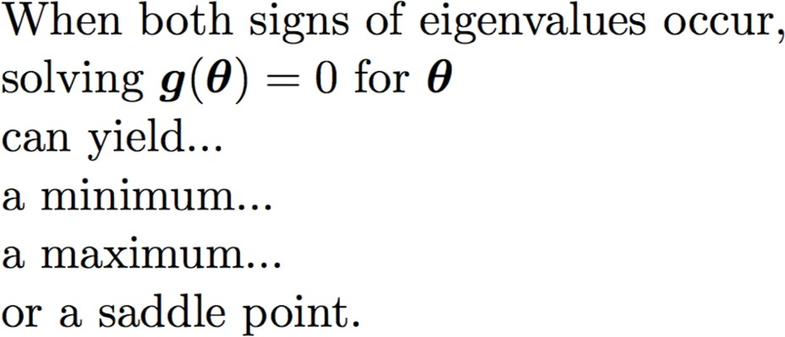
Newton’s method’s failure mode

Slide 11
The view of SGD as "diﬃcult"
SGD usually moves downhill
SGD eventually encounters a critical point
Usually this is a minimum
However, it is a local minimum
J has a high value at this critical point
Some global minimum is the real target, and has a much lower value of J

Slide 12
But, does SGD get stuck on saddle points?
SGD usually moves downhill
SGD eventually encounters a critical point
Usually this is a saddle point
SGD is stuck, and the main reason it is stuck is that it fails to exploit negative curvature
(this happens with Newton’s method, but not very much to SGD)

Slide 13
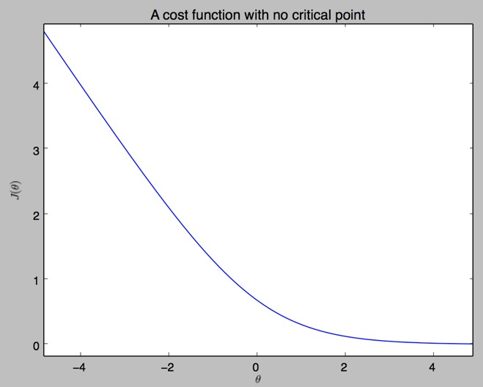
Some functions lack critical points

Slide 14
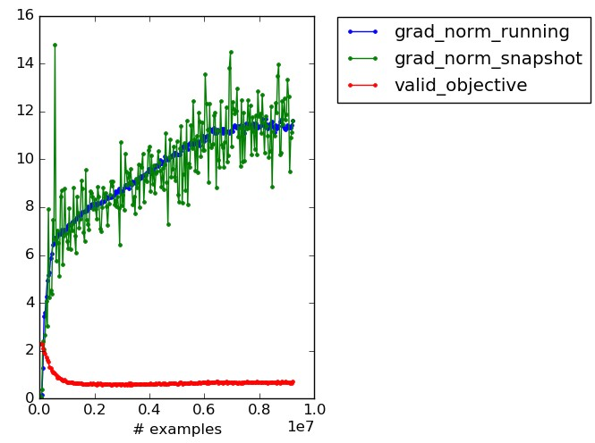
SGD may not encounter critical points

Slide 15
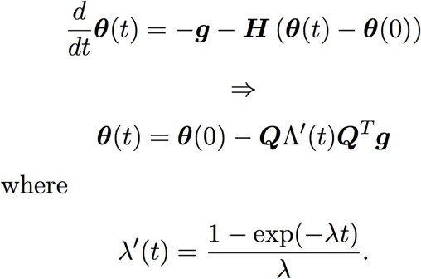
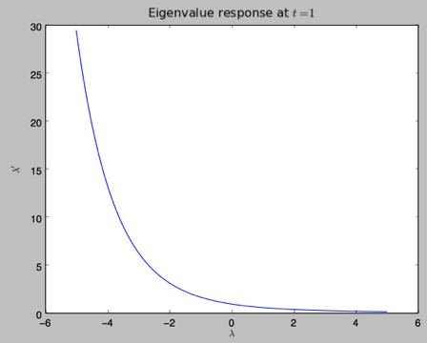
Gradient descent flees saddle points
(Goodfellow 2015)

Slide 16
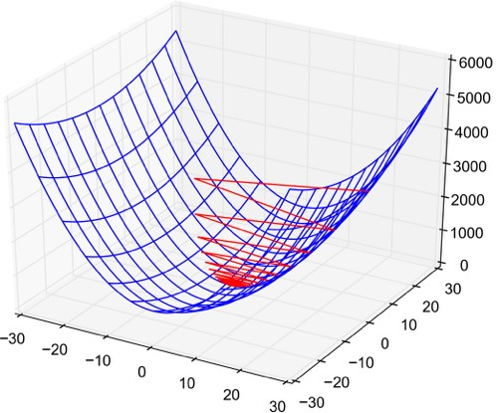
Poor conditioning

Slide 17
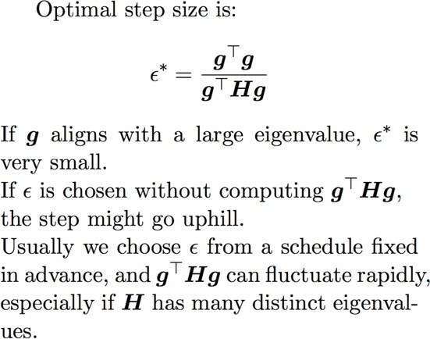
Poor conditioning

Slide 18
Why convergence may not happen
Never stop if function doesn’t have a local minimum
Get “stuck,” possibly still moving but not improving
Poor conditioning
Too much gradient noise Overfitting
Other?
Usually we get “stuck” before finding a critical point
Only Newton’s method and related techniques are attracted to saddle points

Slide 19
Are saddle points or local minima more common?
Imagine for each eigenvalue, you flip a coin
If heads, the eigenvalue is positive, if tails, negative
Need to get all heads to have a minimum
Higher dimensions -> exponentially less likely to get all heads
Random matrix theory
The coin is weighted; the lower J is, the more likely to be heads
So most local minima have low J!
Most critical points with high J are saddle points!

Slide 20
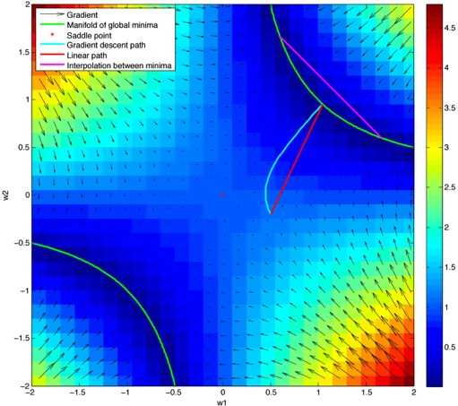
Do neural nets have saddle points?
Saxe et al, 2013:
neural nets without non-linearities have many saddle points
all the minima are global
all the minima form a connected manifold

Slide 21
Do neural nets even have saddle points?
Dauphin et al 2014: Experiments show neural nets do have as many saddle points as random matrix theory predicts
Choromanska et al 2015: Theoretical argument for why this should happen
Major implication: most minima are good, and this is more true for big models
Minor implication: the reason that Newton’s method
works poorly for neural nets is its attraction to the ubiquitous saddle points

Slide 22
The state of modern optimization
We can optimize most classifiers, autoencoders, or recurrent nets if they are based on linear layers
Especially true of LSTM, ReLU, maxout
It may be much slower than we want
Even depth does not prevent success, Sussillo 14 reached 1,000 layers
We may not be able to optimize more exotic models
Optimization benchmarks are usually not done on the exotic models

Slide 23
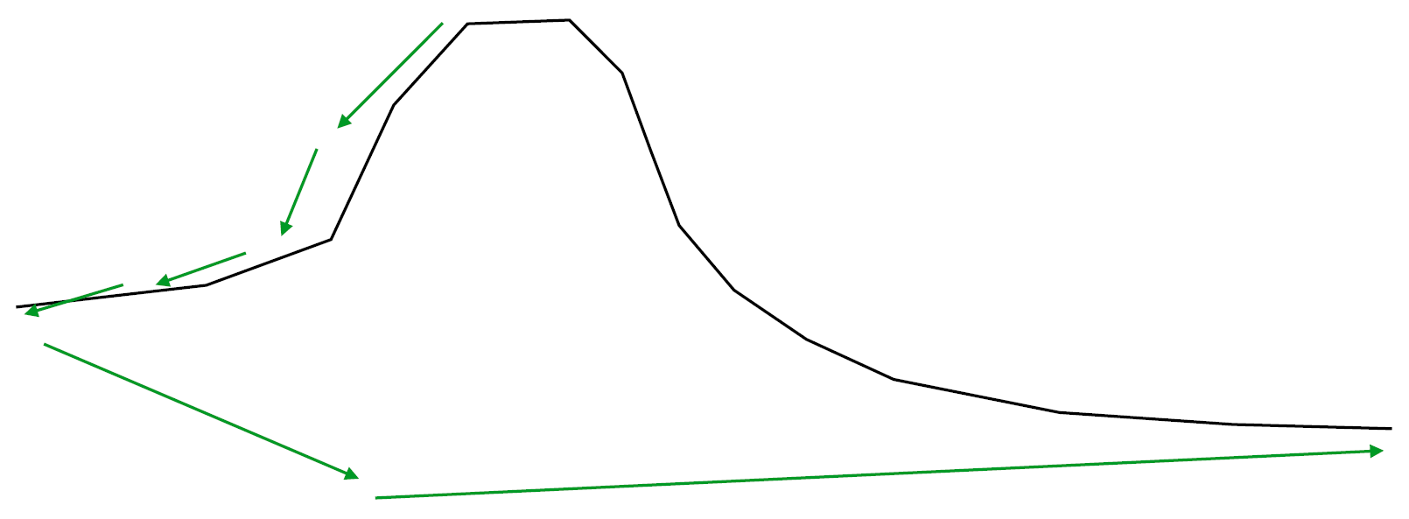
Why is optimization slow?
We can fail to get local updates (i.e. you get “stuck”)?
Local information can disagree with global information, even when there are not any non-global minima, even when there are not any minima of any kind

Slide 24
Questions for visualization
Does SGD get stuck in local minima?
Does SGD get stuck on saddle points?
Does SGD waste time navigating around global obstacles despite properly exploiting local information?
Does SGD wind between multiple local bumpy obstacles?
Does SGD thread a twisting canyon?

Slide 25
History written by the winners
Visualize trajectories of (near) SOTA results
Selection bias: looking at success
Failure is interesting, but hard to attribute to optimization
Careful with interpretation: SGD never encounters X, or SGD fails if it encounters X?

Slide 26
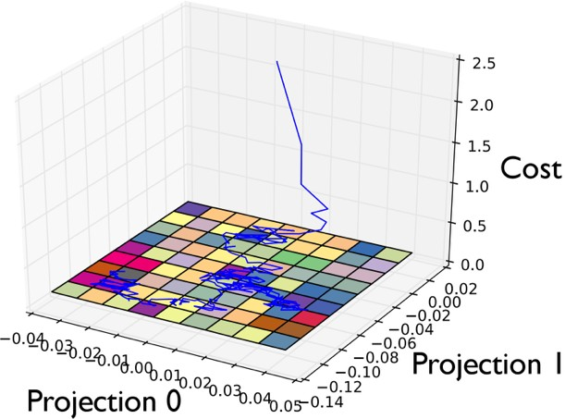
2D Subspace Visualization

Slide 27
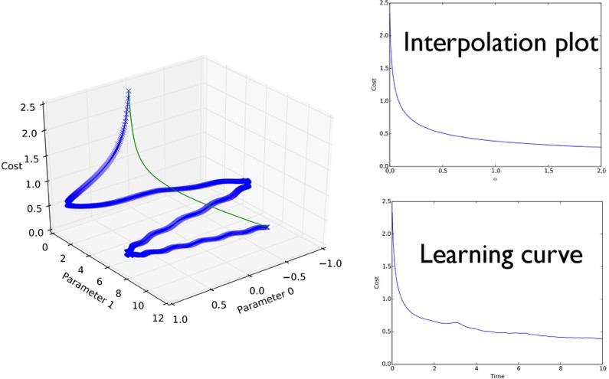
A Special 1-D Subspace

Slide 28
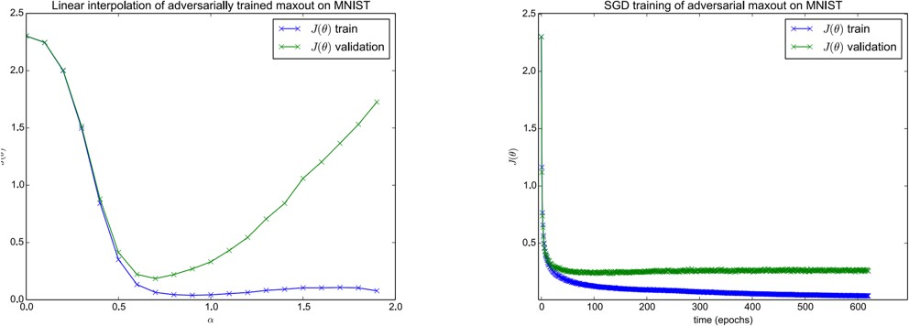
Maxout / MNIST experiment

Slide 29
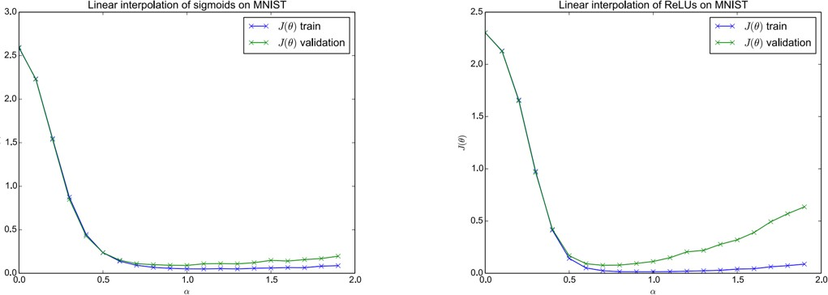
Other activation functions

Slide 30
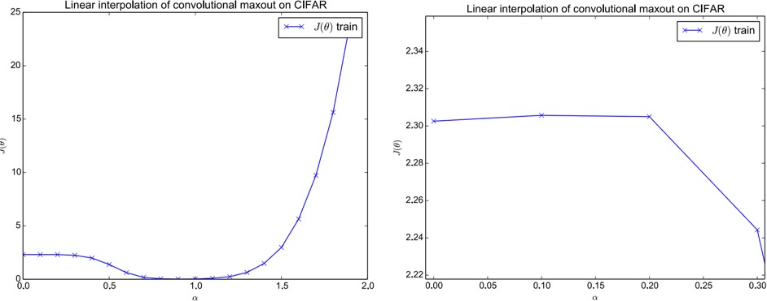
Convolutional network
The “wrong side of the mountain” eﬀect

Slide 31
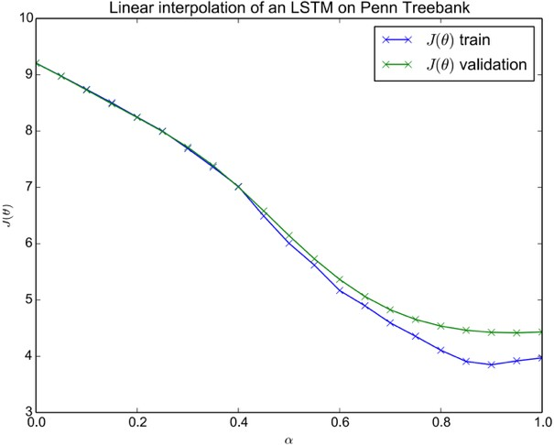
Sequence model (LSTM)

Slide 32
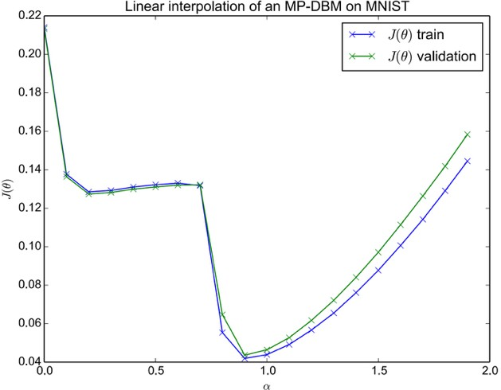
Generative model (MP-DBM)

Slide 33
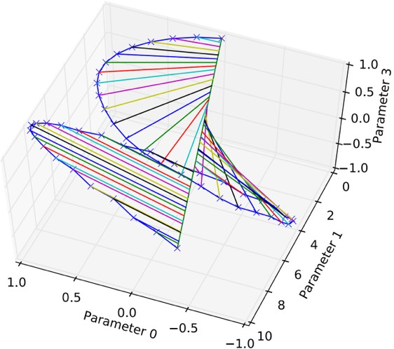
3-D Visualization

Slide 34
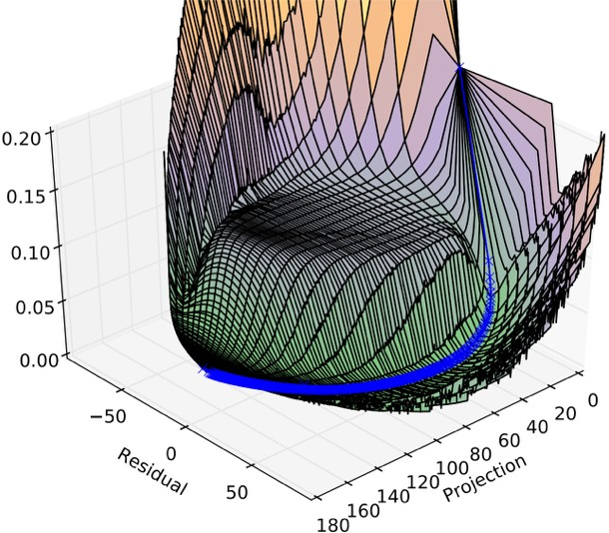
3-D Visualization of MP-DBM

Slide 35
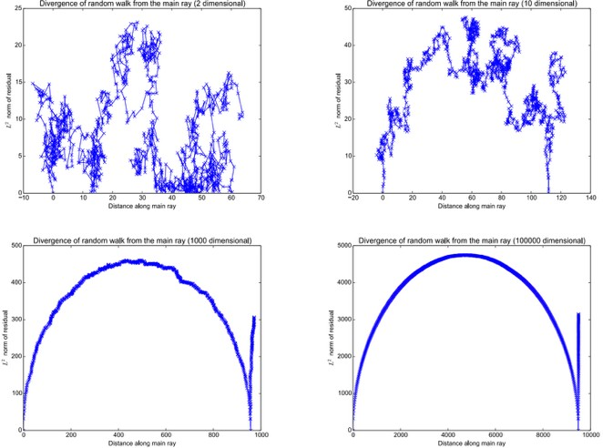
Random walk control experiment

Slide 36
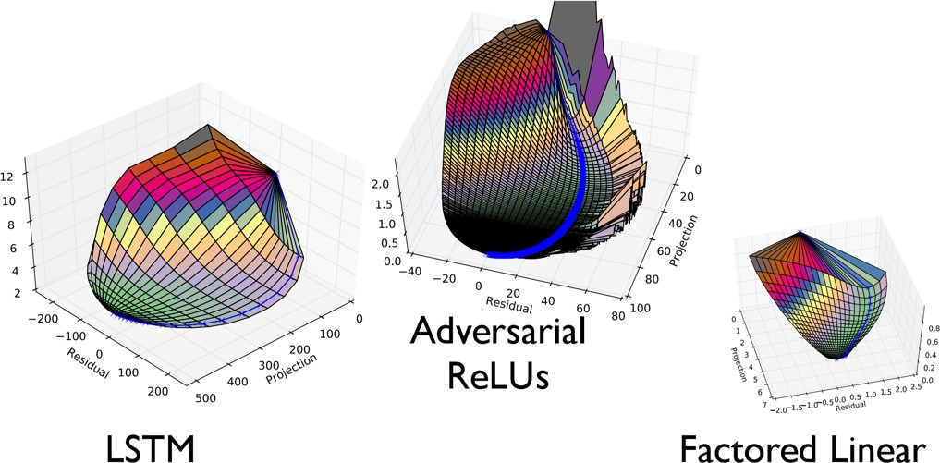
3-D plots without obstacles

Slide 37
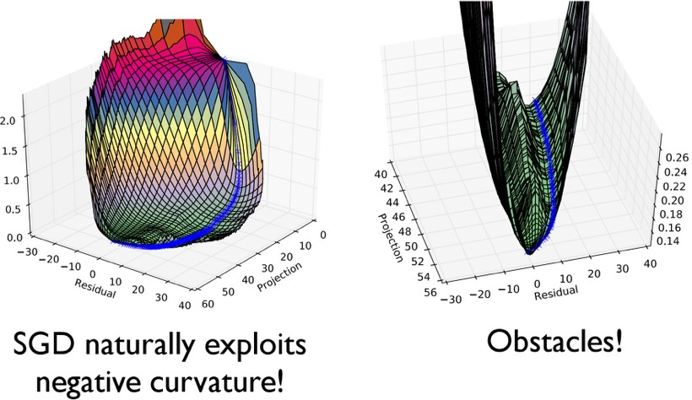
3-D plot of adversarial maxout

Slide 38
Lessons from visualizations
For most problems, there exists a linear subspace of monotonically decreasing values
For some problems, there are obstacles between this subspace the SGD path
Factored linear models capture many qualitative aspects of deep network training

