Slide 1

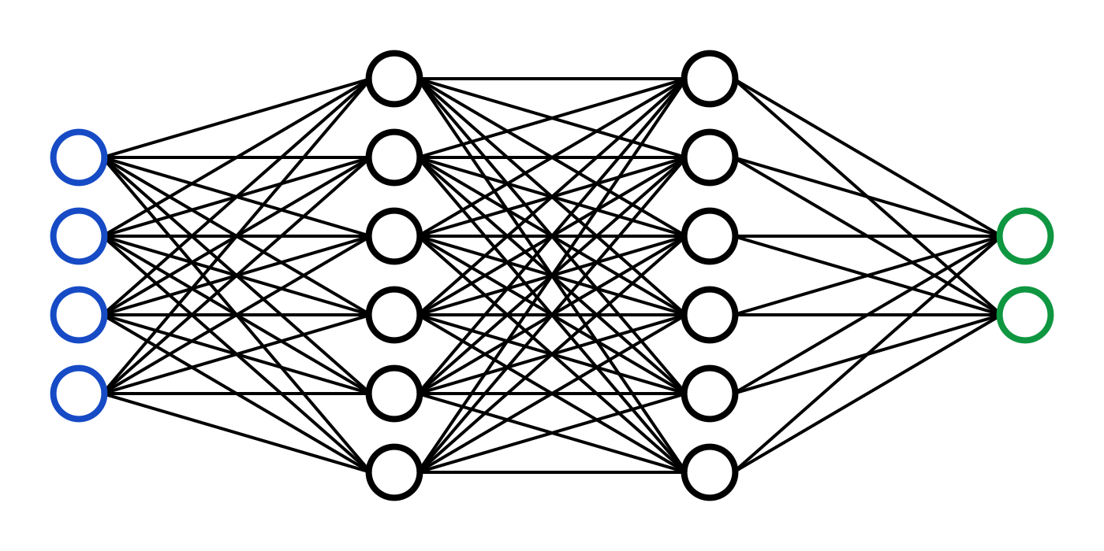
C7082 Techniques in Machine Learning and AI
Ed Harris

Slide 2
09 Convolutional Networks
Scale up neural networks to process VERY large images/video sequences
Sparse connections
Parameter sharing
Automatically generalize across spatial translations of inputs
Applicable to any input that is laid out on a grid (1-D, 2-D, 3-D, …)

Slide 3
Key Idea
Replace matrix multiplication in neural nets with convolution
Everything else stays the same
Maximum likelihood
Back-propagation
etc.

Slide 4

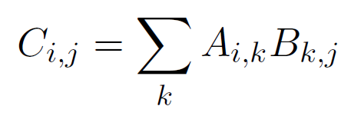



Matrix (Dot) Product
m
= m
n
p
p
n
Must match

Slide 5
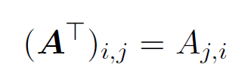
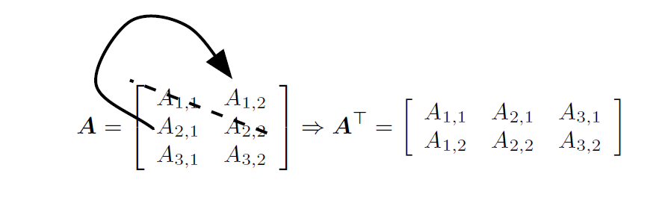
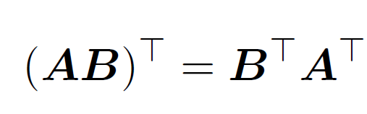
Matrix Transpose
The transpose of the matrix can be thought of as a mirror image across the main diagonal

Slide 6
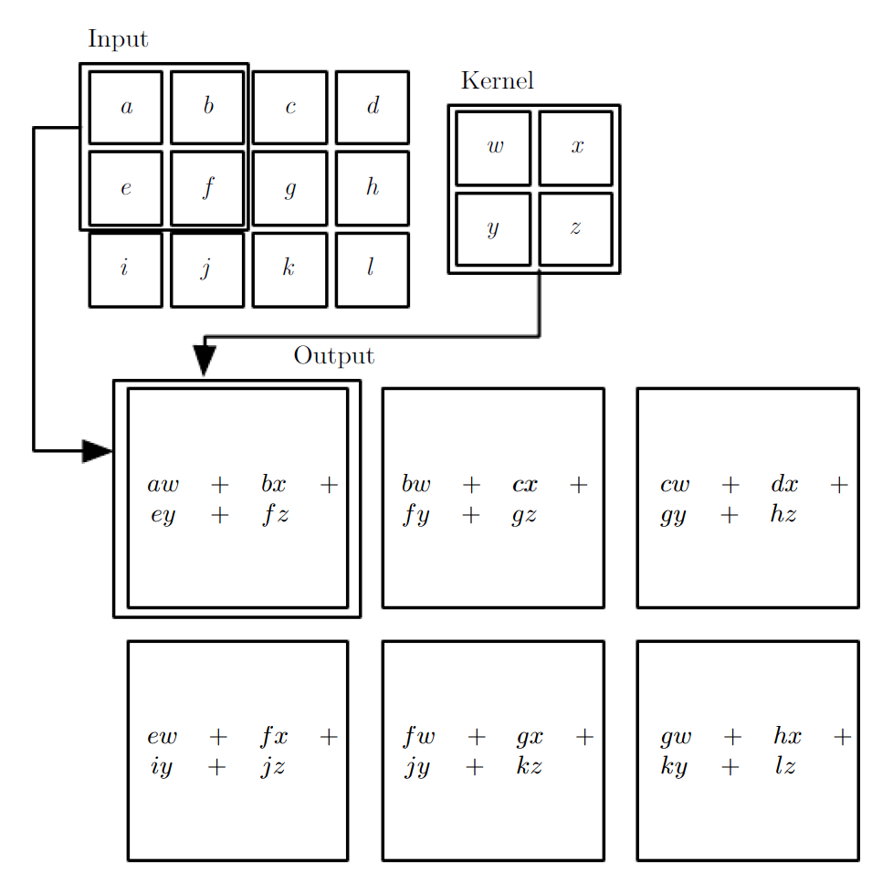
2D Convolution
2-D convolution without kernel-flipping
The output is restricted to positions where the kernel lies entirely within the image, called “valid convolution”
Boxes with arrows indicate how the upper-left element of the output tensor is formed by applying the kernel to the corresponding upper-left region of the input tensor

Slide 7
Three Operations
Convolution: like matrix multiplication
Take an input, produce an output (hidden layer)
“Deconvolution”: like multiplication by transpose of a matrix
Used to back-propagate error from output to input
Reconstruction in autoencoder / RBM
Weight gradient computation
Used to backpropagate error from output to weights
Accounts for the parameter sharing

Slide 8
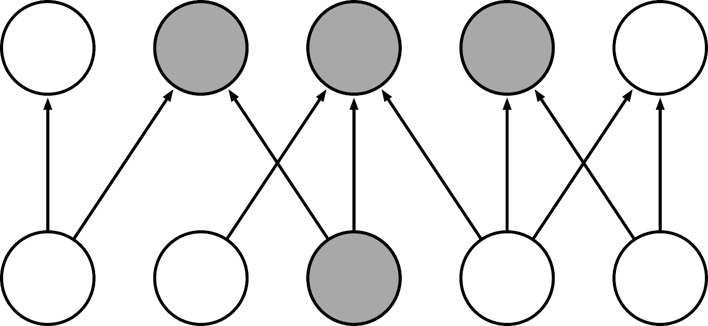
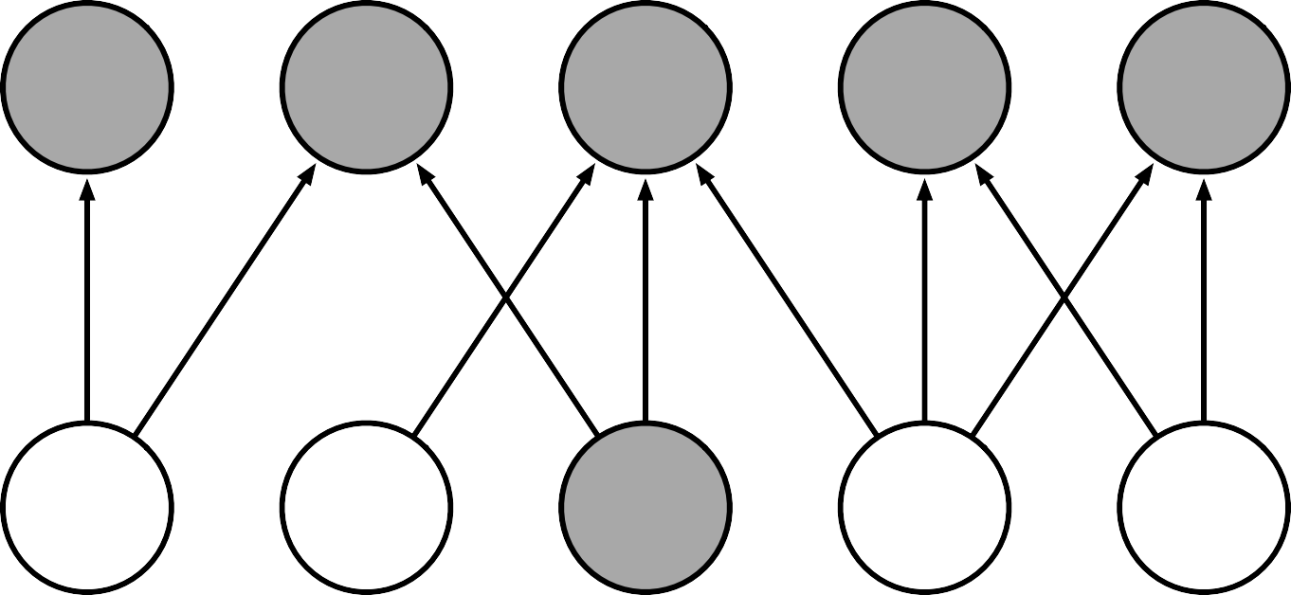
Sparse Connectivity
Sparse connections due to small convolution kernel
s
1
s
2
s
3
s
4
s
5
x₁
x₂
x₃
x₄
x₅
s₁
s₂
s₃
s₄
s₅
Dense connections
x₁
x₂
x₃
x₄
x₅

Slide 9
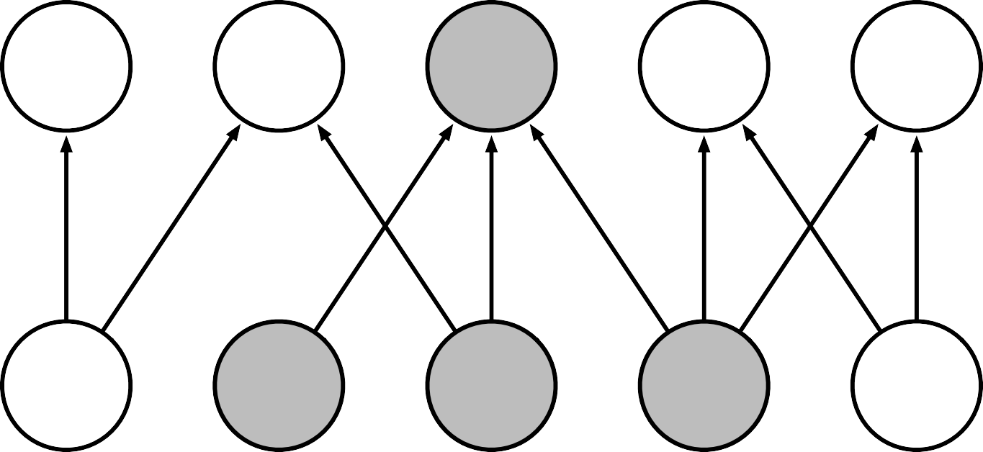
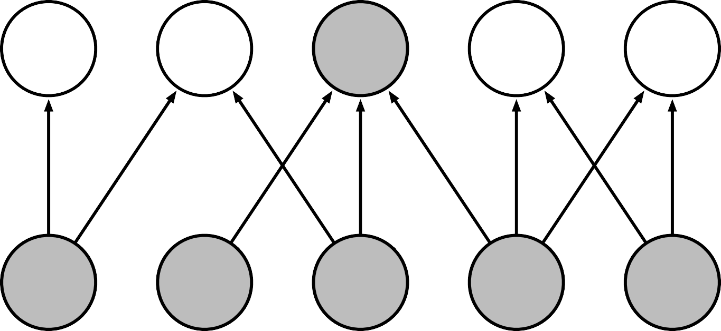
Sparse Connectivity
Sparse connections due to small convolution kernel
s₁
s₂
s₃
s₄
s₅
x₁
x₂
x₃
x₄
x₅
s₁
s₂
s₃
s₄
s₅
Dense connections
x₁
x₂
x₃
x₄
x₅

Slide 10
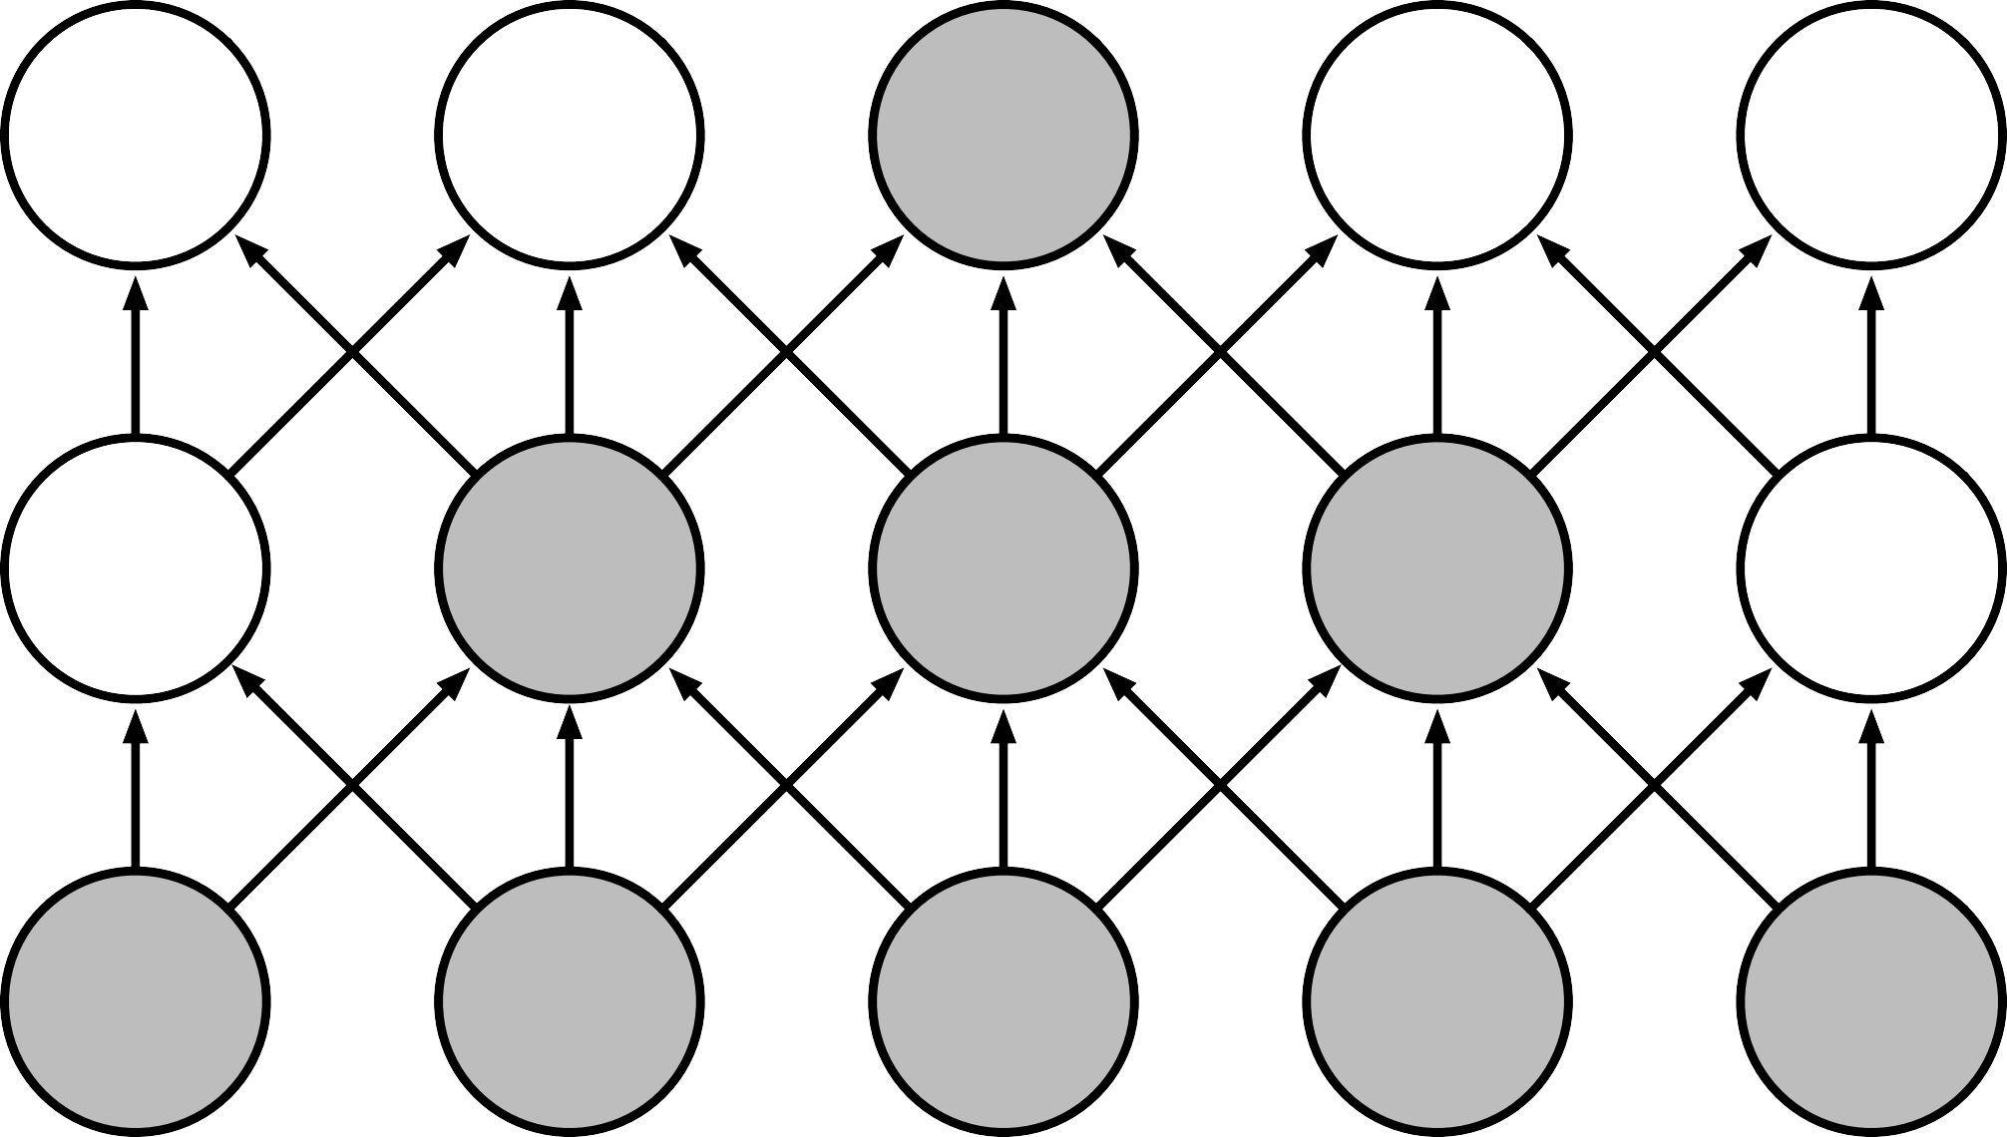
Growing Receptive Fields
g₁
g₂
g₃
g₄
g₅
h₁
h₂
h₃
h₄
h₅
x₁
x₂
x₃
x₄
x₅
The receptive field of the units in the deeper layers of a convolutional network is larger than the receptive field of the units in the shallow layers.

Slide 11
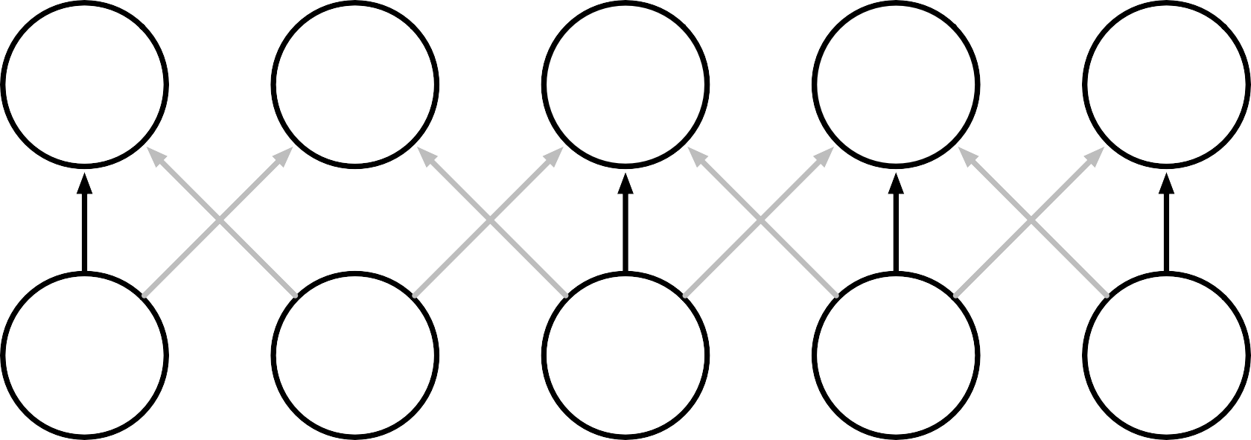
Parameter Sharing
Convolution shares the same parameters
s
1
s
2
s
3
s
4
s
5
across all spatial
x₁ x₂ x₃ x₄ x₅
locations
Traditional matrix multiplication does not share any parameters
s₁
s₂
s₃
s₄
s₅
x₁
x₂
x₃
x₄
x₅

Slide 12
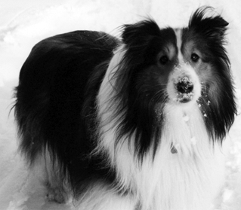
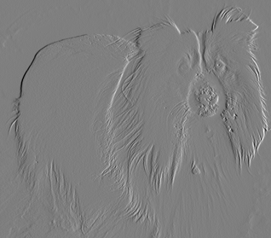
Edge Detection by Convolution
Input
1
-1
Output
Kernel
Convolution can be super-efficient

Slide 13
Eﬃciency of Convolution
Input size: 320 by 280
Kernel size: 2 by 1
Output size: 319 by 280
Convolution |  | Dense matrix | Sparse matrix
Stored floats | 2 | 319*280*320*280 > 8e9 | 2*319*280 = 178,640
Float muls or | 319*280*3 = 267,960 | > 16e9 | Same as convolution (267,960)
adds

Slide 14




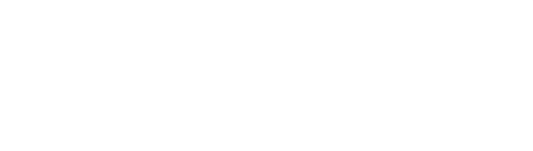

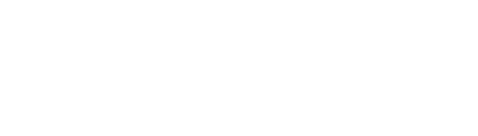
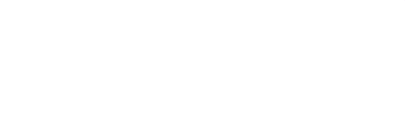

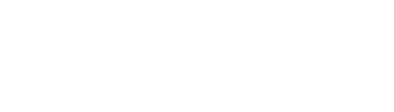



Convolutional Network Components
Complex layer terminology
Simple layer terminology
Next layer
Next layer
Terminology
The components of a typical convolutional neural network layer.
There are two commonly used sets of terminology for describing these layers.
Convolutional Layer
Pooling stage
Pooling layer
Detector stage:
Nonlinearity e.g., rectified linear
Detector layer: Nonlinearity e.g., rectified linear
Convolution stage: Aﬃne transform
Convolution layer: Aﬃne transform
Input to layer
Input to layers

Slide 15
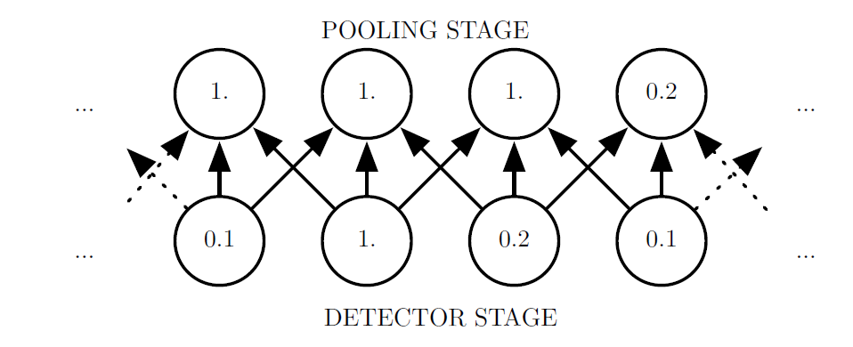
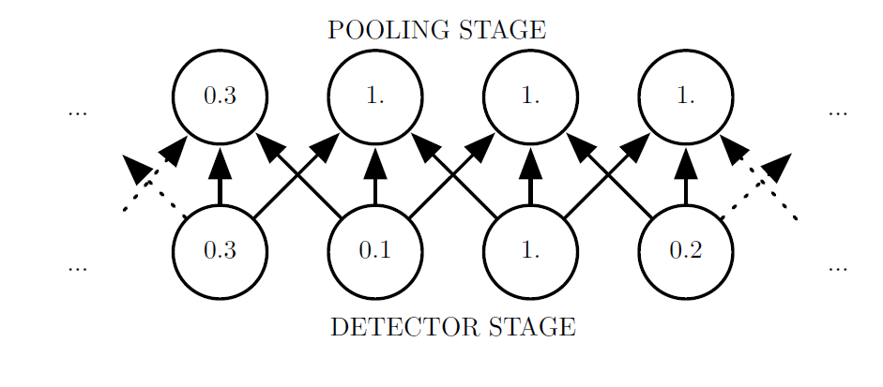
Max Pooling and Invariance to Translation
Max pooling introduces invariance.
(Top)A view of the middle of the output of a convolutional layer. The bottom row shows outputs of the nonlinearity. The top
row shows the outputs of max pooling, with a stride of one pixel between pooling regions and a pooling region width of three pixels.
(Bottom) A view of the same network, after the input has been shifted to the right by one pixel. Every value in the bottom row has
changed, but only half of the values in the top row have changed, because the max pooling units are only sensitive to the maximum value in the neighborhood, not its exact location.

Slide 16

Cross-Channel Pooling and Invariance to Learned Transformations
Large response in pooling unit
Large response in pooling unit
Large
Large response
response in detector
in detector
unit 1
unit 3

Slide 17
Pooling with Downsampling
1.
0.2
0.1
0.1
1.
0.2
0.1
0.0
0.1
Max-pooling with a pool width of three and a stride between pools of two. This reduces the representation size by a factor of two, which reduces the computational and statistical burden on the next layer. Note that the rightmost pooling region has a smaller size, but must be included if we do not want to ignore some of the detector units.

Slide 18
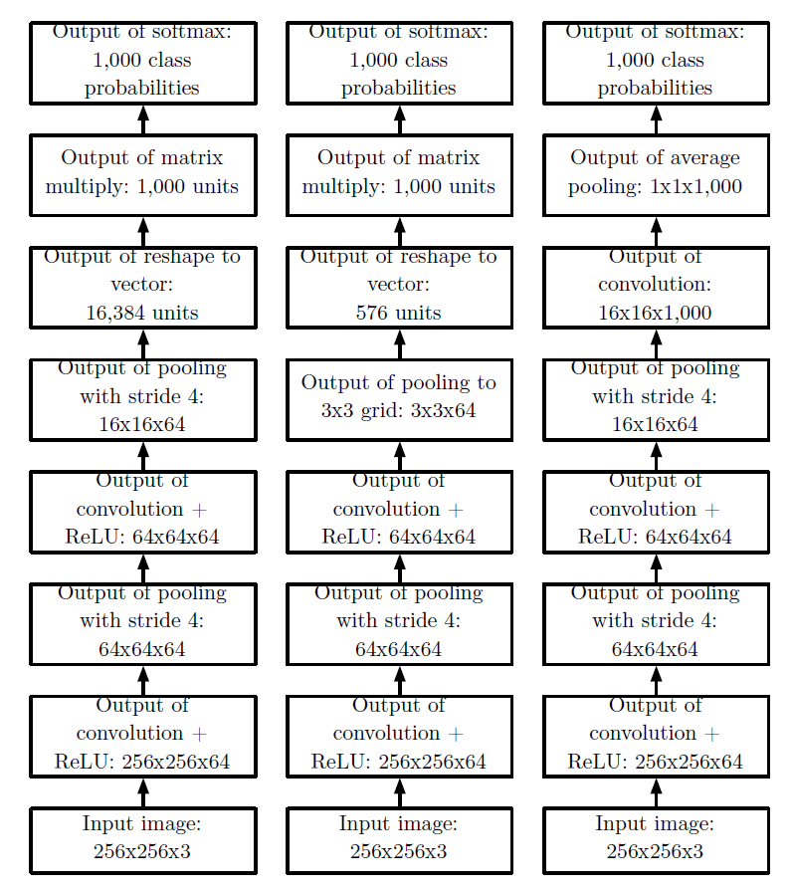
Example Classification Architectures
Examples of different convolutional networks

Slide 19
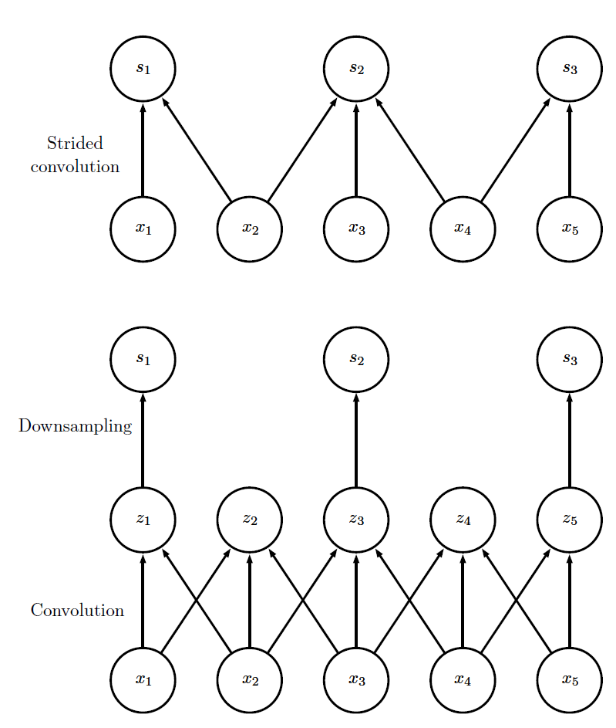
Convolution with Stride
Convolution with a stride
(Top) Convolution with a stride length of two implemented in a single operation.
(Bottom) Convolution with a stride greater than one pixel is mathematically equivalent to convolution with unit stride followed by downsampling.
The two-step approach involving downsampling is computationally wasteful, because it computes many values that are then discarded.

Slide 20
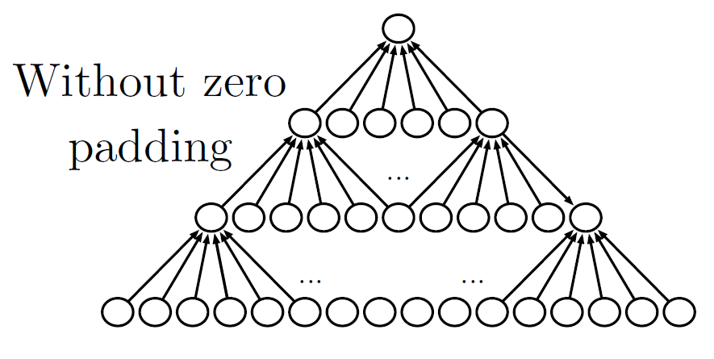
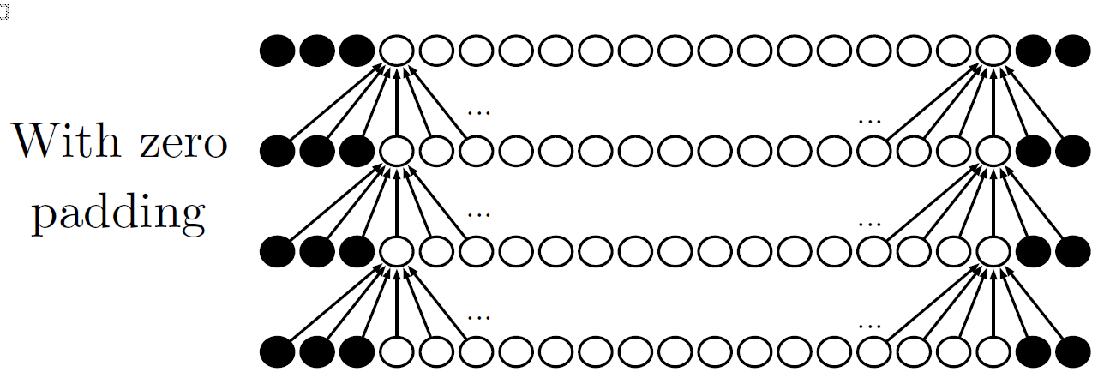
Zero Padding Controls Size
Padding with zeros is a computational trick that allows many layers (an arbitrary number, meaning it can be large!) that do not “shrink”

Slide 21
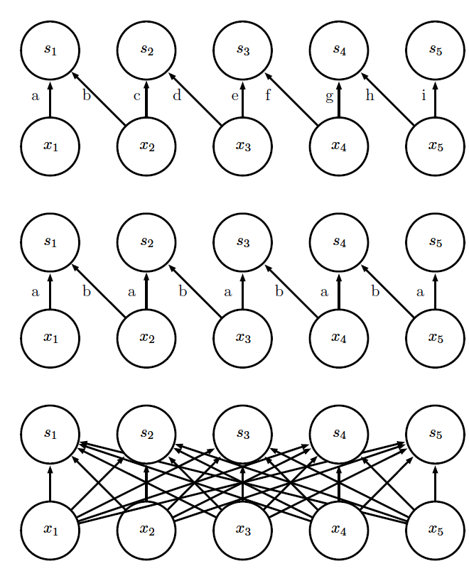
Kinds of Connectivity
(Top) Locally connected layer with a patch size of two pixels. Each edge is labeled with a unique letter to show that each edge is associated with its own weight parameter.
(Center)A convolutional layer with a kernel width of two pixels. Same connectivity as top but no parameter sharing. The convolutional layer uses the same two weights repeatedly across the entire input
(Bottom) Fully connected layer resembles a locally connected layer in the sense that each edge has its own parameter (unlabeled here). No restricted connectivity of the locally connected layer.

Slide 22
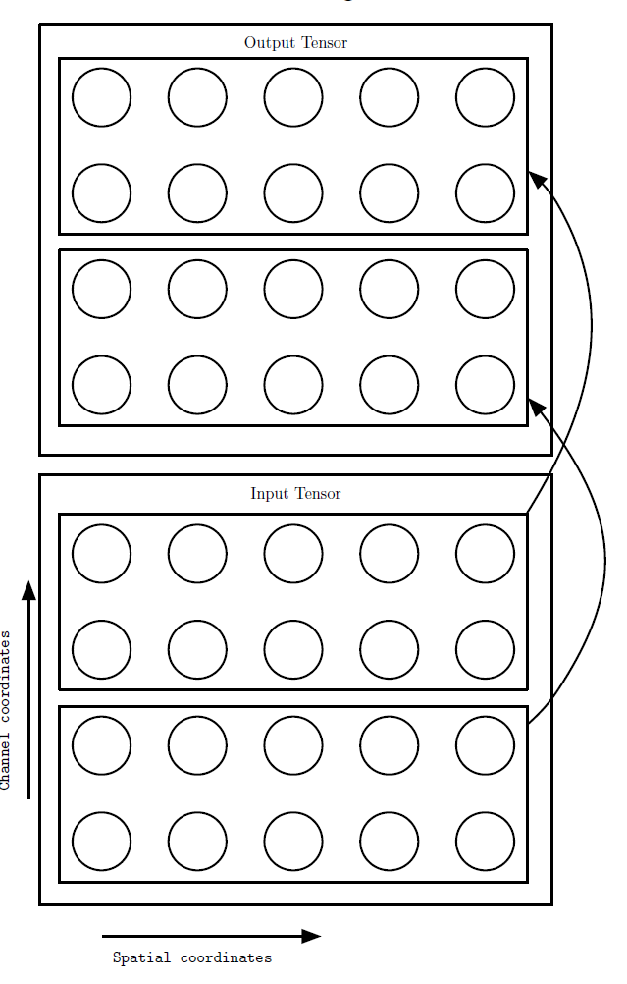
Partial Connectivity Between Channels
A convolutional network with the first two output channels connected to only the first two input channels

Slide 23
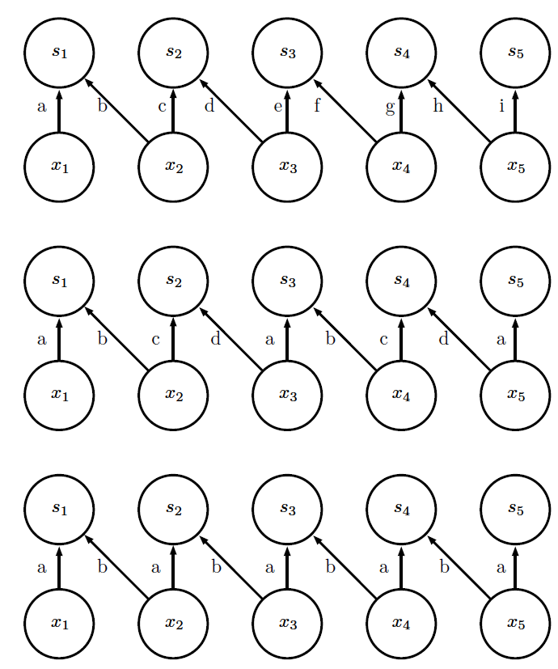
Tiled convolution
Local connection (no sharing)
Tiled convolution
(cycle between groups of shared parameters)
Convolution
(one group shared everywhere)

Slide 24
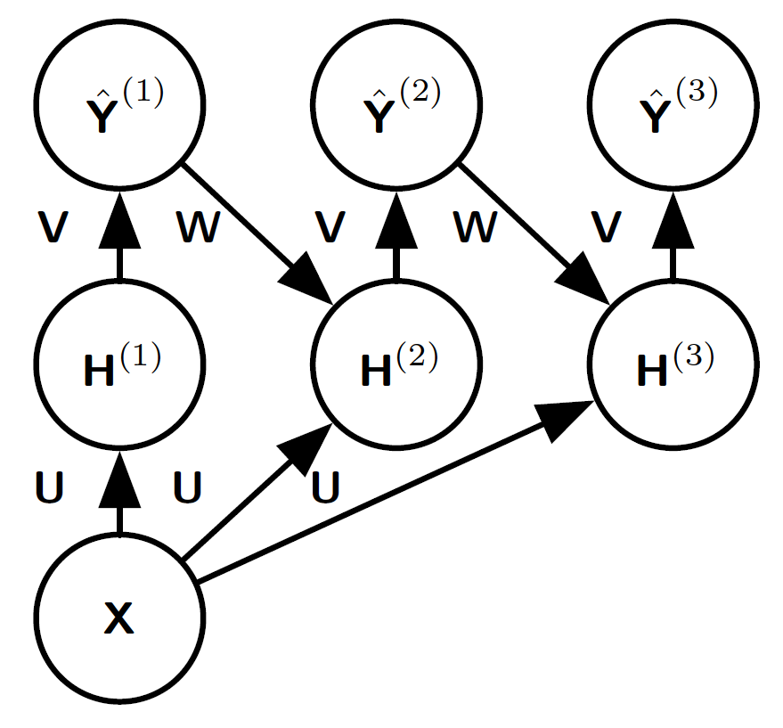
Recurrent Pixel Labeling
An example of a recurrent convolutional network for pixel labeling.
The input is an image tensor X, with axes corresponding to image rows, image columns, and channels (red, green, blue).
The goal is to output a tensor of labels Yˆ, with a probability distribution over labels for each pixel.

Slide 25
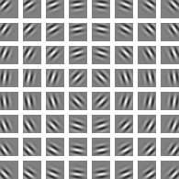
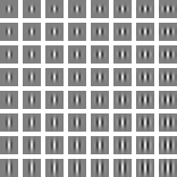
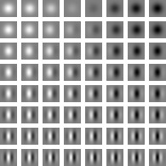
Gabor Functions
Gabor functions with a variety of parameter settings. White indicates large positive weight, black indicates large negative weight, and the background gray corresponds to zero weight.

Slide 26
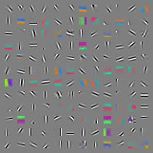
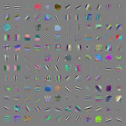
Gabor-like Learned Kernels
Machine learning algorithms can learn features that detect edges or specific colors of edges when applied to natural images.

Slide 27
Major Architectures
Spatial Transducer Net: input size scales with output size, all layers are convolutional
All Convolutional Net: no pooling layers, just use strided convolution to shrink representation size
Inception: complicated architecture designed to achieve high accuracy with low computational cost
ResNet: blocks of layers with same spatial size, with each layer’s output added to the same buﬀer that is repeatedly updated. Very many updates =very deep net, but without vanishing gradient.

