Slide 1

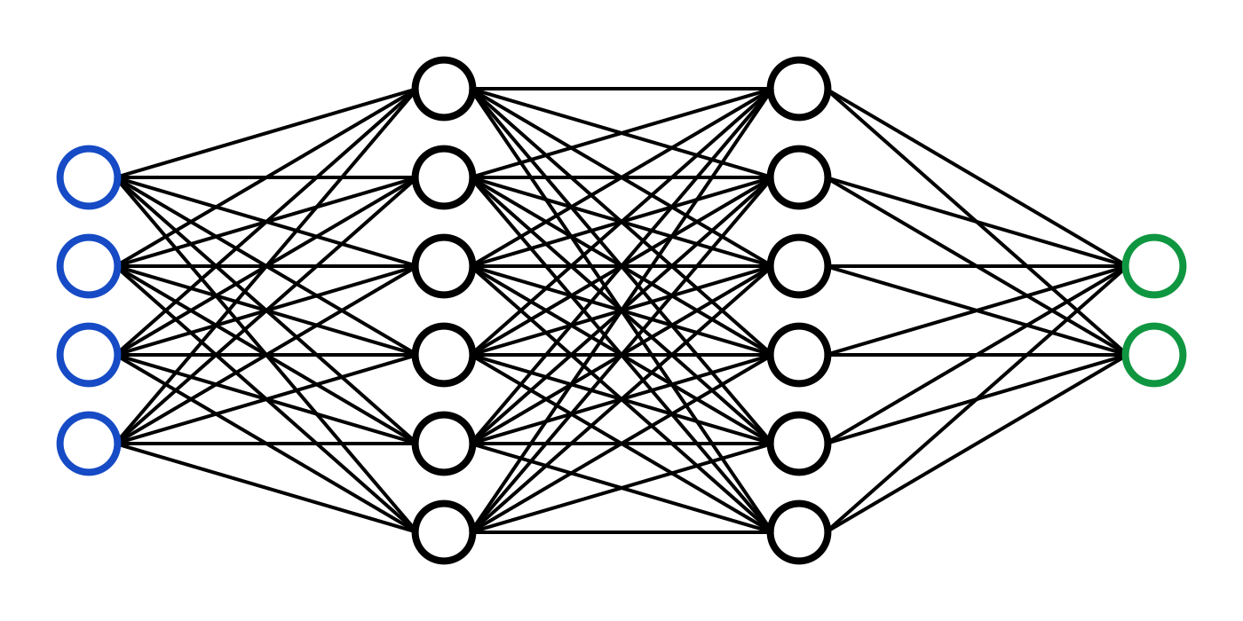
C7082 Techniques in Machine Learning and AI
Ed Harris

Slide 2
10 Sequence Modeling: Recurrent and Recursive Nets
Recurrent neural networks or RNNs are a family of neural networks for processing sequential data.
A convolutional network is a neural network that is specialized for processing a grid of values X such as an image; a recurrent neural network is a neural network that is specialized for processing a sequence of values x(1), . . . , x(τ).
Convolutional networks can readily scale to images with large width and height, and some convolutional networks can process images of variable size, recurrent networks can scale to much longer sequences than would be practical for networks without sequence-based specialization.

Slide 3
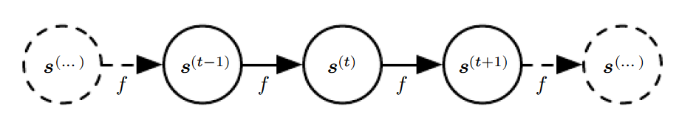
Classical Dynamical Systems
A classical dynamical system illustrated as an unfolded computational graph.
Each node represents the state at some time t and the function f maps the state at t to the state at t + 1. The same parameters (the same value of θ used to parametrize f) are used for all time steps.

Slide 4
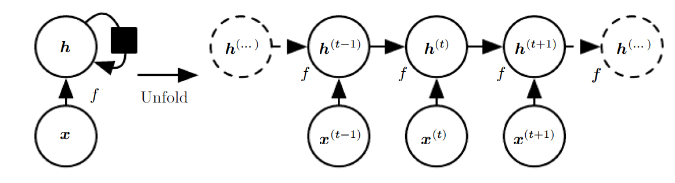
Unfolding Computation Graphs
A recurrent network with no outputs. This recurrent network just processes information from the input x by incorporating it into the state h that is passed forward through time.
(Left) Circuit diagram. The black square indicates a delay of a single time step.
(Right) The same network seen as an unfolded computational graph, where each node is now associated with one particular time instance.

Slide 5
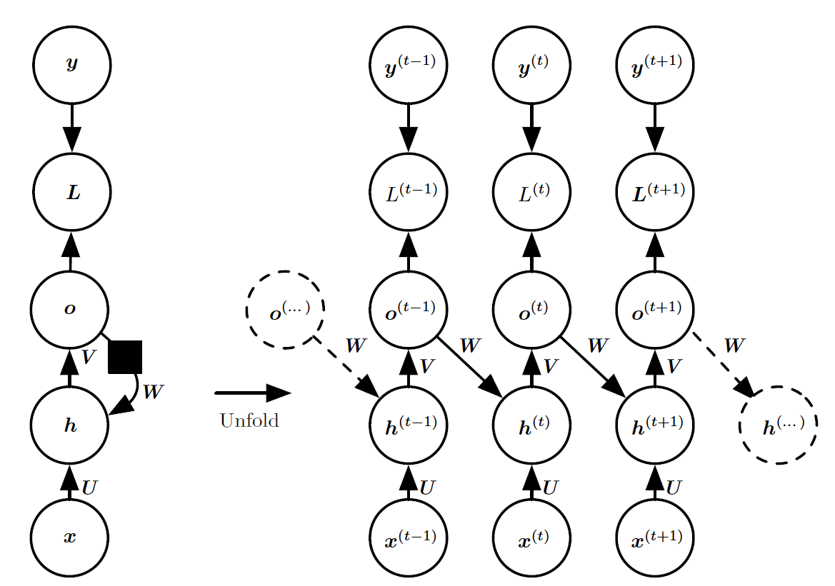
Recurrent Hidden Units

Slide 6
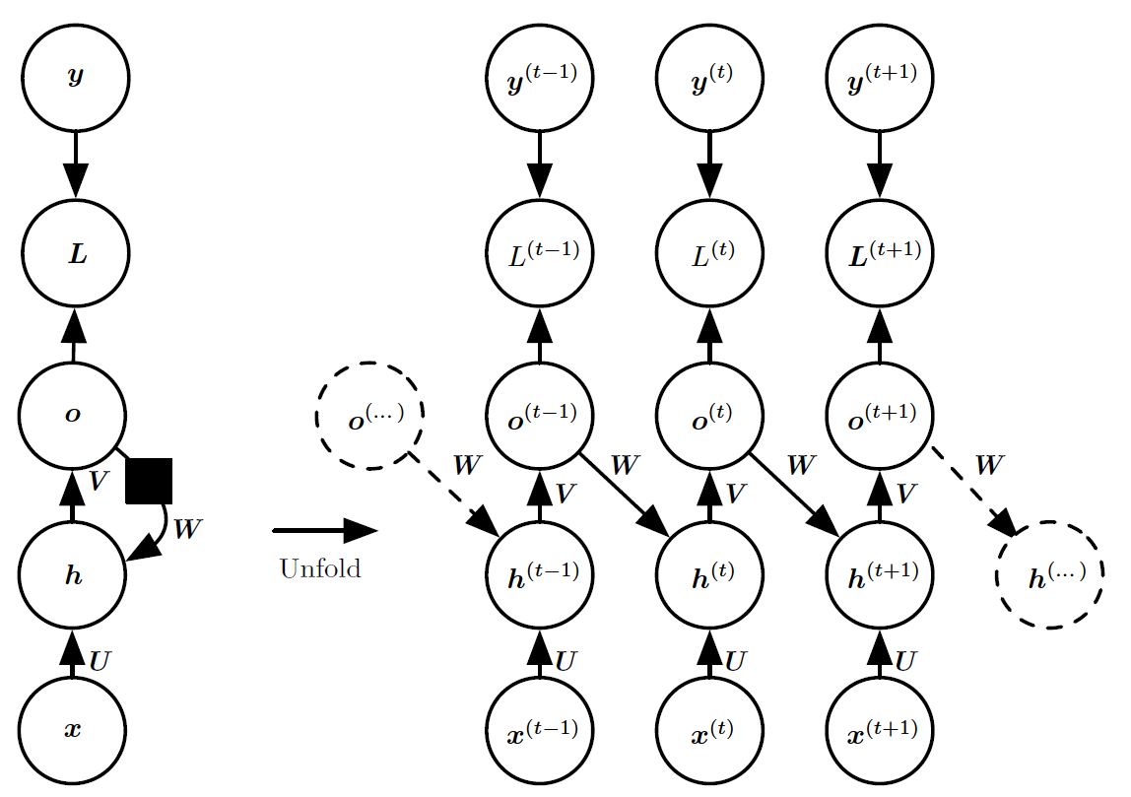
Recurrence through only the Output

Slide 7
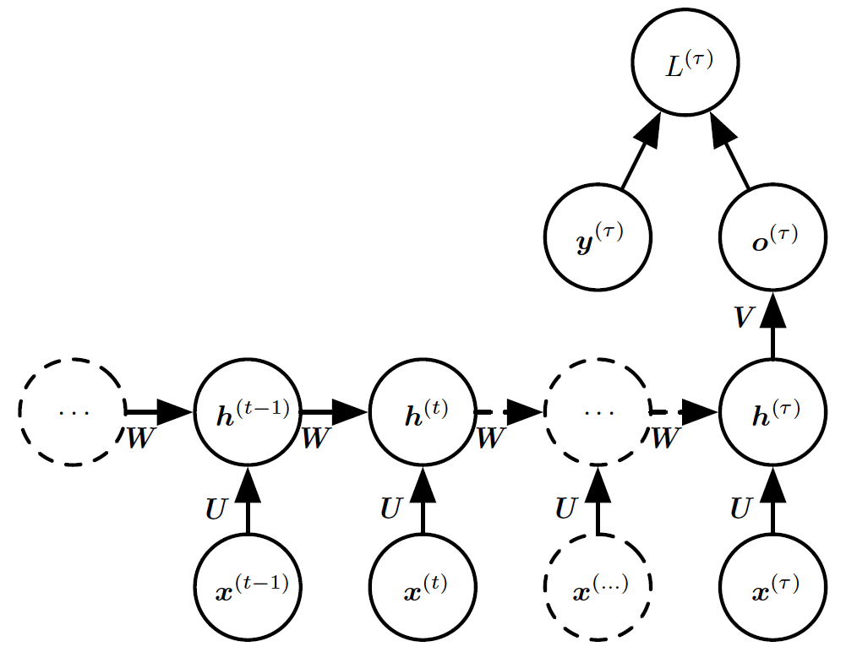
Sequence Input, Single Output

Slide 8

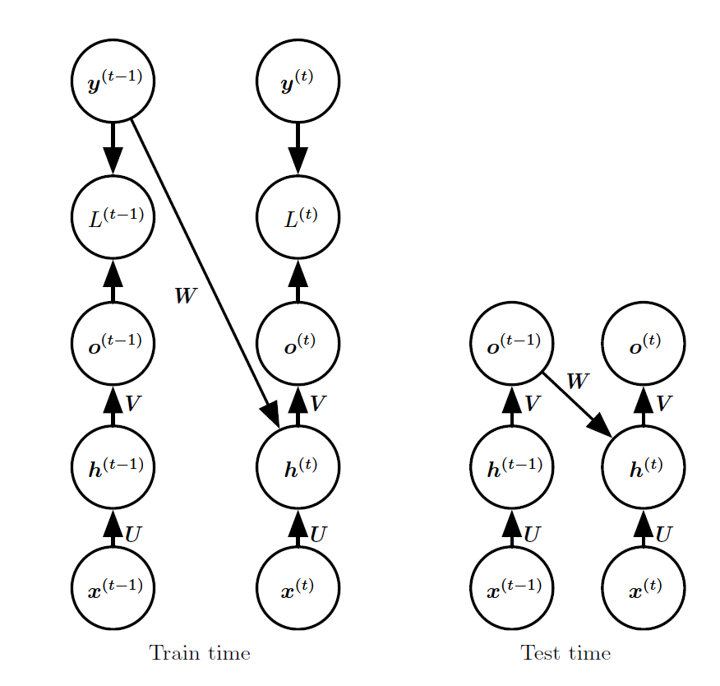
Teacher Forcing
Teacher forcing is a training technique that is applicable to RNNs that have connections from their output to their hidden states at the next time step.

Slide 9
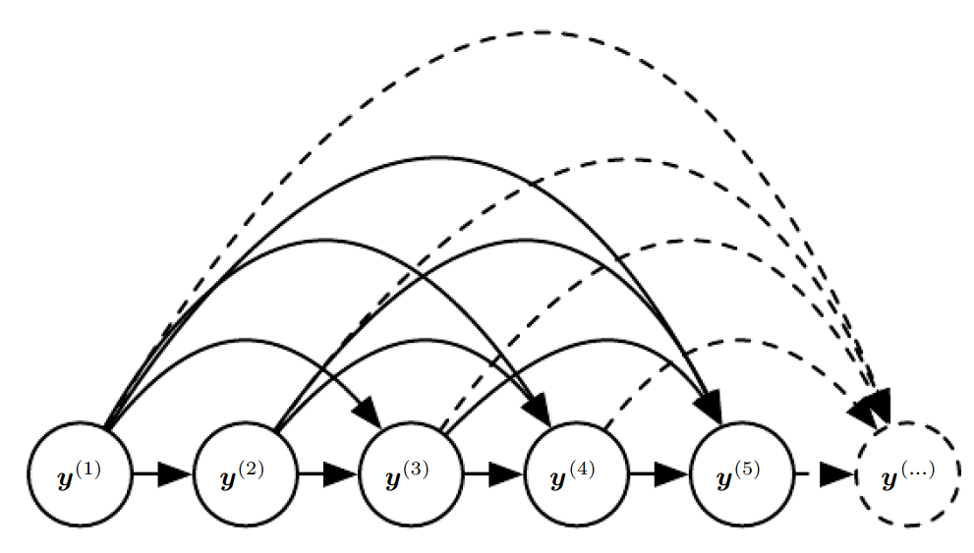
Fully Connected Graphical Model

Slide 10
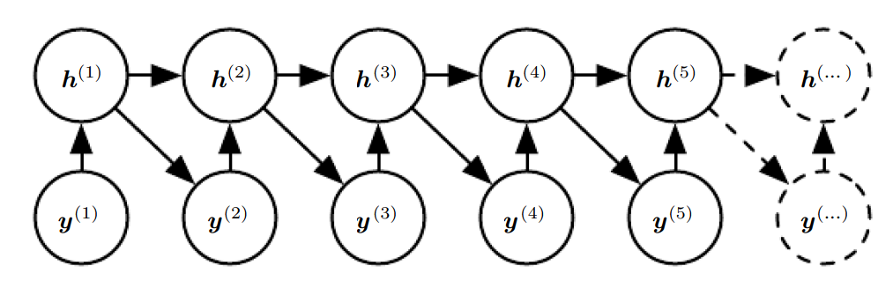
RNN Graphical Model
(The conditional distributions for the hidden units are deterministic)

Slide 11
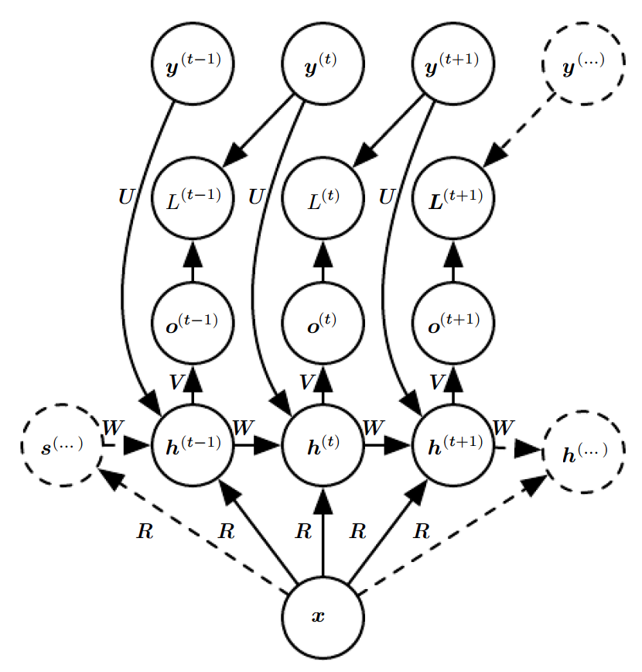
Vector to Sequence
An RNN that maps a fixed-length vector x into a distribution over sequences Y.
This RNN is appropriate for tasks such as image captioning, where a single image is used as input to a model that then produces a sequence of words describing the image

Slide 12
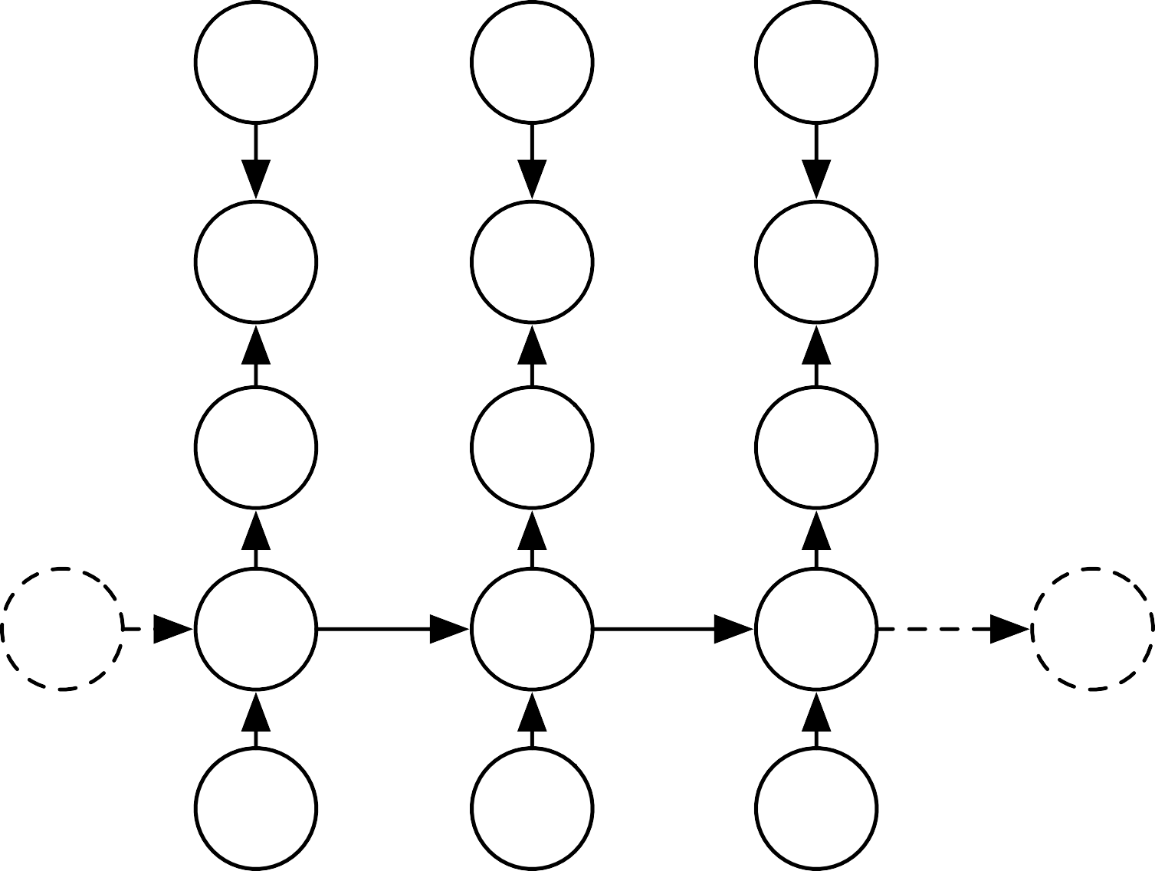


Hidden and Output Recurrence
_{y}(t -1)
_{y}(t)
_{y}(t+1)
_{L}(t -1)
_{L}(t)
_{L}(t+1)
R
R
R
_{o}(t -1)
_{o}(t)
_{o}(t+1)
V
V
V
W
W
W
W
_{h}(... )
_{h}(t -1)
_{h}(t)
_{h}(t+1)
_{h}(... )
U
U
U
_{x}(t - 1) _{x}(t) _{x}(t+1)
The output values are not forced to be conditionally independent in this model.

Slide 13
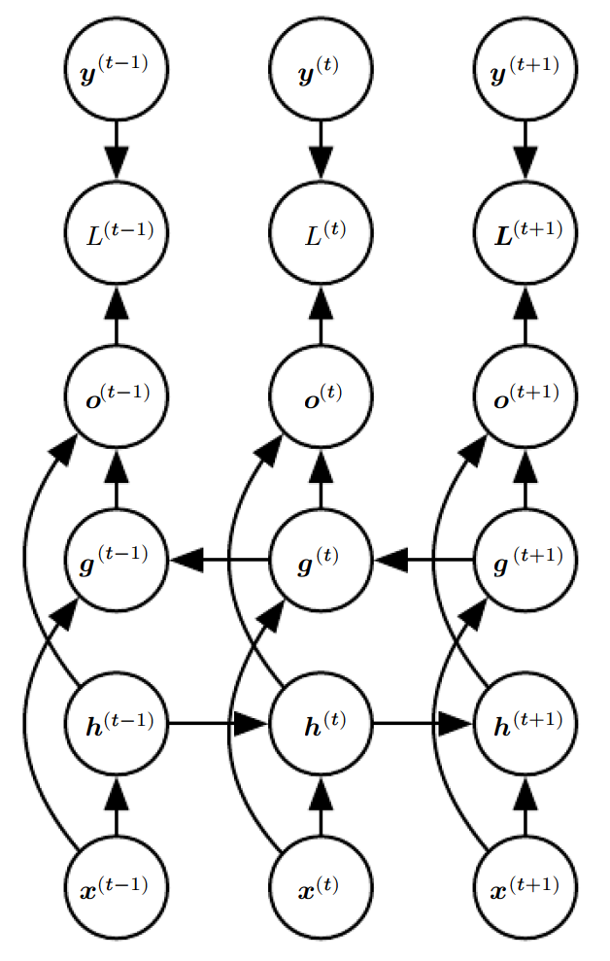
Bidirectional RNN

Slide 14
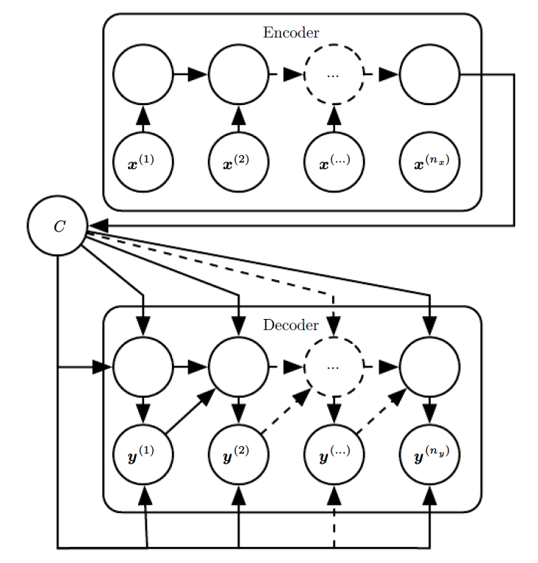
Sequence to Sequence Architecture

Slide 15
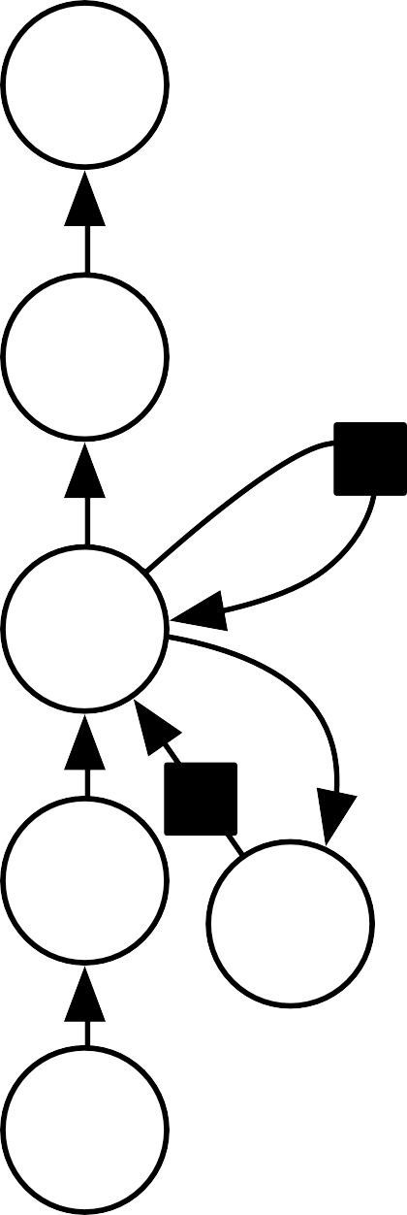






Deep RNNs
y
y
y
h
h
h
(a)
(b)
(c)

Slide 16
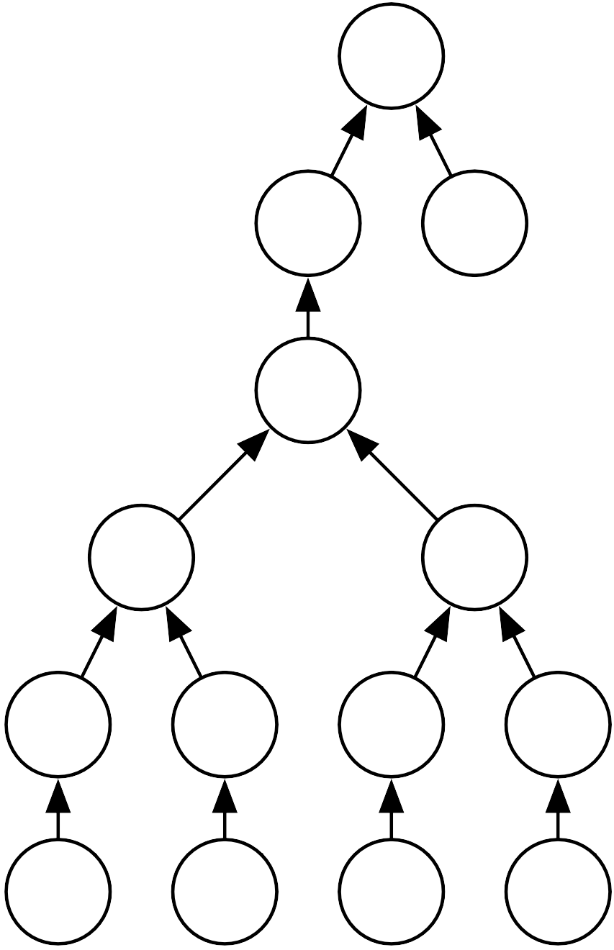
Recursive Network
L
y
U
W
U W
U W
V
V
V
V
_{x}(1)
_{x}(2)
_{x}(3)
_{x}(4)

Slide 17
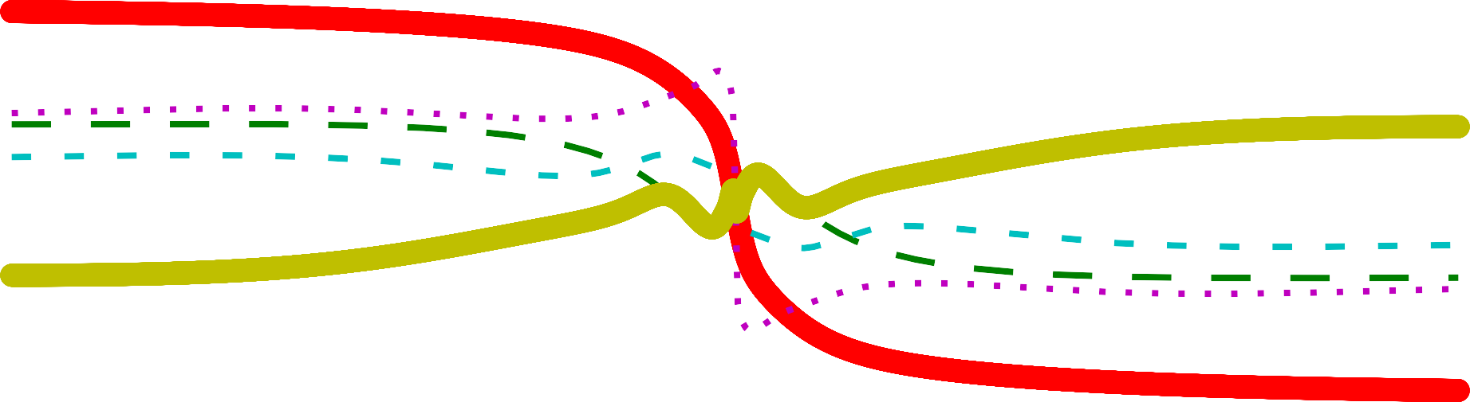
Exploding Gradients from Function Composition
4
3
2
1
0
-1
-2
-3
0
1
2
3
4
5
Projection of output
-4
-60
-40
-20
0
Input coordinate
20
40
60

Slide 18
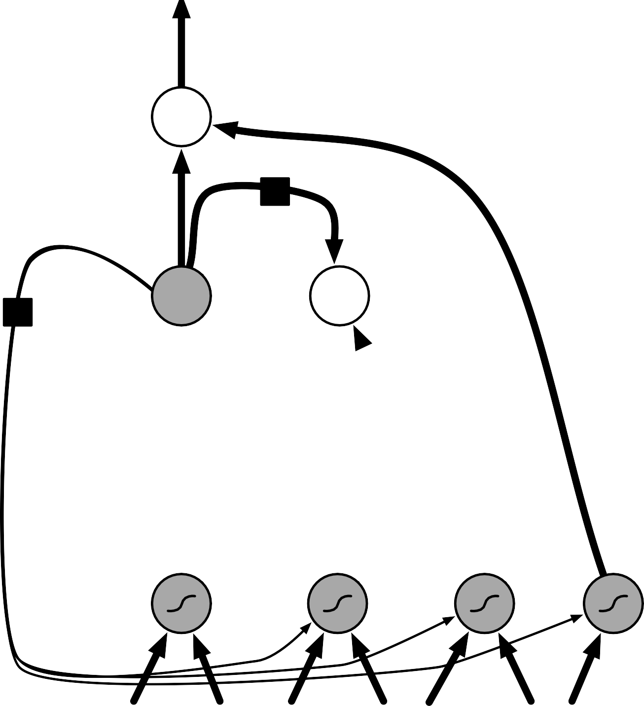




LSTM
output
×
self-loop
+
×
state
×
input
input gate
forget gate
output gate

Slide 19

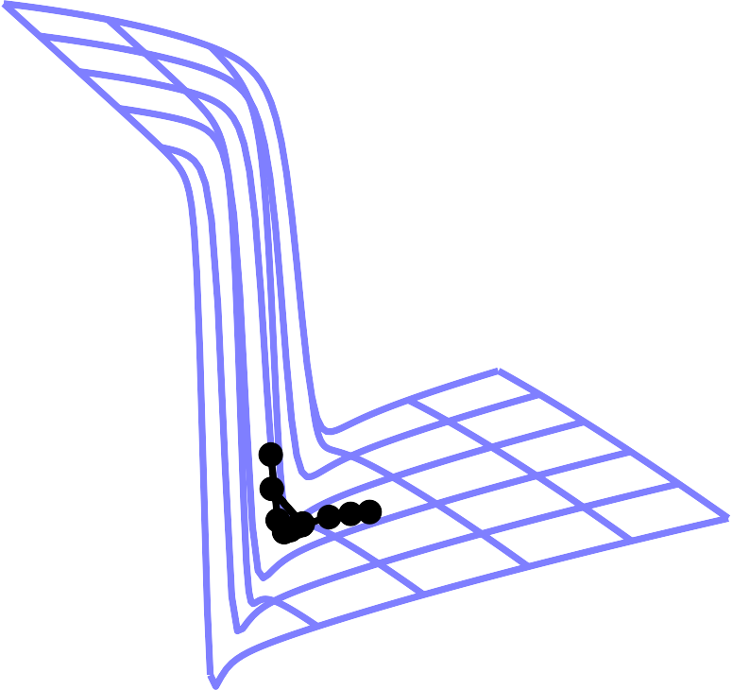

Gradient Clipping
Without clipping With clipping
J(w,b)
J(w,b)
w
w
b
b

Slide 20
Networks with explicit Memory
Memory cells
Reading mechanism
Writing mechanism
Task network, controlling the memory

