Slide 1
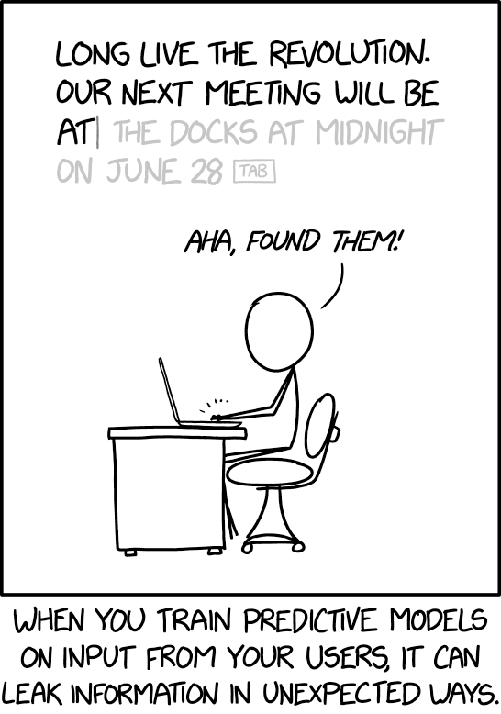
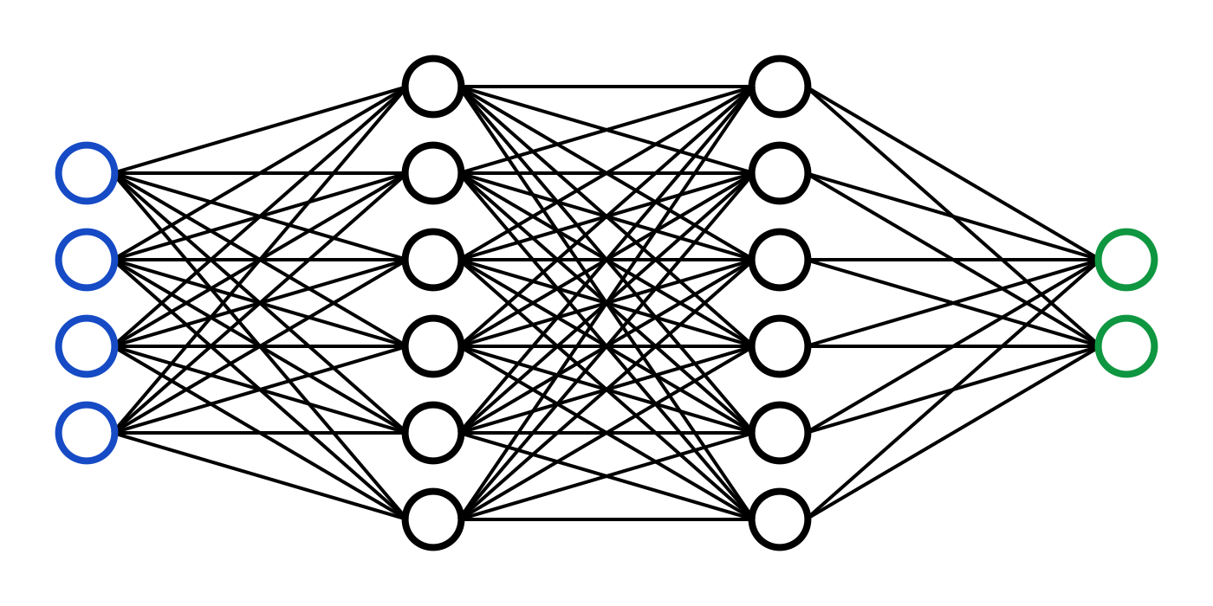
C7082 Techniques in Machine Learning and AI
Ed Harris

Slide 2
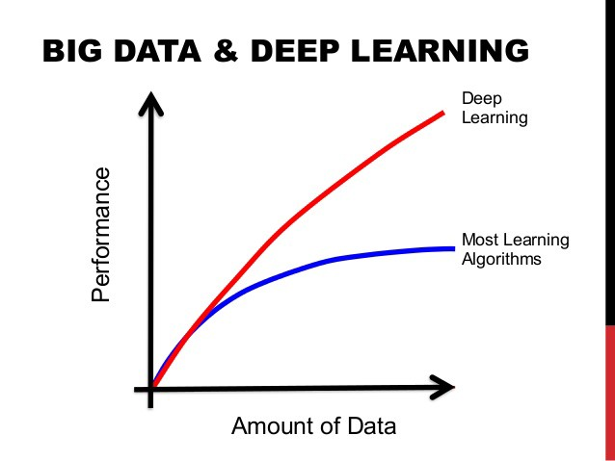
11 Practical Methodology

Slide 3
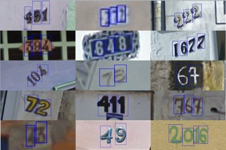
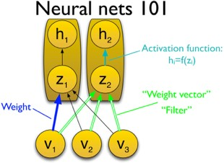
What drives success in ML?
Arcane knowledge of dozens of obscure algorithms?
Knowing how to apply 3-4
standard techniques?
Mountains of data?
(2)
h₁
(2)
h₂
(2)
h₃
(1)
h₁
(1)
h₂
(1)
h₃
(1)
h₄
v₁
v₂
v₃

Slide 4
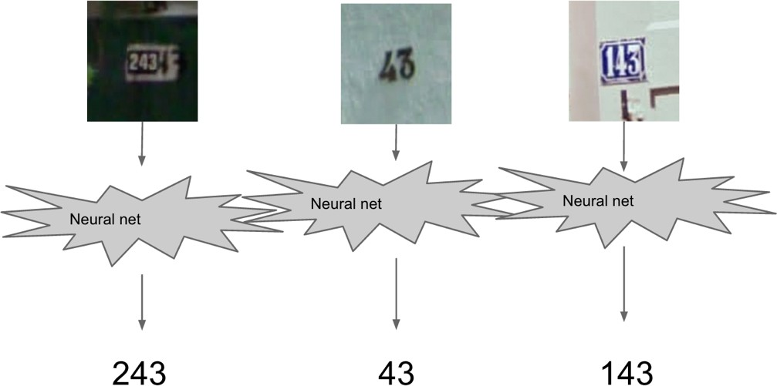
Example: Street View Address Number Transcription
(Goodfellow et al, 2014)

Slide 5
Three Step Process
Use needs to define metric-based goals
Build an end-to-end system
Data-driven refinement

Slide 6
Identify Needs
High accuracy or low accuracy?
Surgery robot: high accuracy
Celebrity look-a-like app: low accuracy

Slide 7
Choose Metrics
Accuracy?
Coverage?
Precision?
Recall?
(% of examples correct)
(% of examples processed)
(% of detections that are right) (% of objects detected)
Amount of error? (For regression problems)

Slide 8
End-to-end System
Get up and running ASAP
Build the simplest viable system first
What baseline to start with though?
Copy state-of-the-art from related, recent publication

Slide 9
Deep or Not?
Lots of noise, little structure -> not deep
Little noise, complex structure -> deep
Good shallow baseline:
Use what you know
Logistic regression, SVM, boosted tree are all good

Slide 10
Choosing Architecture Family
No structure -> fully connected
Spatial structure -> convolutional
Sequential structure -> recurrent

Slide 11
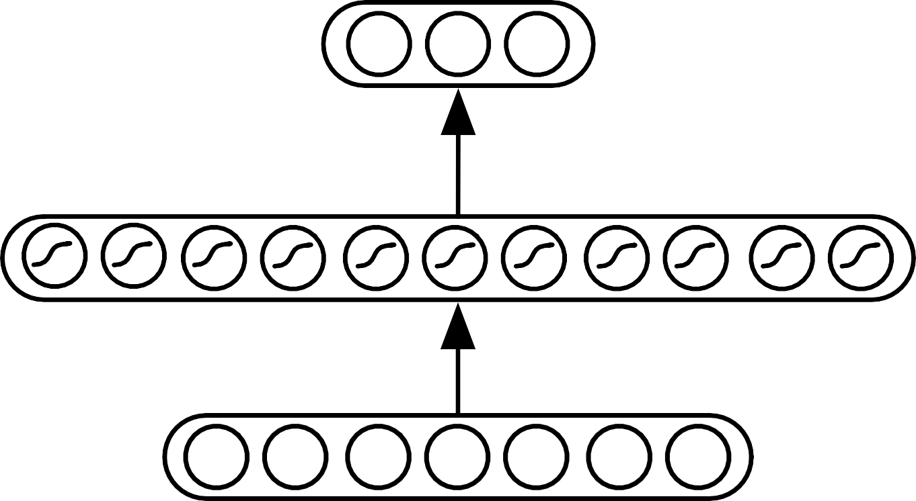
Fully Connected Baseline
2-3 hidden layer feed-forward neural network
AKA “multilayer perceptron”
Rectified linear units
Batch normalization
Adam
Maybe dropout
V
W

Slide 12

Convolutional Network Baseline
Download a pretrained network
Or copy-paste an architecture from a related task
Or:
Deep residual network
Batch normalization
Adam

Slide 13
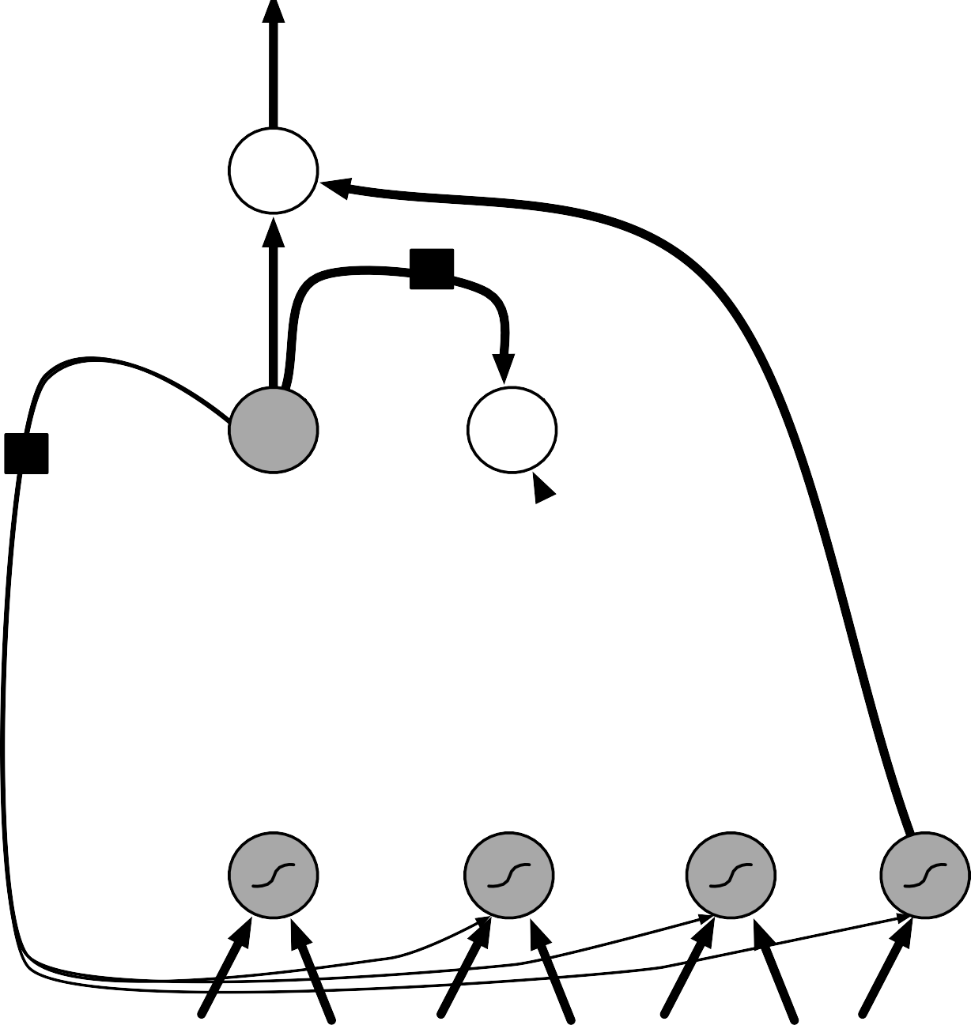
Recurrent Network Baseline
output
LSTM
SGD
Gradient clipping
High forget gate bias
×
output gate
self-loop
+
×
state
forget gate
input gate
×
input

Slide 14
Data-driven Adaptation
Choose what to do based on data
Don’t believe hype
Measure train and test error
“Overfitting” versus “underfitting”

Slide 15
High Train Error
Inspect data for defects
Inspect software for bugs
Don’t roll your own unless you know what you’re doing
Tune learning rate (and other optimization settings)
Make model bigger

Slide 16
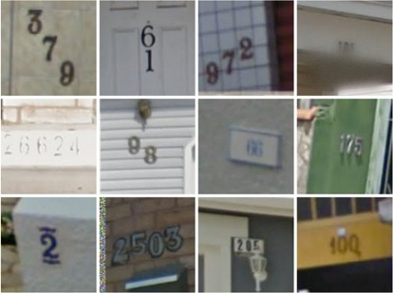
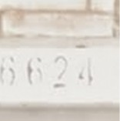
Checking Data for Defects
Can a human process it?
26624

Slide 17
Increasing Depth
96.5
Effect of Depth
96.0
95.5
95.0
94.5
94.0
93.5
93.0
92.5
Test accuracy (%)
92.0₃
4
5
6 7 8
Number of hidden layers
9
10
11

Slide 18
High Test Error
Add dataset augmentation
Add dropout
Collect more data

Slide 19
Increasing Training Set Size
20
Bayes error
Train (quadratic) Test (quadratic)
Test (optimal capacity)
Train (optimal capacity)
6
5
Optimal capacity (polynomial degree)
15
4
Error (MSE)
10
3
2
5
1
0
0
10⁰
10¹ 10² 10³ 10⁴
# train examples
10⁵
10⁰
10¹ 10² 10³ 10⁴
# train examples
10⁵

Slide 20
Tuning the Learning Rate
8
7
6
5
4
3
2
1
Training error
0
₁₀ 2
₁₀ 1
Learning rate (logarithmic scale)
10⁰

Slide 21
Reasoning about Hyperparameters
Hyperparameter
Increases capacity when. . .
increased
Reason
Caveats
Number of hidden units
Increasing the number of hidden units increases the representational capacity of the model.
Increasing the number
of hidden units increases
both the time and memory cost of essentially every op- eration on the model.

Slide 22


































Hyperparameter Search
Grid
Random

