Slide 1

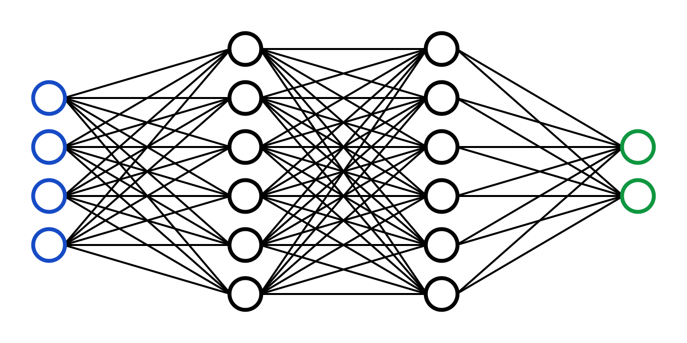
C7082 Techniques in Machine Learning and AI
Ed Harris

Slide 2

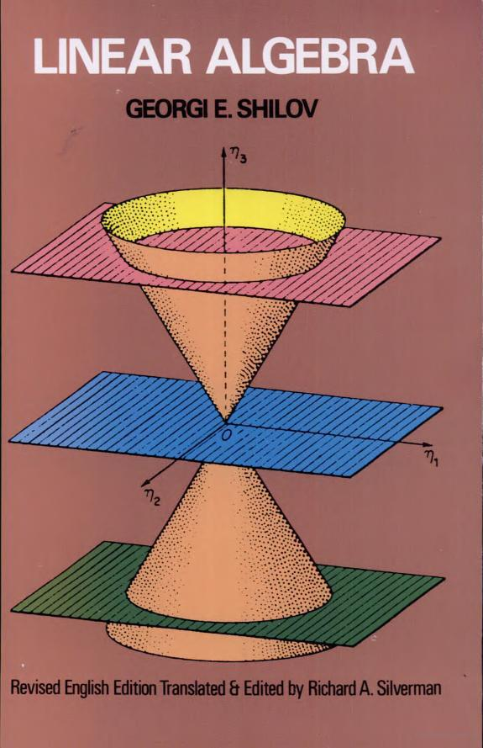
02 Linear Algebra
Primer of linear algebra (again)
Subset most relevant to Deep Learning
Larger subset: e.g., Linear Algebra by Georgi Shilov

Slide 3
Scalars
A scalar is a single number
Integers, real numbers, rational numbers, etc.
Denoted with italic font:
a, n, x

Slide 4
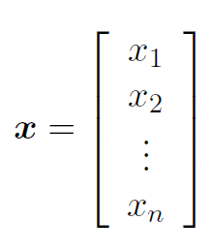
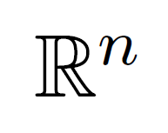
Vectors
A vector is a 1-D array of numbers:
Can be real, binary, integer, etc.
Example notation for type and size:

Slide 5
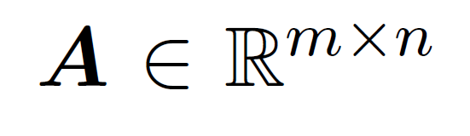
Matrices
A matrix is a 2-D array of numbers:
Row
.
A1,1 A2,1
A1,2 A2,2
Column
Example notation for type and shape:

Slide 6
Tensors
A tensor is an array of numbers, that may have
zero dimensions, and be a scalar
one dimension, and be a vector
two dimensions, and be a matrix
or more dimensions

Slide 7
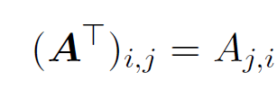
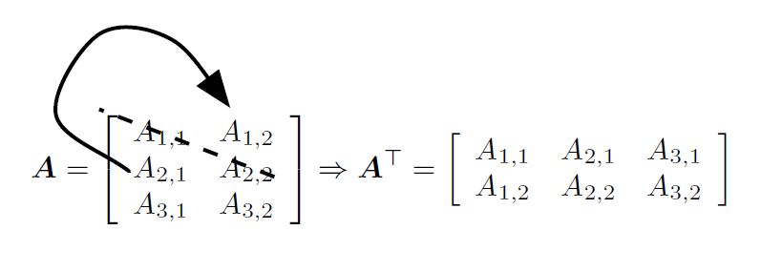
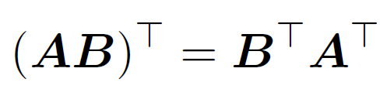
Matrix Transpose
The transpose of the matrix can be thought of as a mirror image across the main diagonal.

Slide 8
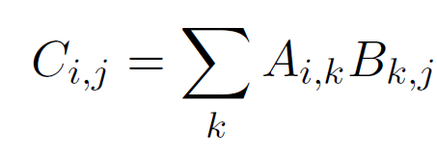



Matrix (Dot) Product
C = AB
m
= m
n
p
p
n
Must match

Slide 9
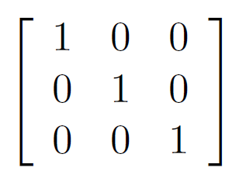
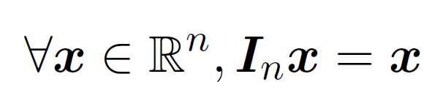
Identity Matrix
Example identity matrix (This is I₃)

Slide 10
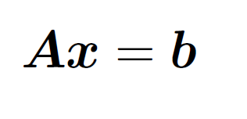
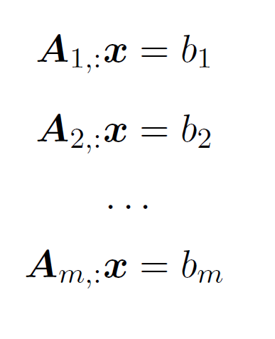
Systems of Equations
expands to

Slide 11
Solving Systems of Equations
A linear system of equations can have:
No solution
Many solutions
Exactly one solution: this means multiplication by the matrix is an "invertible function"

Slide 12

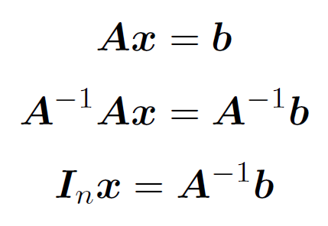
Matrix Inversion
Matrix inverse:
Solving a system using an inverse:
“Numerically unstable“
(but useful for analysis sometimes)

Slide 13
Invertibility
A matrix can’t be inverted if it has…
More rows than columns
More columns than rows
Redundant rows/columns (“linearly dependent”, “low rank”)

Slide 14

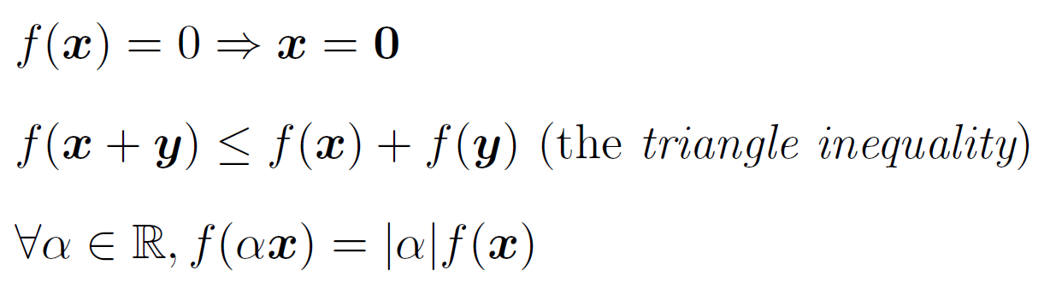
Norms
Functions that measure how “large” a vector is
Similar to a distance between zero and the point represented by the vector

Slide 15
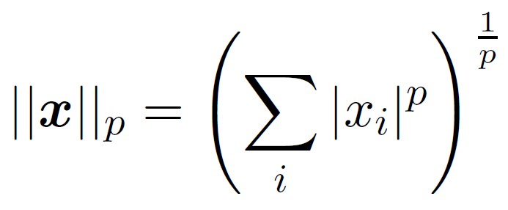
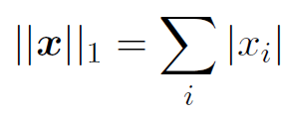

Norms
L^{p} norm
Most popular norm: L2 norm, p=2
L1 norm, p=1:
Max norm, infinite p:

Slide 16
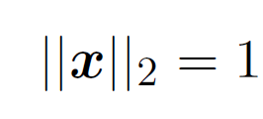
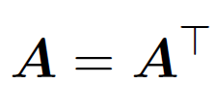
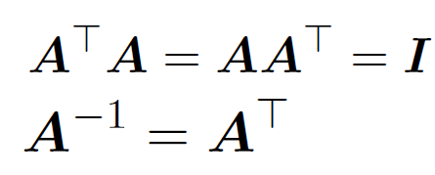
Special Matrices and Vectors
Unit vector:
Symmetric Matrix:
Orthogonal matrix:

Slide 17


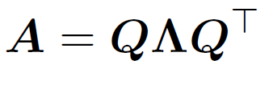
Eigendecomposition
Eigenvector and eigenvalue
Eigendecomposition of a diagonalizable matrix
Every real symmetric matrix has a real, orthogonal eigendecomposition

Slide 18
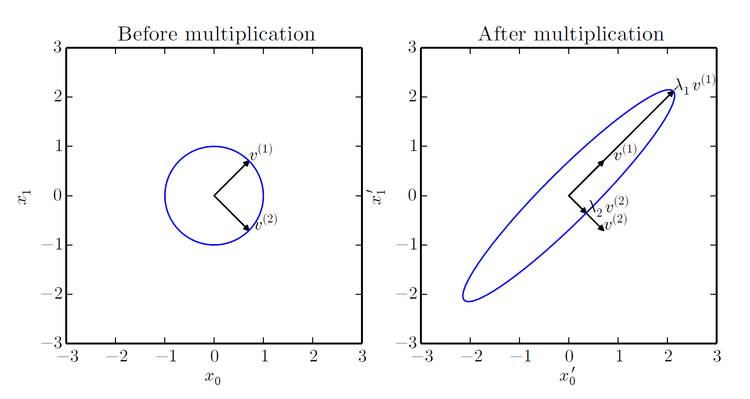
Eﬀect of Eigenvalues

Slide 19
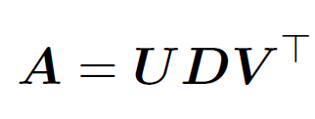
Singular Value Decomposition
Similar to eigendecomposition
More general; matrix need not be square

Slide 20
Moore-Penrose Pseudoinverse
x = A⁺y
If the equation has:
Exactly one solution: this is the same as the inverse
No solution: this gives us the solution with the smallest error ||Ax - y||2
Many solutions: this gives us the solution with the smallest norm of x.

Slide 21

Computing the Pseudoinverse
The SVD allows the computation of the pseudoinverse:
Take reciprocal of non-zero entries

Slide 22
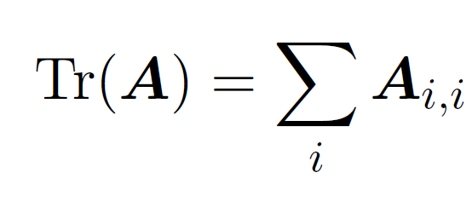
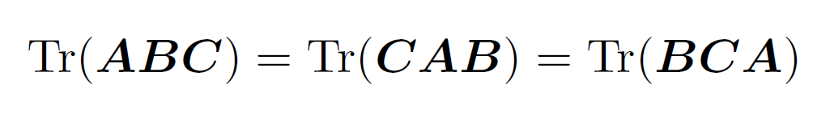
Trace

Slide 23
Learning linear algebra
Do practice problems
Practice in R
Consider following a text
Eventually you will get used to matrix and vector product notation (nice to really follow “what is going on”)

