Slide 1
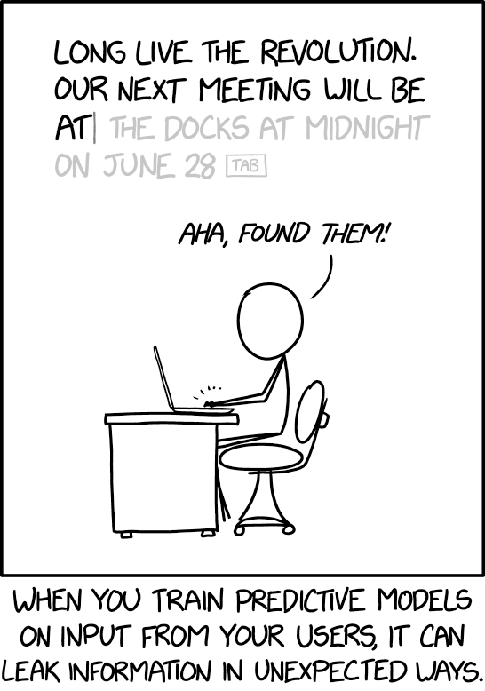
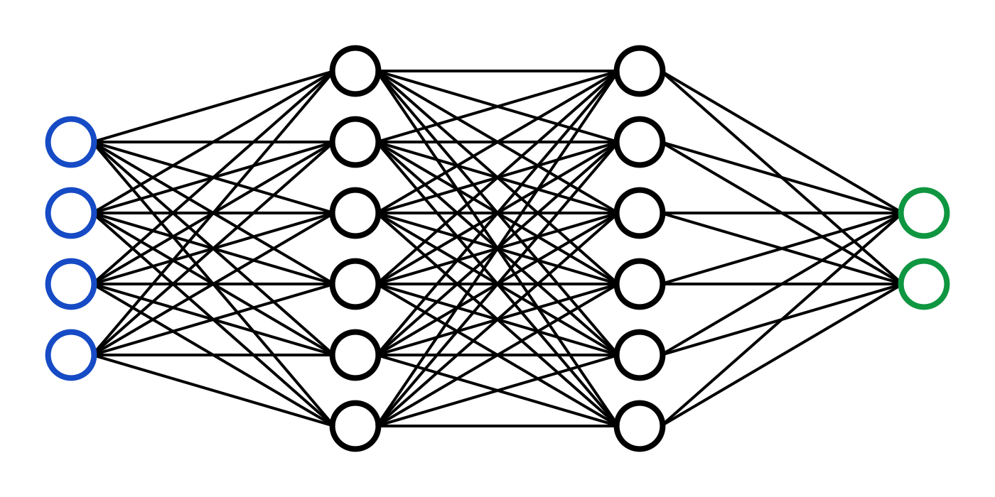
C7082 Techniques in Machine Learning and AI
Ed Harris

Slide 2
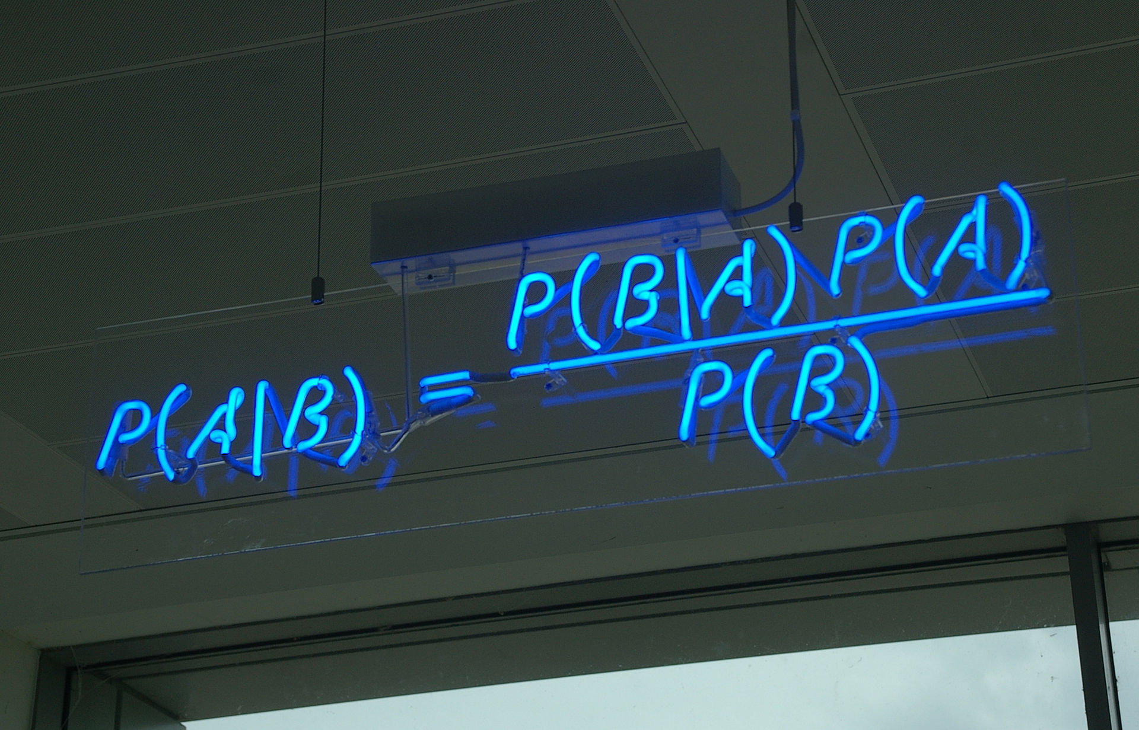
03 Probability

Slide 3


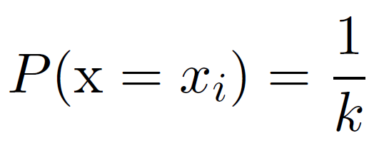
Probability Mass Function
The domain of P must be the set of all possible states of x.
An impossible event has probability 0 and no state can be less probable than that. Likewise, an event that is guaranteed to happen has probability 1, and no state can have a greater chance of occurring.
We refer to this property as being normalized. Without this property, we could obtain probabilities greater than one by computing the probability of one of many events occurring.
Example: uniform distribution:

Slide 4

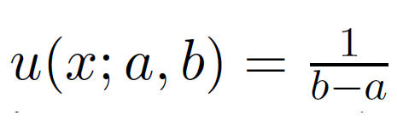
Probability Density Function
The domain of p must be the set of all possible states of x
Note that we do not require p(x) < 1
Example: uniform distribution:

Slide 5
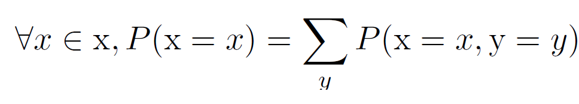
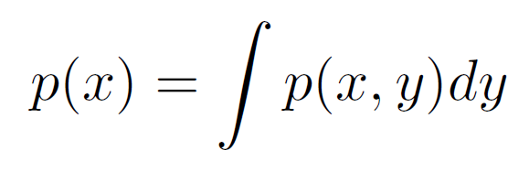
Computing Marginal Probability with the Sum Rule

Slide 6
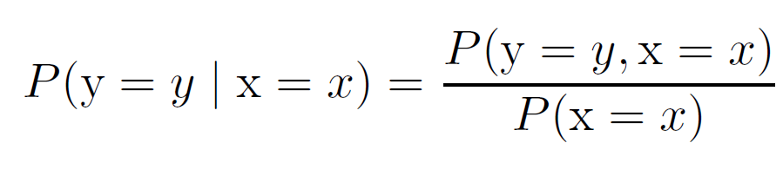
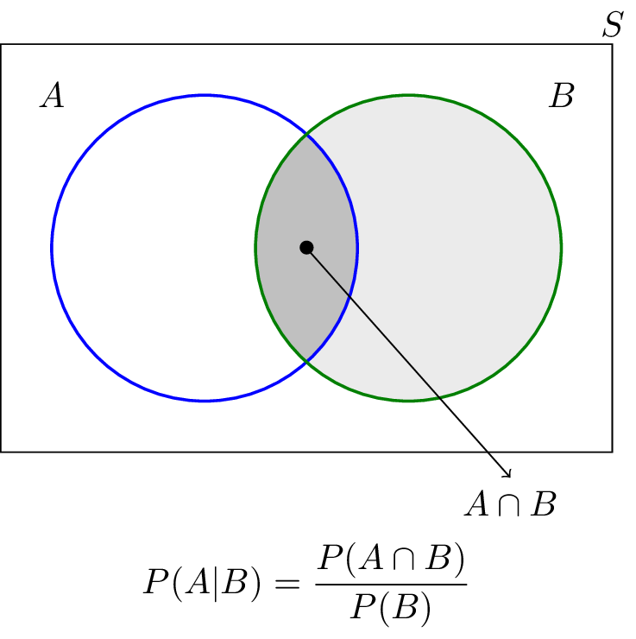
Conditional Probability

Slide 7
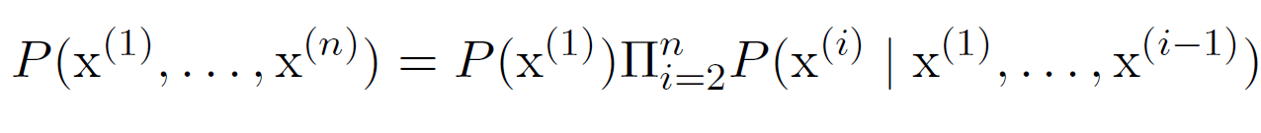
Chain Rule of Probability
Permits the calculation of any member of the joint distribution of a set of random variables using only conditional probabilities
Ex: Probability of yellow ball…

Slide 8
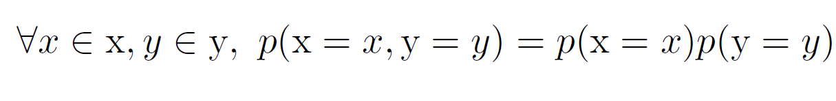
Independence
Two events are independent, statistically independent, or stochastically independent if the occurrence of one does not affect the probability of occurrence of the other

Slide 9


Conditional Independence
In probability theory, two random events A and B are conditionally independent given a third event C precisely if the occurrence of A and the occurrence of B are independent events in their conditional probability distribution given C.

Slide 10
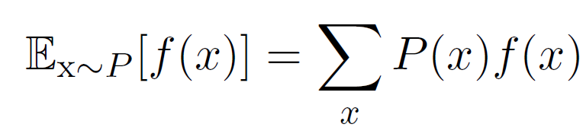
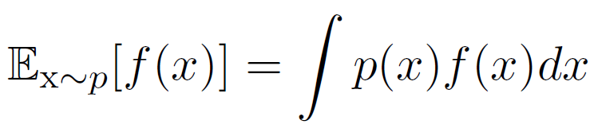
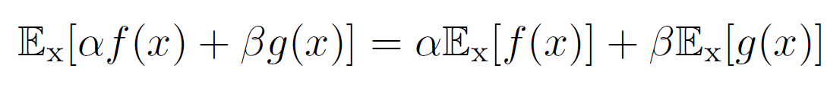
Expectation
Linearity of expectations:
Two factories make light bulbs. Factory X bulbs last an average of 5000 hours, factory Y bulbs last an average of 4000 hours. Factory X supplies 60% of the total bulbs available. What is the expected length of time that a purchased bulb will work for?
Applying the law of total expectation, we have:

Slide 11
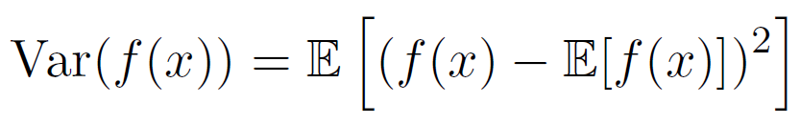
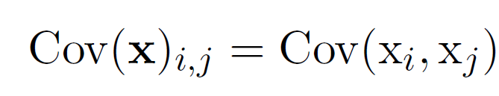
Variance and Covariance
Covariance matrix:

Slide 12
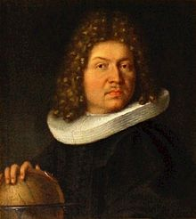
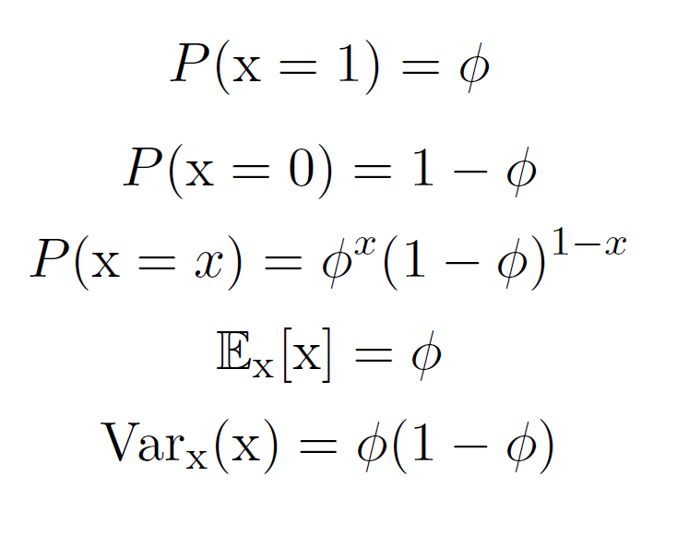
Bernoulli Distribution
The Bernoulli distribution, named after Swiss mathematician Jacob Bernoulli, is the discrete probability distribution of a random variable which takes the value 1 with probability p and the value 0 with probability q=1-p.
Less formally, it can be thought of as a model for the set of possible outcomes of any single experiment that asks a yes–no question.

Slide 13
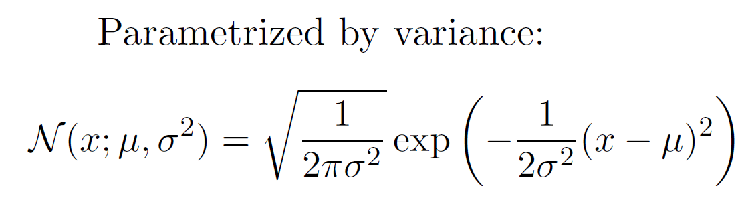
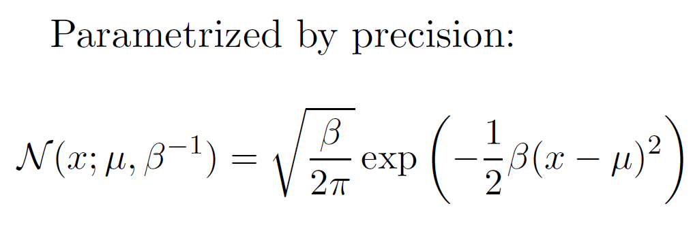
Gaussian Distribution
(the standard Gaussian dist)
Some authors advocate using the precision, as the parameter defining the width of the distribution, instead of the std deviation or the variance. The precision is normally defined as the reciprocal of the variance.

Slide 14
Gaussian Distribution
0.40
0.35
0.30
0.25
0.20
0.15
0.10
0.05
Maximum at x = µ
p(x)
Inflection points at
x = µ ± a
0.00
-2.0
-1.5
-1.0

Slide 15
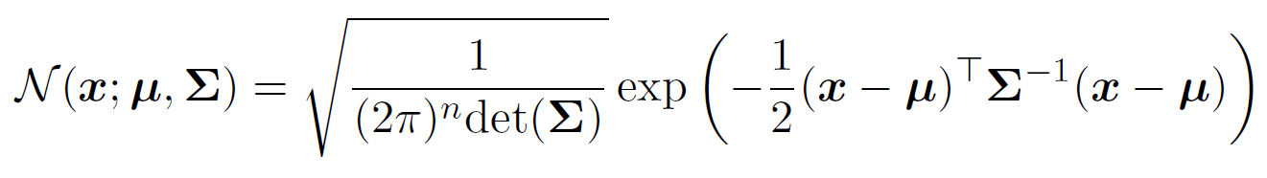
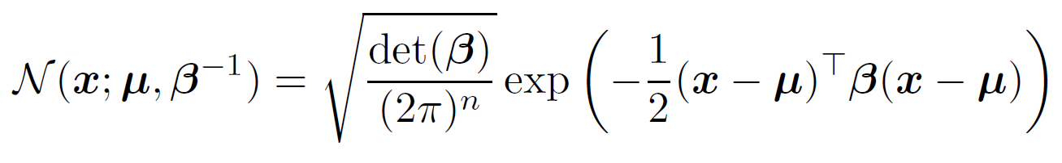
Multivariate Gaussian
Parametrized by covariance matrix:
Parametrized by precision matrix:

Slide 16

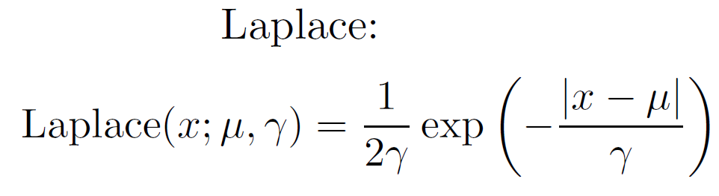
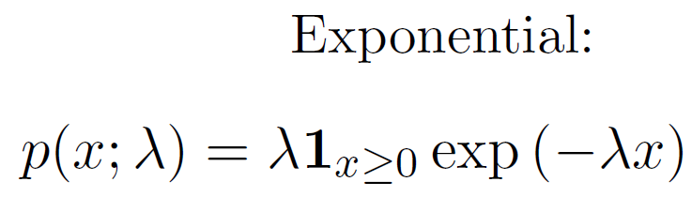
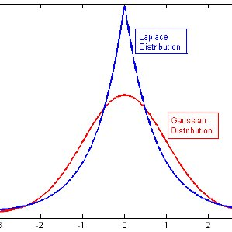
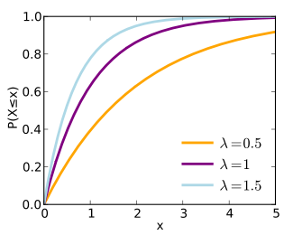
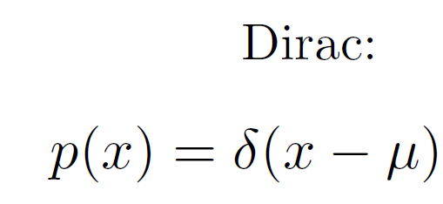
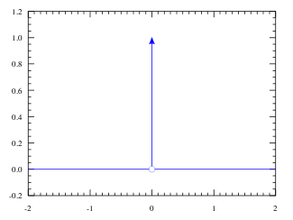
More Distributions

Slide 17
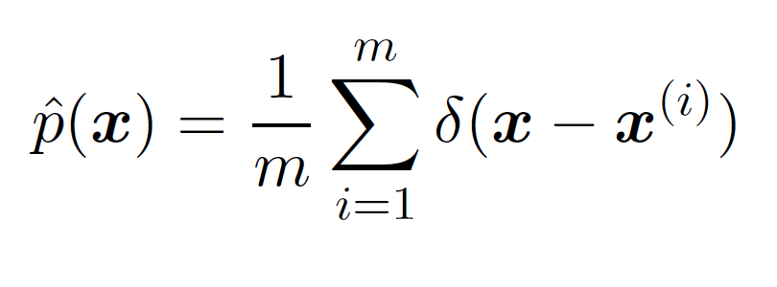
Empirical Distribution
An empirical distribution function is the distribution function associated with the empirical measure of a sample

Slide 18
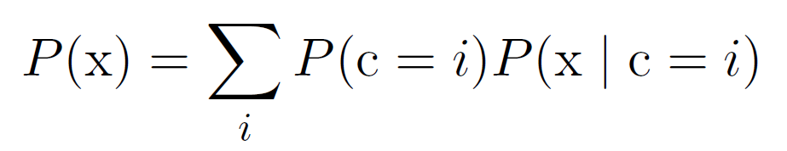
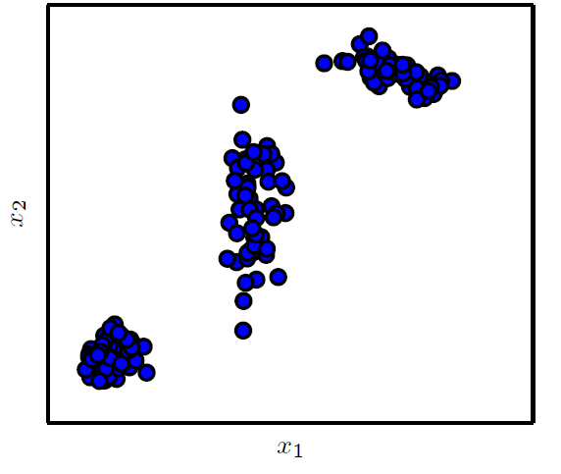
Mixture Distributions
E.g. Gaussian mixture with 3 components

Slide 19
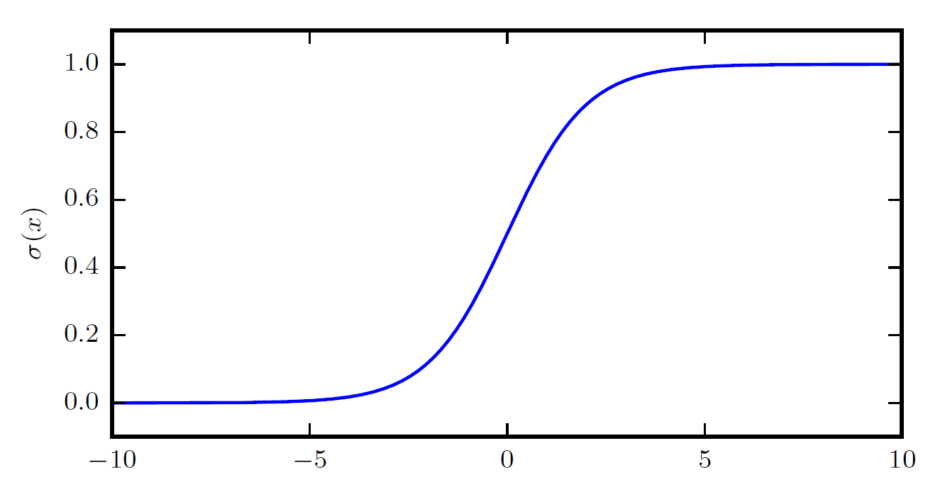
Logistic Sigmoid
The logistic sigmoid function, commonly used to parametrize Bernoulli distributions

Slide 20
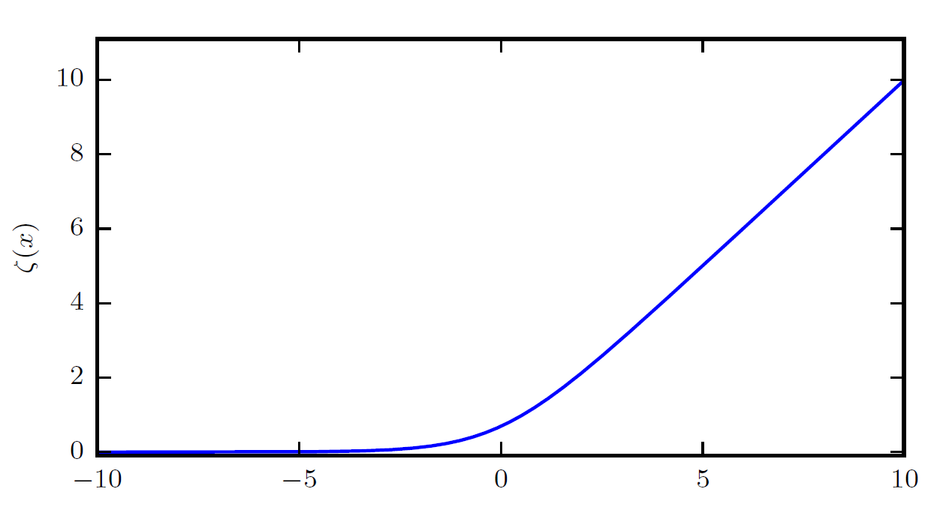
Softplus Function

Slide 21
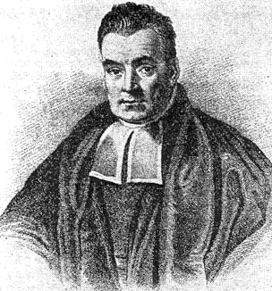
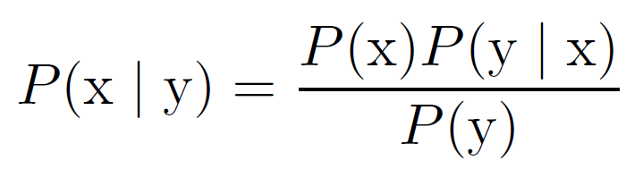
Bayes’ Rule
https://machinelearningmastery.com/bayes-theorem-for-machine-learning/

Slide 22
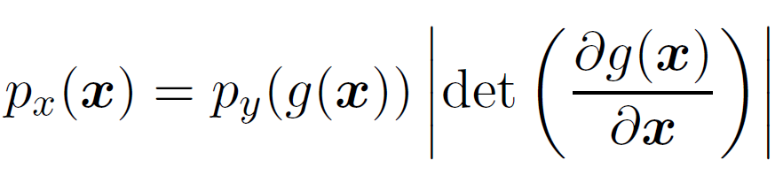
Change of Variables
If the probability density function of a random variable (or vector) X is given, it is possible to calculate the probability density function of some variable Y = g(X). This is also called a “change of variable” and is in practice used to generate a random variable using a known (for instance, uniform) random number generator.

Slide 23
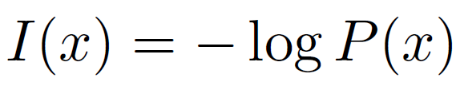
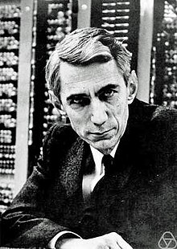
Information Theory
Information theory studies the quantification, storage, and communication of information
Information:
Claude Shannon (also invented circuit design theory in electrical engineering when he was 21 years old, studying his MSc)

Slide 24
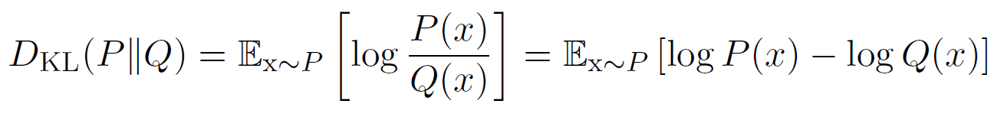
Information Theory
The entropy of a random variable is the average level of "information", "surprise", or "uncertainty" inherent in the variable's possible outcomes
Entropy:
The Kullback–Leibler divergence (also called relative entropy) is a measure of how one probability distribution (here P and Q) is different from a second, reference probability distribution.
KL divergence:

Slide 25
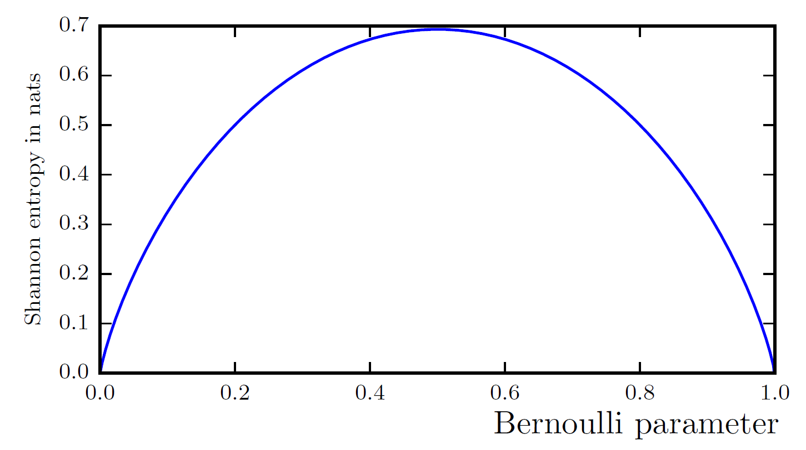
Entropy of a Bernoulli Variable

Slide 26
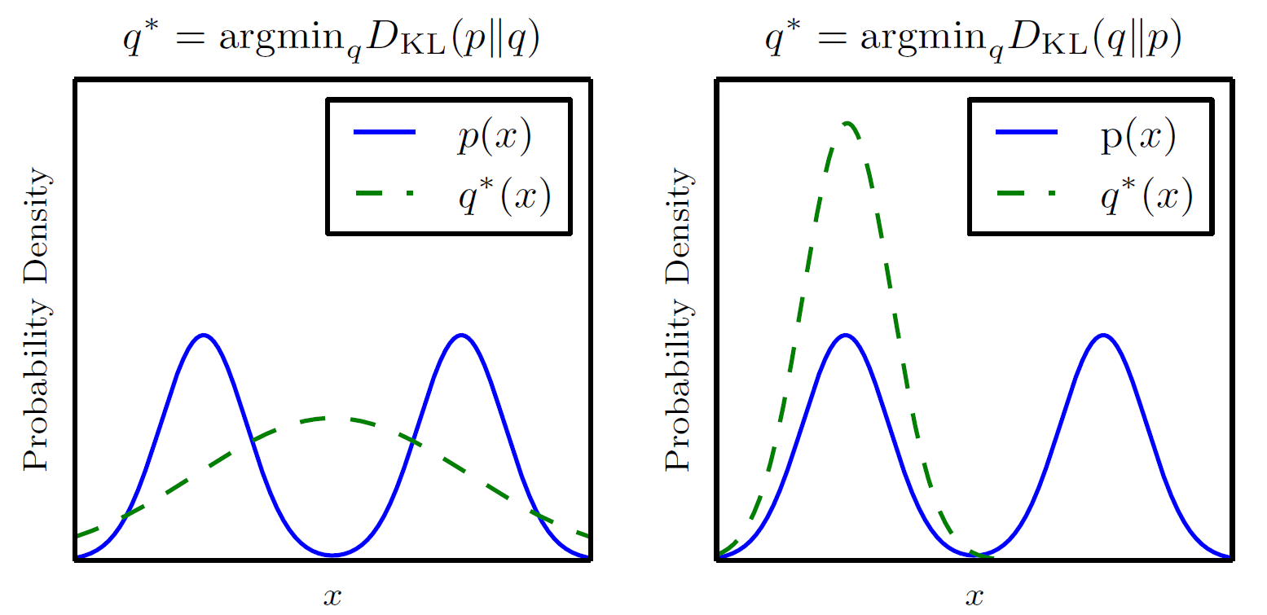
The KL Divergence is Asymmetric

Slide 27
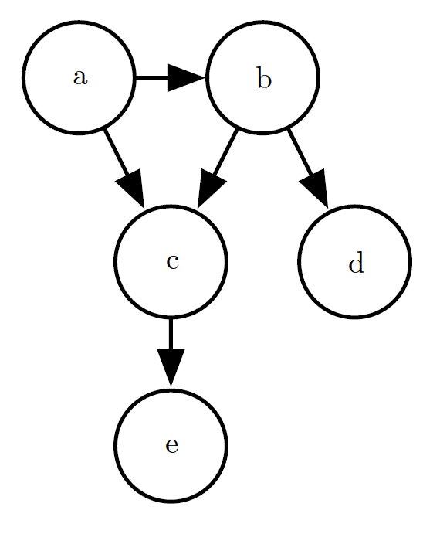
Directed Model
Granger Graphs are used to represent the “directed model”, that infers causality amongst variable nodes
Directed information is a measure of the amount of information that flows from the process e.g., X to Y, where X and Y are vectors of length n
Bayesian probability framework

Slide 28
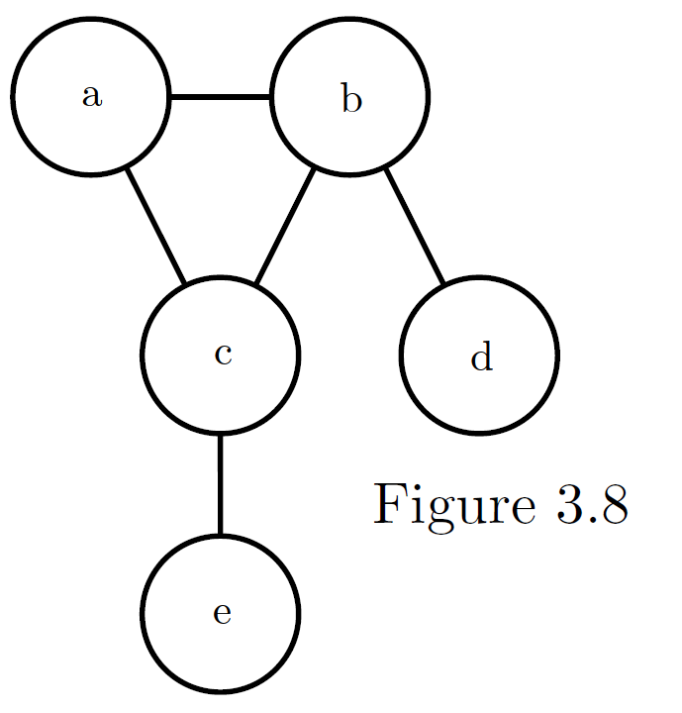
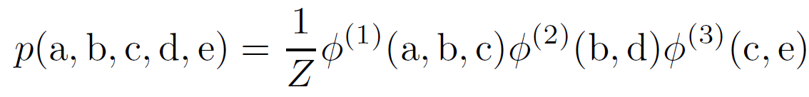
Undirected Model
The undirected model infers no causation and can accommodate many more nodes.
Just scratching the surface here…

