Slide 1
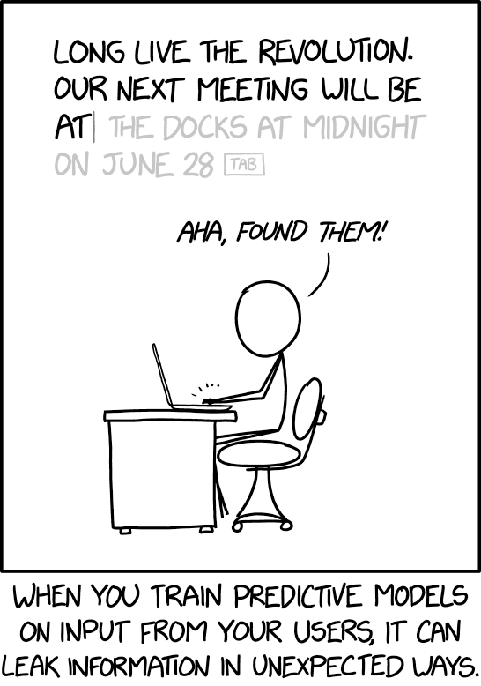
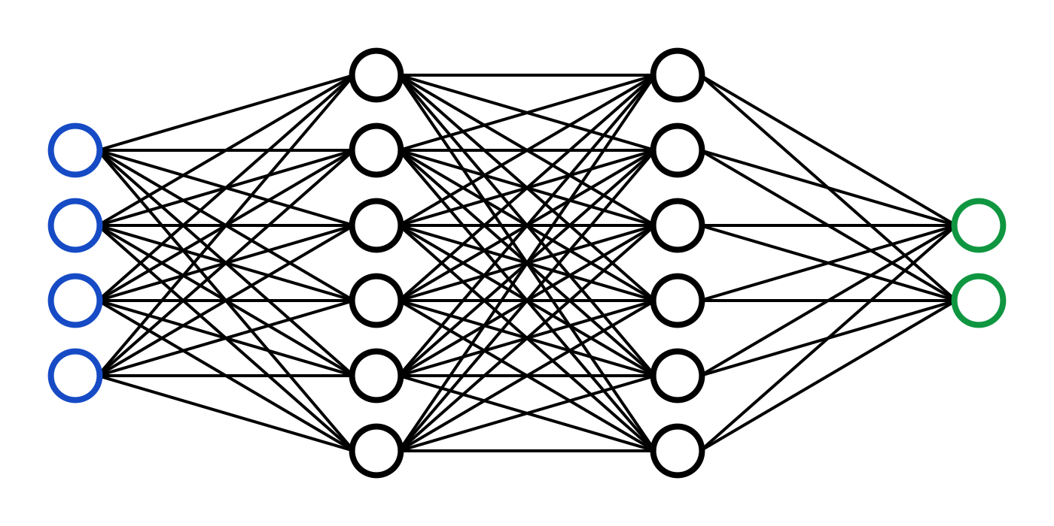
C7082 Techniques in Machine Learning and AI
Ed Harris

Slide 2
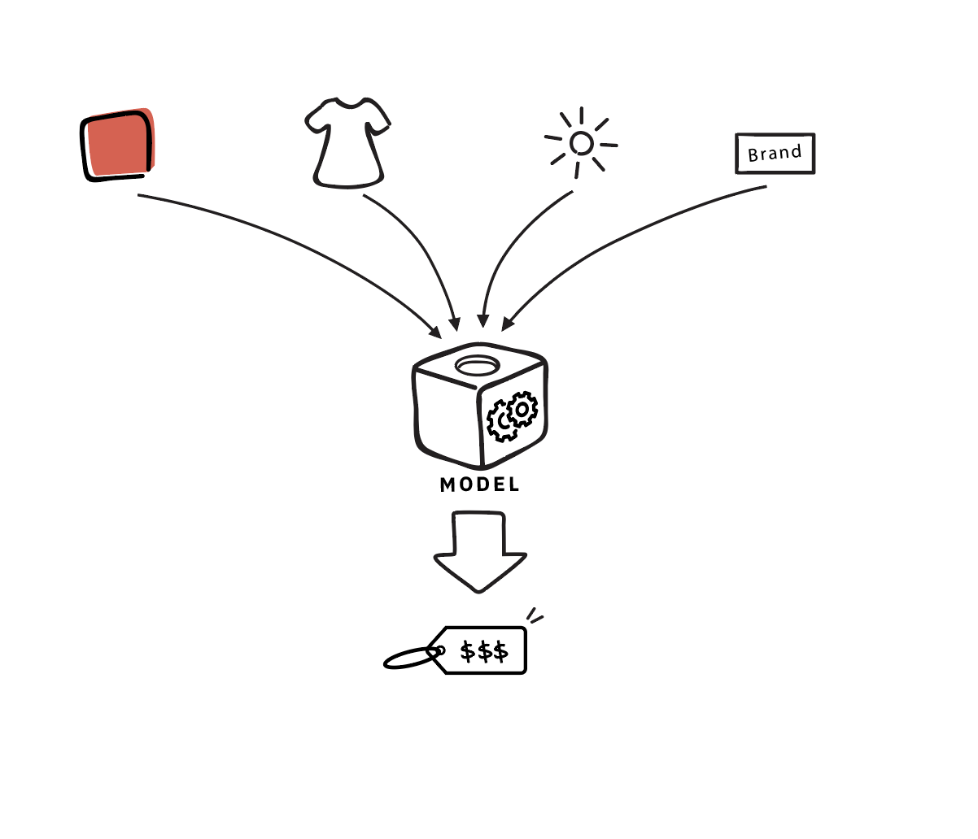

04 Numerical Computation
What’s in the box?

Slide 3
Numerical concerns for implementations of deep learning algorithms
Algorithms are often specified in terms of real numbers; real numbers cannot be implemented in a finite computer
-Does the algorithm still work when implemented with a finite number of bits?
Do small changes in the input to a function cause large changes to an output?
-Rounding errors, noise, measurement errors can cause large changes
-Iterative search for best input is diﬃcult

Slide 4
Roadmap
Iterative Optimization
Rounding error, underflow, overflow

Slide 5
Iterative Optimization
Gradient descent
Curvature
Constrained optimization

Slide 6
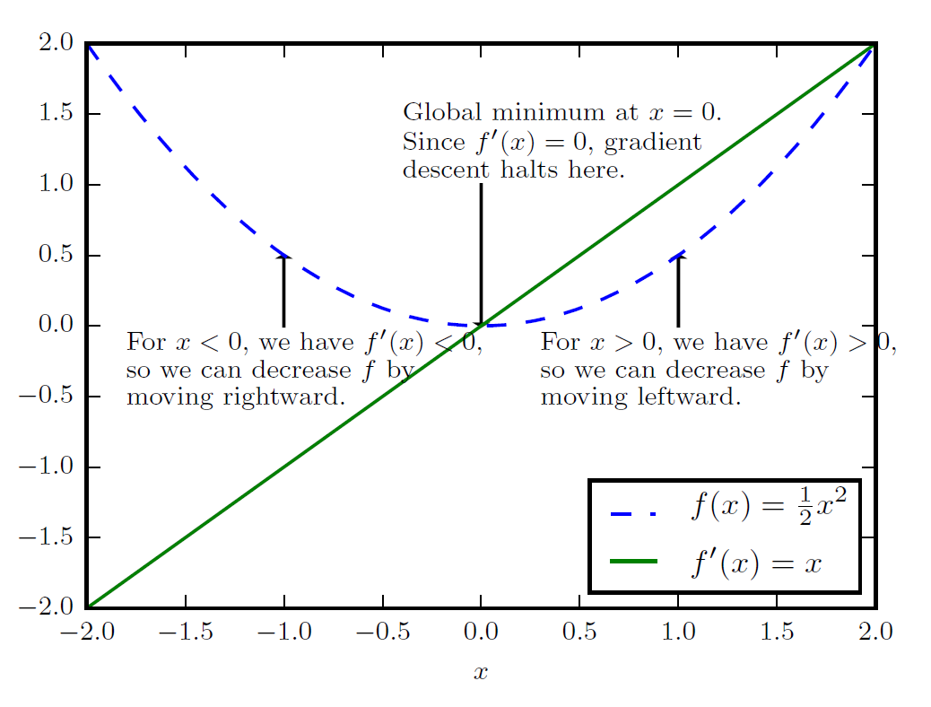
Gradient Descent
Gradient descent is a first-order, iterative optimization algorithm for finding a local minimum of a differentiable function

Slide 7
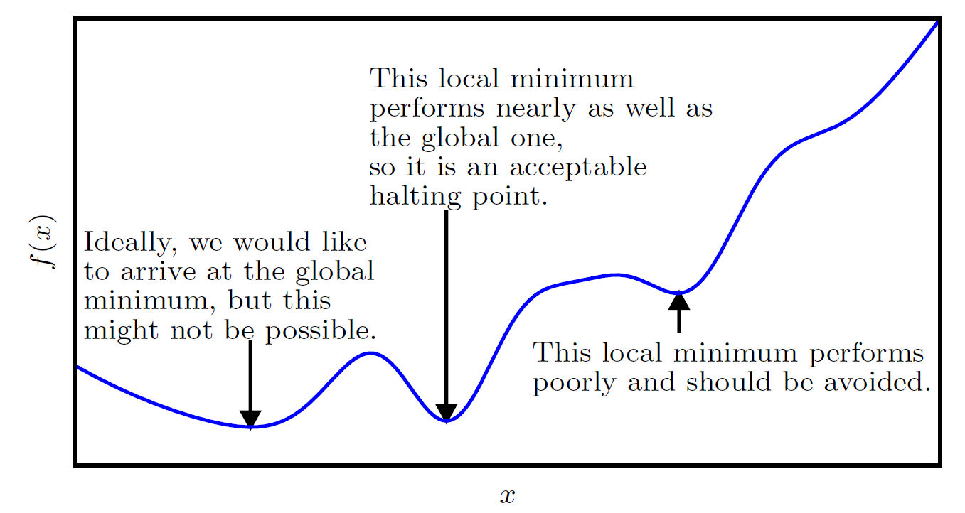
Approximate Optimization
To find a local minimum of a function using gradient descent, we take steps proportional to the negative of the gradient (or approximate gradient) of the function at the current point.

Slide 8
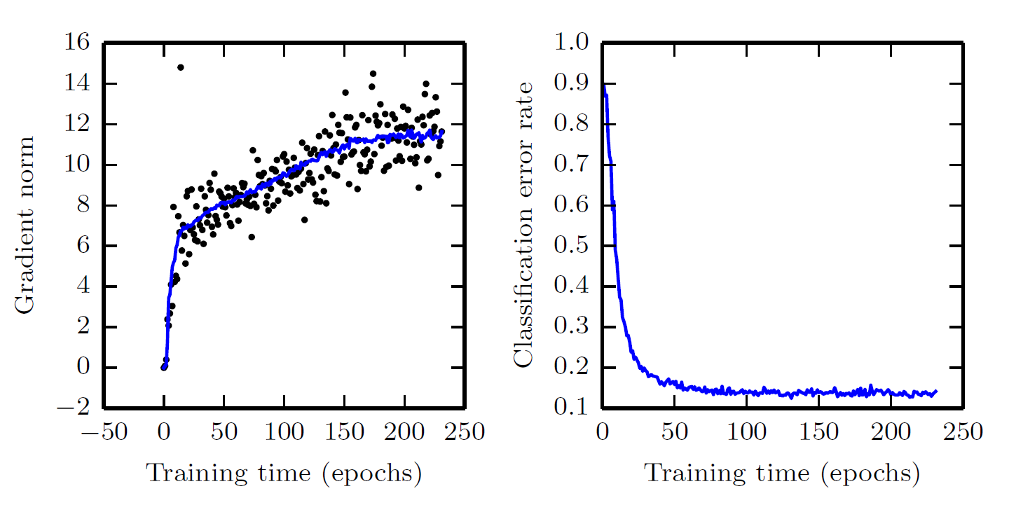
We usually don’t even reach a local minimum

Slide 9
Deep learning optimization way of life
Pure math way of life:
-Find literally the smallest value of f(x)
-Or maybe: find some critical point of f(x) where the value is locally smallest
Deep learning way of life:
-Decrease the value of f(x) a lot

Slide 10
Iterative Optimization
Gradient descent
Curvature
Constrained optimization

Slide 11
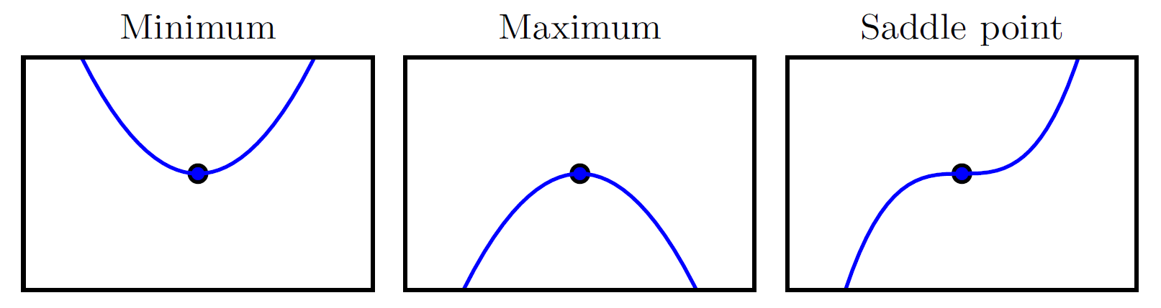
Critical Points
A critical point of a function of a single real variable, f(x), is a value x0 in the domain of f where it is not differentiable or its derivative is 0. These concepts may be visualized through the graph of f: at a critical point, the graph has a horizontal tangent (if you can assign one)

Slide 12
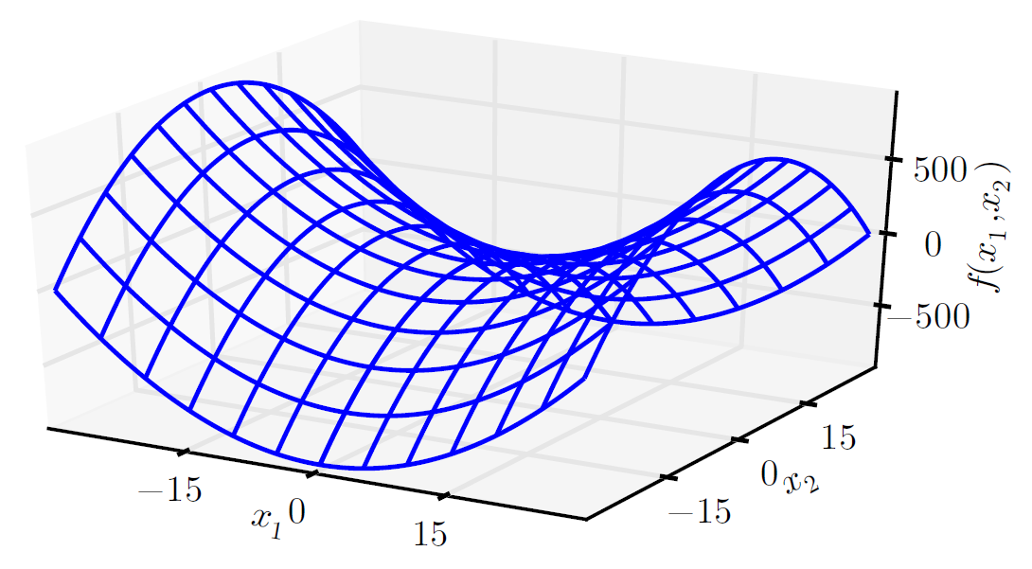
Saddle Points
A saddle point is illustrated in the image above. In a global or local minima, all the directions are going up and in a global or local maxima, all the directions are going down

Slide 13
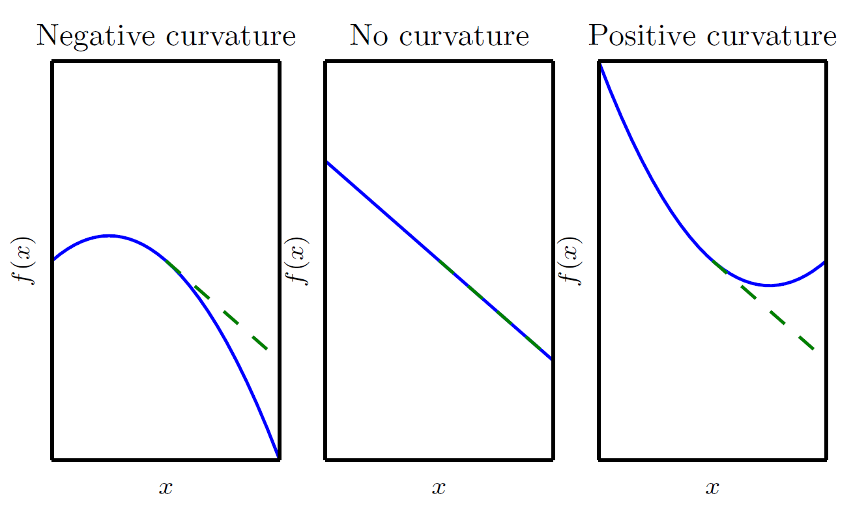
Curvature

Slide 14

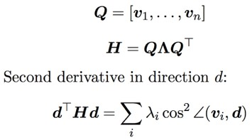
Directional Second Derivatives
Before multiplication After multiplication
3
3
_{¸1 v}(1)
2
2
1
_{v}(1)
1
_{v}(1)
x₁
0
_{x1}0
0
_{¸ v}(2)
_{v}(2)
2
_{v}(2)
−1
−1
−2
−3
−3 −2 −1 0 1
x₀
−2
2
3
−3
−3 −2 −1 0
_{x0}0
1
2
3
We use this to determine whether a points is a LOCAL max, LOCAL min, or saddle point!

Slide 15
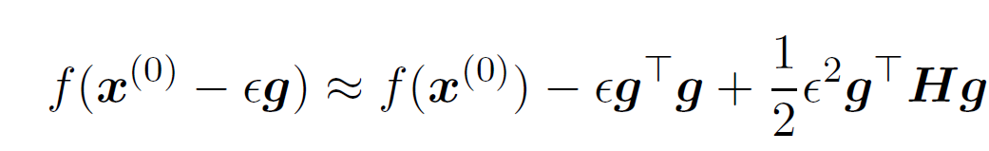
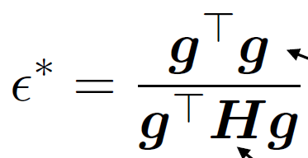
Predicting optimal step size using Taylor series
Big gradients speed you up
Big eigenvalues slow you down if you align with their eigenvectors

Slide 16
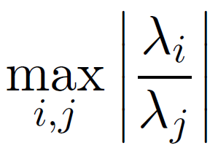
Condition Number
When the condition number is large, sometimes you hit large eigenvalues and sometimes you hit small ones.
The large ones force you to keep the learning rate small, and miss out on moving fast in the small eigenvalue directions.

Slide 17
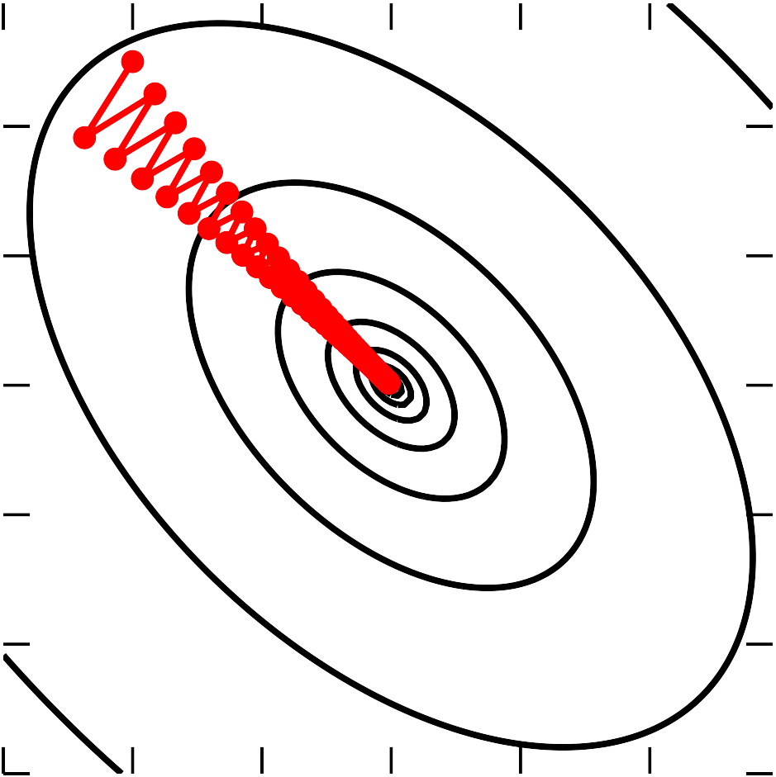
Gradient Descent and Poor Conditioning
A matrix is ill-conditioned if the condition number is very high, usually indicating that (i) the lowest singular value is orders of magnitude smaller than the highest one, and (ii) columns/rows of the matrix are heavily correlated with each other leading to redundancies and a matrix that is pretending to be of a higher rank than it truly is.
20
10
0
-10
-20
x₂
In general, when we say a matrix is poorly conditioned it is almost singular and computing its inverse will lead to large numerical errors. Ex. a matrix that can’t be inverted has a condition number of infinity.
-30
-30 -20 -10 0 10 20
x₁

Slide 18






Neural net visualization
At end of learning:
- gradient is still large
- curvature is huge

Slide 19
Iterative Optimization
Gradient descent
Curvature
Constrained optimization

Slide 20
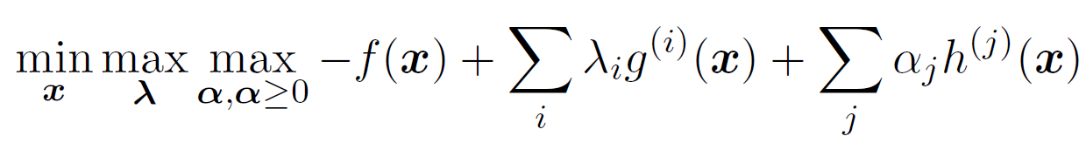
KKT Multipliers
In mathematical optimization, the Karush–Kuhn–Tucker (KKT) conditions, also known as the Kuhn–Tucker conditions, are first derivative tests (sometimes called first-order necessary conditions) for a solution in nonlinear programming to be optimal, provided that some regularity conditions are satisfied.

Slide 21
Roadmap
Iterative Optimization
Rounding error, underflow, overflow

Slide 22
Numerical Precision: A deep learning super skill
Often deep learning algorithms “sort of work”
-Loss goes down, accuracy gets within a few percentage points of state-of-the-art
-No “bugs” per se
Often deep learning algorithms “explode” (NaNs, large values)
Culprit is often loss of numerical precision

Slide 23
Rounding and truncation errors
In a digital computer, we approximate (e.g. float32 or similar) real numbers
A real number x is rounded to x + delta for some small delta
Overflow: large x replaced by inf
Underflow: small x replaced by 0

Slide 24

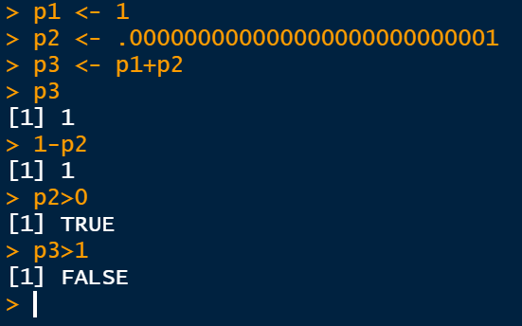
Example
Adding a very small number to a larger one may have no eﬀect. This can cause large changes downstream:

Slide 25
Secondary eﬀects
Suppose we have code that computes x-y
Suppose x overflows to inf
Suppose y overflows to inf
Then x - y = inf - inf = NaN

Slide 26
exp
exp(x) overflows for large x
Doesn’t need to be very large
float32: 89 overflows
Never use large x
exp(x) underflows for very negative x
Possibly not a problem
Possibly catastrophic if exp(x) is a denominator, an argument to a logarithm, etc.

Slide 27
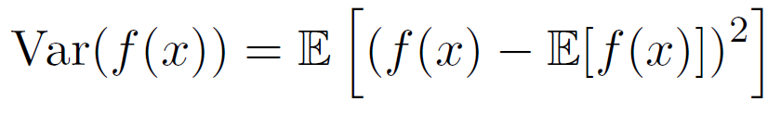

Subtraction
Suppose x and y have similar magnitude
Suppose x is always greater than y
In a computer, x - y may be negative due to rounding error
^{Safe} Dangerous
Example: variance

Slide 28
log and sqrt
log(0) = - inf
log(<negative>) is imaginary, usually NaN in software
sqrt(0) is 0, but its derivative has a divide by zero
Definitely avoid underflow or round-to-negative in the argument!
Common case: standard_dev = sqrt(variance)

Slide 29
log exp
log exp(x) is a common pattern
Should be simplified to x
Avoids:
Overflow in exp
Underflow in exp causing -inf in log

Slide 30
Which is the better hack?
normalized_x = x / st_dev
eps = 1e-7
Should we use these?
st_dev = sqrt(eps + variance)
st_dev = eps + sqrt(variance)
What if variance is implemented safely and will never round to negative?

Slide 31
log(sum(exp))
Naive implementation:
tf.log(tf.reduce_sum(tf.exp(array))
Failure modes:
If any entry is very large, exp overflows
If all entries are very negative, all exps underflow… and then log is -inf

Slide 32
Stable version
mx = tf.reduce_max(array) safe_array = array - mx
log_sum_exp = mx + tf.log(tf.reduce_sum(exp(safe_array))
Built in version:
tf.reduce_logsumexp

Slide 33
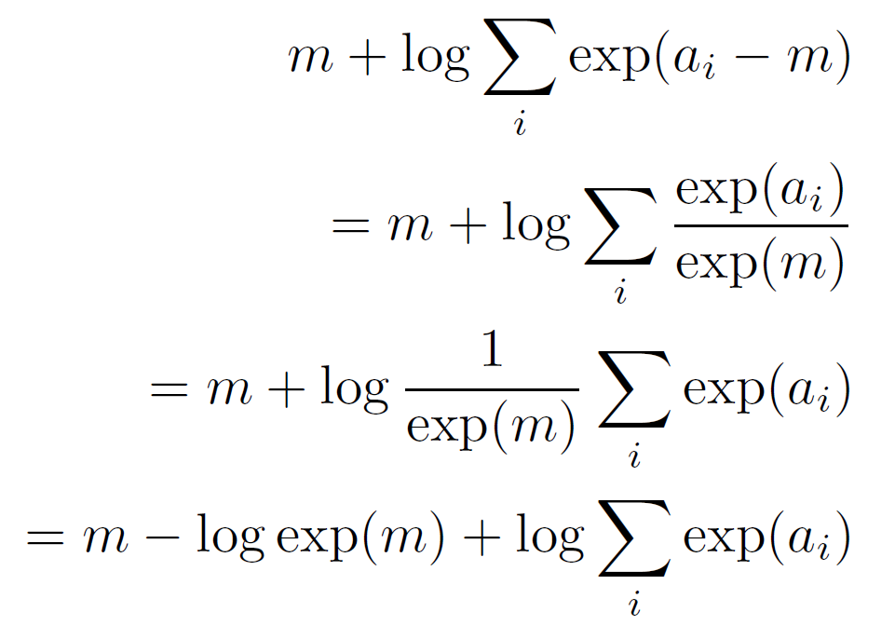
Why does the logsumexp trick work?
Algebraically equivalent to the original version:

Slide 34
Why does the logsumexp trick work?
No overflow:
Entries of safe_array are at most 0
Some of the exp terms underflow, but not all
At least one entry of safe_array is 0
The sum of exp terms is at least 1
The sum is now safe to pass to the log

Slide 35
Softmax
Softmax: some software has built-in "softmax" function
If you build your own, use:
safe_logits = logits - tf.reduce_max(logits) softmax = tf.nn.softmax(safe_logits)
Similar to logsumexp

Slide 36
Sigmoid
Use your library’s built-in sigmoid function
If you build your own:
Recall that sigmoid is just softmax with one of the logits hard-coded to 0

Slide 37
Cross-entropy
Cross-entropy loss for softmax (and sigmoid) has both softmax and logsumexp in it
Compute it using the logits not the probabilities
The probabilities lose gradient due to rounding error where the softmax saturates
Use tf.nn.softmax_cross_entropy_with_logits or similar
If you make your own, use the stabilization tricks for softmax and logsumexp

Slide 38
Bug hunting strategies
If you increase your learning rate and the loss gets stuck, you are probably rounding your gradient to zero somewhere: maybe computing cross-entropy using probabilities instead of logits
For correctly implemented loss, too high of learning rate should usually cause explosion (NaNs, very large values)

Slide 39
Bug hunting strategies
If you see explosion (NaNs, very large values) immediately suspect:
Log, exp, sqrt, division
Always suspect the code that changed most recently

