Slide 1
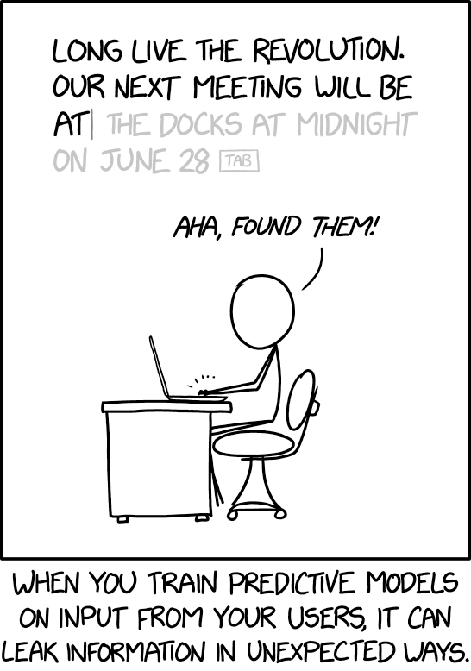
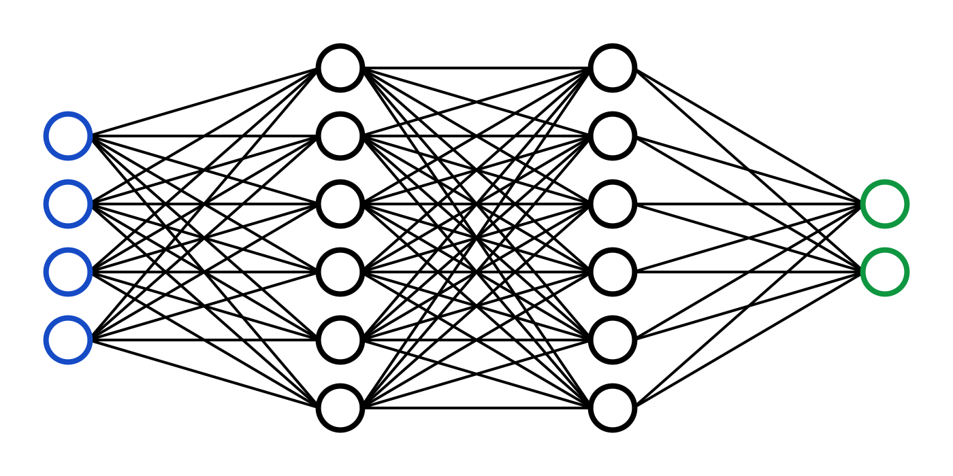
C7082 Techniques in Machine Learning and AI
Ed Harris

Slide 2
07 Regularization
“Regularization is any modification we make to a learning algorithm that is intended to reduce generalization error but not training error”

Slide 3
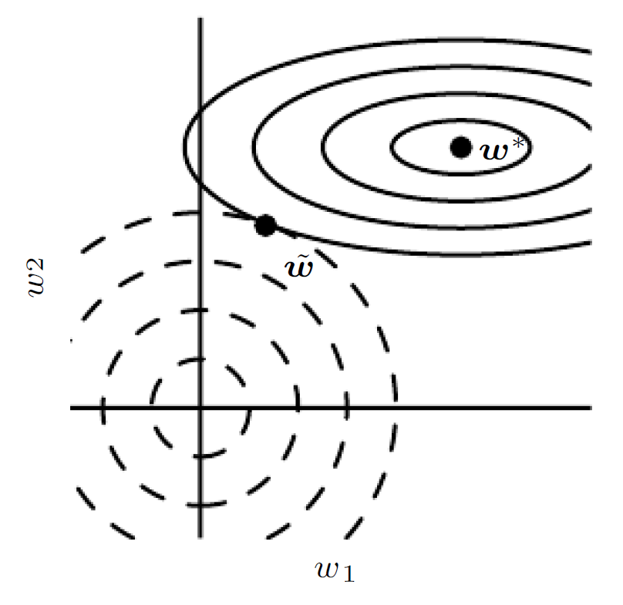
Weight Decay as Constrained Optimization
An illustration of the effect of L2 (or weight decay) regularization on the value of the optimal w.
The solid ellipses represent contours of equal value of the unregularized objective.
The dashed circles represent contours of equal value of the L2 regularizer. At the point w˜, these competing objectives reach an equilibrium

Slide 4
Norm Penalties
L1: Encourages sparsity, equivalent to MAP Bayesian estimation with Laplace prior
Squared L2: Encourages small weights, equivalent to MAP Bayesian estimation with Gaussian prior

Slide 5







Dataset Augmentation
Aﬃne Distortion
Elastic Deformation
Noise
Horizontal flip
Random Translation
Hue Shift

Slide 6
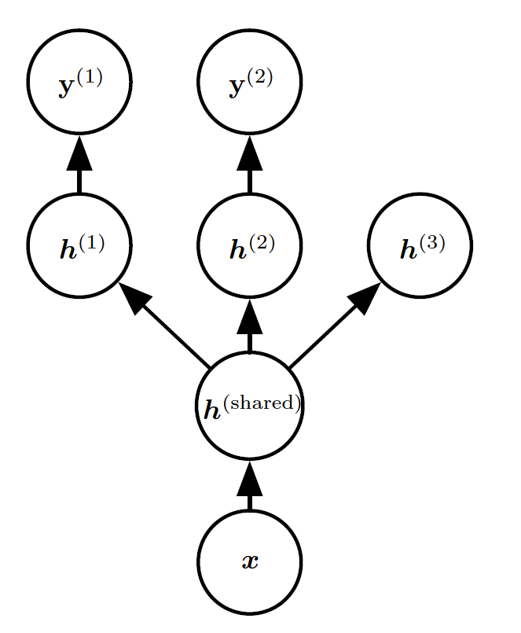
Multi-Task Learning
Multi-task learning (Caruana, 1993) is a way to improve generalization by pooling the examples (which can be seen as soft constraints imposed on the parameters) arising out of several tasks.

Slide 7
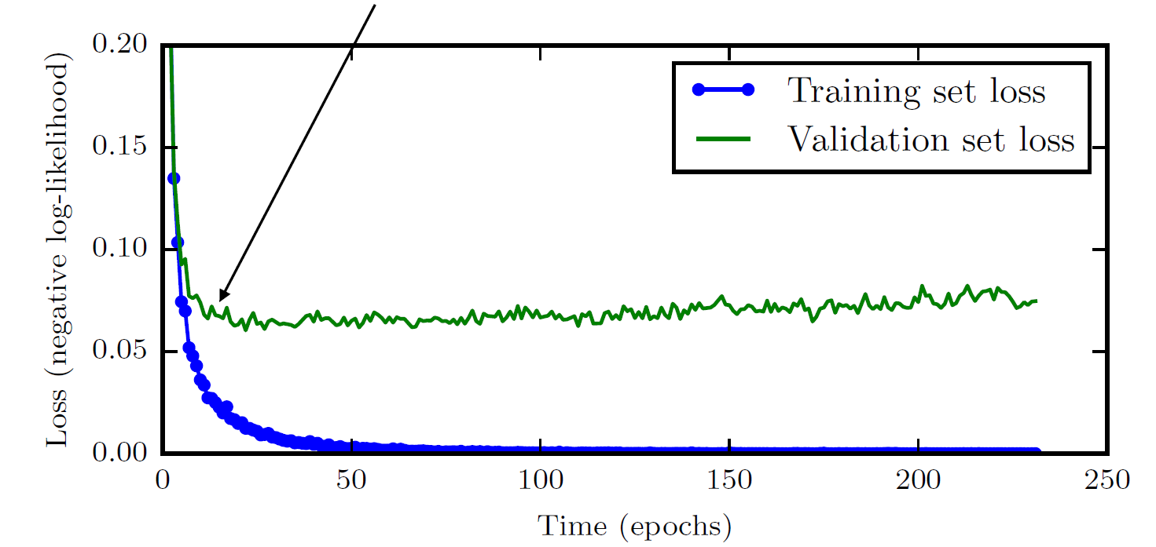
Learning Curves
Early stopping: terminate while validation set performance is better

Slide 8
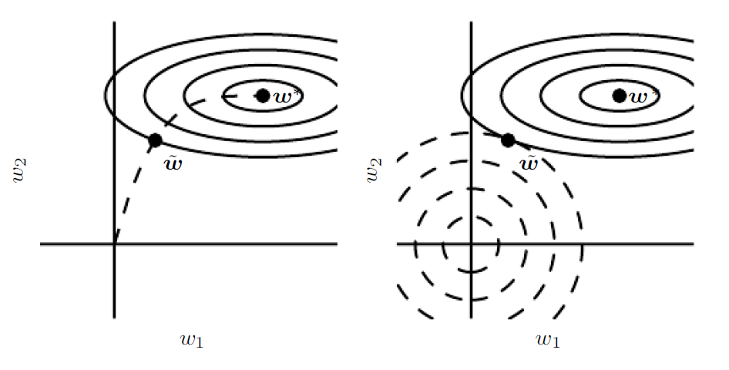
Early Stopping and Weight Decay
An illustration of the effect of early stopping.
(Left)The solid contour lines indicate the contours of the negative log-likelihood. The dashed line indicates the trajectory taken by SGD beginning from the origin. Rather than stopping at the point w∗ that minimizes the cost, early stopping results in the trajectory stopping at an earlier point w˜.
(Right)An illustration of the effect of L2 regularization for comparison. The dashed circles indicate the contours of the L2 penalty, which causes the minimum of the total cost to lie nearer the origin than the minimum of the unregularized cost.

Slide 9
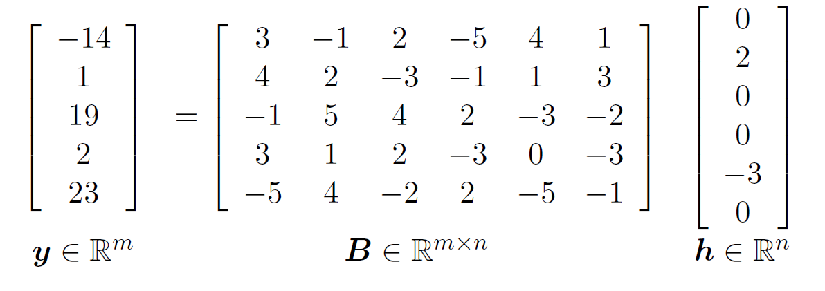
Sparse Representations
Linear regression with a sparse representation h of the data x. That is, h is a function of x that, in some sense, represents the information present in x, but does so with a sparse vector

Slide 10
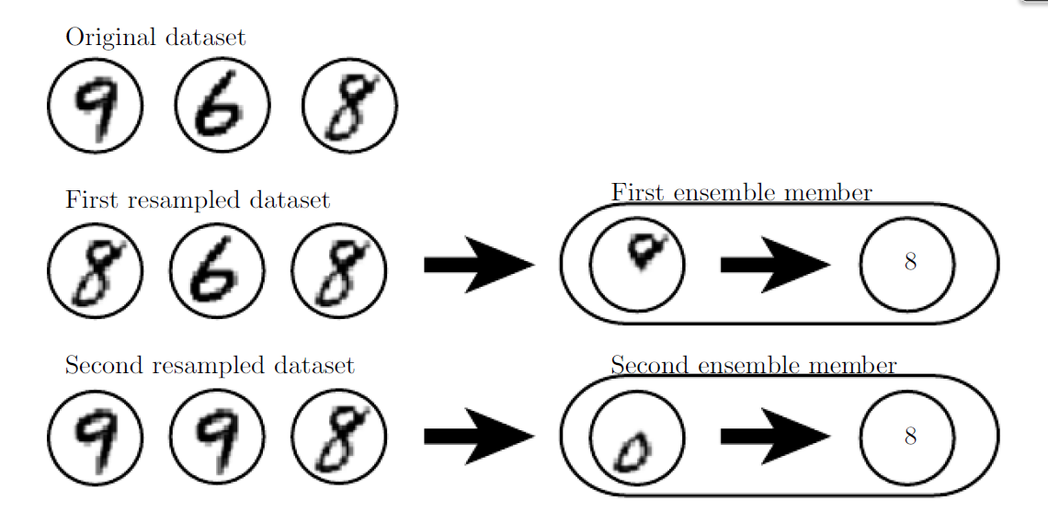
Bagging
Suppose we train an 8 detector on the dataset depicted above, containing an 8, a 6 and a 9. Suppose we make two different resampled datasets. The bagging training procedure is to construct each of these datasets by sampling with replacement.
The first dataset omits the 9 and repeats the 8. On this dataset, the detector learns that a loop on top of the digit corresponds to an 8. On the second dataset, we repeat the 9 and omit the 6. In this case, the detector learns that a loop on the bottom of the digit corresponds to an 8.

Slide 11
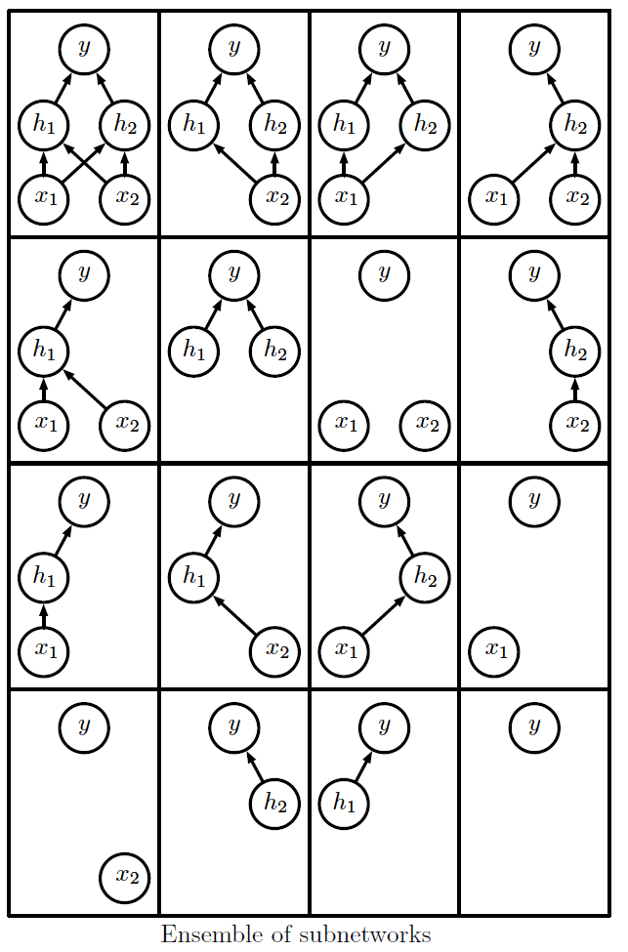
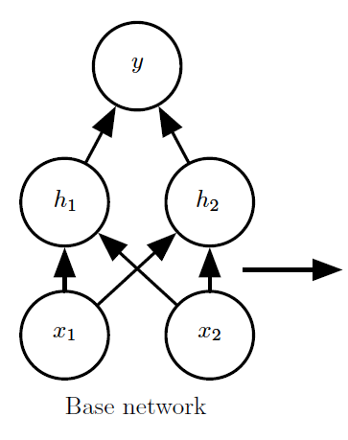
Dropout

Slide 12
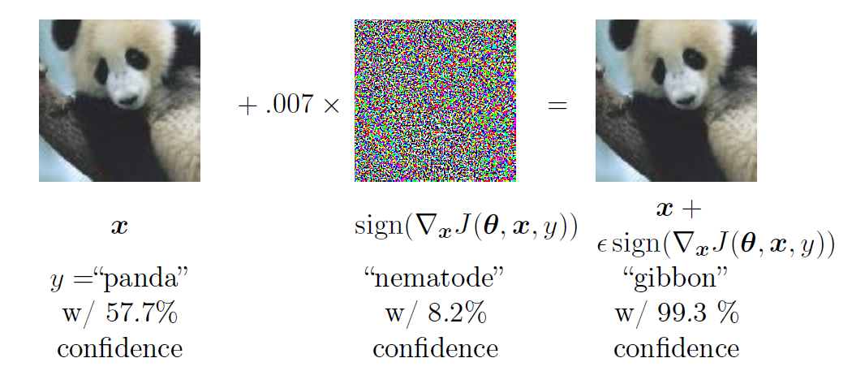
Adversarial Examples
Training on adversarial examples is mostly intended to improve security, but can sometimes provide regularization.

Slide 13
Tangent Propagation
Each curve represents the manifold for a different class, illustrated here as a one-dimensional manifold embedded in a two-dimensional space.
On one curve, we have chosen a single point and drawn a vector that is tangent to the class manifold (parallel to and touching the manifold) and a vector that is normal to the class manifold (orthogonal to the manifold).
In multiple dimensions there may be many tangent directions and many normal directions.
Normal
Tangent
x2
x1

