Slide 1
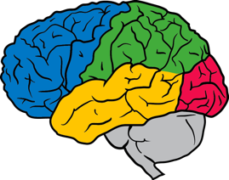

Tutorial on Optimization for Deep Networks
Ian Goodfellow Senior Research Scientist
Google Brain
Re-Work Deep Learning Summit San Francisco
Jan 28, 2016

Slide 2
Approximate minimization
This local minimum performs nearly as well as the global one,
so it is an acceptable halting point.
f(x)
Ideally, we would like to arrive at the global minimum, but this
might not be possible.
This local minimum performs poorly, and should be avoided.
x
www.deeplearningbook.org
Deep Learning, Goodfellow, Bengio, and Courville 2016

Slide 3
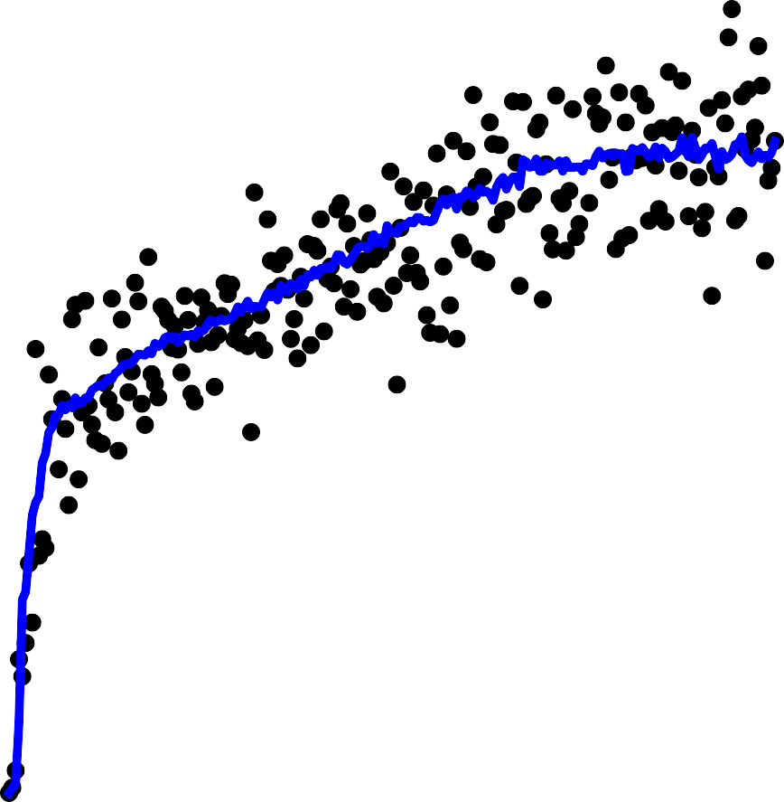
No Critical Point
16
14
12
10
8
6
4
2
0
1.0
0.9
0.8
0.7
0.6
0.5
0.4
0.3
0.2
0.1
Classification error rate
Gradient norm
-2
-50 0 50 100 150 200 250
Training time (epochs)
50 100 150 200 250
Training time (epochs)
0
www.deeplearningbook.org
Deep Learning, Goodfellow, Bengio, and Courville 2016

Slide 4
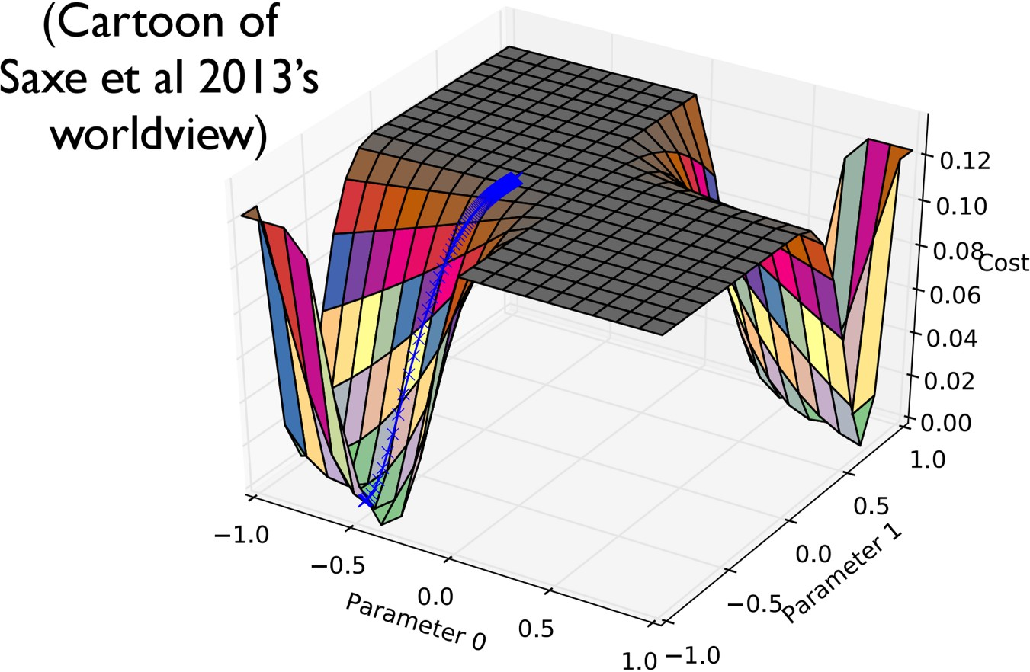

Slide 5
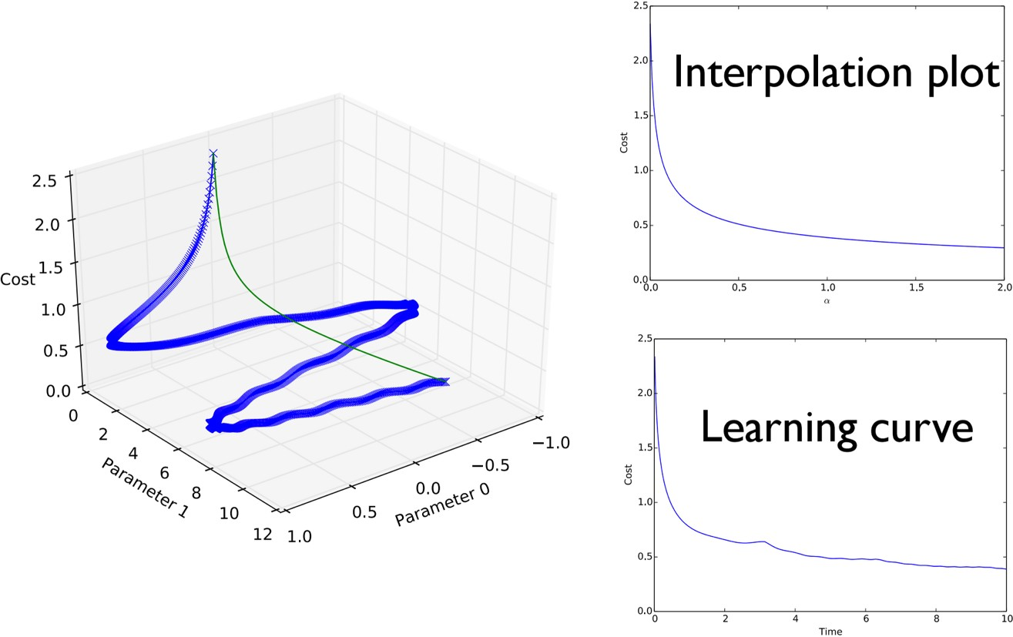
“Qualitatively Characterizing Neural Network Optimization Problems,”
Goodfellow, Vinyals and Saxe, ICLR 2015

Slide 6
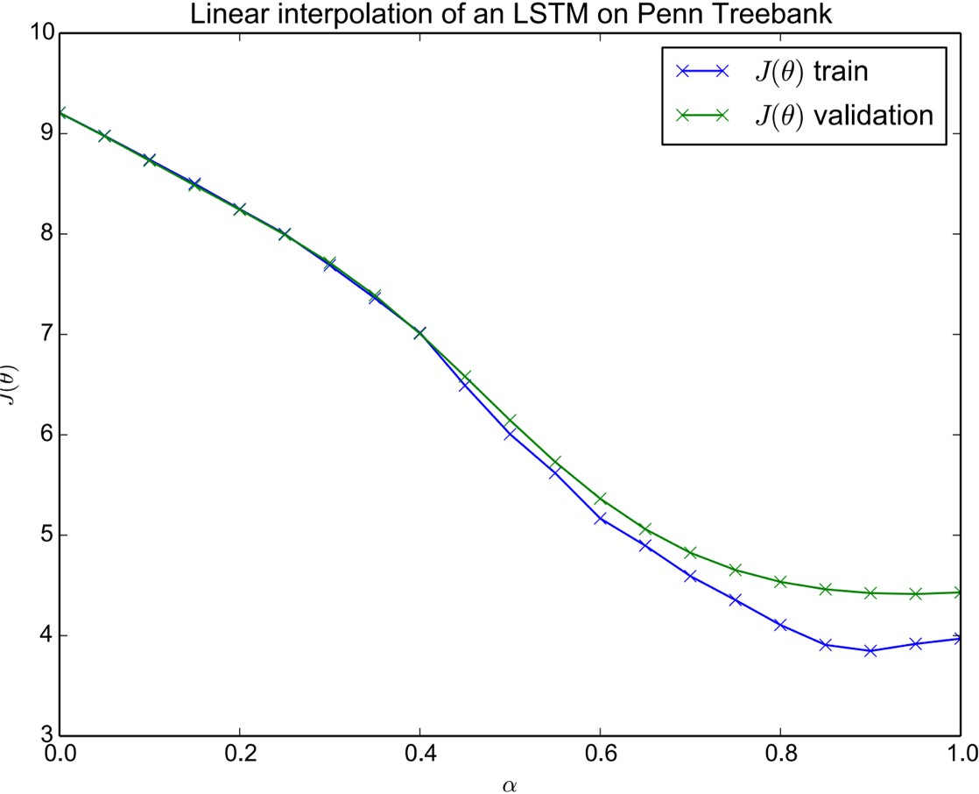
“Qualitatively Characterizing Neural Network Optimization Problems,”
Goodfellow, Vinyals and Saxe, ICLR 2015

Slide 7
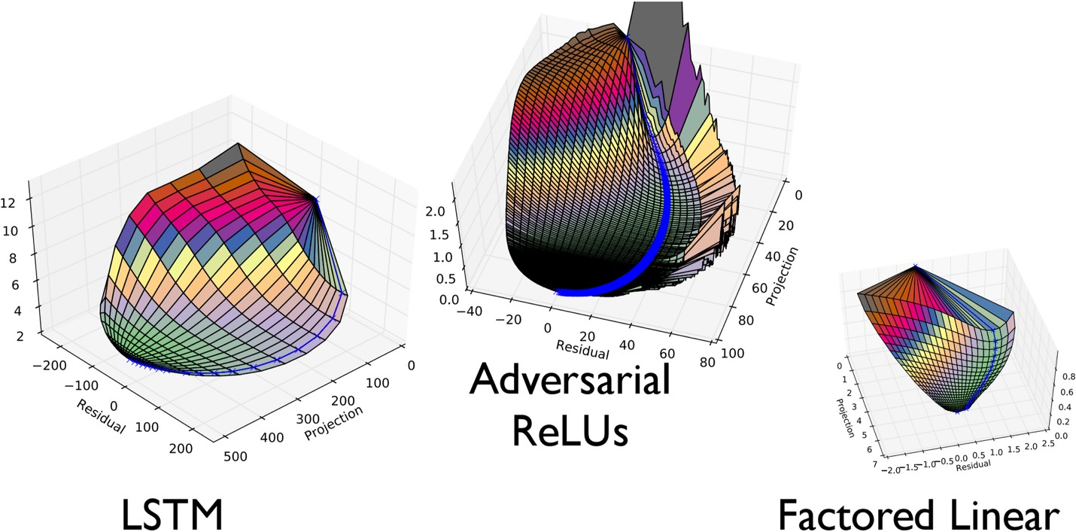
“Qualitatively Characterizing Neural Network Optimization Problems,”
Goodfellow, Vinyals and Saxe, ICLR 2015

Slide 8
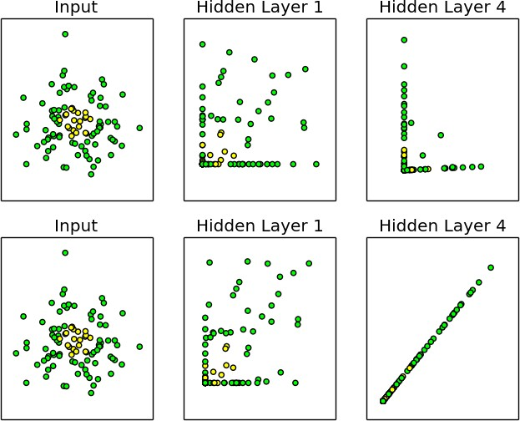
Before SGD step
After SGD step
“Batch Normalization: Accelerating Deep Network Training by Reducing Internal Covariate Shift,” Ioﬀe and Szegedy 2015

Slide 9
Batch Normalization
Z =XW
m
1
X
˜
Z =Z
Z
m
i,:
i=1
_{Z}˜
ˆ
q
Z =
P
˜ 2
1
m
✏ + _{m}
_{i=1} Zi,:
H = max{0, ,Z^{ˆ} + ,B}
“Batch Normalization: Accelerating Deep Network Training by Reducing Internal Covariate Shift,” Ioﬀe and Szegedy 2015

Slide 10
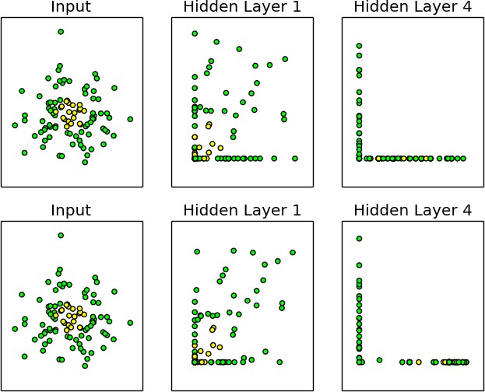
Before SGD step
After SGD step
“Batch Normalization: Accelerating Deep Network Training by Reducing Internal Covariate Shift,” Ioﬀe and Szegedy 2015

Slide 11
0.8
0.7
0.6
Inception BN−Baseline BN−x5 BN−x30
BN−x5−Sigmoid
Steps to match Inception
0.5
0.4
5M
10M
15M
20M 25M 30M
“Batch Normalization: Accelerating Deep Network Training by Reducing Internal Covariate Shift,” Ioﬀe and Szegedy 2015

Slide 12
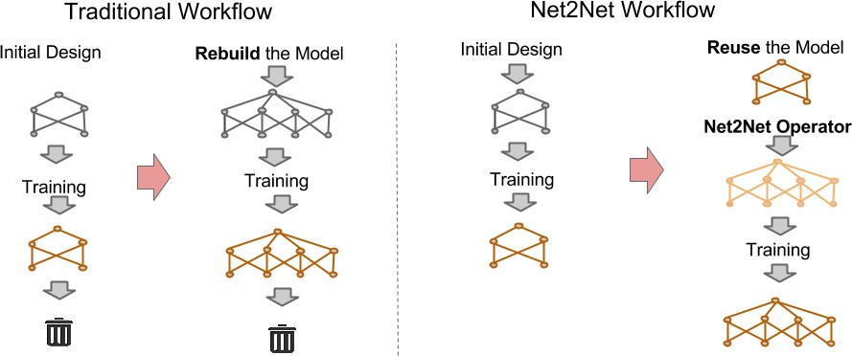
“Net2Net: Accelerating Learning via Knowledge Transfer.” Chen, Goodfellow, and Shlens, submitted to ICLR 2016

Slide 13
y
y
e
f
e
f/2
f/2
h[1]
h[2]
h[1]
h[2]
d
h[3]
b c
b c
c
a
d
a
d
x[1]
x[2]
x[1]
x[2]
“Net2Net: Accelerating Learning via Knowledge Transfer.” Chen, Goodfellow, and Shlens, submitted to ICLR 2016

Slide 14
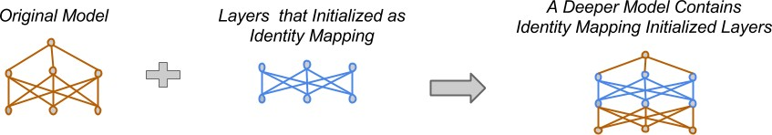
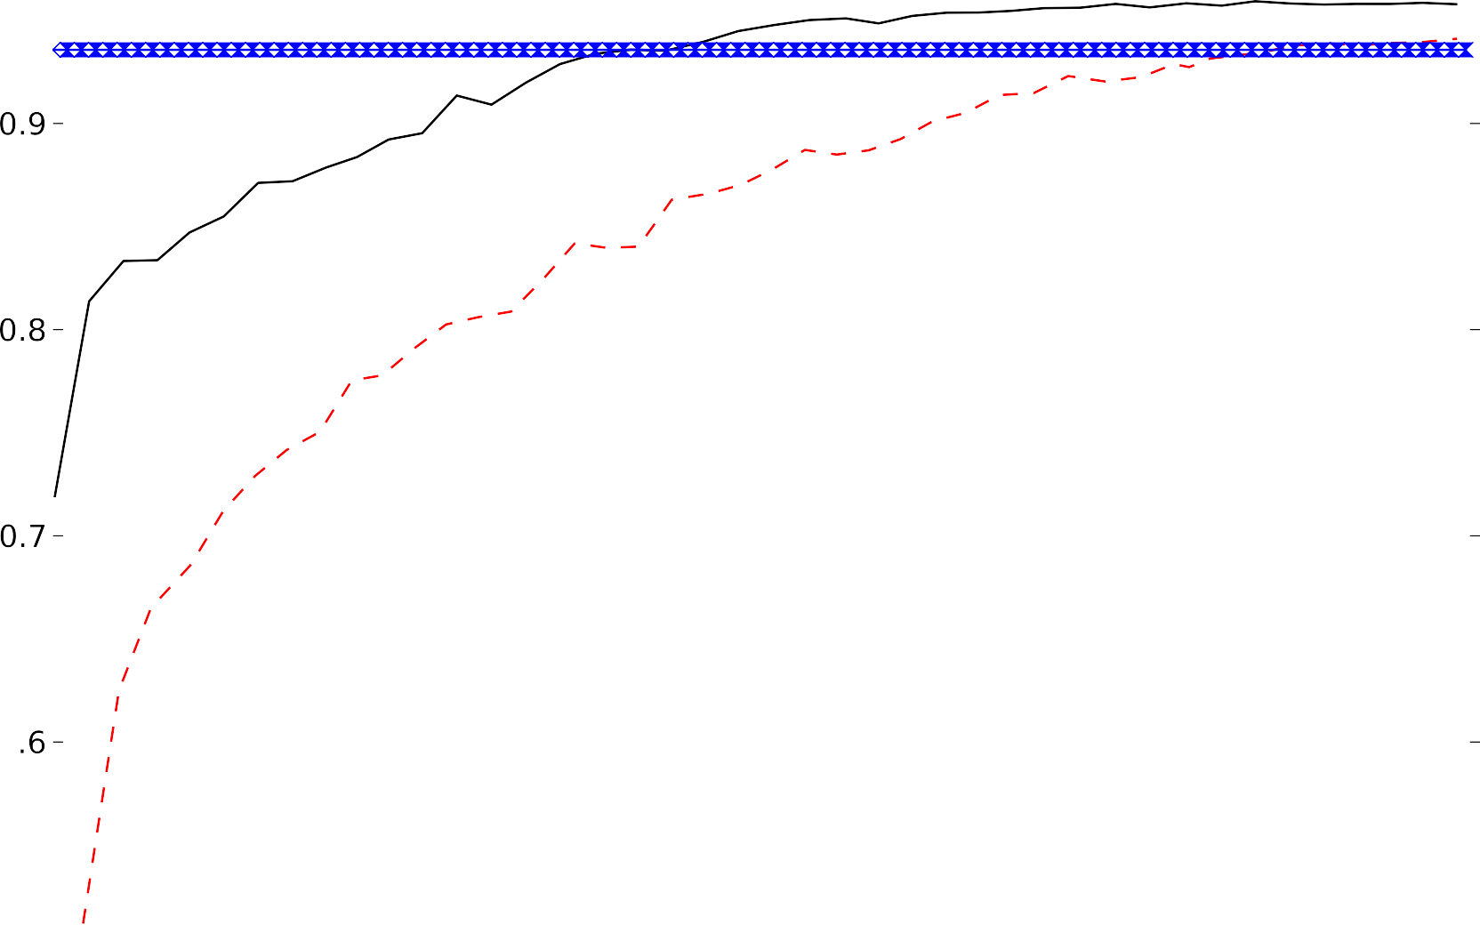



“Net2Net: Accelerating Learning via Knowledge Transfer.” Chen, Goodfellow, and Shlens, submitted to ICLR 2016

Slide 15
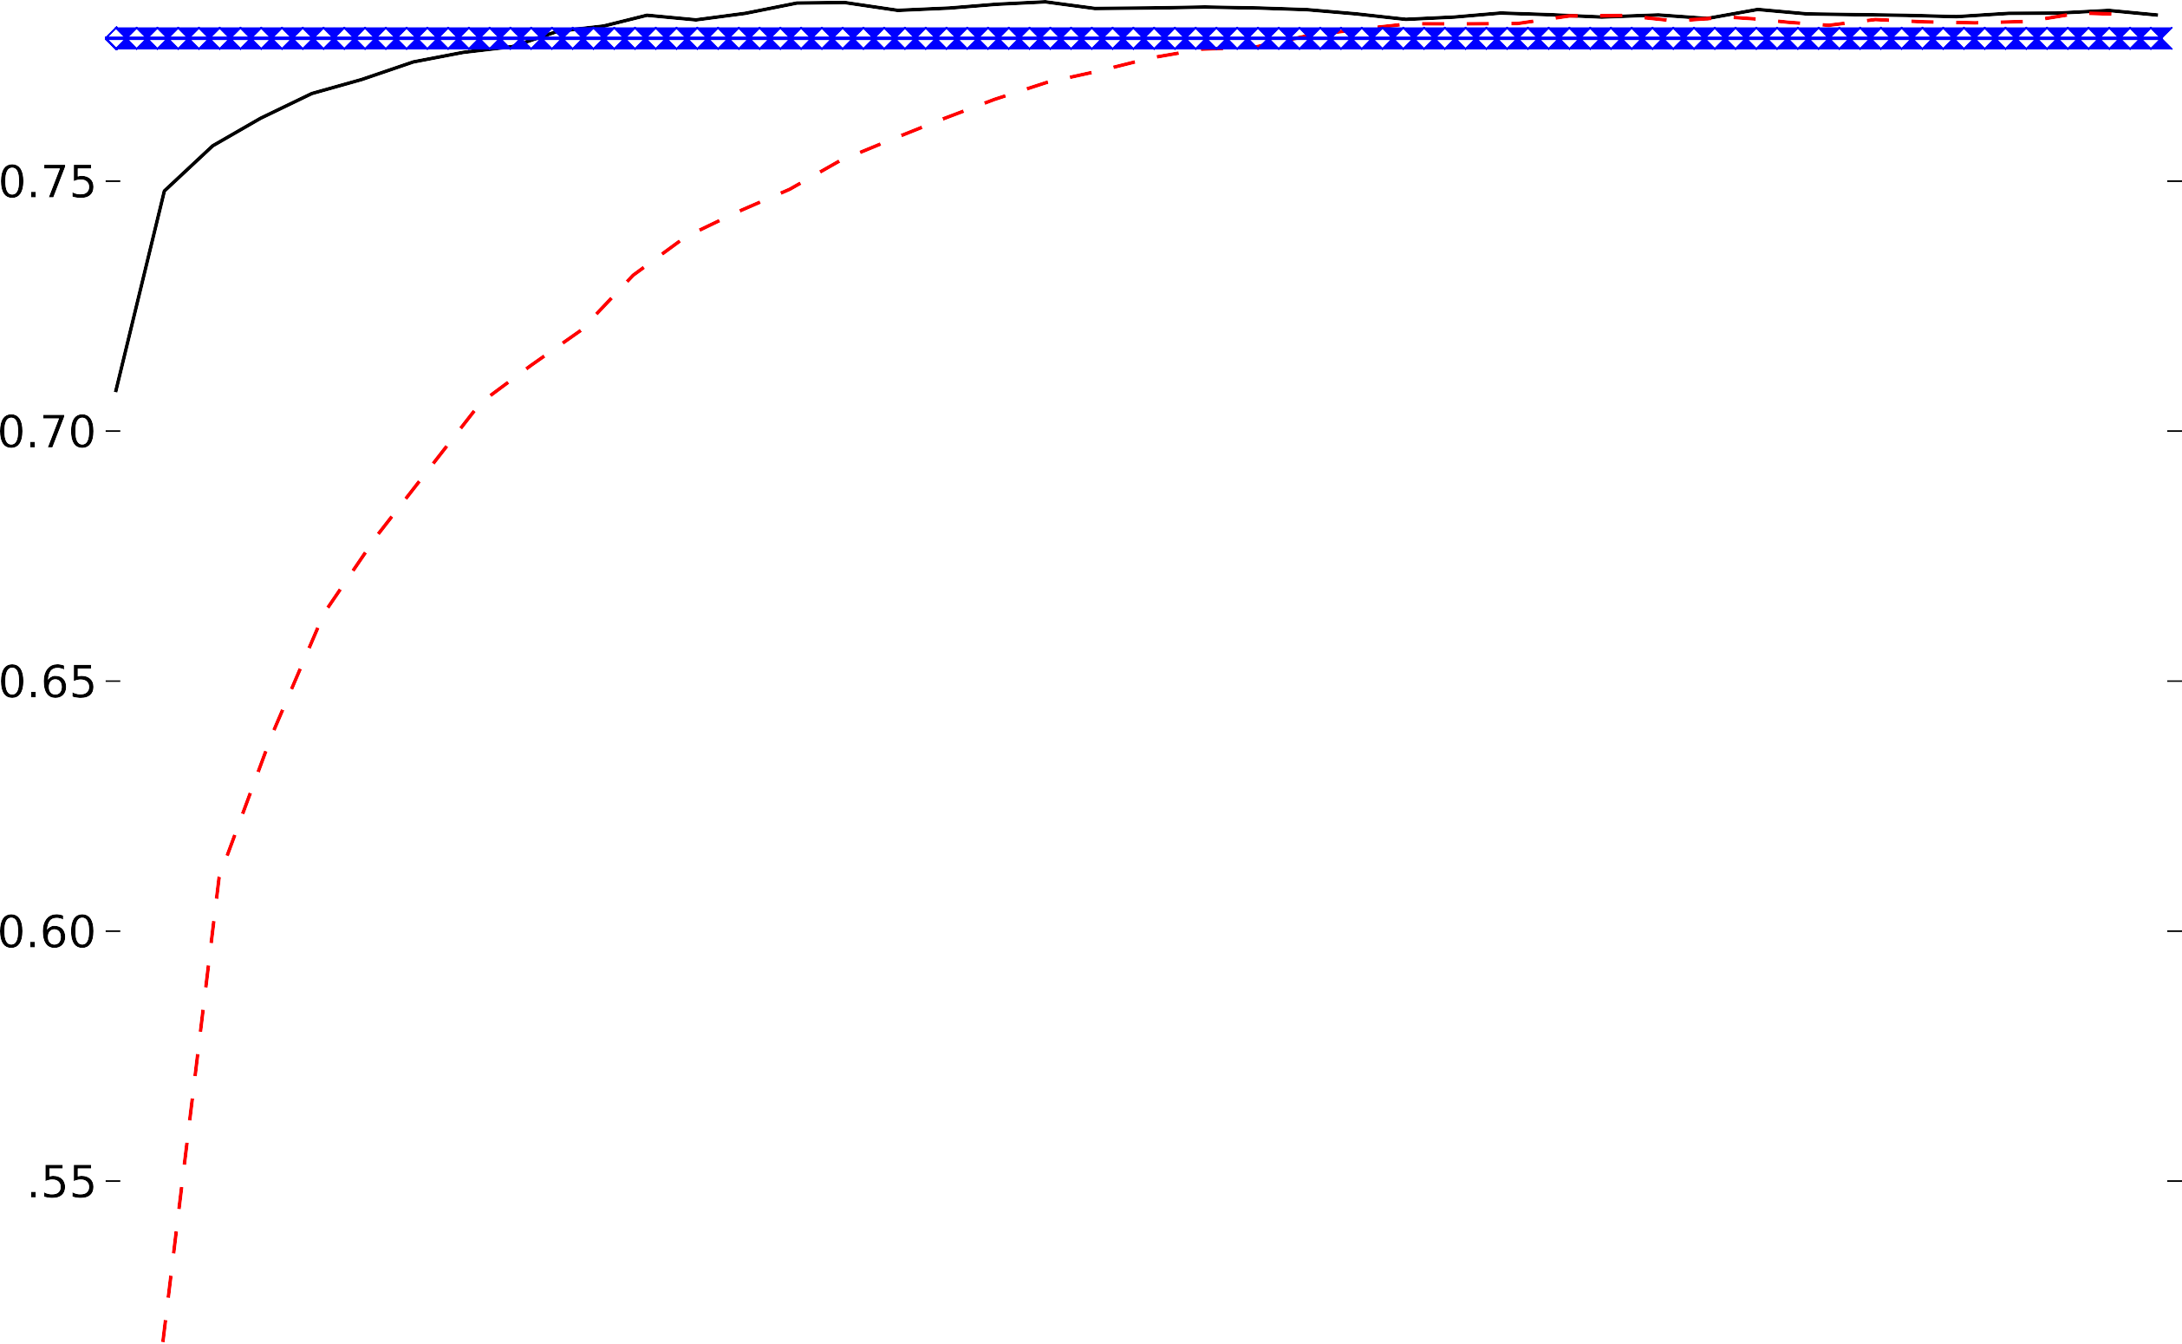













“Net2Net: Accelerating Learning via Knowledge Transfer.” Chen, Goodfellow, and Shlens, submitted to ICLR 2016

Slide 16
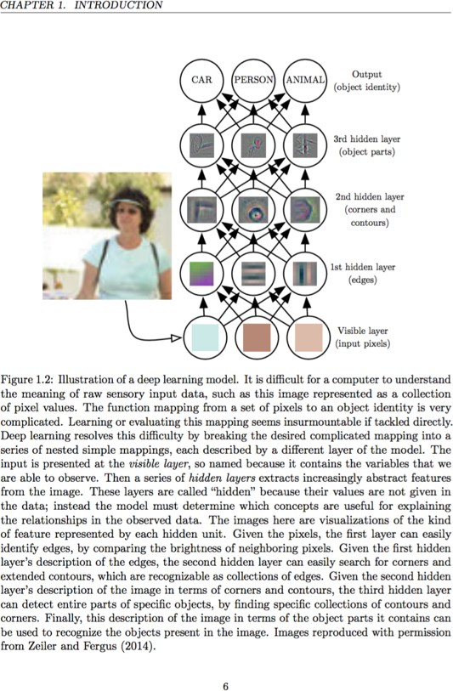
Deep Learning
Goodfellow, Bengio, and Courville
www.deeplearningbook.org In preparation for MIT Press

