Slide 1
Batch Normalization
Ian Goodfellow
Deep Learning Study Group San Francisco
September 12, 2016

Slide 2
Batch Normalization
Z =XW
m
1
X
˜
Z =Z
Z
m
i,:
i=1
_{Z}˜
ˆ
q
Z =
P
˜ 2
1
m
✏ + _{m}
_{i=1} Zi,:
H = max{0, ,Z^{ˆ} + ,B}
“Batch Normalization: Accelerating Deep Network Training by Reducing Internal Covariate Shift,” Ioﬀe and Szegedy 2015

Slide 3
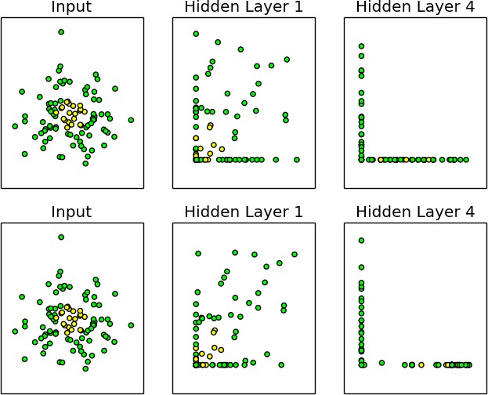
Before SGD step
After SGD step
“Batch Normalization: Accelerating Deep Network Training by Reducing Internal Covariate Shift,” Ioﬀe and Szegedy 2015

Slide 4
0.8
0.7
0.6
Inception BN−Baseline BN−x5 BN−x30
BN−x5−Sigmoid
Steps to match Inception
0.5
0.4
5M
10M
15M
20M 25M 30M
“Batch Normalization: Accelerating Deep Network Training by Reducing Internal Covariate Shift,” Ioﬀe and Szegedy 2015

