Slide 1
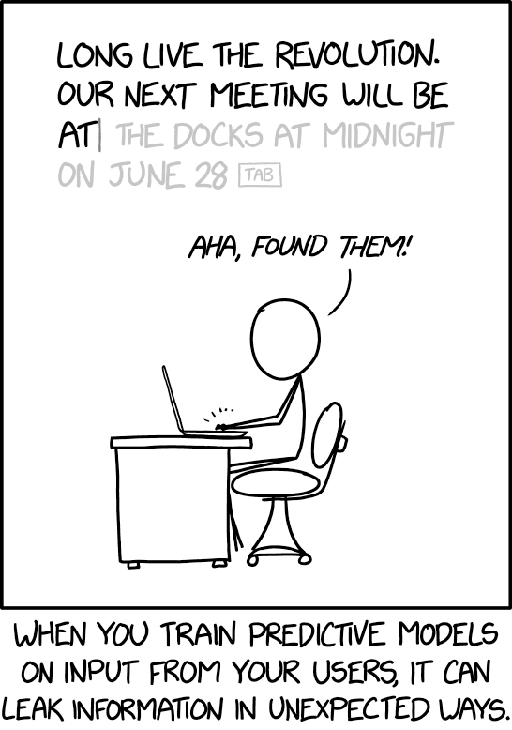
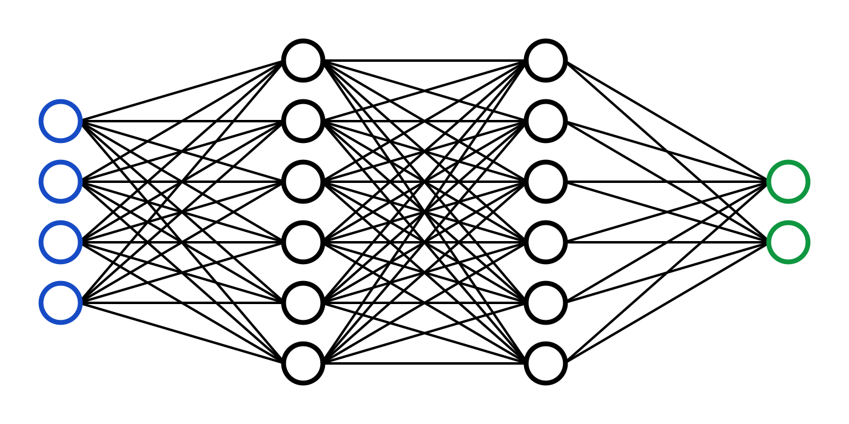
C7082 Techniques in Machine Learning and AI
Ed Harris

Slide 2
12 Applications
Details of applications change much faster than the underlying conceptual ideas
State-of-the-art results come out constantly
Applications involve specific knowledge

Slide 3








Large Scale Deep Learning
Number of neurons (logarithmic scale)
₁₀11
₁₀10
10⁹
10⁸
10⁷
10⁶
10⁵
10⁴
10³
10²
₁₀1
₁₀0 ₁₀ 1 ₁₀ 2
Human
17
16
19
20
18
Octopus
14
11
Frog
8
3
Bee
Ant
13
Leech
1
2
12
10
6
9
7
15
Roundworm
5
4
Sponge
1950
1985 2000 2015
2056

Slide 4
Fast Implementations
CPU
Exploit fixed point arithmetic in CPU families where this oﬀers a speedup
Cache-friendly implementations
GPU
High memory bandwidth
No cache
Warps must be synchronized
TPU
Similar to GPU in many respects but faster
Often requires larger batch size
Sometimes requires reduced precision

Slide 5
Distributed Implementations
Distributed
Multi-GPU
Multi-machine
Model parallelism
Data parallelism
Trivial at test time
Synchronous or asynchronous SGD at train time

Slide 6
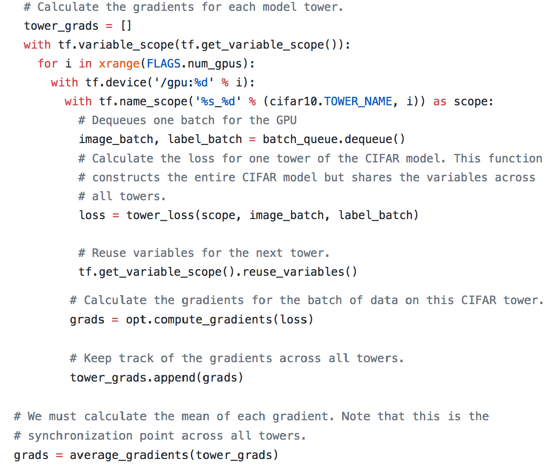
Synchronous SGD
Research…
But also
TensorFlow tutorials

Slide 7
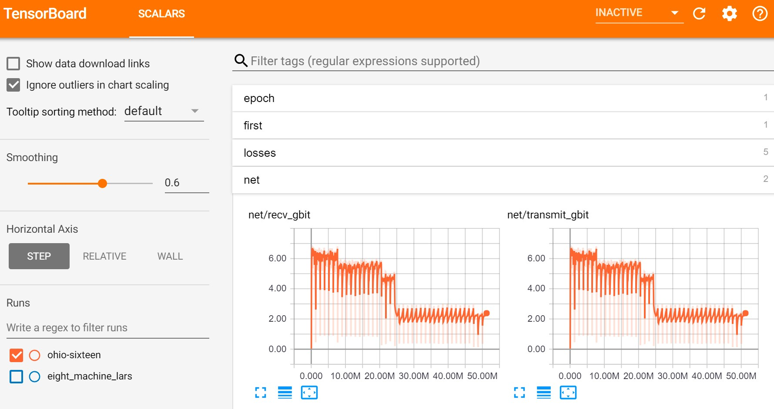
Example: ImageNet in 18 minutes for $40
Read this now… Blog post

Slide 8
Model Compression
Large models often have lower test error
Very large model trained with dropout
Ensemble of many models
Want small model for low resource use at test time
Train a small model to mimic the large one
Obtains better test error than directly training a small model

Slide 9
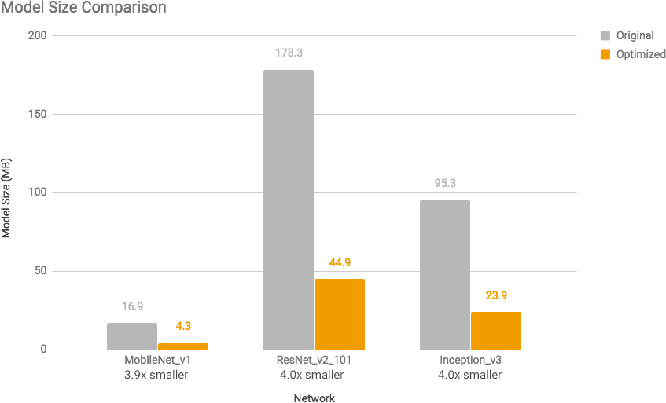
Quantization
(TensorFlow Lite article)
Important for mobile deployment

Slide 10
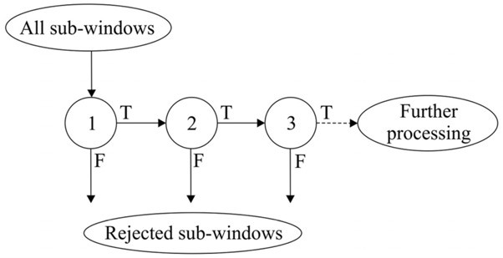
Dynamic Structure: Cascades
(Viola and Jones, 2001)

Slide 11
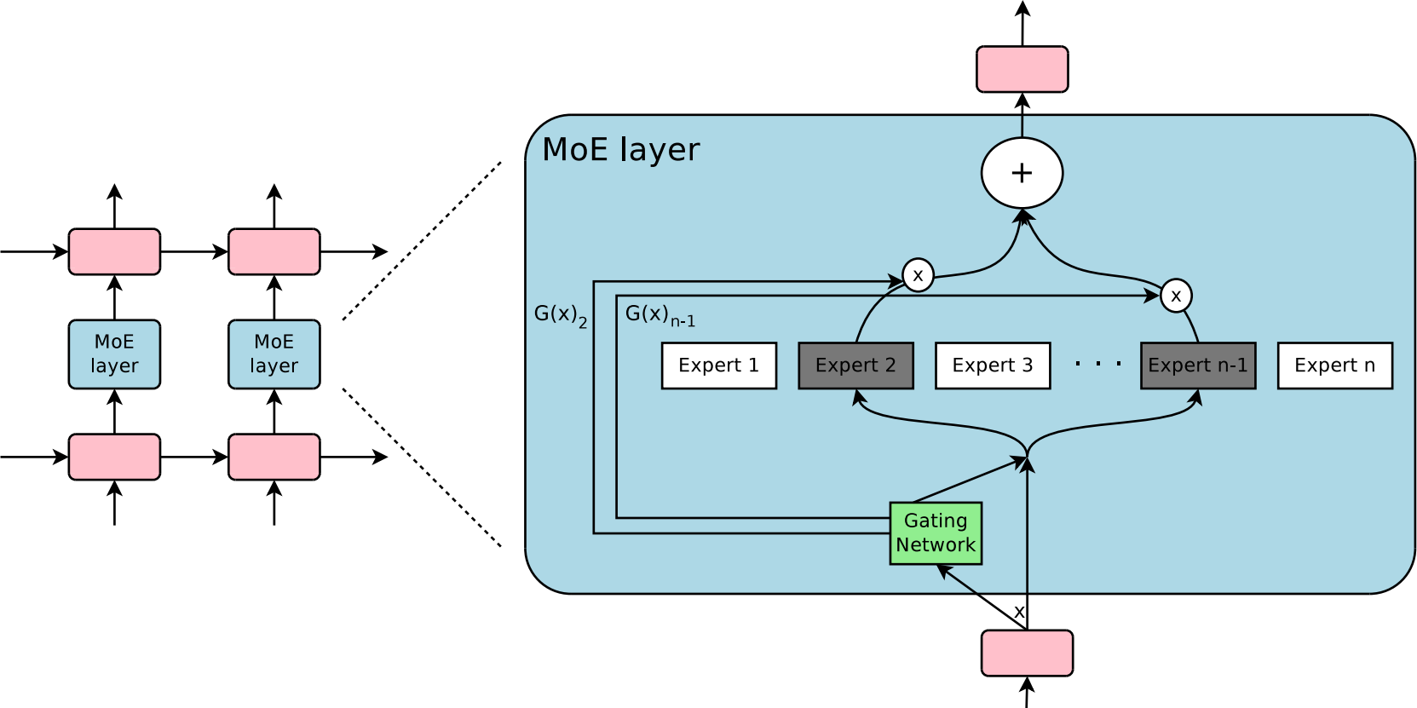
Dynamic Structure
Outrageously Large Neural Networks

Slide 12





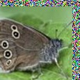

Dataset Augmentation for Computer Vision
Aﬃne Distortion
Elastic Deformation
Noise
Horizontal flip
Random Translation
Hue Shift

Slide 13
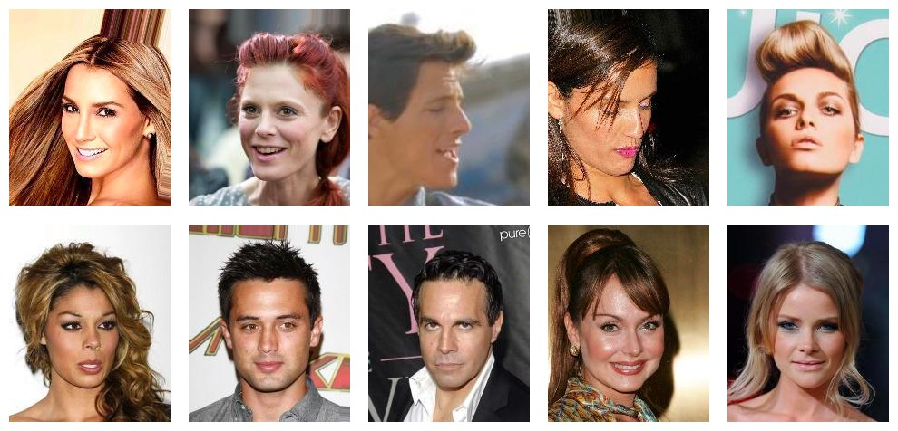
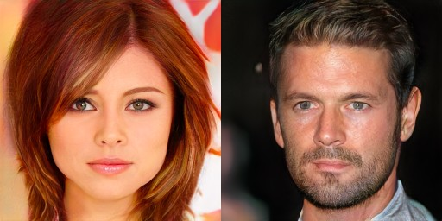
Generative Modeling: Sample Generation
Training Data
Sample Generator
(CelebA)
(Karras et al, 2017)
Underlies many graphics and speech applications
Progressing rapidly

Slide 14
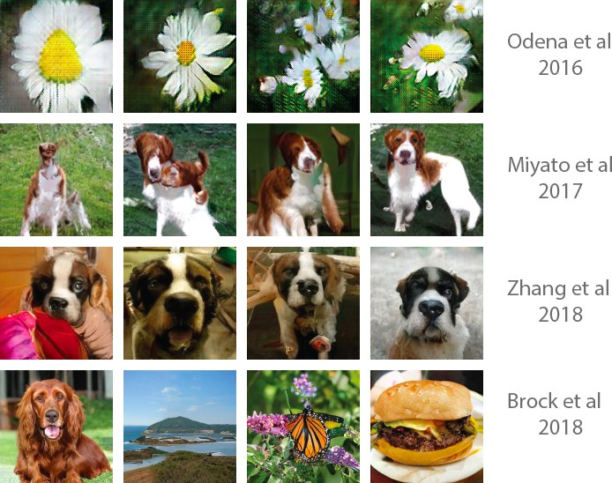
Graphics
(Table by Augustus Odena)

Slide 15
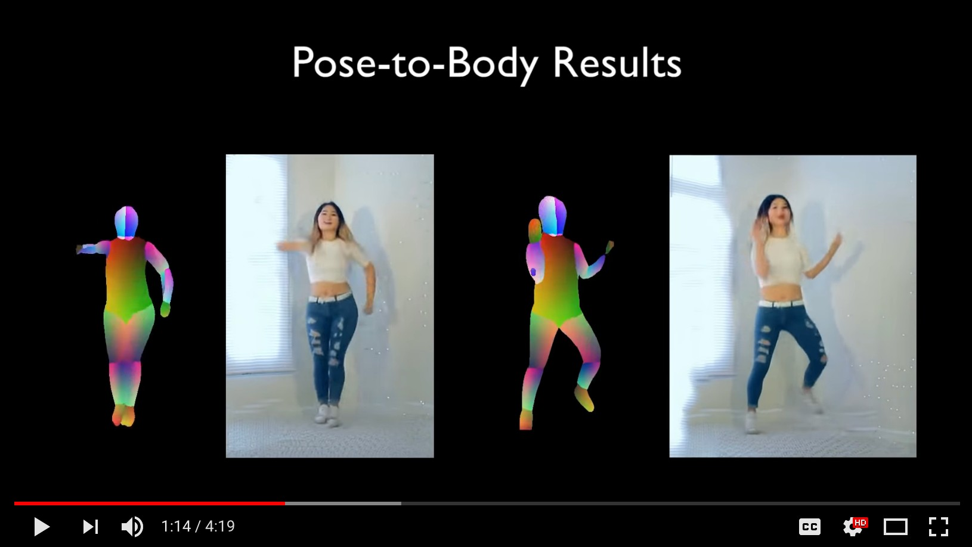
Video Generation
(video Wang et al, 2018)

Slide 16
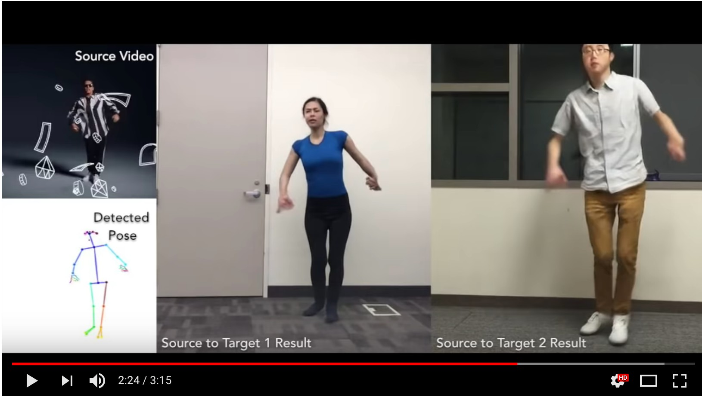
Everybody Dance Now!
(video Chan et al 2018)

Slide 17
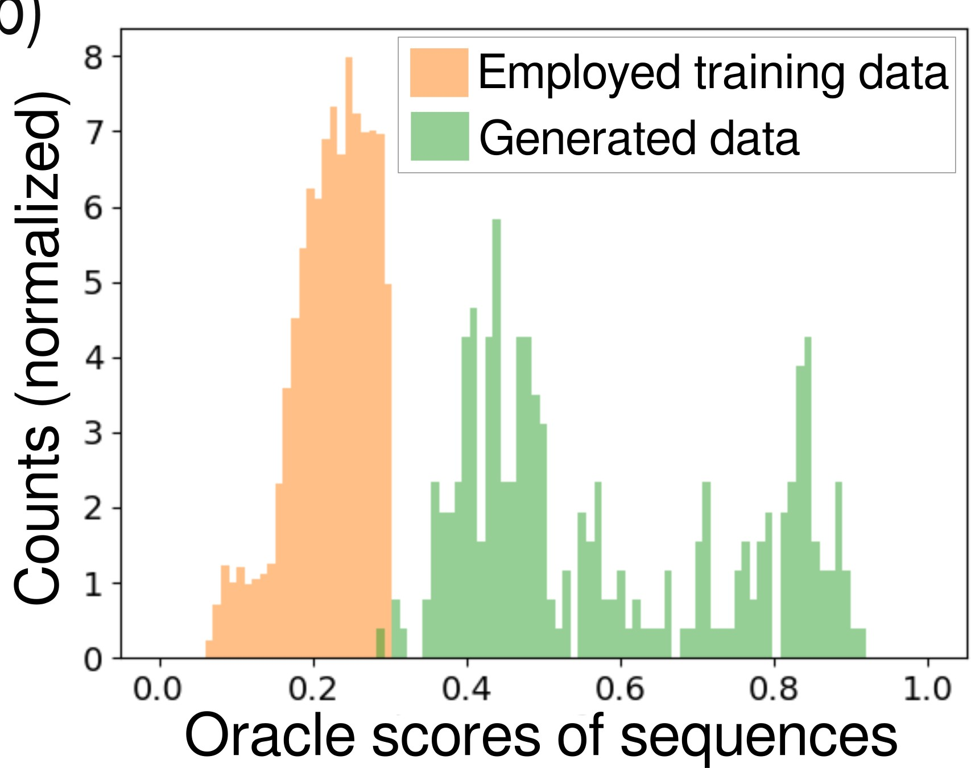
Model-Based Optimization
(Killoran et al, 2017)

Slide 18
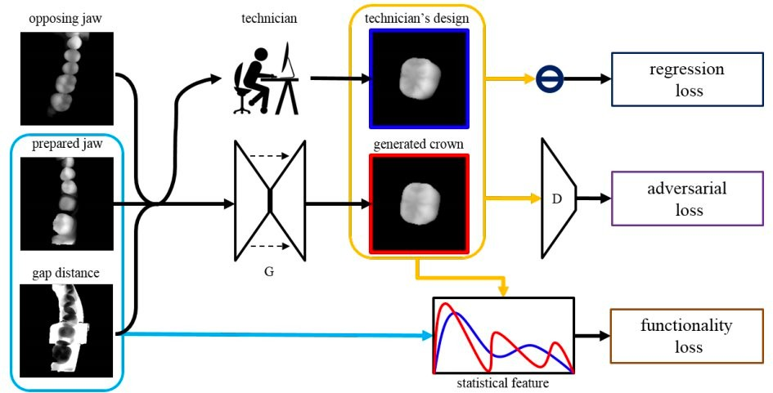
Designing Physical Objects
(Hwang et al 2018)

Slide 19
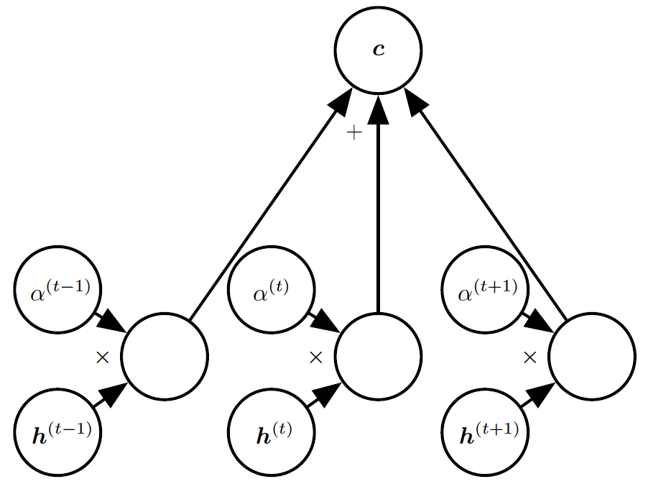
Attention Mechanisms
A neural network is considered to be an effort to mimic human brain actions in a simplified manner.
Attention Mechanism is an attempt to implement the same action of selectively concentrating on a few relevant things, while ignoring others in deep neural networks
Important in many vision, speech, and NLP applications

Slide 20
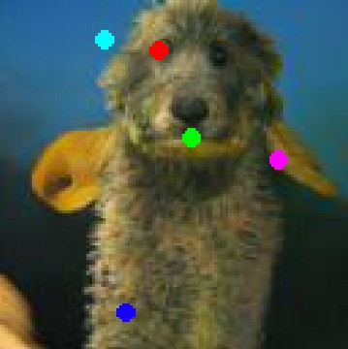
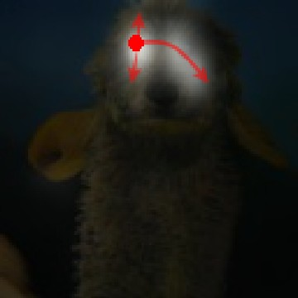
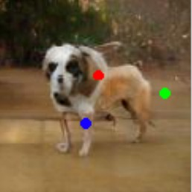
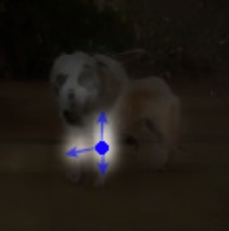
Attention for Images
Attention mechanism from Wang et al 2018
Image model from Zhang et al 2018

Slide 21
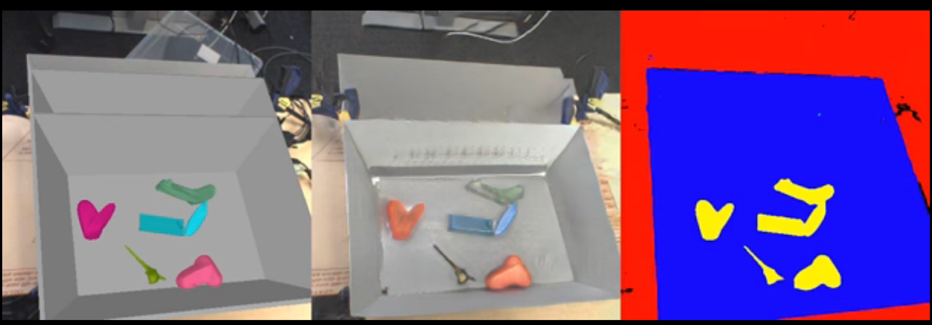
Generating Training Data
(Bousmalis et al, 2017)

Slide 22
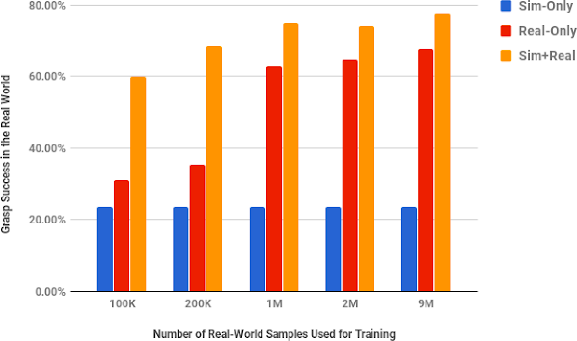
Generating Training Data
(Bousmalis et al, 2017)

Slide 23
Natural Language Processing
An important predecessor to deep NLP is the family of models based on n-grams:
P(THE DOG RAN AWAY) = P₃(THE DOG RAN)P₃(DOG RAN AWAY)/P₂(DOG RAN).
Improve with:
-Smoothing
-Backoﬀ
-Word categories

Slide 24
High-Dimensional Output Layers for Large Vocabularies
Short list
Hierarchical softmax
Importance sampling
Noise contrastive estimation

Slide 25
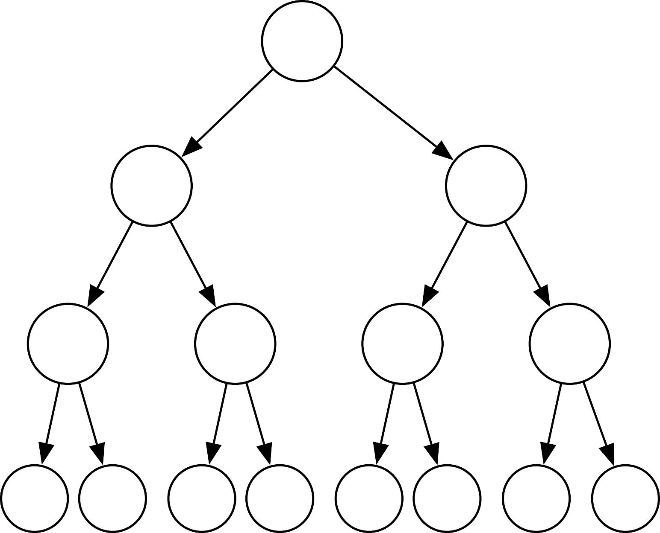
A Hierarchy of Words and Word Categories
(0)
(1)
(0,0)
(0,1)
(1,0)
(1,1)
w₀ | w₁ | w₂ | w₃ | w₄ | w₅ | w₆ | w₇
(0,0,0) | (0,0,1) | (0,1,0) | (0,1,1) | (1,0,0) | (1,0,1) | (1,1,0) | (1,1,1)

Slide 26
Neural Machine Translation
Output object (English sentence)
Decoder Intermediate, semantic representation
Encoder
Source object (French sentence or image)

Slide 27
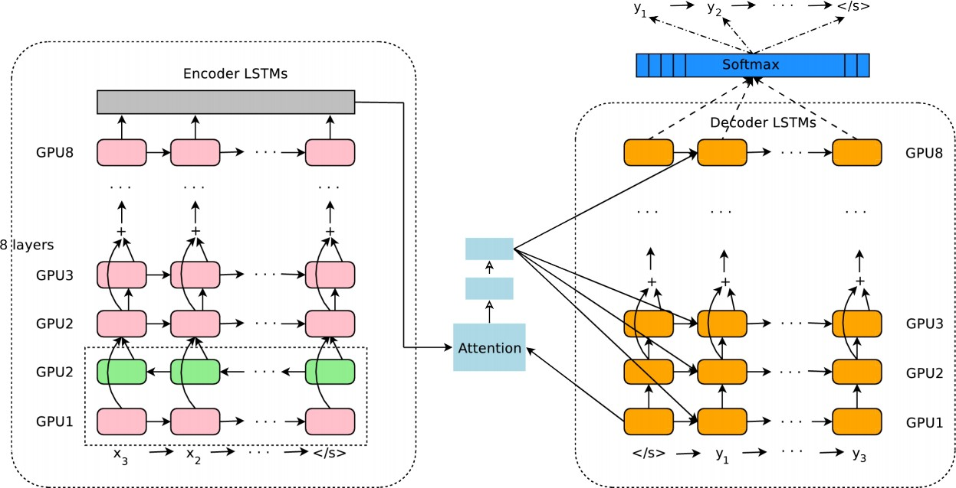
Google Neural Machine Translation
Wu et al 2016

Slide 28
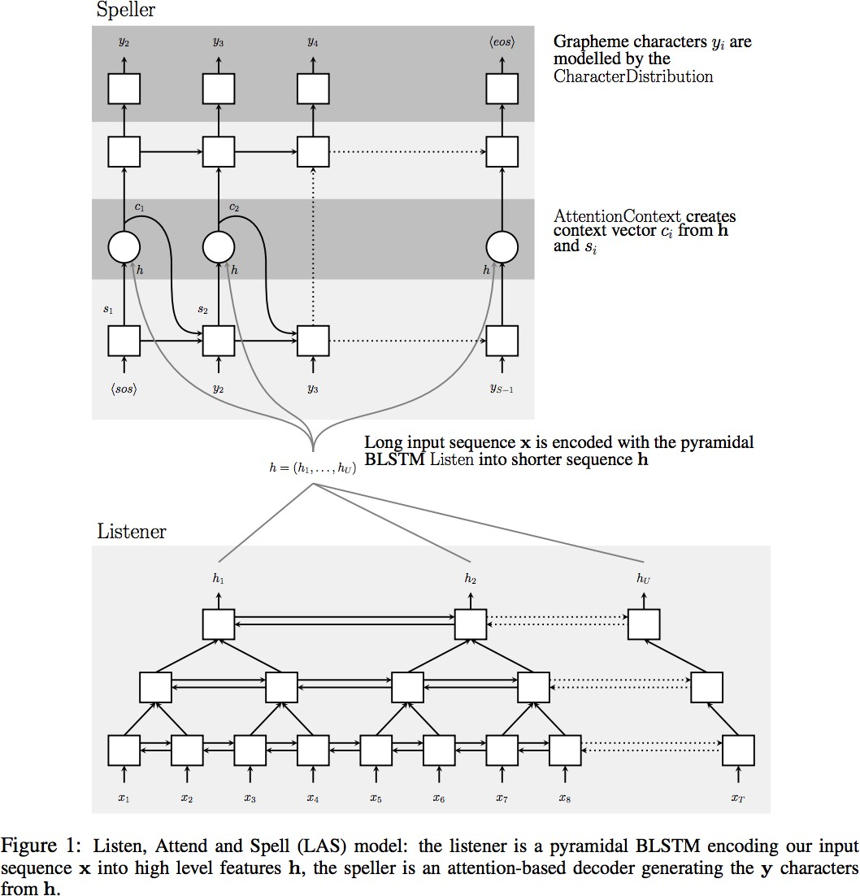
Speech Recognition
Current speech recognition is based on seq2seq with attention
Graphic from
“Listen, Attend, and Spell”
Chan et al 2015

Slide 29
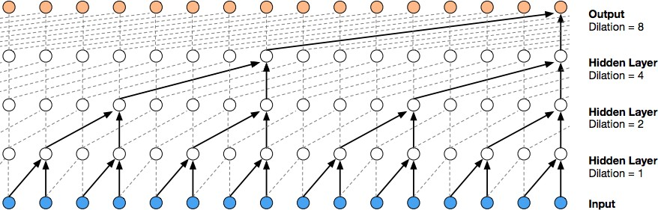
Speech Synthesis
WaveNet
(van den Oord et al, 2016)

Slide 30
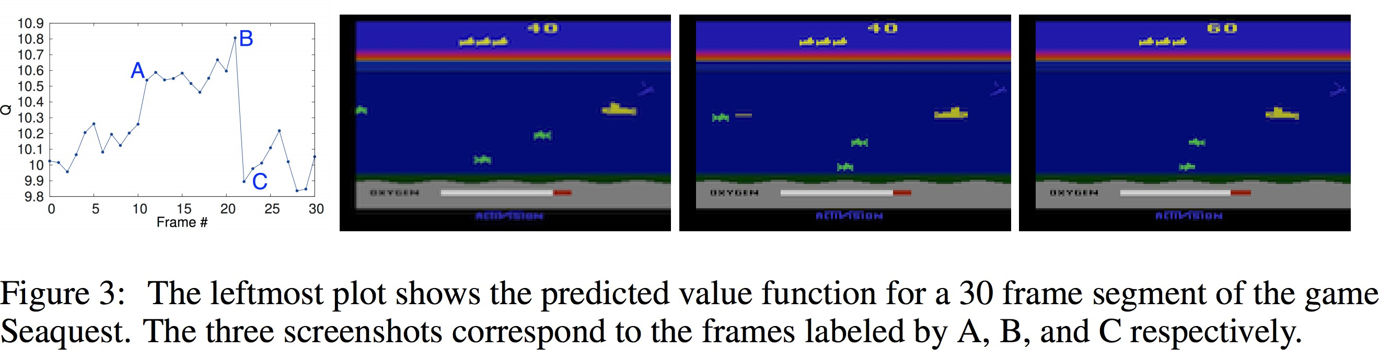
Deep RL for Atari game playing
(Mnih et al 2013)
Convolutional network estimates the value function (future rewards) used to guide the game-playing agent.

Slide 31
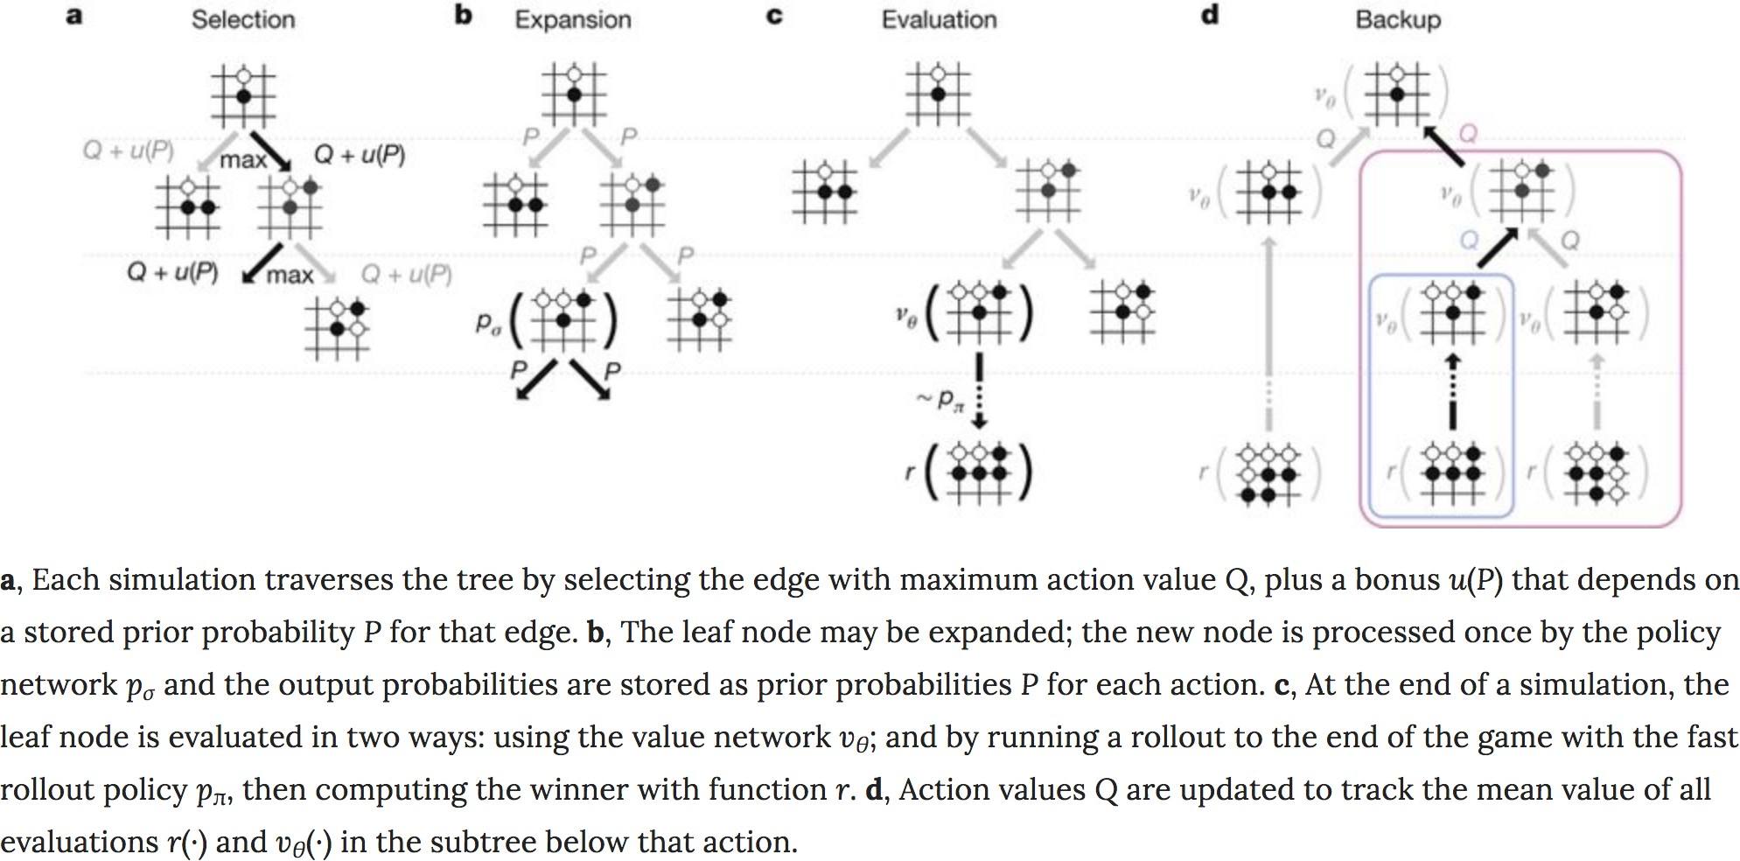
Superhuman Go Performance
Monte Carlo tree search, with convolutional networks for value function and policy
(Silver et al, 2016)

Slide 32
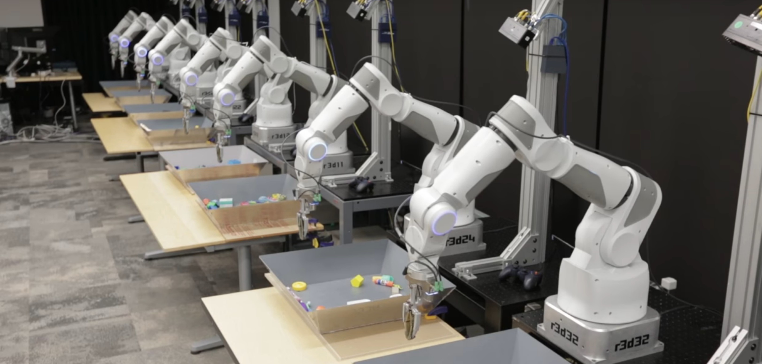
Robotics
(Google Brain robotics)

Slide 33
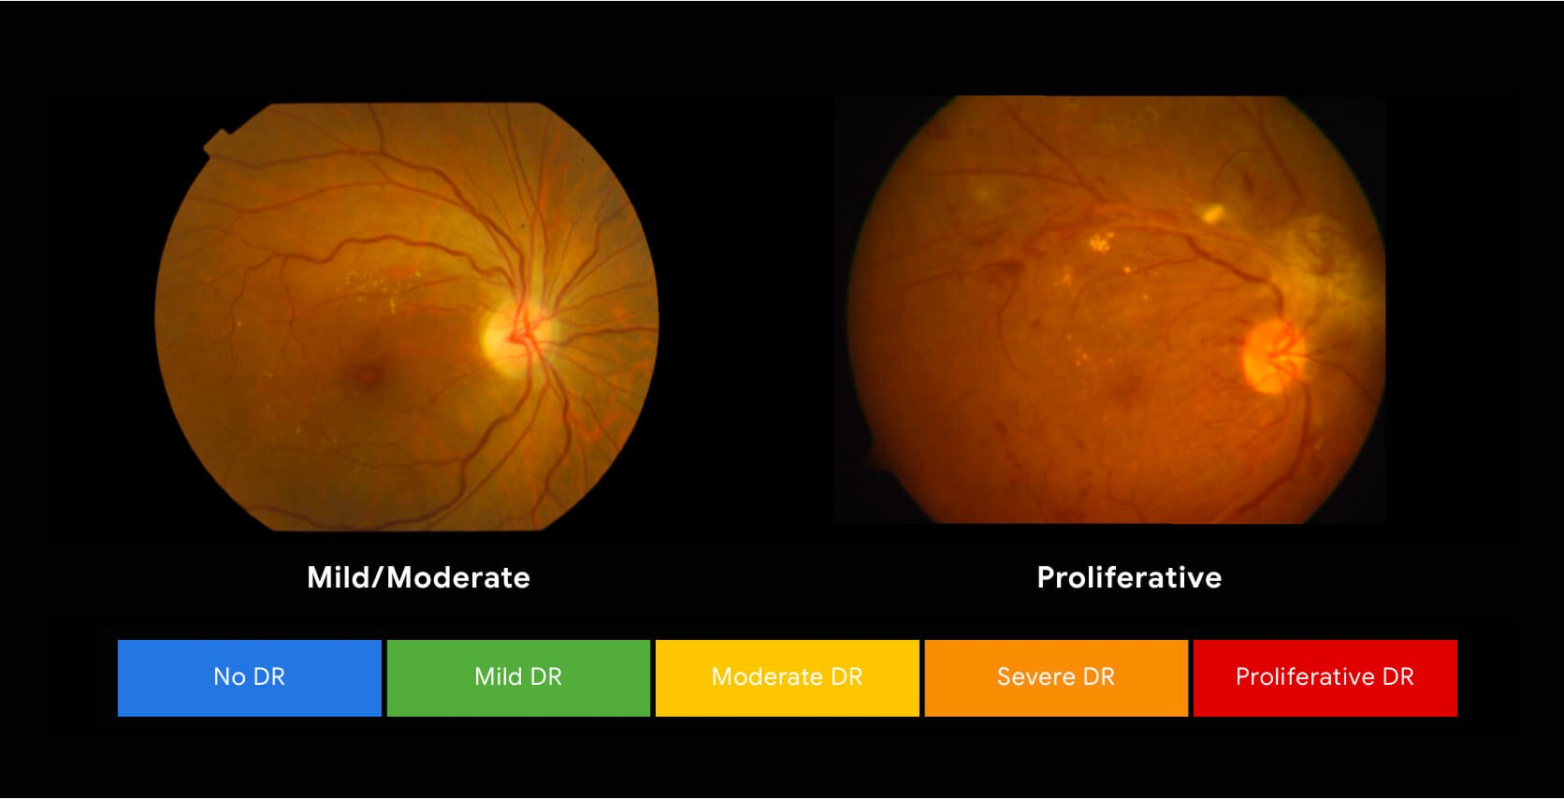
Healthcare and Biosciences
(Google Brain healthcare imaging)

Slide 34
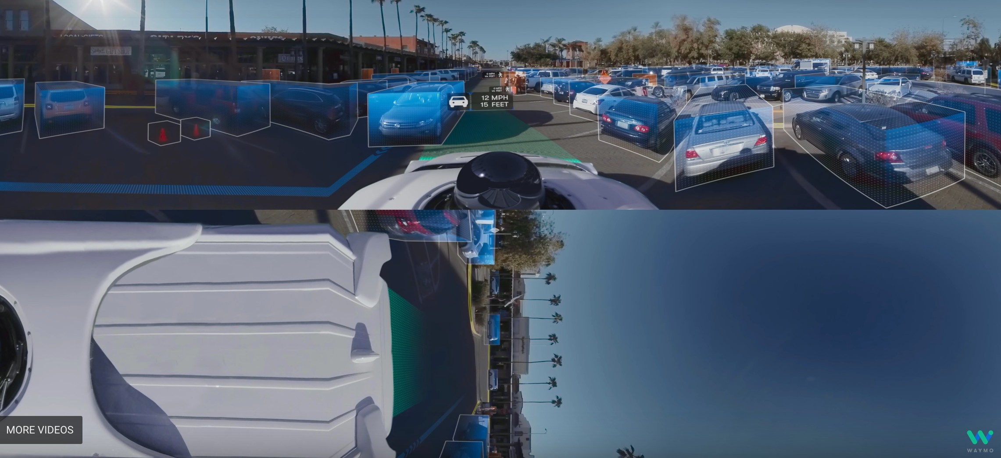
Autonomous Vehicles
(WayMo)

