Slide 1





C7084 Big Data
Ed Harris
QUERY
DATA
Knowledge

Slide 2
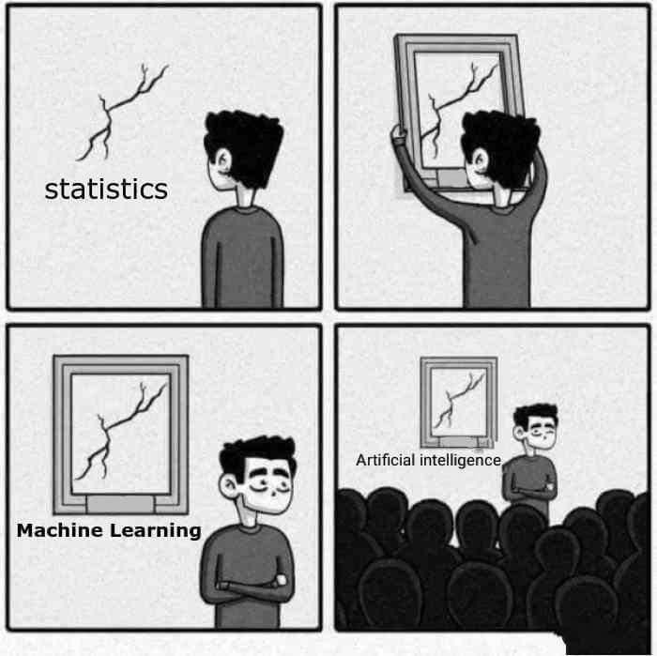
BIG
DATA

Slide 3
Table of Contents
Don't forget to start recording
Every session: community.cloud.databricks.com and Logon
In Left-pane, Click on 'Clusters' or 'Compute' and Terminate old Cluster Then click 'Create Cluster' button to create New one
Mod 00 – Intro and Setup
Mod 01 – Spark Architecture
Mod 02 – SparkSQL (Read/Write DataFrames/Tables)
Hacktivity 00 (Dates) / Hacktivity 01 (Air)
Mod 03 – SparkSQL (Transform)\
Mod 04 – Complex Data Types
Mod 05 – JSON (Optional)
Hacktivity 02 (Fly)
Mod 06 – Streaming
Mod 07 – Architecture-Spark UI
Mod 08 – Catalog-Catalyst-Tungsten
Mod 09 – Adaptive Query Execution
Mod 10 – Performance Tuning
Hacktivity 03 (Stream) / Hacktivity 04 (Air)
Mod 11 – Machine Learning

Slide 4
Module 05 – JSON Data Type

Slide 5
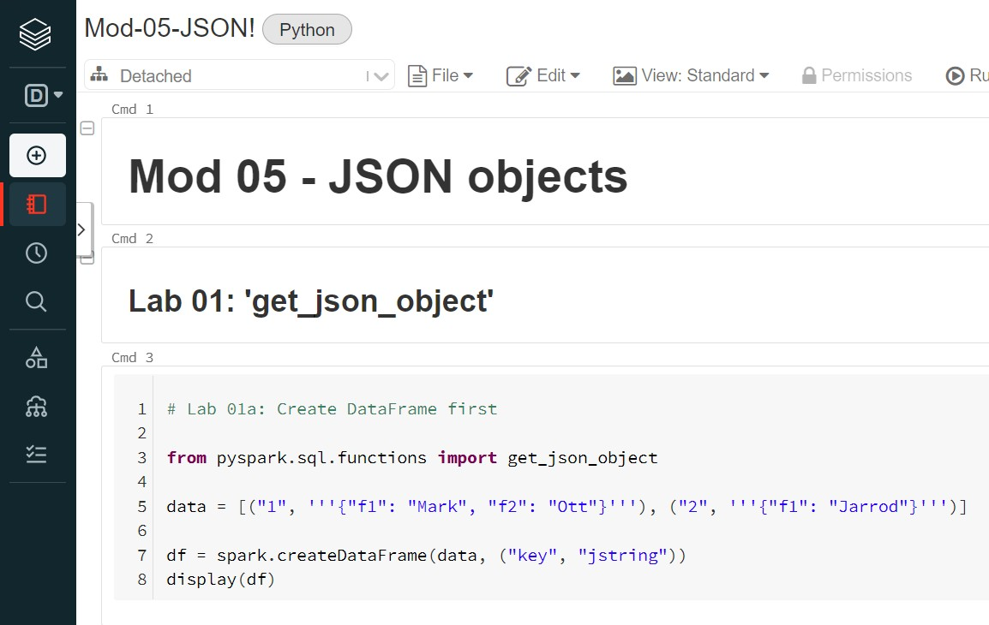
Before We Begin – Open Mod05 Notebook
3

Slide 6

Current Topic
4
Querying JSON objects
Commands include:
get_json_object
to_json
from_json
selectExpr
Nested JSON objects using:
explode
getItem
Most labs in Scala for this module

Slide 7
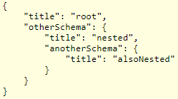
JSON definition
5
JSON Schema defines the media type "application/schema+json", a JSON based format for defining the structure of JSON data. JSON Schema provides a contract for what JSON data is required for a given application and how to interact with it
JSON is typically nested. Here's an example:
JSON schema defines 7 types for values:
Array A JSON array
Boolean A JSON boolean
Integer A JSON number without a fraction or exponent part
Number Any JSON number. Number includes integer
Null
Object
String
The JSON null value
A JSON object A JSON string

Slide 8
Spark functions for JSON
6
Spark SQL provides JSON functions like:
get_json_object extracts JSON object string based on JSON path.
Can use 'normal' Schema (like String) or Struct Schema
to_json() to encode a Struct into JSON string. Requires Struct Schema
from_json() to encode a JSON string into a Struct. Requires Struct
Schema. Can then flatten the Struct to view individual columns
selectExpr Extracts DataFrame column into JSON String
Note the 2 functions that require a Struct data type. A Struct Schema enables many sub-columns to have any data type defined for that sub-column

Slide 9
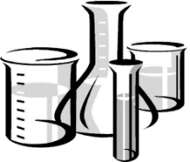
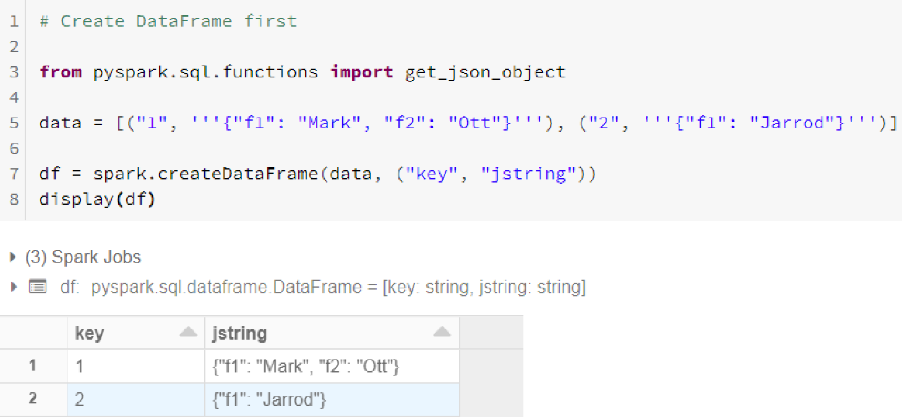
Lab 01a
Create DataFrame to use with get_json_object (Python) 7
Here we assign Parent Column names

Slide 10
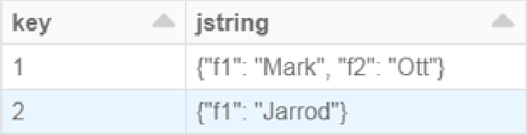
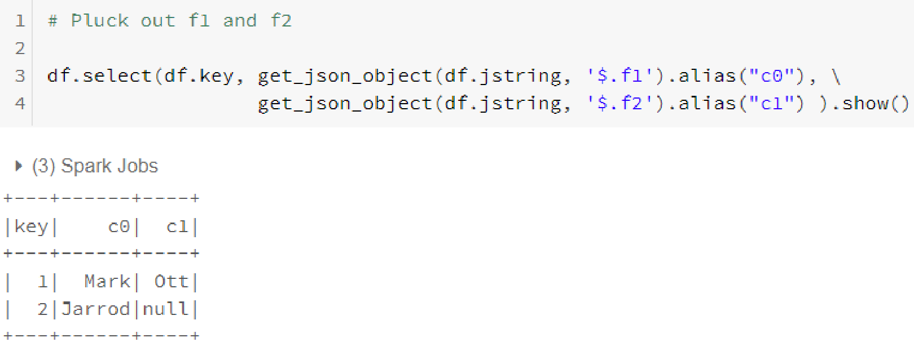
Lab 01b
Query DataFrame via get_json_object (Python)
8
Input

Slide 11

Lab 01c
Create DataFrame to use with get_json_object
9
We have 10 sub-columns nested under the 'json' parent column name
val eventsFromJSONDF = Seq ( | Children columns below in Red
(0, """{"device_id": 0, "device_type": "sensor-ipad", "ip": "68.161.225.1", "cca3": "USA", "cn": "United States", "temp": 25, "signal": 23, "battery_level": 8, "c02_level": 917, "timestamp" :1475600496 }"""), (1, """{"device_id": 1, "device_type": "sensor-igauge", "ip": "213.161.254.1", "cca3": "NOR", "cn": "Norway", "temp": 30, "signal": 18, "battery_level": 6, "c02_level": 1413, "timestamp" :1475600498 }"""), (2, """{"device_id": 2, "device_type": "sensor-ipad", "ip": "88.36.5.1", "cca3": "ITA", "cn": "Italy", "temp": 18, "signal": 25, "battery_level": 5, "c02_level": 1372, "timestamp" :1475600500 }"""), . . .toDF("id", "json") eventsFromJSONDF.printSchema() Here's Parent columns eventsFromJSONDF.show(4, false)

Slide 12
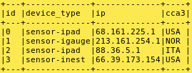
Lab 01d
Query DataFrame via get_json_object
10
We query 3 of 10 sub-columns by pointing to parent 'json' column and child
columns via 'get_json_object'
Input
Parent Children
val jsDF = eventsFromJSONDF.select($"id", get_json_object($"json", "$.device_type").alias("device_type"),
get_json_object($"json", "$.ip").alias("ip"),
get_json_object($"json", "$.cca3").alias("cca3"))
jsDF.show(4, false)

Slide 13
to_json and from_json functions
11
Before we begin, it is important to define a Struct Data Type since they can be used when parsing JSON objects in Spark. A Struct is used to define a Schema in a Parent column, Child column format
Spark SQL provides JSON functions like:
from_json() convert a JSON string column into a Struct. Then you can flatten the Struct display individual columns
to_json() converts Struct into JSON string

Slide 14
Lab 02a
Create JSON schema using Struct
12
This StructType has 10 sub-columns defined. Parent column defined during
'case class' (see next slide)
import org.apache.spark.sql.types._
import org.apache.spark.sql.functions._
val jsonSchema = new StructType()
.add("battery_level", LongType)
.add("c02_level", LongType)
.add("cca3",StringType)
.add("cn", StringType)
.add("device_id", LongType)
.add("device_type", StringType)
.add("signal", LongType)
.add("ip", StringType)
.add("temp", LongType)
.add("timestamp", TimestampType
// Include the Spark Types to define our schema
// Include the Spark helper functions
Two more things need to occur before using 'from_json'. We need to:
Define 'Parent' column via 'case class' and attach to DataFrame
Then Attach Struct Schema to DataFrame
See next 2 slides for details

Slide 15
Lab 02b
Create DataFrame using Schema from previous slide 13
We create a DF. Note parent column 'device' and its 10 sub-columns
// Define a case class
case class DeviceData (id: Int, device: String)
// Create some sample data val eventsDS = Seq (
Here's Parent column
(0, """{"device_id": 0, "device_type": "sensor-ipad", "ip": "68.161.225.1", "cca3": "USA", "cn": "United States", "temp": 25, "signal": 23, "battery_level": 8, "c02_level": 917, "timestamp" :1475600496 }"""),
(1, """{"device_id": 1, "device_type": "sensor-igauge", "ip": "213.161.254.1", "cca3": "NOR", "cn": "Norway",
"temp": 30, "signal": 18, "battery_level": 6, "c02_level": 1413, "timestamp" :1475600498 }"""), . .
.as[DeviceData]
eventsDS.printSchema()
eventsDS.show(4, false)

Slide 16
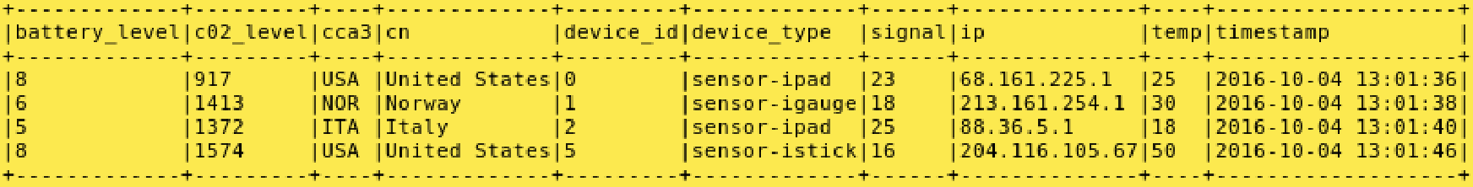
Lab 02c Query DataFrame via from_json
(Convert JSON String to Struct Schema)
14
This is DF created in Lab 02b Attach DF to Struct created in Lab 02a
(Will allow Output to be in Relational format
val devicesDF = eventsDS.select(from_json($"device", jsonSchema) as "devices")
.select($"devices.*").filter($"devices.temp" > 10 and $"devices.signal" > 15)
devicesDF.show(4, false)

Slide 17
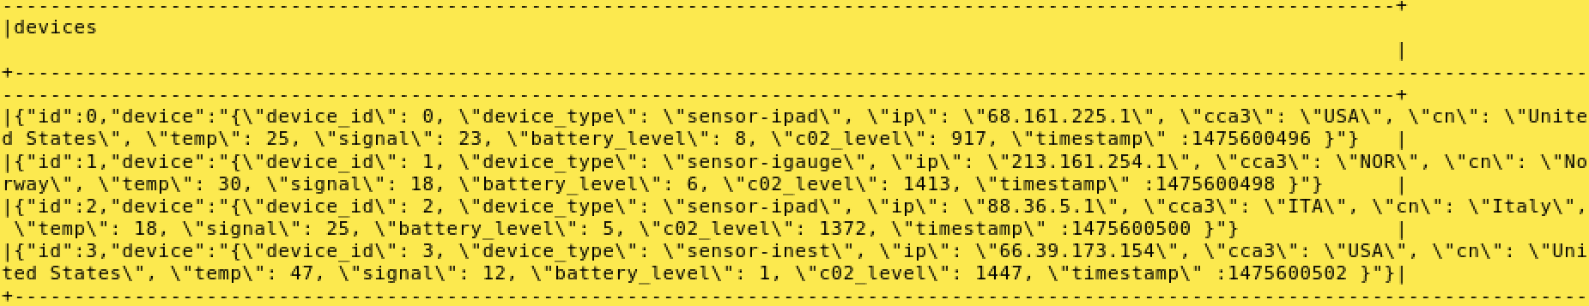
Lab 02d Query DataFrame via to_json
(Convert Struct Schema to JSON String)
15
This is DF created in Lab 02b This is Struct created in Lab 02a
val stringJsonDF = eventsDS.select(to_json(struct($"*"))).toDF("devices") stringJsonDF.show(4, false)

Slide 18

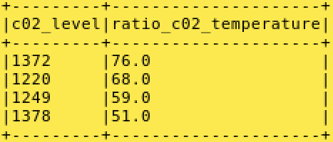
Lab 03
Query DataFrame via selectExpr
16
Using selectExpr, we CAST a JSON object as a String
val stringsDF = eventsDS.selectExpr("CAST(id AS INT)", "CAST(device AS STRING)") strings.printSchema
stringsDF.show(4, false)
devicesDF.selectExpr("c02_level", "round(c02_level/temp) as ratio_c02_temperature")
.orderBy($"ratio_c02_temperature" desc).show(4, false)
selectExpr can convert expressions to create 'manufactured' columns

Slide 19
Nested JSON objects using Map Data Type
17
It's not unreasonable to assume that your JSON nested structures
may have Maps as well as nested JSON
For illustration, let's use a single string comprised of Complex and
Nested data types, including a Map

Slide 20
Lab 04a
Create Complex Data Type schema for JSON data
18
Here we create DF and apply Key-Value pair data to Map Data type
import org.apache.spark.sql.types._
val schema1 = new StructType()
.add("dc_id", StringType)
.add("source", MapType(
// Info about the source of alarm
// Define this as a Map(Key->value)
StringType,
new StructType()
Map consists of 6 Key-Value pairs. Column names are Keys
.add("description", StringType)
.add("ip", StringType)
.add("id", LongType)
.add("temp", LongType)
.add("c02_level", LongType)
.add("geo",
new StructType()
.add("lat", DoubleType)
.add("long", DoubleType) )))

Slide 21
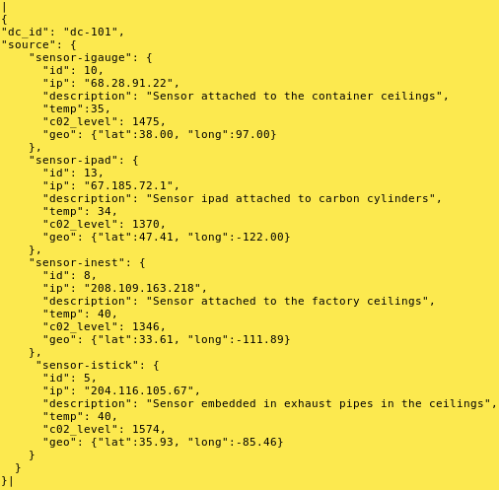
Lab 04b
Create single row complex JSON DataFrame
19
Here we create DF and apply Key-Value pair data to Map Data type
val dataDS = Seq("""
{
"dc_id": "dc-101",
"source": {
"sensor-igauge": {
This is Map's Parent column
And 6 Children columns
"id": 10,
"ip": "68.28.91.22",
"description": "Sensor attached to the container ceilings",
"temp":35, "c02_level": 1475,
"geo": {"lat":38.00, "long":97.00}
}, …toDS()
dataDS.count()

Slide 22
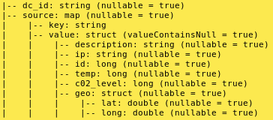
Lab 04c/d
Query the JSON DataFrame
20
Schema create in Lab 04a DF created in Lab 04b
val df = spark.read.schema(schema1).json(dataDS.rdd)
df.printSchema
Inside our String Data type, we have a Nested Map() and a Nested Struct()
df.show(1, false)

Slide 23
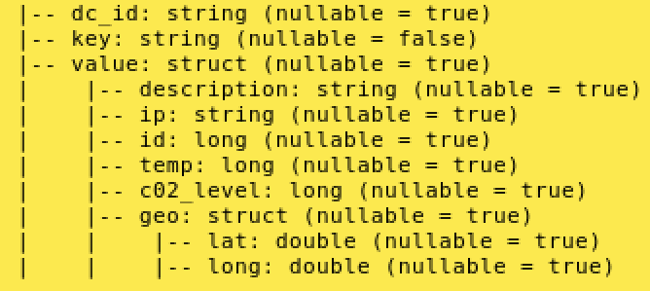
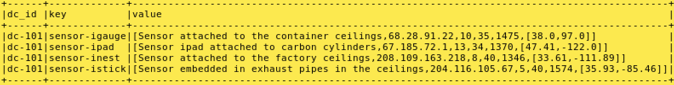
Lab 04e
Query the JSON DataFrame via 'explode'
21
Schema create in Lab 04c This is the Parent column from Map()
val explodedDF = df.select($"dc_id", explode($"source")) explodedDF.printSchema
explodedDF.show(4, false)
Child values from Semi-structured data

Slide 24
Lab 05a
Create Schema and DF using getItem for next lab
22
This is the 'Parent' column from Map() From Lab 04e
//case class to provide Schema for Map() Key-Value pairs
case class DeviceAlert(dcId: String, deviceType:String, ip:String, deviceId:Long, temp:Long, c02_level: Long, lat: Double, lon: Double)
// Access all values using getItem() on value, by providing the "Key," which is attribute in JSON val notifydevicesDS = explodedDF.select( $"dc_id" as "dcId",
$"key" as "deviceType",
'value.getItem("ip") as 'ip,
Pluck out Child 'Values' from Map()
'value.getItem("id") as 'deviceId,
'value.getItem("c02_level") as 'c02_level, 'value.getItem("temp") as 'temp, 'value.getItem("geo").getItem("lat") as 'lat, 'value.getItem("geo").getItem("long") as 'lon)
.as[DeviceAlert]
// 2nd level needs level of fetching
// Return as a Dataset

Slide 25
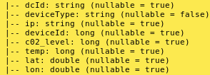
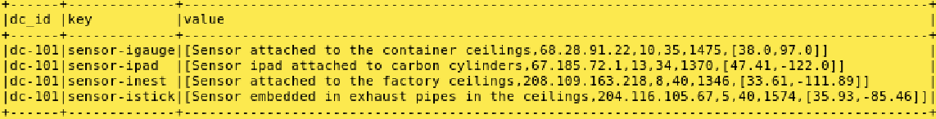
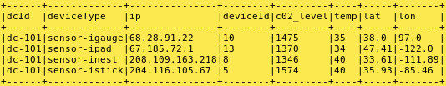
Lab 05b
Query the JSON DF from previous lab
23
With get_item we now have a Relational answer set
notifydevicesDS.printSchema
Before (Semi-structured format)
explodedDF.show(4, false)
notifydevicesDS.show(4, false)
After (Relational)

Slide 26
Current Topic
24
Data Type Overview
Complex Data Type functions
Where to Source
Array
Map
Struct
Putting it All Together
Hackathon
Querying JSON objects
Summary

Slide 27
Review Questions
25
Use this keyword in Standard function for Collections to see NULL rows
_outer
This Complex data type must have same data type
Array
Use this function in Python to create Map data types
create_map
This must not be Null or else the Data type fails when queried
The 'key' of the Map data type
These 2 Complex Data Types use dot notation when querying
Maps and Structs

Slide 28
References
26
Want to learn more about Complex data types? Here's some great reading material
https://databricks.com/blog/2017/06/13/five-spark-sql-utility-functions-extract-explore-complex-data-types.html
https://acadgild.com/blog/hive-complex-data-types-with-examples
https://docs.databricks.com/spark/latest/spark-sql/complex-types.html
https://jaceklaskowski.gitbooks.io/mastering-spark-sql/spark-sql-functions-collection.html
https://stackoverflow.com/questions/39739072/spark-sql-how-to-explode-without-losing-null-values
https://mapr.com/docs/61/Spark/LoadDataDataFrameExplicitSchema.html
https://stackoverflow.com/questions/34833653/filter-spark-dataframe-with-row-field-that-is-an-array-of-strings
https://stackoverflow.com/questions/28332494/querying-spark-sql-dataframe-with-complex-types https://issues.apache.org/jira/browse/SPARK-23899

Slide 29
Summary
27
In this module, you learned how to:
Use complex Data types including:
Standard functions for Collections
How to query JSON objects
─ Array
─ Map
─ Structs

