Slide 1





C7084 Big Data
Ed Harris
QUERY
DATA
Knowledge

Slide 2
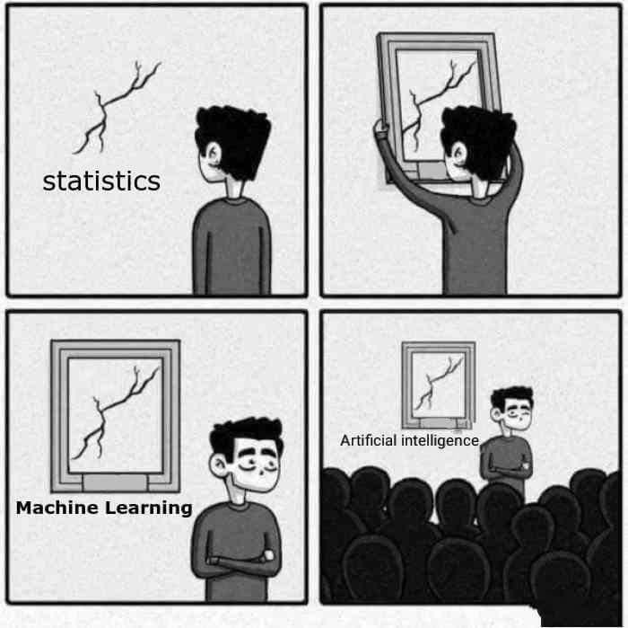
BIG
DATA

Slide 3
Table of Contents
Every session: community.cloud.databricks.com and Logon
In Left-pane, Click on 'Clusters' or 'Compute' and Terminate old Cluster Then click 'Create Cluster' button to create New one
Mod 00 – Intro and Setup
Mod 01 – Spark Architecture
Mod 02 – SparkSQL (Read/Write DataFrames/Tables)
Hacktivity 00 (Dates) / Hacktivity 01 (Air)
Mod 03 – SparkSQL (Transform)\
Mod 04 – Complex Data Types
Mod 05 – JSON (Optional)
Hacktivity 02 (Fly)
Mod 06 – Streaming
Mod 07 – Architecture-Spark UI
Mod 08 – Catalog-Catalyst-Tungsten
Mod 09 – Adaptive Query Execution
Mod 10 – Performance Tuning
Hacktivity 03 (Stream) / Hacktivity 04 (Air)
Mod 11 – Machine Learning

Slide 4
Module 08 – Catalog, Catalyst and Tungsten

Slide 5
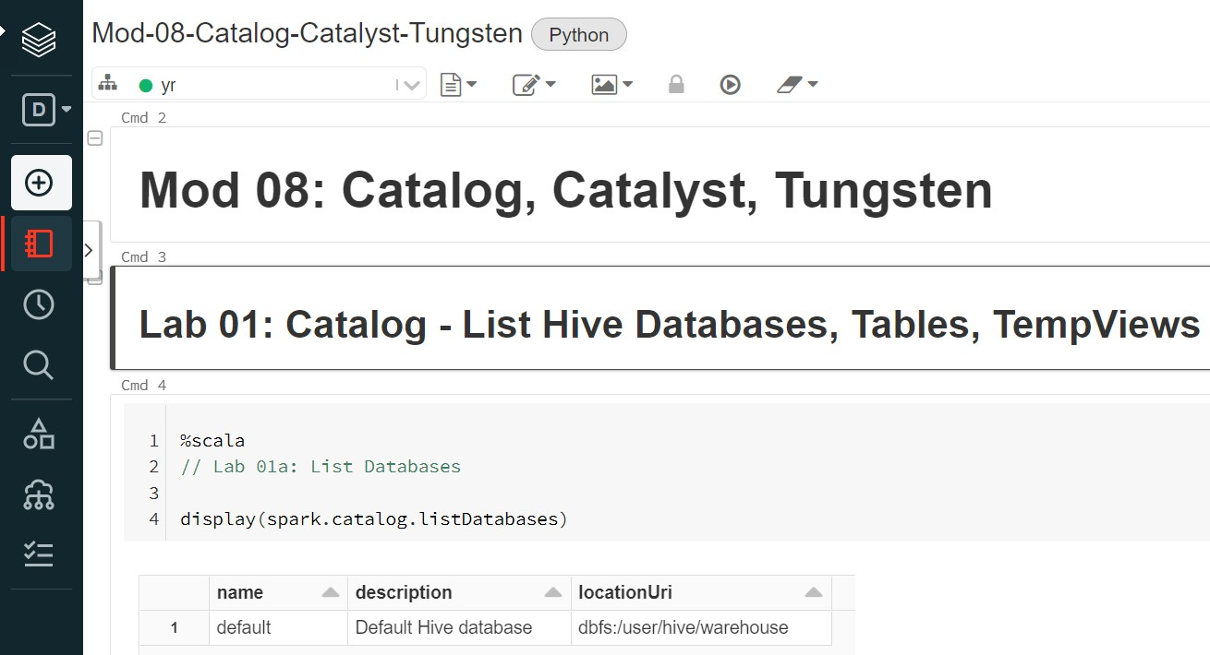
Before We Begin: Open Mod08 Notebook
3

Slide 6
Objectives
4
After completing this module, you will learn about:
Spark Catalog
List Hive tables and Spark Views
List column names on Table
List Spark functions
Catalyst Optimizer functionalities including:
Dropping hints to Optimizer
Column pruning and Predicate pushdown
Tungsten Encoder functionalities including:
Binary processing
Improved memory usage
Whole-stage code generation and Vectorization

Slide 7

Topics
5
Spark Catalog
List Hive tables and Spark Views
List column names on Table
List Spark functions
Catalyst Optimizer
Moving Filters
Dropping Hints
Pruning and Predicates
Tungsten
Overview and Binary Processing
Memory Management
Whole-stage code generation
Parquet Vectorization

Slide 8
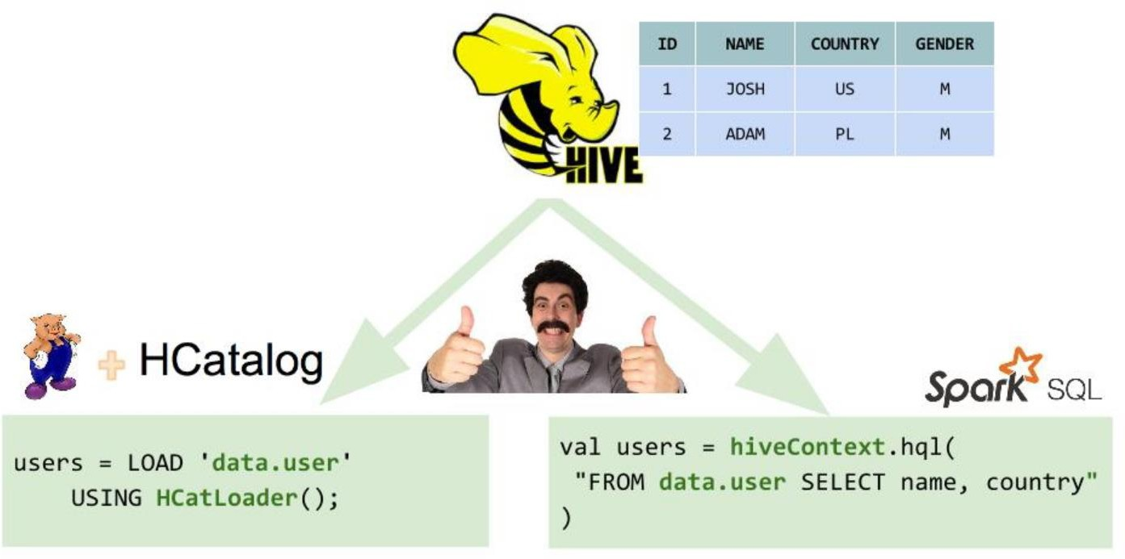
Spark HCatalog Overview
6
One of the important aspects of structured data analysis is managing metadata. It may be temporary metadata like temp table, registered udfs on SQL context or permanent metadata like Hive meta store or HCatalog
Since Spark 2.0, Spark has added a standard API called Catalog for accessing metadata in spark SQL. This works both for spark sql and Hive metadata

Slide 9
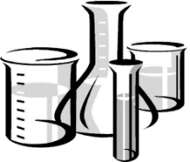
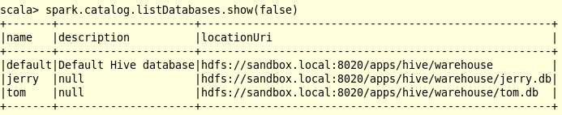
Lab 01a/b
Catalog: List Hive Databases
7
One of the important aspects of structured data analysis is managing metadata. Spark
2.x changes all of this. It has exposed a catalog API which works for both:
─ Spark SQL (registered UDFs, Spark Views)
─ Hive (HCatalog)
Suppose you want to view all the Hive database names
Scala Python
spark.catalog.listDatabases.show(false)
print(spark.catalog.listDatabases())
http://blog.madhukaraphatak.com/introduction-to-spark-two-part-4/ http://blog.madhukaraphatak.com/migrating-to-spark-two-part-8/

Slide 10
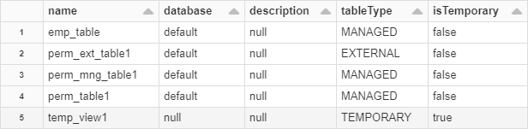
Lab 01c
Catalog: List Hive Tables, Spark TempViews
8
Scala
Python
spark.catalog.listTables.show(100,false)
print(spark.catalog.listTables())

Slide 11



Lab 01 – Other Catalog commands
9

Slide 12
Topics
10
Spark Catalog
List Hive tables and Spark Views
List column names on Table
List Spark functions
Catalyst Optimizer
Moving Filters
Dropping Hints
Pruning and Predicate Pushdown
Tungsten
Overview and Binary Processing
Memory Management
Whole-stage code generation
Parquet Vectorization

Slide 13
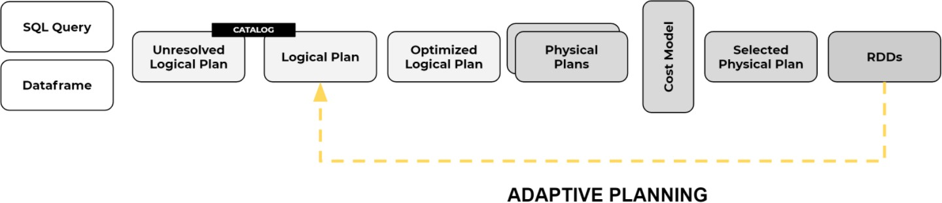
Catalyst Optimizer Overview (1 of 2)
11
DataFrames (DF) , Spark Views and Datasets are Spark SQL objects and all use the Catalyst Optimizer and Tungsten encoder. RDDs do not. There are 5 Plans:
Adaptive Query Execution (AQE)
Based on Statistics, AQE can change Query Plan and have it re-submitted for further Optimizations (more on that in another Module)

Slide 14
Catalyst Optimizer Overview (2 of 2)
12
DataFrames (DF) , Spark Views and Datasets are Spark SQL objects and all use the Catalyst Optimizer and Tungsten encoder. RDDs do not. There are 5 Plans:
Adaptive Query Execution (AQE)
The next few slides will demonstrate Catalyst capabilities for:
Optimizes user code for more efficient processing
More performant join strategy Dropping hints to Optimizer
Column pruning (Filter columns)
Predicate pushdown (Execute code on remote system)

Slide 15

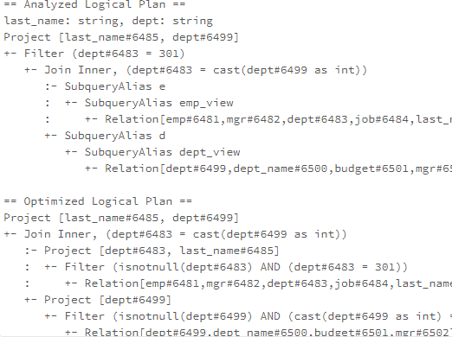
Lab 02b-c
Catalyst: Join on 2 Spark Views (1 of 2)
13
Putting the WHERE clause after the JOIN is inefficient. Why go to all the trouble of JOINing the rows only to throw most of them away with the WHERE clause afterwards
In Analyzed Plan (reading from top to bottom), JOIN done first, followed by Filter. This is inefficient code.
In Optimized Plan, Catalyst moves Filter in
front of the JOIN for better Performance

Slide 16
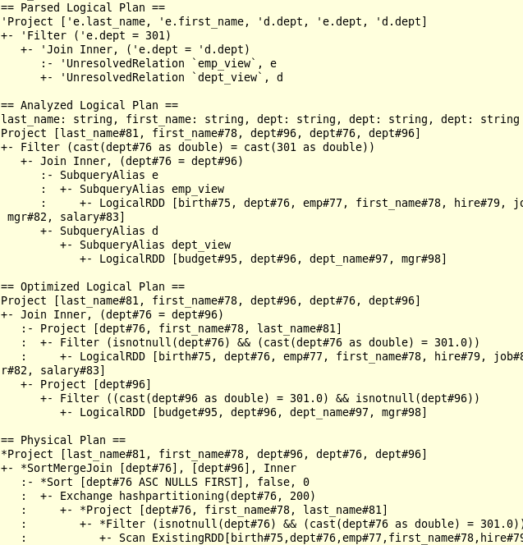
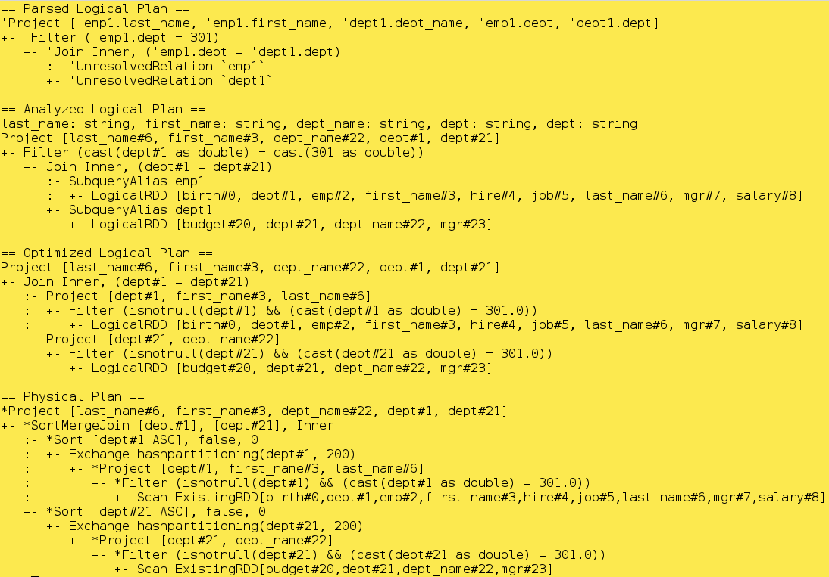
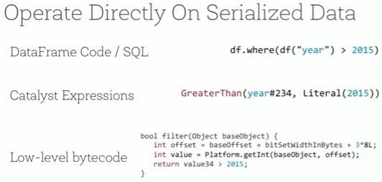
Here's a more complete View
Catalyst: Join on 2 Spark Views (2 of 2)
14
1
As you wrote it. Filter after JOIN
2
Add in data types and CAST as needed. Filter still after JOIN
3
Move FILTER before JOIN
4
Determine Join strategy

Slide 17
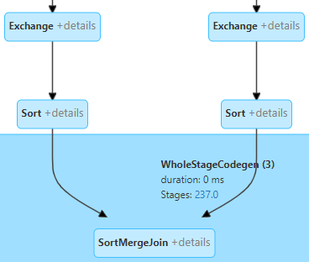
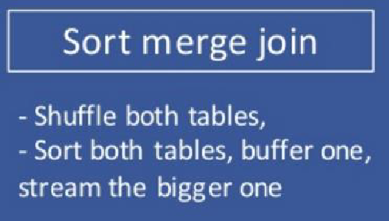
Lab 02d-i
SortMergeJoin
15
SortMergeJoin is most typical JOIN used by Spark when Tables > 10MB. But like most Joins, SortMergeJoin incurs Shuffle
Exchange = Shuffle
A SortMergeJoin, ensures like 'keys' are in the same partition, and inside each partition Rows are sorted by key. Then we can run down both sides together, find matched rows

Slide 18
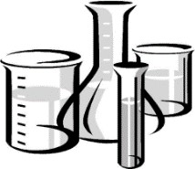
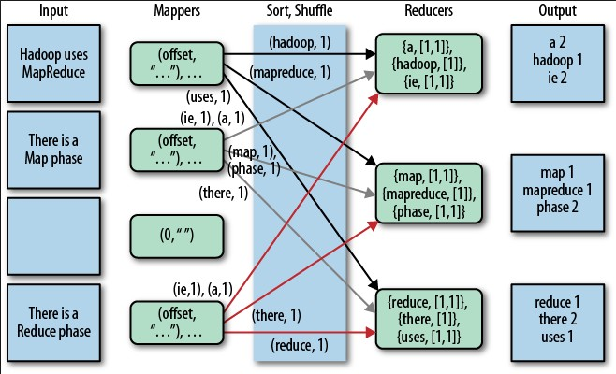
Shuffle (Exchange) Incurs 3 Penalties
16
Disk I/O
Network traffic
Serialize/Deserialize
Java->Binary Binary->Java
Shuffles can occur in Joins, Aggregations

Slide 19
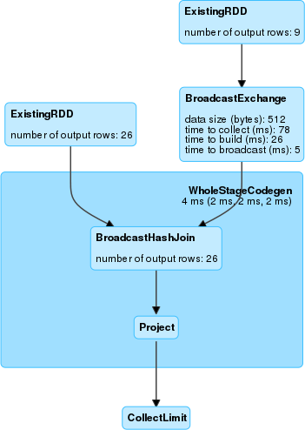
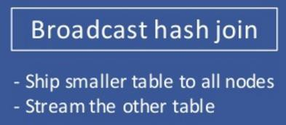
Lab 02d-i
Changing Join Strategy to BroadcastHashJoin
17
What if we could tell Catalyst Optimizer to use different Join Strategy?
Typically, more Performant than a SortMergeJoin since I avoid normal Shuffle. And completely do away with Sort

Slide 20
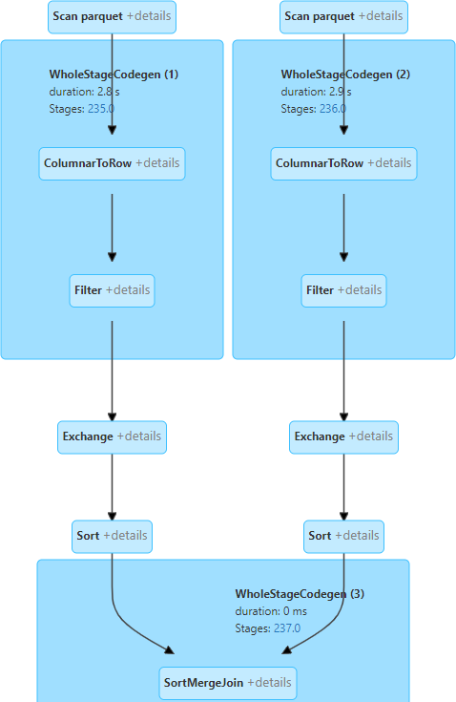
Lab 02d-i
Dropping Hints to Catalyst – Without Hint
18

Slide 21
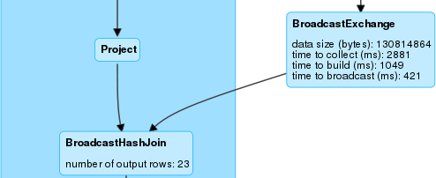
Lab 02d-i
Dropping Hints to Catalyst – With Hint
19
First, we'll change the default size limit from 10MB to 50MB
Then we'll drop the hint in the Join clause
Compare Clock time between 2 Join Strateges

Slide 22
Catalyst: Column Pruning Concepts
20
The idea behind this feature is simple: just read the data for columns that the query needs to process and skip the rest of the data
Column-oriented data formats like Parquet and ORC can implement this feature naturally. This contrasts with Row-oriented data formats (CSV), typically used in relational databases and/or systems where optimizing for single row insert and updates are at a premium
Column pruning can provide an important reduction of the work needed to read the table and result in performance gains. The actual performance gain depends on the query, in particular on the fraction of the data/columns that need to be read to answer the business problem behind the query

Slide 23
Catalyst: Column Pruning Concepts
21
The idea behind this feature is simple: just read the data for columns that the query needs to process and skip the rest of the data
Column-oriented data formats like Parquet and ORC can implement this feature naturally. This contrasts with Row-oriented data formats (CSV), typically used in relational databases and/or systems where optimizing for single row insert and updates are at a premium
Column pruning can provide an important reduction of the work needed to read the table and result in performance gains. The actual performance gain depends on the query, in particular on the fraction of the data/columns that need to be read to answer the business problem behind the query

Slide 24
Catalyst: Column Pruning Concepts
22
The idea behind this feature is simple: just read the data for columns that the query needs to process and skip the rest of the data
Column-oriented data formats like Parquet and ORC can implement this feature naturally. This contrasts with Row-oriented data formats (CSV), typically used in relational databases and/or systems where optimizing for single row insert and updates are at a premium
Column pruning can provide an important reduction of the work needed to read the table and result in performance gains. The actual performance gain depends on the query, in particular on the fraction of the data/columns that need to be read to answer the business problem behind the query

Slide 25
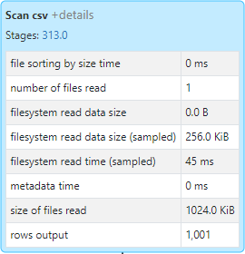
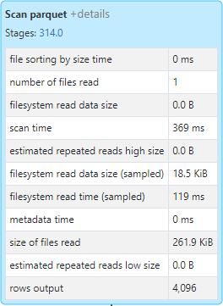
Lab 03
Catalyst: Column Pruning Demo
23
When using Columnar storage files (Parquet, ORC, Delta), Spark can automatically do Column pruning for you
CSV – Non-Columnar Delta (Parquet) – Columnar

Slide 26
Catalyst: Predicate Pushdown Concepts
24
When you execute WHERE or FILTER operators right after loading a dataset, Spark SQL will try to push the where/filter predicate down to the data source using a corresponding SQL query with WHERE clause
This optimization is called filter pushdown or Predicate pushdown and aims at pushing down the filtering to the "bare metal", i.e., a data source engine. The filtering is performed at the very low level rather than dealing with the entire dataset after it has been loaded to Spark’s memory and perhaps causing memory issues
Benefits include:
Less data shuffled between systems
Less RAM utilization in Spark
Less data serialization

Slide 27


Lab 04
Catalyst: Predicate Pushed Filters
Note: Must drill down under 'Spark Jobs' > View > SQL tab > Details to see 'PushedFilters'
2
5

Slide 28
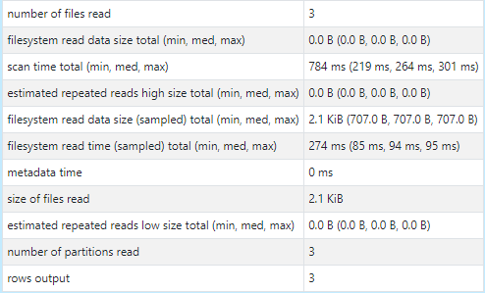
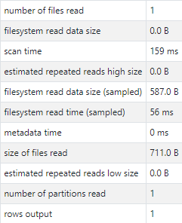
Lab 05a-f
Catalyst: Partition Pruning on Table
26
Non-Partitioned Table Partitioned Table

Slide 29
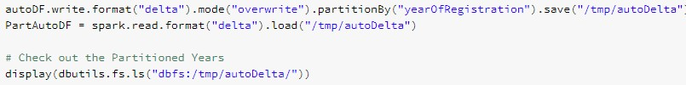
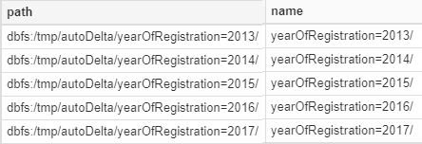
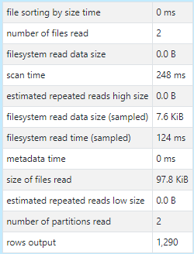
Lab 05g-h
Catalyst: Partition Pruning on DataFrame
27

Slide 30
Topics
28
Spark Catalog
List Hive tables and Spark Views
List column names on Table
List Spark functions
Catalyst Optimizer
Moving Filters
Dropping Hints
Pruning and Predicates
Tungsten
Overview and Binary Processing
Memory Management
Whole-stage code generation
Parquet Vectorization

Slide 31
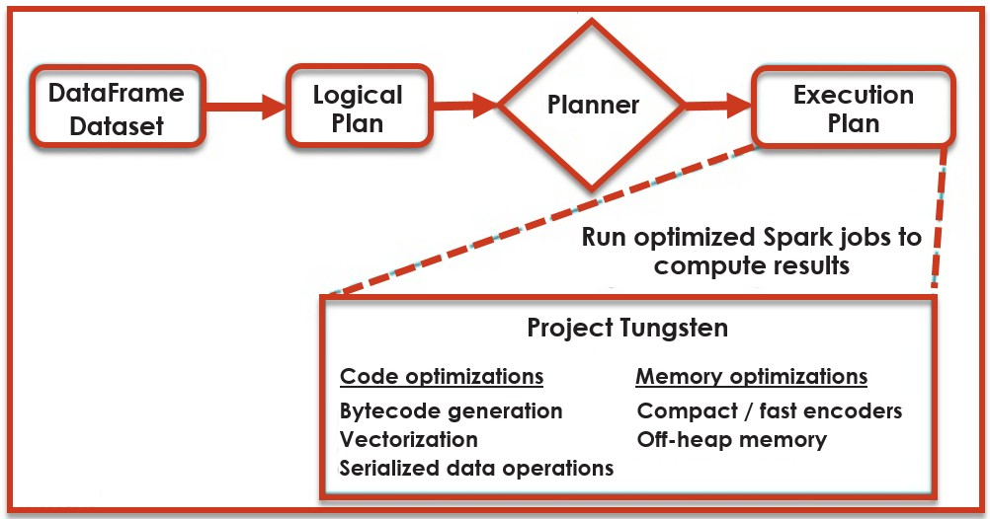
Tungsten Overview
29
Project Tungsten will be the largest change to Spark’s memory execution engine since the project’s inception. It focuses on substantially improving efficiency of memory and CPU for Spark applications, to push performance closer to the limits of modern hardware. This effort includes three initiatives:
Binary Processing: leveraging application semantics to manage memory explicitly and
eliminate the overhead of JVM object model and minimize garbage collection
Improved Memory Usage
Whole-stage Code generation: Using code generation to exploit modern compilers/CPUs, including Vectorization

Slide 32
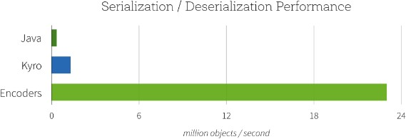
Tungsten: Binary Processing
30
The Encoder is responsible for converting between JVM objects and tabular representation
Encoders serialize data (into binary format) 8x faster than Kryo and 20x faster than JAVA
In addition to speed, the resulting serialized size of encoded data can be significantly smaller (up to 2x), reducing the cost of network transfers
Furthermore, the serialized data is already in the Tungsten binary format, which means that many operations can be done in-place, without need to materialize a Java object at all
Serialization/Deserialization Performance
Java Kyro Encoder
Since can process data in binary format in off-heap memory (instead of deserializing as JAVA object), minimize overhead of JAVA Garbage Collection (which is 'stop-the-world' event)

Slide 33
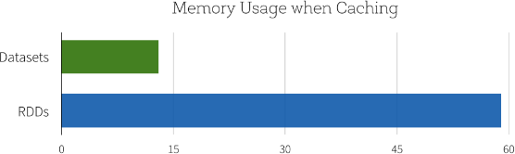
Tungsten: Improved Memory Usage
31
Another benefit of this new Dataset API is the reduction in memory usage. Since Spark understands the structure of data in Datasets, it can create a more optimal layout in memory when caching Datasets
Memory Usage when Caching
Datasets
RDDs
0
15
30
45

Slide 34
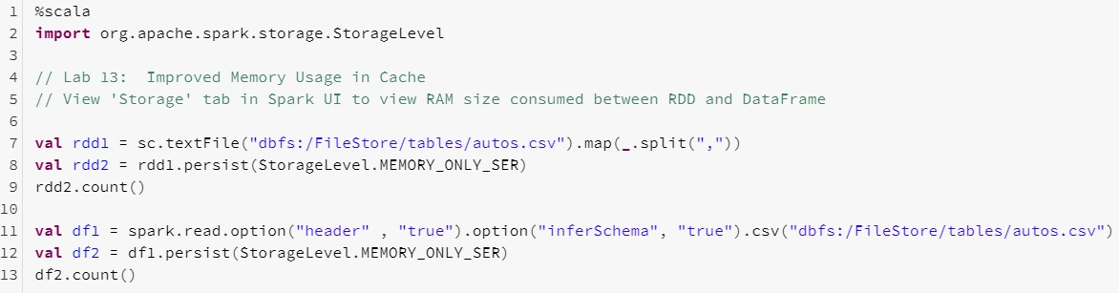
Lab 06a
Tungsten: Improved Caching
32
First create both an RDD and a DataFrame using the same underlying file.
Next persist it in RAM

Slide 35
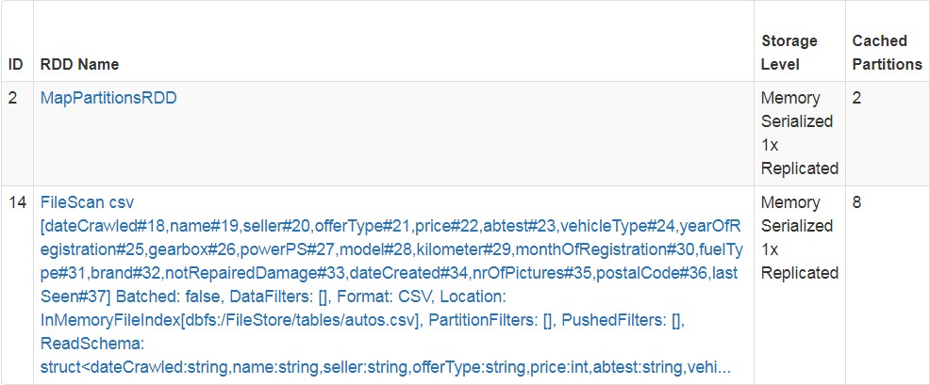
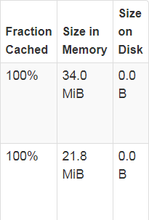
Lab 06b
Tungsten: Improved Caching
33
From the Spark UI, go the 'Storage' tab to compare the RAM size.
RDD's cannot take advantage of Tungsten. But Tungsten can store DataFrames and Tables more efficiently as shown here

Slide 36
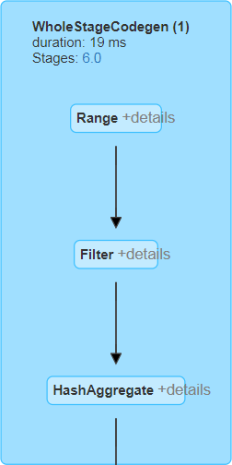
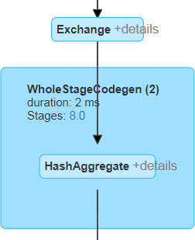
Lab06c
Tungsten: WholeStage Code Generation
34
Whole-Stage Code Generation fuses multiple operators (as a subtree of plans that support code generation) together into a single Java function that is aimed at improving execution performance
It collapses a query into a single optimized function that eliminates function calls and leverages CPU registers (instead of slower RAM and cache) for intermediate data
Project Tungsten uses sun.misc.unsafe API for direct memory access to bypass the JVM in order to avoid Garbage Collection. It operates directly on serialized binary data without the need to Deserialize

Slide 37
Summary
35
After completing this module, learned about:
Spark Catalog
List Hive tables and Spark Views
List column names on Table
List Spark functions
Catalyst Optimizer functionalities including:
Dropping hints to Optimizer
Column pruning and Predicate pushdown
Tungsten Encoder functionalities including:
Binary processing
Improved memory usage
Whole-stage code generation and Vectorization

