Slide 1



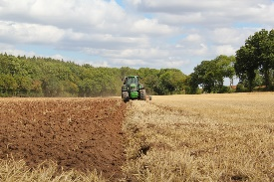

C7084 Big Data
Ed Harris
QUERY
DATA
Knowledge

Slide 2
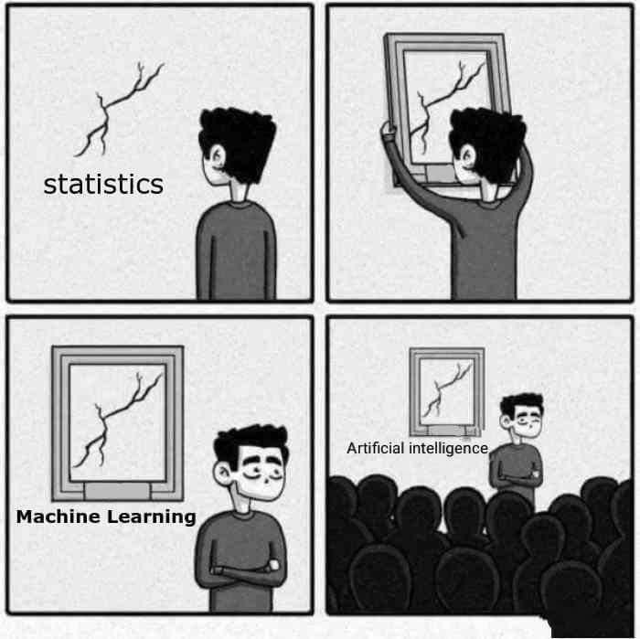
BIG
DATA

Slide 3
Table of Contents
Don't forget to start recording
Every session: community.cloud.databricks.com and Logon
In Left-pane, Click on 'Clusters' or 'Compute' and Terminate old Cluster Then click 'Create Cluster' button to create New one
Mod 00 – Intro and Setup
Mod 01 – Spark Architecture
Mod 02 – SparkSQL (Read/Write DataFrames/Tables)
Hacktivity 00 (Dates) / Hacktivity 01 (Air)
Mod 03 – SparkSQL (Transform)\
Mod 04 – Complex Data Types
Mod 05 – JSON (Optional)
Hacktivity 02 (Fly)
Mod 06 – Streaming
Mod 07 – Architecture-Spark UI
Mod 08 – Catalog-Catalyst-Tungsten
Mod 09 – Adaptive Query Execution
Mod 10 – Performance Tuning
Hacktivity 03 (Stream) / Hacktivity 04 (Air)
Mod 11 – Machine Learning

Slide 4

Mod 00 - Intro and setup
What you will learn
After completing this, you will have hands-on exposure to:
Spark architecture
Reading and Writing DataFrames, Tables and TempViews
Spark SQL Transformations and Action
Complex Data types (Array, Map, Structs, JSON)
Spark Streaming
Interpreting Spark UI
Catalog, Catalyst, and Tungsten
Adaptive Query Execution (AQE)
Performance Tuning
Spark Machine Learning

Slide 5
Prerequisites
This course is designed for:
Students of data science, applied scientists, other interesting people
Prerequisites
Python coding recommended
Linux command line experience recommended
Experience with Cloud technology (Google, AWS or Azure)

Slide 6

Introductions
If we do not know each other, Before we begin our Voyage of Discovery …
Your Name
Experience with Python
Expectations

Slide 7

Before we Begin: Training environment
You are here
AWS cloud
Spark cluster

Slide 8
Before we Begin: Files you'll need
All files are up on the module website
Unzip any files (Syllabus, Labs, Files and PDF courseware)
You’ll eventually need to upload the Lab Files and Notebooks to your Spark server

Slide 9
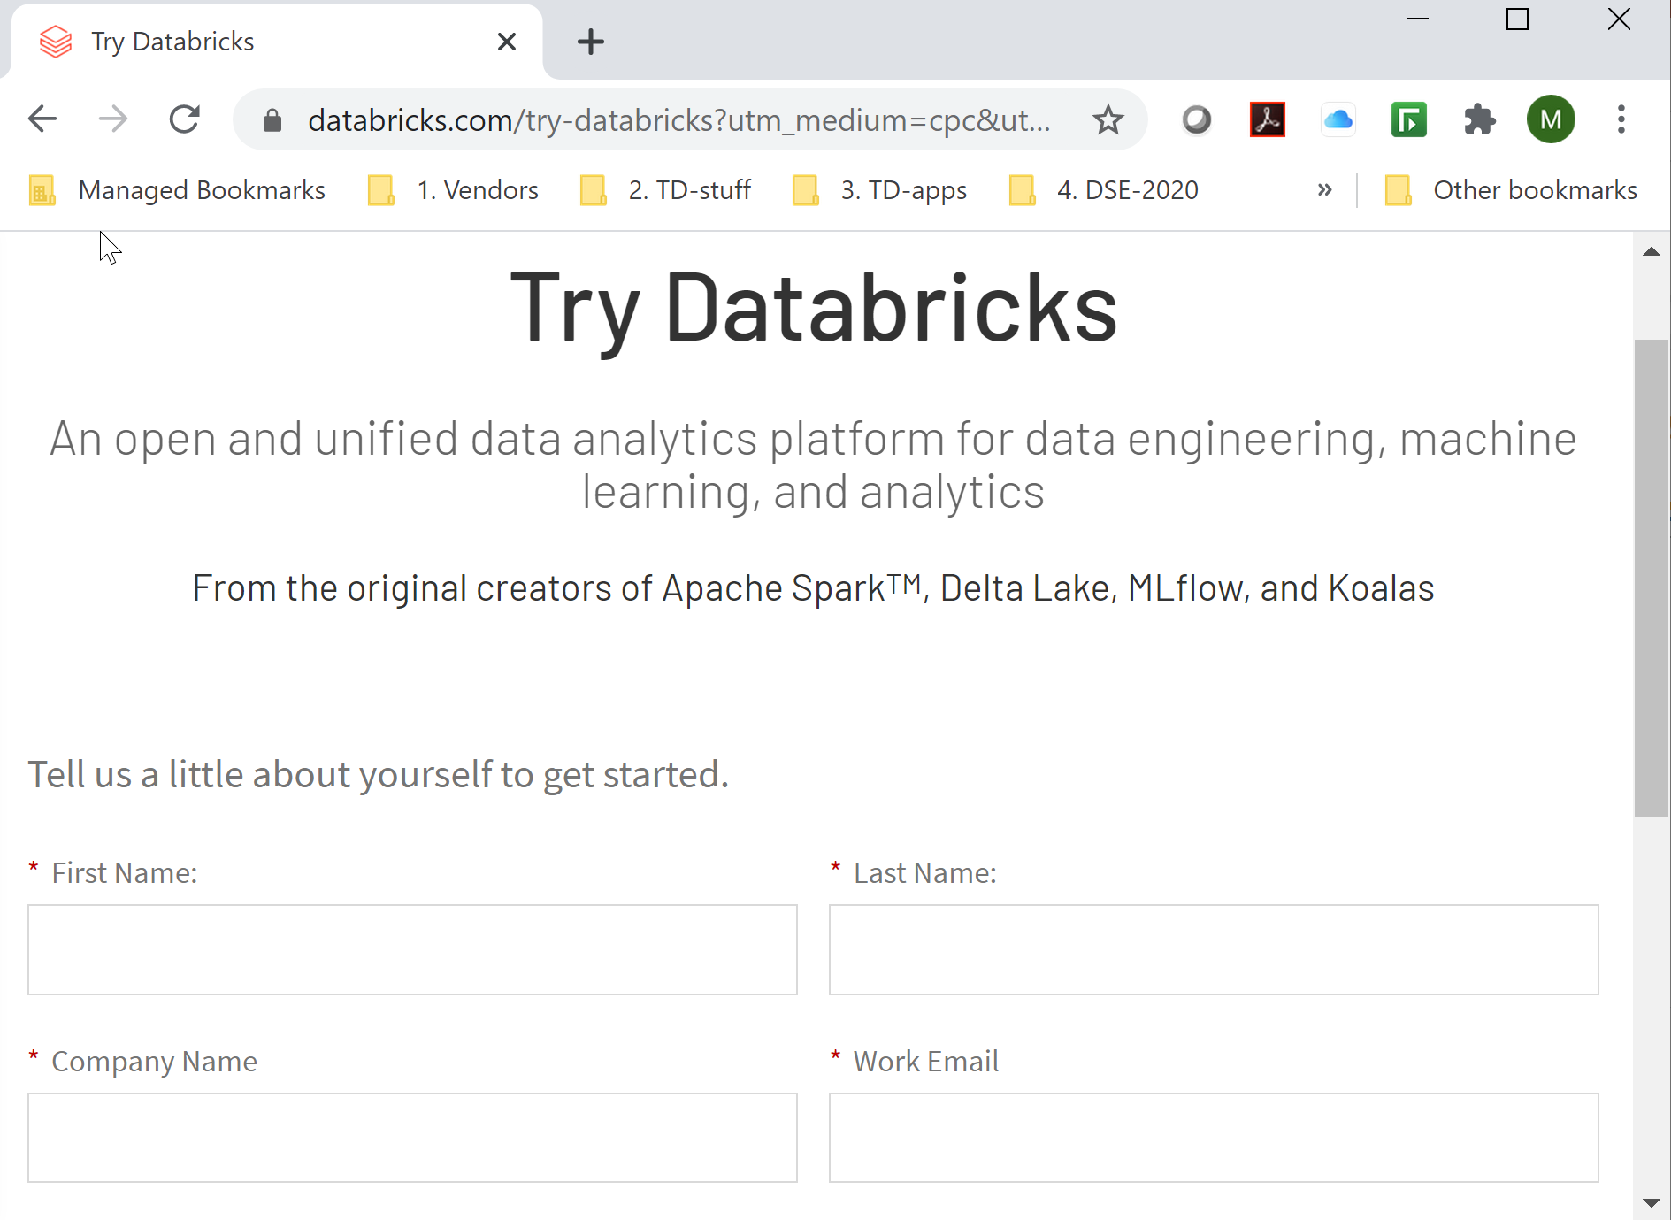
Lab 01a: Setup your Databricks Community Edition Instance
Go to : databricks.com and create an Account now. Ensure you sign up for the Community Edition which is free
(the other Instances charge you a fee). Then Sign Up
Preferred email
Harper Adams University

Slide 10
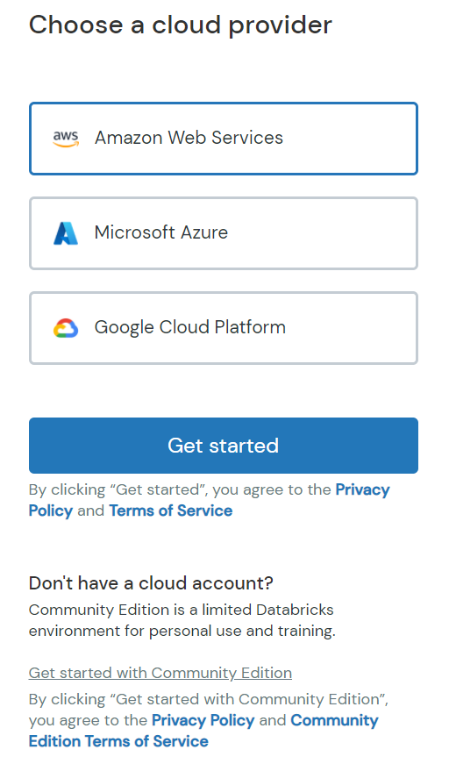
Lab 01b: Access Community Edition
Make sure you sign up for the 'Community Edition' only
(Screen shot may vary from what's shown)
Click here

Slide 11
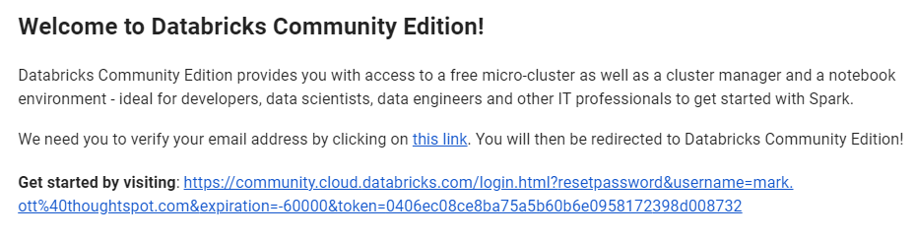
Lab 01c: Here's the Email you'll get
Databricks will send you an Email. Sometimes this email will be delayed for an hour or so
If you don't get the email after 4 hours, then something is wrong.
Once get Email, Click on 'this Link' to continue

Slide 12
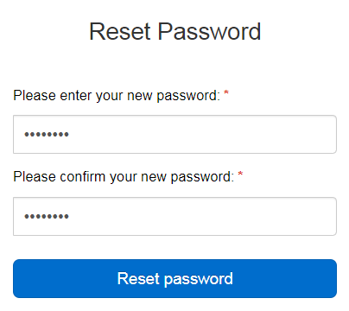
Lab 01d: Reset Password
Create a Password.
Maybe use your UC Password so it's easy to remember?

Slide 13
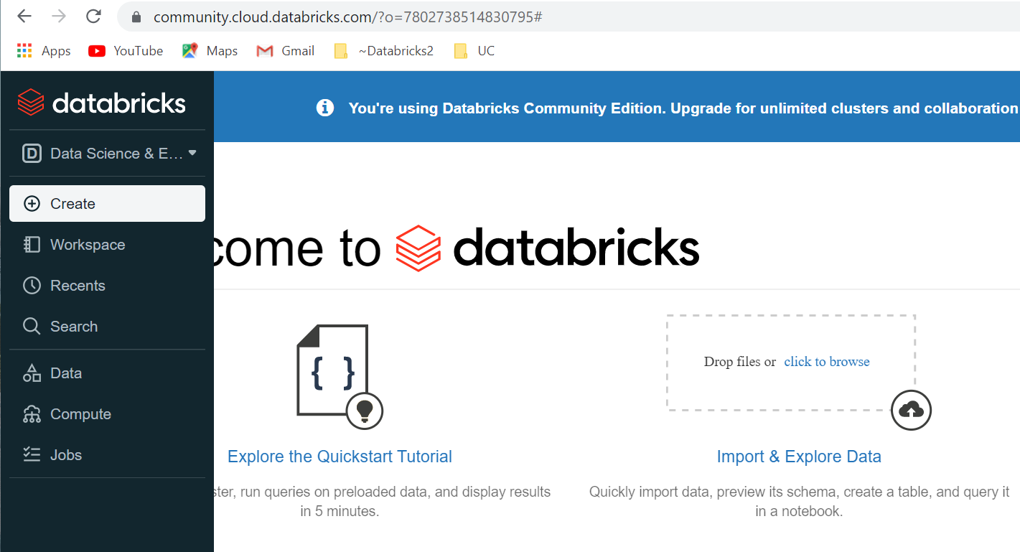
Lab 01e: Databrick UI
Click on Databricks logo, then click ' Explore the Quickstart Tutorial'.
Follow directions to attach the Cluster and run all Cells

Slide 14

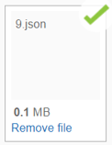
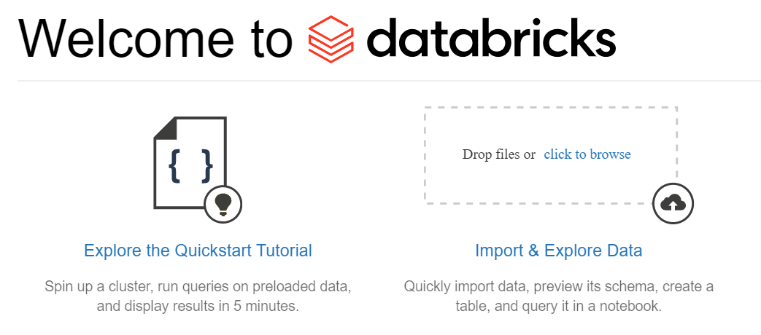
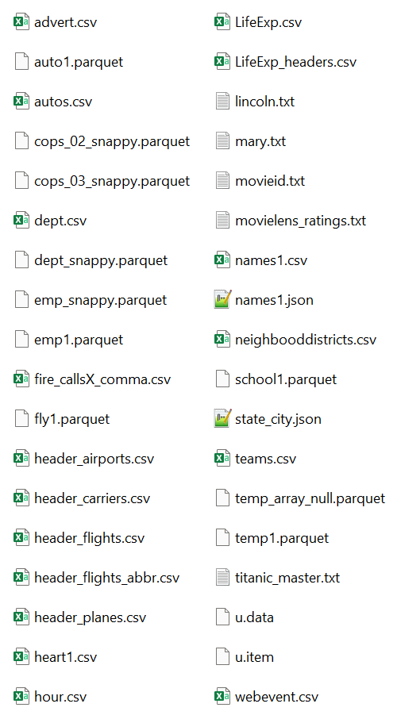
Lab 01f: Copy files to your Cluster
In left-side Vertical pane, select top Icon
First unzip DB-Files.zip (from our website) and drop files on 'Drop files' link
Wait until all 36 files have Green checkbox (may take an hour to upload)
Note: You will be unable to copy files over unless you first have an Active Cluster. This step should have been completed in Lab 01e
Do NOT drag the files over a 2nd time as this will create double the files in the Cluster. Just confirm see Green check

Slide 15

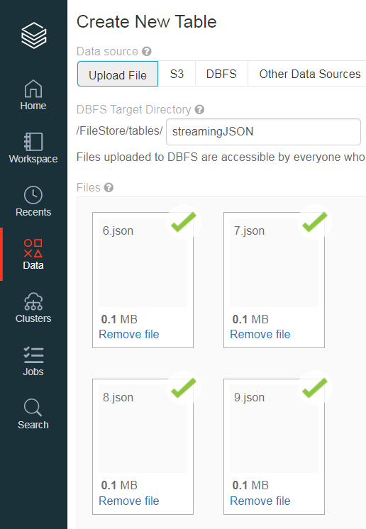

Lab 01g: Creating 2 Folders (stream1 and sfpd1), then nest Files in these folders
First unzip the stream1.zip file (it has 20 files)
From Databricks, click Data icon,
Then click 'Create Table' button (not shown in screen shot)
In FileStore/tables/ directory,
type: stream1
Then drag 20 files from ZIP file into the 'Drop files to upload' caption
Wait until see Green checkbox on every file
Repeat using the sfpd1.zip file.
In FileStore/tables/ directory,
type: sfpd1 Then drag 32 files from ZIP file into the 'Drop files to upload' caption

Slide 16

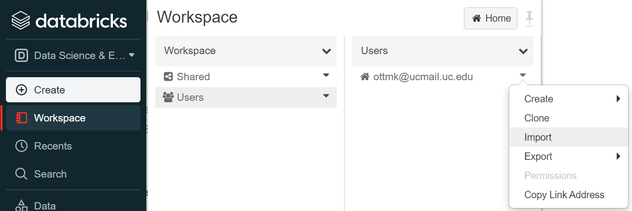
Lab 01h: Import -UC-Final.dbc as Notebook
In left-side Vertical pane, select Workspace Icon.
Go to Workspace > Users > Your E-mail User > Import
<Your email>

Slide 17
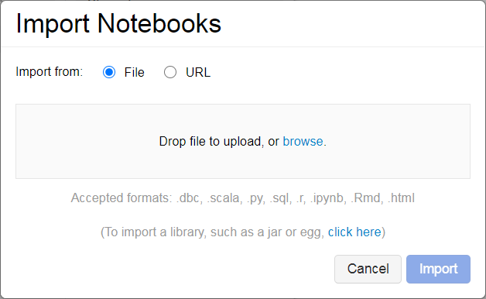
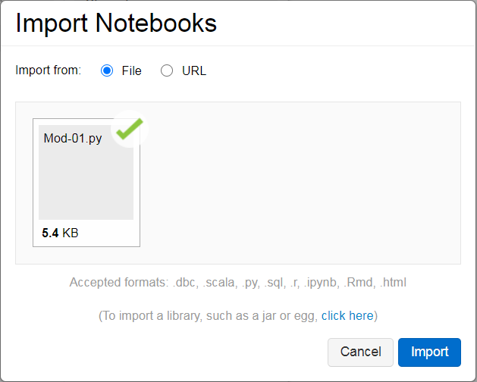
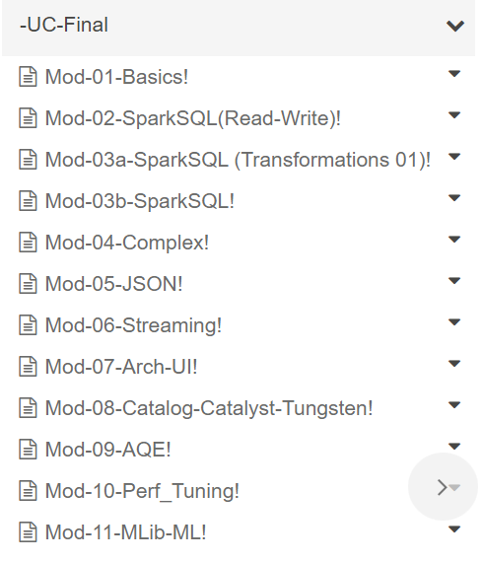
Lab 01i: Import -UC-Final.dbc as Notebook
Drop one -UC-Final.dbc file on the 'Drop file to upload' hotlink.
Then click the 'Import' button. When finished will look like this

Slide 18
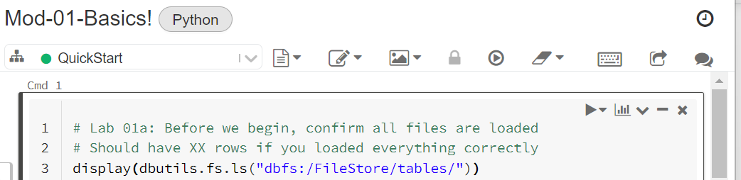
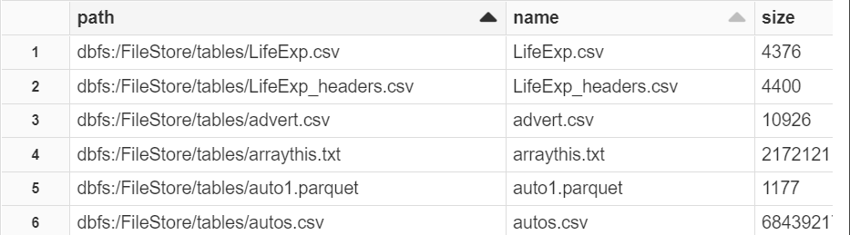
Lab 01j: Open Mod-01 Notebooks
Click on Workspace icon. Then go to 'Workspace' v ' Shared' and click on 'Mod-01-Basics!' to open Notebook
Ensure 'QuickStart' cluster is selected in pull-down. Highlight first Cell, then click 'Run Cell' icon. You should about 39 rows if you loaded all files correctly (37 files) and (2 subfolders)

Slide 19
Lab 01k: Logout and Log back in
In upper right-hand corner, click on 'Account' icon and 'Log Out'.
Next, bookmark this URL: (https://community.cloud.databricks.com/login.html)
Now 'Sign in' using your UC email account and password you created earlier. Go back to Workspace icon and from Mod-01, run Cell 1 again.
If everything works as it did earlier, you are good to go

Slide 20
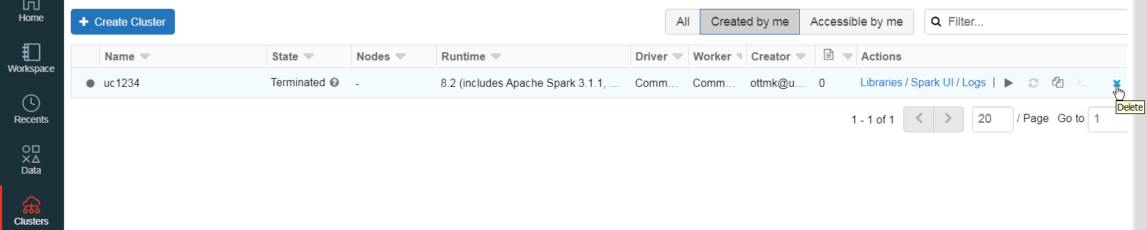
One more thing
Your Cluster will Time Out after 2 hours on inactivity. This means you won't be able to run any queries from your Notebooks until you do the following:
In vertical Toolbar, Click on Clusters icon
Delete your inactive Cluster by going to far right and clicking on X icon
Next click the Create Cluster button to create a new Active cluster
You will need to do this every time

Slide 21

Done with Introduction and Setup

