Slide 1





C7084 Big Data
Ed Harris
QUERY
DATA
Knowledge

Slide 2

BIG
DATA

Slide 3
Table of Contents
Don't forget to start recording
Every session: community.cloud.databricks.com and Logon
In Left-pane, Click on 'Clusters' or 'Compute' and Terminate old Cluster Then click 'Create Cluster' button to create New one
Mod 00 – Intro and Setup
Mod 01 – Spark Architecture
Mod 02 – SparkSQL (Read/Write DataFrames/Tables)
Hacktivity 00 (Dates) / Hacktivity 01 (Air)
Mod 03 – SparkSQL (Transform)\
Mod 04 – Complex Data Types
Mod 05 – JSON (Optional)
Hacktivity 02 (Fly)
Mod 06 – Streaming
Mod 07 – Architecture-Spark UI
Mod 08 – Catalog-Catalyst-Tungsten
Mod 09 – Adaptive Query Execution
Mod 10 – Performance Tuning
Hacktivity 03 (Stream) / Hacktivity 04 (Air)
Mod 11 – Machine Learning

Slide 4
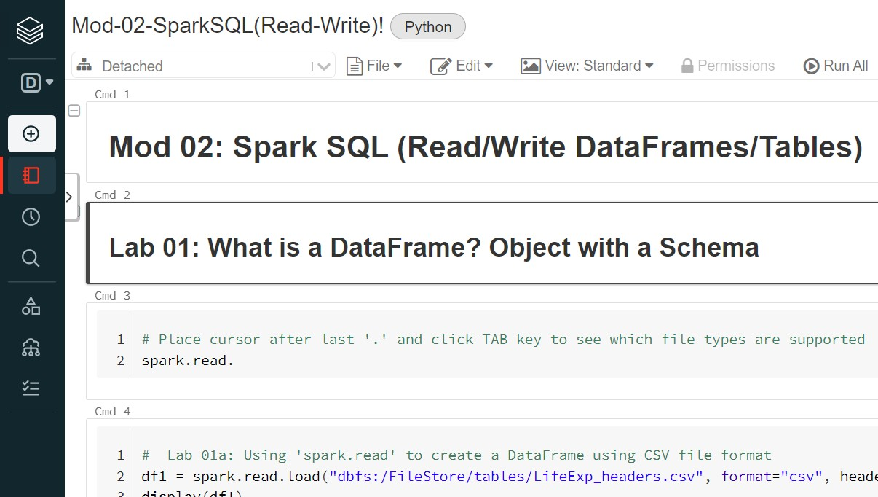
Before we Begin: Open Notebook Mod-02

Slide 5
Module 02 – Spark SQL
After completing this module, you'll be able to work with Spark SQL including:
What is Spark SQL?
DataFrames
Tables
TempViews (Datasets, GlobalViews)
DataFrame API Python, Scala, Java, R
SQL
The Catalyst Optimizer
What is Hive?
Creating DataFrames from five sources including:
Structured files, parallelize(), textFile(), Hive and mySQL
CREATE TABLE function (Partition Tables and Bucket Tables)
CreateOrReplaceTempView function and GlobalTempViews
Code displayed will be Python unless noted otherwise in Title bar

Slide 6
What is Apache Spark SQL?
Spark SQL brings native support for SQL to Spark and streamlines the process of querying data stored both in RDDs (and in external sources)
Spark SQL conveniently blurs the lines between RDDs and relational tables. Unifying these powerful abstractions makes it easy for developers to intermix SQL commands querying external data with complex analytics, all within in a single application
Concretely, Spark SQL will allow developers to:
Import relational data from Parquet files and Hive tables
Run SQL queries over imported data and existing RDDs
Easily write RDDs out to Hive tables or Parquet files
Spark SQL also includes a Cost-based optimizer (Catalyst), columnar storage, and code generation to make queries fast
Bottom line: Spark SQL refers to both DataFrames and Tables/Views.
And there is a 3rd object called DataSets (Scala only)

Slide 7
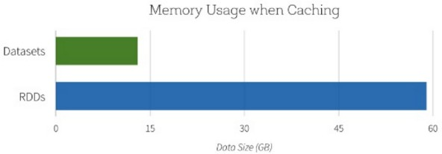
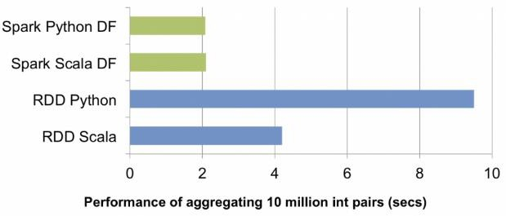
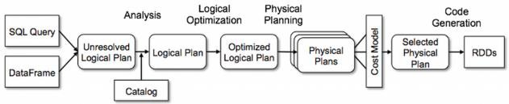


Spark SQL uses Catalyst Optimizer/Tungsten
Spark SQL uses the knowledge of the data types to more efficiently represent the data. For example, when caching data, it uses an in- memory columnar storage. In addition, instead of reading the entire data like the MapReduce engine normally does, Spark SQL can prune the data resulting in less Disk I/O
Spark SQL uses the Catalyst optimizer which contains a general library for representing trees and applying rules to manipulate them. It can perform predicate push-down to optimize the query. In addition, Catalyst can efficiently serialize/deserialize JVM object using Tungsten Encoders that creates compact bytecode that can execute at superior speeds
DataSet
Also get push-down operations to remote data store (predicate pushdown, Index, etc)

Slide 8
What is Apache Hive?
http://hive.apache.org
A Data warehousing infrastructure based on Hadoop
Hive QL, which is an SQL-like language, enables users familiar with SQL
to do ad-hoc querying, summarization and data analysis easily
At the same time, Hive QL also allows traditional map/reduce programmers to be able to plug in their custom mappers and reducers to do more sophisticated analysis that may not be
supported by the built-in capabilities of the language
Invented at Facebook. Open sourced to Apache in 2008

Slide 9

Hive integration with Spark
Spark SQL can read and write data stored in Apache Hive
Hive has certain drawbacks. Initially, due to MapReduce jobs underneath, this process is slow. Secondly, it is only suitable for batch processing, and not for interactive queries or iterative jobs
Spark SQL, on the other hand, addresses these issues remarkably well. We can directly access Hive tables on Spark SQL and use SQLContext queries or DataFrame APIs to work on those tables. The process is fast and highly efficient compared to Hive

Slide 10
Spark SQL and the three APIs
Spark SQL is a Spark module for structured data processing. Unlike the basic Spark RDD API, the interfaces provided by Spark SQL give you more information about the structure of both the data and the computation being performed
Internally, Spark SQL uses this extra information to perform additional optimizations. There are several ways to interact with Spark SQL including:
DataFrame API
Hive API
via toDF() and createDataFrame() function
via spark.table(), Spark can integrate into Hive and create Hive tables from Spark DataFrame. Once created, users can access tables globally (don't need to login to Spark)
via CREATE TABLE and createOrReplaceTempView
Spark SQL API
Bottom line: Spark SQL refers to both DataFrames and Tables/Views.
And there is a 3rd object called DataSets (Scala only)

Slide 11
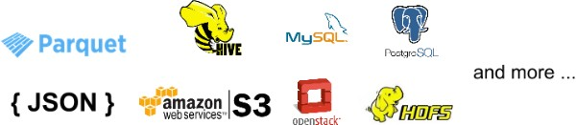
Spark SQL - Big Picture
Similar in many aspects to Apache Hive, Spark SQL allows you to query using two API versions (Data Frame and SQL)
file
CSV
Dataframe (df)
file
JSON
name | gender | age | wt | eye
Juli | female | 59 | 125 | green
Mark | male | 58 | 182 | brown
Holly | female | 25 | 130 | hazel
Andrew | male | 28 | 185 | brown
file
Spark SQL
Parquet/Delta
Hive
mySQL

Slide 12
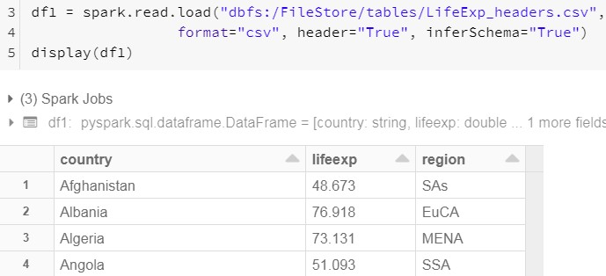
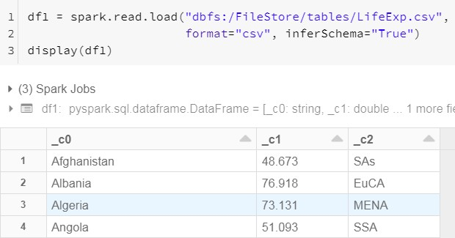
01: DataFrame Reader (spark.read)
SparkSQL provides for a special type of RDD called DataFrame (note in some documentation it is referred to as SchemaRDD)
A DataFrame is an immutable RDD of Row objects which means it knows the Column names. It is conceptually equivalent to a table in a relational database or a data frame in R/Python, but with richer optimizations (ie: can use Catalyst optimizer)
DataFrames can be constructed from a wide array of sources such as: structured data files (JSON, Parquet), existing RDDs, or Hive tables using 'spark.read' method
Column names (Explicit or Inferred)

Slide 13
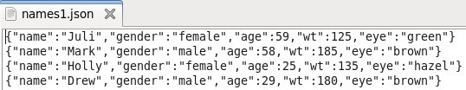
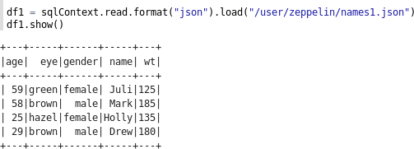
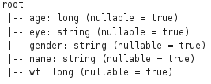
02a/b: Create DataFrame from Structured JSON file using spark.read()
file
JSON, ORC,
parquet
Here is the multi-structured JSON file we will first load into Spark
First, we read in DataFrame from an existing JSON file using the spark API
Once loaded, we can use the DataFrame API to query via the show() function
df1.printSchema() displays Schema in tree format
Spark 3.x Scala syntax: val df = spark.read.json("/user/zeppelin/names1.json").show()

Slide 14



02c: DataFrame syntax – Querying using show()
Depending on which language you are using, there are numerous ways to reference
columns in DataFrames using the DataFrame API
Here's some examples of querying a DataFrame named 'df1' using Python along with select argument
df1.select("name").show()
df1.select(df1.name).show()
df1.select(df1["name"], df1["age"]).show() df1[df1.age<50].show()

Slide 15
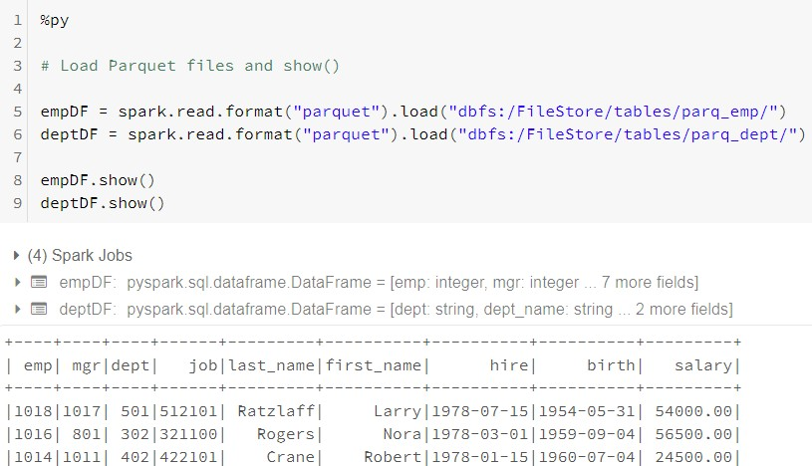
file
03: Read Parquet files using spark.read
JSON, ORC,
parquet
Here we create 2 DataFrames from existing parquet files
Unlike CSV, Parquet files have Metadata that stores
Schema automatically

Slide 16
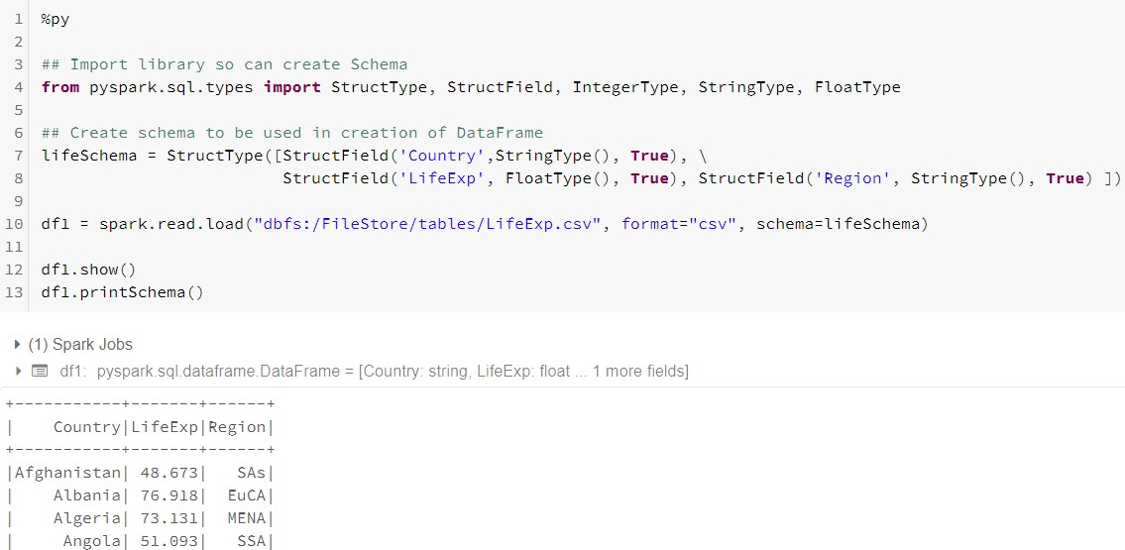
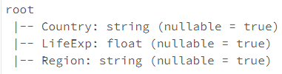
04a: spark.read.load with StructType Library and format and schema arguments
If don't have structured file (like JSON, Parquet, ORC, etc) can create Schema using StructType and apply it to the unstructured file type (like CSV)

Slide 17
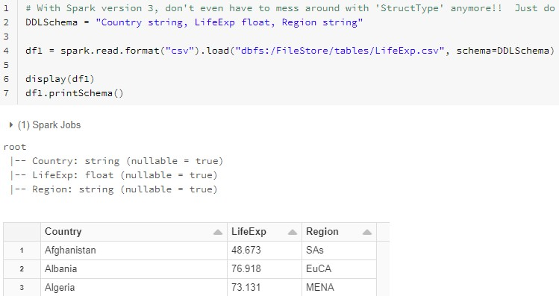
04b: spark.read with Schema hard-coded
sans StructType
With Spark 3.x, can forgo 'StructType' library when creating your Schema

Slide 18

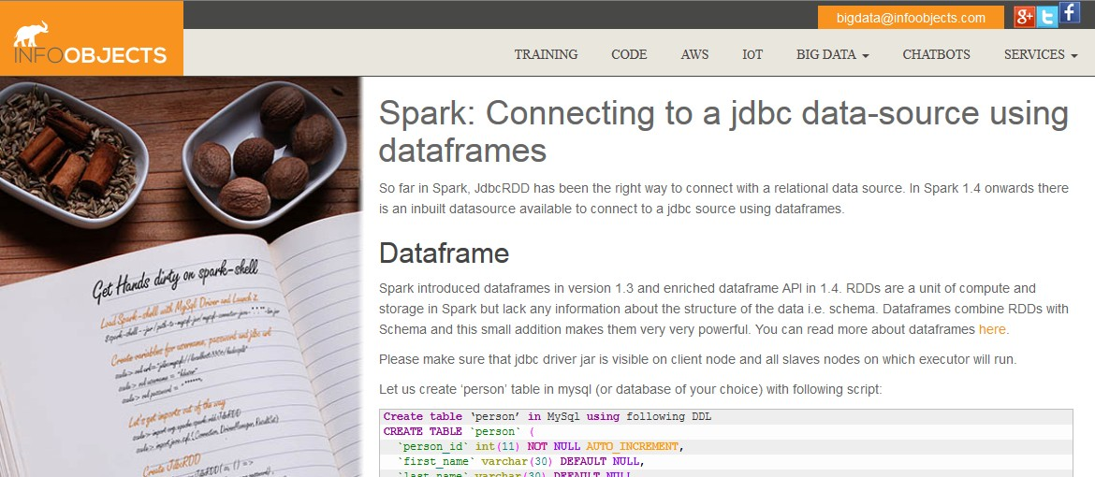
Movie: Create DF from RDBMS table using jdbc Connector to remote database
3
To connect Spark to a relational database, jdbc is the way to go
Open up 'mysql-conn.txt' file from your Desktop and follow the labs. You will
From cmd prompt, logon to mySQL and create table 'person' in 'test' database
Logon to Spark using the mySQL connector via Scala
Configure JDBC URL and mySQL properties so can connect to mySQL
Load mySQL table into Spark and run multiple queries
Save answer set into a new mySQL table
Log back into mySQL and confirm table exists
http://www.infoobjects.com/spark-connecting-to-a-jdbc-data-source-using-dataframes/

Slide 19
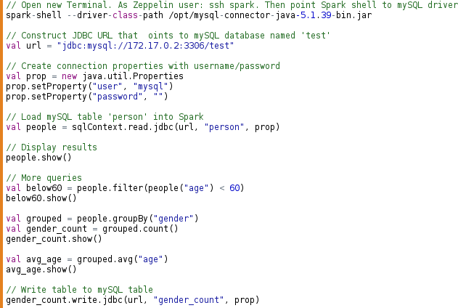
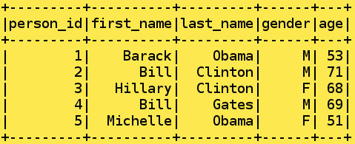
Lab 05: Create DF from RDBMS (mysql) (Scala)
Use HDP_2_5 image
mySQL

Slide 20
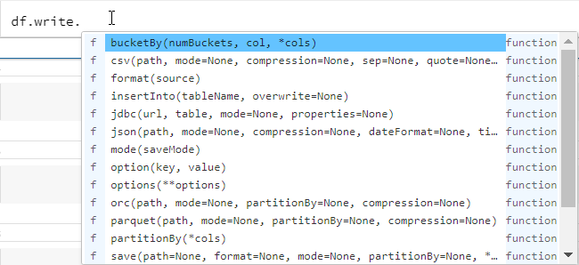
06: DataFrame Writer (write)
Used to write a DataFrame to external storage
Supports multiple file formats (CSV, Parquet, Delta, etc)
Can even write as an SQL Table too
(df.write
.option("compression", "snappy")
.mode("overwrite")
.parquet(outPath))
'Mode' include:
Append
Overwrite
ErrorIfExists
Ignore
Instead of writing to file format, can write as an SQL table too
Alternative coding:

Slide 21
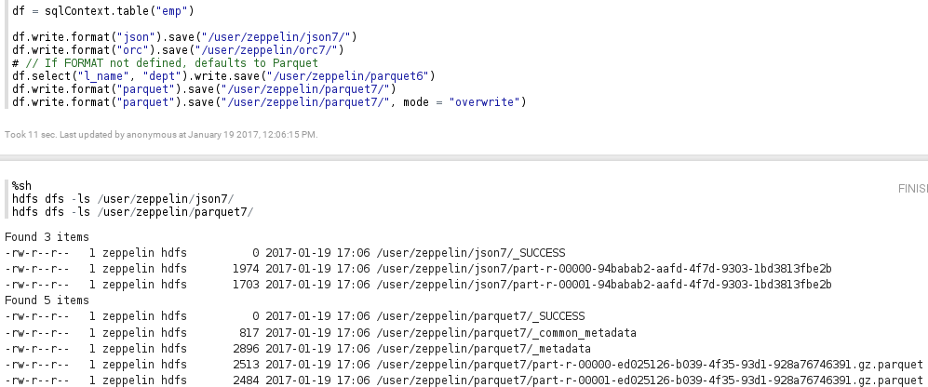
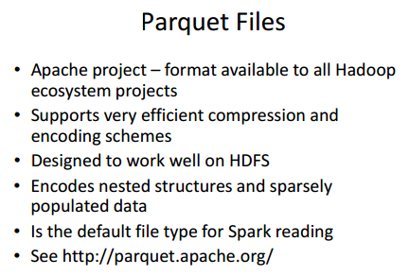
07: Saving DF as file using write() (1 of 2)
write() function allows you to export the Data Frame into a file or external storage systems (ie: Cassandra, HDFS, etc.)
There are several file formats available (ie: JSON, ORC, parquet, etc.)
https://spark.apache.org/docs/1.6.1/sql-programming-guide.html

Slide 22


Saving DF as file using write() (2 of 2)
Save operations can optionally take a SaveMode, that specifies how to handle existing data if present. It is important to realize that these save modes do not utilize any locking and are not atomic. Additionally, when performing a Overwrite, the data will be deleted before writing out the new data.
Scala/Java | Any Language | Meaning
mode = ErrorIfExists(default) | "error"(default) | When saving a DataFrame to a data source, if data already exists, an exception is expected to be thrown.
mode = append | "append" | When saving a DataFrame to a data source, if data/table already exists, contents of the DataFrame are expected to be appended to existing data.
mode = overwrite | "overwrite" | Overwrite mode means that when saving a DataFrame to a data source, if data/table already exists, existing data is expected to be overwritten by the contents of the DataFrame.
mode = ignore | "ignore" | Ignore mode means that when saving a DataFrame to a data source, if data already exists, the save operation is expected to not save the contents of the DataFrame and to not change the existing data. This is similar to a CREATE TABLE IF NOT EXISTS in SQL.

Slide 23
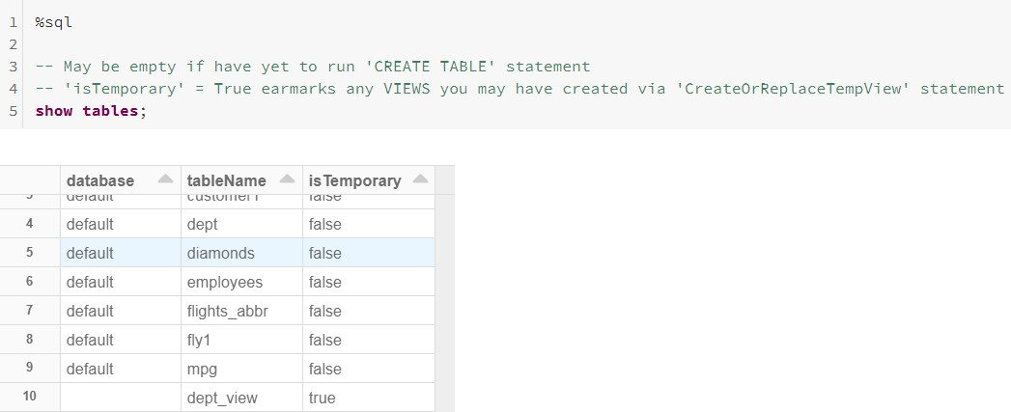
08: Show Tables
(Displays Perm Tables and Temp View)
'SHOW TABLES' display any existing Tables you have created via the Spark 'CREATE TABLE' statement
Permanent Hive tables have 'is Temporary' = false Temporary Views have 'is Temporary' = true

Slide 24
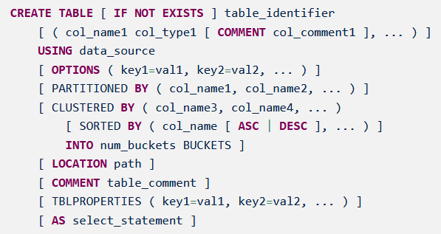
Create Table for Spark SQL: Generic Syntax
All 'CREATE TABLE' are stored as Hive tables. This is because Spark is a Processing Engine only and requires a 3rd Party application like Apache Hive to store Table objects

Slide 25
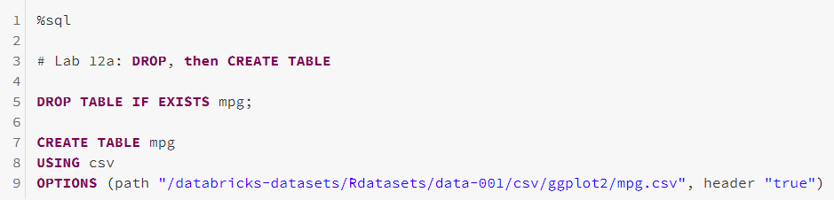
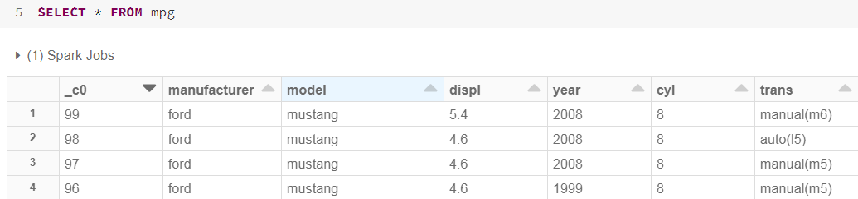
09: Create Table: USING / OPTIONS with header argument
Defined Column names in first row of file
Define file format here
USING data_source: TEXT, CSV, JSON, JDBC, PARQUET,
ORC, HIVE, DELTA, LIBSVM
OPTIONS: Point to Directory or file location along with other parameters

Slide 26
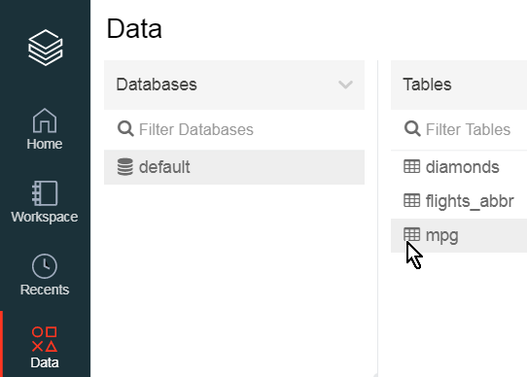
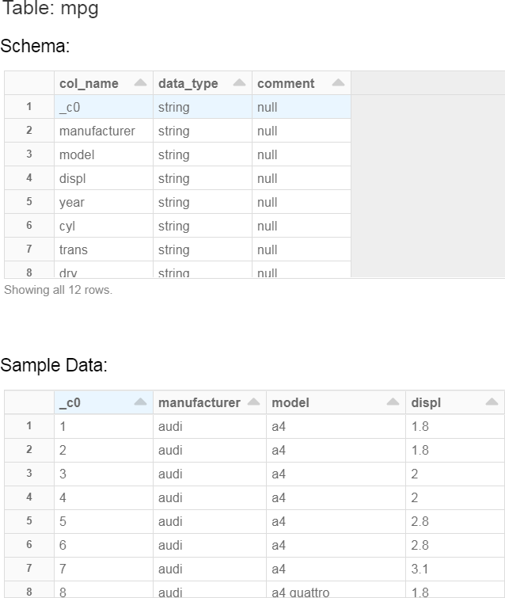
10: View Table details
Once you create a Table, can View it in UI via the left vertical pane.
Click 'Data', then select 'default' > 'mpg'

Slide 27
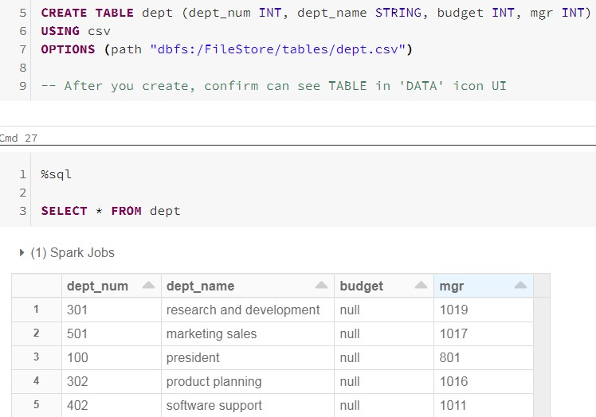
11a-b: Create Table without Header info by creating Column names/data types manually

Slide 28
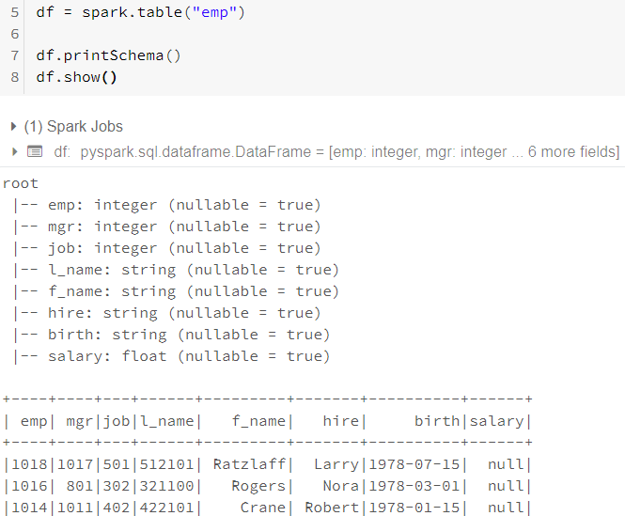
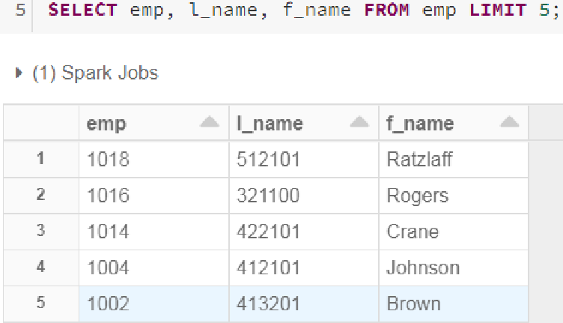
11c: Create DF from (Hive) Table in prior Lab
Hive
Using spark API, you can convert a Hive table to a DataFrame via table() function
And since Hive table has pre-existing schema, don't need Row() or StructType()
It is important to note you can query a Hive table directly from Spark client without the need to create a Dataframe as shown here

Slide 29
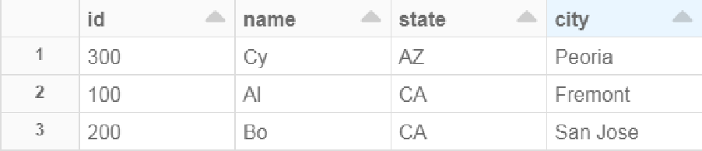
12a-d: Create Table: PARTITION BY
Partitioning is a Performance enhancement technique which can Dynamical read only Partition files when those Partition columns are in the WHERE clause
CREATE TABLE cust_part
(id INT, name STRING)
PARTITIONED BY (state STRING, city STRING);
INSERT INTO cust_part PARTITION (state = 'CA', city = 'Fremont') VALUES (100, 'Al'); INSERT INTO cust_part PARTITION (state = 'CA', city = 'San Jose') VALUES (200, 'Bo'); INSERT INTO cust_part PARTITION (state = 'AZ', city = 'Peoria') VALUES (300, 'Cy');
SELECT * from cust_part;
SELECT * from cust_part WHERE state = 'CA'
Only had to read 1 Partition

Slide 30
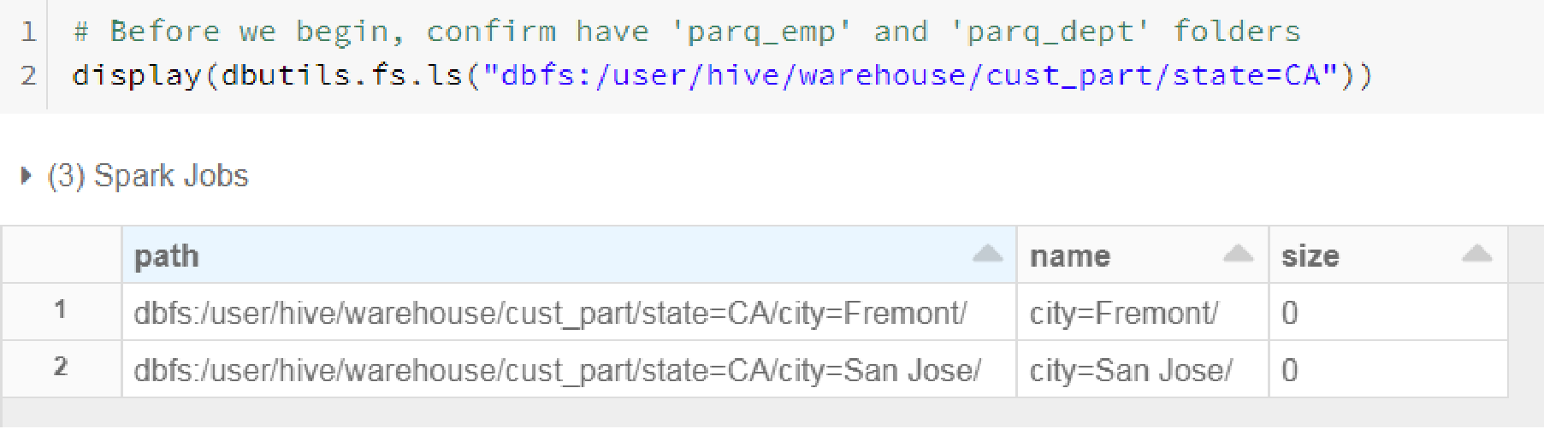
12e-g: Create Table: PARTITION BY
By creating a Table with Partitions, if the query has the Partitioning column in the WHERE clause, can reduce Disk I/O by reading only the file(s) pertaining to your query
Below you can see there were 2

Slide 31
13a-d: CREATE TABLE: CLUSTERED BY / SORTED BY INTO NUM_BUCKETS and COMMENT
Bucketing a table means that during a load, the Bucket column value is hashed and that determines which Bucket it will be stored
Physically each Bucket is a file in the table directory
Advantages include:
Like Partitioning, Bucketed tables provide faster query responses
2 bucketed tables joined together is efficient if Bucket columns are Join columns since these rows guaranteed to be in the same Bucket
If include SORTED BY, Map-side joins are even more efficient since SORT is already done for Merge join
Bucket tables can also be an efficient way of Sampling
CREATE TABLE bucket_table (state STRING, population INTEGER, yr INTEGER,) USING CSV
COMMENT 'A bucketed sorted user table' CLUSTERED BY (state) SORTED BY (state) INTO 25 BUCKETS | STATE is hash colu | the mn
INSERT OVERWRITE bucket_table VALUES ("Ohio",11664129,2017), ("Oklahoma",3932640,2017), …

Slide 32
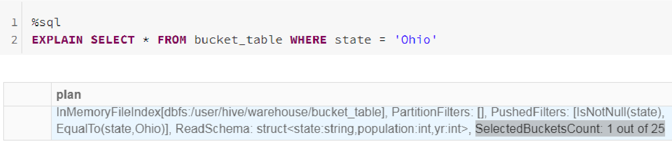
13-a/d: View Buckets read
Only had to read 1 out of the 25 buckets

Slide 33
PARTITION versus BUCKET
Although you can enact both Partitioning and Bucketing on the same table, each has their own advantages
Partitioning gives effective results when:
There are a limited number of partitions
Comparatively equal sized partitions
For example, if Partitioning by 'Country population', a few partitions will have large number of rows (China, India) while others will have small number of rows (Vatican, Monaco). In cases like this, Bucketing can be more effective since you can minimize Skew

Slide 34
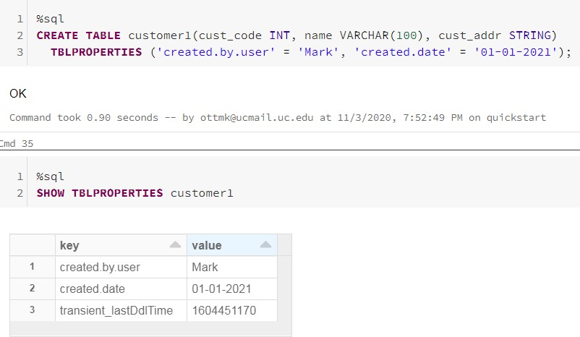
14a-c: Create Table: TBLPROPERTIES
A List of Key-Value pairs that is used to tag the table definition

Slide 35
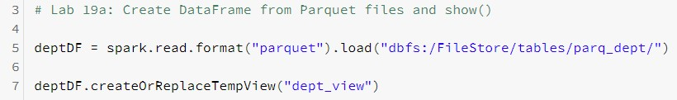
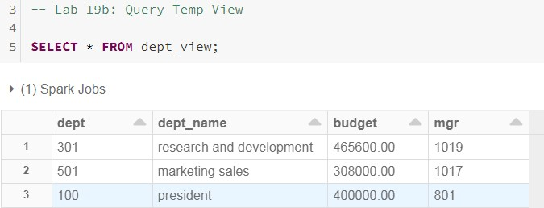
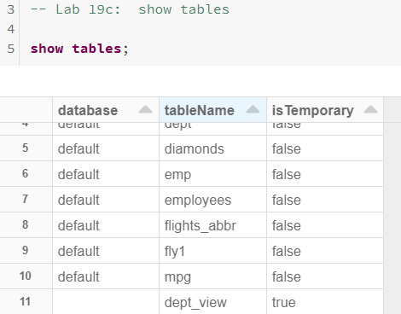
15a/d: Create TempView from DataFrame via createOrReplaceTempView()
You can convert a DataFrame into a Spark Temp table via createOrReplaceTempView. Once done, you can now query via Spark SQL API
Can convert a Temp View into a Perm Table via the 'CREATE TABLE AS' syntax

Slide 36
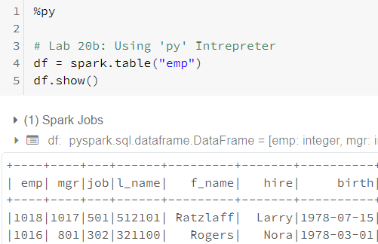
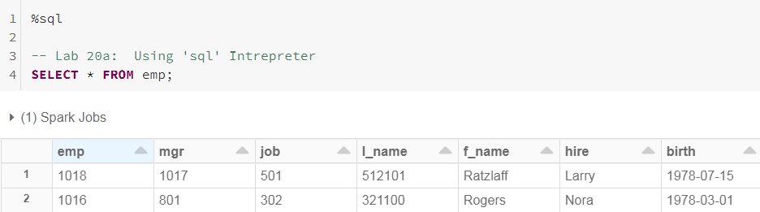
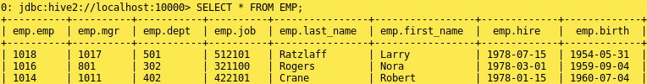
15e: Unlike TempViews, (Perm) Tables, can survive being queried in other Contexts
PYTHON() API
TempTables are materialized only in the Context they were created
By making Permanent table, can now use in
other Contexts as shown below
Regardless of which API you use, rest assured you are using the Catalyst optimizer
 | TempViews are transient. If you lose your Cluster, all TempViews are de-materialized In-line lab: Remove Cluster, create Cluster, then
SQL API | confirm TempView is removed from | 'show tables'
Hive context

Slide 37
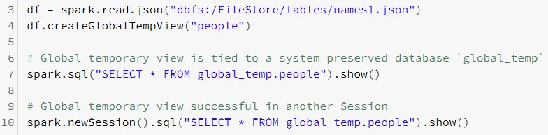
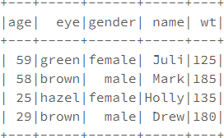
16a: One more Thing: Global Temporary Views
Global Temporary Views are introduced in Spark 2.1.0 release. This feature is useful when you want to share data among different sessions and keep alive until your application ends. In Spark SQL, temporary views are session- scoped and will be automatically dropped if the session terminates.
All the global temporary views are tied to a system preserved temporary database ' global_temp'

Slide 38
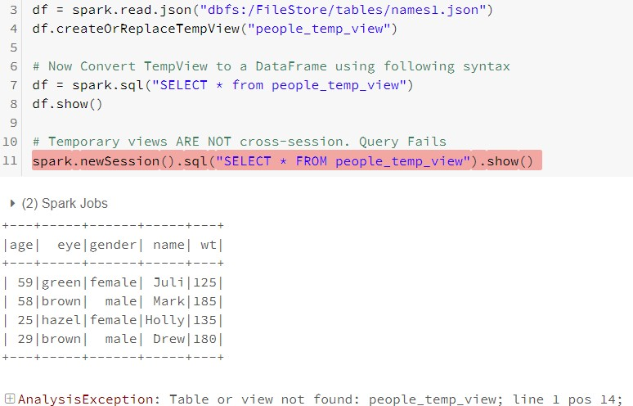
16b: Global Temporary Views vs Temporary Views
Notice how a Temporary View fails when execute using a different Session

Slide 39
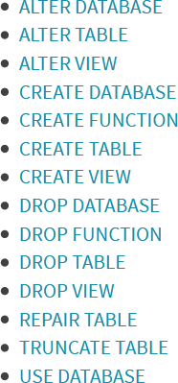
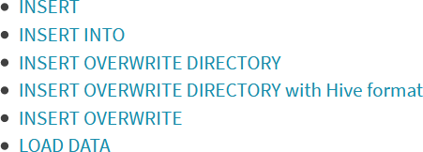

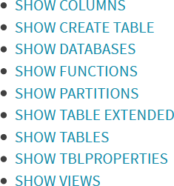
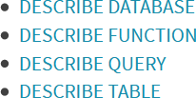
Spark SQL statements (Tables, Views)
DDL
DML
Retrieval
Show
Describe
https://spark.apache.org/docs/latest/sql-ref.html

Slide 40
In Review: Spark SQL
After completing this module, you'll be able to work with Spark SQL including:
What is Spark SQL?
DataFrames
Tables
TempViews (Datasets, GlobalViews)
The Catalyst Optimizer
What is Hive?
Creating DataFrames from five sources including:
Structured files, parallelize(), textFile(), Hive and mySQL
CREATE TABLE function (Partition Tables and Bucket Tables)
CreateOrReplaceTempView function and GlobalTempViews

