Slide 1





C7084 Big Data
Ed Harris
QUERY
DATA
Knowledge

Slide 2

BIG
DATA

Slide 3
Table of Contents
Don't forget to start recording
Every session: community.cloud.databricks.com and Logon
In Left-pane, Click on 'Clusters' or 'Compute' and Terminate old Cluster Then click 'Create Cluster' button to create New one
Mod 00 – Intro and Setup
Mod 01 – Spark Architecture
Mod 02 – SparkSQL (Read/Write DataFrames/Tables)
Hacktivity 00 (Dates) / Hacktivity 01 (Air)
Mod 03 – SparkSQL (Transform)\
Mod 04 – Complex Data Types
Mod 05 – JSON (Optional)
Hacktivity 02 (Fly)
Mod 06 – Streaming
Mod 07 – Architecture-Spark UI
Mod 08 – Catalog-Catalyst-Tungsten
Mod 09 – Adaptive Query Execution
Mod 10 – Performance Tuning
Hacktivity 03 (Stream) / Hacktivity 04 (Air)
Mod 11 – Machine Learning

Slide 4
According to IBM, 60% of all sensory information
loses value in a few milliseconds if it is not acted on. Bearing in mind that the Big Data and analytics market has reached $125 billion and a large chunk of this will be attributed to IoT in the future, the inability to tap real-time information will result in a loss of billions of dollars.
Module 06: Structured Streaming
https://www.youtube.com/watch?v=c4MAgdriJz

Slide 5
Table of Contents
Don't forget to start WebEx recording Do Spark Jeopardy review
Go to: community.cloud.databricks.com and Logon
In Left-pane, Click on 'Clusters' or 'Compute' and Terminate old
Cluster Then click 'Create Cluster' button to create New one
Session 1-2
Mod 00 – Intro and Setup Mod 01 – Spark Architecture
Mod 02 – SparkSQL (Read/Write DataFrames/Tables)
Mod 03 – SparkSQL (Transform) Hack 00 (Date) / Hack 01 (Air)
Session 3-4
Mod 04 – Complex Data Types Mod 05 – JSON (Optional) Mod 06 – Streaming
Mod 07 – Architecture-Spark UI
Hackathon 02 (Fly)
Hackathon 03 (Stream)
Session 5-7
Mod 08 – Catalog-Catalyst-Tungsten Mod 09 – Adaptive Query Execution
Mod 10 – Performance Tuning Hackathon 04 (Air)
Mod 11 – Machine Learning
Final Exam

Slide 6
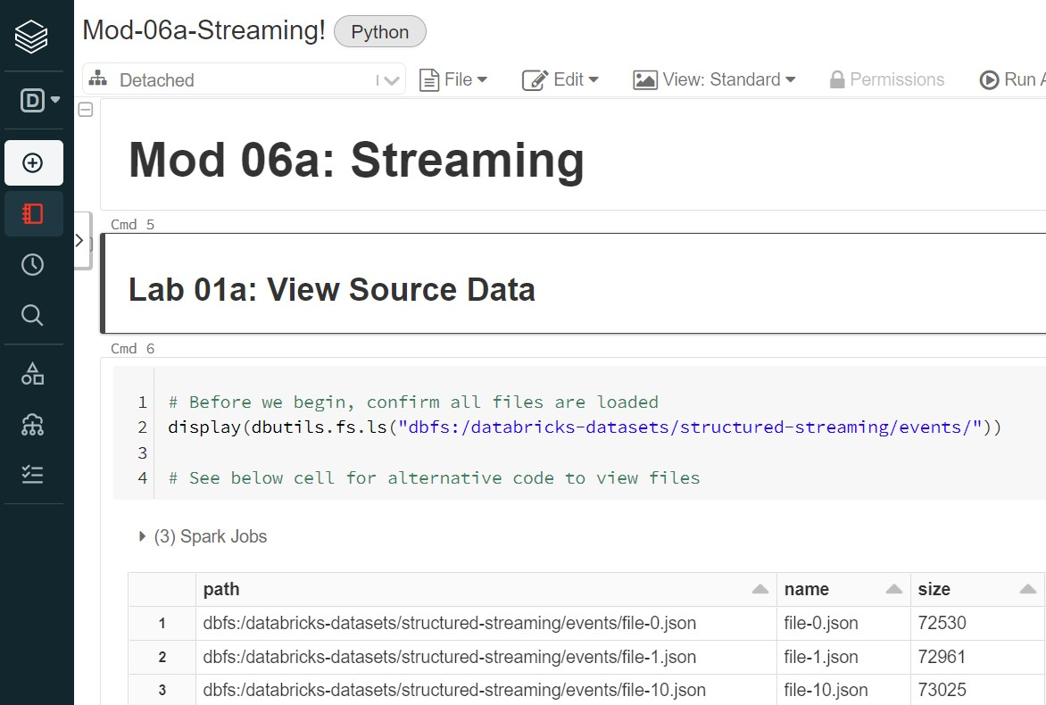
Before We Begin – Open Mod-06 Notebook
3

Slide 7
Objectives
4
After completing this module, you'll have working knowledge of Spark Structured
Streaming including:
What is a Spark Structured Streaming ?
Batch versus Streaming Datasets/DataFrames
Structured Streaming Model
Input: read.stream()function
Output: write.stream()function and most common arguments
format()
outputMode()
Demos or Hands-on labs including:
Socket streaming using 3 outputMode()
Batch Processing vs Micro-Batch
Windowed Streaming
https://www.slideshare.net/databricks/a-deep-dive-into-structured-streaming

Slide 8

Topics
5
Structured Streaming
What it is
Batch versus Streaming
Structured Streaming Model
Comparison to other Streaming engines
Structured Streaming functions
read.stream()
write.stream() arguments
format()
outputMode()
Hands-on labs
Socket streaming using 3 outputMode()
Batch Processing vs Micro-Batch
Windowed Streaming

Slide 9
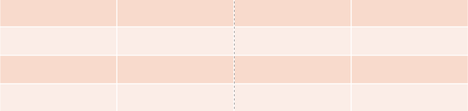
What is Structured Streaming?
6
Structured Streaming is a scalable and fault-tolerant stream processing engine built on the Spark SQL engine using Datasets/DataFrames/Views (and not RDDs)
It's more than just Streaming, it's a 'Continuous Application'. It can interact with batch data, interactive analysis and machine learning
Datasets are a distributed bounded/unbounded collection of data with known schema
Data stream as an Unbounded table. New
rows appended to bottom of that table
Data stream

Slide 10
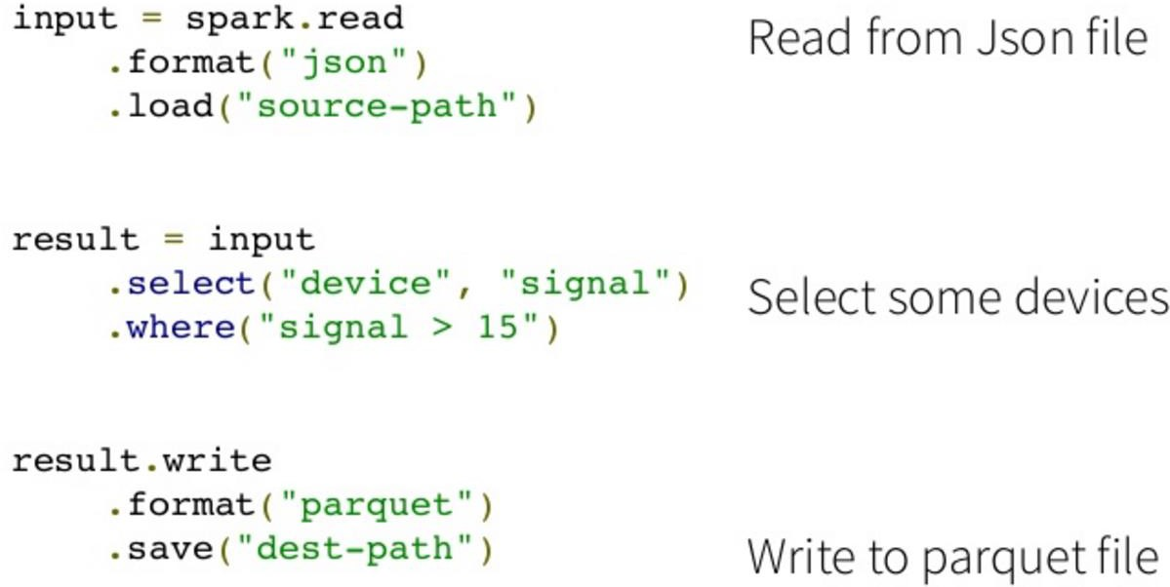
Batch ETL with DataFrames (Generic)
7
Read from file
SELECT query
Write to parquet file

Slide 11
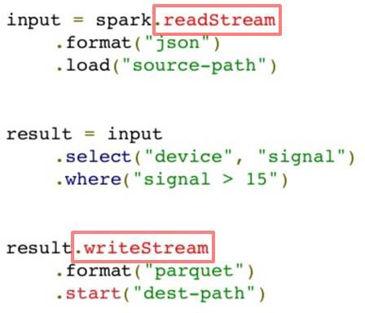
Streaming ETL with DataFrames (Generic)
8
Read from file
SELECT query
Write to parquet file

Slide 12

Fault Tolerance baked into Spark Streaming
9
1. Checkpointing:
Directed Acyclic Graph (DAG) of all DStream transformations stored in reliable storage (along with optional State)
To commit offsets
2. Write-ahead logs:
Idempotent sinks: Writes given row only once, even if sent multiple
Replayable data sources: Job allowed to poll data again

Slide 13
Structured Streaming Model
10
Input:
Query:
Trigger:
Data from source as an Append-only table Dataset/DataFrame Operations on input
How frequently to check Input for new data (optionally
configured in Output)
Final table updated with every trigger interval (implicit)
Which part of data to write to Data sink after every trigger
(complete, append, or update)
Result:
Output:

Slide 14
Topics
11
Structured Streaming
What it is
Batch versus Streaming
Structured Streaming Model
Comparison to other Streaming engines
Structured Streaming functions
read.stream()
write.stream() arguments
format()
outputMode()
Hands-on labs
Socket streaming using 3 outputMode()
Batch Processing vs Micro-Batch
Windowed Streaming

Slide 15

Input: readStream() Data Sources
12
1. File source - Reads files written in a directory as a stream of data. Supported file formats are text, csv, json, parquet. Note the files must be atomically placed in the given directory, which in most file systems, can be achieved by file move operations
val wordsDF = spark.readStream.schema(customSchema).json("/user/zeppelin/live_stream2/")
2. Kafka source - Poll data from Kafka. It’s compatible with Kafka broker versions 0.10.0 or higher.
See the Kafka Integration Guide for more details
val ds1 = spark
.readStream.format("kafka").option("kafka.bootstrap.servers", "host1:port1,host2:port2") .option("subscribe", "topic1") .load()
3. Socket source (for testing) - Reads UTF8 text data from a socket connection. The listening server socket is at the Driver. Used only for testing (does not provide end-to-end fault-tolerance)
val lines = spark.readStream.format("socket").option("host", "localhost").option("port", 9999).load()
Input data stream is treated as an Unbounded table

Slide 16
Input: readStream() Transformations
13
Once you have defined the readStream input configuration, you can code your Transformations
spark.readStream
<insert input configuration>
.filter(col("action") == "close")
.groupBy("provider".count()

Slide 17
Trigger Types (How often to product Results)
14
Default
Process each micro-batch as soon as the previous one has been processed (500 ms (1/2 second) since DB 8.0)
Fixed interval
Micro-batch processing kicked off at the user-specified interval
One-time
Process the available data as a single micro-batch and then automatically stop
the query
Continuous Processing
Long-running tasks that continuously read, process, and write data as soon
events are available experimental, Spark 2.3+

Slide 18
Output: Starting a Streaming Query with
writeStream().start()
15
Once you have defined the final DataFrame/Dataset, all that is left is for you to start the streaming computation. This is accomplished through writeStream(). You will specify one or more of following:
Details of the output sink: Data format, location, etc.
Output mode: Specify what gets written to the output sink
Query name: Optionally, specify a unique name of the query for identification
Trigger interval: Optionally, specify trigger interval. If it is not specified, the system will check for availability of new data as soon as previous processing completes
Checkpoint location: For some output sinks where the end-to-end fault-tolerance can be guaranteed, specify the location where the system will write all the checkpoint information. This should be a directory in an HDFS-compatible fault-tolerant file system
queryDF = DF1.writeStream.format("memory").queryName("view_1")
.outputMode("complete").start()
queryDF = DF1.writeStream.format("parquet").option("path","/user/stream3/")
.option("checkpointLocation", "/user/zeppelin/chkpnt3").start()
queryDF = DF1.writeStream.trigger(processingTime="10 seconds")
.outputMode("complete").format("console").start()

Slide 19
Output: writeStream() Arguments
16
The two arguments you typically manually configure in writeStream()are:
•1 format() - Where output is directed:
─ In file system directory
─ Foreach sink
─ In console
─ In memory
•2 outputMode() - What data gets output
─ Append
─ Complete
─ Update
Generic code for writeStream's format argument
….writeStream.format("parquet … | console | memory … ") \
.outputMode("append | complete | update") \
.start()

Slide 20
Output: writeStream().format
1 17
There are a few types of built-in output sinks
1. File sink - Stores the output to a file system directory
val queryDF = wcDF.writeStream.format("parquet").option("path", "/user/cloud/").start()
Foreach sink - Runs arbitrary computation on the records in the output
Console sink (for debugging) - Prints the output to the console/stdout every time there is a trigger. Both Append and Complete output modes, are supported. This should be used for debugging purposes on low data volumes as the entire output is collected and stored in the Driver’s memory after every trigger
val queryDF =
wordCounts.writeStream.format("console").outputMode("complete").start()
4. Memory sink (for debugging) - The output is stored in memory as an in-memory Temp View. Both Append and Complete output modes, are supported. This should be used for debugging purposes on low data volumes as the entire output is collected and stored in the Driver’s memory after every trigger
val queryDF = wcDF.writeStream.format("memory").queryName("spark_view_1")
.outputMode("complete").start()

Slide 21

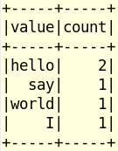
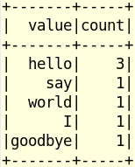


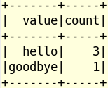
Output: writeStream().outputMode()
2
Input
18
The OutputMode() defines what gets written to storage when there is a Trigger
(implicit/explicit). You have 3 options:
1. outputMode("complete") - The entire updated Result Table will be written to external storage. It is up to storage connector to decide how to handle writing of entire table. Typically used with aggregations
val query = wordCounts.writeStream.outputMode("complete").format("console").start()
outputMode(append) - Only the new rows appended in the Result Table since the last trigger will be written to the external storage. This is applicable only on the queries where existing rows in the Result Table are not expected to change (must be non-aggregate)
val query = wordCounts.writeStream.outputMode("append").format("console").start()
oututMode(update) - Only the rows that were updated in the Result Table since the last trigger will be written to the external storage. Note that this is different from the Complete Mode in that this mode only outputs the rows that have changed since the last trigger. If the query doesn’t contain aggregations, it will be equivalent to Complete mode
val query =
wordCounts.writeStream.outputMode("update").format("console").start()

Slide 22
Output: writeStream().outputMode() Visualization
19
Many streaming systems require the user to maintain running aggregations themselves
In this model, Spark is responsible for updating the Result Table when there is new data, thus relieving the users from coding this logic

Slide 23
Putting it All Together – Streaming Query
20
spark.readStream
.schema(dataSchema)
.option("maxFilesPerTrigger", 3)
.parquet(webPath)
.filter(col("action") == "close")
.groupBy("provider").count()
Need explicit Schema
.writeStream
.outputMode("append")
.format("parquet")
.queryName("buy_path")
.trigger(processingTime="5 seconds")
.option("checkpointLocation", checkPath)
.start(outputDir)
Metadata and data on reliable storage

Slide 24
Topics
21
Structured Streaming
What it is
Batch versus Streaming
Structured Streaming Model
Comparison to other Streaming engines
Structured Streaming functions
read.stream()
write.stream() arguments
format()
outputMode()
Hands-on labs
Socket streaming using 3 outputMode()
Batch Processing vs Micro-Batch
Windowed Streaming

Slide 25
Hands-on Structured Streaming Labs
22
We will be doing several different types of Structured Streaming labs as follows:
Socket source (for testing) - Reads UTF8 text data from a socket connection. The listening server socket is at the driver. Note that this should be used only for testing as this does not provide end-to-end fault-tolerance guarantees
HDFS File source - Reads files written in a directory as a stream of data. Supported file formats are text, csv, json, parquet. See the docs of the DataStreamReader interface for a more up-to-date list, and supported options for each file format. Note that the files must be atomically placed in the given directory, which in most file systems, can be achieved by file move operations
Windowed Streaming over time - Normally done when want to do things such as
moving averages over time
Joining a Static View to a Streaming View
We will be using all 3 'outputMode' (complete, update, append) and 3 'format' (memory, console, file)

Slide 26

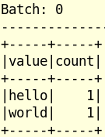
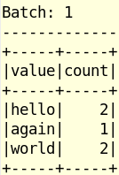

Demo 01 (Mod 08)-
Use HDP_26 image-Run query to stop Swapping prior to Class
Socket Streaming outputMode("complete")
23
// Open PuTTY prompt and fire up nCat ( I logged in as zeppelin user for both Terminals )
// Must do this first or get 'Connection Refused' later
nc -lk 9999
import org.apache.spark.sql.functions._
import org.apache.spark.sql.SparkSession
Query: Accumulating Wordcount
val spark = SparkSession.builder.appName("StructuredNetworkWordCount").getOrCreate() import spark.implicits._
// Input: Representing the stream of input lines from connection to localhost:9999
val linesDF=spark.readStream.format("socket").option("host", "localhost").option("port", 9999).load()
// Create Dataset and define delimiter
val wordsDS = linesDF.as[String].flatMap(_.split(" "))
// Note the use of RDD function 'flatMap' in Dataset
// Query: Run wordcount on Dataset (default column name = 'value')
val wcDF = wordsDS.groupBy("value").count()
// Output: Run the query that prints the running counts to the console
val query = wcDF.writeStream.outputMode("complete").format("console").start()
// Now start typing stuff in nCat window
// It will appear in the Streaming window
// Stop by typing:
query.stop()
// In this example, each 'ENTER' keystroke equals an implicit Trigger

Slide 27
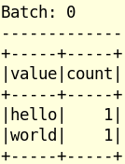
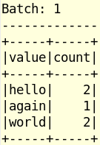
Demo 02
Socket Streaming outputMode("update")
24
// Open PuTTY prompt and fire up nCat ( I logged in as zeppelin user for both Terminals )
// Must do this first or get 'Connection Refused' later on
nc -lk 9999
import org.apache.spark.sql.functions._ import org.apache.spark.sql.SparkSession
Query: Accumulating Wordcount
val spark = SparkSession.builder.appName("StructuredNetworkWordCount").getOrCreate() import spark.implicits._
// 01 Input: Representing the stream of input lines from connection to localhost:9999
val linesDF = spark.readStream.format("socket").option("host", "localhost").option("port", 9999).load()
// 02 Create Dataset and define delimiter
val wordsDF = linesDF.as[String].flatMap(_.split(" "))
// 03 Query: Run wordcount on Dataset
val wcDF = wordsDF.groupBy("value").count()
// 04 Output: Run the query that prints the running counts to the console
val query = wcDF.writeStream.outputMode("update").format("console").start()
// Now start typing stuff in nCat window
// It will appear in the Streaming window

Slide 28


Demo 03
Socket Streaming outputMode("append")
25
// Open PuTTY prompt and fire up nCat ( I logged in as zeppelin user for both Terminals )
// Must do this first or get 'Connection Refused' later on
nc -lk 9999
Query: Display words only (can't aggregate on Append)
import org.apache.spark.sql.functions._ import org.apache.spark.sql.SparkSession
val spark = SparkSession.builder.appName("StructuredNetworkWordCount").getOrCreate() import spark.implicits._
// 01 Input: Representing the stream of input lines from connection to localhost:9999
val linesDF = spark.readStream.format("socket").option("host", "localhost").option("port", 9999).load()
// 02 Query: Create Dataset and define delimiter, then display
val wordsDF = linesDF.as[String].flatMap(_.split(" "))
// 03 Output: Run query that prints the running counts to the console
val query = wordsDF.writeStream.outputMode("append").format("console").start()
// Now start typing stuff in your nCat window
// It will appear in the Streaming window

Slide 29
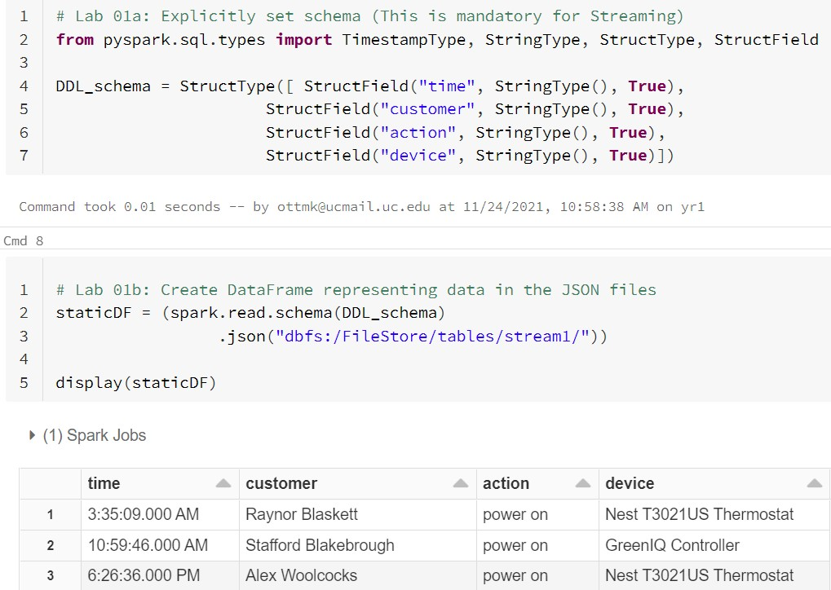
Lab 01a: First do Batch Processing via 'spark.read'
26

Slide 30
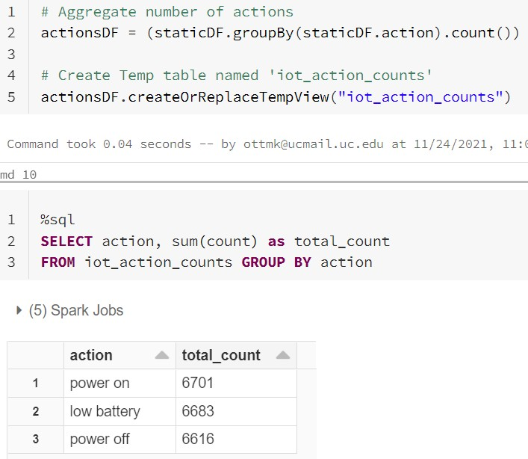
Lab 01b: Compute the Batch Aggregate
27

Slide 31
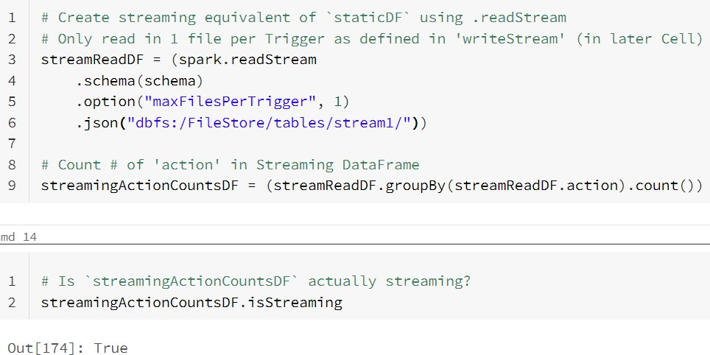
Lab 02a: Aggregation via STREAMING 'read.stream'
28

Slide 32
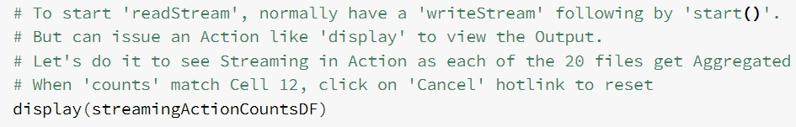
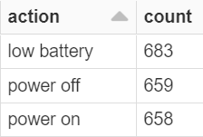
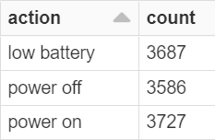
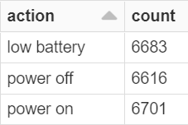
Lab 02b: Display the 'read.stream'
29

Slide 33
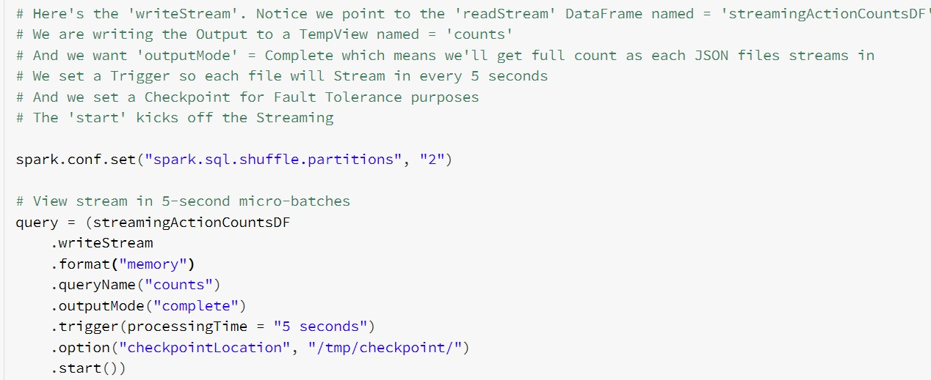
Lab 02c: Start the 'writeStream'
30

Slide 34
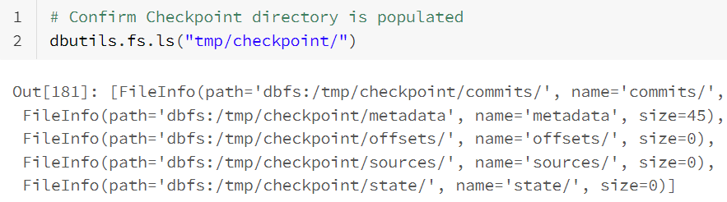

Lab 02d: Check the Checkpoint Directory
31

Slide 35
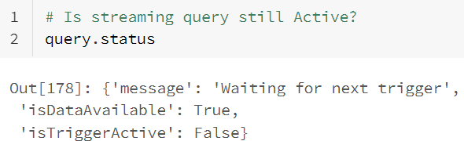
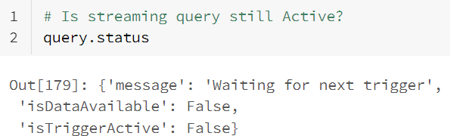
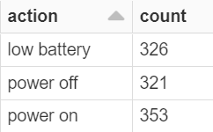
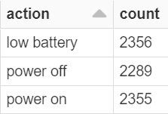


Lab 02e: Monitor, query Temp View, then Stop Streaming
32

Slide 36
Time-based Streaming Windowing Options
33
Tumbling Windows Sliding Windows
Non-Overlap Windows
Any given event gets aggregated into only one window group
1:00–2:00, 2:00–3:00 , 3:00-4:00, ...
Windows overlap
Any given event gets aggregated into
multiple window groups
1:00-2:00, 1:30–2:30, 2:00–3:00, ...

Slide 37
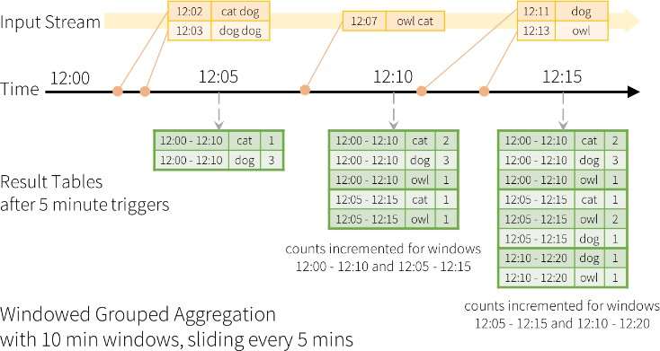
Windowed Streaming
34
Windowed (Stateful) operations are useful when you want to calculate over time. For example, you could compute event every 5 minutes using the last 10 minutes worth of data. Here's an example of Sliding window

Slide 38
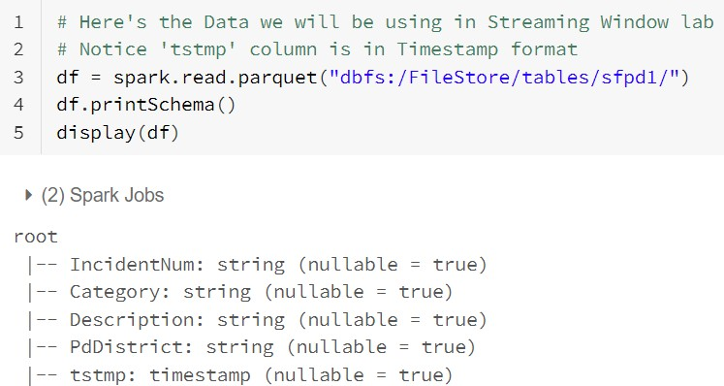
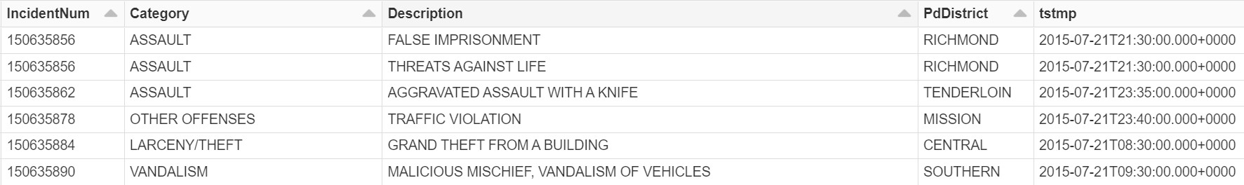
Lab 03a: Tumbling Windowed Streaming
35

Slide 39
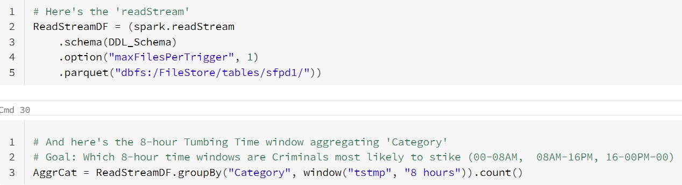
Lab 03b: 'readStream', then code 8-hour Window Aggregate36
Goal is to determine which 8-hour Time Window are San Francisco criminals
most likely to commit their crimes

Slide 40
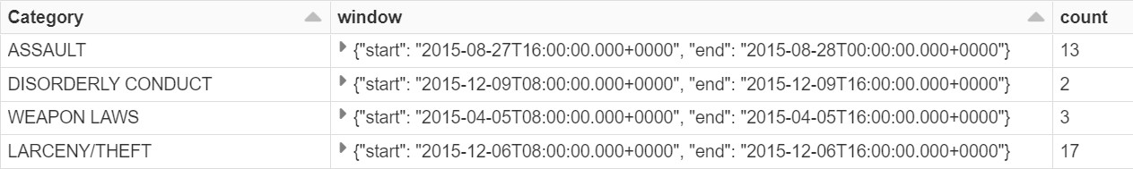
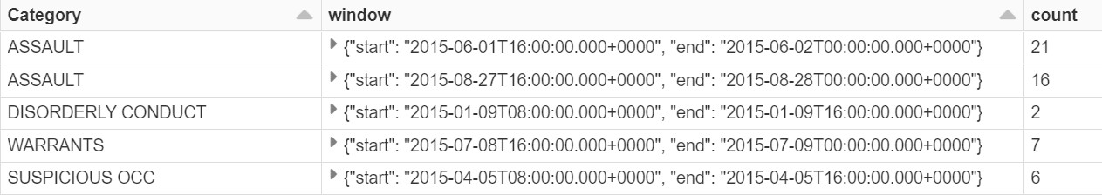
Lab 03c: Display the 'readStream'
37
Confirm data is changing over Time, then 'Cancel'

Slide 41
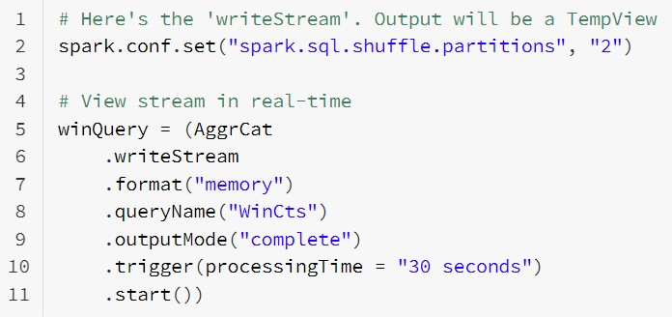
Lab 03d: Start the 'writeStream'
38
Output is saved to TempView named 'WinCts'

Slide 42
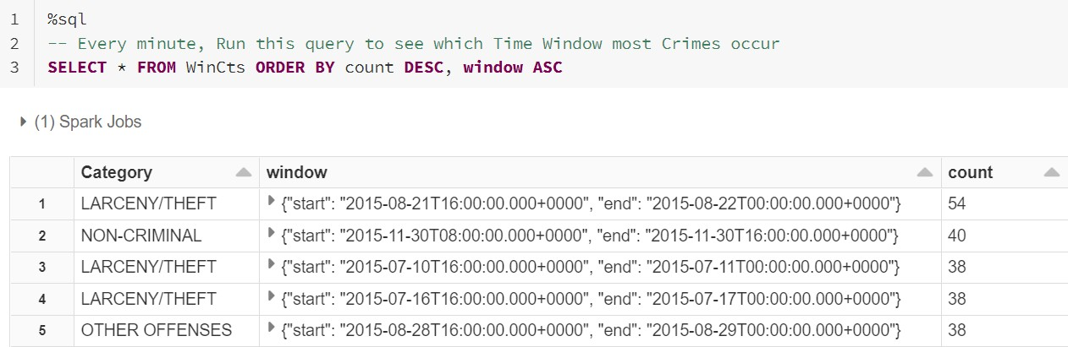

Lab 03e: Query Temp View, then Stop query
39
Notice Windowed Streaming Job gets new column = 'window' Most crimes take place between 4:00 PM - Midnight

Slide 43
Summary
40
After completing this module, you'll have working knowledge of Spark Structured
Streaming including:
What is a Spark Structured Streaming ?
Batch versus Streaming Datasets/DataFrames
Structured Streaming Model
Input: read.stream()function
Output: write.stream()function and most common arguments
format()
outputMode()
Demos or Hands-on labs including:
Socket streaming using 3 outputMode()
Batch Processing vs Micro-Batch
Windowed Streaming

