Slide 1
Module 11-2 – Spark Machine Learning
https://www.bmc.com/blogs/python-spark-machine-learning-classification/ https://vishalmnemonic.github.io/DC11/ https://medium.com/@Sushil_Kumar/machine-learning-pipelines-with-spark-ml- 94cd9b4c973d

Slide 2

Lab 01(MLib – Lab 02 (ML) Collaborative Filtering - Concepts
24
Very common use case for retailers, on-line retailers, internet and consumer- focused financial institutions
Source data could be:
Retail purchase data
On-line purchase data
Activity data
Credit card purchase data
Collaborative Filtering makes predictions by collecting preferences from many users. It assumes if person A has the same opinion as a person B on an issue, A is more likely to have B's opinion on a different issue x
Output could fuel "analytics products" like:
"People who bought this also bought …"
"People who viewed this profile also viewed…"
"People who liked this job also liked …"

Slide 3


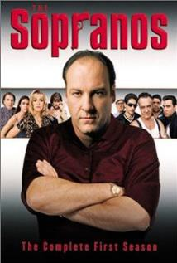
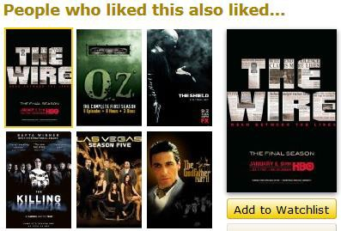
Collaborative Filtering Example
25
Allows for Merchandise opportunities such as cross-sell, and co-location of product

Slide 4
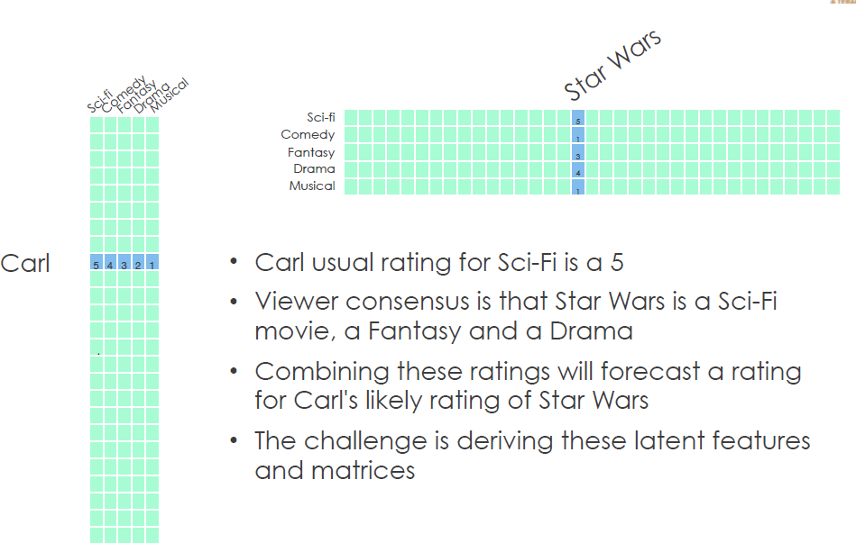
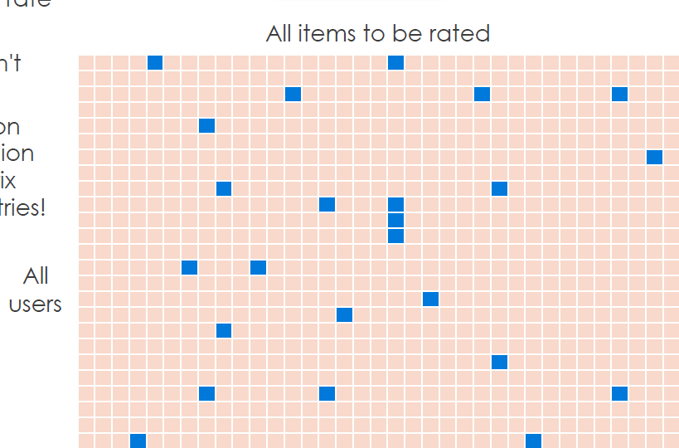
Collaborative Filtering Factors
26
Most users only rate a few movies. Imagine 1 million Users and 1 million
Movies. The Matrix has 1 Trillion entries
Collaborative Filtering uses 'Factors' to reduce the Sparseness of the data

Slide 5
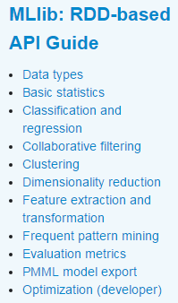
RDD – Machine Learning (MLlib)
27
First we'll focus on RDD MLlib. Later we'll do DataFrame ML
MLlib – For RDD's
We'll be using the ALS (Alternating Lease Square) function to perform the Collaborative Filtering

Slide 6





MLLib Classification uses LabelPoint (ML-Vectors)
28
Label Y-variable must be numeric and can be binary values or a range of values
Feature Variables (X-variables) The majority of ML models operate on numeric data in the form of Feature Vectors. Feature Vectors are the X-variables. They are normally formatted in an Array and typically assigned a data type of Double
LabelPoint (Used for Supervised classification algorithms)
Format of the Y-var followed by the X-variables. Here's an example:
Y-var value X1:value1 X2:value2 …
X-variables:
(mo/day/deptime/arrtime/carrier/elapsedtime/origin/dest
Y- variable: Delayed (1), Not delay (0)
// Making LabeledPoint of features - this is the training data for the model
val mldata = mlprep.map(x => LabeledPoint(x(0), Vectors.dense(x(1), x(2), x(3), x(4), x(5), x(6), x(7), x(8))))
mldata.take(1)
//res7: Array[org.apache.spark.mllib.regression.LabeledPoint] = Array((0.0,[0.0,2.0,900.0,1225.0,6.0,385.0,214.0,294.0]))

Slide 7
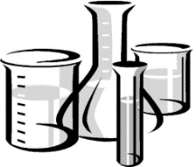
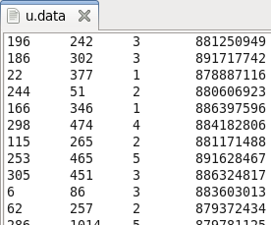
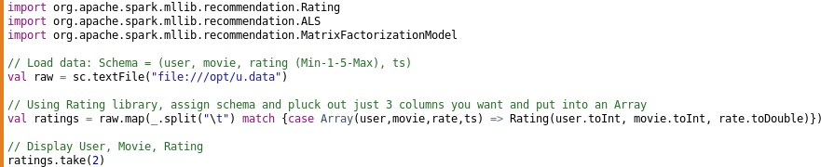
Lab 01a
CF - Load Movie Data
29
Load IMPORTS and file 'u.data'. File consists of : (user Int, movie Int, rating: Double, ts: string) Rating are 1-5 (with 1 = Bad and 5 = Excellent)
Then filter columns you want (user, movie, rating) into an Array using RATING library along with map()and case()
https://www.slideshare.net/sscdotopen/latent-factor-models-for-collaborative-filtering

Slide 8
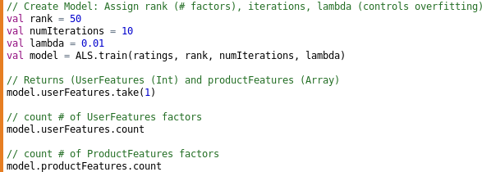
Lab 01b
CF - Create Model and Factors
30
Create Model and then view Factors from that Model
These are called 'Hyperparameters' and determines how to build Model. Note there is 'alpha' which is weighting schema that will be set to default value = .01 if not defined

Slide 9
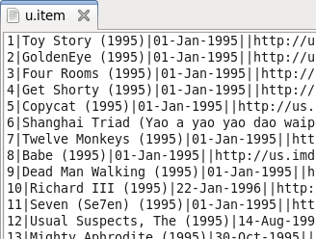
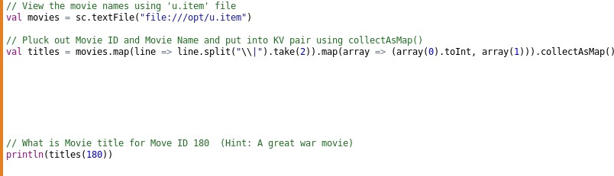


Lab 01c
CF - Map MovieID to MovieName
31
Since we want to display the Movie title instead of just a Movie integer, load the 'u.item' file that has both Movie Integer and Movie title
Use map() to pluck out just first 2 indexes (Movie
Integer and Movie title), then collectAsMap() to
put in KeyValue format so can query by Key

Slide 10
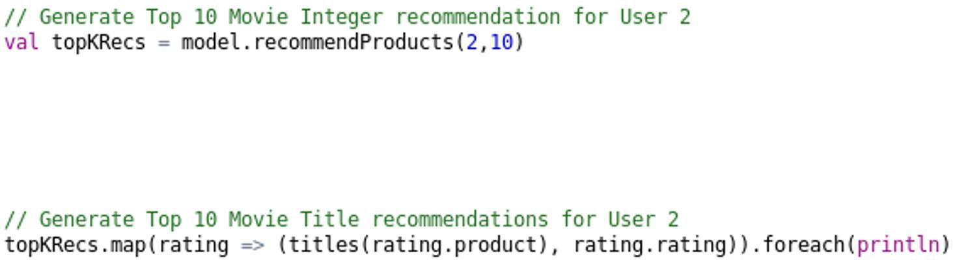

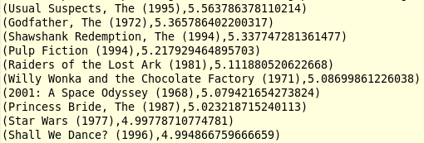
Lab 01d
CF - Make User Recommendation
32
For User 2, find:
Top 10 Movie Integers recommendations (User, MovidID, Rating)
Top 10 Movie Title recommendations (MovieName, Rating)

Slide 11
Lab 01e/f
CF - Make User Recommendation
33
For User 2, find:
Top 10 Movie Integer recommendations
Top 10 Movie Title recommendations

Slide 12
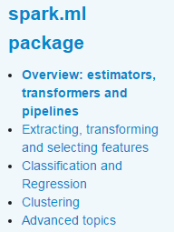
DataFrames – Machine Learning (ML)
34
Now let's focus on ML using Spark DataFrames
ML – For DataFrames
Let use the same function only this time
doing it as a DataFrame
We'll do a deeper dive of ML afterwards

Slide 13
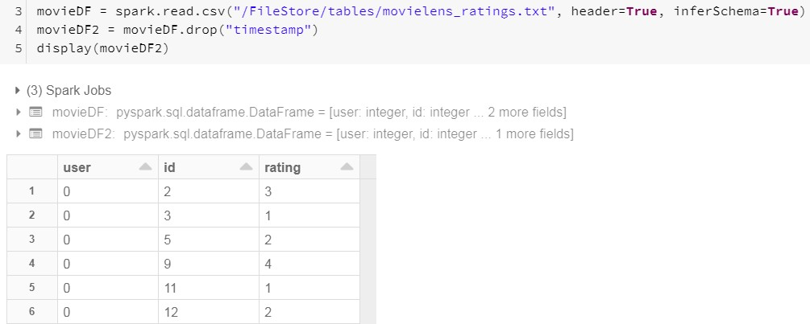
Lab 02a
CF - Load DataFrame, remove 'timestamp' column, Display35
Note 'id' is just MovieID and not actual Movie Name. We'll fix that in the next Lab
https://towardsdatascience.com/build-recommendation-system-with-pyspark-using-
alternating-least-squares-als-matrix-factorisation-ebe1ad2e7679

Slide 14
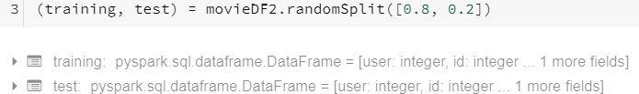
Lab 02b
CF - Split into TRAIN/TEST DataFrames
36

Slide 15
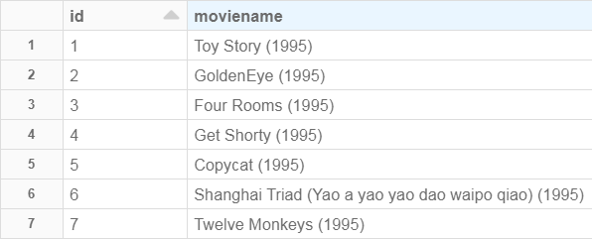
Lab 02c
CF - Load Movie Name into a DataFrame too
37

Slide 16
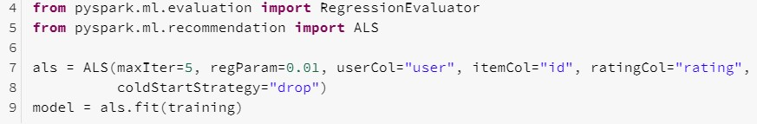
Lab 02d
CF - Create ALS (CF) Model
38
Run 5 iterations and don't Overfit (regParam) the Model

Slide 17
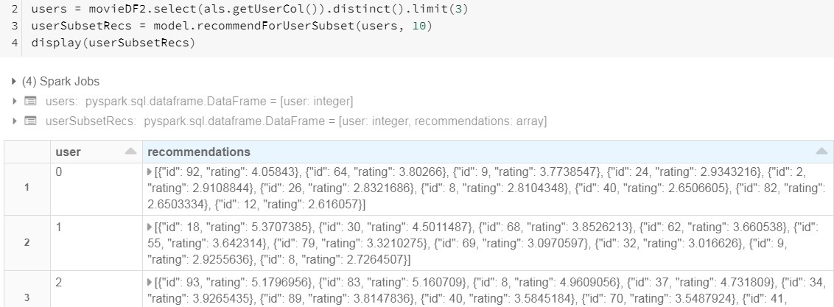
Lab 02e
CF - Top 10 Movie IDs for User 0, 1 2
39

Slide 18
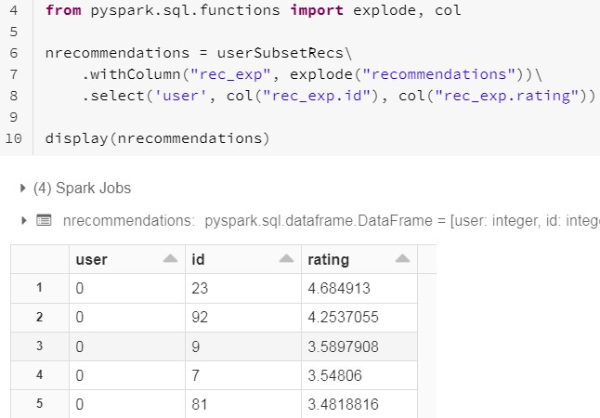
Lab 02f
CF – To convert Movie ID to Movie Name, we first 'explode4'0

Slide 19
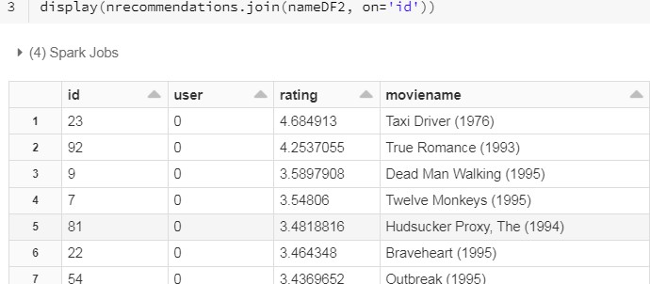
Lab 02g
CF – Join to get Movie Names for User's Recomendations
41

Slide 20

Current Topic
42
Machine Learning concepts
Terminology
MLib (RDD) vs ML (DataFrames)
Collaborative Filtering (ALS) example
ML (non-Predictive) examples
Correlation
KMeans
ML Predictive concepts
Transformer, Estimator, Pipeline
ML Predictive examples
Logistic Regression
Gradiant Boost Tree
Decision Tree

Slide 21
Correlation - Concepts (1 of 2)
43
Measuring Correlation lets you determine if the value of one variable (X-var) is useful in predicting the Y-var value . Useful when determining which X-Variables to include in your Predictive Modeling functions (NB, SVM, LinReg)
Correlation makes no assumption as to whether 1 variable is dependent on the other. Instead it gives degree of association between variables. It tests for interdependence of variables. Regression attempts to describe dependence of unknown variable on 1 or more known variables
Correlation has 2 useful features when creating a Predictive Model
Which are 'best' X-variables to use when making a Prediction on Y-variable
Which X-variables are highly Correlated. (MultiCollinearity occurs when have Absolute Correlation > .7 between 2 Predictors). If this case, one strategy is to remove one of X-variables from Model creation to reduce Variance in Model

Slide 22
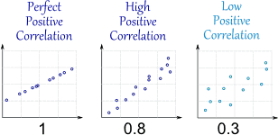
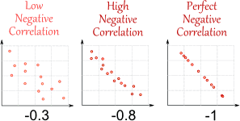

Correlation - Concepts (2 of 2)
44
For Positive correlations: as value increase in one, it increases in other
1 : Move in same direction
0 : No correlation
-1 : Move in opposite direction
Correlation Is Not Causation. Correlation does not mean one thing causes the other. For example, the more firefighters you have, the more property damage you have
http://tylervigen.com/spurious-correlations
https://www.mathsisfun.com/

Slide 23
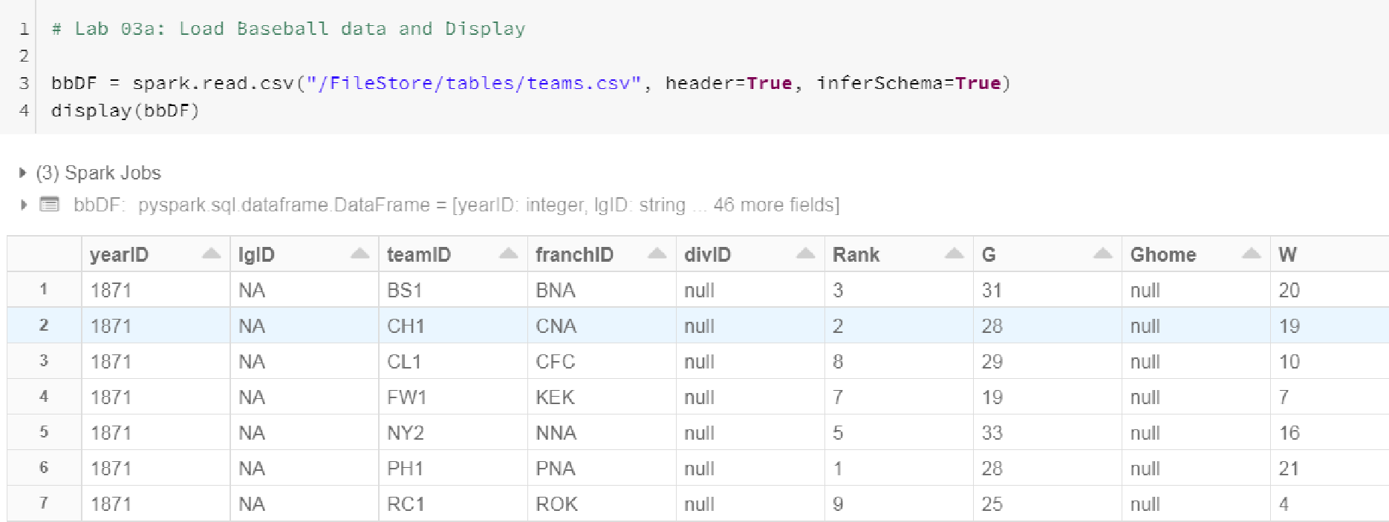
Lab 03a
Which Correlates best to Baseball W(ins)? Hits,Run,HR or ERA45

Slide 24
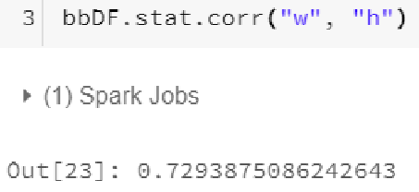
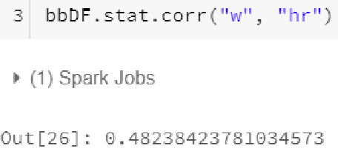
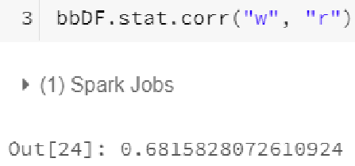
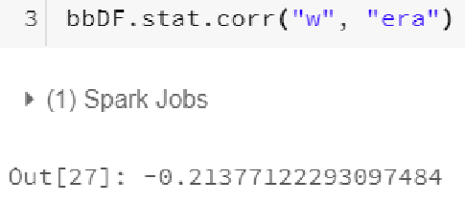
Lab 03b
Which Correlates most to W(ins)? Hits, Run, HR or ERA
46
Looks like H(its) has the strongest Correlation with W(ins)

Slide 25
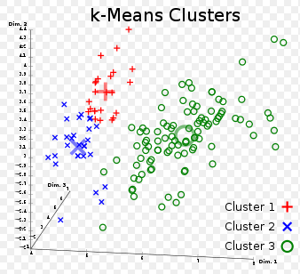
Lab 04
KMeans – Concepts
47
Is Unsupervised Clustering. It splits a datasets into number clusters based on similarity of points. For example, can break down sales into purchasing groups
Algorithm:
Starting with K clustroids - User specified/pick random points in space/pick random points
Calculate cluster membership for each data points – find closest clustroid
Recompute clustroid as avg of cluster member points
Repeat steps 2 and 3 until converge
or reach limit in # iterations
Data points are set of numeric values

Slide 26
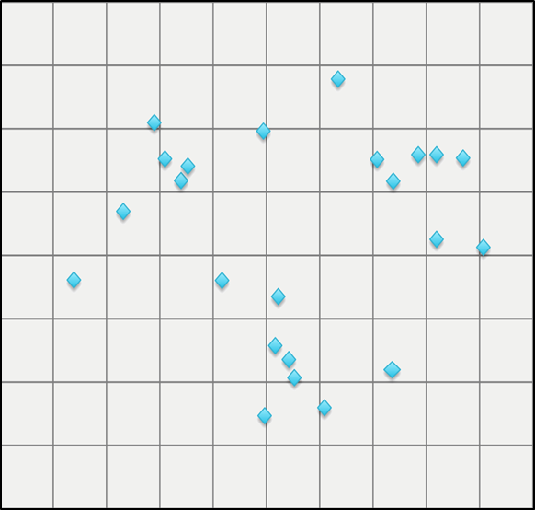
How Cluster Algorithms work (1 of 2)
48
1. Which Nodes are in which clusters?
Note you manually define the Number of Clusters you want – Can use Canopy function to do this beforehand

Slide 27
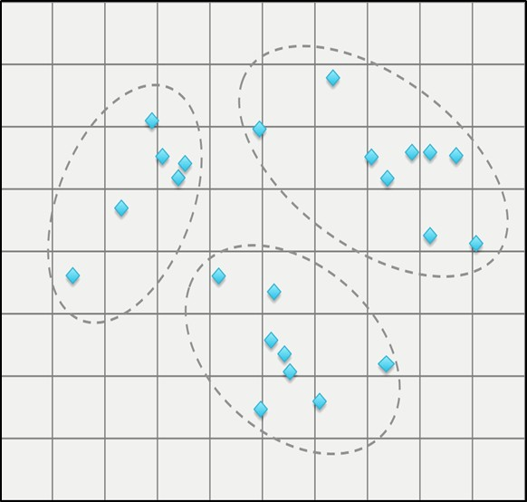
How Cluster Algorithms work (2 of 2)
49
2. Here's the final iteration where KMeansKMeansPredict decided which nodes were in the (User-defined) 3 clusters
But how did we get here?
See next slides for the details

Slide 28
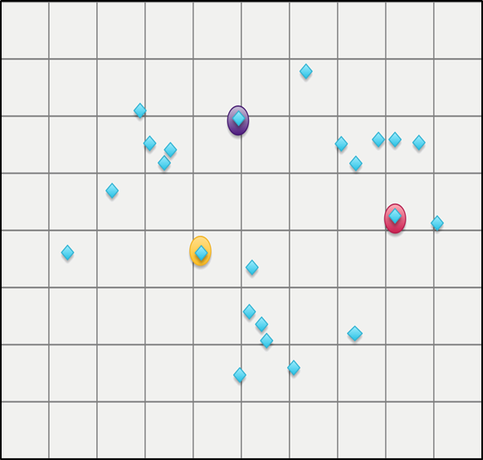
How KMeans works (1 of 6)
50
1. First choose random points as cluster centers (Centroids). Note you decide up front number of clusters you want, in our case, 3

Slide 29
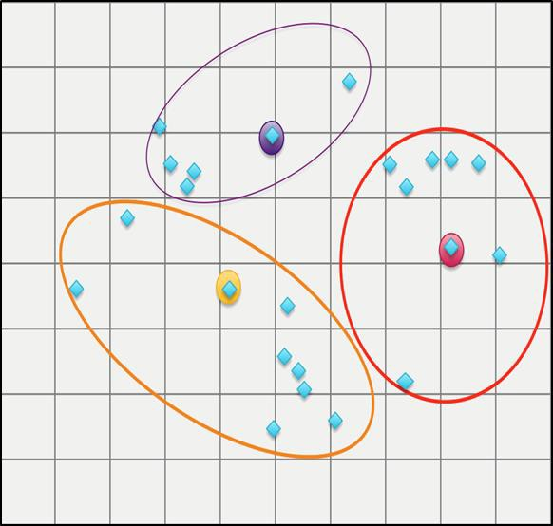
How KMeans works (2 of 6)
51
2. Find all Nodes closest to each center point

Slide 30
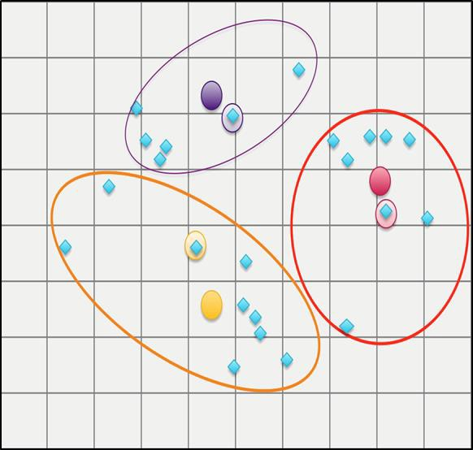
How KMeans works (3 of 6)
52
3. Find the average center of each cluster

Slide 31
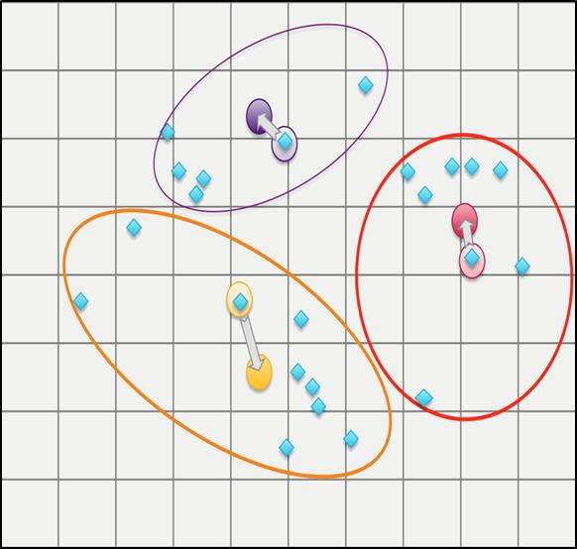
How KMeans works (4 of 6)
53
4. If centers change (by a minimum threshold), iterate again. If not stop

Slide 32
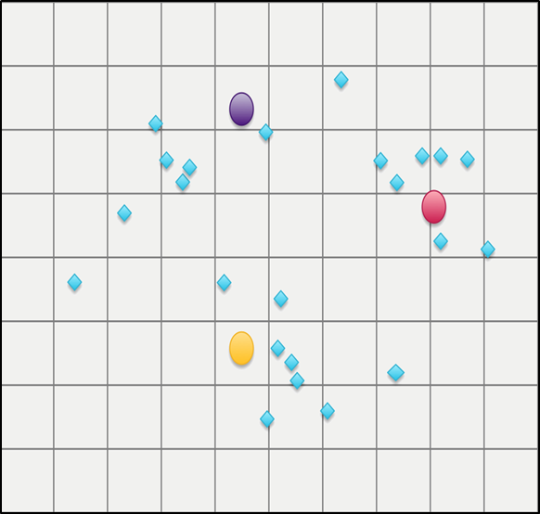
How KMeans works (5 of 6)
54
5. Repeat (Find all Nodes closest to center, find the center (avg) of each
cluster. If centers change by minimum threshold, iterate again)

Slide 33
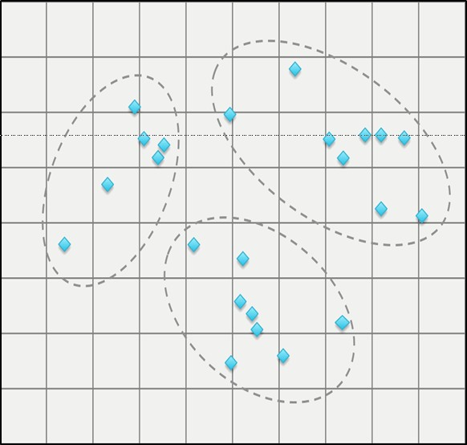
How KMeans works (6 of 6)
55
6. Finished. Here is the best fit. Each node defined in a cluster

Slide 34
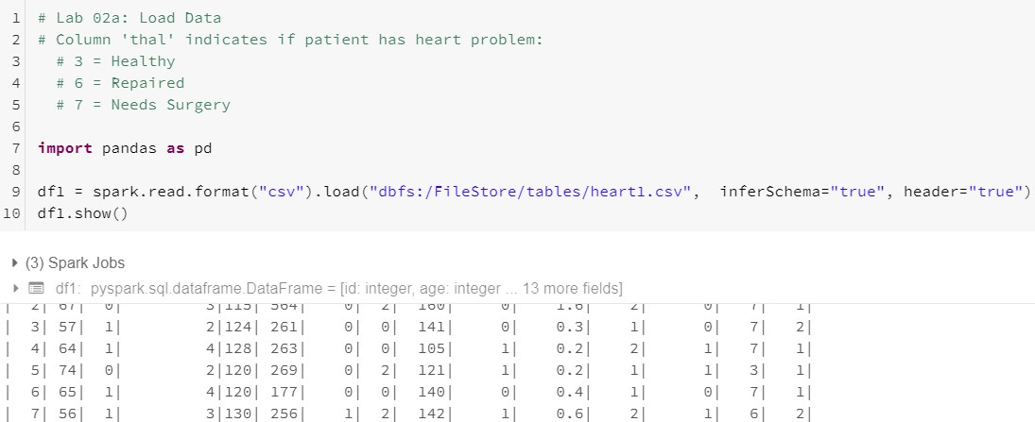
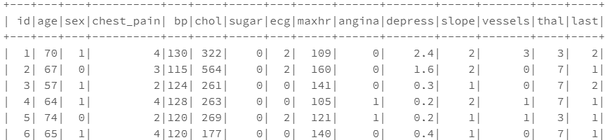
Lab 04a
Load DataFrame
56

Slide 35
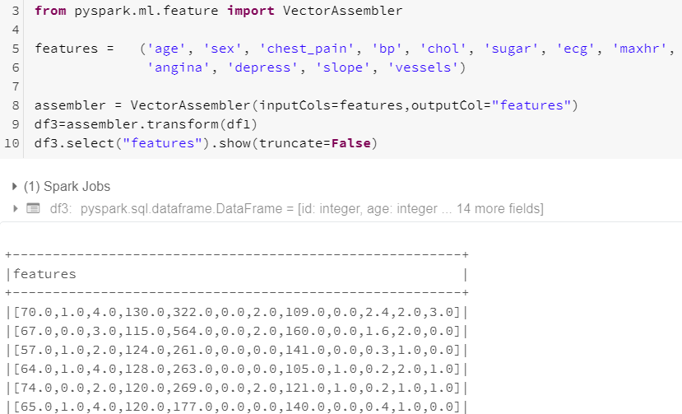
Lab 04b
Assign X-variables to Vector and Display
57
Create Vector of X-var

Slide 36
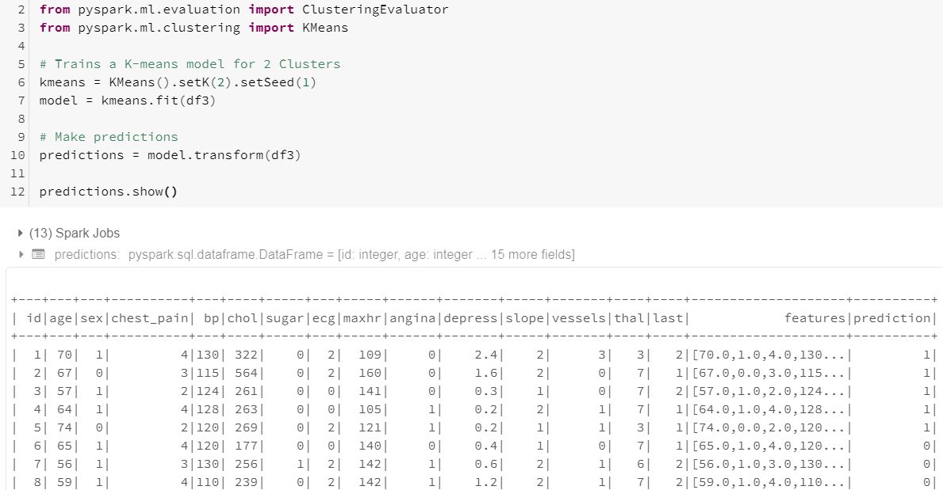
Lab 04c
Run KMeans for 2 Clusters and Display
58
setK() = Tell KMeans # of Clusters to create

Slide 37
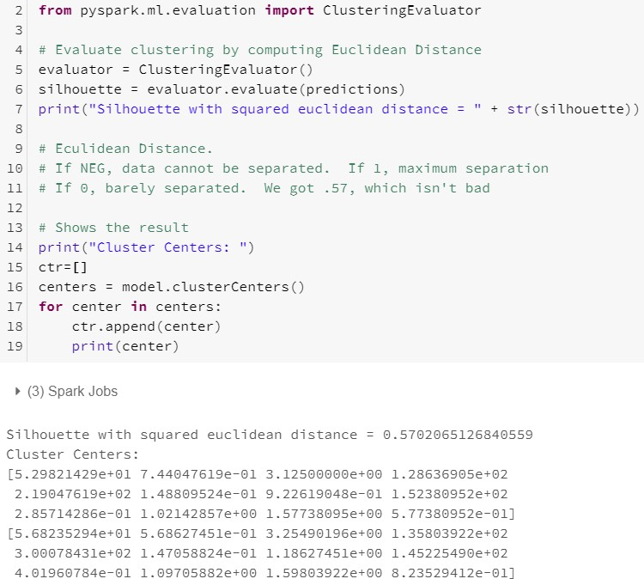
Lab 04d
Evaluate Clusters for Euclidean Distance. Show Centroids
59
Are Clusters far enough apart to
be considered Accurate?
Show Cluster centers

Slide 38
Current Topic
60
Machine Learning concepts
Terminology
MLib (RDD) vs ML (DataFrames)
Collaborative Filtering (ALS) example
ML (non-Predictive) examples
Correlation
KMeans
ML Predictive concepts
Transformer, Estimator, Pipeline
ML Predictive examples
Logistic Regression
Gradiant Boost Tree
Decision Tree

Slide 39
ML Pipeline Terminology (1 of 2)
61
Spark 3.0 ML standardizes APIs for machine learning algorithms to make it easier to combine multiple algorithms into a single pipeline, or workflow
DataFrame: Spark ML uses DataFrame from Spark SQL as an ML dataset, which can hold a variety of data types. E.g., a DataFrame could have different columns storing text, feature vectors, true labels, and predictions
Transformer: A Transformer is an algorithm which can transform one DataFrame into another DataFrame. For example, VectorAssembler is a Transformer as it takes the input dataframe and returns the transformed dataframe with a new column which is Vector representation of all the features. An ML Model is a Transformer which transforms DataFrame with features into a new DataFrame
Estimator: An Estimator is an algorithm which can be fit on a DataFrame to produce a Transformer; e.g., a learning algorithm is an Estimator which trains on
a DataFrame and produces a Model. For example, LogisticRegression is an Estimator which returns a LogisticRegresionModel (a Transformer)

Slide 40
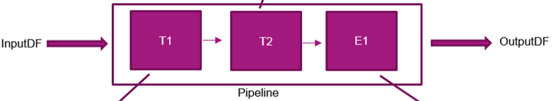

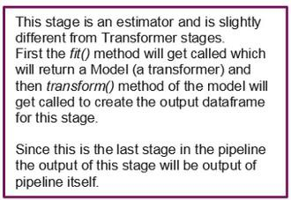
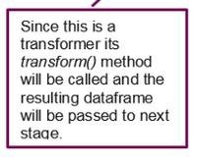
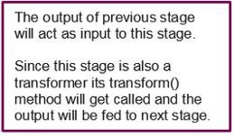
ML Pipeline Terminology (2 of 2)
62
Pipeline: A Pipeline chains multiple Transformers (X-Y variables: VectorAssembler) and Estimators (ML Algorithm) together to specify an ML workflow. Spark provides a class which forms by combining different PipelineStages (Estimator and Transformers) which run in sequential order
fit() method creates the Model on train set
transform() method Scores the Model (Makes Prediction on test set)

Slide 41
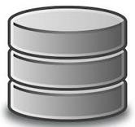
How ML Pipeline Works
63
A Pipeline is specified as a sequence of stages, and each stage is either a Transformer or an Estimator. These stages are run in order, and the input DataFrame is transformed as it passes through each stage. For Transformer stages, the transform() method is called on the DataFrame. For Estimator stage, the fit() method is called to produce a Transformer
VectorAssembler
Tokenize
VectorAssembler
HashingTF
ML Algorithm
Logistic Regression
Pipeline (2 Transformers
+ 1 Estimator)
Transformer
Pipeline.fit()
Logistic Regression Model
Above the top row represents a Pipeline of 3 stages. The first 2 (Tokenizer and HashingTF) are Transformers and the 3rd (LogisticRegression) is an Estimator. The bottom row represents data flowing through the pipeline, where cylinders are DataFrames
http://www.slideshare.net/databricks/dataframes-and-pipelines

Slide 42
Current Topic
64
Machine Learning concepts
Terminology
MLib (RDD) vs ML (DataFrames)
Collaborative Filtering (ALS) example
ML (non-Predictive) examples
Correlation
KMeans
ML Predictive concepts
Transformer, Estimator, Pipeline
ML Predictive examples
Logistic Regression
Gradiant Boost Tree
Decision Tree

Slide 43
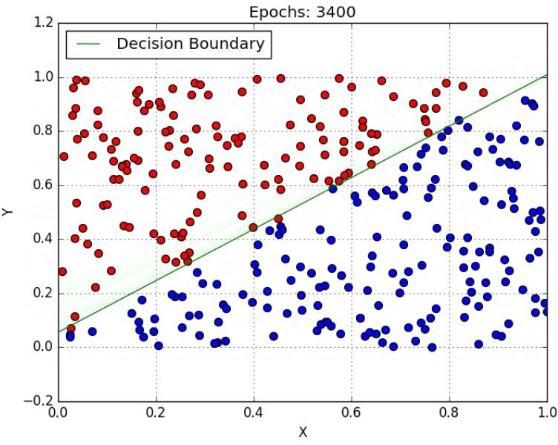
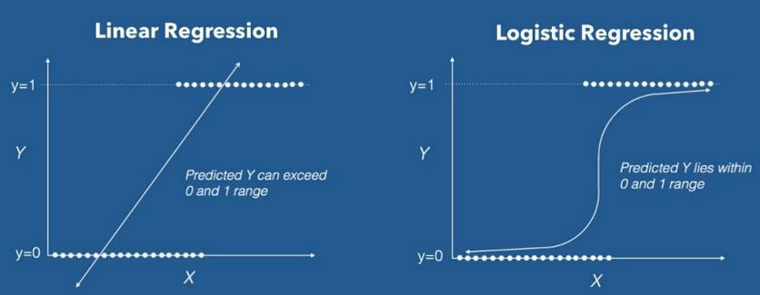
Lab 05
Logistical Regression – Concepts
65
Logistic Regression is a Machine Learning algorithm which is used for the classification problems, it is a predictive analysis algorithm and based on the concept of probability. In order to map predicted values to probabilities, we use the Sigmoid function. The function maps any real value into another value between 0 and 1

Slide 44
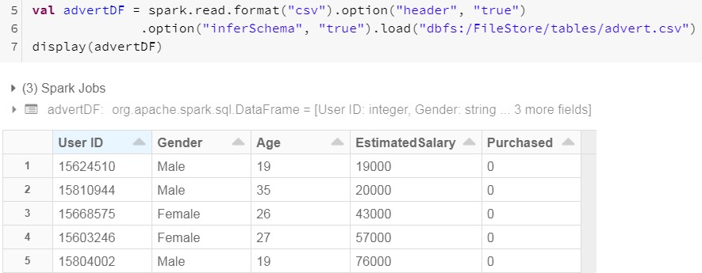
Lab 05a
Make 'Purchase' Prediction: Load Data
66
Here's the Data. We wish to predict the Y-variable 'Purchase' based on 3 x-
variables (Gender, Age, Salary)
x x x y

Slide 45

Lab 05b
Split DataFrame into TRAIN and TEST DataFrames
67
We need 2 DataFrames; one to build the Model and one to Score (or Make
Prediction using the Model)
We use Seed so DataFrame contents will be same if run it again

Slide 46


Lab 05c
Convert STRING data type into Numeric
68
Spark ML requires all X-variables to be Numeric.
We can use 'StringIndexer' and 'OneHotEncoder' to do this
Was
Now this

Slide 47

Lab 05d
Format X-vars as Vector, then Normalize. Define Y-variabl6e9
3 X-vars
Y-var

Slide 48

Lab 05e
Tie X-vars and Y-var to Logistic Regression (LabelPoint)
70
Point LogisticRegrression ML function to the X and Y variables
3 X-vars in Vector Y-var

Slide 49

Lab 05f
Assemble Pipeline, cache TRAIN, Create Model via fit()
71

Slide 50


Lab 05g
Score Model via transform() on TEST DataFrame
72
Actual
Predict
3 out of 4 isn't bad

Slide 51


Lab 05h Calculate Model Accuracy via
BinaryClassificationEvaluator
73

Slide 52
Lab 6
Logistical Regression again
74
Let's do another one. This time we'll walk through each Process in a little more
detail including:
Cross Validation function to minimize Error of the Model
Goal: We wish to Predict if your Income < $50,000 or Income > $50,000

Slide 53

Step 1: Lab 06a/f
Load Data into Schema, create TRAIN/TEST. Then examine 75
Here's the Data. We wish to predict the Y-variable 'Income' based on Number
of X-variables
x x x x x x x
y

