Slide 1
Module 11-4 – Spark Machine Learning
https://www.bmc.com/blogs/python-spark-machine-learning-classification/ https://vishalmnemonic.github.io/DC11/ https://medium.com/@Sushil_Kumar/machine-learning-pipelines-with-spark-ml- 94cd9b4c973d

Slide 2
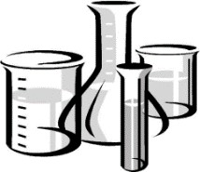
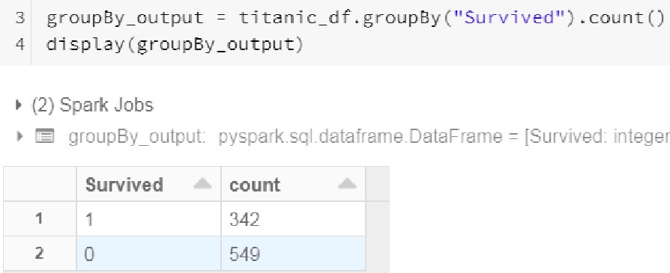
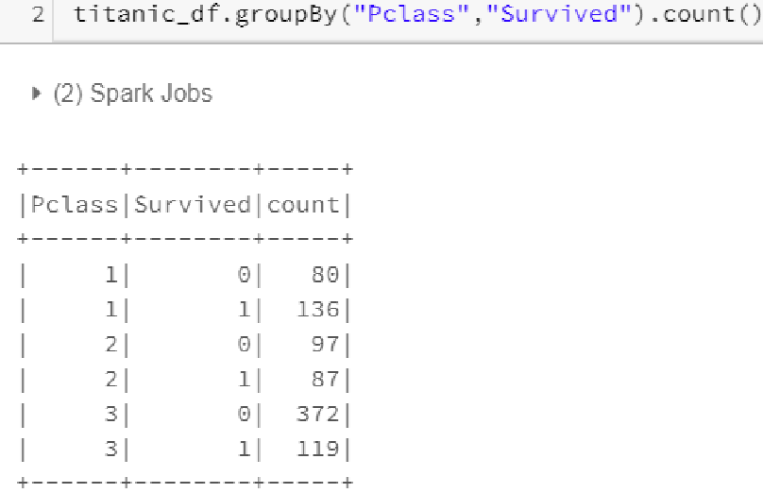
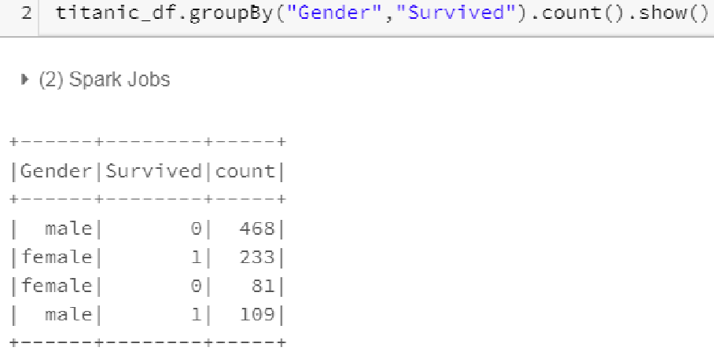
Lab 08b
View Statistical Data
111

Slide 3
Lab 08c
Clean the Data
112
We create a Defined Function to find NULLs
Fix misspelled Salutations (Mme > Miss
Calculate Mean Age for the NULLs based on Salutations
Fix NULLs for 'Embarked' columns
Drop 'Cabin' column since too many NULLs
Create new column 'Family_size' via calculation of 2 existing columns

Slide 4
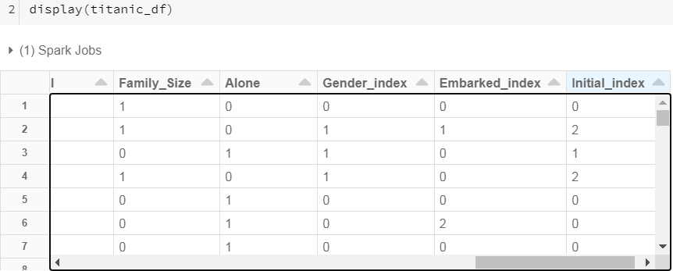
Lab 08d
Via 'StringIndexer', convert Categorical to Numeric
113
After we convert to Numeric, Pipeline and Transform

Slide 5
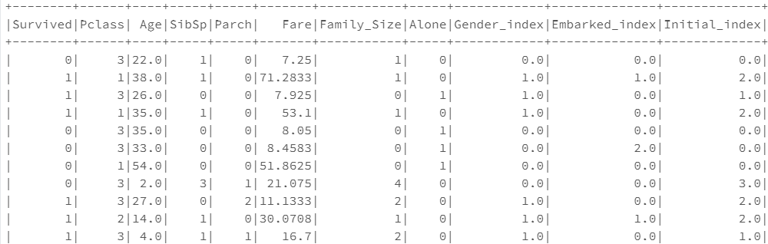
Lab 08e
Drop Columns not Required and View
114

Slide 6
Lab 08f Put all X-variables in a Vector and Transform.
Then split into TRAIN and TEST
115

Slide 7
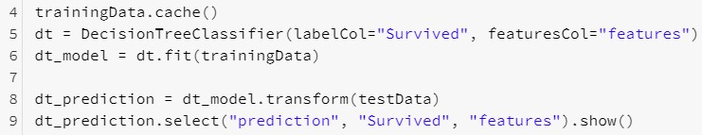
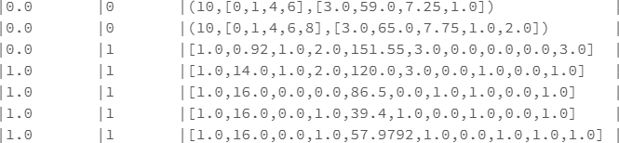
Lab 08g
Run Decision Tree to create Model. Then make Prediction 116
Note I cache TRAIN since this is an iterative process

Slide 8
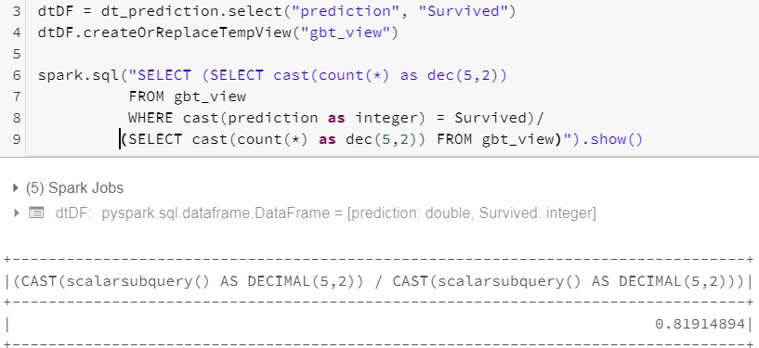
Lab 08h
Evaluate Accuracy of Decision Tree
117

Slide 9
Review Questions
118
What is the difference between MLlib and ML?
MLlib for RDD, ML for DF
What is a Transformer?
Transforms one DataFrame into another DataFrame
What is an Estimator?
Takes DF and produces a Model
Describe Feature Vectors
Create a single features columns by concatenating multiple X-var columns
What does fit() do?
Will run feature processing, model tuning, and training in a single call and return the best model

Slide 10
Summary
119
In this module, you became familiar with the following terms and concepts:
Difference between Supervised and Unsupervised
Four common MLlib functions
How MLlib Models are created
Hands-on MLlib labs (RDDs)
KMeans clustering
Collaborative Filtering
Classification including:
Logistic Regression
Support Vector Machines (SVM)
NaiveBayes
Decision Trees
Predicting Home price (Linear Regression and Normalization)
Spark 2.x ML (Using DataFrames)
Correlation
Predicting Bike rentals (GBT regression
Predicting Titanic Survivors (Random forest)

Slide 11
120

Slide 12

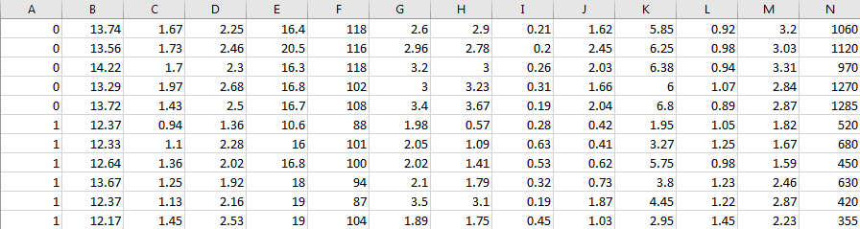
KMeans – Scenario
121
Have 178 rows, 3 classes of wine and 13 features (x-var). Using KMeans, create 3 Clusters
Class
Alcohol
Malic acid
Ash
Alcalinity of ash
Magnesium
Total phenols
Flavanoids
Nonflavanoid phenols
Proanthocyanins
Color intensity
Hue
OD280/OD315
Proline
// Create Hive table and load data (Already done for you) create table wine (class float, alcohol float, acid float, ash float, alcalinity float, mag float, phenols float, flavanoids float, nonflavanoid float, proantholcyanins float, color float, hue float, od float, proline float) row format delimited fields
terminated by '\,'; load data local inpath '/opt/wine2.csv' into
table wine;
http://www.slideshare.net/MammothData/intro-to-apache-spark-lab

Slide 13
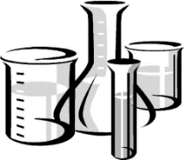
Demo 02
KMeans – Load Data
122
import org.apache.spark.sql.functions._
import org.apache.spark.sql._
val rdd1 = sc.textFile("file:/opt/wine2.csv")
case class schema1(label: Double, alcohol:Float, acid:Float,ash:Float, alcalinity:Float
,mag:Float, phenols:Float, flavanoids:Float, nonflavanoid:Float, proanthocyanins:Float,
color:Float, hue:Float, od:Float, proline:Float)
val rdd2 = rdd1.map(s => s.split(",")).map(c => schema1( c(0).toDouble, c(1).toFloat, c(2).toFloat, c(3).toFloat, c(4).toFloat, c(5).toFloat, c(6).toFloat, c(7).toFloat,
c(8).toFloat, c(9).toFloat, c(10).toFloat, c(11).toFloat, c(12).toFloat, c(13).toFloat ))
val df = rdd2.toDF() rdd2.toDF().createOrReplaceTempView("wine")
spark.sql("select label, count(label) as ct from wine
group by label order by label").show() // To make for easier viewing, let's use Spark SQL
val featureCols = spark.sql("select flavanoids, acid, proline from wine")
featureCols.take(3)
Note Spark requires Float data types for X-vars and Y-var. See next slide to convert them to Floats

Slide 14
Demo 02
KMeans – Create Model and Predict
123
Now let's create a Vector of 3 Float data type X-vars and create a Model, then Predict
import org.apache.spark.mllib.linalg.Vectors import org.apache.spark.mllib.clustering.KMeans
Code putting X-var into an Array
val features = spark.sql("select flavanoids, acid, proline from wine").rdd.map
{case Row(flavanoids:Float, acid:Float, proline :Float) =>
Vectors.dense(flavanoids, acid, proline) }
features.cache // Cache since it iterable features.collect()
Now X-vars are Float data types
val | numClusters = 3 | // Want 3 clusters
val | numIterations = 40 | // Repeat up to 40 | times
val | model = KMeans.train( | features, numClusters, | numIterations)
Actual
val predictions = features .map(features => model.predict(feature))
val counts = predictions.map(p => (p,1)).reduceByKey(_+_)
counts.collect()
Predict

Slide 15

Demo 02
KMeans – Compare Actual to Prediction
124
Compare Actual to Prediction. Not bad
val featureCols = df.selectExpr( "cast(label as Double)", "cast(flavanoids as Double)",
"cast(acid as Double)", "cast(proline as Double)" )
featureCols.take(1)
// Put in LabelPoint ( in other words, Y-var and X-variables must be in an Array format) val features = featureCols.rdd.map{case Row(l:Double,f:Double,a:Double,p:Double) =>
(l,Vectors.dense(f,a,p))}
features.take(1)
// Actual VS. Predict
Actual
Predict
val predictions = features.map(c => (c._1, model.predict(c._2))) predictions.collect()
//Roll-up the Actual/Predict and their counts
val counts = predictions.map(c => (c,1)).reduceByKey(_+_)
counts.collect()
Actual
Prediction % correct
0: 46/59 = 78% 1: 50/71 = 70% 2: 29/48 60%

Slide 16

125

Slide 17
Classification Functions (Supervised)
126
Classification aims to divide items into categories. The most common classification type is binary classification, where there are two categories, usually named positive and negative. If there are more than two categories, it is called multi-class classification
Linear SVMs supports only binary classification, while Logistic regression
supports both binary and multi-class classification problems
We'll be demonstrating:
─ Logistical Regression
─ Support Vector Machines (SVM)
─ NaiveBayes
─ Decision Trees

Slide 18
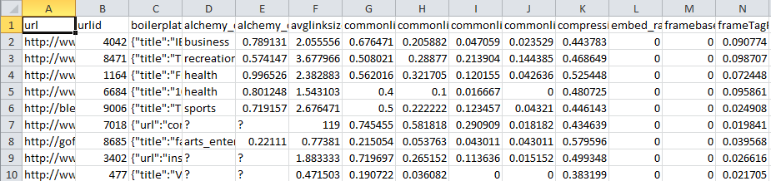
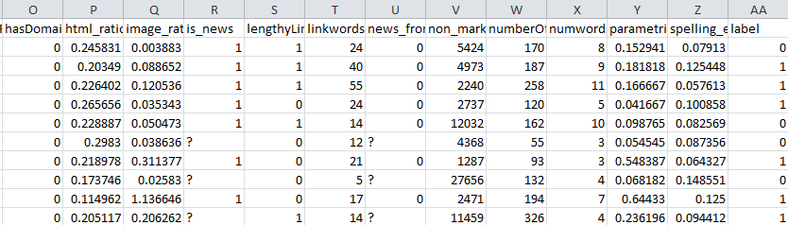
Logistic Regression, Support Vector Machines,
NaïveBayes, and Decision Tree (Supervised)
127
We will now be classifying data based on four MLlib (Logistic Regress, Support Vector Machines, NaiveBayes and Decision Trees)
Here's the data. These are web pages (URL) and their attributes
Goal: Predict which web pages will be persistently popular (evergreen) or passing fad
26 columns 0-25 X-variables 26 – Y-var (Labe | l)
Label
1 = Evergreen
0 = Fad

Slide 19
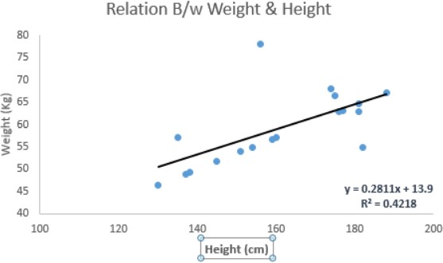
Lab 03 (Using MLLIB – RDD example)
Linear Regression – Concepts
128
In this technique, the dependent variable is continuous, independent variable(s) can
be continuous or discrete, and nature of regression line is linear
Linear Regression establishes a relationship between dependent variable (Y) and one or more independent variables (X) using a best fit straight line (also known as regression line)
It is represented by an
equation Y=a+b*X + e, where a is intercept, b is slope of the
line and e is error term. This equation can be used to predict the value of target variable based on given predictor variable(s)

Slide 20
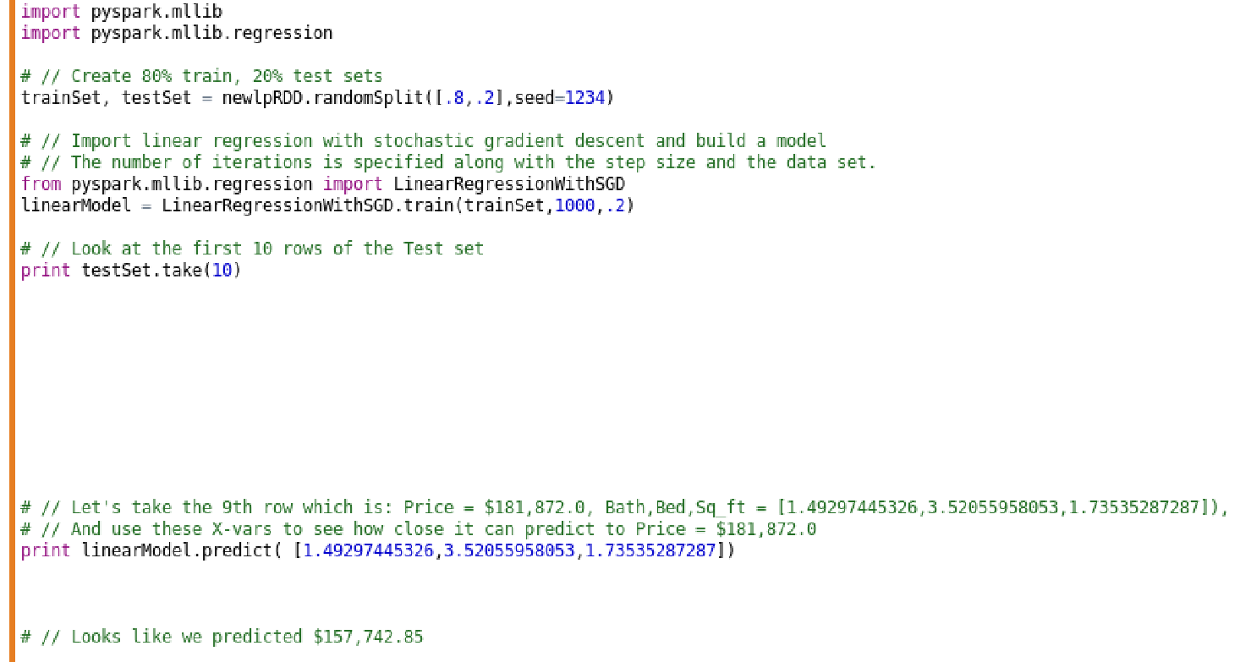
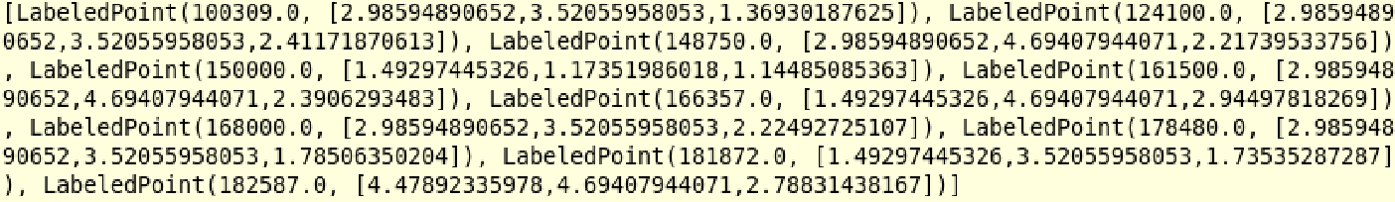

Lab 03f
Predict Home Prices: Create Train/Test, Model, and Prediction 129
Now create Model and make Prediction of Price based on beds, baths, sq_ft.
We use same X- var as 9th row in Test set and see which value it spits back for Price
The Actual Price =
$181,872. My
Prediction was
$157,742. Not
bad, but not great

Slide 21

Predict Home Prices (Linear Regression and Normalization)130
Over the next many pages, we will take a Housing dataset and use Linear Regression along with Normalization to make a prediction on Home prices. Note that we will use both DataFrames and RDDs in this example.

Slide 22
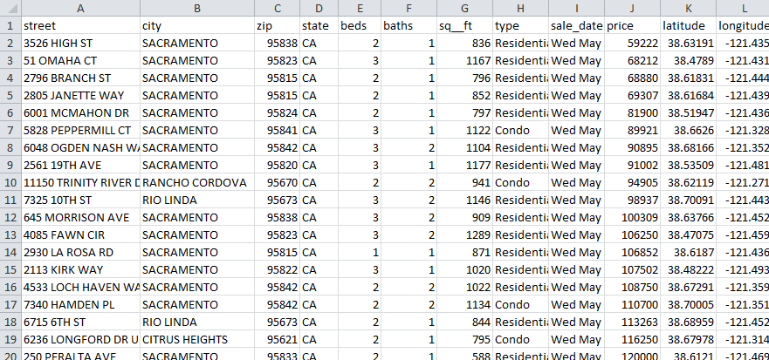
Predict Home Prices: Scenario (Supervised)
131
We have 985 rows with 12 columns as follows. We wish to predict home Price (Y-var) based on beds, baths, and sq_ft (X-vars) using Linear Regression. We will also Normalize the data using the StandardScaler library
3 X-variables 1 Y-variable

Slide 23
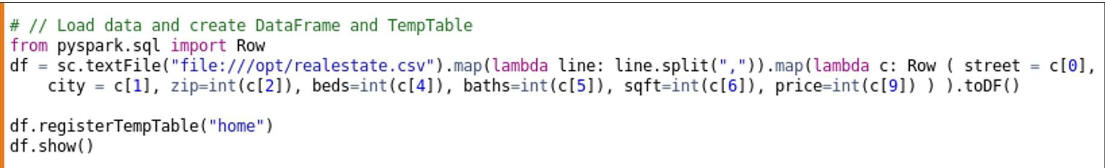
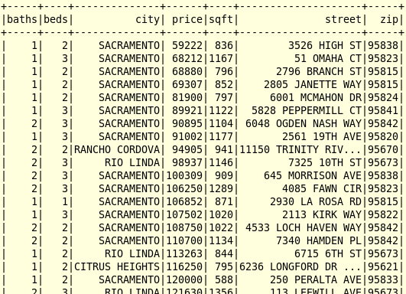
Lab 03a
Predict Home Prices: Load Data
132
Load data and create DataFrame and TempTable. Confirm can query

Slide 24
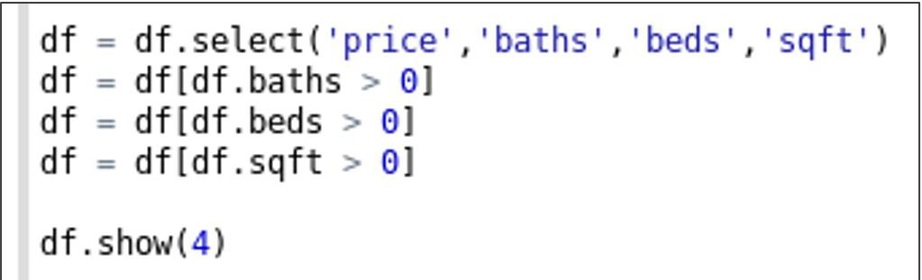
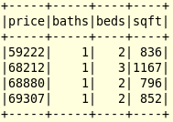
Lab 03b
Predict Home Prices: Select Y-var and X-vars
133
Pluck out 4 columns. We want to predict Price based on baths, beds, and sq_ft
So Price will be the Label (Y-var) and baths, beds, and sq_ft will be the
Feature Vectors (X-variables)

Slide 25
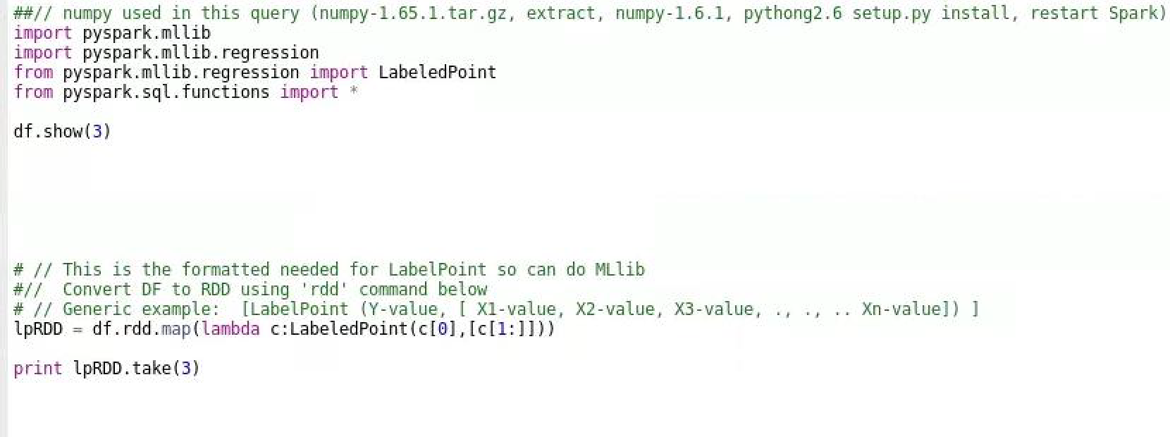
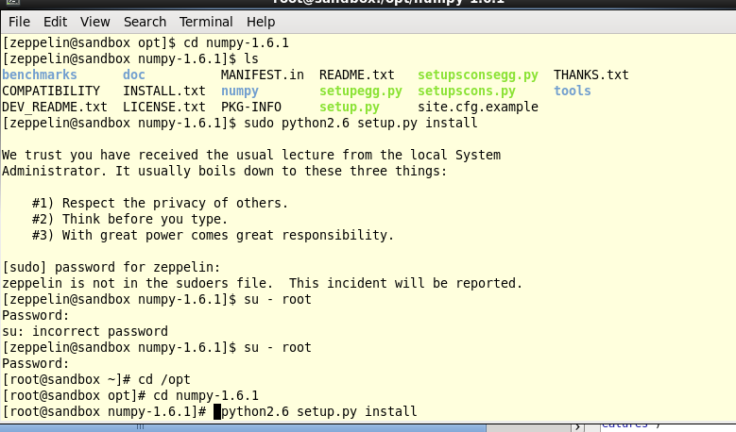
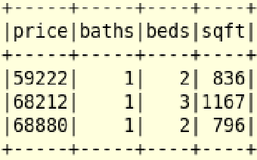
Lab 03c
Predict Home Prices: Create LabelPoint
134
Put numpy-1.65.1.tar.gz.gz in
/OPT folder
Go into File Manager and Extract su - root
cd /numpy-1.6.1
python2.6 setup.py install
We want to predict Price based on baths, beds and sq_ft
So we create a LabelPoint where:
Price will be the Label (Y-var)
baths, beds, and sq_ft will be the Feature Vectors (X-variables) ^{Restart Spark2 and it should}
work

Slide 26
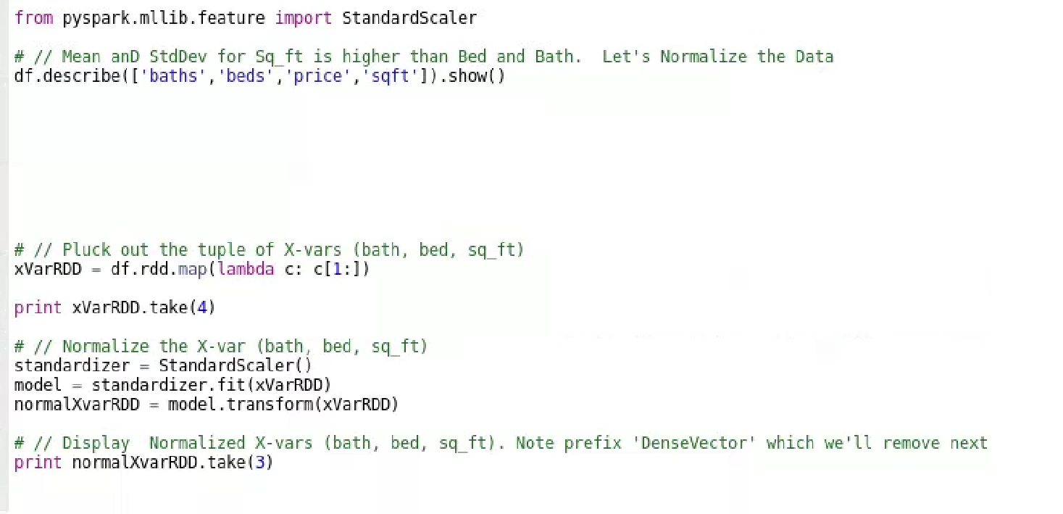
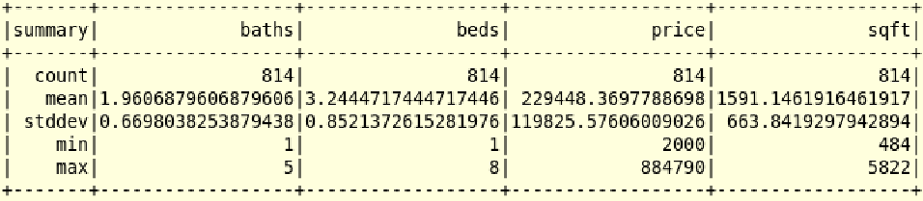
Lab 03d
Predict Home Prices: Normalize Data
135
Notice how sq_ft's mean and stddev are so much higher than baths and beds
Let's Normalize the data using StandardScaler. But afterwards, we have 'DenseVector' that now needs to be removed so as to put back into LabelPoint format

Slide 27
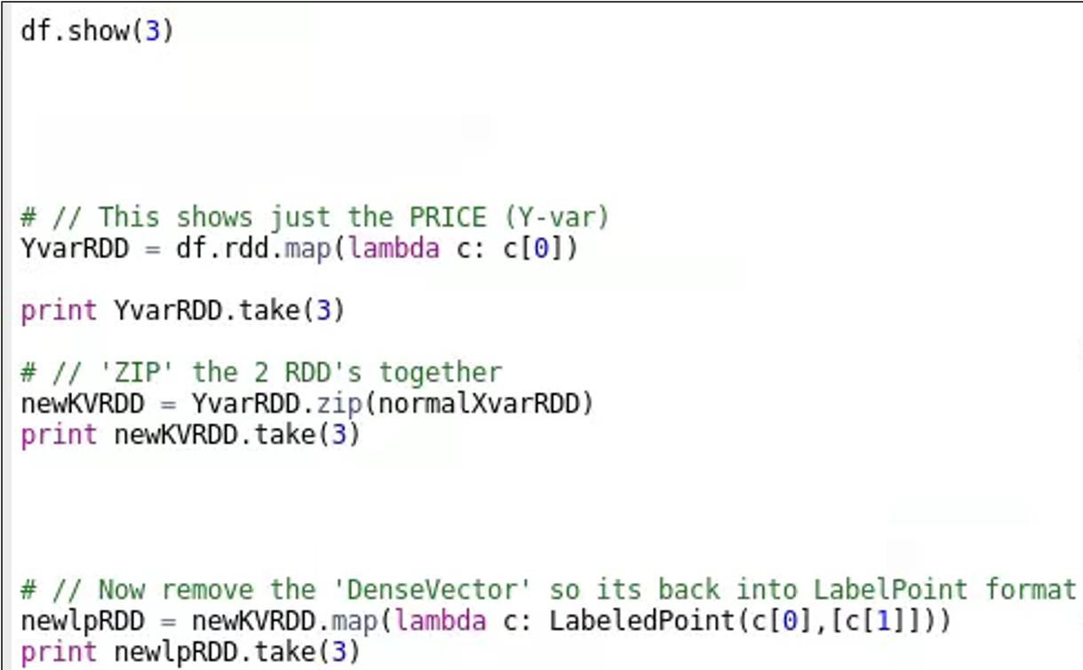
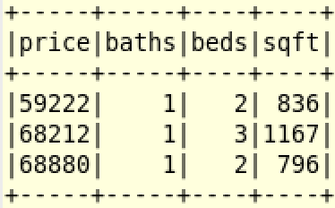

Lab 03e
Predict Home Prices: Create new LabelPoint
136
Re-manufacture LabelPoint of Price with Array [bed, bath, sq_ft] using Normalized values

Slide 28
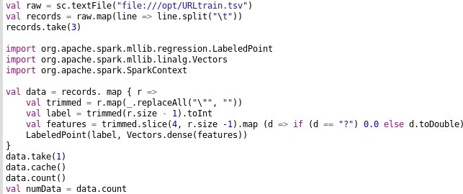
Lab 6.04a
Logistic Regression, Support Vector Machines, NaïveBayes, a
nd
Decision Tree
137
Load data, clean data (remove ' " ' and replace '?' with '0' and put in LabelPoint format
Features 5 - 25

Slide 29
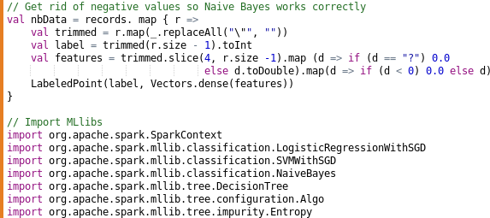
Lab 04b
Logistic Regression, Support Vector Machines, NaïveBayes, a
nd
Decision Tree
138
For NaiveBayes, must not have negative values. So clean data and put in LabelPoint format. Then load the 4 MLlib functions we'll be using and their dependency libraries

Slide 30
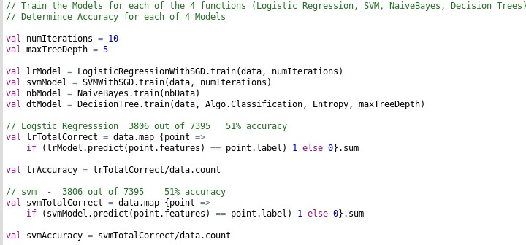
Lab 04c
Logistic Regression, Support Vector Machines, NaïveBayes, a
nd
Decision Tree (1 of 2)
139
Since we have a binary Y-variable, it's easy to test for Accuracy.
Accuracy = number of correct rows / total # of rows
Looks like Logistic Regression and SVM didn't do too well. Barely 50% accuracy

Slide 31
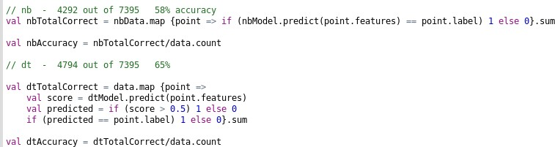

Lab 04c
Logistic Regression, Support Vector Machines, NaïveBayes, a
Decision Tree (2 of 2)
nd
140
NaïveBayes did slightly better (58%) , and Decision Trees did best of all
(65%)
Note there is an Appendix Lab in this Zeppelin note for Linear Regression

Slide 32
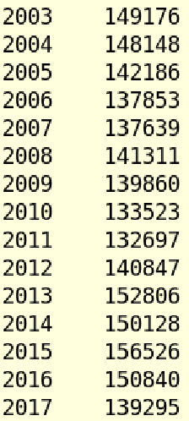
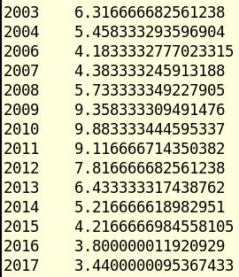

Lab 06
Correlation: Does Crime Freq Correlate to Unemployment Rate?141
%spark2.pyspark
#// spark.table('sf_unemploy2').createTempView("unemploy_view")
Open Adv_Spark: Mod 04b:
ML (Correlation)
#// spark.table('yr_crime').createTempView("yr_crime_view")
#// spark.sql("select u.pcent, c.freq from unemploy_view u join yr_crime_view c on u.yr =
c.yeartime").show()
#// spark.sql("create table corr_crime_unemploy as select u.pcent, c.freq from
Yr – Freq (# crimes)
unemploy_view u join yr_crime_view c on u.yr = c.yeartime").show()
#// spark.sql("select * from corr_crime_unemploy").show() df1 = spark.table("corr_crime_unemploy") df1.printSchema()
from pyspark.mllib.stat import Statistics
df1.stat.corr("pcent", "freq")
Yr – Pcent (Unemployment rate)

Slide 33

Topics
142
Machine Learning concepts
2 types of Spark Machine Learning
How Models are created
Supervised/Unsupervised Learning
Spark MLib functions (RDDs)
KMeans cluster algorithm
Collaborative Filtering recommender
Logistics Regression, Support Vector
Machines, Naïve Bayes, Decision Trees
Linear Regression and Normalization
Spark ML functions (DataFrames)
Correlation
GBT Regression
Random Forest

Slide 34
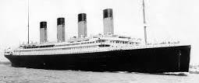
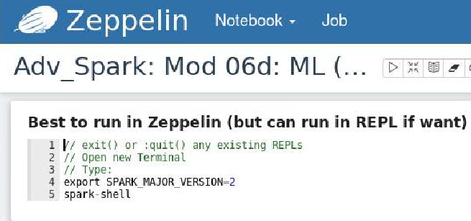
Predict Titanic Survivors (Random Forest)
143
Intro: This Scala notebook demonstrates creating an ML Pipeline to preprocess a dataset, train a Machine Learning model, and make predictions
Data: The dataset contains demographics on the passengers on the Titanic
Goal: In this challenge, we ask you to complete the analysis of what sorts of people were likely to survive. In particular, we ask you to apply the tools of machine learning to predict which passengers survived the tragedy
Approach: We will use Spark ML Pipelines, which help users piece together parts of a
workflow such as feature processing and model training. We will also demonstrate model selection (a.k.a. hyperparameter tuning) using Cross Validation in order to fine-tune and improve our ML model
https://benfradet.github.io/blog/2015/12/16/Exploring- spark.ml-with-the-Titanic-Kaggle-competition

Slide 35
Lab 08a
Predict Titanic Survivors: Know the Data
144
Want to predict Survived (Y-var) - Label based on X-var)
Passengerid Survived Pclass Name
Sex Age Sibsp Parch Ticket Fare Cabin
Embarked
Unique id
Survived (0 = No; 1 = Yes) -- Null in TEST Passenger Class (1 = 1st; 2 = 2nd; 3 = 3rd) Name
Gender (0 = Female; 1 = Male) Age
Number of Siblings/Spouses Aboard Number of Parents/Children Aboard Ticket Number
Passenger Fare Cabin
Port of Embarkation
(1 = Cherbourg; 2 = Southampton; 3 = Queenstown)

Slide 36
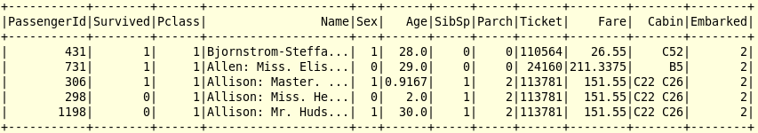
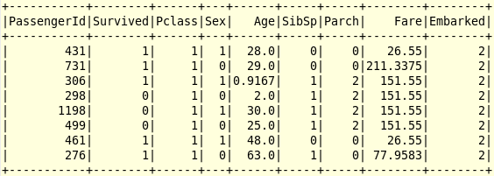
Lab 08b
Load and View Data Types and Data
145
We create a DataFrame by inferring the schema, then drop 3 X-variables
Just want the numeric data so dump 'Name', 'Cabin'. Drop 'Ticket' since not relevant

Slide 37
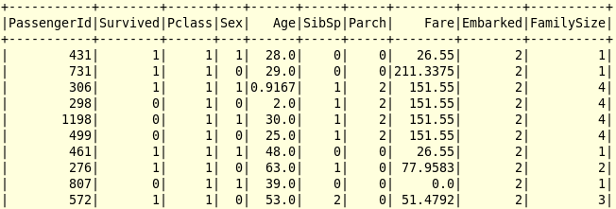
Lab 08c
Clean Data - Add Column 'FamilySize'
146
We suspect Families have a higher Survival rate so let's manufacture that column. Doing this is called 'Feature Enhancement' and can lead to more accurate predictions

Slide 38
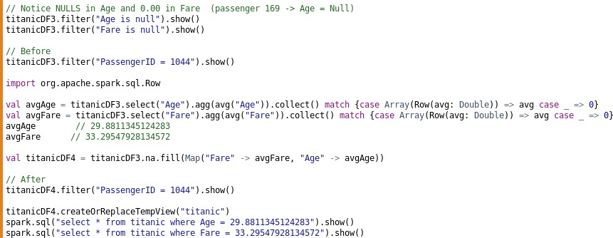


Lab 08d
Clean Data – Replace NULLs
147
Add avg(Age) and avg(Fare) for those rows where value = NULL
Before
After

Slide 39
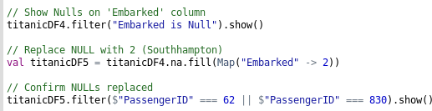


Lab 08e
Clean Data - Replace Empty Strings
148
Two rows have empty strings in the 'Embarked' column. Replace with ‘2'
Before
After

Slide 40
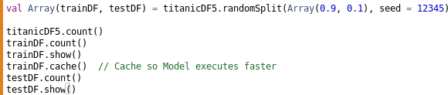
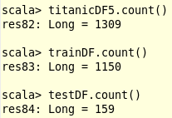
Lab 08f
Split DataFrame into TrainDF / TestDF
149
We will create a Decision Tree Model using TrainDF, then predict Survival on TestDF

Slide 41
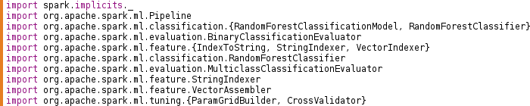
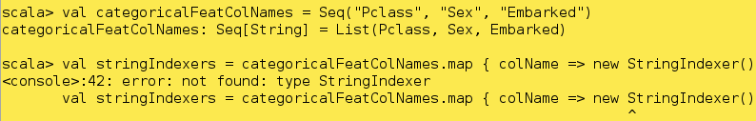
Lab 08g
import ML Packages
150
If you forget your IMPORTs, you'll get Error messages like the following (here I'm defining Categorical columns. If other words, numeric data that is not be mathematically rolled up)

Slide 42
Lab 08h
Index Categorical and Label Columns
151
There are two built-in transformers to index categorical Features to choose from:
Assemble all the Features into one vector (through VectorAssembler) and then use a VectorIndexer. The problem with VectorIndexer is that it will index every feature which has less than maxCategories (which you can set with setMaxCategories) no matter whether it is indeed categorical or not. In our case, there are categorical features with quite a few categories (Title for example) and quantitative features without too many different values (such as SibSp or Parch). That’s why I don’t think this is the way to go
Index every Feature, which you know is categorical, one-by-one with StringIndexer We will proceed with option 2 in order to have a bit more control over which Features
is getting indexed. Pclass, Sex, and Embarked are 3 categorical features we point to
(There are 3 Pclasse values, 2 Sex values and 3 Embarked values)

Slide 43
Lab 08i
Assemble All Features into Vector
152
Now that our Indexing is done, we just need to assemble all our Feature columns (X-var) into one single column containing a Vector regrouping all our features.
To do that, we’ll use the built-in VectorAssembler transformer

Slide 44
Lab 08j/k/l
Using Decision Tree Classifier, Retrieving Original Labels,
Creating Pipeline
153
08j: Here we point to name of our Y-variable (Label) called 'SurvivedIndexed' and all our Features called 'Features'
08k: IndexToString is the reverse operation of StringIndexer and will convert back our indexes to the original labels so they can be interpretable. Indeed, as indicated in the documentation for random forests, the call on the transform method of the model produced by the RandomForestClassifier will produce a predictioncolumn which will contain indexed labels which we need unindexed
08l: We first apply each StringIndexer for every one of our categorical features and our label, we then assemble every feature into one column. Then, we train our random forest and we finally convert back the indexed labels predicted to the original ones

Slide 45
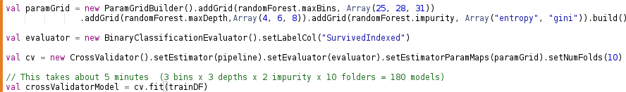
Lab 08m
Selecting the Best Model (5 Minute Query)
154
In order to select the best Model, you’ll often find yourself performing a grid search over a set of parameters, for each combination of parameters do a Cross validation and keep the best model according to some performance indicator. This is a bit tedious and spark.ml aims to simplify that with an easy-to-use API
A quick reminder if you don’t know what Cross validation is: you chose a number k of folds, for example 3, your dataset will be split into three parts, from those 3 parts, 3 different pairs of training and test data will be generated (2/3 of the data for the training and 1/3 for the test). Then the Model is evaluated on the average of the chosen performance indicator over the three pairs
Since our CrossValidator is an Estimator, we can obtain the best Model for our data by calling
the fit method on it:

Slide 46
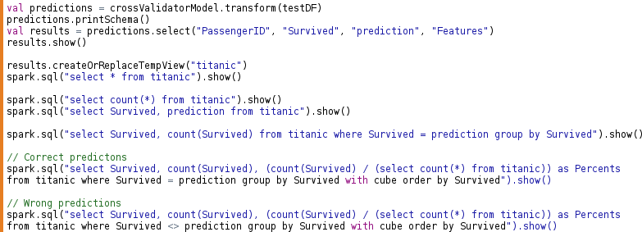
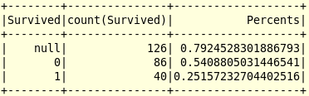
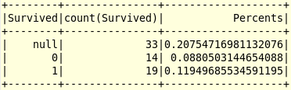
Lab 08n
Make Prediction Using TestDF
155
Using TRANSFORM,
we run our Model against the TestDF. From here we can view our results using either DataFrame syntax or better yet, SQL syntax
Correct Predictions: 79%
Wrong Predictions: 21%

Slide 47
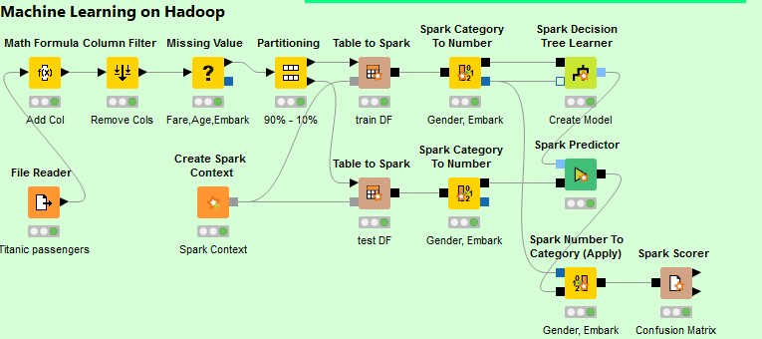

Using Knime application to do same thing
156
3rd Party Knime application allows you to use a GUI with a minimal of coding to do the same thing using Spark under-the-covers
Correct Predictions: 79%
Wrong Predictions: 21%

