Slide 1



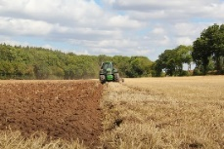

C7084 Big Data
Ed Harris
QUERY
DATA
Knowledge

Slide 2
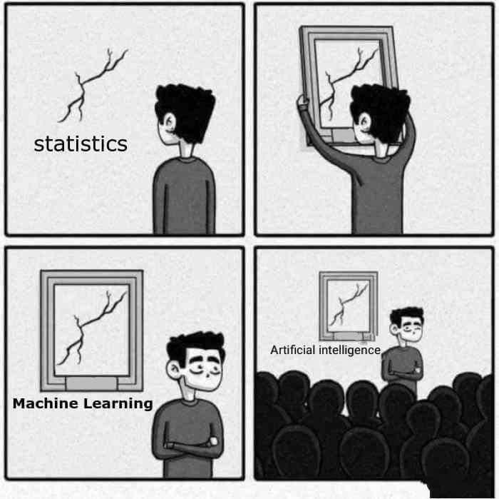
BIG
DATA

Slide 3
Table of Contents
Don't forget to start recording
Every session: community.cloud.databricks.com and Logon
In Left-pane, Click on 'Clusters' or 'Compute' and Terminate old Cluster Then click 'Create Cluster' button to create New one
Mod 00 – Intro and Setup
Mod 01 – Spark Architecture
Mod 02 – SparkSQL (Read/Write DataFrames/Tables)
Hacktivity 00 (Dates) / Hacktivity 01 (Air)
Mod 03 – SparkSQL (Transform)\
Mod 04 – Complex Data Types
Mod 05 – JSON (Optional)
Hacktivity 02 (Fly)
Mod 06 – Streaming
Mod 07 – Architecture-Spark UI
Mod 08 – Catalog-Catalyst-Tungsten
Mod 09 – Adaptive Query Execution
Mod 10 – Performance Tuning
Hacktivity 03 (Stream) / Hacktivity 04 (Air)
Mod 11 – Machine Learning

Slide 4
Module 01 – Spark Architecture
After completing this module, you should be able name core Spark components and their functions including:
What is Apache Spark?
Spark with Hadoop
Logging into Spark
Spark architecture - The Big Picture
Programming languages, Unified Stack, Cluster Manager, Data, BI tools
Resilient Distributed Datasets (RDD)
Spark cluster components
Driver, Spark Context, YARN, Worker nodes and Executors, Files
Glossary of Spark terminology

Slide 5

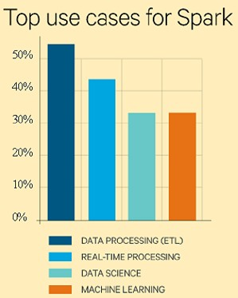
What is Apache Spark?
Is an Open-Source fast and general Processing engine for large-scale data processing done in-memory
Can run both inside or outside of Hadoop
Spark does not have its own file system. So must source from local file system, HDFS, HBase, Cassandra, etc
Supports many application languages including Java, Scala, Python, R, SQL
Supports various workloads including batch applications, iterative algorithms, visualizations and interactive queries along with Streaming
Not best choice for certain types of queries
(OLTP and small datasets)

Slide 6
Spark versus Hadoop – Spark with Hadoop
For developers, there is almost no overlap between the two. Hadoop is a framework in which you write MapReduce job by inheriting Java classes. Spark is a library that enables parallel computation via function calls
What Hadoop gives Spark
YARN Resource Management
Distributed File System
Disaster Recover capabilities
Data Security (ie: Knox, Ranger)
Distributed Data Platform
What Spark give Hadoop
Machine Learning
Caching
Streaming
Graph processing
In-memory processing
Spark can operate independent of Hadoop. Spark does not require: Hadoop, Map Reduce, HDFS, YARN/Tez, Hive, HBase, Mahout, Impala
However, in many instances, Spark depends on Hadoop's HDFS for input data and can optionally use YARN Resource Manager

Slide 7
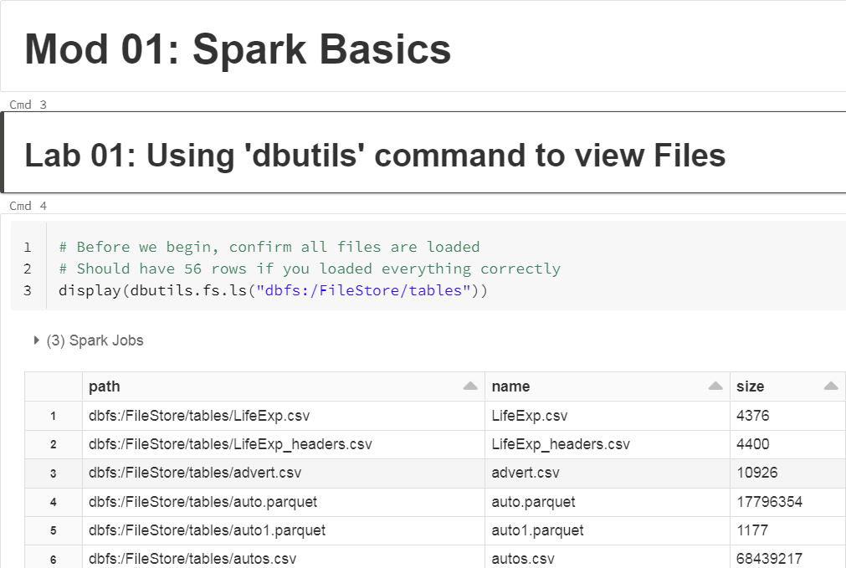
Before we Begin: Open Notebook Mod-01
From Databricks Community image, click on:
Workspace > Shared > Mod-01-Basics

Slide 8
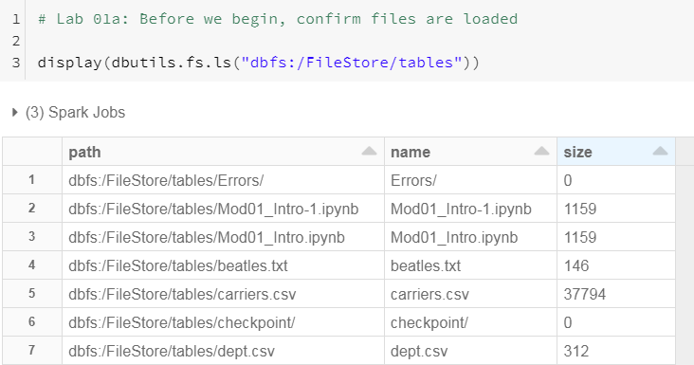
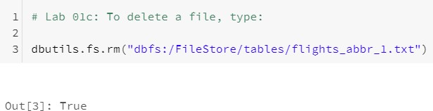
Lab 01: Using 'dbutils' to view Files
First, let's confirm we can view the Files we uploaded earlier as well as delete a file
using the 'dbutils' command

Slide 9
Lab 02: Language Interpreters
Databrick's UI is a new web-based notebook which brings data exploration, visualization, sharing and collaboration features to Spark. It support Python, but also a growing list of programming languages such as:
R (%R)
Markdown (%md)
Python (%py)
Scala (%scala)
SparkSQL (%sql),
Shell (%sh)
Hive (%hive)
Default language is shown in upper left-hand corner of Spark UI
Default language does not require language defined as first row in Cell
However if wish to use non-default language, must explicitly code it via %
Each Language has its own syntax for comments

Slide 10
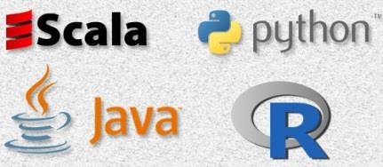
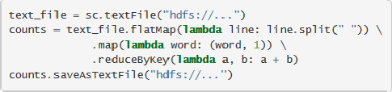
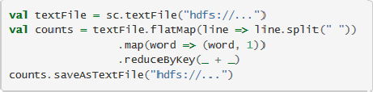
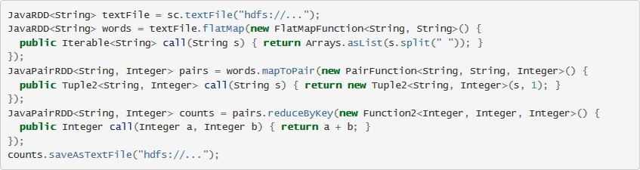
The Big Picture – Languages (1 of 2)
Programming Languages – Python, Scala, Java, R
Spark can use Python (./bin/pyspark), Scala (./bin/spark-shell), Java and R. Here's example of Python, Scala and Java languages to execute a wordcount
Python (pyspark)
Scala (spark-shell)
Java

Slide 11
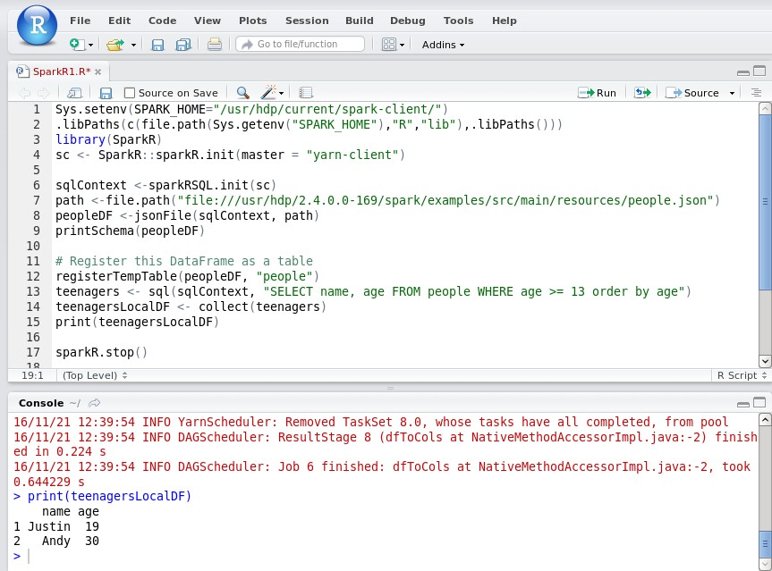
The Big Picture – Languages (2 of 2)
Programming Languages – Python, Scala, Java, R

Slide 12
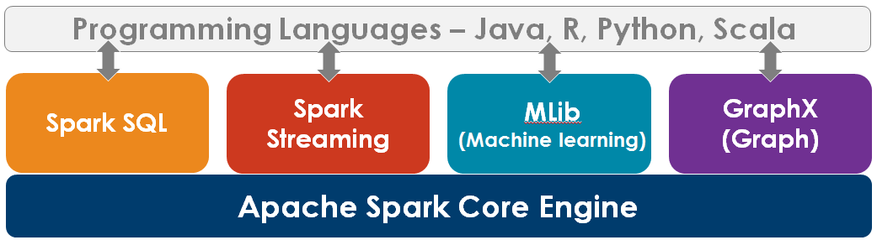

The Big Picture – Add Unified Stack
1
2
3
4
5
1• Spark SQL – Allows you to work with DataFrames/Datasets/Views using structured data. It allows querying with the Apache Hive variant of SQL
2• Spark Streaming – Enables processing of live data streams (mini-batches and RT)
3• Spark MLib – Multiple machine learning algorithms such as classification, regression, clustering and collaborative filtering, etc
4• GraphX –
5• Spark Core –
Graph functions such as PageRank and triangle counting
Basic functionality including task scheduling, memory management,
fault recover, storage and Resilient Distributed Datasets (RDDs)

Slide 13

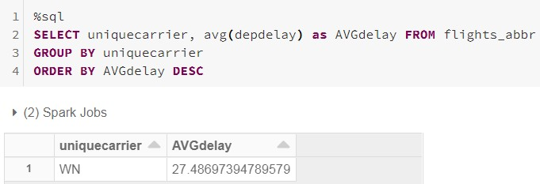

1 Lab 03: Spark SQL (Tables)
Starting with Spark version 1.3, DataFrames, Tables, TempViews and DataSets have been introduced so Spark data can be processed in tabular form and ANSI SQL-like language using keywords like: SELECT, FROM, WHERE, GROUP BY, etc
Spark SQL is defined as objects which have a Schema (column names and data
types
And even better, Spark SQL uses an Optimizer that is typically performs faster than a comparable RDD (more on this later)

Slide 14
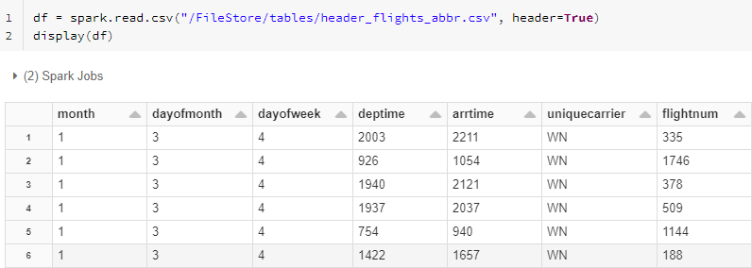
1 Lab 04: Spark SQL (DataFrames)
Here's an example using the DataFrame API to read and then display

Slide 15


2 Spark Streaming: Mini-batches and Real Time
Incoming data streams collected for X seconds per node
Captured as RDDs
Batch sizes as low as half a second
Normally 1-60 seconds
Spark operators process mini-batches
•
Additional processing in Hadoop or in-database
Competes with Apache Storm

Slide 16


3 Machine Learning
Classification and regression
Clustering
– K-means
Dimensionality reduction
Linear support vector
machine
Logistic regression
Linear least squares, Lasso, ridge regression
Decision tree
Naive Bayes
Singular value decomposition
Principal component analysis
–
Optimization
Collaborative filtering
– Alternating least squares
Stochastic gradient descent
Limited-memory BFGS
In Spark 2.0+, it's called ML

Slide 17

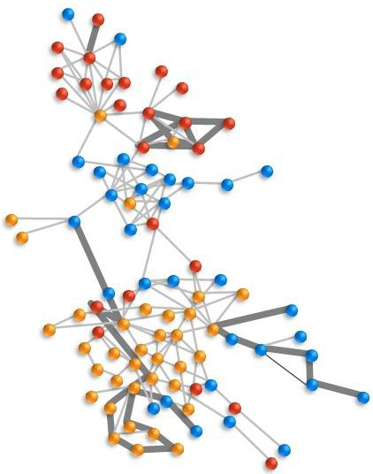
4 GraphX
Analyzes tabular data
Nodes: People and things (nouns/keys)
Edges: relationships between nodes
Graph engine, not a Graph database
Like Aster® Graph, Apache Giraph
Algorithms
PageRank
Connected components
Label propagation
SVD++
Strongly connected components
Triangle count
In Spark 2.0+, it's called SparkGraph
https://www.mapr.com/blog/how-get-started-using-apache-spark-graphx-scala

Slide 18
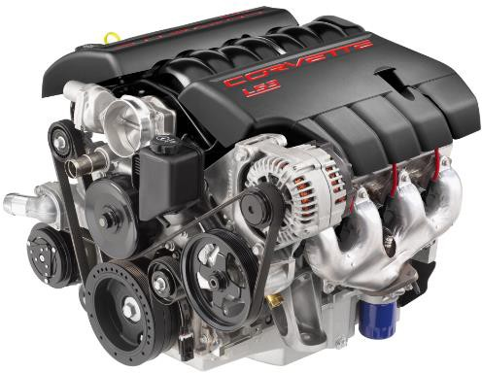
5 Spark Core Engine
Is the general purpose Processing
Engine for Spark
Provides in-memory computing capabilities and parallel processing
Supports various workloads (interactive, batch, streaming)
Ease of development with native APIs in Java, Scala, Python, R, SQL

Slide 19
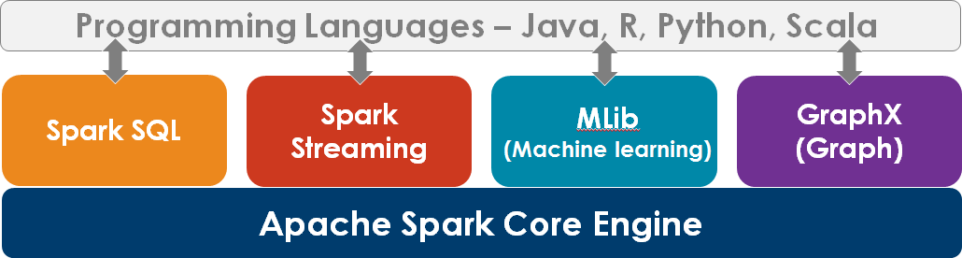
The Big Picture – Add Resource Manager
Spark runs over a variety of Cluster Managers. Spark's built-in Standalone mode is the easiest way to deploy. However if you want to share with other applications, Spark can run on Hadoop's YARN and Apache Mesos
Note there is a 4th Manager named 'Local' used for testing/prototyping

Slide 20
The Big Picture – Add Data
Spark is dependent on data storage as it has none of its own. Spark supports both Hadoop Distributed File System (HDFS) as well as Local File System (LFS). In addition, it supports data from other Projects for ingestion
We will be using 'dbfs' file system. See next slide

Slide 21



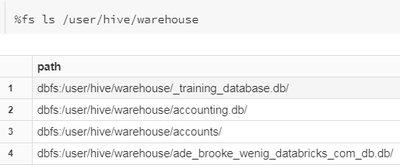

Data
DBFS (Databricks File System) is a layer typically over a Cloud-based object store
It has mounts to your Cloud data storage
It also hooks into Hive Metastore for your SQL Tables
mounts
DBFS
In our environment, we will store our Data in DBFS system
SQL Metastore
Cloud Data
/FileStore: Imported data files, generated plots,
and uploaded libraries
/databricks-datasets: Sample public datasets
/databricks-results: Files generated by
downloading the full results of a query
/databricks/init: init scripts
/user/hive/warehouse: Data and metadata for non- external Hive table

Slide 22
Data Files Sourced from Databricks dbfs
Databricks File System (DBFS) is a distributed file system mounted into a Databricks workspace and available on Databricks clusters. DBFS is an abstraction on top of scalable object storage and offers the following benefits:
Allows you to mount storage objects so that you can seamlessly access data without requiring credentials
Allows you to interact with object storage using directory and file semantics instead of storage URLs
Persists files to object storage, so you won’t lose data after you terminate a
cluster
https://docs.databricks.com/data/databricks-file-system.html#special-dbfs-root-location

Slide 23
Data Sources – File Formats
Spark supports most common Data file formats including:
CSV
TSV
JSON
AVRO
Text
Parquet
Delta
Name
Score
ID
. . . . . . . . . . . . .
Row-Oriented data on disk (CSV)
Kit 4.2 1 Alex 4.5
Column-Oriented data on disk (Parquet, Delta, ORC)
Kit Alex Terry 4.2
2
Terry
4.1
3
4.5
4.1
1
2
3

Slide 24
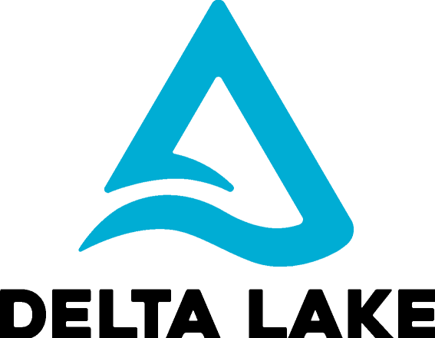
Delta File Format
Technology designed to be used with Apache Spark to build robust data lakes
ACID transactions
Metadata handling
Data versioning
Batch and Streaming unification
Schema enforcement/Schema evolution
Audit history
Merge
'Delta' file format is one component of Delta Lake

Slide 25
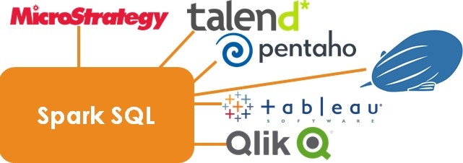

The Big Picture – Add BI Tools
Since Spark SQL is structured data, you can use BI and ETL tools

Slide 26
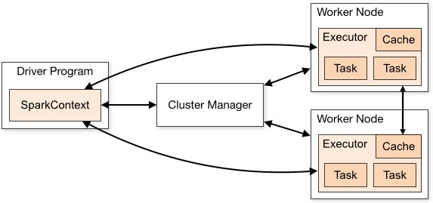
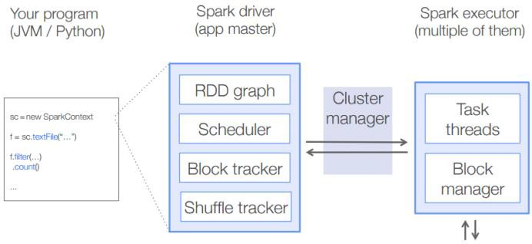
Spark Cluster components (using YARN)
Driver
SparkContext
Resource Manager (can be Standalone, Mesos, Hadoop YARN)
Worker Nodes and Executors
Files (Either HDFS or local file system)
File(s)
YARN
File(s)

Slide 27
Driver and Spark Context (and SparkConf)
1. Driver
– Is a JVM that maintains connections and submits tasks to Executors on Worker nodes for execution. Responsible for creating Directed Acyclical Graph (DAG) of Transformations and Actions
2. SparkContext – Java class that contains the code to process data in a parallel fashion. Coordinates with YARN to schedule resources. Created when user invokes REPL (Read, Evaluate, Print, Loop)
In order to create a SparkContext you should first create a SparkConf. The SparkConf
stores configuration parameters that your Spark Driver application will pass to SparkContext

Slide 28
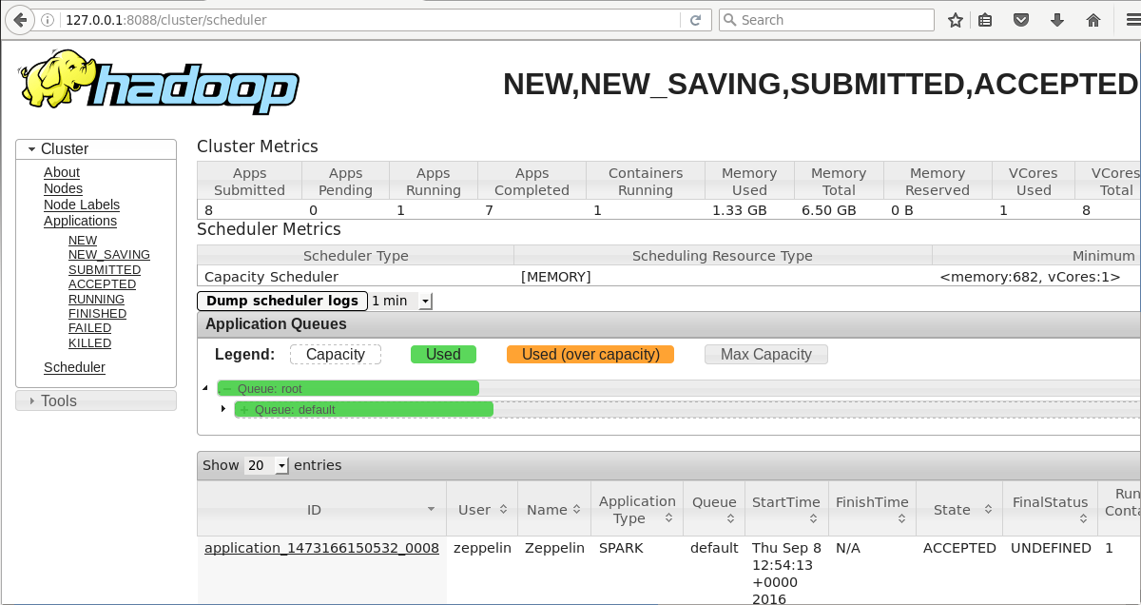
Resource Manager - YARN
3. Resource Manager – Spark is agnostic to underlying cluster manager as long as it can acquire executor processes. When running in an Hadoop environment, YARN will typically arbitrate all the available cluster resources and thus helps manage the distributed applications

Slide 29
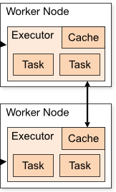
Worker nodes and Executors
4. Worker nodes – Worker nodes are the physical servers that run Executors. Note you may have multiple Executors per Worker node. Workers have a fixed set of resources (CPU and RAM) assigned to it by YARN. Worker nodes must share their resources since multiple applications may be run on same Worker
File(s)
Block Mgr
File(s)
Block Mgr

Slide 30

Executors
4. Executors – Processes which carry out the Tasks. Tasks are composed typically of either Map or Reduce. Each Executor creates task threads and holds the RDD (Resilient Distributed Dataset) in memory from the underlying file(s)
Each Executor runs a single JVM and has a configurable amount of resources
available to it which you can allocate
The Spark processing occurs within the Executor' RAM
For example, if you submit the Spark query in 1st graphic above, the Job will be run in the Executor's RAM. After the result set is returned (either to the Console or in our case, written to a Text File, the RAM contents are immediately flushed. It is not retained in Cache unless explicitly coded to do so

Slide 31
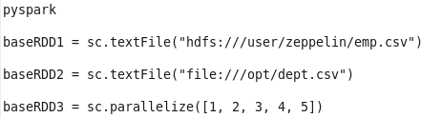


Resilient Distributed Datasets (RDDs)
Basic building block of Spark is the concept of a Resilient Distributed Dataset (RDD), which is a fault-tolerant collection of elements that can be operated in parallel. There are two ways to create new RDD: parallelizing an existing collection in your driver program, or referencing a dataset in an external storage system, such as a shared filesystem, HDFS, HBase, or any data source offering a Hadoop InputFormat
HDFS
If don't use prefix for file system, Spark assumes HDFS
LFS
On-the-fly
RDDs use more RAM instead of network and disk I/O so its relatively fast when compared to Hadoop using the Map-Reduce processing engine
Traditional Map Reduce has extensive Disk I/O
RDD's can be configured to use RAM or Disk I/O

Slide 32


Lab 05a/c: Resilient Distributed Datasets
RDD's are a read-only distributed (partitioned) collection of records. It's one of the objects that you perform ETL scripts on (ie: Map, Reduce tasks)
Read-only. If want to run an ETL, must create a new RDD based on the
previous RDD. In below 2 queries, we count number of words in poem
After loading file into RDD1, we perform 3
transformations before dumping to Console …
… or can pipeline RDDs together into one
Answer set
Distributed (partitioned) refers to breaking the RDD data into smaller blocks so they can be operated in parallel. At a minimum Spark defaults to 2 partitions

Slide 33
Spark 3.0+ new features (vs. Spark 2.x)
Enhancements to: Core Engine and SparkSQL (17x faster than Spark 2)
3400 JIRA's resolved
Enhanced Performance
Adaptive Query Execution (Better stats means faster queries)
Better Join strategies (via Statistics)
Shrink number of Reducers after Over-Partitioning
Data Skew minimized
Coalesce Shuffle Partitions
Dynamic Partition Pruning
JOIN Optimizer Hints expanded
Other
32 new built-in functions, Monitoring, Structured Streaming UI
Delta Lake, DDL and DML enhancements, SQL compatibility
https://databricks.com/session_na20/deep-dive-into-the-new-features-of-apache-spark-3-0

Slide 34
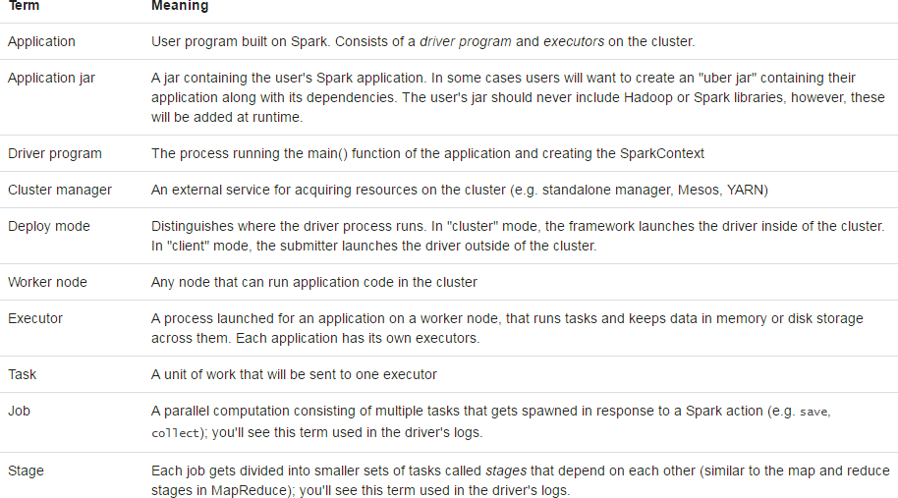
Glossary - Spark terminology
http://spark.apache.org/docs/latest/cluster-overview.html

Slide 35
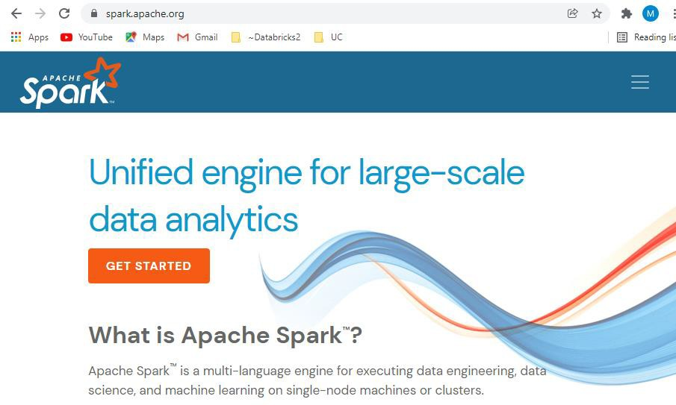
Want to Learn More? Go to: spark.apache.org

Slide 36
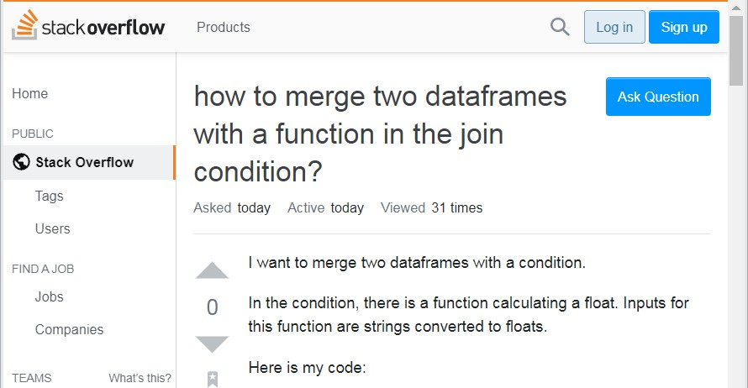
For Troubleshooting, Go to: Stackoverflow

Slide 37
In Review: Spark Architecture
After completing this module, you should familiar with the
following terms and concepts
Spark is an in-memory processing engine dependent on external storage
You login to Spark using REPL (sometimes called Spark shells)
Spark consists of:
Programming languages (Scala, Python, etc.),
Unified Stack including: Spark SQL, Streaming, MLib and GraphX
Resource Manager
Data
BI and ETL tools
What Resilient Distributed Datasets(RDD) are
Spark Cluster components include:
Driver
SparkContext
YARN
Worker nodes and Executors
hdfs dfs -du -h -s /user/zeppelin/job.csv (see RF 1 size and RF 3 size)

