Slide 1





C7084 Big Data
Ed Harris
QUERY
DATA
Knowledge

Slide 2
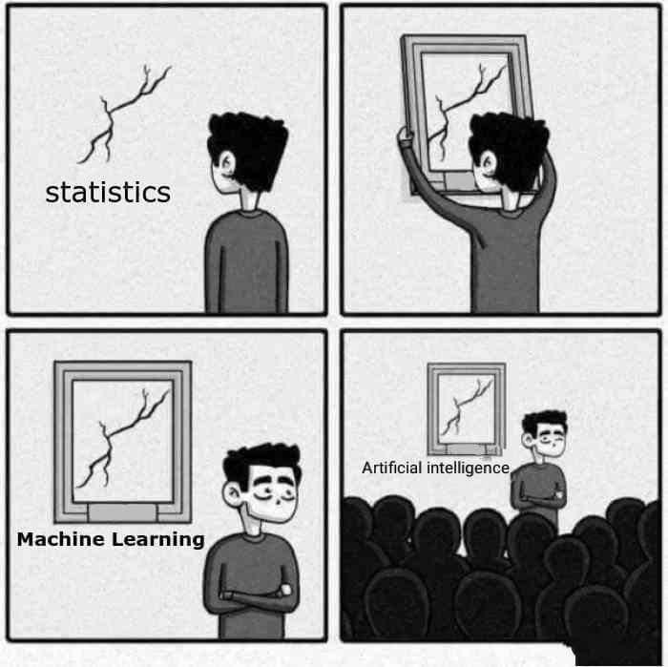
BIG
DATA

Slide 3
Table of Contents
Every session: community.cloud.databricks.com and Logon
In Left-pane, Click on 'Clusters' or 'Compute' and Terminate old Cluster Then click 'Create Cluster' button to create New one
Mod 00 – Intro and Setup
Mod 01 – Spark Architecture
Mod 02 – SparkSQL (Read/Write DataFrames/Tables)
Hacktivity 00 (Dates) / Hacktivity 01 (Air)
Mod 03 – SparkSQL (Transform)\
Mod 04 – Complex Data Types
Mod 05 – JSON (Optional)
Hacktivity 02 (Fly)
Mod 06 – Streaming
Mod 07 – Architecture-Spark UI
Mod 08 – Catalog-Catalyst-Tungsten
Mod 09 – Adaptive Query Execution
Mod 10 – Performance Tuning
Hacktivity 03 (Stream) / Hacktivity 04 (Air)
Mod 11 – Machine Learning

Slide 4
Module 07: Job Architecture and Spark UI

Slide 5
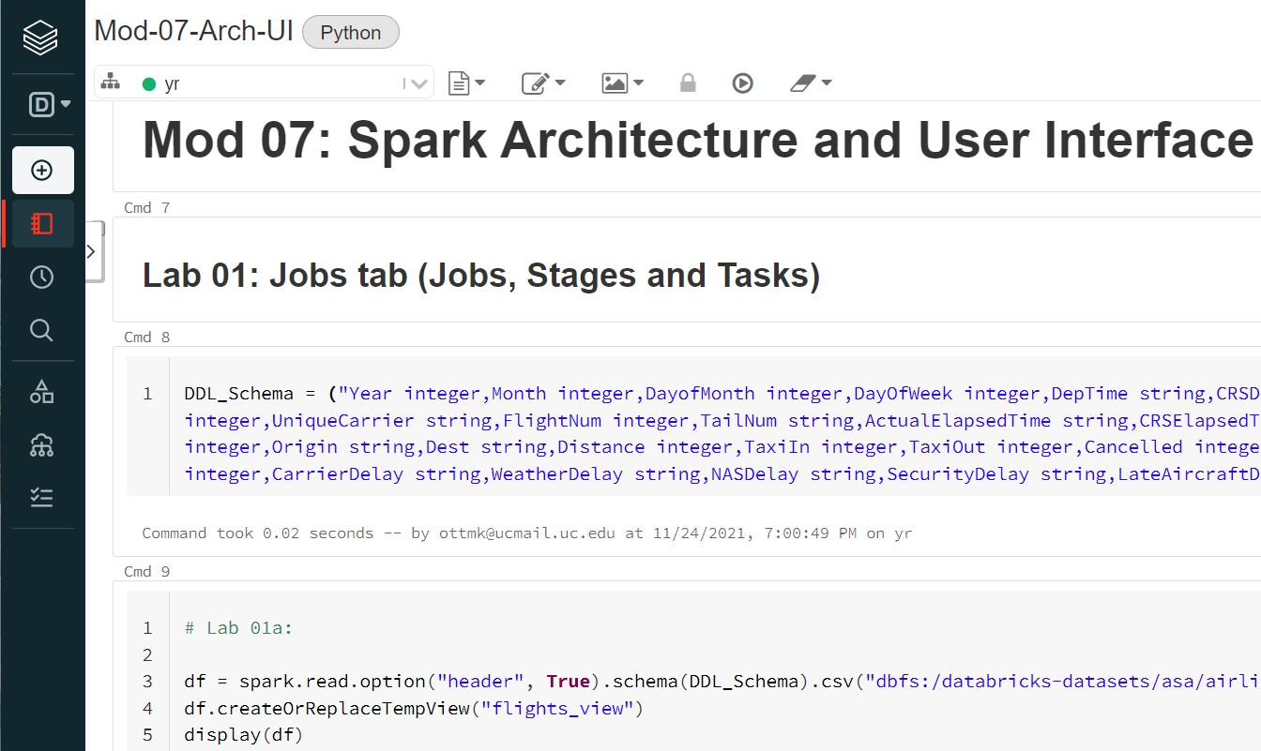
Before we Begin: Open Mod-07 Notebook

Slide 6
Module 08 – Architecture and Spark UI
After completing this module, you will have a knowledge of working elements of an executing Spark query
The three main components of a Spark query
Job, Stage and Task
Execution for these components across a distributed architecture
Monitoring Spark jobs via the Spark UI including:
Jobs tab
Stages tab
Storage tab
Environment tab
Executors tab
SQL tab
JDBC/ODBC Server
Structured Streaming tab

Slide 7
Spark Execution – The Big Picture
What happens when a Spark application is submitted?
df1 = spark.read... display(df1)
Creates a Spark Context from Driver
Creates Spark object (i.e.: rdd, dataframe, table, view)
DAG (Directed Acyclical Graph) created (from Spark object and transformations applied, followed by Action on transformation)
DAG Scheduler
Gets objects and functions to run on each partition with listener for results
For a Job, builds Stages of Tasks objects (code + preferred location)
Submits Tasks to Task Scheduler which assigns Tasks to Workers via Executor
Failed Stages are resubmitted
Task Scheduler
Launches Tasks on Executors
Re-launches failed Tasks
Reports to DAG Scheduler
https://jaceklaskowski.gitbooks.io/mastering-apache-spark/content/spark-dagscheduler-stages.html

Slide 8
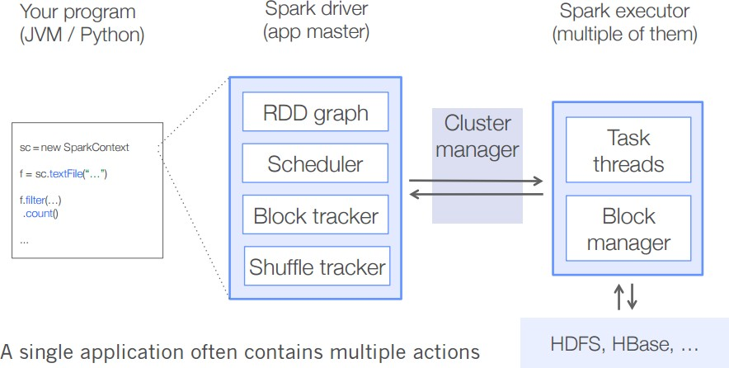
Driver and SparkContext
The Driver and SparkContext are responsible for launching and managing running Spark applications. Duties include:
Assigns Partitions to Worker Executors
Driver hosts the SparkContext which manages internal constructs such as the:
Accumulator (ie: counters) and Broadcast Variables
Maintains connection to all Worker nodes
Translates the code into a Directed Acyclic Graph (DAG). This execution plan consists of transformations and actions
Handles communication with Cluster Manager (ie: YARN) to request resources
Client
WorkerX

Slide 9




Putting it All Together
Driver, Workers, Executors, Cores, Partitions and Tasks
How does the Driver decide on Number and Size of the Partitions to hand out to the Executors?
Data Partition
Driver
Worker
Executor
Worker
Executor
Core Core
Task
Worker
Executor
Core Core
Worker
Executor
Core
Task
Core
Task
Core
Task
Core
Task
Spark Cluster

Slide 10
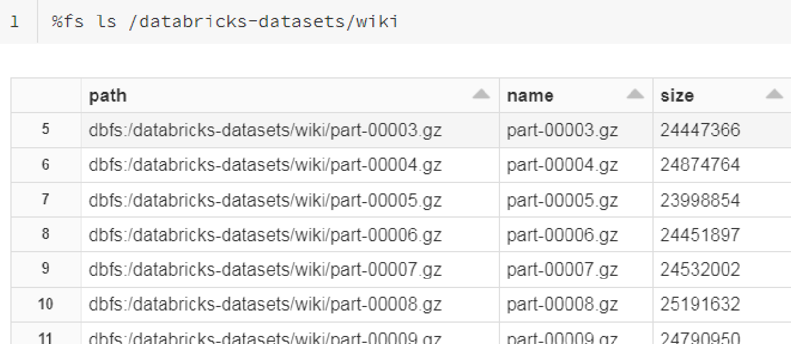
01: How Driver decides on (Memory) Partitions (1 of 4)
Here's the files we wish to create a DataFrame.
It consists of 192 compressed files roughly 24.6 MB in size. Total size = 4734 MB
So how does the Driver decide:
How many Partitions?
Partition size?

Slide 11

01: How Driver decides on (Memory) Partitions (2 of 4)
sc.defaultParallelism
Number of Cores in Cluster
spark.sql.files.maxPartitionBytes
The Maximum number of bytes to pack into a single Partition when reading files. This configuration is effective only when using file-based sources such as Parquet, JSON and ORC
Default
128 MB
spark.sql.files.openCostInBytes
The estimated cost to open a file, measured by the number of bytes could be scanned in the same time. This is used when putting multiple
files into a Partition
Default
4 MB

Slide 12
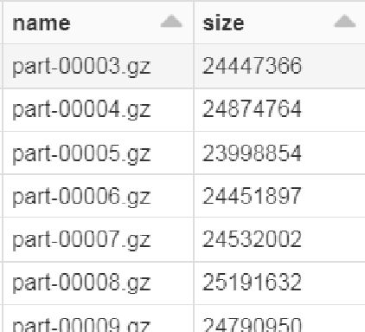
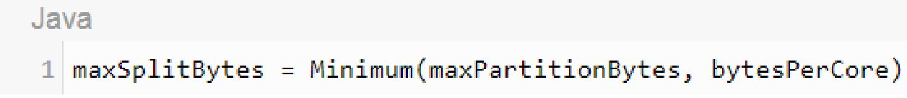
01: How Driver decides on (Memory) Partitions (3 of 4)
Using prior config parameters values, a Maximum split guideline named maxSplitBytes is calculated as follows:
4734 MB + (192 files * 4 MB)/8 cores = 5502 MB /8 cores = 687.75 MB
Input files
128 MB
687.75 MB
For our Cluster, the maxSplitBytes = 128 MB, so we can pack multiple file splits together into Partition size =128 MB. See next slide for demo of Packing files into Partitions
Sum Data files = 4734 MB

Slide 13
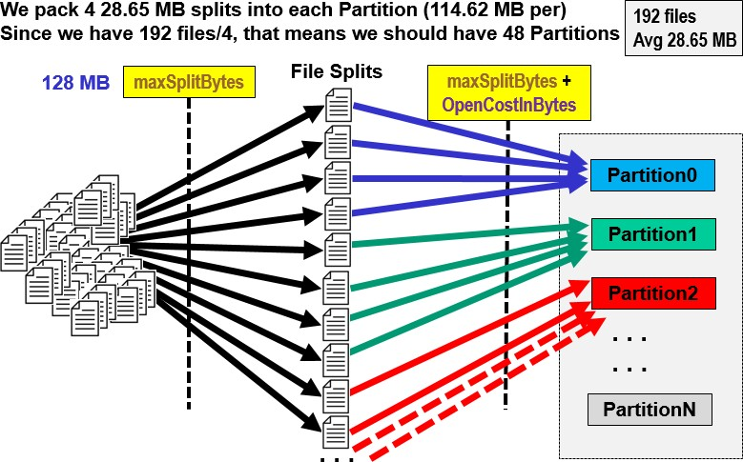

01: How Driver decides on (Memory) Partitions (4 of 4)

Slide 14
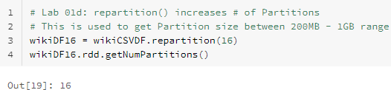
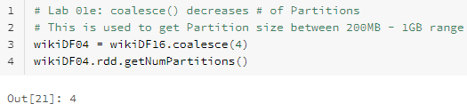
01: Changing Partition Count
You can change the Partition Count manually
repartition()
coalesce()
Used to increase # of Partitions
Used to decrease # of Partitions

Slide 15

Terminology
Job(s)
Stage(s)
Jobs typically refers to the number of Actions you have in query They are broken down in to one or more Stages
Task(s)
Stages are a grouping of Task(s) that must be processed before being passed to
another Stage. Stages within a Job are based on shuffle boundaries
The transfer of data between Stages is a Shuffle
Tasks are a unit of work within a Stage. Each Task operates on one Partition
Wide tasks (such as distinct, repartition, most Joins, groupBy, aggregations) require data movement (Shuffle/Exchange) between Executors. This will cause a new Stage to be spawned
Shuffles require:
Disk I/O,
Network traffic
Serialization (from Java object to binary object) & Deserialization (binary to Java)

Slide 16
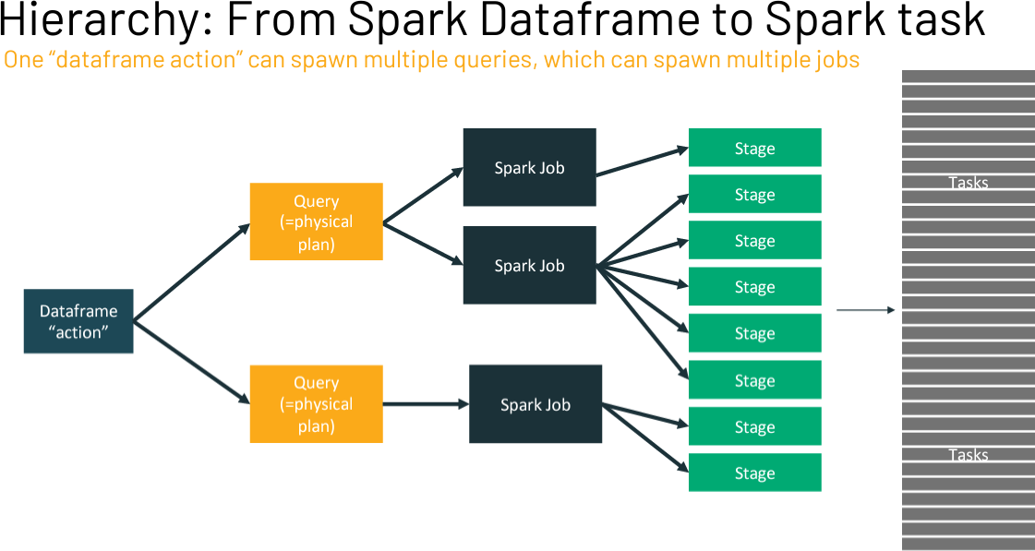
The Big Picture

Slide 17
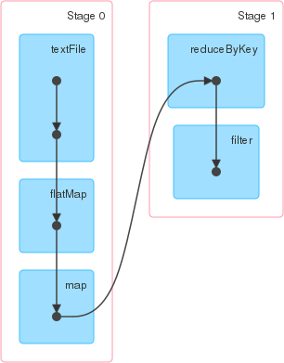
The Big Picture: Job > Stages > Tasks
Query: Find words that occurred > 1
val rdd = sc.textFile("/user/zeppelin/mary.txt,4")
.flatMap(x => x.split(" "))
.map(word => (word,1))
.reduceByKey((_+_),2)
.filter{case (key, value) => value > 1}
.collect()
Forcing 4 Partitions and 2 Partitions here
val rdd1 = sc.textFile("/user/zeppelin/mary.txt").flatMap(x
=> x.split(" ")).map(word => (word,1)).reduceByKey (_+_).filter{case (key, value) => value > 1}.collect()
Job
Job = 1
Stage 0 – All narrow tasks
= Task where Partitions processed
Stage = 2
Tasks = 6
*rdd1 *rdd2 *rdd3
Stage 1
textFile task
flatMap task
map task
*rdd4 *rdd5
textFile task
flatMap task
map task
reduceByKey task
filter task
hdfs file
collect()
textFile task
flatMap task
map task
reduceByKey task
filter task
textFile
task
flatMap task
map task
Shuffle write
Shuffle read

Slide 18
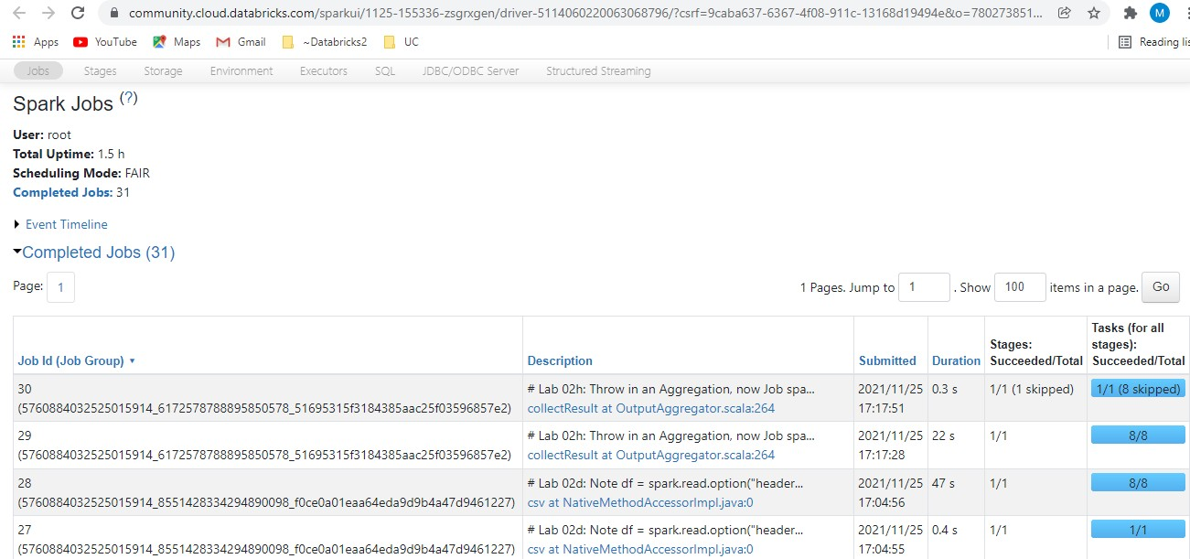
Spark UI
Spark provides a suite of Web UI/User Interfaces
(Jobs, Stages, Tasks, Storage, Environment, Executors, and SQL) to monitor
the status of your Spark/PySpark application, resource consumption of
Spark cluster, and Spark configurations

Slide 19
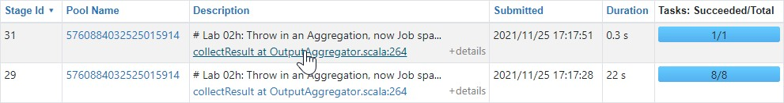

02: Spark UI walkthrough
To drill down on specific object, click on the hotlink under 'Description'
You will find that 'Stages' and 'SQL' tab are used most frequently
Note there is a learning curve with Spark UI
First execute the following Join …
… then follow along with the Instructor as we walk through a few of the Tabs

Slide 20
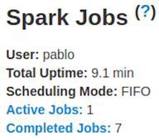
Jobs tab: Overview
The Jobs tab displays a summary page of all jobs in the Spark application and a details page for each job. The summary page shows high-level information, such as the status, duration, and progress of all jobs and the overall event timeline. When you click on a job on the summary page, you see the details page for that job. The details page further shows the event timeline, DAG visualization, and all stages of the job
The information that is displayed in this section is: User: Current Spark user
Total uptime: Time since Spark application started Scheduling mode: See job scheduling
Number of jobs per status: Active, Completed, Failed

Slide 21
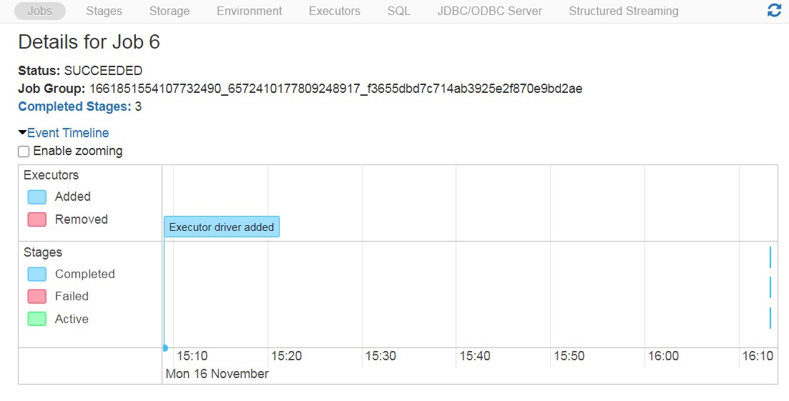
Jobs > Events Timeline
Really not much to see here (Stages > Events Timeline much more informative).
Although can see 'Completed Stages' for that Job

Slide 22
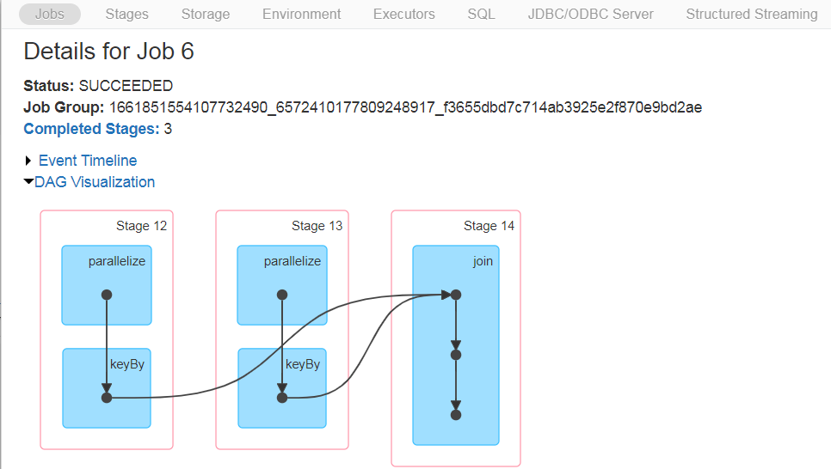
Jobs > DAG Visualization
Really not much to see here (Stages > Events Timeline much more informative).
Although can see 'Completed Stages' for that Job

Slide 23
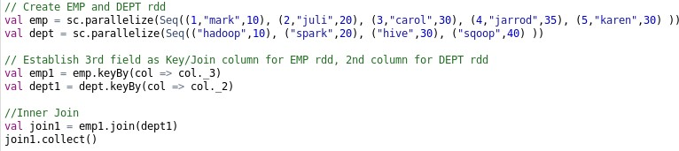
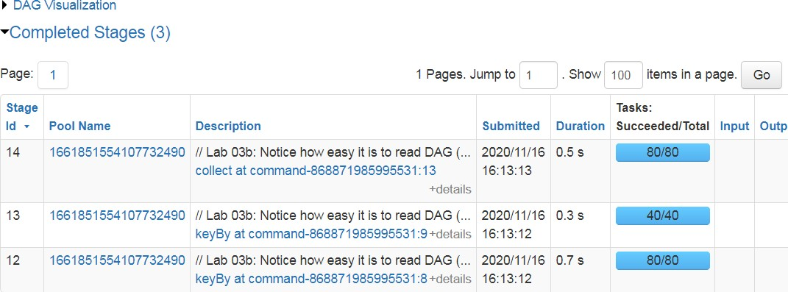
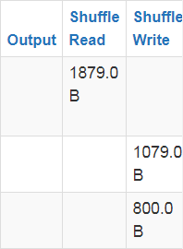
Jobs > Completed Stages
Here we see the Stages and Tasks in those Stages
Click here to be transported to Stages tab
where you see details about that Stage
Stages ID's
Shuffled data size between stages
# of Tasks =
# of partitions

Slide 24
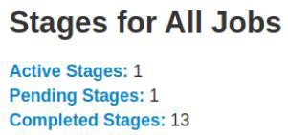
Stages tab: Overview
The Stages tab displays a summary page that shows the current state of all stages
of all jobs in the Spark application
At the beginning of the page is the summary with the count of all stages by status (active, pending, completed, skipped, and failed)

Slide 25
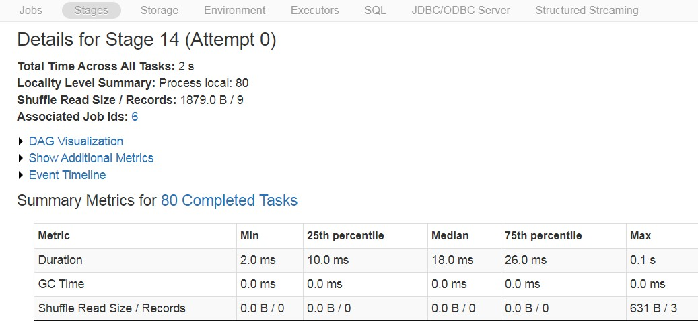
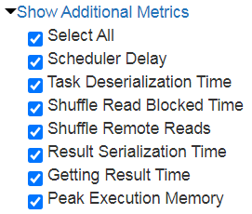
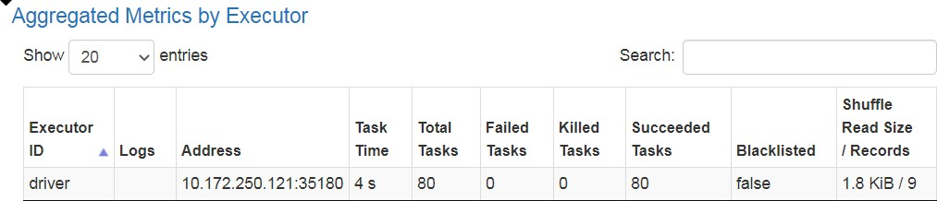
Stages > Show Additional Metrics and Aggregated Metrics by Executor

Slide 26
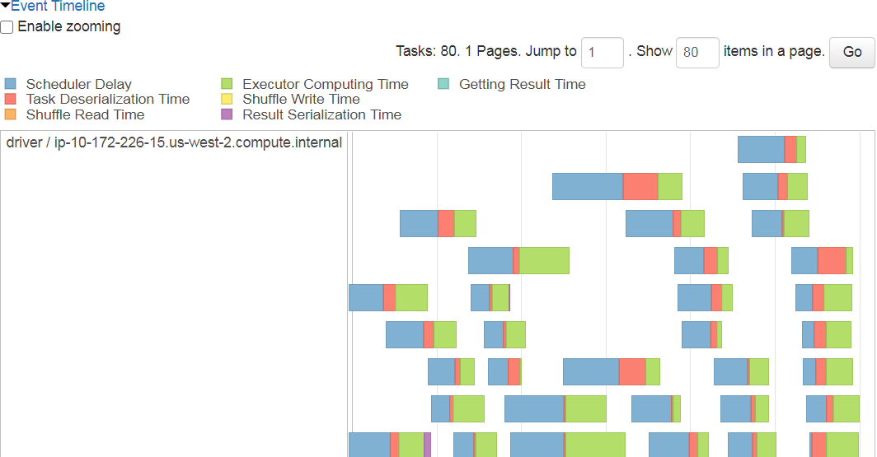
Stages > Event Timeline (Lab 03b: Highest Stage)
Each bar represents a Task and how much time each Process took

Slide 27
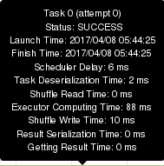
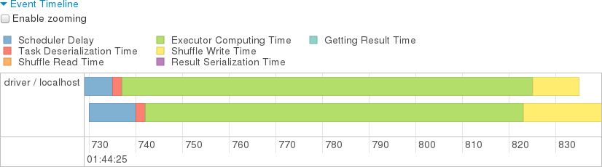
Stages > Event Timeline (con't)
The Green color in the task indicates "Executor Computing Time" and we would ideally like this to make up at least 70% of the time spent on the task. If you see many tasks filled up with other colors, representing non-compute activities such as "Task Deserialization", and only a small slice of green "Computing Time" that is an indicator that you may have too many tasks/partitions or, equivalently, that the partitions are too small (data) or require too little work (compute) to be optimally efficient
Stages > Event Timeline good for finding bottlenecks

Slide 28
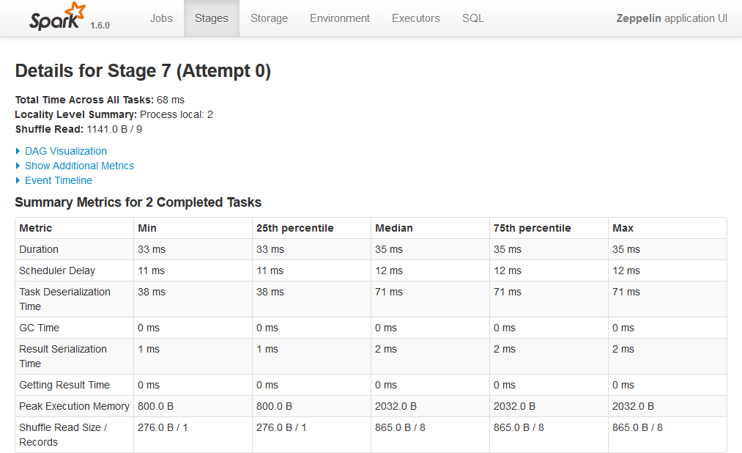

Stages > Summary Metrics
If Max metric figures are substantially higher than the corresponding 75% figures, that suggests a number o^{C}f '^{l}s^{i}t^{c}ra^{k}gºg^{n}ler^{t}'^{h}ta^{e}sk^{h}sº, ^{t}t^{l}a^{in}ki^{k}ng^{u}t^{n}oo^{de}m^{r}u^{D}ch^{e}t^{s}im^{cr}e^{ip}to^{tio}co^{n}m^{t}pºut^{s}e^{e}(^{e}or^{t}t^{h}ri^{e}gg^{S}er^{t}iªn^{g}g ^{e}e^{s}xcªe^{n}ss^{d}G^{T}Cª)^{s}, ^{k}a^{s}nd^{i}/^{n}or^{th}opºe^{s}r^{e}ati^{S}ng^{ta}o^{g}v^{e}er^{s} partitions with larger skewed amounts of data
If Min values at or close to zero, that suggests we have empty (or near empty) partitions and/or tasks that aren’t computing anything (our compute logic might not be the same for all records, so we could have large partitions whose tasks do no work)
Duration: Skew if 75th% is much higher than 25th%
Scheduler Delay: Can't really control
Input Size: Skew if Max 3-5 higher than Median Garbage Collection (GC): Want to minimize (Java Mem Mgt)

Slide 29
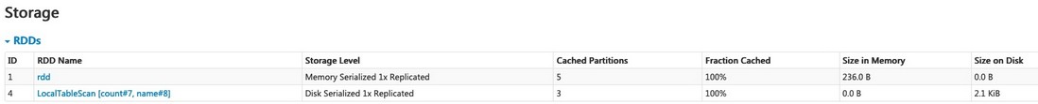
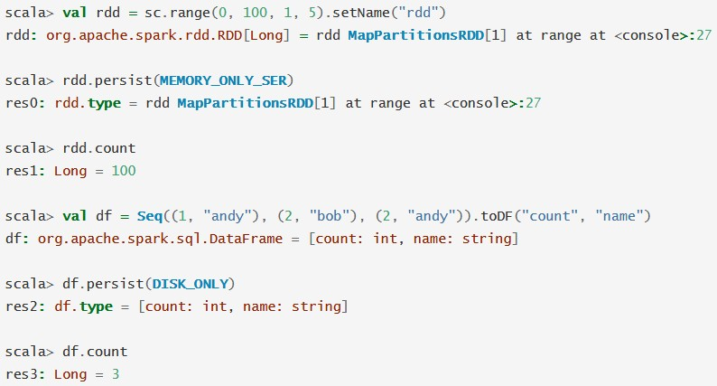
Storage tab: Overview
The Storage tab displays the persisted RDDs and DataFrames, if any, in the application. The summary page shows the storage levels, sizes and partitions of all RDDs, and the details page shows the sizes and using executors for all partitions in an RDD or DataFrame

Slide 30

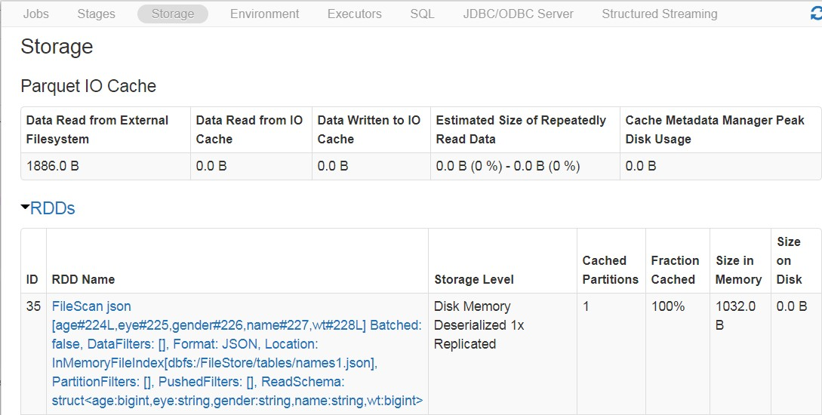
Storage > Cache on DataFrame
Displays amount of Executor RAM utilized for cache() and persist()

Slide 31
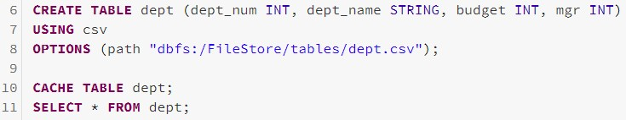
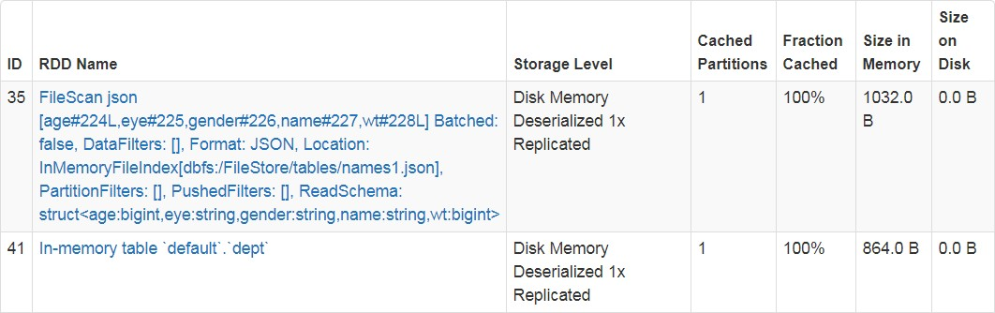
Storage > Cache on Table
Displays amount of Executor RAM utilized for cache() and persist()

Slide 32
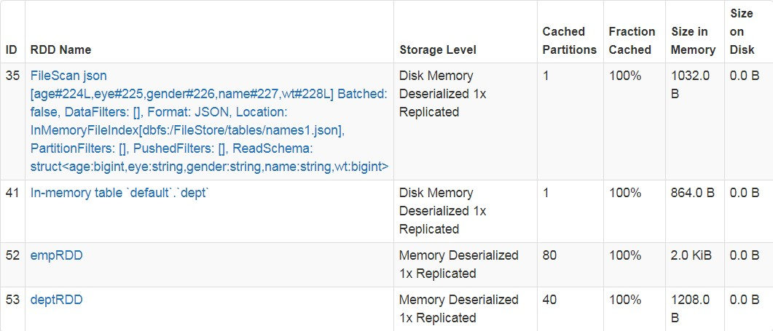
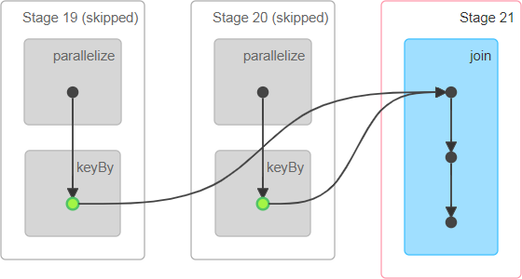

Storage > Cache on RDD
Displays amount of Executor RAM utilized for cache() and persist()
Once cached, if execute again, won't need to read the data from disk, hence these Stages can be skipped
If not named

Slide 33
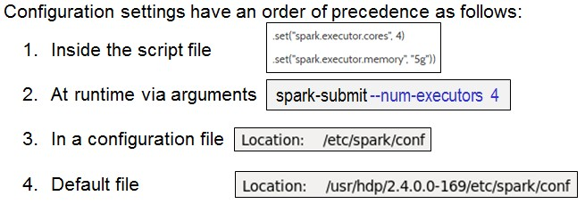
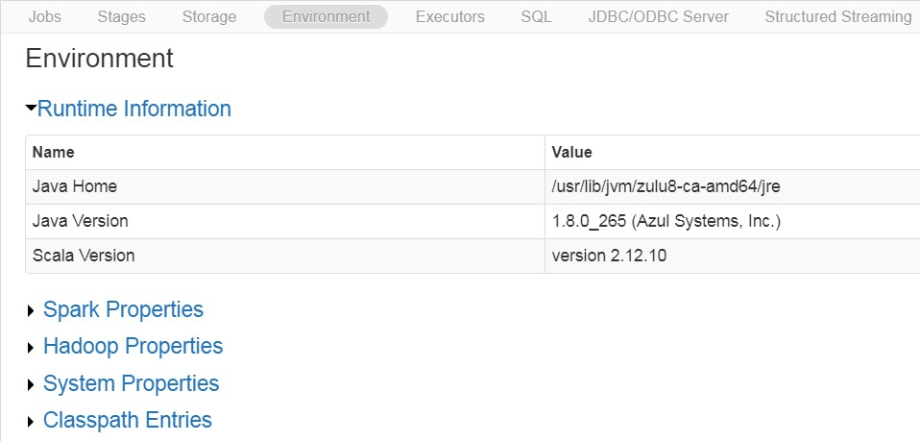
Environment tab
The Environment tab displays the values for the different environment and configuration variables, including JVM, Spark, and system properties
Read-only settings of your Spark cluster. Can edit thru Management Consoles

Slide 34
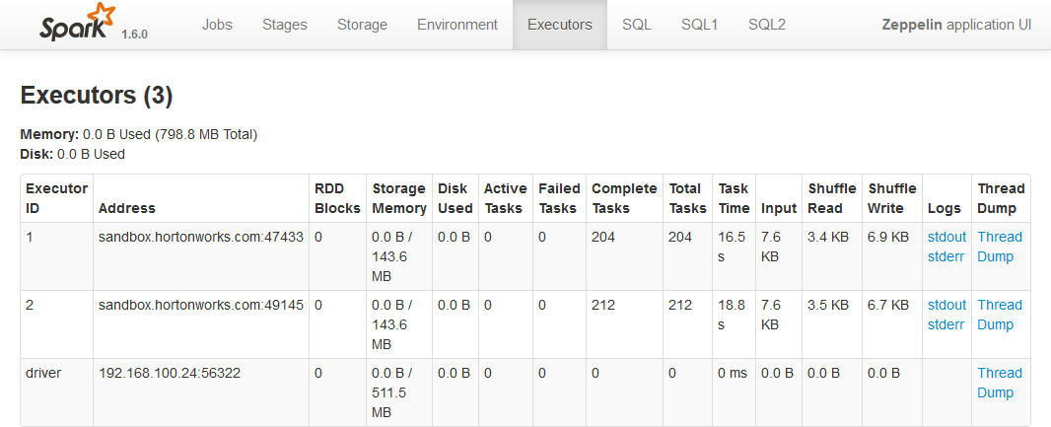
Executors tab (and Drivers)
The Executors tab displays summary information about the executors that were created for the application, including memory and disk usage and task and shuffle information. The Storage Memory column shows the amount of memory used and reserved for caching data

Slide 35
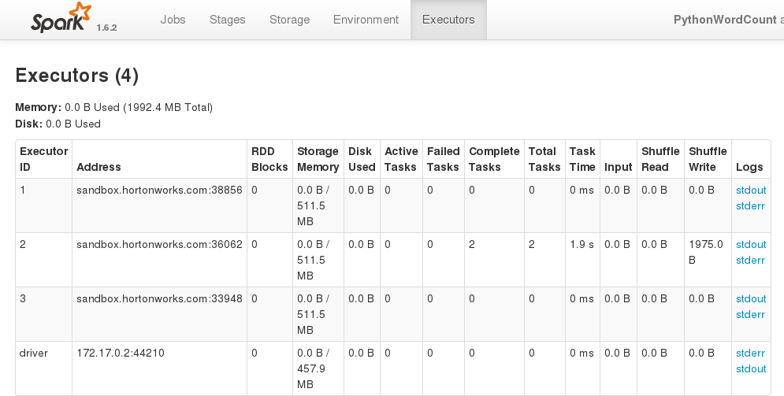
How to Add more Spark Executors (not possible in Databrick Community)
Since our Resource Manager = 'Local Mode', we have 1 Executor embedded inside the Driver

Slide 36
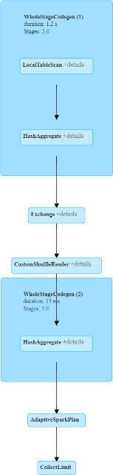
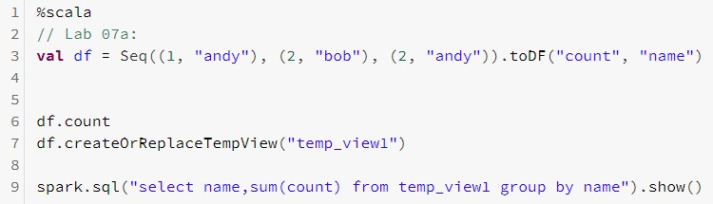
SQL tab: On TempView
If the application executes Spark SQL queries, the SQL tab displays information, such as the duration, jobs, and physical/logical plans for the queries
Compare this Explain Plan to the one under the Jobs tab
Note don't need to have an '%sql' cell to execute SQL language. Instead use 'spark.sql' argument in the %scala or %python Interpreter

Slide 37
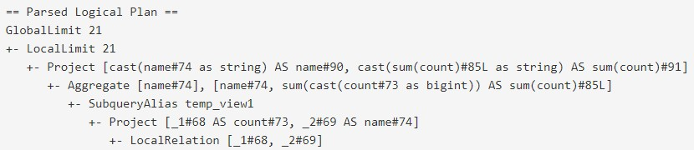
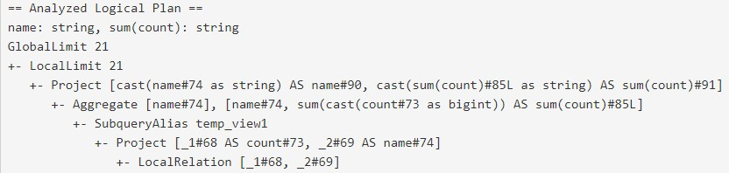
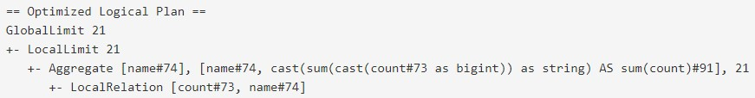
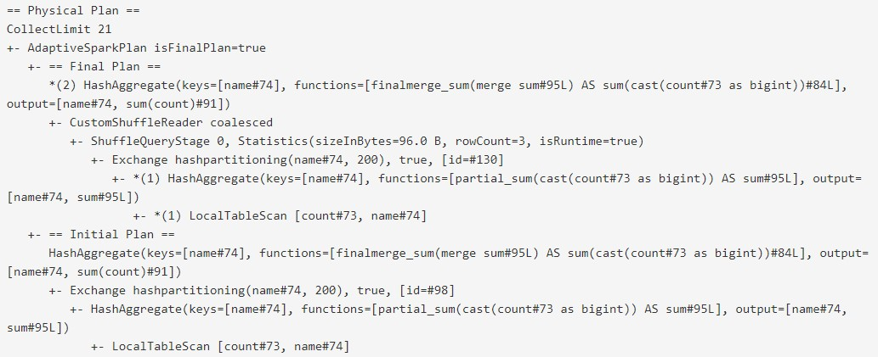
SQL tab: TempView

Slide 38
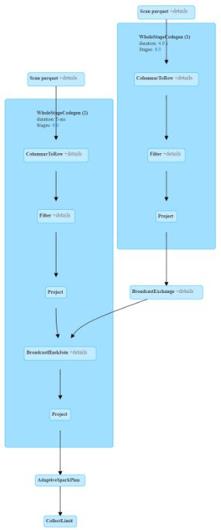

SQL tab: Joining DataFrames

Slide 39
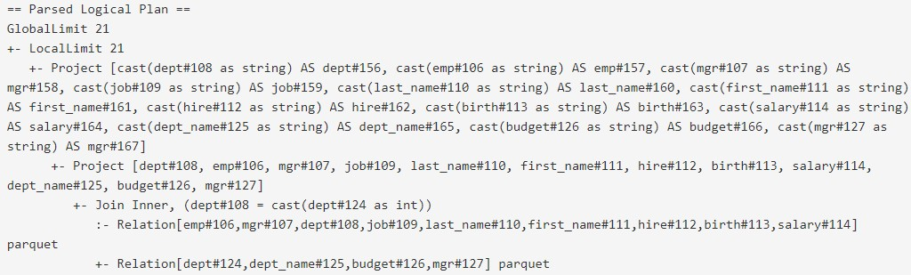
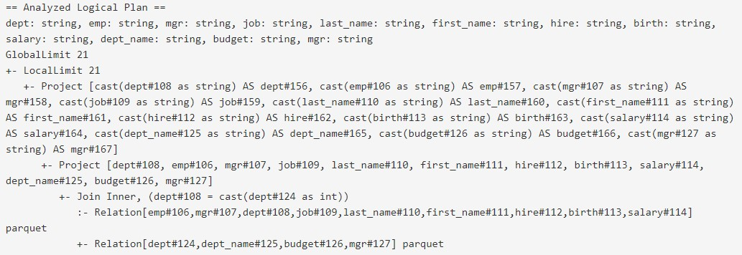
SQL tab: Joining DataFrames

Slide 40
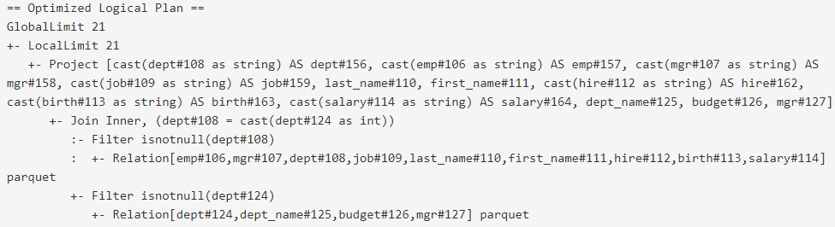
SQL tab: Joining DataFrames

Slide 41
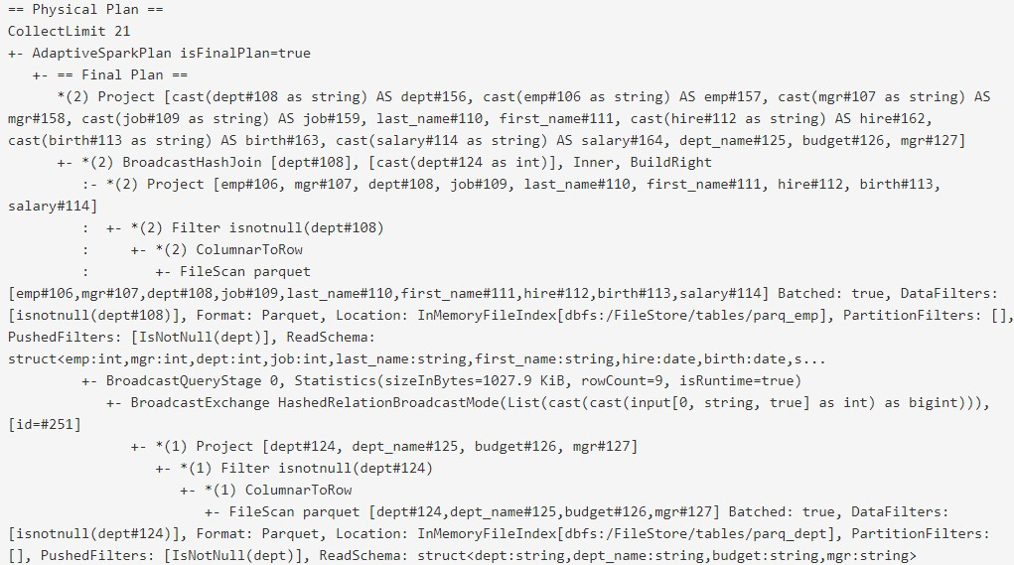
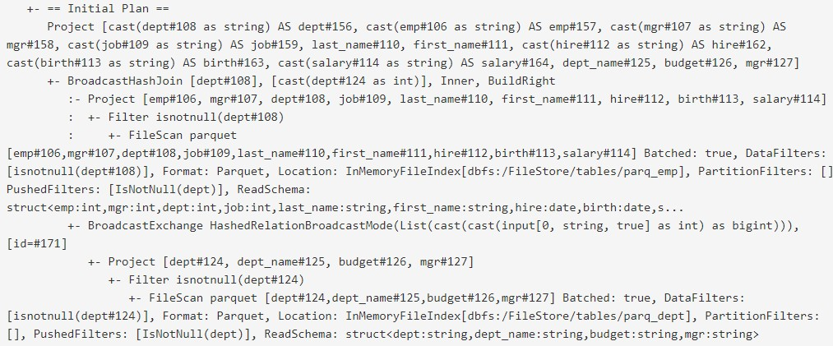
SQL tab: Joining DataFrames

Slide 42

JDBC/ODBC Server tab
Spark SQL can also act as a distributed query engine using its JDBC/ODBC or command-line interface. In this mode, end-users or applications can interact with Spark SQL directly to run SQL queries, without the need to write any code
Databrick Community does not support JDBC/ODBC

Slide 43


Structured Streaming tab
The web UI includes a Streaming tab if the application uses Spark streaming. This tab displays scheduling delay and processing time for each micro-batch in the data stream, which can be useful for troubleshooting the streaming application.

Slide 44




Structured Streaming tab (1 of 3)

Slide 45


Structured Streaming tab (2 of 3)

Slide 46

Structured Streaming tab (3 of 3)

Slide 47


Use HDP_2.5 VMware image
Demo: A word about: Spark History Server
Spark keeps a history of past jobs. Just go to: <host>:18080

Slide 48



03: 'inferSchema' is not your Friend
1. Read in a DataFrame with 'inferSchema' is slow (44 seconds)
This causes 2 Jobs to be Spawned as follows:
First Job: Scan 1st row to determine if Column names present
Second Job: Scan file to discern Data types
2. Read in a DataFrame with hard-coded Schema doesn't even spawn a Job

Slide 49

Spark Components – Wide, Narrow Tasks
At each Stage boundary, data is written to disk (/tmp) by Tasks in the parent stages and then fetched over the network by tasks in the child Stage. Because they incur heavy disk and network I/O, stage boundaries can be expensive and should be avoided when possible
Narrow and Wide Transformation
Narrow transformations like orderBy() or filter(), the records required to compute
the records in a single partition reside in a single partition in the parent
RDD... (in other words, input data comes from single partition)
Wide dependencies such as Joins and Aggregations. In these dependencies, the data required to compute the records in from Many source partitions into a Single Partition

Slide 50



04: Narrow Tasks stay in Stage
Following methods all stay in the same Stage so must be Narrow Tasks
Select
Filter
OrderBy
Union

Slide 51



05: Wide Tasks spawn new Stage
Following methods spawn new Stages so must be Wide Tasks
Join
Aggregation
Distinct

Slide 52




In Review: How many Stages?
1 Stage
3 Stage

Slide 53
In Review – Job Architecture and Spark UI
What has to take place for a Job to post in the Spark UI? An Action
Jobs are hierarchically arranged in this order Job > Stages > Tasks
What are some characteristics concerning Narrow and Wide tasks
Narrow tasks – 1 to 1 partition, stay within a Stage
Wide tasks – Many partitions feed into 1 partition, boundary between Stages
Stages can be dependent or independent. Give examples of both
Independent – Can process without waiting for data (2 sc.textFiles) Dependent – Have to wait for Shuffle before Joining 2 sc.textFiles

