Slide 1



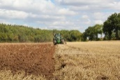

C7084 Big Data
Ed Harris
QUERY
DATA
Knowledge

Slide 2

BIG
DATA

Slide 3
Table of Contents
Every session: community.cloud.databricks.com and Logon
In Left-pane, Click on 'Clusters' or 'Compute' and Terminate old Cluster Then click 'Create Cluster' button to create New one
Mod 00 – Intro and Setup
Mod 01 – Spark Architecture
Mod 02 – SparkSQL (Read/Write DataFrames/Tables)
Hacktivity 00 (Dates) / Hacktivity 01 (Air)
Mod 03 – SparkSQL (Transform)\
Mod 04 – Complex Data Types
Mod 05 – JSON (Optional)
Hacktivity 02 (Fly)
Mod 06 – Streaming
Mod 07 – Architecture-Spark UI
Mod 08 – Catalog-Catalyst-Tungsten
Mod 09 – Adaptive Query Execution
Mod 10 – Performance Tuning
Hacktivity 03 (Stream) / Hacktivity 04 (Air)
Mod 11 – Machine Learning

Slide 4
Module 09:
Adaptive Query Execution and Dynamic Partition Pruning

Slide 5
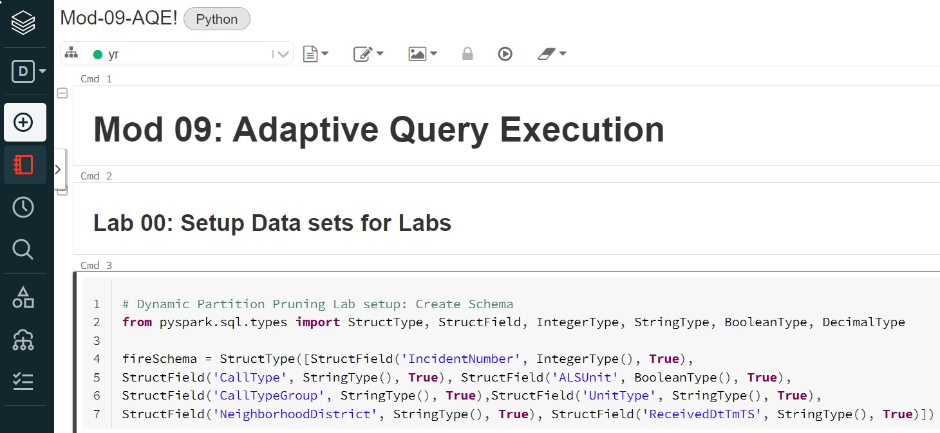
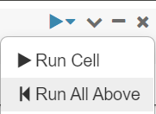
Before we Begin: Open Mod-09 Notebook
Then go to Cell 17 and 'Run All Above' to setup the Tables

Slide 6


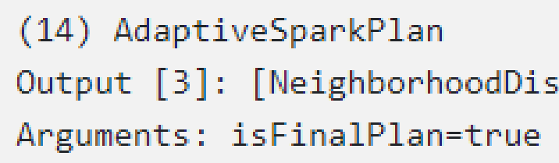








Before we Begin
Spark Adaptive Query Execution (AQE) functionalities including:
Change Join Strategies from SortMerge to BroadcastHash
Dynamic Coalesce Shuffle Partitions
Handle Skew Partitions in the Join operation
In addition, there is another functionality not part of AQE called
Dynamic (Directory) Partition Pruning (technically not part of AQE)
AQE's like having a Superhero turbo-charging your queries
How do you know if AQE is enabled?
Look for 'AdaptiveSparkPlan' in Spark UI

Slide 7
Objectives – Spark 3 Adaptive Query Execution
Spark Adaptive Query Execution (AQE) functionalities including:
Change Join Strategies from SortMerge to BroadcastHash
Dynamic Coalesce Shuffle Partitions
Handle Skew Partitions in the Join operation
In addition, there is another functionality not part of AQE called
Dynamic (Directory) Partition Pruning (technically not part of AQE)
AQE's like having a Superhero turbo-charging your queries
How do you know if AQE is enabled?
Look for 'AdaptiveSparkPlan' in Spark UI

Slide 8
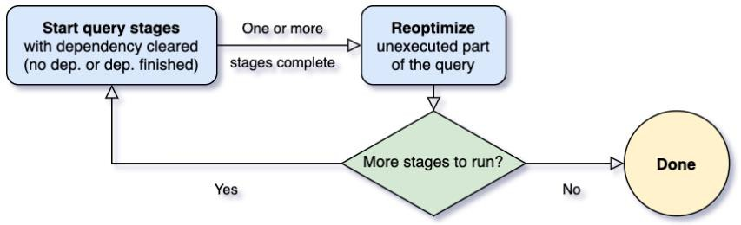
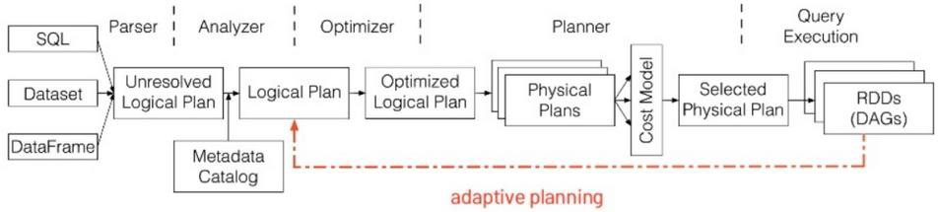
Introducing Adaptive Query Execution (AQE)
The Spark SQL engine can keep updating the Execution Plan per computation at
Runtime based on the observed properties (Statistics) of the data on per Stage basis
Rule
Stats-based Cost Model

Slide 9
01: Change from SortMergeJoin to BroadcastHashJoin
Features of Adaptive Query Execution include:
Change Join Strategies from SortMerge to BroadcastHash
Dynamic Coalesce Shuffle Partitions
Handle Skew Partitions in a Join operation
https://medium.com/agile-lab-engineering/spark-3-0-first-hands-on-approach-with-adaptive-query- execution-part-2-35223d532637
https://blog.knoldus.com/adaptive-query-execution-aqe-in-spark-3-0/

Slide 10
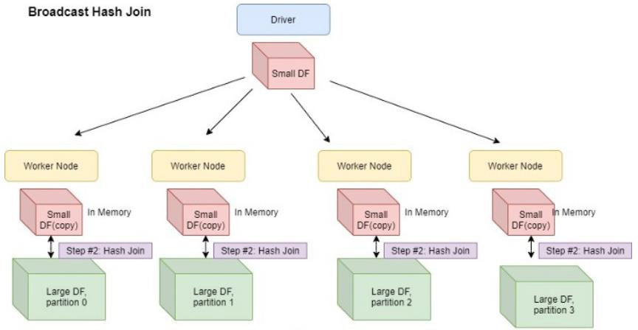
BroadcastHashJoin Visualized
Spark allows the smaller Dataframe involved in the join to be copied once to Executor's RAM based on specified size threshold (10 MB) using efficient p2p algorithm to reduce Communication cost
No Shuffle, No Sort (unlike SortMergeJoin)

Slide 11

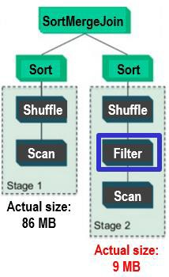

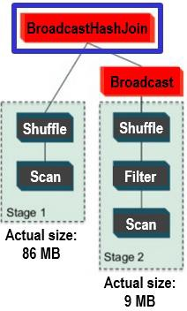
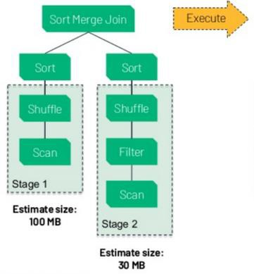
Based on Statistics,
can change Join Strategy on-the-fly
Spark won't do BroadcastHashJoins unless one Table < 10 MB. Prior to Spark 3.x, Estimated size was used. With Spark 3, Statistics re-evaluates at Stage boundary and discovers smaller Table = 9 MB. Join Strategy changed to Performant one
In-Memory Hash table built on smaller table
Thinking
Thinking
Doing
SortMergeJoin
Execute
Optimize
Sort
Sort
Shuffle
Shuffle
Scan
Filter
Estimated size: 100 MB
Scan
Estimated size:
30 MB
Collect Statistics

Slide 12

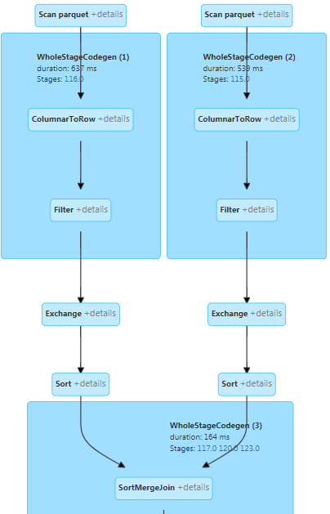
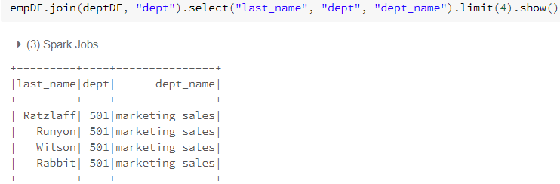
Problem: SortMergeJoin is Poor Performer
Here I force SortMergeJoin strategy to view Performance
Notice the Sort and the Exchange (Shuffle) These are both time-intensive operations

Slide 13

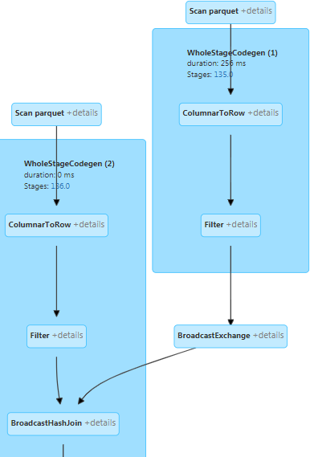






Solution: AQE changes to BroadcastHashJoin
I enable BroadcastHashJoin and AQE and re-Run query
There is no Sort and no Exchange (Shuffle). There is a BroadcastExchange where smaller table is sent to each Executor
SortMerge
BroadcastHash

Slide 14
02: Dynamic Coalesce Shuffle Partitions
Features of Adaptive Query Execution include:
Change Join Strategies from SortMerge to BroadcastHash
Dynamic Coalesce Shuffle Partitions
Handle Skew Partitions in a Join operation
Shuffle Partitions occurs when have:
Join
Aggregation
https://kyuubi.readthedocs.io/en/latest/deployment/spark/aqe.html

Slide 15
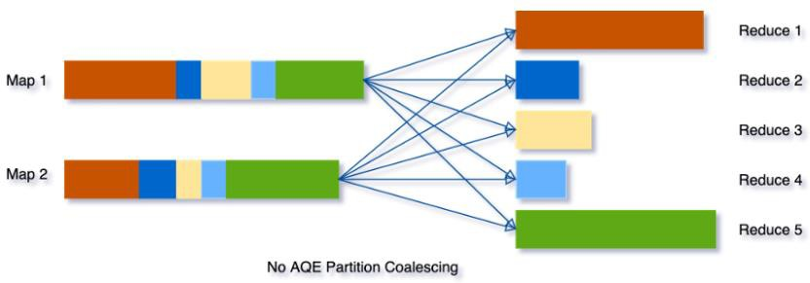
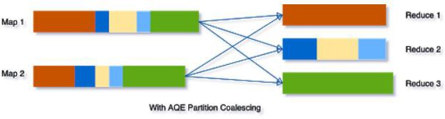
Coalescing Shuffle Partitions Visualized (via AQE)
Goal is even sized Partitions.
From 5 uneven sized Partitions to 3 evenly sized Partitions. Each Partition finishes executing around the same time and not waiting for one giant Partition to finish

Slide 16
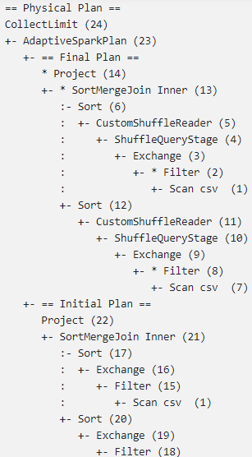
Dynamically Coalescing Shuffle Partitions
Here you can see how the DAG was changed from the Initial Plan to a Final Plan where a CustomShuffle was enacted via Adaptive Spark Plan
Here's a Hint that Spark implemented a Custom Shuffle to Coalesce Shuffle Partitions

Slide 17

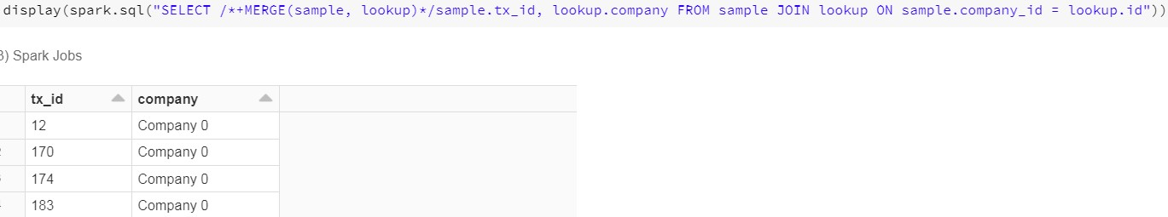
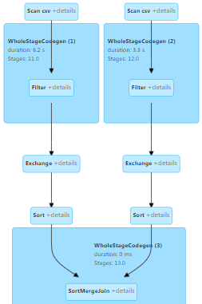
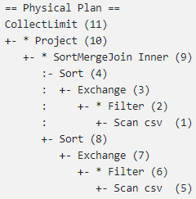
Without AQE: Hard-code Shuffle Partitions
(No Coalesce Shuffle Partitions)
Notice lack of 'CustomShuffleReader'
No Coalescing of Shuffle Partitions
No Adaptive Plan

Slide 18
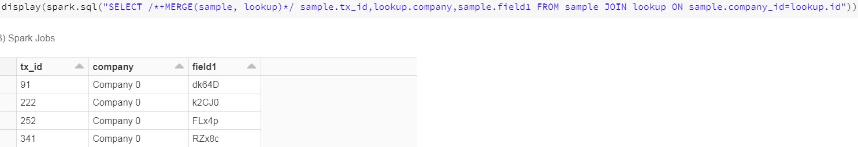
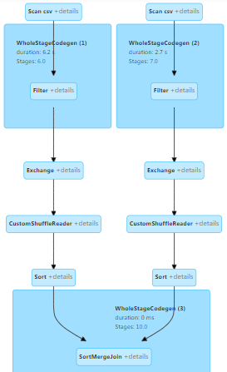







With AQE: Coalesce Shuffle Partitions
(with 'CustomShuffleReader')
Without Coalesce With Coalesce
Notice 'CustomShuffleReader'
This is Coalescing Shuffle Partitions

Slide 19
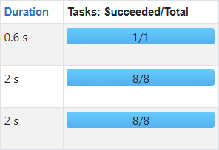




Without Coalesce / With Coalesce
Number of Partitions went from 21 to 17 and Performance increased
Without Coalesce Partitions,
Total Partition Count = 21
With Coalesce Partitions,
Total Partition Count = 17
Coalesce
Total Time: 4.8 seconds
Total Time: 4.1 seconds

Slide 20
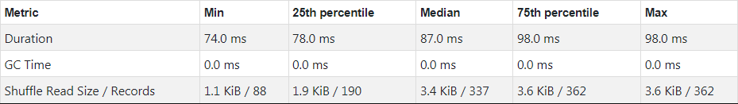
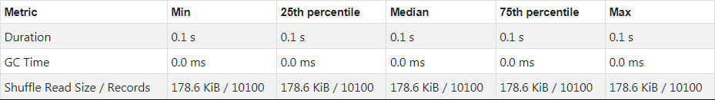
Without Coalesce / With Coalesce
Without Coalesce Partitions, note time differences between 25th and Max
With Coalesce Partitions, evenly sized Partition means better Performance

Slide 21
03: Handle Skew Partitions in a Join Operation
Features of Adaptive Query Execution include:
Change Join Strategies from SortMerge to BroadcastHash
Dynamic Coalesce Shuffle Partitions
Handle Skew Partitions in a Join Operation
http://www.openkb.info/2021/03/spark-tuning-adaptive-query-execution1_18.html https://kyuubi.readthedocs.io/en/latest/deployment/spark/aqe.html
https://medium.com/agile-lab-engineering/spark-3-0-first-hands-on-approach-with-adaptive-query- execution-part-3-ea6012a8f216
https://coxautomotivedatasolutions.github.io/datadriven/spark/data%20skew/joins/data_skew/

Slide 22
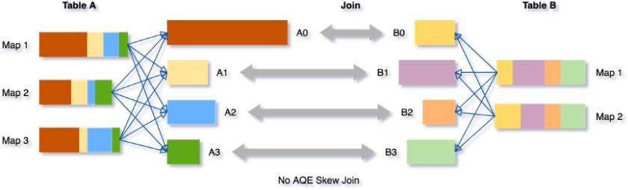
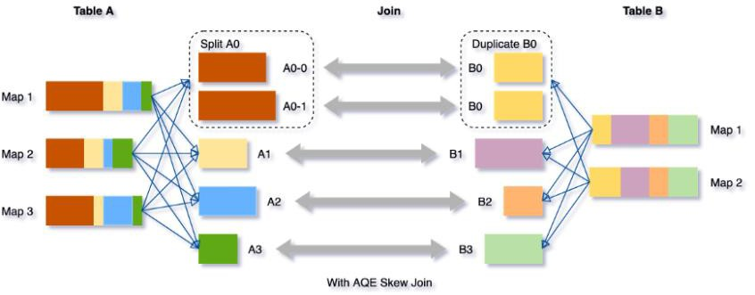
Skew Partitions Visualized
Have Skewed (over-sized) Partition (when compared to A1-A3 Partitions)
AQE is the Solution
(A0 – A3 Partitions more evenly sized now)
Goal is to increase # of Partitions on Skew Partitions to even out Partition size (so don't spill to disk)

Slide 23
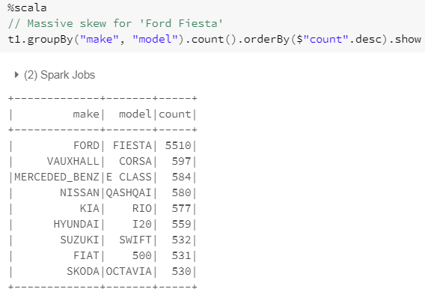
Problem: Ford Fiesta is 50% of all rows in one of the Tables

Slide 24

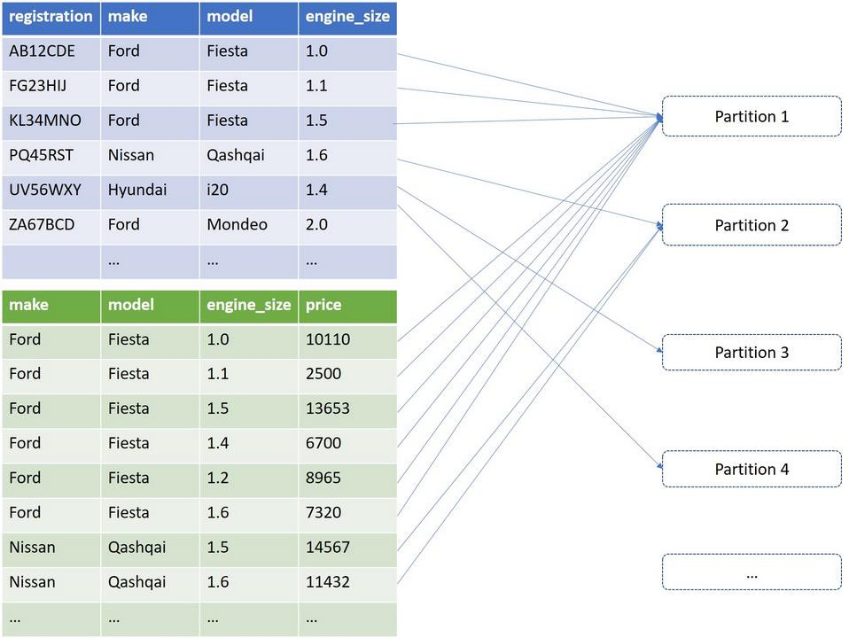
Problem: Skewed Partition during JOIN operation
We want to break that big Ford Fiesta partition into smaller partitions, thereby
distributing our processing better. One advantage is less chance for Disk spills
Ford Fiesta = 50% all rows
Skew

Slide 25
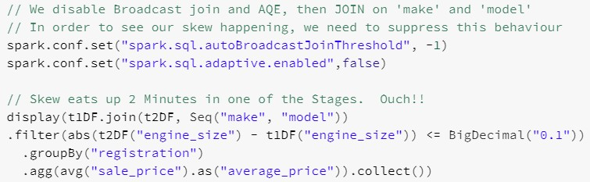
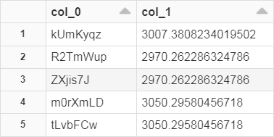
Problem: Skewed Partition
Took > 2 minutes to execute. Let's look at Individual Stages (see next slide)

Slide 26
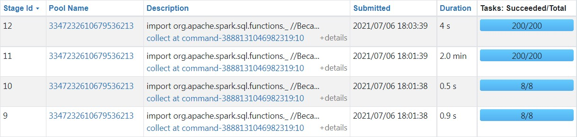
Without AQE, 200 Shuffle Partitions took 2 Minutes
But we can't tell if this was due to Skewed Partitions since we can't see Partition size.
Let's dig further (see next slide)

Slide 27
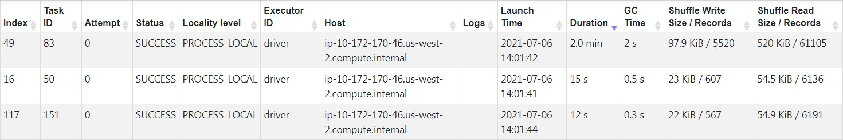
One Partition is almost 10x larger than Others
Check out the 'Shuffle Read Size/Records' column. Task ID 83 is much larger than other Tasks
Task 83 is almost 10x larger than other Tasks!
And under the Stage tab of the Spark UI, the Summary Metrics confirms a Skew condition. Task 83 hit the Max percentile for the Job

Slide 28

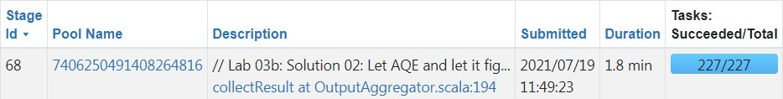
With AQE, Skew Partitions are carved in Multiple Smaller ones
3rd Job
With AQE enabled, # of Partitions is now greater than 200 AQE is increasing # of Partitions to shrink Partition size
Did not get ton of Performance, but better than 2 minutes with AQE disabled

Slide 29
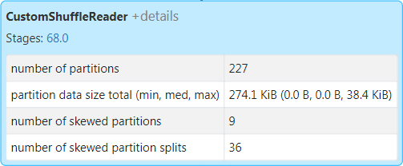
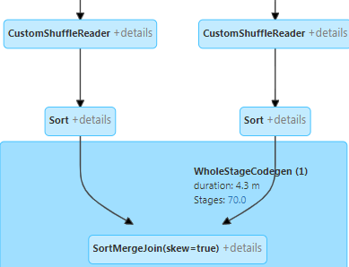






Had 9 Skew Partitions broken into 36 smaller Partitions
And we can confirm we had a Skew situation.
In SQL tab of Spark UI, we see 9 Skewed Partitions were Split into 36 smaller Partitions
If AQE had not triggered this Skew Optimization, there would have been only 228 Partitions

Slide 30
04: Dynamic Partition Pruning (not really part of AQE)
Features of Adaptive Query Execution include:
Change Join Strategies from SortMerge to BroadcastHash
Dynamic Coalesce Shuffle Partitions
Handle Skew Partitions in a Join Operation
Dynamic (Directory) Partition Pruning
It is important to note we are talking about Directory Partitions (Disk I/O) as opposed to Partitions that are nested in Tasks
https://medium.com/agile-lab-engineering/spark-3-0-first-hands-on-approach-with-adaptive-query- execution-part-2-35223d532637
https://blog.knoldus.com/adaptive-query-execution-aqe-in-spark-3-0/

Slide 31
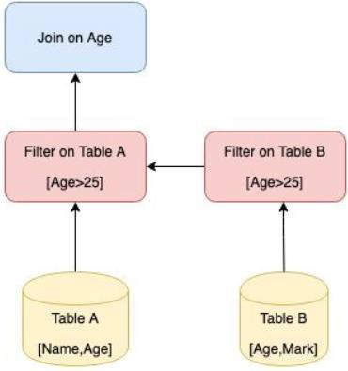


Dynamic Directory Partition Pruning Visualized
Join-2 will be much faster and efficient, compared to Join-1, as it joins only data from the Partitioned directories (not to be confused with Partitions in Tasks)
Join-1 (sans AQE)
Join-2 (via AQE)
via PartitionPruning
Fact Dim Fact
Dim
AQE will add (Directory) Partition Pruning
on Larger table prior to JOIN for better Performance

Slide 32
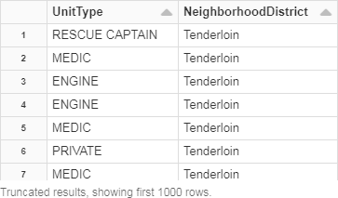
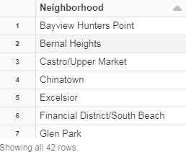
Here's the 2 Tables we'll be Joining
FirePartition_view is a FACT table
that's over 2 GB in size.
It is Partitioned by 42 values in the 'NeighborhoodDistrict' column
Neighbor_view is Small table with the list of 42 Neighborhoods. We will put a FILTER on this Table in the JOIN statement
FirePartition_view
Neighbor_view
A Partitioned Table is mandatory to take advantage of Dynamic Partition Pruning

Slide 33
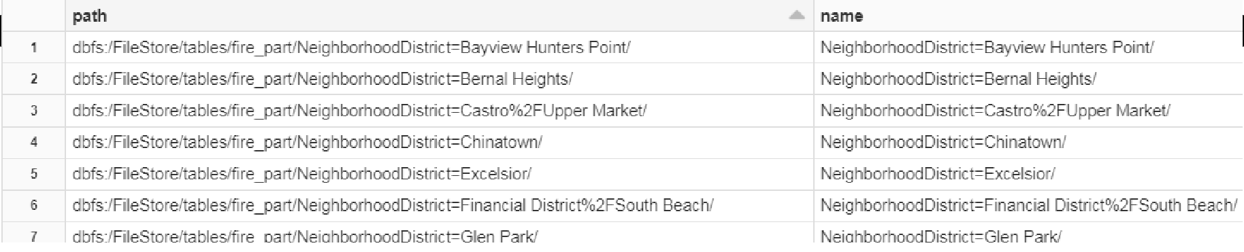
How to Create a Partition Table and What Directories look like
A Partition Table has one or more columns defined as a Partitioning column. This will
cause each value in that Column to have its own Directory on the file system
While querying, if the WHERE clause contains that Partitioning column (or from Join Column of another Table that matches Partitioning column), disk I/O is only done on those Partitioned Directories while other Directories are ignored
Creating a Partitioned View
Viewing the Directory structure for each NeighborhoodDistrict
. . . . . .
. . . . . .

Slide 34

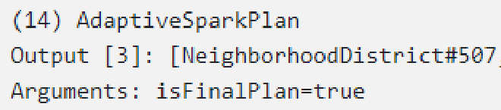





Dynamic (Directory) Partition Pruning occurs on FACT table
This view Partitioned
Execute from bottom to top
== Optimized Logical Plan ==
Project [NeighborhoodDistrict#340, Neighborhood#411, UnitType#324]
+- Join Inner, (Neighborhood#411 = NeighborhoodDistrict#340), leftHint=(dynamicPruningFilterId=Some(462))
:- Filter (Neighborhood#411 IN (Golden Gate Park, Twin Peaks) AND isnotnull(Neighborhood#411))
+- Project [UnitType#324, NeighborhoodDistrict#340]
+- Filter((isnotnull(NeighborhoodDistrict#340) AND NeighborhoodDistrict#340 IN (Golden Gate Park, Twin Peaks)) AND dynamicpruning)
Here's additional FILTER with Dynamic Pruning in firePartition_view before JOIN

Slide 35

Dynamic Partition Pruning will NOT happen if Fact table NOT Partitioned
This view NOT Partitioned
== Optimized Logical Plan ==
Project [NeighborhoodDistrict#490, Neighborhood#411, UnitType#486]
+- Join Inner, (Neighborhood#411 = NeighborhoodDistrict#490)
:- Filter (Neighborhood#411 IN (Golden Gate Park, Twin Peaks) AND isnotnull(Neighborhood#411))
: +- Project [UnitType#486, NeighborhoodDistrict#490]
+- Filter (isnotnull(NeighborhoodDistrict#490) AND NeighborhoodDistrict#490 IN (Golden Gate Park, Twin Peaks)))
Here's additional FILTER but all Table rows will be scanned due to non- Partitioned table (fireNotPart_view)

Slide 36
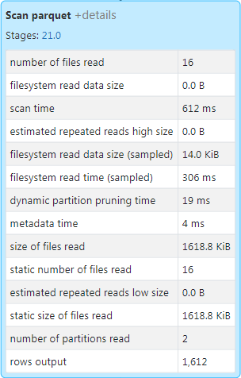
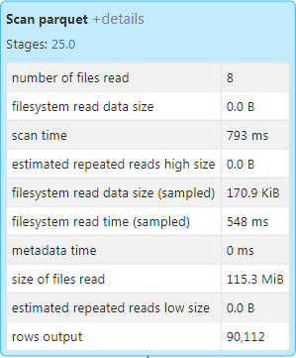
Comparing # of Rows on Partitioned/Non-Partitioned Tables
Partitioned Table
Non-Partitioned Table

Slide 37
Summary
Spark Adaptive Query Execution (AQE) functionalities including:
Change Join Strategies from SortMerge to BroadcastHash
Dynamic Coalesce Shuffle Partitions
Handle Skew Partitions in the Join operation
In addition, there is another functionality not part of AQE called
Dynamic (Directory) Partition Pruning (technically not part of AQE)

Slide 38
After completing this module, learned about:
Spark Catalog
List Hive tables and Spark Views
List column names on Table
List Spark functions
Catalyst Optimizer functionalities including:
Dropping hints to Optimizer
Column pruning and Predicate pushdown
Tungsten Encoder functionalities including:
Binary processing
Improved memory usage
Whole-stage code generation and Vectorization

