Slide 1
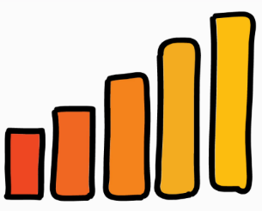




C7084 Big Data
Ed Harris
QUERY
DATA
Knowledge

Slide 2
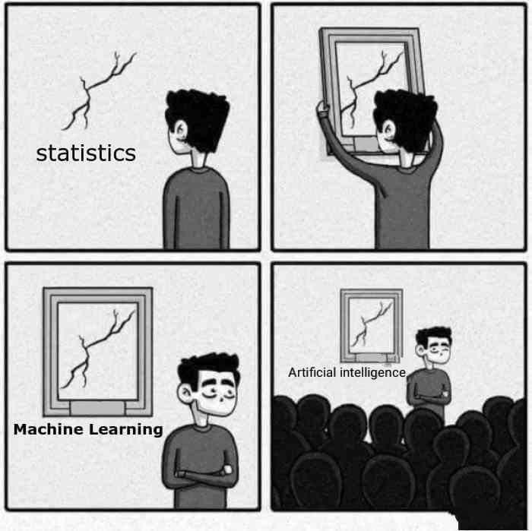
BIG
DATA

Slide 3
Table of Contents
Every session: community.cloud.databricks.com and Logon
In Left-pane, Click on 'Clusters' or 'Compute' and Terminate old Cluster Then click 'Create Cluster' button to create New one
Mod 00 – Intro and Setup
Mod 01 – Spark Architecture
Mod 02 – SparkSQL (Read/Write DataFrames/Tables)
Hacktivity 00 (Dates) / Hacktivity 01 (Air)
Mod 03 – SparkSQL (Transform)\
Mod 04 – Complex Data Types
Mod 05 – JSON (Optional)
Hacktivity 02 (Fly)
Mod 06 – Streaming
Mod 07 – Architecture-Spark UI
Mod 08 – Catalog-Catalyst-Tungsten
Mod 09 – Adaptive Query Execution
Mod 10 – Performance Tuning
Hacktivity 03 (Stream) / Hacktivity 04 (Air)
Mod 11 – Machine Learning

Slide 4
Module 11-1 – Spark Machine Learning
https://www.bmc.com/blogs/python-spark-machine-learning-classification/ https://vishalmnemonic.github.io/DC11/ https://medium.com/@Sushil_Kumar/machine-learning-pipelines-with-spark-ml- 94cd9b4c973d

Slide 5
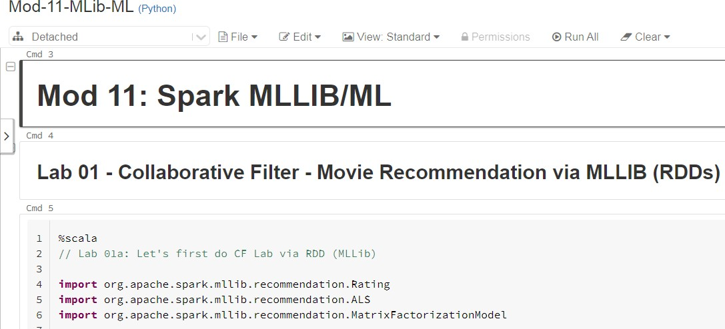
Before We Begin: Open Mod 11 Notebook
3

Slide 6

Current Topic
4
Machine Learning concepts
Terminology
MLib (RDD) vs ML (DataFrames)
Collaborative Filtering (ALS) example
ML (non-Predictive) examples
Correlation
KMeans
ML Predictive concepts
Transformer, Estimator, Pipeline
ML Predictive examples
Logistic Regression
Gradiant Boost Tree
Decision Tree

Slide 7
Current Topic
5
Machine Learning concepts
Terminology
MLib (RDD) vs ML (DataFrames)
Collaborative Filtering (ALS) example
ML (non-Predictive) examples
Correlation
KMeans
ML Predictive concepts
Transformer, Estimator, Pipeline
ML Predictive examples
Logistic Regression
Gradiant Boost Tree
Decision Tree

Slide 8
Model and Scoring: Definitions
6
Model - A machine learning model can be a mathematical representation of a real- world process. The learning algorithm finds patterns in the training data such that the input parameters correspond to the target. The output of the training process is
a machine learning model which you can then use to make predictions
Scoring - (also called Prediction) is the process of generating values based on a
trained machine learning model, given some new input data. The values
or scores that are created can represent predictions of future values, but they might also represent a likely category or outcome
In real-world examples, this is typically a 2-Step Process:
First create the Model on the TRAIN (Known data) and
Then Score (Make Prediction) on the PRODUCTION (Unknown) data
Optionally may also view Accuracy of the Model if the Known data is available
(using either Confusion Matrix function) or simple calculations

Slide 9
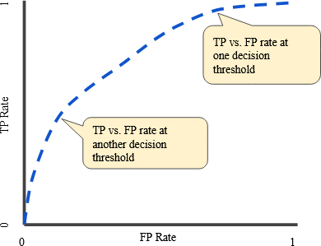
What is Model Evaluation?
7
Determines how Accurate the Model is. There are numerous way to do this including:
Simple statistics
Confusion matrix (True Positive, False Positive, True Negative, False Negative)
ROC (Receiver Operating Characteristic) An ROC curve is a graph showing the performance of a classification model at all classification thresholds. This curve plots two parameters: True Positive Rate and False Positive Rate
The best possible prediction method would yield a point in the upper left corner or coordinate (0,1) of the ROC space, representing 100% sensitivity (no false negatives) and 100% specificity (no false positives).

Slide 10
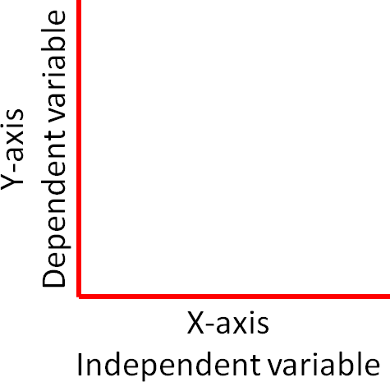
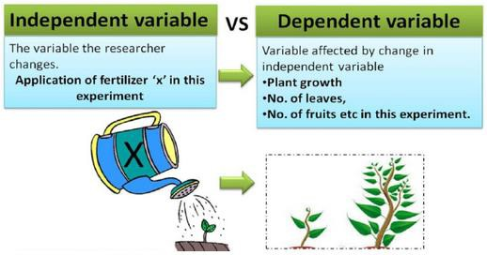
Independent and Dependent Variables: Definitions
8
Independent Variable - Variable you have control over, what you can choose and manipulate. It is usually what you think will affect the Dependent variable
Dependent Variable - What you measure in the experiment and what is affected during the experiment. The Dependent variable responds to the independent variable. It is called Dependent because it depends on Independent variable. In a scientific experiment, you cannot have a Dependent variable without an Independent variable
Independent variables are sometimes called Predictors or X-variables
Dependent variables are sometimes called the
Response, Target or Y-variable
For remainder of this Module, we'll use X-var, Y-var terms

Slide 11
Independent Variable Types: Definitions
9
Numeric - This variable has a Numeric data type and can mathematically be aggregated. Numeric variables are classified into:
1. Continuous - Value obtained by Measuring. Infinity possible values
Examples: Height, Weight, Distance, Time
2. Discrete
- Value obtained by Counting. Have specific values Examples: # of students, # of books
Categorical - Can be Numeric or String data type. However arithmetic operations cannot be
performed on the values. Categorical variables are classified into:
Nominal - Label or Name:
Examples: Eye Color, Country, Marital Status (Cannot order these)
Ordinal - Class Position:
Examples: Pollution = Low, Medium, High Airline seat = First, Second, Third
(Can order these) (Can order these)

Slide 12

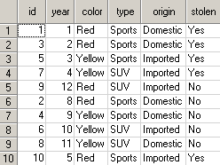

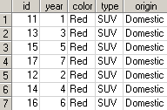
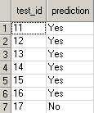

Most Predictive Functions Operate in 2-Step Process
10
Known Data (Split TRAIN 80% / TEST 20%) –Typically consists of X-variables and Y-variable. Run data through algorithm and create Model to use on Unknown data
Unknown data (Production set) – Consists of only X-variables. You run the Unknown data through function using the Model to predict Y-variable
x x x x y x x x x y
x x x x
Prediction of car
being Stolen (Y-var)
Known Data - Train
Known Data - Test
Unknown Data - Prod
+
Build Model
(Train Set)
Evaluate Model
(Test Set)
Score Model
(Production Data)
Answer Set

Slide 13
What is Supervised Learning?
11
Supervised learning is where you have Input variables (X) and an Output variable (Y) and you use an algorithm to learn the mapping function from the input to the output
It is called Supervised learning because the process of an algorithm learning from the training dataset can be thought of as a teacher supervising the learning process. We know the correct answers, the algorithm iteratively makes predictions on the training data and is corrected by the teacher. Learning stops when the algorithm achieves an acceptable level of performance
Supervised learning can be grouped into:
Classification: A Classification problem is when the Output variable(Y) is a
category, such as 'red' or 'blue' or 'disease' and 'no disease'
Regression: A Regression problem is when the Output variable(Y) is a real value, such as 'dollars' or 'weight'

Slide 14
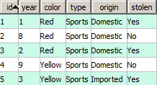
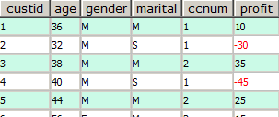
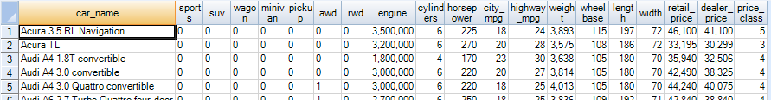
Supervised Learning Example
12
Supervised Learning – Training set composed of X-variables and Y-variables. The Y-variable is labeled as either Classification or Regression (value)
x x x x y x x x x y
x x x x x x x x x x x x x x x x x x y
Examples of Supervised ML: Naïve Bayes, Decision Trees, GLM, LARS, XGBoost

Slide 15
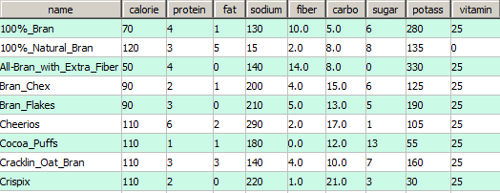

What is Unsupervised Learning?
13
Unsupervised Learning – Algorithm is not provided with information about the
Y-variable. The machine is tasked with discovering this
x x x x x x x x x
Here's a dataset of cereals. We ask the algorithm to discover how many 'like' clusters there are
Answer set says 4 clusters of cereals
Unsupervised ML Algorithms:
Canopy, KMeans, KModes
OutlierFilter, Principal Component Analysis (PCA)
x
x x x x x x x x

Slide 16
Normalization
14
In statistics and applications of statistics, Normalization can have a range of meanings. In the simplest cases, normalization of ratings means adjusting values measured on different scales to a notionally common scale, often prior to averaging
In more complicated cases, Normalization may refer to more sophisticated adjustments where the intention is to bring the entire probability distributions of adjusted values into alignment. In the case of normalization of scores in educational assessment, there may be an intention to align distributions to a normal distribution
https://www.google.com/search?q=how+to+normalize+data&rlz=1C1GCEV_enUS844US8 44&oq=how+to+normalize+&aqs=chrome.0.0j69i57j0l6.3628j0j4&sourceid=chrome&ie=U TF-8#kpvalbx=_d8uNXtq2BpqxtQbnn5qACQ38
High-bias ML algorithms (like Linear Regression, Logistic Regression, Kmeans) can
underfit Model; i.e., can't make accurate Models on your TRAIN set.
Normalization can minimize this tendency

Slide 17
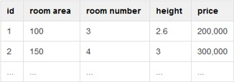
Why Use Normalization?
15
The black box answer is you can’t train models when your features have different ranges (1-5 vs 1-5000)
In essence, Normalization is done to have the same range of values for each of the
inputs to the Model. This can guarantee stable convergence of weight and biases
If one of the features has a broad range of values, the distance will be governed by this particular feature
Range in column 'room area' is 50 and it is significantly larger than the range in column 'height'. So we can't compare them directly

Slide 18
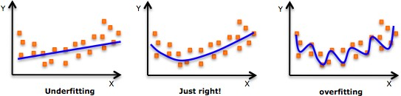
Model Overfitting and Underfitting
16
Goal of Machine Learning is to Model the Pattern and ignore the Noise.
Anytime an algorithm is fitting the Noise in addition to Pattern, it is Overfitting
In middle diagram, algorithm returns the best fit line given those points while
the Right diagram is Modeling the Noise.
Regularization is a one way to reduce Overfitting

Slide 19
What is Hyperparameter Tuning?
17
Parameters which define the model architecture are referred to as hyperparameters and thus this process of searching for the ideal model architecture is referred to as hyperparameter tuning
Hyperparameter tuning works by running multiple trials in a single training job. Each trial is a complete execution of your training application with values for your chosen hyperparameters, set within limits you specify
These hyperparameters might address model design questions such as:
What degree of polynomial features should I use for my linear model?
What should be the maximum depth allowed for my decision tree?
What should be the minimum number of samples required at a leaf node in my decision tree?
How many trees should I include in my random forest?

Slide 20
What is Cross Validation?
18
Cross validation is used to estimate and minimize the Prediction Error. In K-fold cross validation, we sample the dataset into K folds (parts) and iteratively keep one part aside for testing. The advantage of using this method is that all examples in the dataset are eventually used for both training and testing
When K is equal to N (the total number of samples or examples in the data set), the method is known as leave-one-out cross validation as it trains on N-1 samples leaving only 1 sample out for testing in every iteration. K-fold works like this:
Divide the dataset into K subsets of equal size.
For k = 1...K, keep the data in subset k for testing and train a model on the remaining K-1 subsets.
Vary the tuning parameter for each set and obtain the corresponding predictions.
For every tuning parameter, compute the average error across all K subsets.
Select the value of the tuning parameter (Step #) that minimizes the cross validation curve, that is, the Step # with the minimum average error (within 1 Std Dev)
Cross Validation limits problems like Model Over-fitting

Slide 21





What is LabelPoint (MLLib)? (Called VectorAssembler in ML)
19
Label Y-variable must be numeric and can be binary values or a range of values
Feature Variables (X-variables) The majority of ML models operate on numeric data in the form of Feature Vectors. Feature Vectors are the X-variables. They are normally formatted in an Array and typically assigned a data type of Double
LabelPoint (Used for Supervised classification algorithms)
Format of the Y-var followed by the X-variables. Here's an example:
Y-var value X1:value1 X2:value2 …
X-variables:
(mo/day/deptime/arrtime/carrier/elapsedtime/origin/dest
Y- variable: Delayed (1), Not delay (0)
// Making LabeledPoint of features - this is the training data for the model
val mldata = mlprep.map(x => LabeledPoint(x(0), Vectors.dense(x(1), x(2), x(3), x(4), x(5), x(6), x(7), x(8))))
mldata.take(1)
//res7: Array[org.apache.spark.mllib.regression.LabeledPoint] = Array((0.0,[0.0,2.0,900.0,1225.0,6.0,385.0,214.0,294.0]))

Slide 22



















What is Feature Enhancement?
20
Feature Engineering is the process of transforming raw data into features (adding new X-variable columns) that better represent the predictive Models, resulting in improved accuracy on Test data
Partial list of Feature Engineering examples

Slide 23

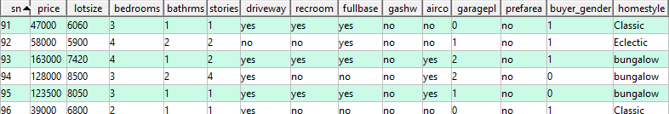
Review: Predictive Analytics Overview
21
Assume wish to predict column 'homestyle' below. Answer the following:
What's the Y-variable?
How many X-variables?
How many Numeric X-vars?
'homestyle' column
13 Don't count 'sn' since it's unique ID
6 price, lotsize, bedrooms, bathrms, stories, garagepl
How Many Categorical X-vars? 7 driveway, recroom, fullbase, gashw, airco,
prefarea, buyer_gender
Classification or Regression?
0 1 2 3 4 5 6 7 8 9 10 11 12 13
Classification since Y-variable is not numeric value or a future value
Y-var
If want to Predict 'Price' and had 'country' column too, now what? Normalize data, use Regression, Partition by 'country'

Slide 24
Current Topic
22
Machine Learning concepts
Terminology
MLib (RDD) vs ML (DataFrames)
Collaborative Filtering (ALS) example
ML (non-Predictive) examples
Correlation
KMeans
ML Predictive concepts
Transformer, Estimator, Pipeline
ML Predictive examples
Logistic Regression
Gradiant Boost Tree
Decision Tree

Slide 25
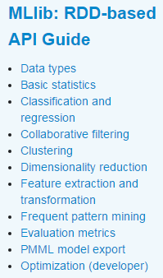
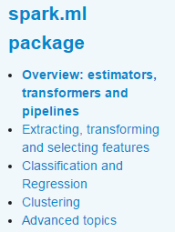
Two Types of Spark Machine Learning
23
There are two Packages available for Machine Learning as follows: MLlib – For RDD's ML – For DataFrames
http://spark.apache.org/docs/latest/ml-guide.html
http://spark.apache.org/docs/latest/mllib-guide.html

