Slide 1
Module 11-3 – Spark Machine Learning
https://www.bmc.com/blogs/python-spark-machine-learning-classification/ https://vishalmnemonic.github.io/DC11/ https://medium.com/@Sushil_Kumar/machine-learning-pipelines-with-spark-ml- 94cd9b4c973d

Slide 2
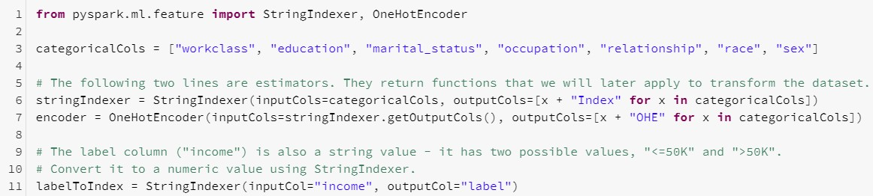

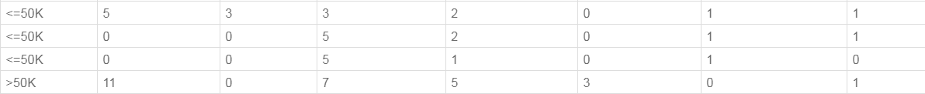
Step 2: Lab 06g-h
Convert Categorical into Numeric and fit
76
Via StringIndexer() and OneHotEncoder(), we create Vector of X-variables
Create Model then Display

Slide 3
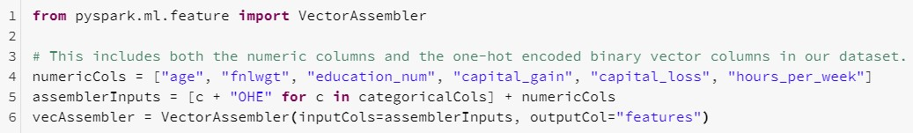
Step 2: Lab 06i
Convert into Single Vector
77
We use: VectorAssembler to format the X-variables

Slide 4
Step 3: Lab 06j
Create Model
78
Via LogisticRegression(), we point to:
X-variables
Y-variable

Slide 5
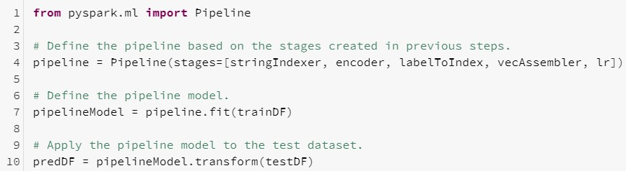
Step 4: Lab 06k
Build Pipeline via fit, then Score Model via transform)
79
Via the pipeline() function, we:
fit() to create Model and
transform() to Score the Model on the Test set

Slide 6
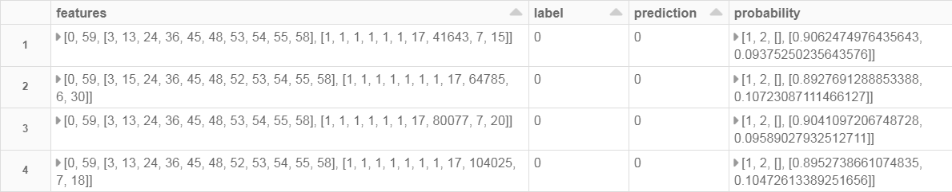
Step 4: Lab 06l
Display Prediction
80
Actual
Predict

Slide 7
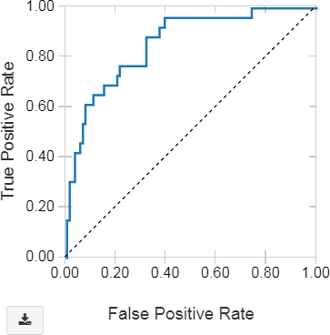
Step 5: Lab 06m
Evaluate Model via ROC (Receiver Operating Characteristic)
81

Slide 8
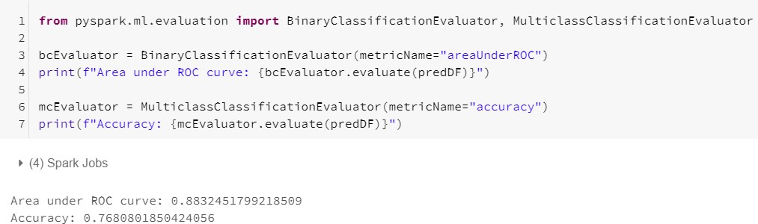
Step 5: Lab 06n
Evaluate Model via ROC (Receiver Operating Characteristic)
82
We use the following functions:
BinaryClassificationEvaluator and
MulticlassClassificationEvaluator

Slide 9
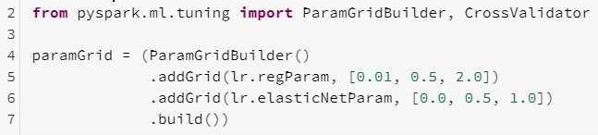
Step 6: Lab 06o
Hyperparameter Tuning
83
We use the following functions: ParamGridBuilder and
CrossValidator
We use Regularization via 'regParam' and 'ElasticNet' so we don't Overfit the Model. We provide 3 different values to try and the best set that minimizes the error will be used

Slide 10
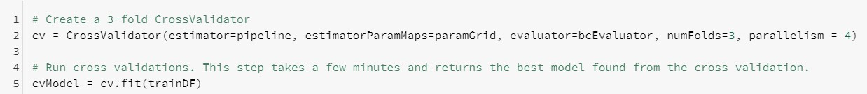
Step 6: Lab 06p
Cross Validation
84
We use the following functions: CrossValidator
WARNING: This takes from 5-7 minutes to Execute
And spawns over 100 jobs

Slide 11
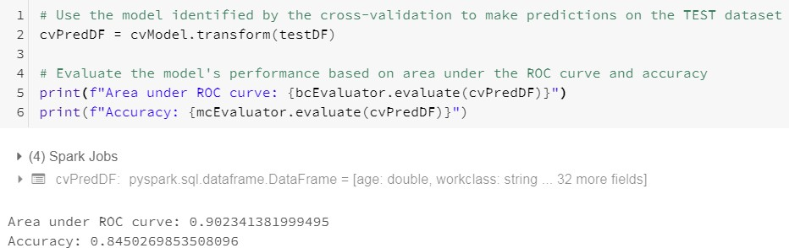

Step 7: Lab 06q
Run Improved Model against TEST and confirm Accuracy
85
Old Model
This beats old Model by almost 8%

Slide 12
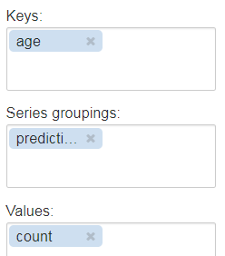
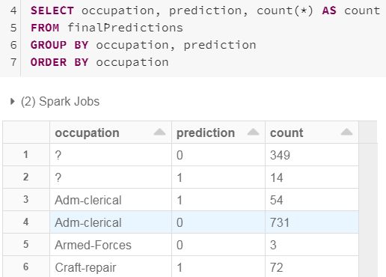
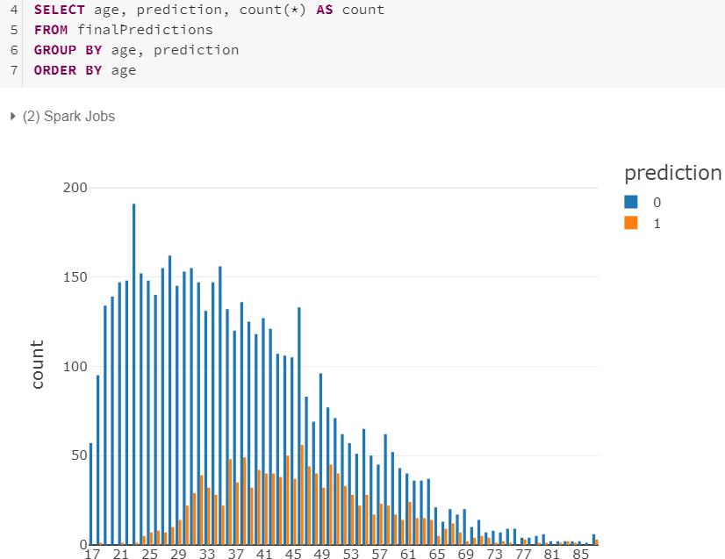
Step 7: Lab 06r/s/t
Convert to TempView and Display by occupation/age
86

Slide 13
Step 7: Lab 06s/t
Run Improved Model against TEST and confirm Accuracy
87
Old Model
This beats old Model by almost 8%

Slide 14

Current Topic
88
Machine Learning concepts
Terminology
MLib (RDD) vs ML (DataFrames)
Collaborative Filtering (ALS) example
ML (non-Predictive) examples
Correlation
KMeans
ML Predictive concepts
Transformer, Estimator, Pipeline
ML Predictive examples
Logistic Regression
Gradiant Boost Tree
Decision Tree

Slide 15
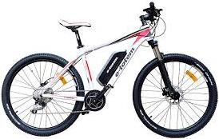
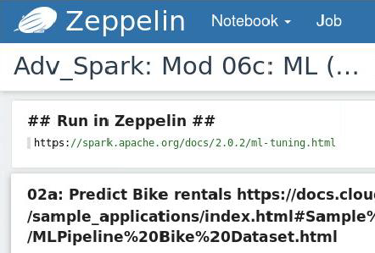
Predict Bike Rentals (GradientBoost Tree Regression)
89
Intro: This Python notebook demonstrates creating an ML Pipeline to preprocess a dataset, train a Machine Learning model, and make predictions. The next many pages will walk you through the process.
Data: The dataset contains bike rental info from 2011 and 2012 in the Capital
bikeshare system, plus additional relevant information such as weather.
Goal: We want to learn to predict bike rental counts (per hour) from information such as day of the week, weather, season, etc. Having good predictions of customer demand allows a business to prepare and increase supply as needed
Approach: We will use Spark ML Pipelines, which help users piece together parts of a
workflow such as feature processing and model training. We will also demonstrate model selection (a.k.a. hyperparameter tuning) using Cross
Validation in order to fine-tune and improve our ML model
Open Adv_Spark: Mod 06c: ML
(Bike Rental)

Slide 16
Lab 07
Know the Data – Bike Rental Data Bike Rentals
90
Feature columns: (Potential X-variables) Feature columns: (Potential X-variables) (cont’d)
instant: record index
dteday: date
season: season (1:spring, 2:summer, 3:fall, 4:winter)
yr: year (0:2011, 1:2012)
mnth: month (1 to 12)
hr: hour (0 to 23)
holiday: whether day is holiday or not
weekday: day of the week
workingday: if day is neither weekend nor holiday is 1, otherwise is 0.
weather:
Clear, Few clouds, Partly cloudy, Partly cloudy
Mist + Cloudy, Mist + Broken clouds, Mist + Few
clouds, Mist
Light Snow, Light Rain + Thunderstorm + Scattered clouds, Light Rain + Scattered clouds
Heavy Rain + Ice Pallets + Thunderstorm + Mist, Snow + Fog
temp: Normalized temperature in Celsius. The values are derived via (t-t_min)/(t_max- t_min), t_min=-8, t_max=+39 (only in hourly scale)
atemp: Normalized feeling temperature in Celsius. The values are derived via (t- t_min)/(t_max-t_min),t_min=-16, t_max=+50 (only in hourly scale)
hum: Normalized humidity. The values are divided to 100 (max)
windspeed: Normalized wind speed. The values are divided to 67 (max)
casual: count of casual users
registered: count of registered users
Label columns: (Y-variable: what I want to predict)
cnt: count of total rental bikes including both casual and registered
Want to predict how many Bike rentals I'll need based on demographics Predict cnt (Y-var Label) based on X-var).

Slide 17

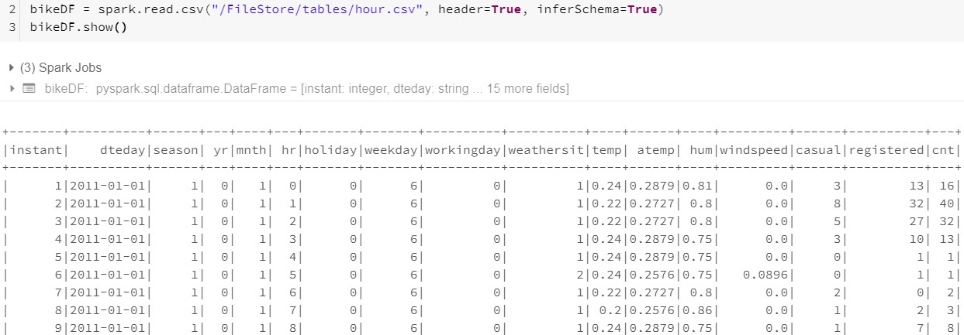
Lab 07a
Load and View Data
91

Slide 18
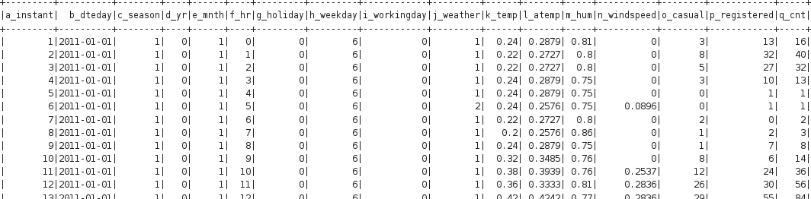
Lab 07b
Clean the Data: Remove Columns (1 of 2)
92
Here's the data as a DataFrame. We'll remove some columns as follows:
Recall our goal: Predict count of bike rentals (the cnt column). We refer to the count as label
Features: What can we use as features (info describing each row) to predict the cnt label? Some of the columns contain duplicate information. For example, the cnt column we want to predict equals the sum of the casual + registered columns. We will remove
the casual and registered columns to ensure we do not use them to predict cnt. We will remove dteday, since other columns season, yr, mnth, and weekday. We will discard instant column too as it has no value
Features (X-var)
Remove Remove Label (Y-var)

Slide 19
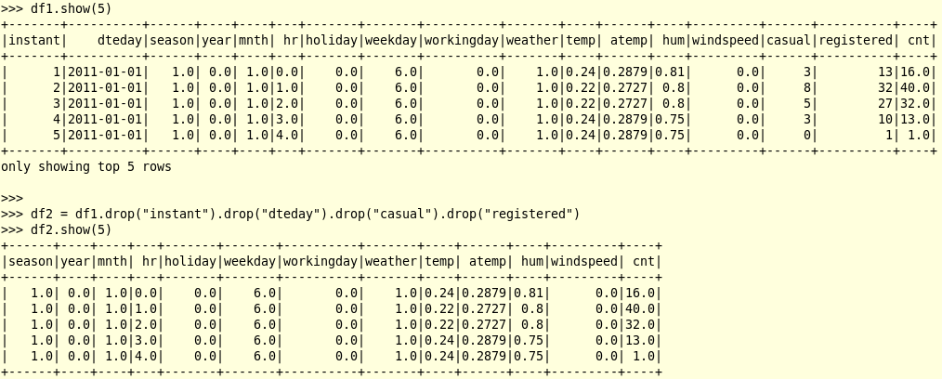
Lab 07b
Clean the Data: Remove Columns (2 of 2)
93
Once we drop our 4 columns, we have the following. But we still have a
problem since every column is defined as a String. See next slide

Slide 20
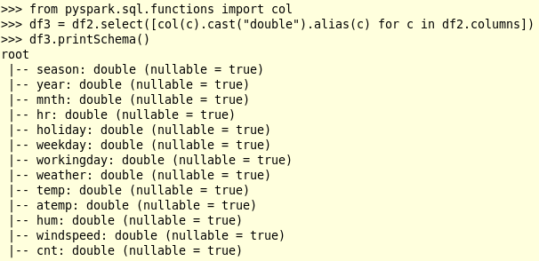
Lab 07c
Clean the Data: Change to Double
94
Now we change all the columns to Double data type since ML requires all data to be Numeric

Slide 21
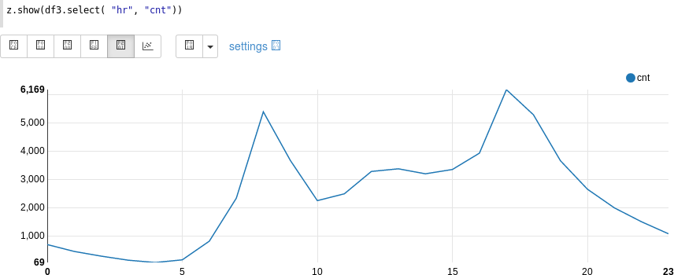
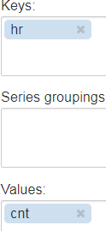
Lab 07d
Visualize the DataFrame in Zeppelin
95
We compare bike rental counts (Y-var) versus hour (X-var) of the day. As one might expect, rentals are low during the night, and they peak in the morning (8am) and early evening (6pm). This indicates the hr feature is useful and can help us predict our label cnt. On your own, you can try visualizing other features to get a sense of how useful they are in this task

Slide 22
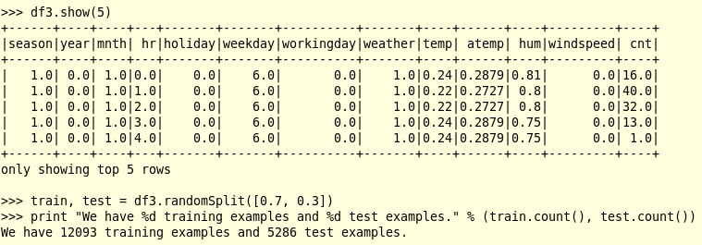
Lab 07e
Create TRAIN/TEST from DataFrame
96
Now that we have understood our data and prepared it as a DataFrame with numeric values, let's learn an ML model to predict bike sharing rentals in the future. Most ML algorithms expect to predict a single "label" column (cnt for our dataset) using a single "features" column of feature vectors. For each row in our data, the feature vector should describe what we know: weather, day of the week, etc., and the label should be what we want to predict (cnt)
Before we start, let's create a Train for Model and Test set to then predict from Model
Should cache 'train' DataFrame so Model generates faster

Slide 23
Train ML Pipeline – The Big Picture
97
We will put together a simple Pipeline with the following stages:
VectorAssembler: Assemble the feature columns into a feature vector
VectorIndexer: Identify columns which should be treated as categorical. This is done heuristically, identifying any column with a small number of distinct values as being categorical. For us, this will yr (2), season (4), holiday (2), workingday (2), and weather (4)
GBTRegressor: This will use the Gradient-Boosted Trees (GBT) algorithm to learn how to predict rental counts from the feature vectors
CrossValidator: The GBT algorithm has several hyperparameters, and tuning them to our data can improve accuracy. We will do this tuning using Spark's Cross Validation framework, which automatically tests a grid of hyperparameters and chooses the best
CrossValidator
Vector
Assembler
Vector Indexer
GBT
Regressor
Feature processing
Model training and tuning

Slide 24
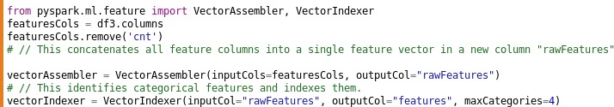
Lab 07f
Define Feature Processing Pipeline
98
First, we define the feature processing stages of the Pipeline:
Assemble feature columns into a Feature vector
Identify Categorical features, and Index them
Yr, Season, Holiday, WorkingDay,
Weather columns treated as Categorical
Vector
Assembler
Vector Indexer
Feature processing
Any columns with 4 or less unique values consider Categorical

Slide 25

Lab 07g
Point GBTRegressor to Y-variable ("cnt")
99
Second, we define the model training stage of the
Pipeline. GBTRegressor takes Feature vectors and Labels as input and learns to predict labels of new examples
Feature processing
Model training
GBT
Regressor
Vector
Assembler
Vector Indexer

Slide 26
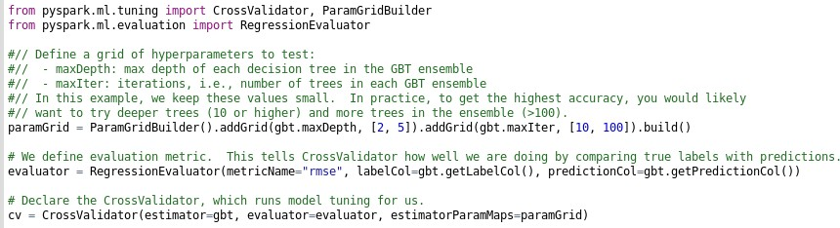
Lab 07h
Add CrossValidation to Pipeline
100
Third, we wrap the model training stage with a CrossValidator stage.
CrossValidator knows how to call the GBT algorithm with different hyperparameter settings. It will train multiple models and choose the best one, based on minimizing some metric. In this example, our metric
is Root Mean Squared Error (RMSE)
CrossValidator
GBT
Regressor
Model training and tuning

Slide 27
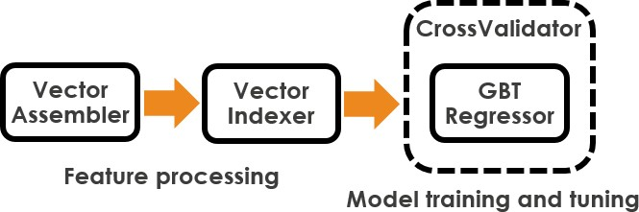
Lab 07i
Tie Features/Model Together in Pipeline
101
Finally, we can tie our feature processing and model training stages together
into a single Pipeline
Pipeline
Feature
Categorical columns
Cross Validation
columns

Slide 28

Lab 07j
Create Model on TRAIN
102
Now that we have set up our workflow, we can train the Pipeline in a single call. Calling fit() will run feature processing, model tuning, and training in a single call. We get back a fitted Pipeline with the best model found
This next cell can take at least 10 minutes. This is because it is training a lot of trees:
For each random sample of data in Cross Validation
For each setting of the hyperparameters
CrossValidator is training a separate GBT ensemble which contains many
Decision Trees
Features and Model
WARNING: This takes from 5-7 minutes to Execute
And spawns over 100 jobs
We cached 'train' so it should run faster than if not cached

Slide 29

Lab 07k
Score Model on TEST, Evaluate Results (1 of 2)
103
Our final step will be to use our fitted model to make predictions on new data. We will use our held-out test set, but you could also use this model to make predictions on completely new data. For example, if we created some features data based on weather predictions for the next week, we could predict bike rentals expected during the next week!
We will also evaluate our predictions. Computing evaluation metrics is important for understanding the quality of predictions, as well as for comparing models and tuning parameters
How it works: Calling transform() on a new dataset passes that data through
feature processing and uses the fitted model to make predictions. We get back a DataFrame with a new column predictions (as well as intermediate results such as our rawFeatures column from feature processing)

Slide 30

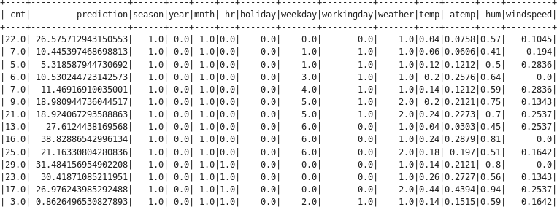
Lab 07k
Make Predictions, Evaluate Results (2 of 2)
104
Are these good results? They are not perfect, but you can see correlation between the counts and predictions. And there is room to improve---see the next section for ideas to take you further!

Slide 31
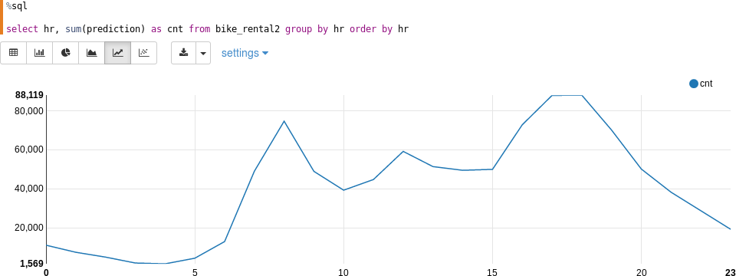
Lab 07l
Visualize the Prediction
105
Visualization: Plotting predictions vs. features can help us make sure that the model "understands" the input features and is using them properly to make predictions. Below, we can see that the model predictions are correlated with the hour of the day, just like the true labels were in the Train data

Slide 32
Improving the Model
106
There are several ways we could further improve our model:
Expert knowledge: We may not be experts on bike sharing programs, but …
─ The count of rentals cannot be negative. GBTRegressor does not know that, but we
could threshold the predictions to be >= 0 post-hoc.
─ The count of rentals is the sum of registered and casual rentals. These two counts may have different behavior. (Frequent cyclists and casual cyclists probably rent bikes for different reasons.) The best models for this dataset take this into account. Try training one GBT model for registered and one for casual, and then add their predictions together to get the full prediction
Better tuning: To make this notebook run quickly, we only tried a few hyperparameter settings. To get the most out of our data, we should test more settings. Start by increasing the number of trees in our GBT model by setting maxIter=200; it will take longer to train but can be more accurate
Feature engineering: We used the basic set of features given to us, but we could potentially improve them. For example, we may guess that weather is more or less important depending on whether or not it is a workday vs. weekend. To take advantage of that, we could build a few feature by combining those two base features. MLlib provides a suite of feature transformers; find out more in the ML guide

Slide 33
Current Topic
107
Machine Learning concepts
Terminology
MLib (RDD) vs ML (DataFrames)
Collaborative Filtering (ALS) example
ML (non-Predictive) examples
Correlation
KMeans
ML Predictive concepts
Transformer, Estimator, Pipeline
ML Predictive examples
Logistic Regression
Gradiant Boost Tree
Decision Tree

Slide 34


Lab 08
Predict Titanic Survivors (Decision Tree)
108
We know use Decision Tree to predict who will Survive the sinking of the Titanic
It works by building a Tree of best X-variables to use when making a Prediction. Here's example of predicting Poisonous/Edible mushrooms
Root: 3116(Poison) + 3337(Edible) = 6453
Still not sure about these so keep walking Tree
So stop tree on this side
P1 = 3021 Odor: 3021
Odor: 3432
P2 = 3071
Spore_Print_Color: 50
Spore_Print_Color: 3382
Stalk_Color_Below_Ring: 3365
Stalk_Color_Below_Ring: 17
Final P4 Predict 3093 = 'P'
Actual 3132
Final Predict 3360 ='E'
Actual 3359 = 'E'
Cap_surface: 3360
Cap_surface: 5
P3 = 3076

Slide 35









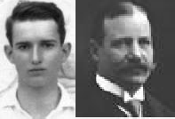
Lab 08
Know the Data
109
Passengerid Survived Pclass Name Gender Age
Sibsp Parch Ticket Fare Cabin Embarked
Unique id
Survived (0 = No; 1 = Yes) -- Null in TEST file
Passenger Class (1 = 1st; 2 = 2nd; 3 = 3rd) Name
Gender
Age
Number of Siblings/Spouses Aboard Number of Parents/Children Aboard Ticket Number
Passenger Fare
Cabin
Port of Embarkation (C = Cherbourg; Q = Queenstown; S = Southampton)

Slide 36
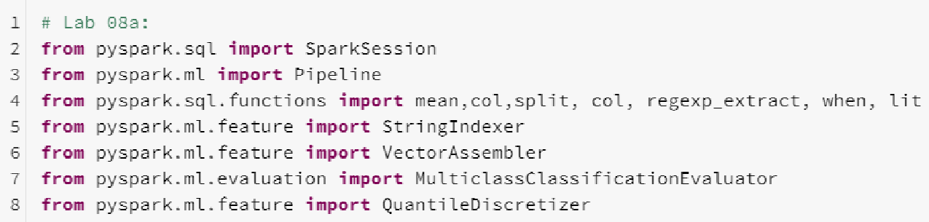
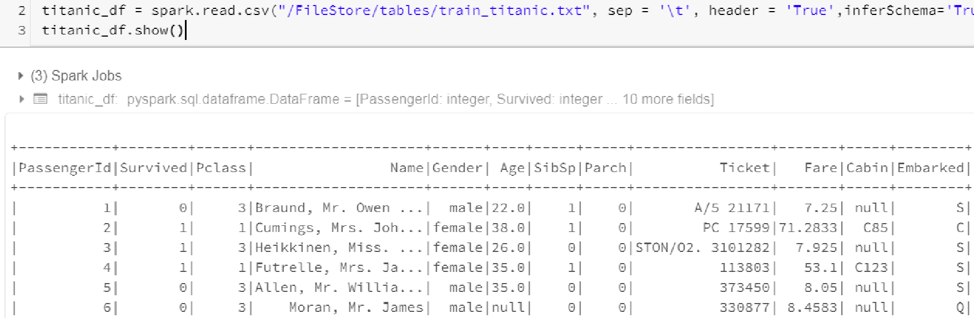
Lab 08a
Load Libraries and Load/View DataFrame
110

