Slide 1
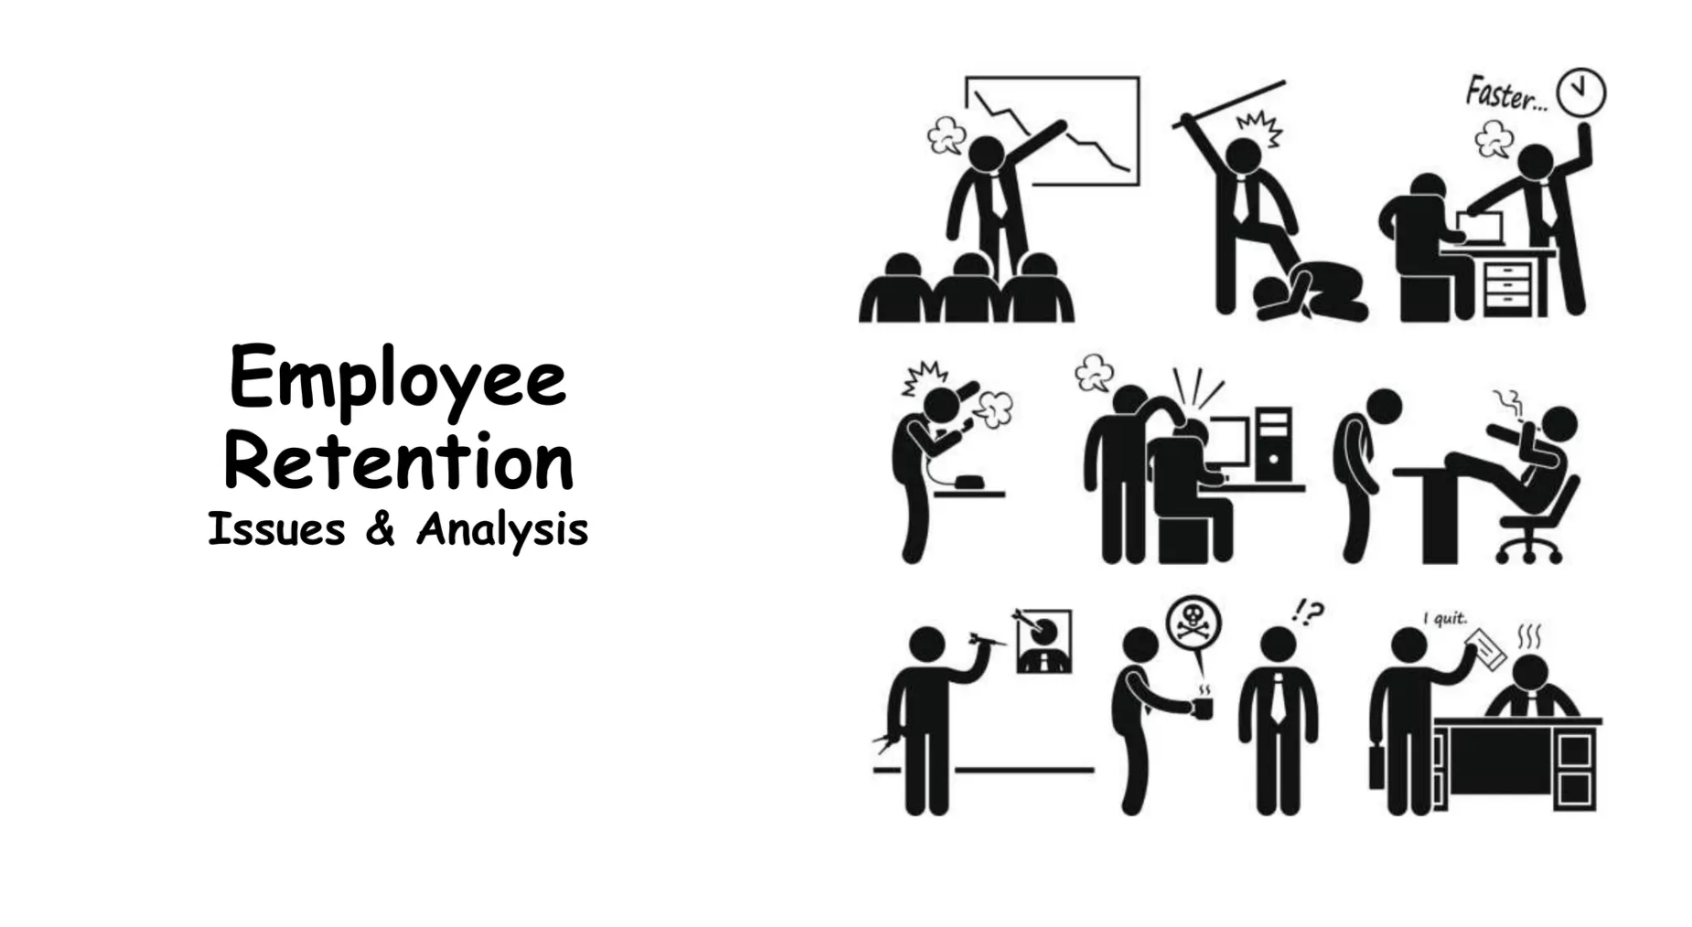

Employee Churn Analysis
Group G1
Albert, Gizem, İhsan, İpek, Osman, Safiye

Slide 2






AGENDA
BUISNESS PROBLEMS
DATA VISUALIZATION
DATA UNDERSTANDING
MODEL BUILDING
DATA PROCESSING
FUTURE ENHANCEMENT

Slide 3
BUSINESS PROBLEMS
People are expected to give their all – labor, passion, and time – to their jobs. But if their jobs don’t give back enough, they will leave.
As have 4.5 million burned-out American employees who quit their jobs since November 2021 due to low satisfaction.
Ref:https://datasciencedojo.com/blog/churn-rate-prediction/#

Slide 4
WHAT IS EMPLOYEER CHURN ANALYSIS?
Employee churn analysis refers to the process of examining and evaluating the factors that contribute to employees leaving an organization voluntarily or involuntarily. Also known as employee turnover or attrition, employee churn is a critical metric for businesses to understand, as high turnover rates can be costly and disruptive.
The analysis involves studying patterns, trends, and reasons behind employees leaving the company. It aims to identify the root causes of turnover, assess the impact on the organization, and develop strategies to reduce or manage employee churn.

Slide 5




WHY DO WE CARE ?
Cost
Talent Retention

Slide 6











ATTRIBUTES
Numerical
Non-Numerical
Satisfaction Level
Work Accident
Last Evaluation
Promotion Last 5 Year
Target Variable
Left
Number of Project
Salary
Average Montly Hours
Department
Time Spend Company
Left

Slide 7

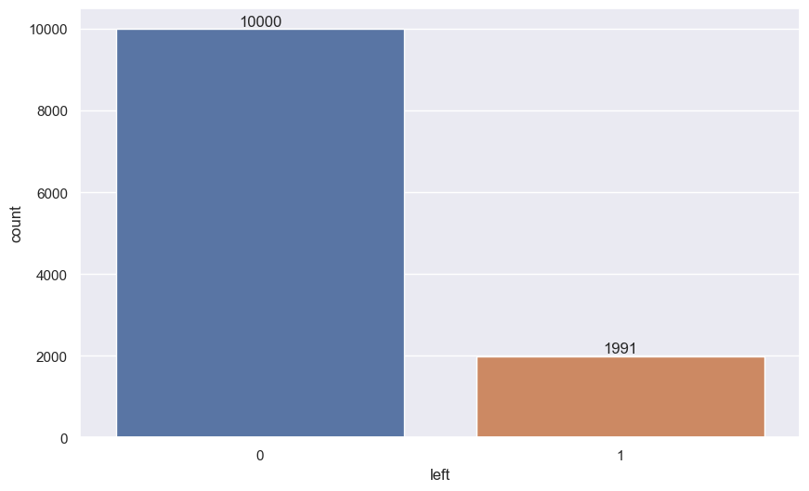
DATA UNDERSTANDING
Total number of observations is 14999 with 9 independent attributes.
The given data has mix of numerical and categorical attributes.
Target Variable
Left
It is discrete and has high class imbalance.
ATRIBUTE | 0 | 1
LEFT | 11428 | 3571
LEFT (DISTINCT) | 10000 | 1991

Slide 8
ATTRIBUTE RANGE LEVELS
There are eight continuous variables and two categorical variables in the data set that offers information about 14999 employees. Continuous variables are those with numerical values, and categorical variables group things into category headers, like “Departments” that can have values similar to sales, marketing, consumer, operations, and so on.
ATTRIBUTE | RANGE/LEVEL
Satisfaction Level | 0.09 – 1.00
Last Evaluation | 0.36 to 1.00
Number of Project | 2 - 7
Average Monthly Hours | 96- 310
Time Spend Company | 2- 10
Department | 10 levels
Salary | 3 levels
Left, Work Accident, Promotion Last % Years | 0,1

Slide 9

DATA PROCESSING
Task
Dublicate records
No Missing Values
Subsetting and Categorical Conversion
Standardization
Handling Class Imbalance
Implementation
Using Distinct function
---
Using as factor () function
Using Range
Using smote

Slide 10
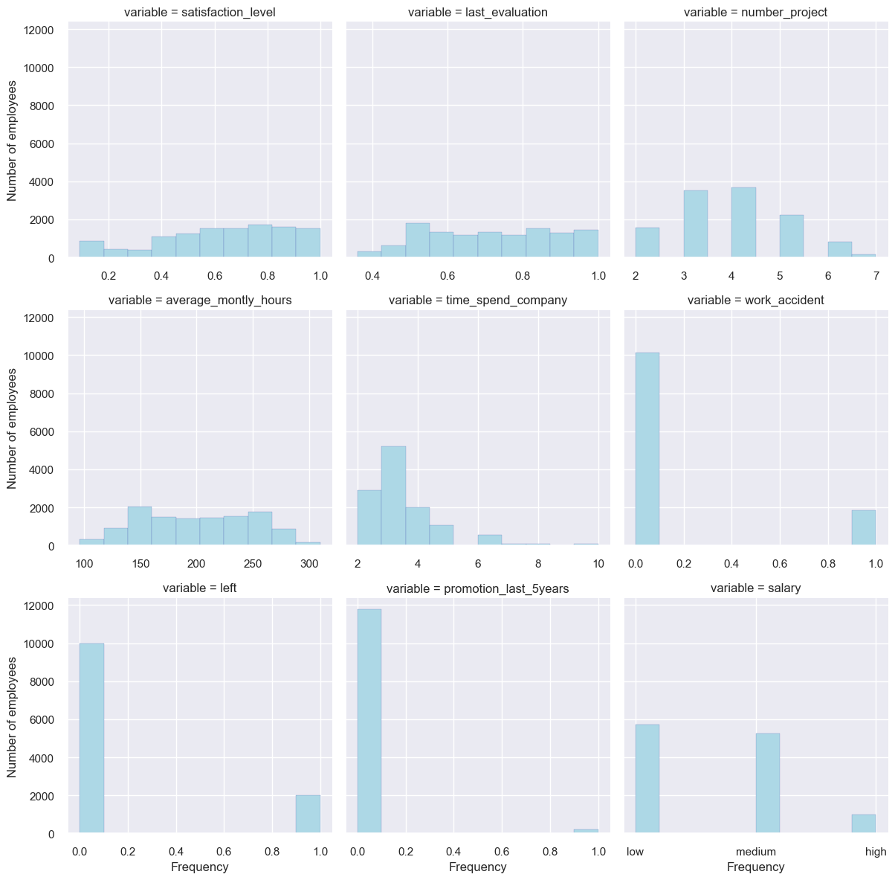

These graph provides a convenient way to visualize the distribution of values across different variables in Data Frame, making it easier to compare and analyze patterns. The use of facets allows to see these distributions side by side for better insights.
Satisfaction level: Most employees are highly satisfied.
Last evaluation: Most employees are good performers with 75%
of the data set being evaluated between 56%-87%.
Number of projects: most employees do a reasonable number of projects.
Average monthly hours: Most employees spend, fairly, a higher
number of hours at work.
Time spent in the company: Fewer employees stay beyond 4 years.

Slide 11
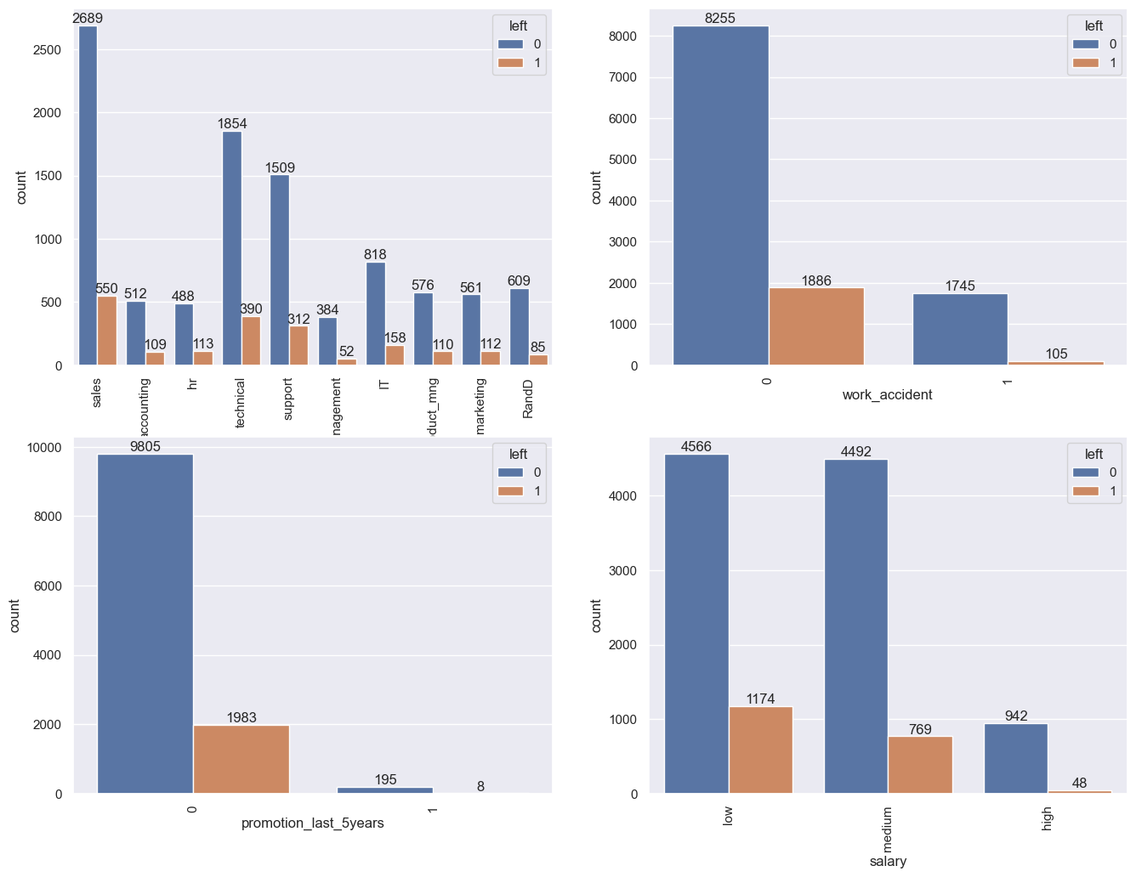
The rates of departures in departments are proportionally close to each other.
It has been observed that individuals who have not experienced work accidents tend to leave their positions more than those who have not.
The proportion of individuals who did not receive promotions and left is relatively higher.
It can be stated that the salary category with the highest departure rate is 'low.'

Slide 12
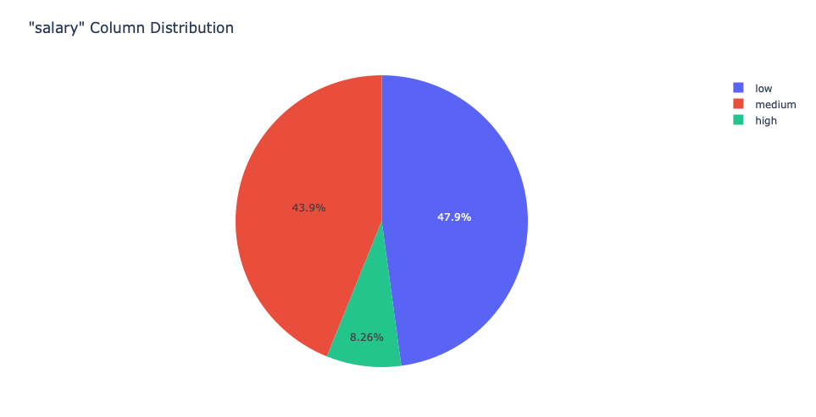
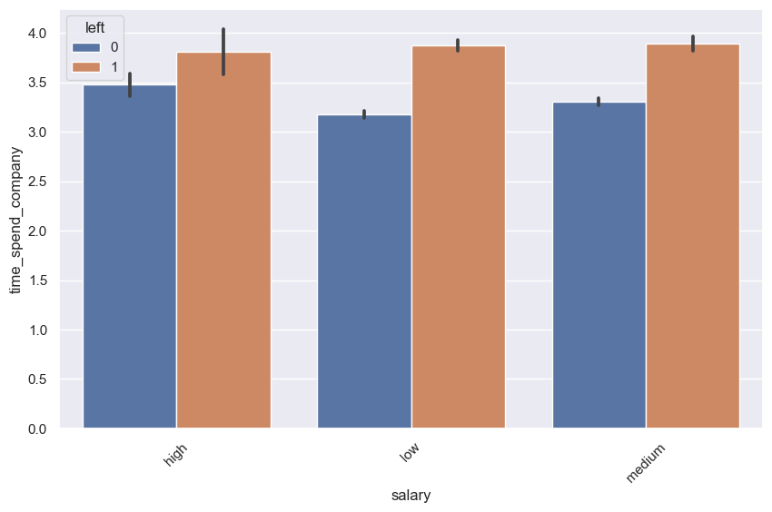
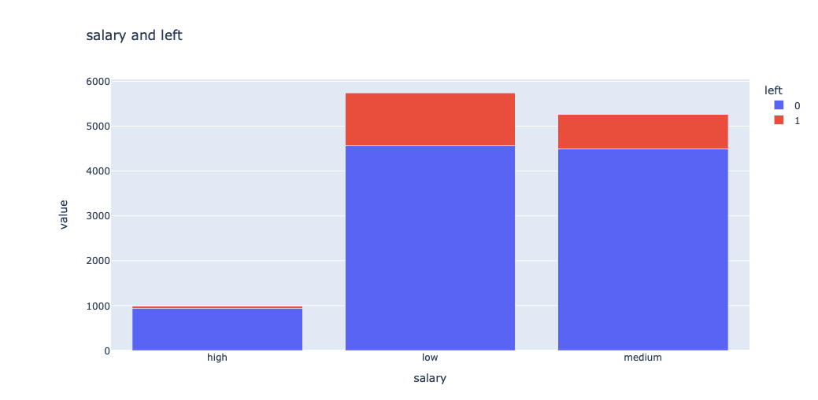
The number of individuals with high salaries in the dataset is very low.

Slide 13
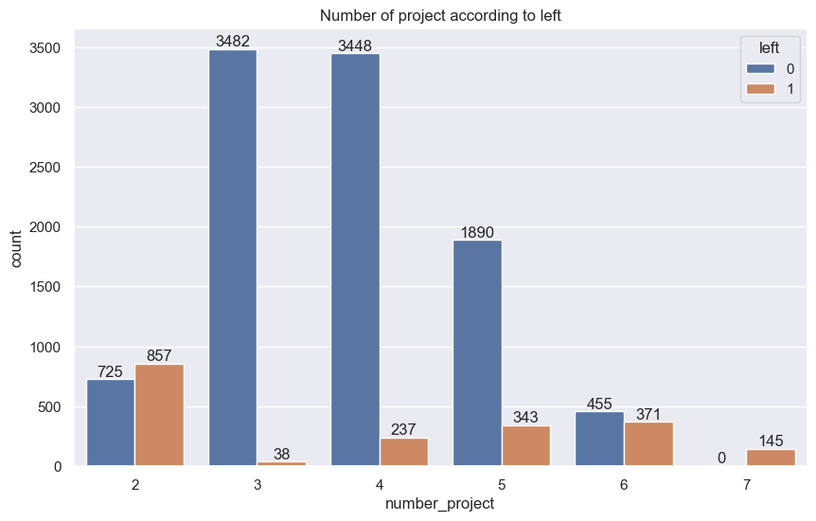
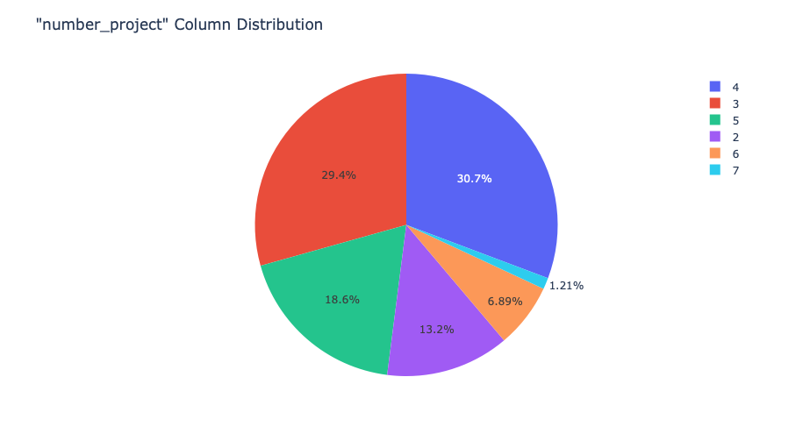
More than fifty percent of the employees are assigned to projects rated 3 or higher.
The number of leaving employees is higher among those who have only two projects during the period. This can be summed up as: "the employees with only two projects feel worthless or emptied". Because most of the employees work on three or four projects. With the 6th project, the number of resignings is getting over the number of ongoings. There are no ongoing staff members who were assigned to 7 projects. Working on more projects may cause intensive workload, regarding to this the satisfaction level may decrease with the insufficient motivators.

Slide 14
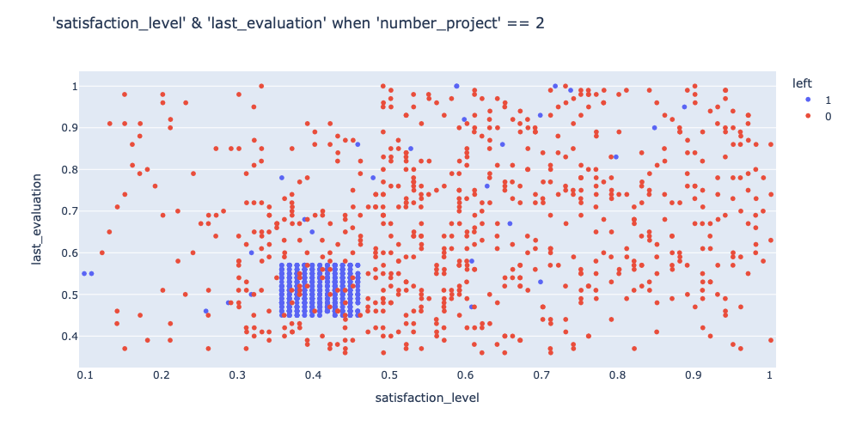
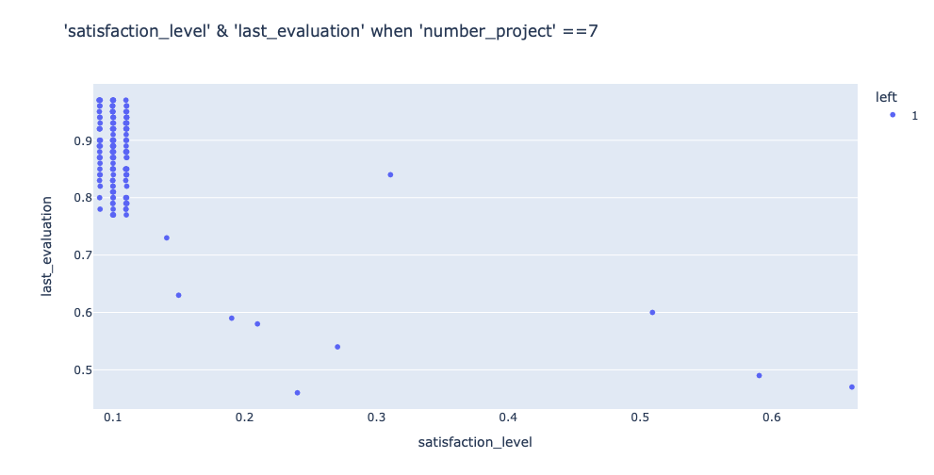
Satısfactıon level
We had considered that taking on seven projects might also lead to resignations, and this trend is clearly demonstrated in the graph. Therefore, having too few or too many projects could be a reason for resigning.

Slide 15
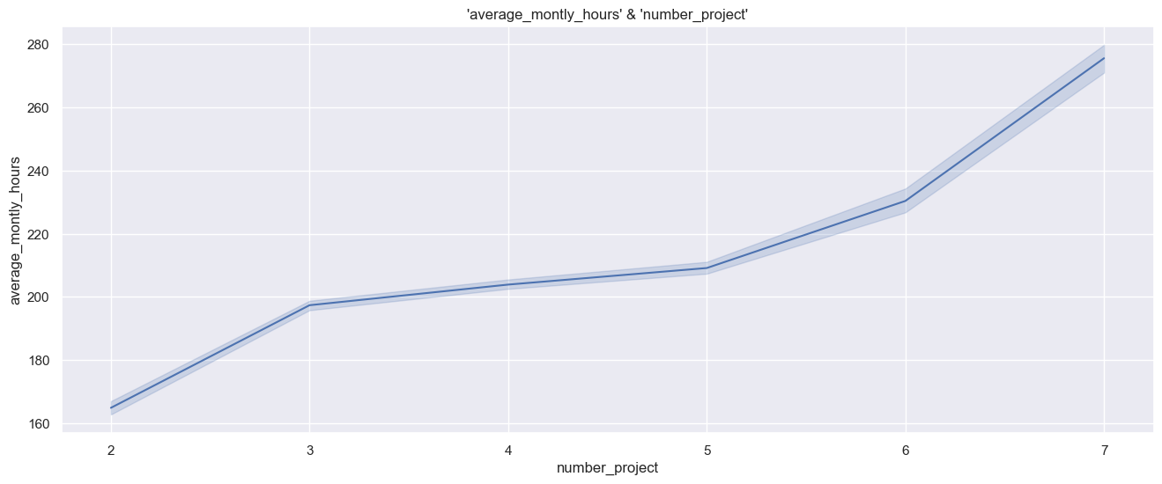
There is a dramatic increase in the monthly working hours when transitioning from two projects to three projects and six projects to seven projects.

Slide 16
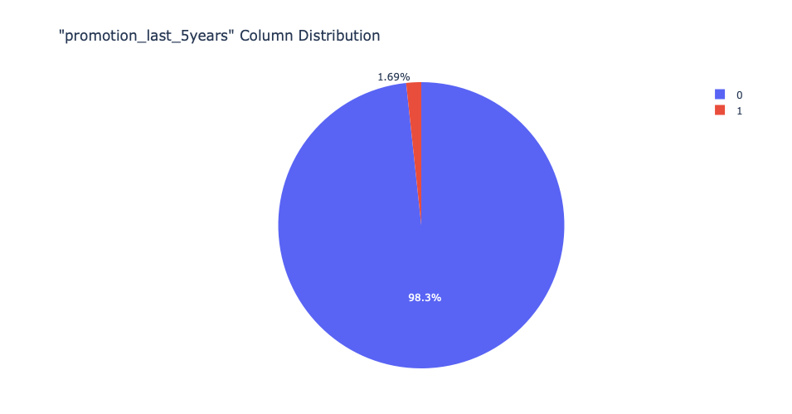
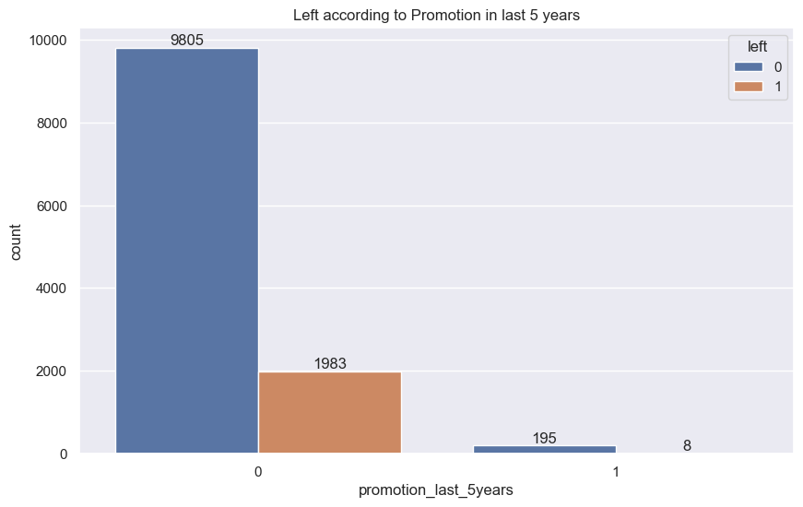
Almost nobody in the company has received a promotion in the last five years.
The number of individuals receiving promotions is very low. Additionally, among those who do not receive promotions, the departure rate is high.

Slide 17
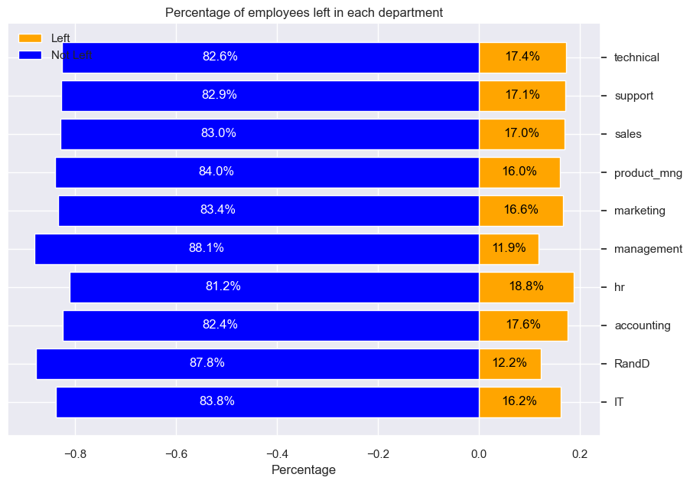

The departure rates in each department are very close to each other.

Slide 18
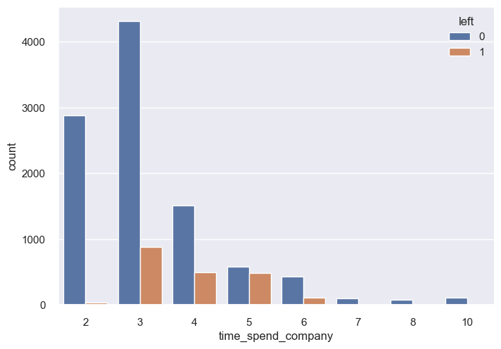
Observing the TIME SPEND COMPANY, the instances of employees leaving the company tend to increase during the 3rd year of employment, followed by a gradual decline until the 6th year.

Slide 19
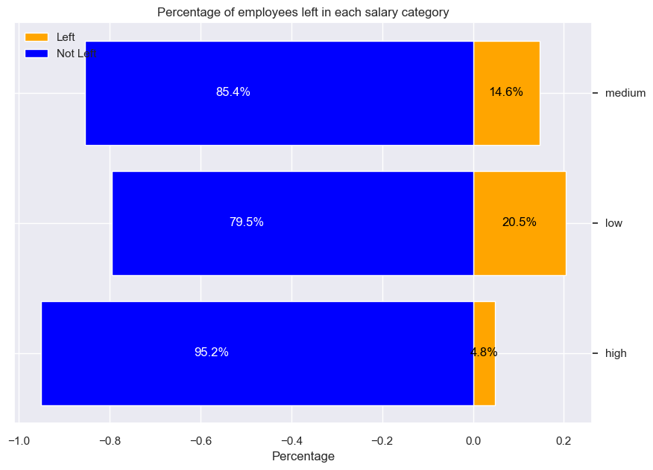
It was observed that the individuals with the highest departure rates predominantly consist of those with low salaries.

Slide 20

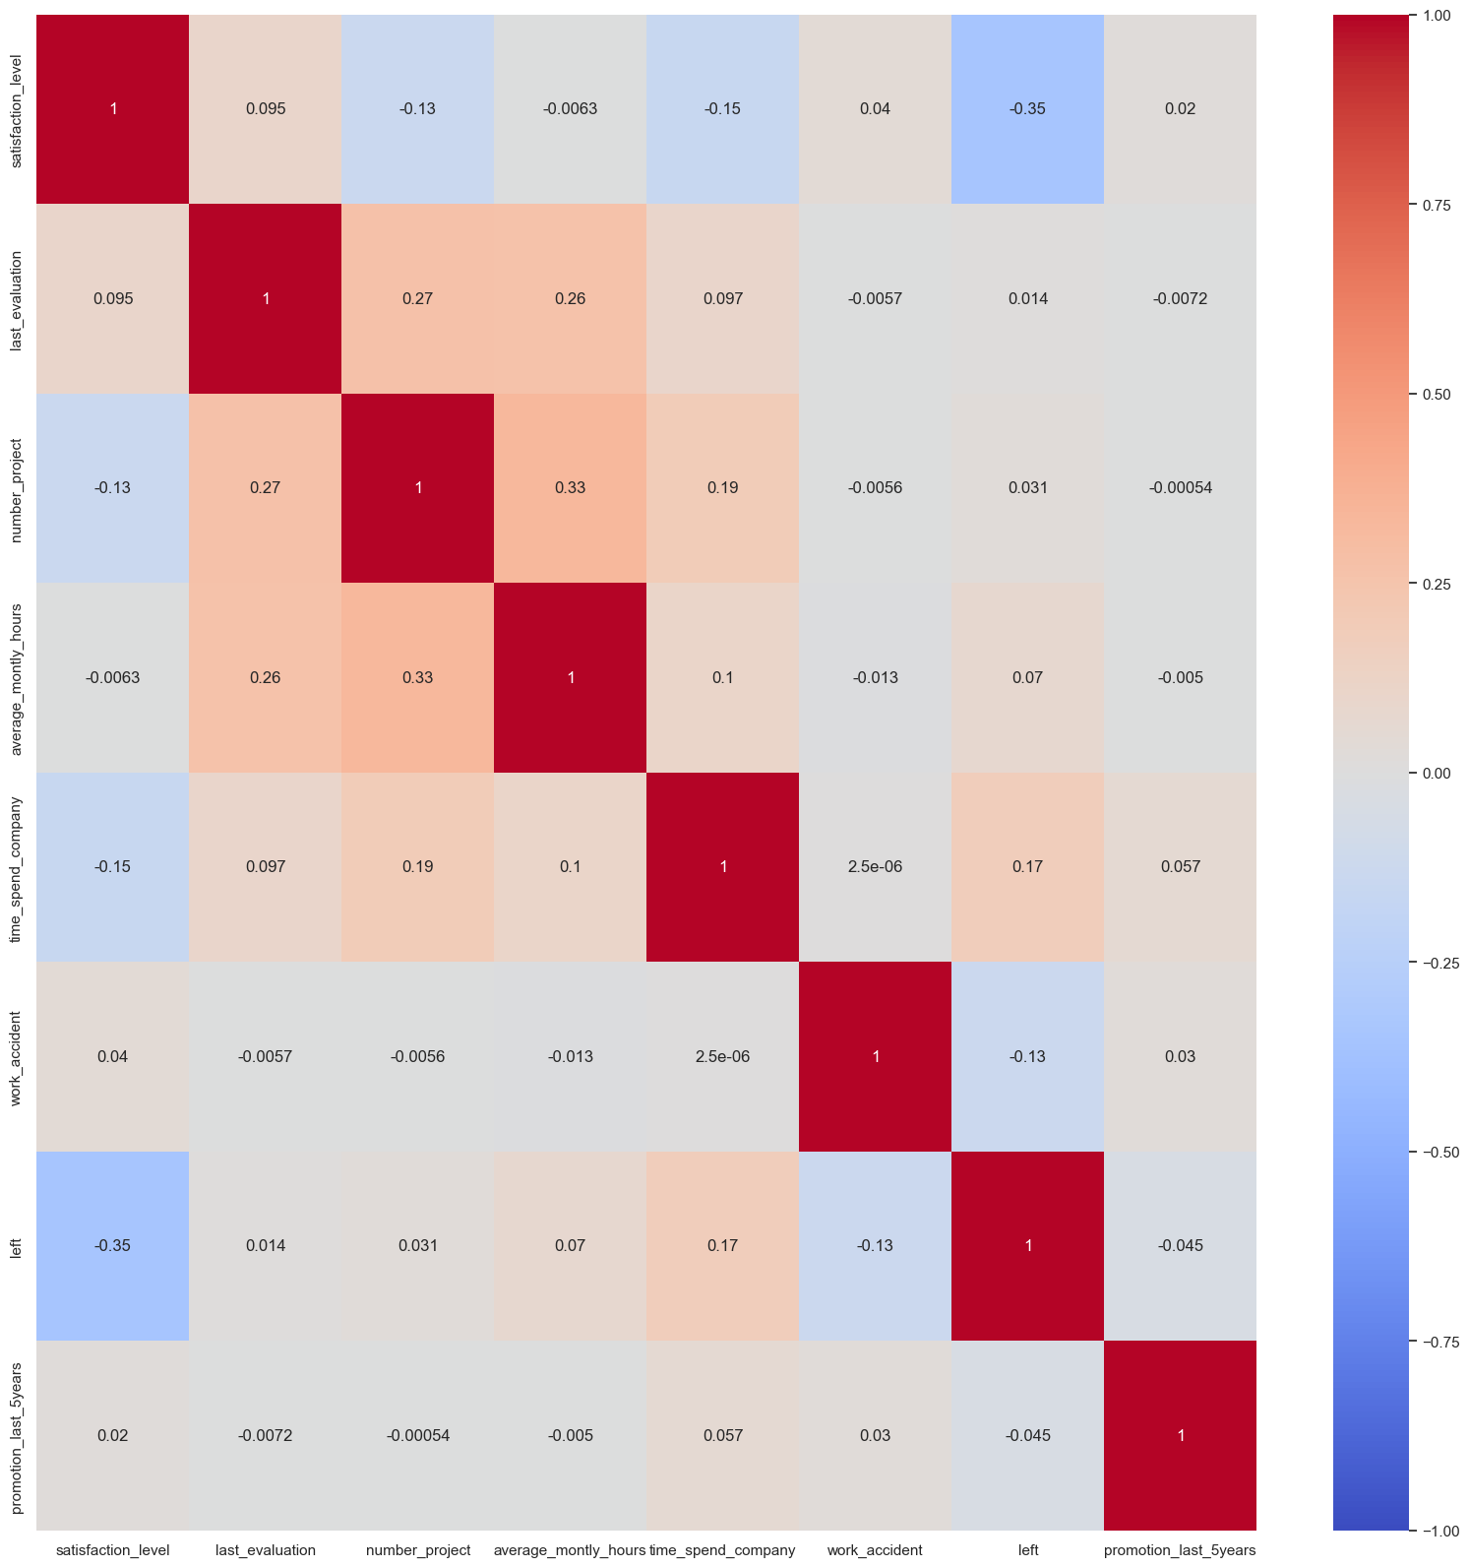
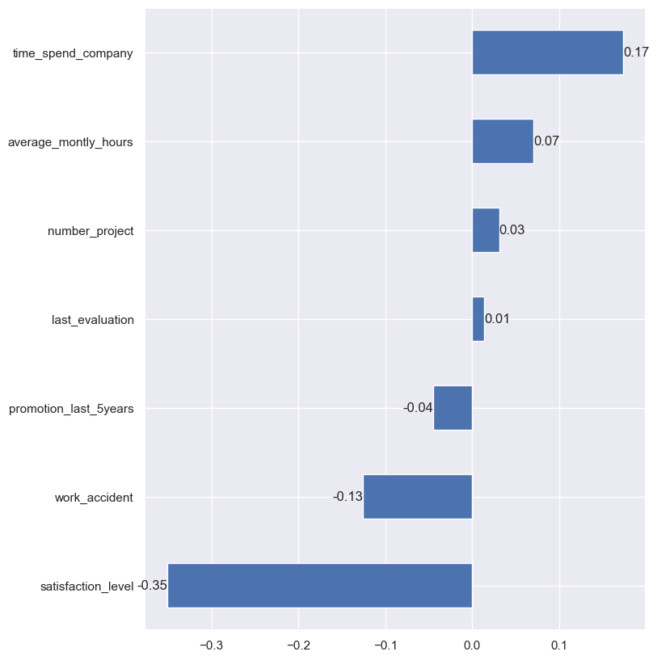
DATA VISUALIZATION
There is no significant correlation among the features. Weak negative correlations are observed between 'left' and 'satisfaction_level' (-0.35), 'time_spend_company' and 'satisfaction level' (-0.15), as well as 'number_project' and 'satisfaction level' (-0.13). Additionally, weak positive correlations are observed between 'number_project' and 'average_monthly_hours' (0.33), 'last_evaluation' and 'number_project' (0.27), and 'last_evaluation' and 'average_monthly_hours' (0.26). The most prominent negative relationship is observed between 'left' and 'satisfaction_level', while the positive one is between 'number_project' and 'average_monthy_hours'.
CORRELATION PLOT
Possitive Corelation
Number of Project, Last Evaluation, Average Monthly Hours, Time Spend Company
Negative Corelation
Satisfaction Level, Number of Project, Time Spend Company

Slide 21
INFERENCE
REASON QUALIFIED PEOPLE LEAVING
Low Satisfaction Level
Experienced
Spend more Time at Work
Experienced people may not have challenges level at work to improve their skills.
Work to pay ratio is high : Low salary but high working hours.

Slide 22

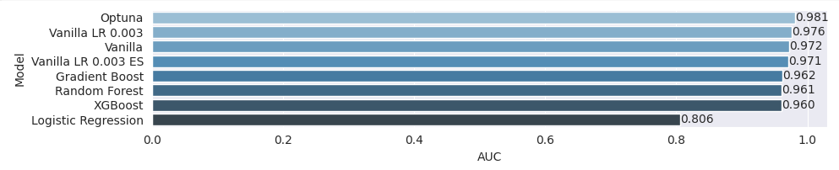
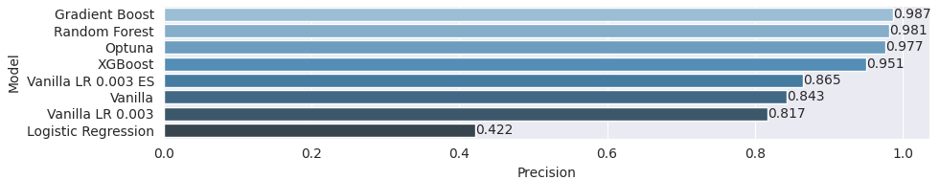
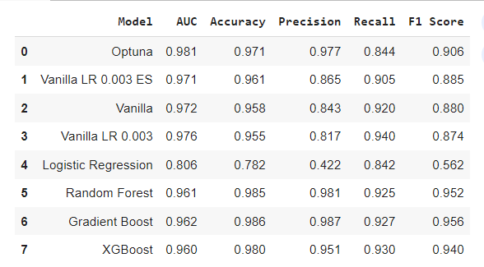
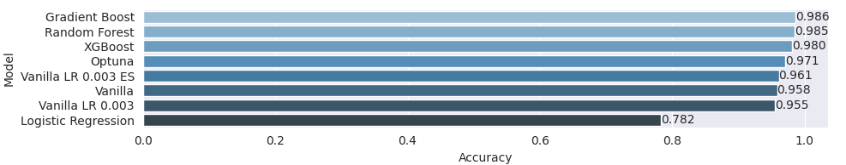
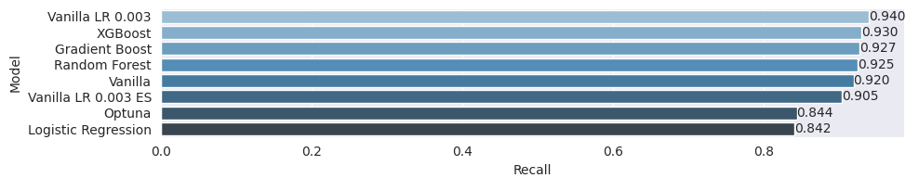
MODEL BUILDING In ML and DL
As target variable Left is discrete hence various classification techniques has to be applied.
Started Logistic Regression, Gradient Boast, Random Forest and last XG Boast are applied.
After ML , DL models are built.

Slide 23
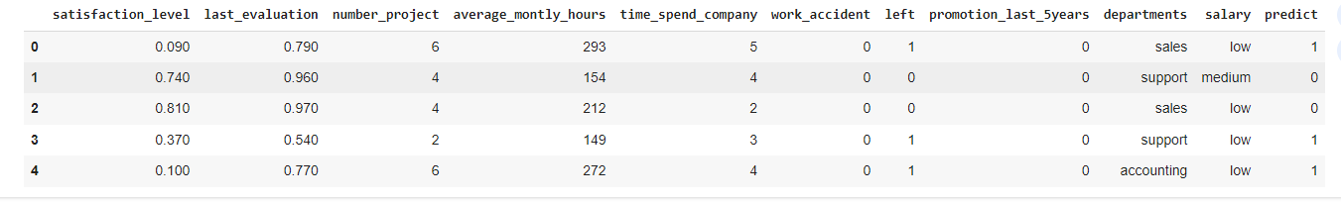
DL MODEL LAST EVALUATION

Slide 24

Conclusion
Characterizing loyalty
Three conditions that affect loyalty are:
a high level of satisfaction (satisfaction_level >= 47%)
have spent at least 4 years in the organization (time_spend_company < 5 years)
good performers with an evaluation of at least 80% (last_evaluation < 81%)
Characterizing left
Three conditions that affect ‘resigned’ are:
low or moderate satisfaction (satisfaction_level < 47%)
have a workload of 6 or more projects (number_project >= 6 projects) and
their performance being evaluated at least 58% (last_evaluation >= 58 %)
To Sum up :
HR analytics, the provenance of a few leading companies, a decade ago, is a solution that is being widely applied now by several growing businesses to uncover surprising sources of talent and counterintuitive insights about what drives employees to be loyal to their organization. We hope this encourages you to leverage the power of HR analytics to retain talent and save hiring costs

Slide 25

THANK YOU FOR YOUR ATTENTION ☺
G1

