Slide 1
Sub-1 GHz Sensor to Cloud IoT Gateway
Adrian Ruiz

Slide 2
Goal
Main Goal
The goal of the project is to implement the Beagle Bone Black as a Sub-GHz Sensor Gateway
Objectives
Ex: The goal(s) were accomplished by using two CC1350 launchpads. One CC1350 interfaces with the Beagle Bone Black while the other CC1350 reads sensor data and send it to the other CC1350. The data read recieved is passed to the BBB , and BBB will transmitt the data to the TI 15.4 Stack application.

Slide 3
Outcome - Accomplishments
Outcome
The onboard temperature sensor gathers data, and this data is sent the stack application
Sending Sensor values is very beneficial.
For example, the temperature can be used to determine if there is a fire going on.

Slide 4
Components Used in Design
TI 15.4 Stack Linux Gateway SDK
http://www.ti.com/tool/ti-15.4-stack-gateway-linux-sdk
Am335x-Linux Image
http://software-dl.ti.com/processor-sdk-linux/esd/AM335X/latest/index_FDS.html
Beagle Bone Black
https://beagleboard.org/black
CC1350
http://www.ti.com/product/CC1350

Slide 5
Tools used in Design
Code Composer Studio
http://www.ti.com/tool/CCSTUDIO
Virtual Box
https://www.virtualbox.org
Ubuntu
https://www.ubuntu.com/download
Etcher
https://etcher.io

Slide 6
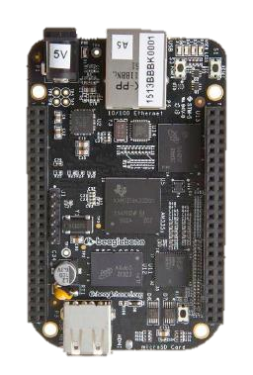
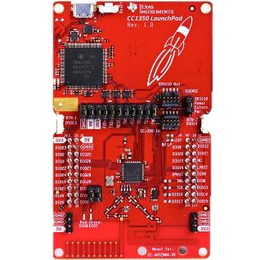

Schematics
One Launchpad gets data and sends it. The other Launchpad gets the data and passes it to the BBB. The BBB then uploads the data to the app.

Slide 7
Pre-requisites used in Design
Prerequisites
2x CC1350 and 1xBBB
Virtual Machine with Ubuntu
Arm-evm-linux image
Commands to install prerequisites
$ sudo apt-get update && sudo apt-get upgrade
$ scp bbb_prebuilt.tar.gz root@192.168.6.2:/home/root
$tar –xvf bbb_prebuilt.tar.gz

Slide 8
Implementation Details
Steps used in design for CC1350:
Download Code Composer Studio
Download Simple Link CC13x0_SDK library
Import the Sensor example code from the \Examples\Dev tools\CC 1350 LaunchPad\TI 15.4 stack folder
Import the Collector example code from the \Examples\Dev tools\CC 1350 LaunchPad\TI 15.4 stack folder
Flash the one CC1350 with the Sensor code and flash the another one with the Collector code

Slide 9
Implementation Details
Steps used in Design for Linux
Download TI 15.4 Stack SDK to the ubuntu machine.
Install the SDK
Transfer the bbb_prebuilt.tar.gz to the BBB
Steps used in Design for BBB
Flash the SD card with Linux image using Ethcer
Boot off the SD card
Find the BBB ip address using ifconfig command
Extract the bbb_prebuilt.tar.gz that is passed from Ubuntu
Connect the BBB the network and connect the collector Launchpad to the BBB

Slide 10
Implementation Details
Steps used in Design for BBB Continued
Check if the Launchpad is enumerated
Enter the prebuilt folder
Run the run_demo.sh application
Copy the url into the browser

Slide 11
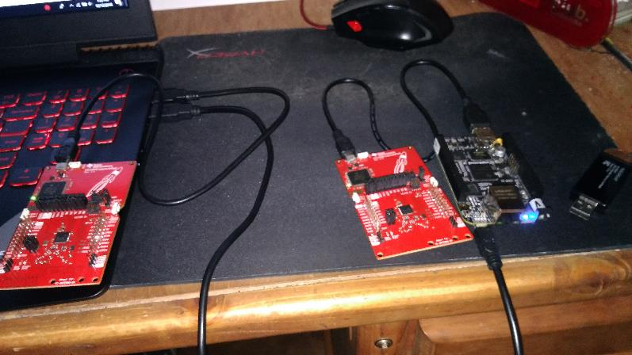
Actual project set-up
Screenshot of the project will all components

Slide 12
Demo
Just the Two Launchpads communicating:
https://youtu.be/lhAG0SOZAZ0

Slide 13
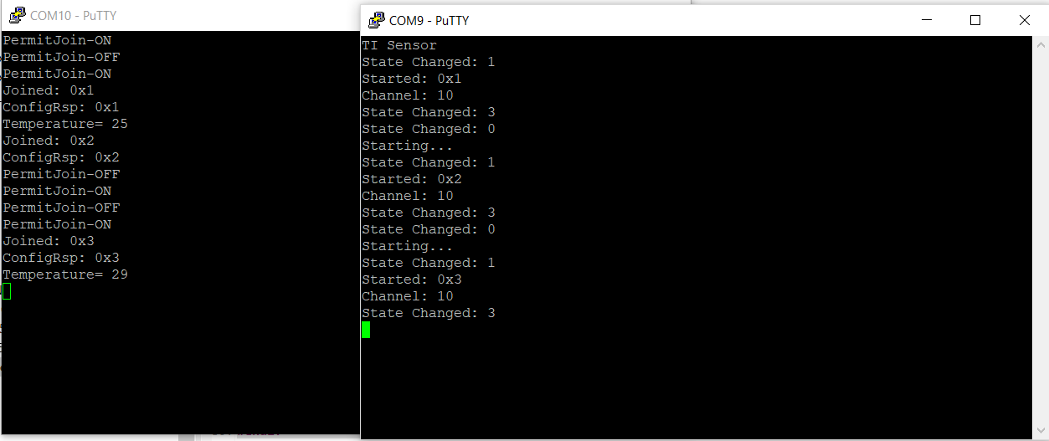
Results and Conclusions
Show screenshot of outcomes
Screenshot of CC1350 communication

