Slide 1
LEARN Style Inventory

Slide 2
Hero
Home, Get Coverage, Change or Update Plan

Slide 3


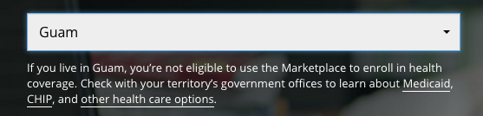
H1 – Open Sans 60px #FFF font-weight 400, letter-spacing -2, line-height 67px
Subhead – Open Sans 18px, letter-spacing 0, line-height 25px
Below Primary CTA – Open Sans 13px #FFF, letter-spacing 0, line-height 18px
Multiline Below Primary CTA – div 500px

Slide 4




Button Default – Open Sans 20px Bold #FFF, background #12890e, padding 35px,
Button Rollover – Open Sans 20px Bold #FFF, background #138F0E, padding 35px
Dual CTA – 35px between
Dropdown – Open Sans 1.5em #555, dropdown height 44px, background #EEE

Slide 5
Hero
Get Answers

Slide 6
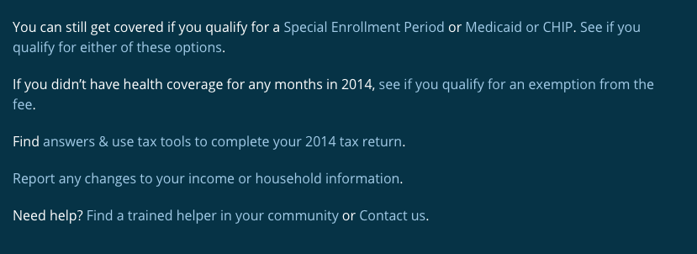
H1 – Bitter 36px #FFF font-weight 400, letter-spacing normal, line-height 44px
Paragraph – Open Sans 16px #FFF, line-height 24px
Links #A3CCE8 – Rollover #CFEFFE

Slide 7

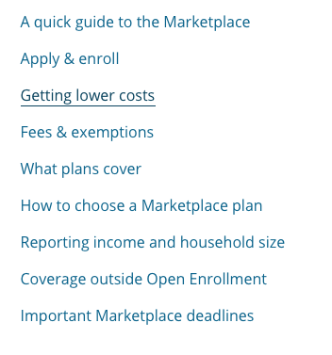
H2 – Bitter 35px #333 font-weight 400, letter-spacing normal, line-height 32px
H3 – Bitter 21px #666 font-weight 400, letter-spacing normal, line-height 25px
Border-bottom – 1px #CCC
List – Open Sans 16px #0C648C font-weight 400, text decoration underline, line-height 24px

Slide 8
Secondary CTA

Slide 9



Glyphicon – 34px #FFF, font-weight 400, background-color #043F59
Title – Open Sans 26px #FFF, font-weight: bold, letter-spacing -1px
Button Default – Open Sans 20px Bold #FFF, background #12890e, padding 35px,
Button Rollover – Open Sans 20px Bold #FFF, background #138F0E, padding 35px,

Slide 10
Action Bar

Slide 11
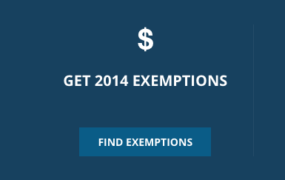
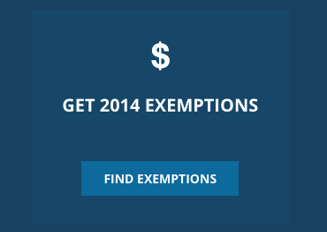



Tile Default – Background #17415F
Tile Rollover – Background #164769
Text – Open Sans 20px Bold #FFF
Glyphicon – 30px #FFF
Button Default – Open Sans 1.5em #FFF, Background #0A5C87, Rollover Background #0C6A9C

Slide 12
Subscribe Module

Slide 13



H2 – Open Sans 20px Bold #FFF
Descriptor text – Open Sans 13px #FFF, line-height 17px
Form field default – Height 38px, background #EEE
Button – Open Sans 16px Bold #FFF, Background #063346
Button rollover – Background #1295e8
Form field text – Open Sans 16px #555
Footnote – Open Sans 10px #FFF, link 1px underline

Slide 14
Blog Module

Slide 15




H2 – Open Sans 20px Bold #FFF, Rollover underline
Glyphicon – 20px Bold #FFF
Date – Open Sans 13px Bold #FFF, line-height 17px, border-bottom 2px Solid #39C
Title – Open Sans 13px Regular #FFF, line-height 17px, Rollover underline
Button Default – Height 38px, background #EEE
Button – Open Sans 16px Bold #FFF, Background #063346
Button rollover – Background #1295e8

Slide 16
Explainer

Slide 17


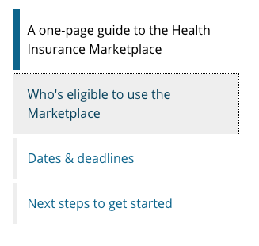
H1 – Bitter 36px Font-weight 400 #333, line-height 44px, letter-spacing normal
H1 – Bitter 22px Font-weight 400 #666, line-height 24px
Nav Tabs – Open Sans 16px Font-weight 400 #000, link #0C648C, background #eee, underline line-height 24px

Slide 18
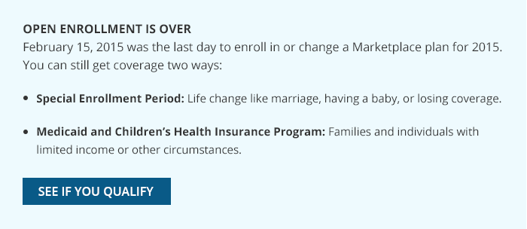
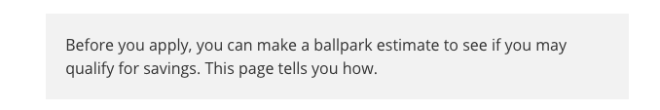
Notification Box - Background #EEFAFE
H2 – Open Sans 16px Bold #333, letter-spacing normal, line-height 32px
P – Open Sans 16px #333, line-height 24px
List – Open Sans 15px #333, link #0C648C
Button – Open Sans 16px Bold #FFF, Background #0A5c87, Rolllover #0C6A9C
Block quote - Background #F2F2F2
Open Sans 16px Bold #333, line-height 24px, link #0C648C

Slide 19
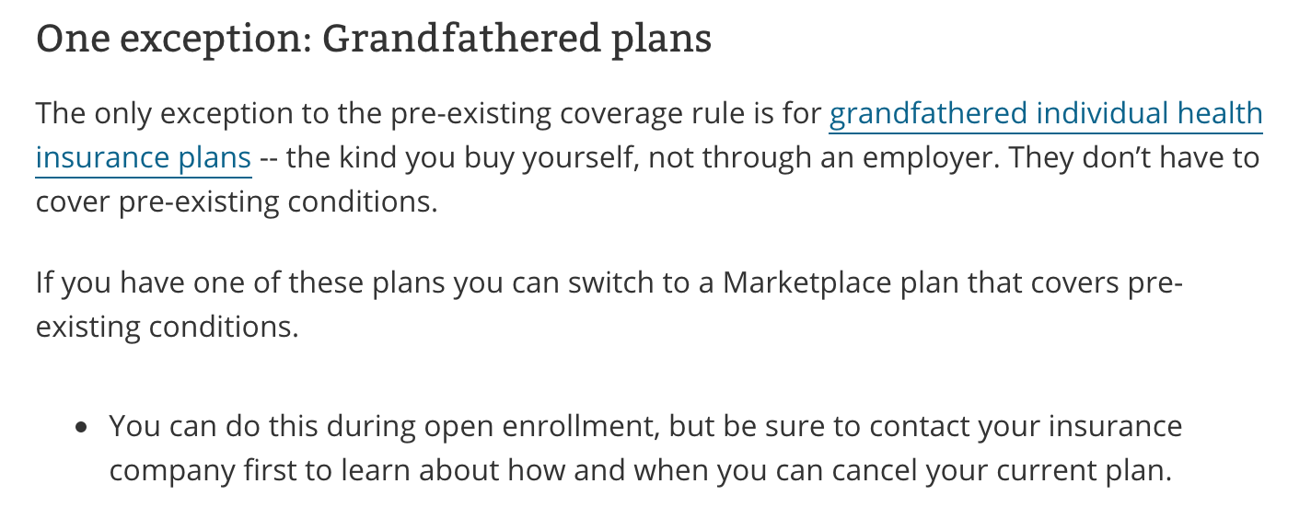
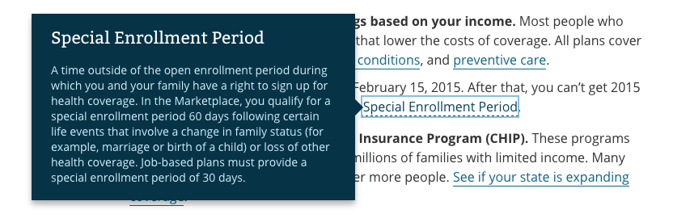
H3 – Bitter 21px font-weight normal #333, letter-spacing normal, line-height 25px
P – Open Sans 16px #333, link #0C648C, border-bottom 1px #0C648C, line-height 24px
Glossary-term – border-bottom dashed
Tooltip
Title – Bitter 21px #FFF font-weight normal
Text – Open Sans 14px #CDEDFA font-weight normal, line-spacing 19px

Slide 20
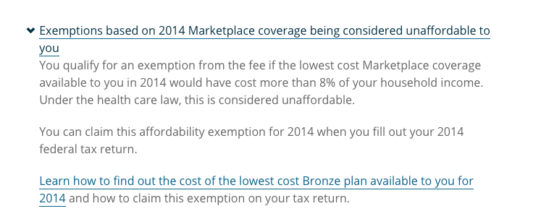

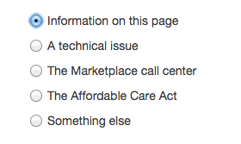
FAQ Question – Open Sans 16px font-weight normal #063346, letter-spacing normal, line-height 24px, border-bottom 1px #08425D
FAQ Question .answer – Open Sans 16px #666, line-height 24px
Survey H2 – Bitter 24px, line-height 32px
Questions – Helvetica Neue 14px #3B3B3B

Slide 21
Article

Slide 22
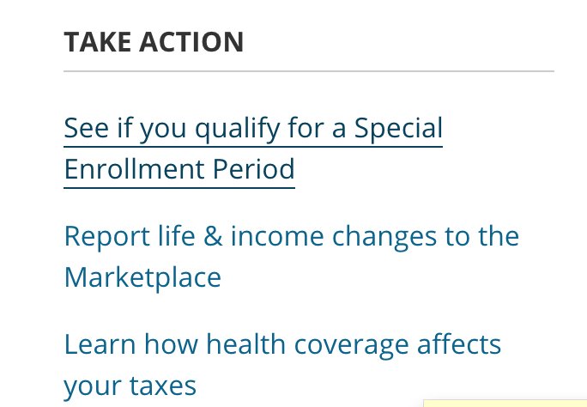
Take Action
H4 – Open Sans 16px Bold#333, line-height 24px
List – Open Sans 16px normal, links #0C648C, Rollover underline
Content styling same as Explainer pages

Slide 23
Blog

Slide 24


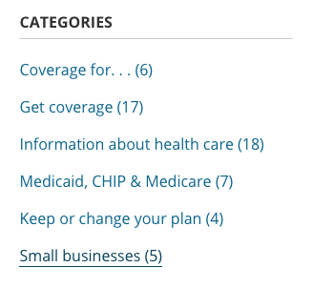
H1 – Bitter 36px font-weight 400 #333, letter-spacing normal, line-height 44px
H2 – Bitter 24px font-weight 400 #0C648C, letter-spacing normal, line-height 32px
Date – Open Sans 14px #666, line-height 24px
H4 – Open Sans 16px Bold#333, line-height 24px
List – Open Sans 16px normal, links #0C648C, Rollover underline

Slide 25

Button – Open Sans 16px font-weight 700 #0E70B4, Background #EEE, rollover #0E70B4
Content styling same as Explainer pages

Slide 26
Sitemap

Slide 27



H1 – Bitter 36px font-weight 400 #333, letter-spacing normal, line-height 44px
H2 – Bitter 24px font-weight 400 #0C648C, Rollover #08425d
H3 – Open Sans 16px font-weight 700 #333, Text-transform uppercase
List – Open Sans 1.5em font-weight 400 #0C648C, Rollover 1px #08425d

Slide 28
Glossary

Slide 29

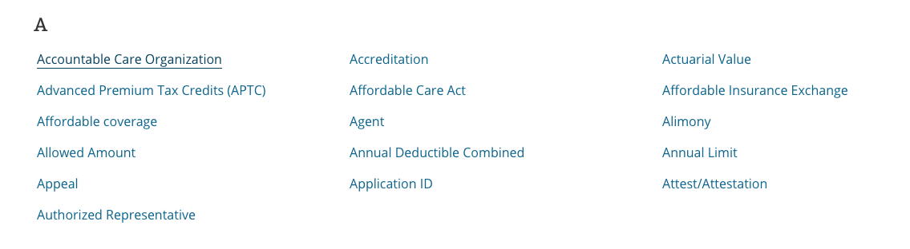
H1 – Bitter 36px font-weight 400 #333, letter-spacing normal, line-height 44px
Nav – Open Sans 16px font-weight Bold #0C648C, Rollover #000000, Background #EEE
Links
H2 – Bitter 24px font-weight 400 #333,
List – Open Sans 16px #0C648C, rollover #08425d underline, line-height 24px,

Slide 30
Modal

Slide 31
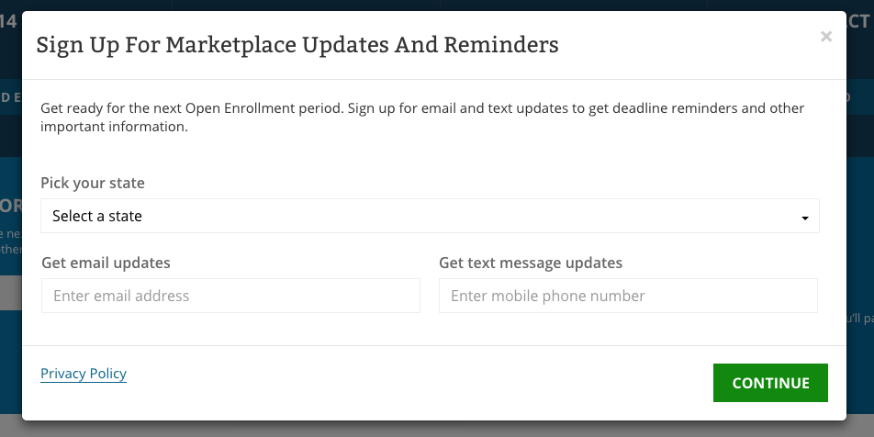

Slide 32



H1 – Bitter 24px font-weight 400 #333, letter-spacing normal, line-height 44px
Text – Open Sans 1.5em font-weight 400 #333, line-height 24px
Form Label – Open Sans 16px font-weight 600 #666, line-height 24px
Form Field – Open Sans 1.5em font-weight normal #000, Border-color #EEE
Button – Open Sans 16px font-weight 700 #FFF, Background #12890E, Rollover #0F720C

