Slide 1

Identifying Polynomials

Slide 2
It's easier to understand what makes something a polynomial expression by looking at examples and non-examples
√
5x + 1
a polynomial
since the exponent of the variable is 1, a non-negative integer.
ᵡ
5x⁻² +1
not a polynomial
because the exponent of the variable is -2, a negative integer.

Slide 3
2
a polynomial
since the exponent of the variable is 0, a non-negative integer.

Slide 4


A polynomial is an algebraic expression involving only the basic operations
And raising to non-negative natural number powers on constant and variables
What is Polynomial ?
The quotient where the denominator contains no variable.

Slide 5

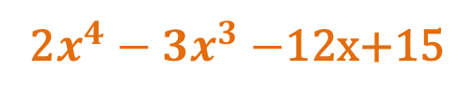
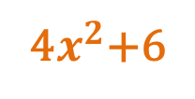
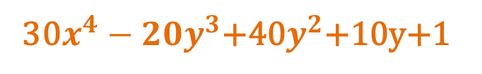
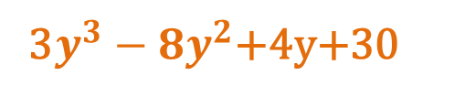

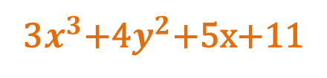
Kinds of Polynomials
Linear Polynomials
Is a first degree polynomial
4y-1
12x+1v
Quadratic Polynomials
is a second degree polynomial
4$x^{2}$+6
$${2x}^{2}+{2y}^{2}$$
Cubic Polynomials
is a third degree polynomial
3$x^{3}$+4$y^{2}$+5x+11
3$y^{3}−8y^{2}$+4y+30
Quartic Polynomials
is a fourth degree polynomial
2$x^{4}−{3x}^{3}−$12x+15
30$x^{4}−{20y}^{3}$+40$y^{2}$+10y+1

Slide 6

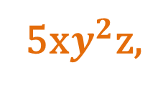
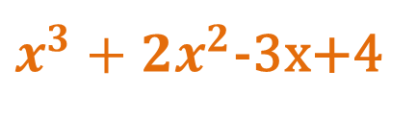

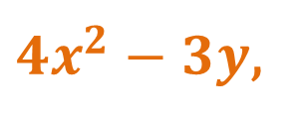
Classification of Polynomials
a. Monomial
2x,
-8,
5x$y^{2}$z,
$${(x+1)}^{2}$$
b. Binomial
x-1,
2x+3,
${4x}^{2}−3y$,
$$x^{2}−4xy+{4y}^{2},$$
x+y-z
c. Trinomial
d. Polynomial
$x^{3}+{2x}^{2}$-3x+4

Slide 7
Term
Is a number alone, or a product of a number and one or more variables
A term is separated from each other by plus/minus sign
Here’s a polynomial
2x³ – 5x² + x + 9
term
term
term
term
So , this expression has 4 terms

Slide 8




Degree
Every term has a degree
The degree of a term in one variable determined by the exponent on the variable
The degree of constant is zero except for the zero constant which has no zero.
If a term has more than one variable, the degree of a term is the sum of the exponent of the variables in the term
$$m^{2 }$$
$$m$$
$$3$$
$${3m}^{3}n^{2}$$
The degree is 2
The degree is 1
The degree is 0
The degree 5

