Slide 1

Application Problems of Rational Algebraic Expressions

Slide 2

Example 1: Twelve divided by the sum of a number and 2 equals the quotient of 4 and the number reduced by 2. Find the number.

Slide 3


Solution:
Step 1: (Representation)
Use a variable to represent what is asked in the problem.
Let x = the unknown number
Twelve divided by the sum of a number and 2
Equal
Quotient of 4 and the number reduced by 2
$$\frac{12}{x + 2}$$
$$\frac{4}{x − 2}$$
=

Slide 4

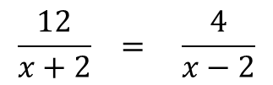
Step 2: (Equation)
$$\frac{12}{x+2} = \frac{4}{x−2}$$
Step 3 : ( Solve)
$\frac{12}{x + 2}$ = $\frac{4}{x − 2}$ ; x ≠ -2, 2
(x + 2)(x -2) ($\frac{12}{x + 2})$ = ($\frac{4}{x − 2})\left(x+2\right)\left(x −2\right)$
12(x - 2) = 4( x + 2)
12x – 24 = 4x + 8
12x – 4x = 8 + 24
$\frac{8x}{8} = \frac{32}{8}$
x= 4
Thus, the unknown number is 4.

Slide 5


Work Problems
Work problems usually deal with persons or machines working at different rates or speed. The first step in solving these problems involves determining how much of the work an individual or a machine can do in a given unit of time.

Slide 6
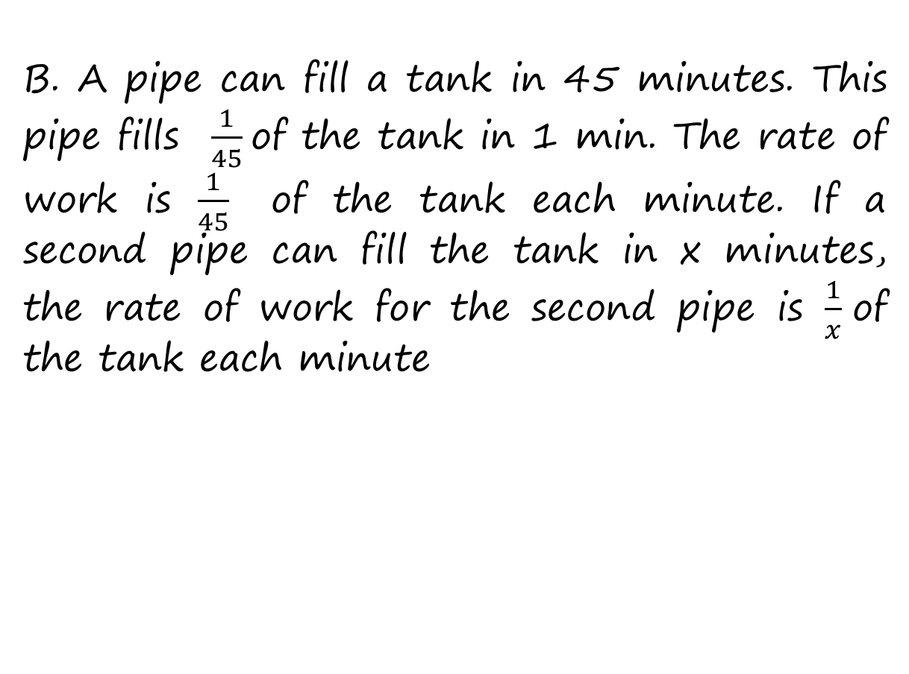
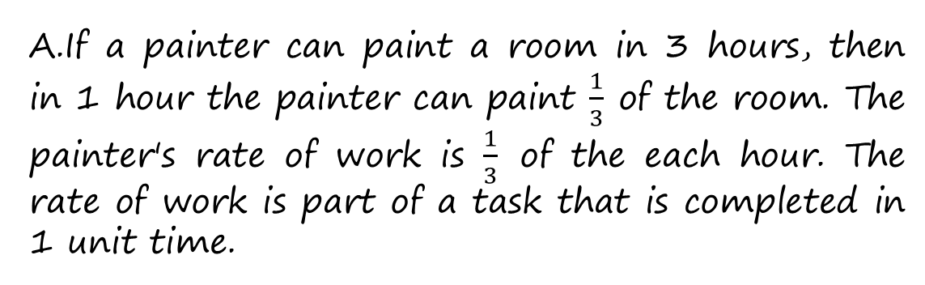
Example:
If a painter can paint a room in 3 hours, then in 1 hour the painter can paint $\frac{1}{3}$ of the room. The painter's rate of work is $\frac{1}{3}$ of the each hour. The rate of work is part of a task that is completed in 1 unit time.
B. A pipe can fill a tank in 45 minutes. This pipe fills $\frac{1}{45}$of the tank in 1 min. The rate of work is $\frac{1}{45}$ of the tank each minute. If a second pipe can fill the tank in x minutes, the rate of work for the second pipe is $\frac{1}{x}$of the tank each minute

Slide 7
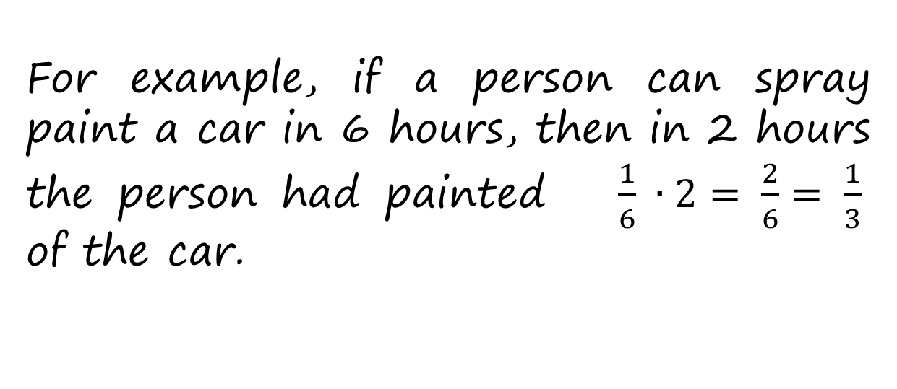
Thus,
The basic equation that is used to solve work problem is
Rate of work × Time worked = work done
r × t = w
For example, if a person can spray paint a car in 6 hours, then in 2 hours the person had painted $\frac{1}{6} ∙2= \frac{2}{6}= \frac{1}{3}$ of the car.

Slide 8
Strategy for solving work problems
* For each person or machine, write a numerical or algebraic expressions for the rate of work, the time worked, and the part of the task completed. The results can be recorded in a table.
* Determine how the parts of the task completed are related. Use the fact that the sum of the parts of the task completed must equal to 1, the complete task.

Slide 9


Example 1:
Lina can clean the garden in 5 hours. After working alone for 2 hours, Marlou joined her. Together they finish the job in 1 more hour. How long would it take Marlou to clean the garden alone?

Slide 10
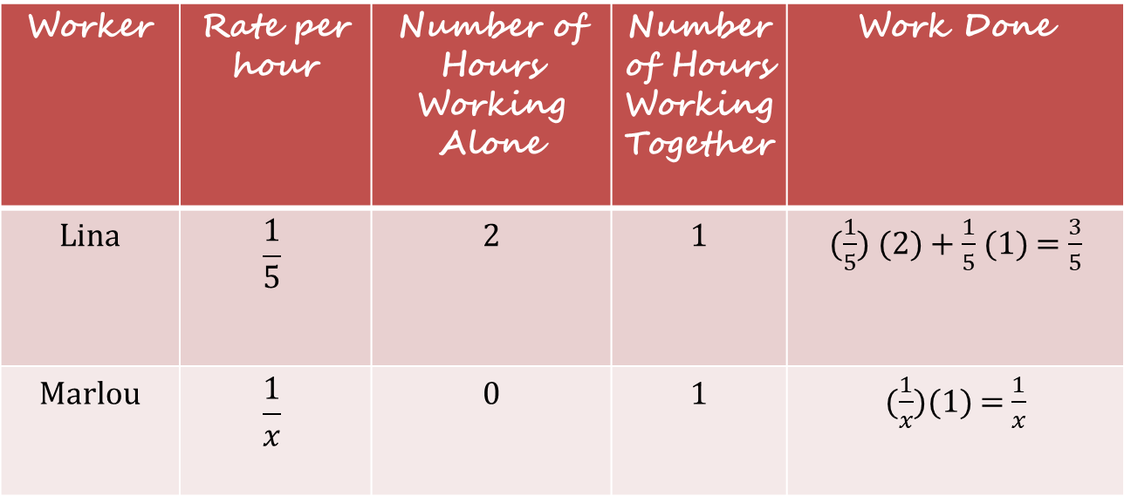
Solution:
Step 1: (Representation)
Use a variable to represent what is asked in the problem.
Let x = be the number of hours Marlou can clean the garden alone
Worker | Rate per hour | Number of Hours Working Alone | Number of Hours Working Together | Work Done
Lina | $$\frac{1}{5}$$ | 2 | 1 | ($\frac{1}{5}$) (2) + $\frac{1}{5}$ (1) = $\frac{3}{5}$
Marlou | $$\frac{1}{x}$$ | 0 | 1 | ($\frac{1}{x}$)(1) = $\frac{1}{x}$

Slide 11


Step 2: (Equation)
Work done by Lina
Work done by Marlou
Total work done
$\frac{3}{5}$
₊
$\frac{1}{x}$
1
=

Slide 12

Step 3: (Solve)
5x ( $\frac{3}{5}+ \frac{1}{x} )=5x\left(1\right)$
3x + 5 = 5x
-2x = -5
x = $\frac{5}{2}=2.5$
Step 4: (Answer)
Marlou can clean the garden alone in 2.5 hours.

Slide 13
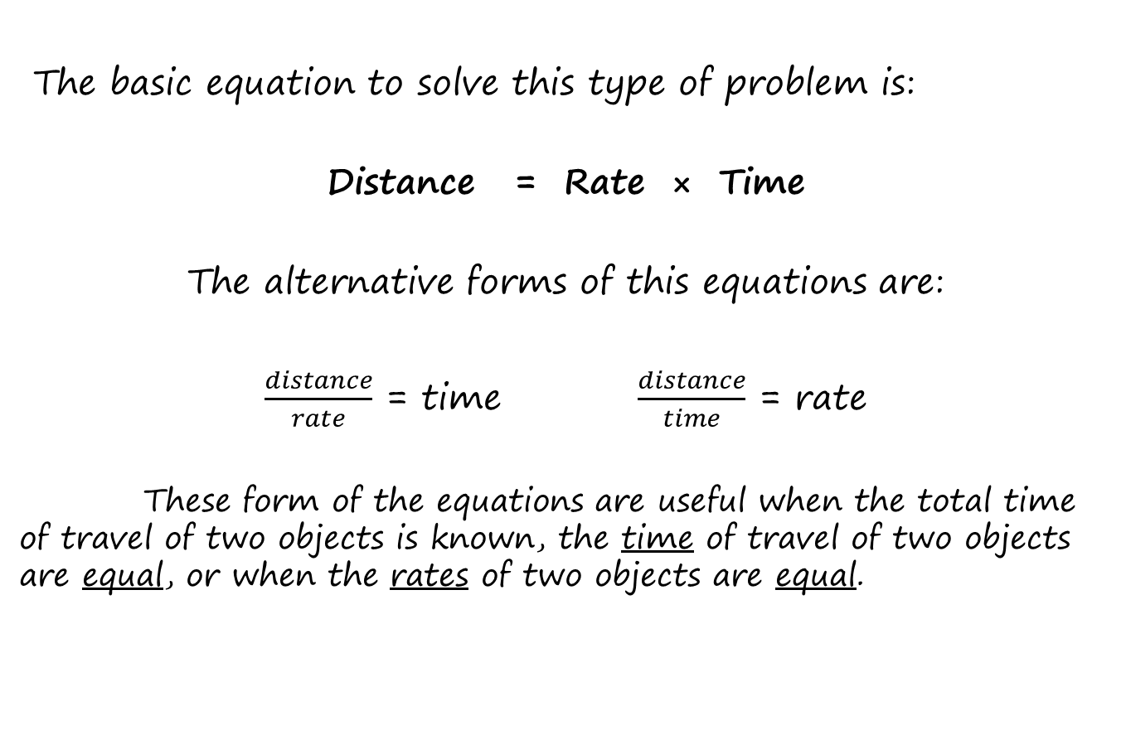
Uniform Motion Problems
The basic equation to solve this type of problem is:
Distance = Rate × Time
The alternative forms of this equations are:
$\frac{distance}{rate}$ = time $\frac{distance}{time}$ = rate
These form of the equations are useful when the total time of travel of two objects is known, the time of travel of two objects are equal, or when the rates of two objects are equal.

Slide 14


Example 1:
A police car is moving 40 kph faster than a bus. The time that it takes the bus to travel is 3 km, while the police car travels 5 km. Find their speeds.

Slide 15
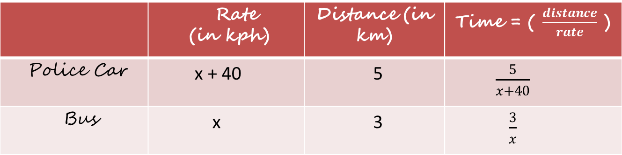
Solution:
Step 1: (Representation)
Use a variable to represent what is asked in the problem.
Let, x = be the speed of the bus in kph
x + 40 = be the speed of the police car in kph
 | Rate (in kph) | Distance (in km) | Time = ( $\frac{distance}{rate}$ )
Police Car | x + 40 | 5 | $\frac{5}{x+40}$
Bus | x | 3 | $\frac{3}{x}$

Slide 16
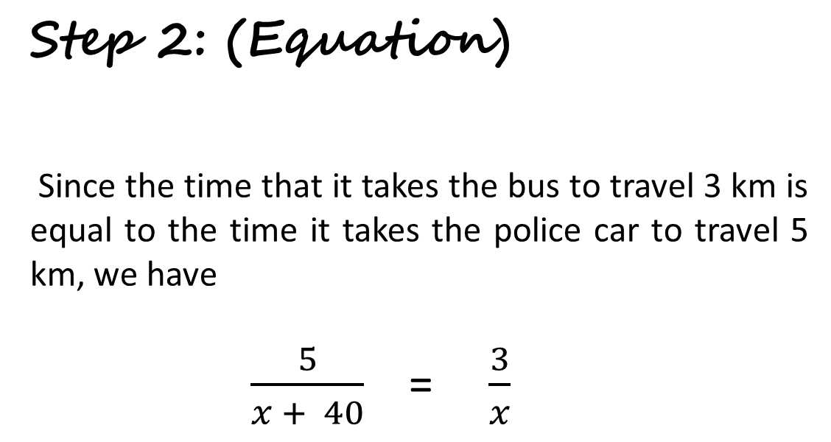
Step 2: (Equation)
Since the time that it takes the bus to travel 3 km is equal to the time it takes the police car to travel 5 km, we have
$\frac{5}{x + 40}$ = $\frac{3}{x}$

Slide 17
Step 3: (Solve)
Cross-multiply,
5x = 3( x + 40)
5x = 3x + 120
5x - 3x = 120
2x = 120 (Divide both sides by 2 )
x = 60
Step 4: (Answer)
The rate of the bus = 60 kph
The rate of the police car = 60 + 40 = 100 kph

Slide 18
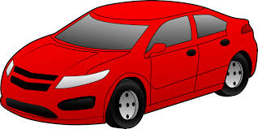

Example 2:
Miguel’s car is just as fast as Joaquin’s. It takes Miguel 1 hour more than it takes Joaquin to drive to town. If Miguel is 20 km from town and Joaquin is 15 km from town, how long does it take Joaquin to drive to town?

Slide 19
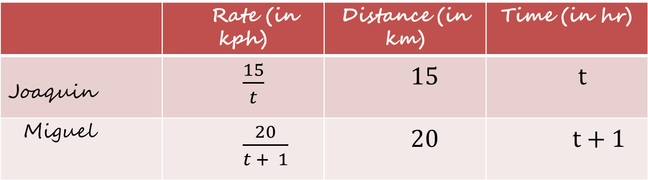
Solution:
Step 1: (Representation)
Use a variable to represent what is asked in the problem.
Let t = be the number of hours it takes Joaquin to drive to town
t + 1 = be the number of hours time it takes Miguel to drive to town
Step 2: (Given)
 | Rate (in kph) | Distance (in km) | Time (in hr)
Joaquin | $\frac{15}{t}$ | 15 | t
Miguel | $\frac{20}{t + 1}$ | 20 | t + 1

Slide 20
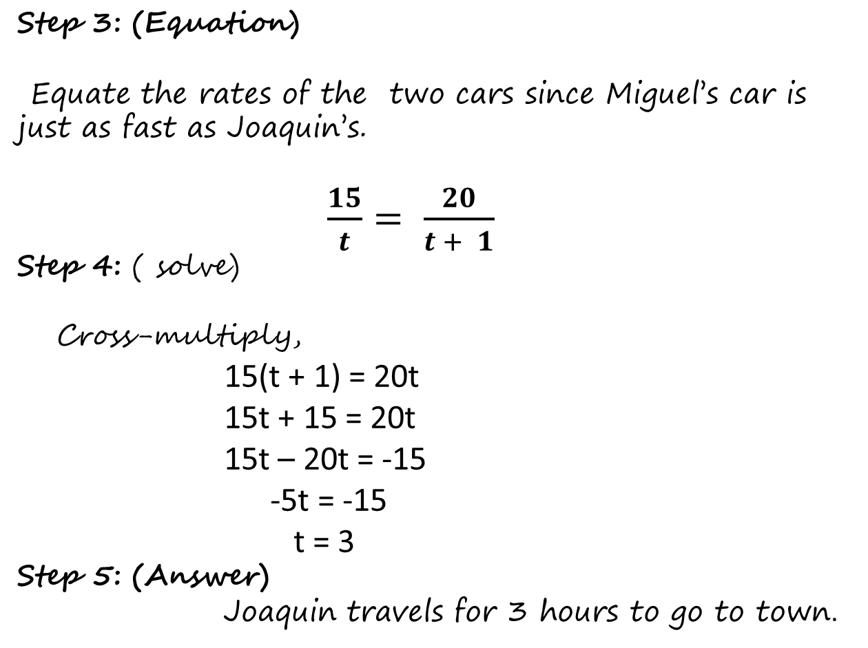
Step 3: (Equation)
Equate the rates of the two cars since Miguel’s car is just as fast as Joaquin’s.
$\frac{15}{t}= \frac{20}{t + 1}$
Step 4: ( solve)
Cross-multiply,
15(t + 1) = 20t
15t + 15 = 20t
15t – 20t = -15
-5t = -15
t = 3
Step 5: (Answer)
Joaquin travels for 3 hours to go to town.

