Slide 1

Common Monomial Factor

Slide 2
Terms to Know
Example/Illustration
Monomial
Polynomial with only one term
6, -2x, 15x²
Greatest common factor (GCF)
The largest number that is a factor of two natural numbers
The GCF of 90 and 84
is 12

Slide 3

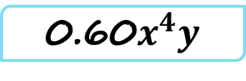
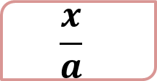

Monomial
Not Monomial
9
x
y-6
$$x^{−2}$$
9x
6xy
6+x
$${3x}^{\frac{1}{2}}$$
0.60$x^{4}y$
$$\frac{x}{a}$$

Slide 4
Factoring Polynomials
.
Is the process of finding factors of a given polynomial
One of the method of Factoring Polynomials is Common monomial factor.

Slide 5
To factor a polynomial whose terms have a common monomial factor:
1. Find the greatest monomial that is a factor of each term of the polynomial.
2. Divide the polynomial by the factor found in step 1. The quotient is the other factor.
3. Express the polynomial as the product of the two factors.

Slide 6
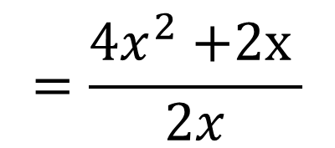
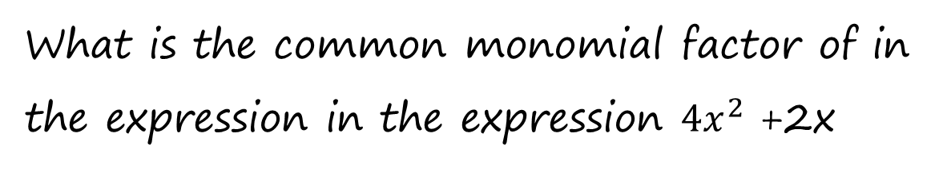
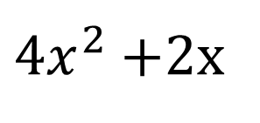
Example 1:
What is the common monomial factor of in the expression in the expression ${4x}^{2}$ +2x
Solution:
The factor common to each term is 2x
Since we can divide each term by 2x
$$=\frac{{4x}^{2}\text{ +2}\text{x} }{2x}$$
${4x}^{2}$ +2x
Therefore , the common monomial factor is 2x
= 2x+1

Slide 7
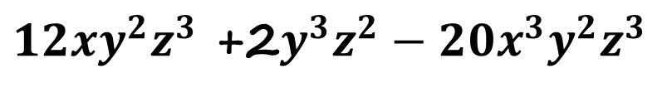
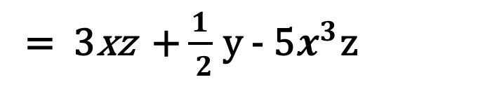
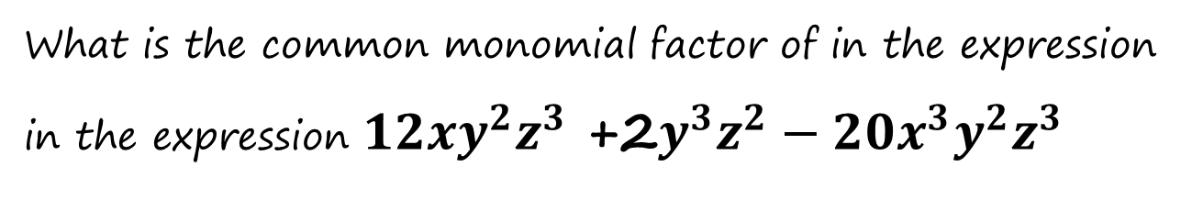
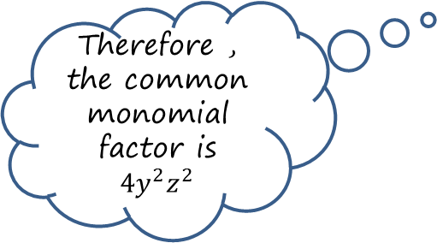
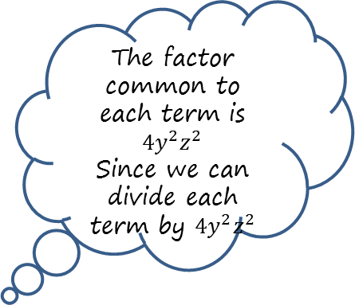
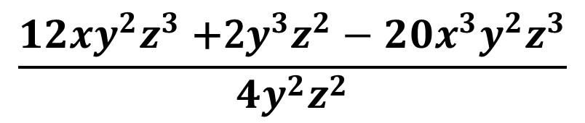
Example 2:
What is the common monomial factor of in the expression in the expression ${12xy}^{2}z^{3}$ +2$y^{3}z^{2}−20x^{3}y^{2}z^{3}$
Solution:
The factor common to each term is $4y^{2}z^{2}$
Since we can divide each term by $4y^{2}z^{2}$
${12xy}^{2}z^{3}$ +2$y^{3}z^{2}−20x^{3}y^{2}z^{3}$
$$\frac{{12xy}^{2}z^{3}\text{ +2}y^{3}z^{2}−20x^{3}y^{2}z^{3}}{4y^{2}z^{2}}$$
Therefore , the common monomial factor is $4y^{2}z^{2}$
= 3xz + $\frac{1}{ 2}$ y - 5$x^{3}$z

