Slide 1

Illustrate Rational Algebraic Expression

Slide 2

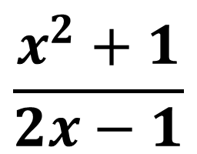
A rational algebraic expression is a ratio of two polynomials provided that the denominator is not equal to zero
numerator
$$\frac{x^{2}+1}{2x−1}$$
denominator

Slide 3
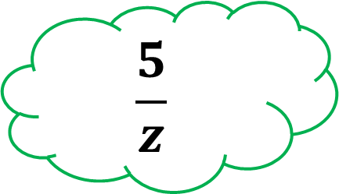
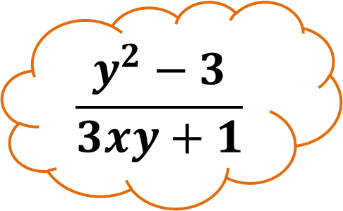
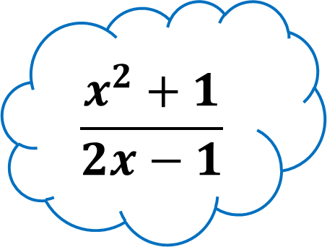
Examples of rational Algebraic expression
$$\frac{x^{2}+1}{2x−1}$$
$$\frac{5}{z}$$
$$\frac{y^{2}−3}{3xy+1}$$

Slide 4
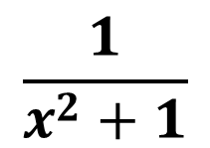

Also
$$\frac{1}{x^{2}+1}$$
is polynomial because the numerator is 1 which is a rational number.
Is a polynomial As it could also be written
where the denominator is 1.
$$\frac{\text{5}\text{x}\text{2}\text{ + 1 }}{1}$$
5x² + 1

Slide 5
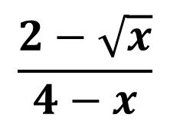

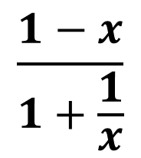
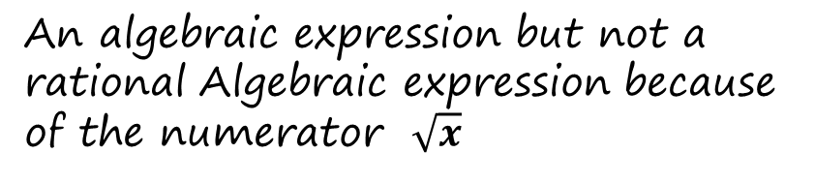
NOTE:
$$\frac{2−\sqrt{x}}{4−x}$$
An algebraic expression but not a rational Algebraic expression because of the numerator $\sqrt{x}$
$$\frac{1−x}{1+\frac{1}{x}}$$
not a rational algebraic expression since the denominator has
$$\frac{1}{x}$$

Slide 6
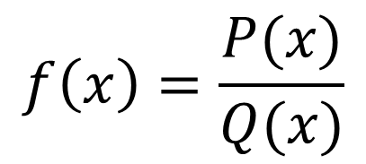
In General
Rational function is the ratio of two polynomials P(x) and Q(x) like this
$$f\left(x\right)=\frac{P(x)}{Q(x)}$$
Except that Q(x) cannot be zero (if Q(x) =0 is undefined)

