Slide 1

Simplifying Rational Algebraic Expressions

Slide 2
Simplifies Rational Algebraic Expressions
The process of writing a rational algebraic expression in lowest terms or simplest form is called simplifying a rational algebraic expression.
A Rational Algebraic Expression is in simplest form when the numerator and denominator have no common factors other than 1 and -1.

Slide 3
Steps in Simplifying Rational Algebraic Expressions
Remember:
1.) Completely factor the numerator and denominator.
2.) Divide both the numerator and denominator by all common factors.

Slide 4
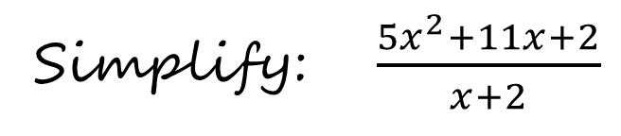

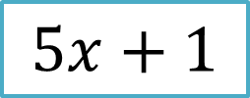
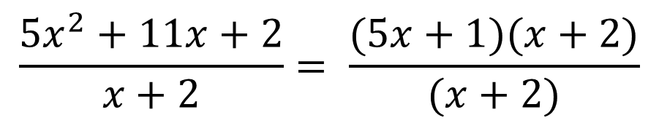
Example 1:
The numerator is factorable , that’s why you need to factor it first.
Simplify: $\frac{{5x}^{2}+11x+2}{x+2}$
Solution:
$$\frac{{5x}^{2}+11x+2}{x+2}= \frac{(5x+1)(x+2)}{(x+2)}$$
Now, you can cancel out the common factor, which is (x+2).
$$=$$
$$5x+1$$

Slide 5
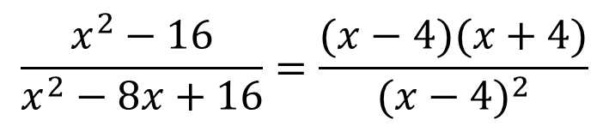
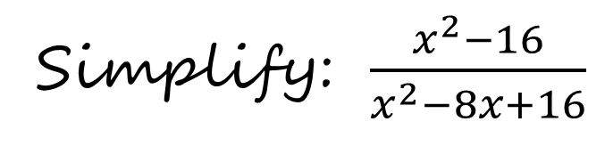

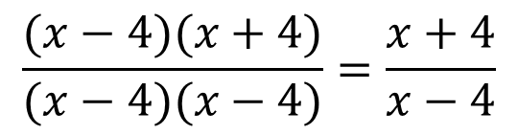
Example 2:
Simplify: $\frac{x^{2}−16}{x^{2}−8x+16}$
Factor the Numerator and the Denominator.
Solution:
Cancel out the Common
Factor, which is
(x-4).
$$\frac{x^{2}−16}{x^{2}−8x+16}=\frac{(x−4)(x+4)}{{(x−4)}^{2}}$$
$$\frac{(x−4)(x+4)}{(x−4)(x−4)}=\frac{x+4}{x−4}$$
$$=$$

Slide 6

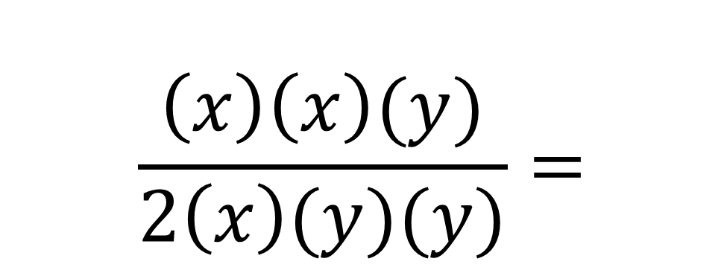

Example 3:
Factor the Numerator and the Denominator.
Simplify: $\frac{x^{2}y}{2xy^{2}}$
Solution:
$$\frac{\left(x\right)\left(x\right)(y)}{2\left(x\right)(y)(y)}=$$
Cancel Out the Common Factor (x) and (y).
$$\frac{x}{2y}$$

Slide 7
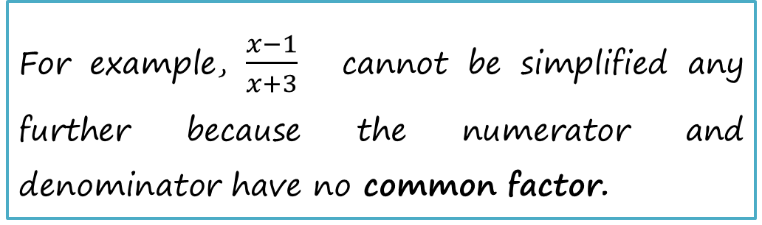
Remember:
When simplifying a rational algebraic expression, common factors are divided out, not common terms.
For example, $\frac{x−1}{x+3}$ cannot be simplified any further because the numerator and denominator have no common factor.

Slide 8
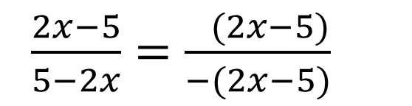
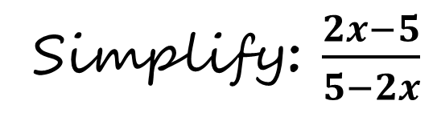

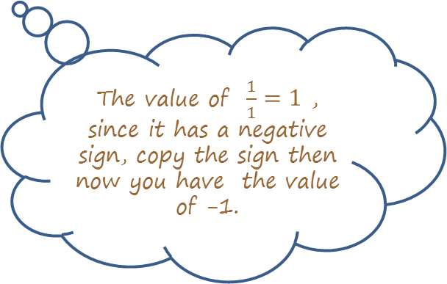
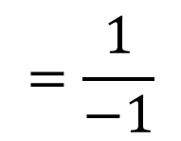
Example 1:
The expression can be simplified by recognizing that 5 - 2x can be written as - (2x - 5).
Simplify: $\frac{2x−5}{5−2x}$
Solution :
$\frac{2x−5}{5−2x}=\frac{ (2x−5)}{−(2x−5)}$
$$=\frac{1}{−1}$$
$$=−1$$
Cancel out the common factor.
The value of $\frac{1}{1}=1$ , since it has a negative sign, copy the sign then now you have the value of -1.

