Slide 1

Operations of Algebraic Expression

Slide 2
Addition and Subtraction of Rational Algebraic Expressions
We add and subtract rational expressions in the same way as we add and subtract rational numbers.

Slide 3
Examples in Adding and Subtracting Rational Algebraic Expressions with the Same Denominator

Slide 4
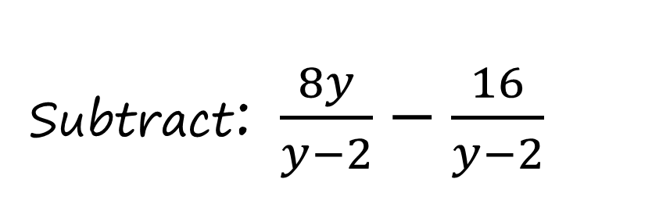
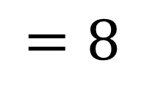
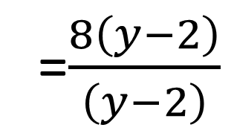


Subtract: $\frac{8y}{y−2}−\frac{16}{y−2}$
Example 1:
Get the common factor (8) and factor it out divide it to each term in the numerator
Solution:
$$=\frac{8y−16}{y−2}$$
$$\frac{8y}{y−2}−\frac{16}{y−2}$$
=$\frac{8\left(y−2\right)}{\left(y−2\right)}$
$$=8$$

Slide 5
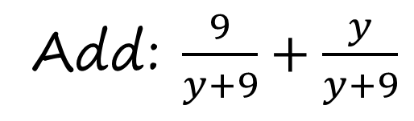
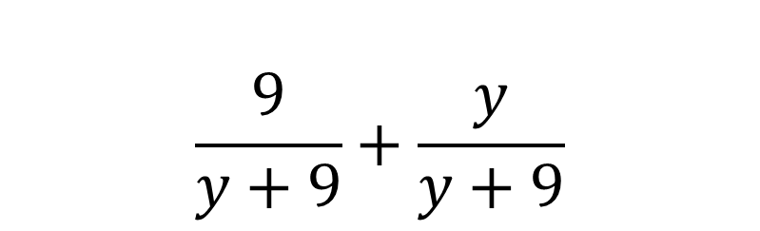
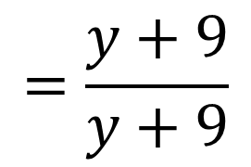
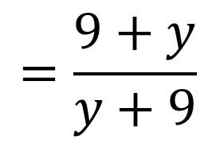
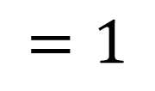
Example 2:
Add: $\frac{9}{y+9}+\frac{y}{y+9}$
When canceling the same value it is always equal to 1 not equals 0.
The term can be interchange as long as you carry its sign
Solution:
$$\frac{9}{y+9}+\frac{y}{y+9}$$
$$=\frac{9+y}{y+9}$$
$$=\frac{y+9}{y+9}$$
$$=1$$

Slide 6
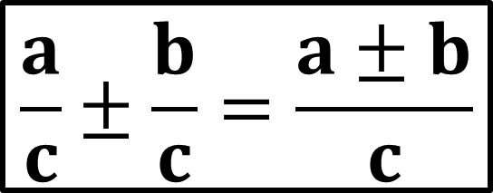
Adding and Subtracting Rational Algebraic Expressions with the Same Denominator
When adding or subtracting rational algebraic expressions in which the denominators are the same, add or subtract the numerators. The denominator of the sum is the common denominator.
General
Form
$$\frac{a}{c}±\frac{b}{c}=\frac{a±b}{c}$$

Slide 7
Adding and subtracting rational expressions with different denominators

Slide 8





Remember:
Steps in adding and subtracting rational expressions are summarized below.
1
Find the LCD of the rational algebraic expressions.
2
Rewrite each rational expression as an equivalent expression whose denominator is the LCD found in step 1.
3
Add or subtract the numerators and write the sum or difference over the LCD.
4
Write the rational expression in lowest terms.

Slide 9
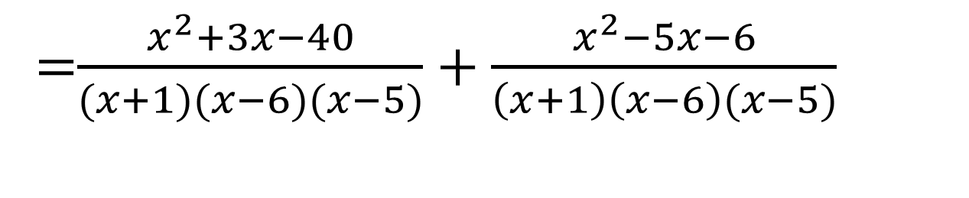
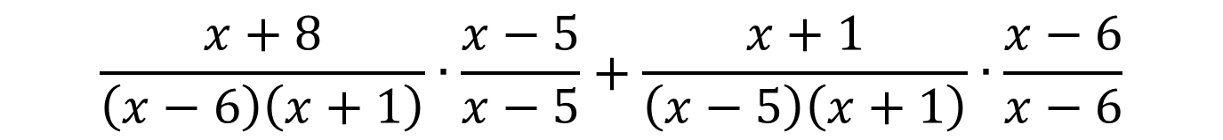
Step 2: Rewrite each rational expression as an equivalent expression whose denominator is the LCD (x + 1) (x - 6) (x - 5).
$$\frac{x+8}{\left(x−6\right)\left(x+1\right)}∙\frac{x−5}{x−5}+\frac{x+1}{\left(x−5\right)\left(x+1\right)}∙\frac{x−6}{x−6}$$
=$\frac{x^{2}+3x−40}{(x+1)(x−6)(x−5)}+\frac{x^{2}−5x−6}{\left(x+1\right)\left(x−6\right)(x−5)}$

Slide 10
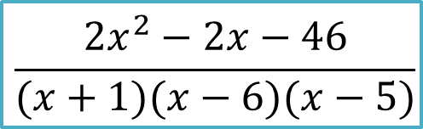
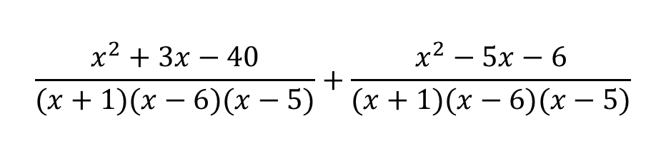
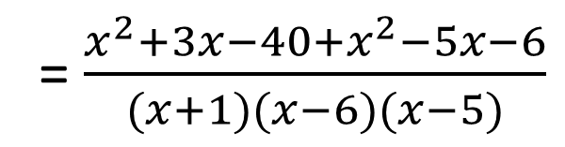
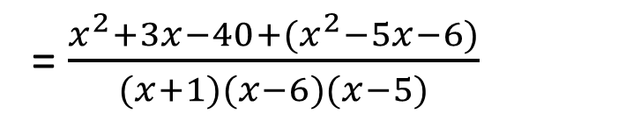
Step 3: Add the numerators.
$$\frac{x^{2}+3x−40}{(x+1)(x−6)(x−5)}+\frac{x^{2}−5x−6}{(x+1)(x−6)(x−5)}$$
Combine like terms
= $\frac{x^{2}+3x−40+(x^{2}−5x−6)}{(x+1)(x−6)(x−5)}$
= $\frac{x^{2}+3x−40+x^{2}−5x−6}{(x+1)(x−6)(x−5)}$
$$\frac{{2x}^{2}−2x−46}{(x+1)(x−6)(x−5)}$$
=

Slide 11
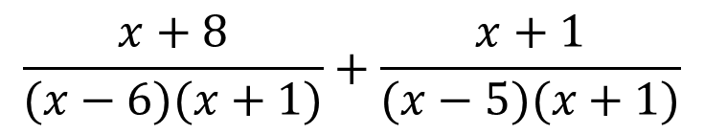
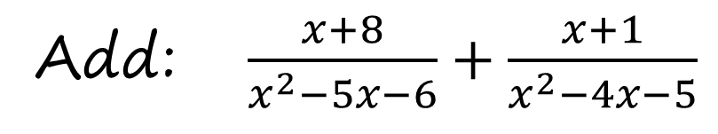
Example 1:
Add: $\frac{x+8}{x^{2}−5x−6}+\frac{x+1}{x^{2}−4x−5}$
Solution:
Step 1: Factor the denominator to find LCD.
$$\frac{x+8}{(x−6)(x+1)}+\frac{x+1}{(x−5)(x+1)}$$
The LCD is (x + 1) (x - 6) (x - 5).

Slide 12
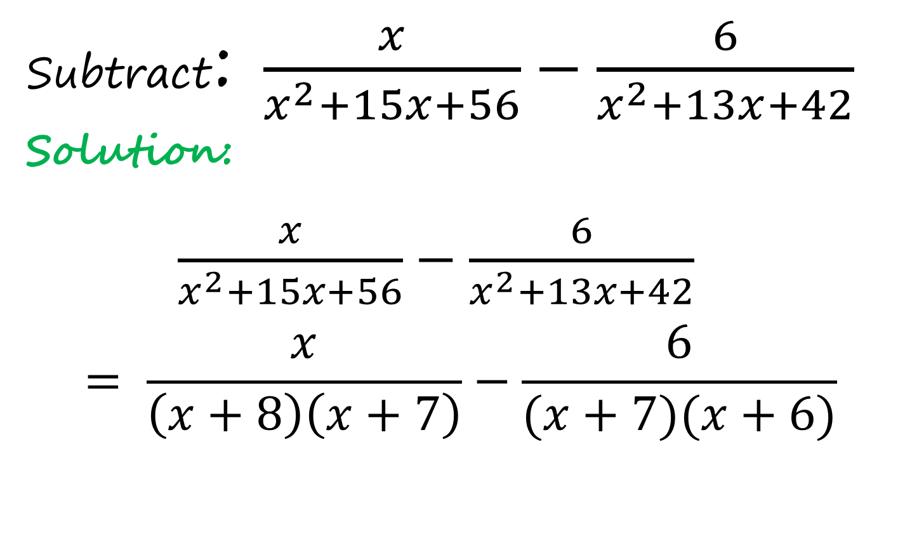
Example 2:
Subtract: $\frac{x}{x^{2}+15x+56}−\frac{6}{x^{2}+13x+42}$
Solution:
$\frac{x}{x^{2}+15x+56}−\frac{6}{x^{2}+13x+42}$
$$= \frac{x}{\left(x+8\right)\left(x+7\right)}−\frac{6}{(x+7)(x+6)}$$

Slide 13
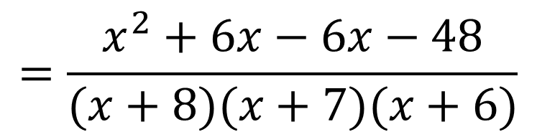
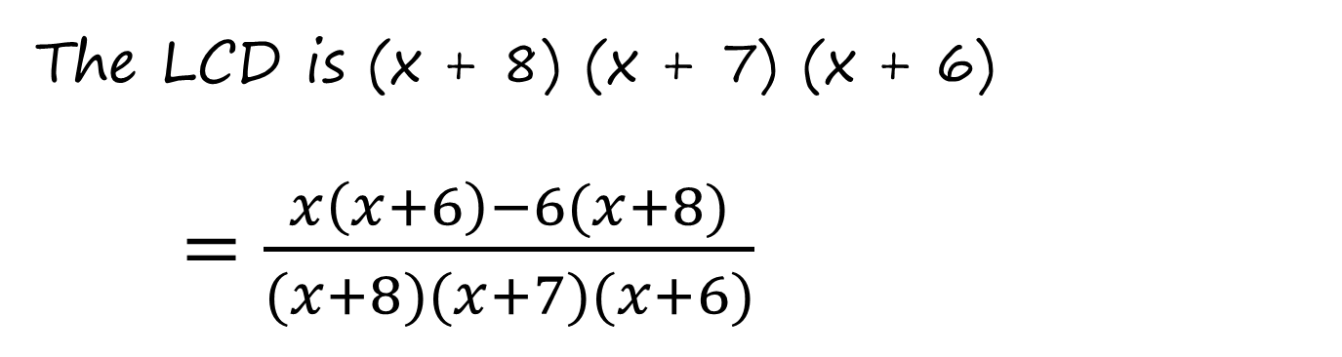
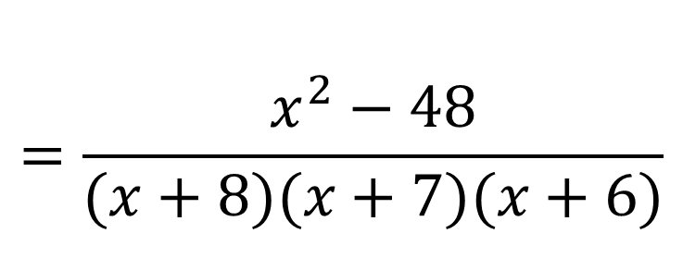
The LCD is (x + 8) (x + 7) (x + 6)
$=\frac{x\left(x+6\right)−6(x+8)}{(x+8)(x+7)(x+6)}$
$$=\frac{x^{2}+6x−6x−48}{(x+8)(x+7)(x+6)}$$
$$=\frac{x^{2}−48}{(x+8)(x+7)(x+6)}$$

Slide 14
Multiplication and Division of Rational Algebraic Expressions

Slide 15
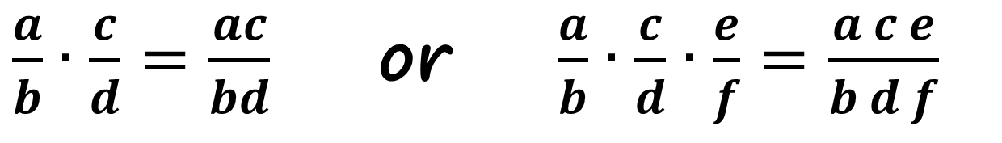
Multiplying Rational Expressions
The product of two or more fractions is a fraction whose numerator is the product of the numerators of the fractions and whose denominator is the product of the denominators of the fractions,
$\frac{a}{b}∙\frac{c}{d}=\frac{ac}{bd}$ or $\frac{a}{b}∙\frac{c}{d}∙\frac{e}{f}=\frac{a c e}{b d f}$

Slide 16
To Multiply Rational Expressions
1. Completely factor the numerators and the denominators.
2. Divide out any factor that is common to both a numerator and a denominator.
3. Multiply the numerators and multiply the denominators.

Slide 17
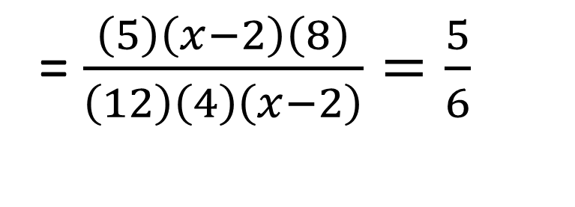

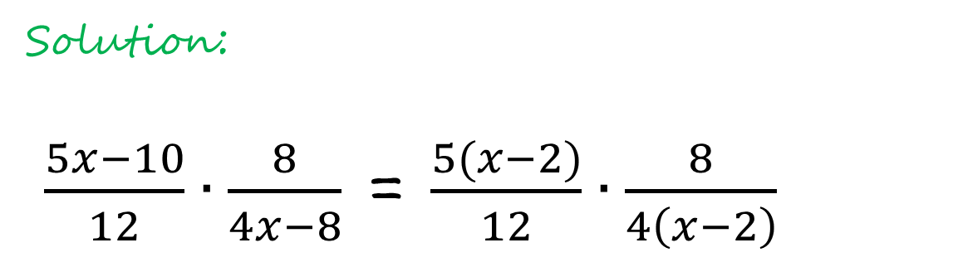
Example 1:
Multiply: $\frac{5x−10}{12}∙\frac{8}{4x−8}$
Solution:
$\frac{5x−10}{12}∙\frac{8}{4x−8}$ = $\frac{5(x−2)}{12}∙\frac{8}{4\left(x−2\right)}$
= $\frac{\left(5\right)\left(x−2\right)\left(8\right)}{\left(12\right)\left(4\right)\left(x−2\right)}=\frac{5}{6}$

Slide 18
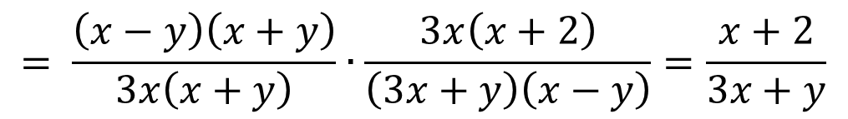
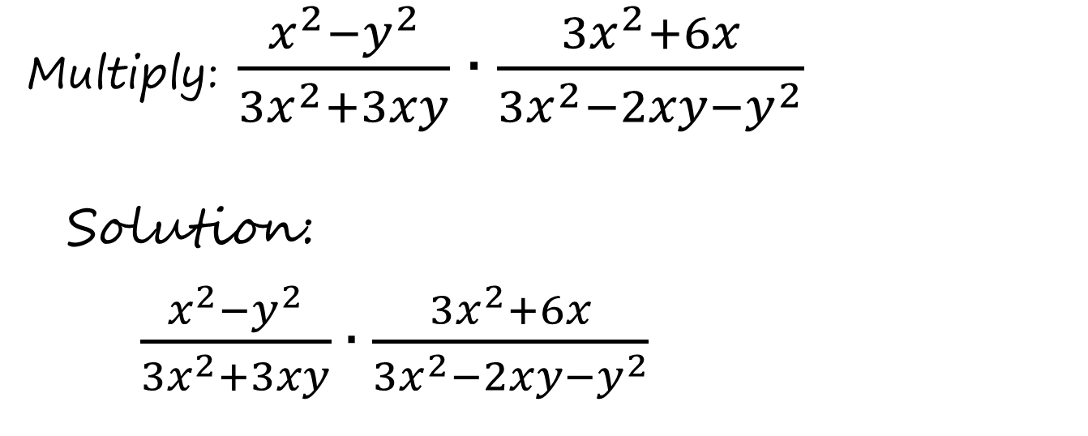
Example 2:
Multiply: $\frac{x^{2}−y^{2}}{{3x}^{2}+3xy}∙\frac{{3x}^{2}+6x}{{3x}^{2}−2xy−y^{2}}$
Solution:
$\frac{x^{2}−y^{2}}{{3x}^{2}+3xy}∙\frac{{3x}^{2}+6x}{{3x}^{2}−2xy−y^{2}}$
$$= \frac{\left(x−y\right)\left(x+y\right)}{3x\left(x+y\right)}∙\frac{3x\left(x+2\right)}{\left(3x+y\right)\left(x−y\right)}=\frac{x+2}{3x+y}$$

Slide 19
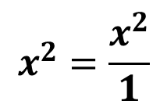
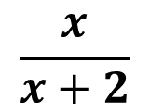
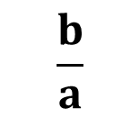


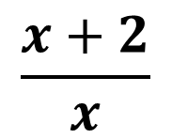
The reciprocal of a fraction is a fraction with the numerator and denominator interchanged.
Dividing Rational Expressions
Fraction
Reciprocal
$$\frac{b}{a}$$
$$\frac{a}{b}$$
$$x^{2}=\frac{x^{2}}{1}$$
$$\frac{1}{x^{2}}$$
$$\frac{x+2}{x}$$
$$\frac{x}{x+2}$$

Slide 20
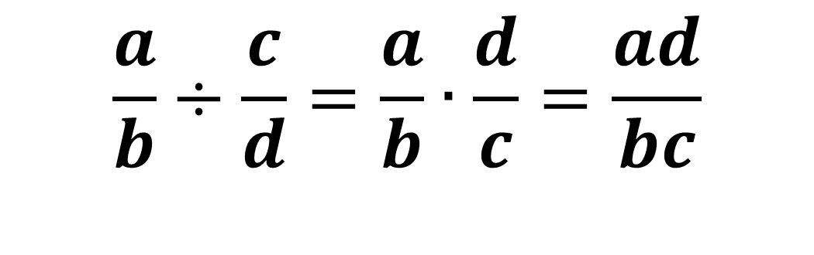
To divide two fractions, multiply the dividend by the reciprocal of the divisor.
$$\frac{a}{b}÷\frac{c}{d}=\frac{a}{b}∙\frac{d}{c}=\frac{ad}{bc}$$

Slide 21
Division of Rational Expressions
To divide rational expressions, multiply the first expression (the dividend) by the reciprocal of the second (the divisor).

Slide 22
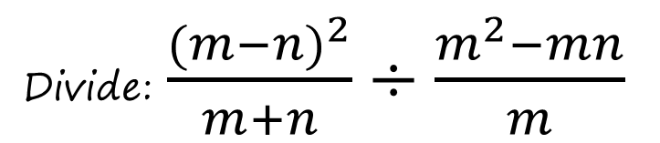
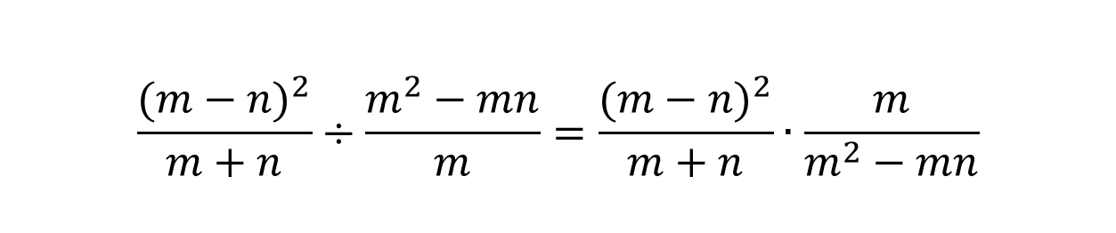
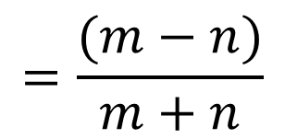
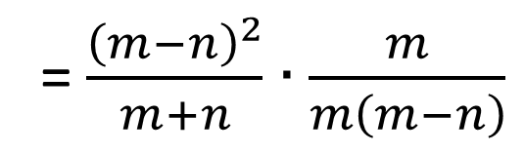
Example 1
Divide: $\frac{{(m−n)}^{2}}{m+n}÷\frac{m^{2}−mn}{m}$
Solution:
$$\frac{{(m−n)}^{2}}{m+n}÷\frac{m^{2}−mn}{m}=\frac{{(m−n)}^{2}}{m+n}∙\frac{m}{m^{2}−mn}$$
= $\frac{{\left(m−n\right)}^{2}}{m+n}∙\frac{m}{m\left(m−n\right)}$
$$=\frac{(m−n)}{m+n}$$

Slide 23
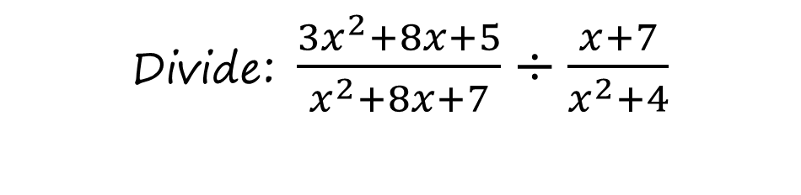

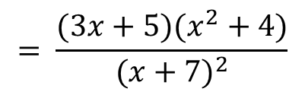


Example 2:
Divide: $\frac{{3x}^{2}+8x+5}{x^{2}+8x+7}÷\frac{x+7}{x^{2}+4}$
Solution:
$$\frac{{3x}^{2}+8x+5}{x^{2}+8x+7}÷\frac{x+7}{x^{2}+4}$$
= $\frac{{3x}^{2}+8x+5}{x^{2}+8x+7}∙\frac{x^{2}+4}{x+7}$
$$=\frac{\left(3x+5\right)\left(x+1\right)}{\left(x+7\right)\left(x+1\right)}∙\frac{x^{2}+4}{x+7}$$
$$= \frac{(3x+5)(x^{2}+4)}{{(x+7)}^{2}}$$

