Slide 1

FridgeMate

Slide 2
What:
An app to match your kitchen
ingredients to recipes!

Slide 3
MVP Features:
Authentication.
User accounts.
User preferences.
Fridge/pantry ingredients.
Recipe search.
Save recipes.

Slide 4
Extra Features:
Search history.
Oauth.
Recipe of the week.
Collections.
Meal time filter.
Rate and review.
Profiles.

Slide 5
Who:
Key Demographics
Gender: Anyone, predominantly women.
Age: 20-55.
Family status: Cooking for self, partner or
dependents.
Profession: Students, professionals and
homemakers.
Language: English.
Main interests: cooking, health, diet, low waste,
saving money, trying new things.

Slide 6
Who:
Key Psychographics
Dislikes repetitive meals, like variety
and new options.
Dislikes spending lots of money on lots
of ingredients and food waste.
Enjoys sharing and preparing meals.

Slide 7
Who:
Challenges
Finds it difficult to create recipes
Has a limited food budget or limited access
to ingredients
Has an interest in cooking but limitations
(eg budget, dietary restrictions, skill).

Slide 8
Who:
Preferred Channels
Follows celebrity chefs and food themed
accounts on social media.
Searches for recipes/blogs on Google.
Preferred Content Types
Articles.
Blog posts.
Social media posts.

Slide 9
How:
Design and Planning:
Trello
Miro
xtensio
Lucid Chart
Slack
Frontend:
HTML5
CSS3
React JS
JavaScript
JSX
Material-UI
Bootstrap
Axios
Backend:
ExpressJS
Node JS
Passport
Passport-JWT
Express Session
Database:
MongoDB
Mongoose
Testing:
Cypress
Supertest
Mocha
Other:
Edamam API or Spoonacular
Heroku
Netlify

Slide 10
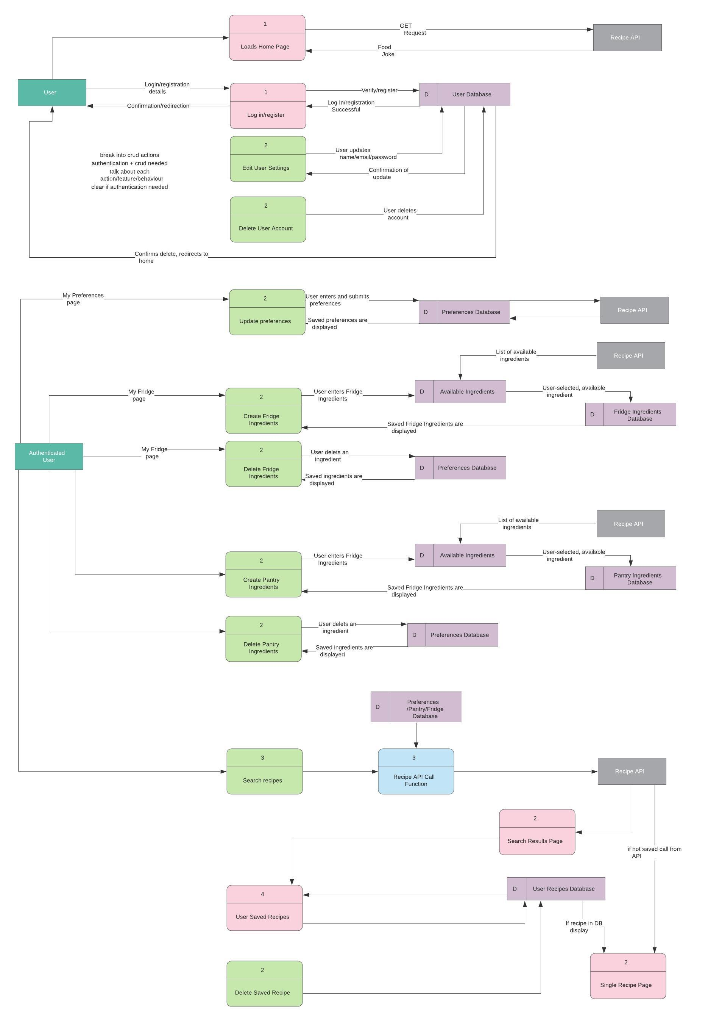
How:

Slide 11
How:
Cont…

Slide 12
How:
Cont…

Slide 13
How:
Cont…

Slide 14
How:
Cont…

Slide 15
What:
An app to match your kitchen
ingredients to recipes!

