Slide 1

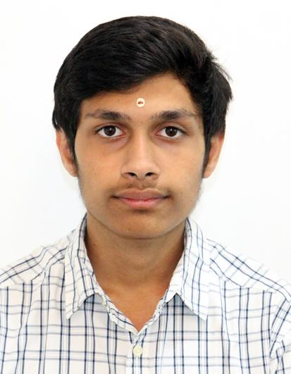
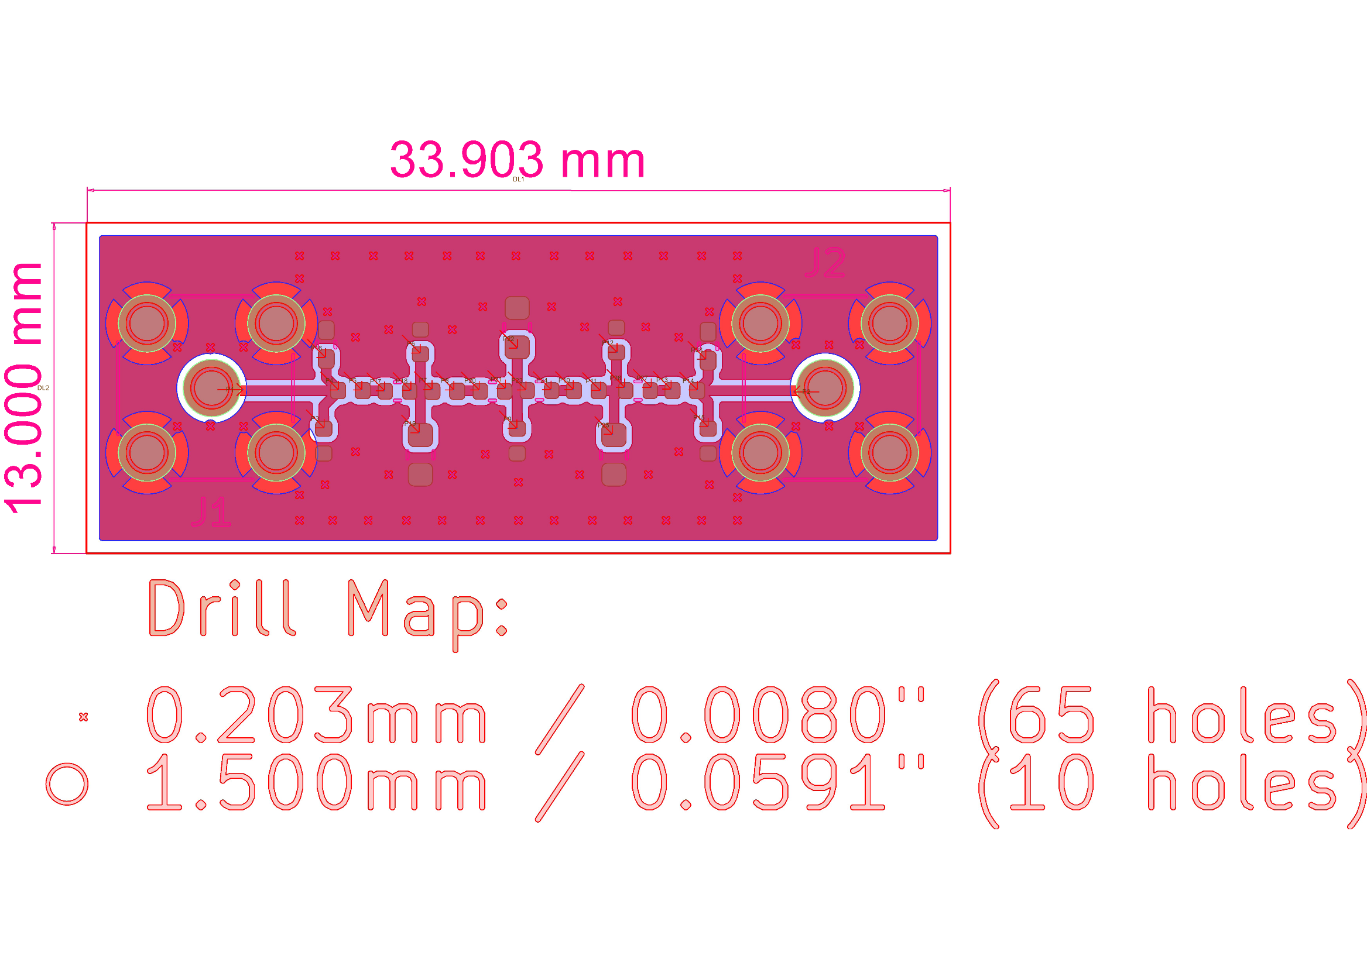
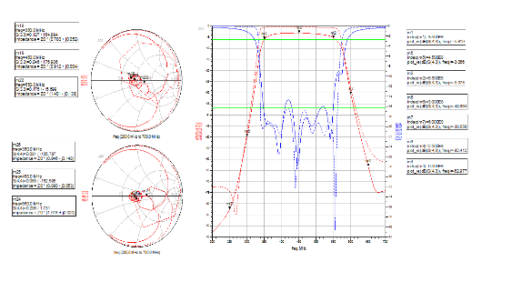
DESIGN AND DEVELOPMENT OF ANALOG BAND PASS FILTER FOR DCG (DIGITAL CHIRP GENERATOR)
SRTD-RTMG-MISA
Name: CHILKUNDA ACHUTHA THYAGARAJU
Designation: SUMMER RESEARCH INTERN
Institution: NATIONAL INSTITUTE OF TECHNOLOGY, ROURKELA
Guide: SRI RITESH KUMAR SHARMA / SMT. SHIVANI BHARGAV
Contact e-mail: ritesh@sac.isro.gov.in/shivani@sac.isro.gov.in
PHOTO
MAJOR OBJECTIVES:
Design and optimize an analog band-pass filter (350-550 MHz).
Achieve high stopband attenuation for Nyquist image suppression (e.g., 50-60 dB at 250 MHz and 650 MHz).
Maintain minimum insertion loss with good return loss performance.
Develop a manufacturable PCB layout accounting for real-world component and parasitic effects.
14 MAY 2025 to
23 JULY 2025
METHODOLOGY FLOW CHART:
RESULTS/MAJOR FINDINGS:
TOOL FAMILIARIZATION & CIRCUIT SCHEMATIC DESIGN
Filter Type: 9th-order LC Chebyshev Band-pass Filter [2 Layer PCB – 0.25mmFR4].
Passband: 350 MHz to 550 MHz.
Insertion Loss: Approx. 5.5 dB overall, with 3.8 dB at 450 MHz.
Stopband Rejection: 75 dB at 250 MHz, 56 dB at 650 MHz.
Return Loss: Consistently under 16 dB in passband (target was ≥20 dB).
Phase Response: Linear and usable.
LAYOUT DESIGN
IF PERFORMANCE NOT SATISFACTORY
Key Findings:
Successful integration of real component models and PCB parasitics.
Importance of iterative trace width optimization and coaxial pad matching using SIPro.
Practical challenges with component footprint availability and their impact on performance.
EM SIMULATIONS & PERFORMANCE VALIDATION
CONCLUSION:
Successfully designed and simulated a 9th-order analog band-pass filter.
Achieved excellent Nyquist image suppression (75 dB at 250 MHz, 56 dB at 650 MHz).
Demonstrated robust methodology including component optimization, PCB layout, and EM co-simulation.
Acknowledged practical trade-offs in insertion loss and return loss while meeting critical rejection targets.
FABRICATION & HARDWARE TESTING

