Slide 1

Massachusetts
Territorial Analysis
BY: Carlos Arellano
This Photo by Unknown Author is licensed under CC BY-SA-NC

Slide 2
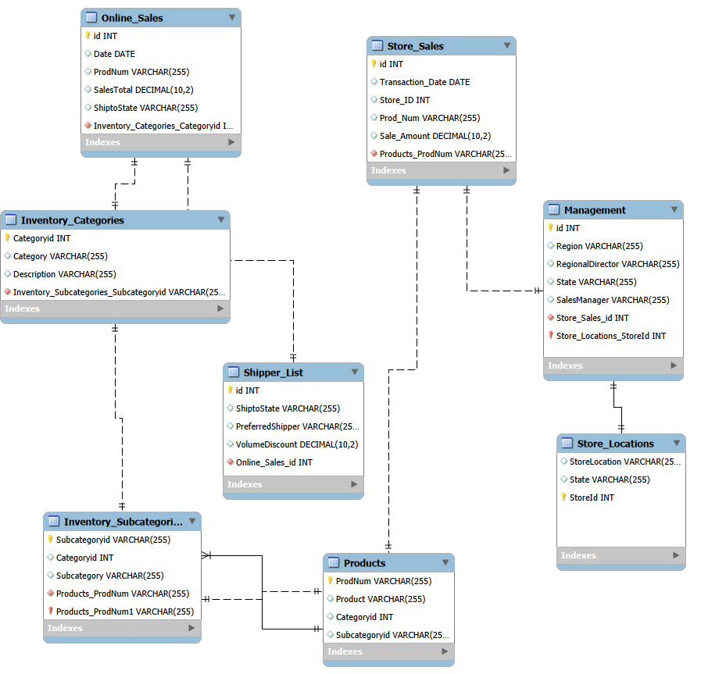
Utilizing MySQL Workbench:
SALES DATABASE ERD and IT’S RELATIONSHIPS
Imported sample_sales script to create the database.
reverse-engineer the MYSQL script to view as an ERD
Familiarize myself with tables, columns and relationships

Slide 3
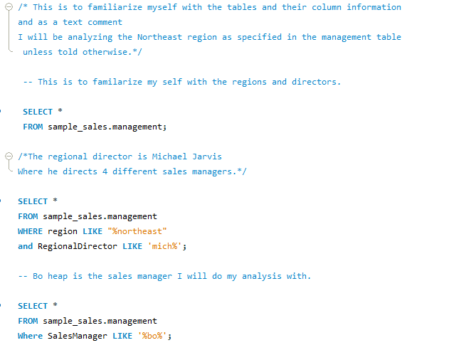
Choosing The Region
&
Territory
Determined by selecting all columns from the management table
Region: Northeast under Michael Jarvis
4 Territories under the Northeast region
Territory: Massachusetts under Bo Heap
*checking which territories Bo Heap oversaw

Slide 4
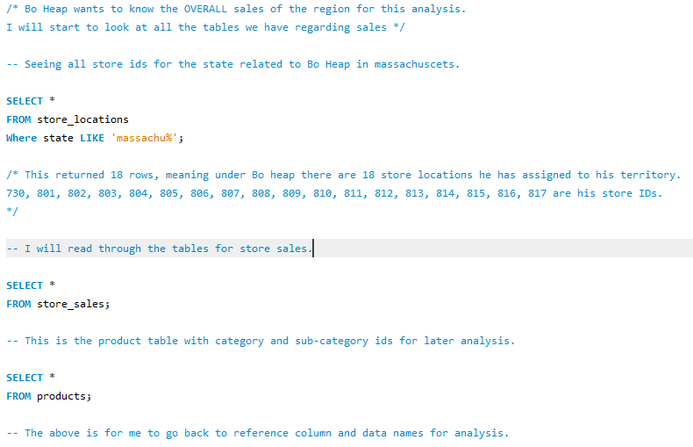
Utilizing SELECT * for Store_ID, Sales, & Products
Getting to know the territory and sales table
Utilized WHERE clause found all stores in Massachusetts
Utilized SELECT * to see data types in store sales
Utilized SELECT * to view the kind of product data for future analysis

Slide 5
Query and Question Analysis
My step by step

Slide 6
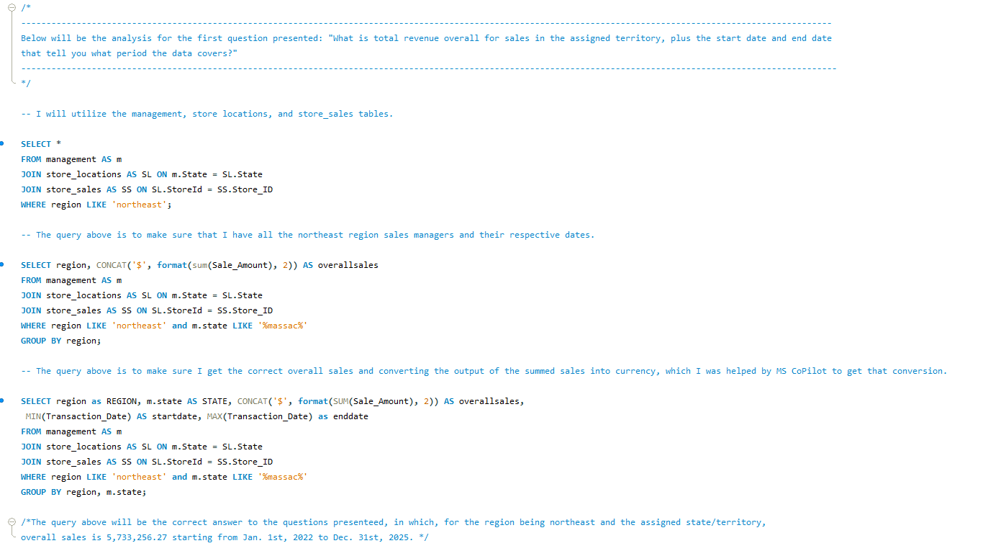

Analysis:
First Question
Queries for First Question
Utilizing JOIN with relationship on management, store locations, & store sales
Confirming data is correct, proceeded to do SUM for overall sales in the territory.
Once confirming SUM was correct, added MIN & MAX dates from the GROUP BY
Results for Final Query
* Note comment in script shows that I utilize MS CoPilot to help get a format to convert plain numbers into currency

Slide 7
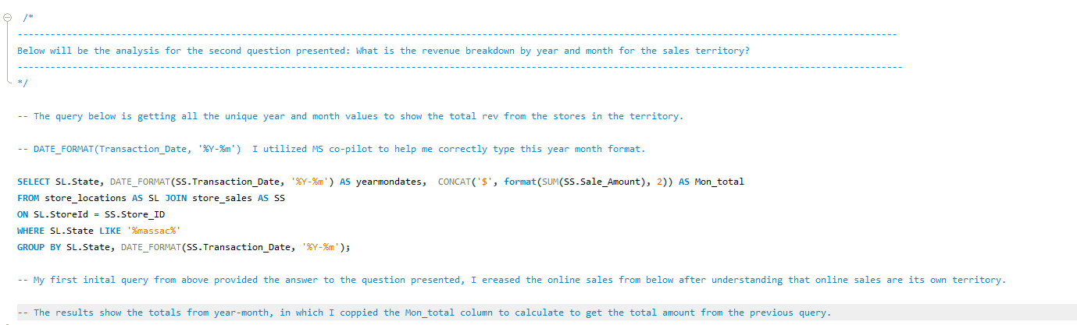
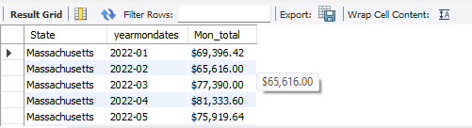
Analysis:
Second Question
Query for Second Question
Utilizing JOIN for store locations and store sales.
Formatting the transaction date to year and month (MS CoPilot helped me get the format)
GROUP BY state and date to receive the monthly totals per year
Results for Final Query
* Note comment in script shows that I utilize MS CoPilot to help get the format for Year/Mon.

Slide 8
Pivot Chart for Question 2

Slide 9
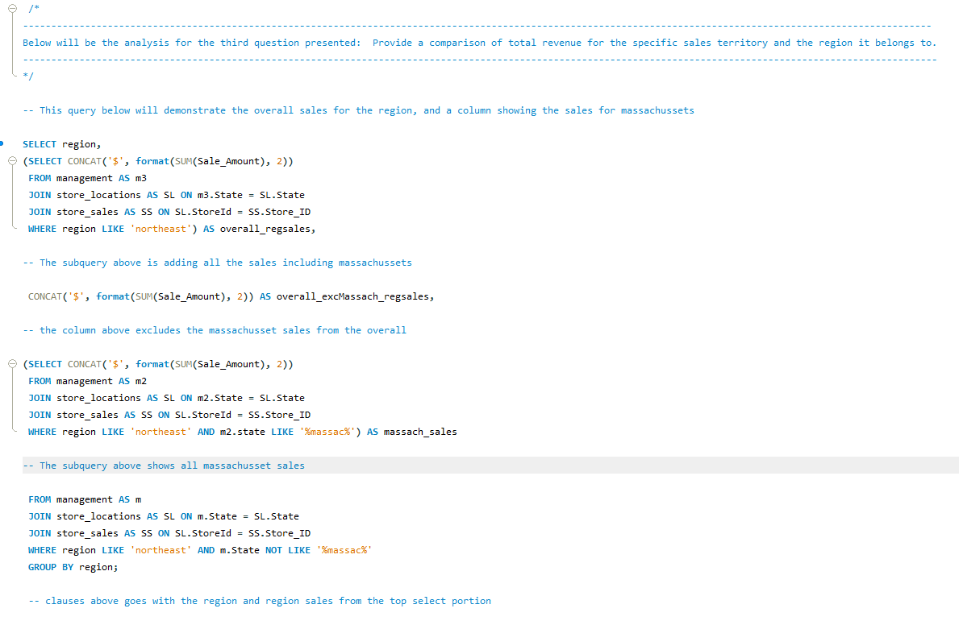

Analysis:
Third Question
Query for Third Question
Utilizing subqueries to output results for comparison against region and territory.
Utilizing JOINs from main query and subquery for overall region sales.
Added in overall sales excluding my territory.
Adding in total sales for my territory in the last column.
Results for Final Query

Slide 10
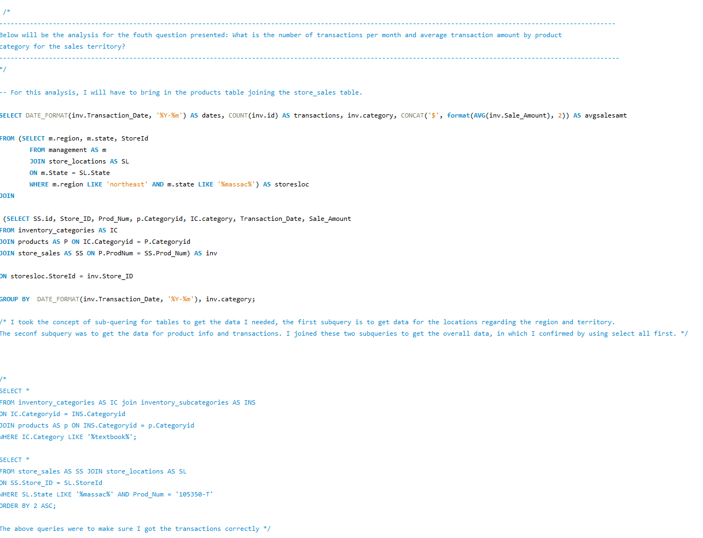
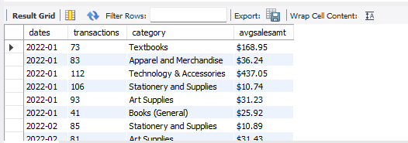
Analysis:
Fourth Question
Query for Fourth Question
Utilizing two sub-queries in the FROM clause, allowed me to make a table to answer this question.
Once joined, results output the dates, counts of transactions, categories per each month, and their average amount for sales.
I made queries to double check my work (in multi-line comment).
Results for Final Query

Slide 11
Pivot Chart for Question 4

Slide 12
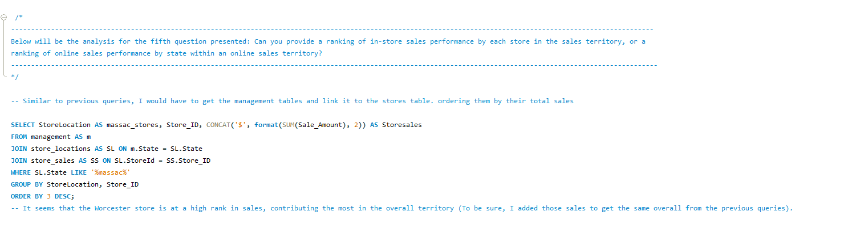
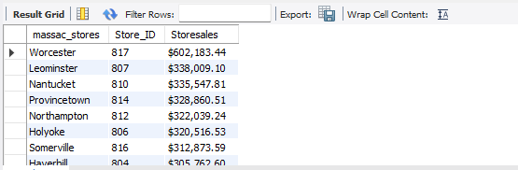
Analysis:
Fifth Question
Query for Fifth Question
Utilizing JOINs in the FROM clause with management, store locations, and stores.
Created relationships from those tables to get the store locations, store id, and store sales.
Utilized GROUP BY for location and id.
Utilized ORDER BY to rank from high to low in sales.
Results for Fifth Query

Slide 13
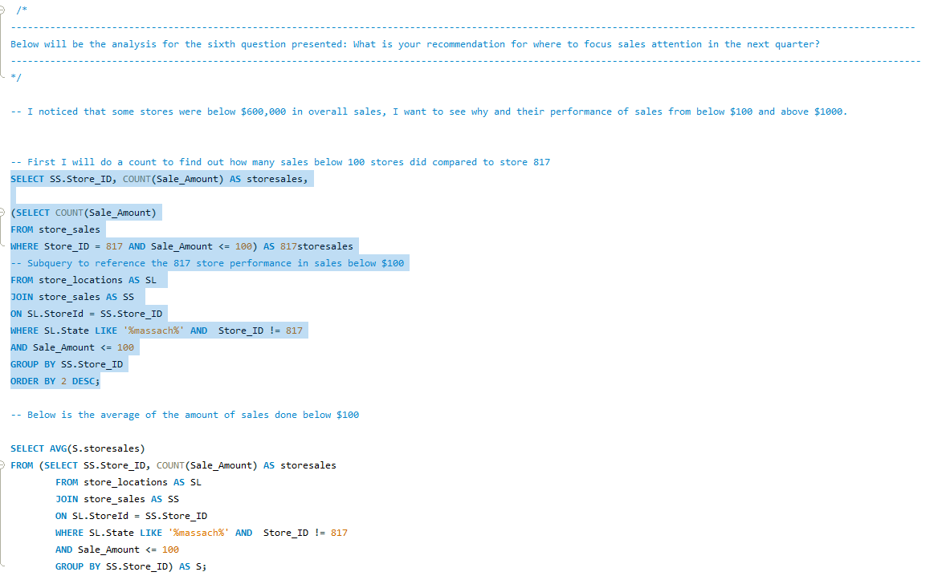
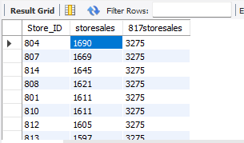

Analysis:
Final Question
Queries on how many sales $100 and below and their average
I asked my self the following:
Why does store 817 have over 600 grand in sales, while the rest of the stores were below $340,000?
What is the total sale amount for stores where they sold $100 or below and $1000 and above?
How many sales of the amounts mentioned and the average?
The number of sales compared to store 817
The average amount from those sales

Slide 14
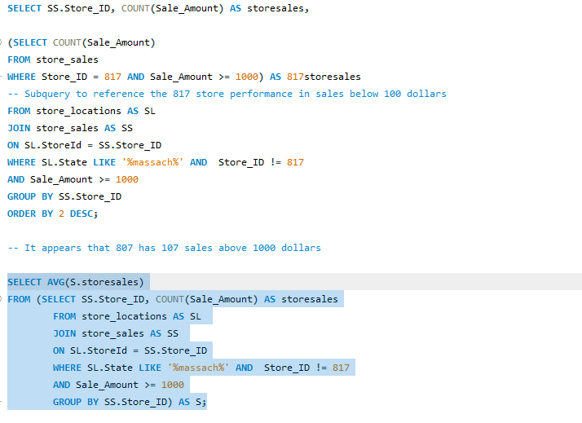
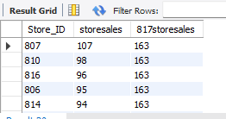

Analysis:
Final Question (Continued)
Queries on how many sales of $1000 and above and their average
The previous and the current slide are similar in script
I made JOINs for store locations and store sales.
Second query, utilizing a subquery in the FROM clause, like query above to receive an average of sales ranging $100 or below and $1000 and above.
The number of sales compared to store 817
The average amount from those sales

Slide 15
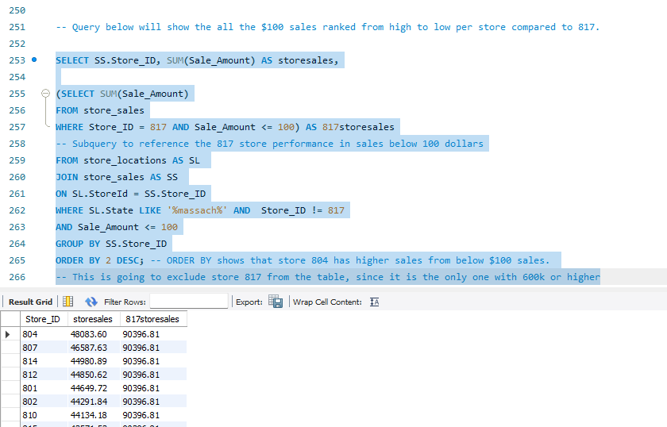
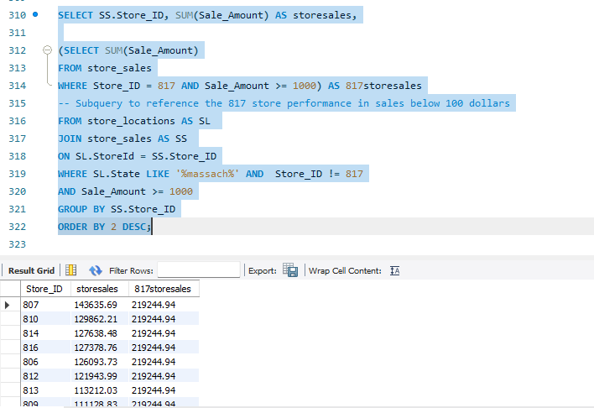
Analysis:
Final Question (Continued)
Queries on total sales for both $1000 and above and $100 and below
These scripts show the total overall sales compared to store 817
Both queries are similar with the change of the value in the WHERE clause.
Utilized a subquery in the SELECT clause to compare numbers from store 817 to other stores.
Utilized JOINs in the FROM clause, like previous slide.

Slide 16
CONCLUSION
Raising the number of sales $100 and below and sales $1000 and above will dramatically increase the overall revenue for stores in the territory for the Northeast region
This Photo by Unknown Author is licensed under CC BY-SA-NC

