Slide 1
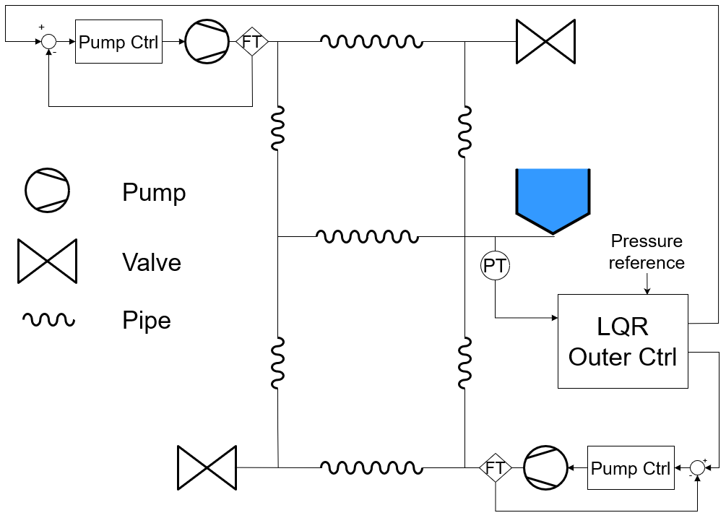
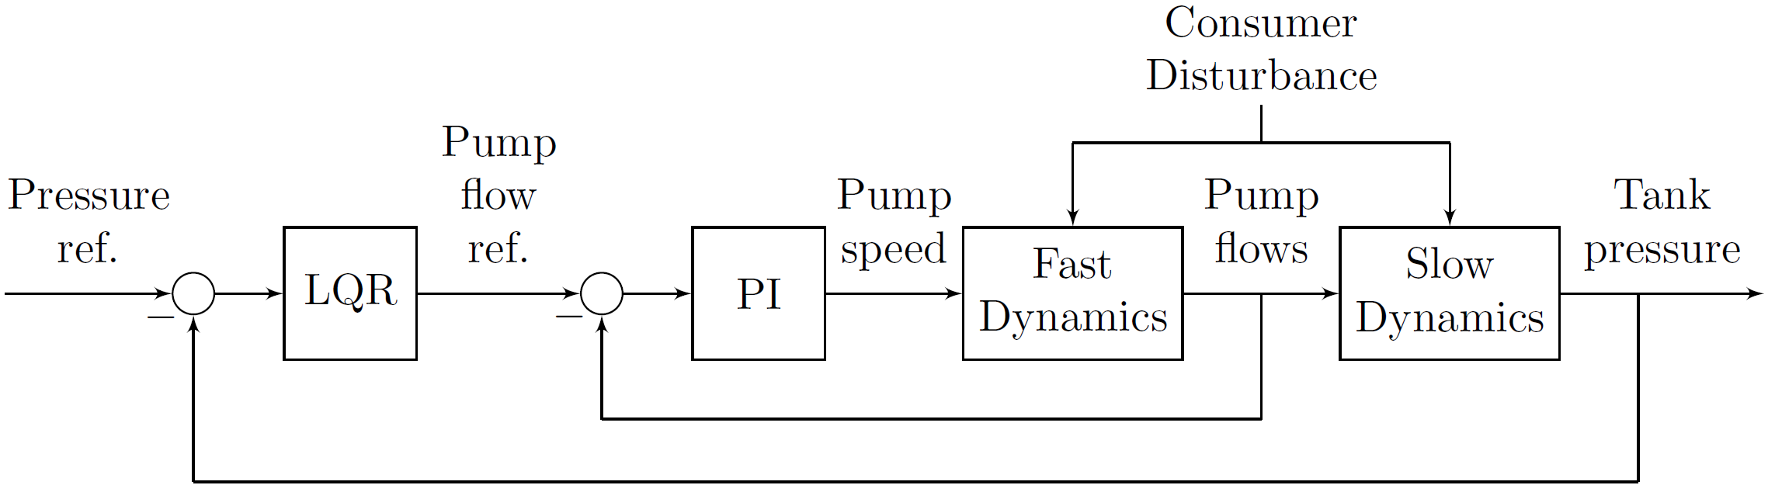
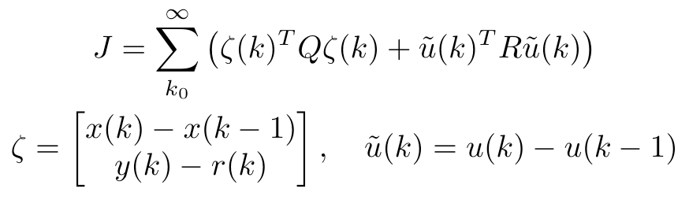
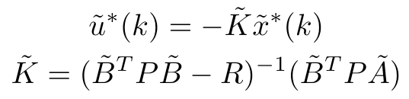
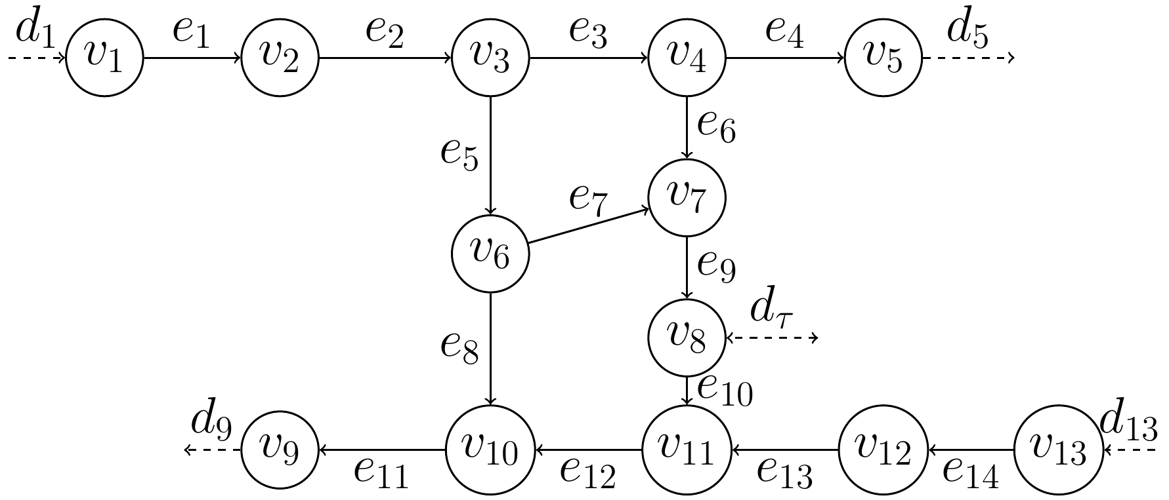
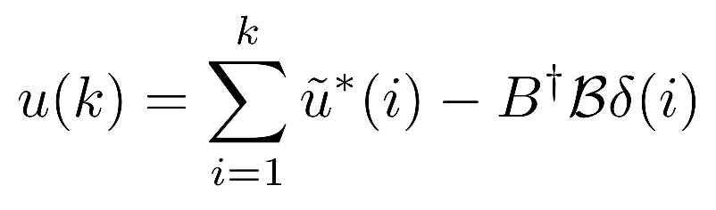
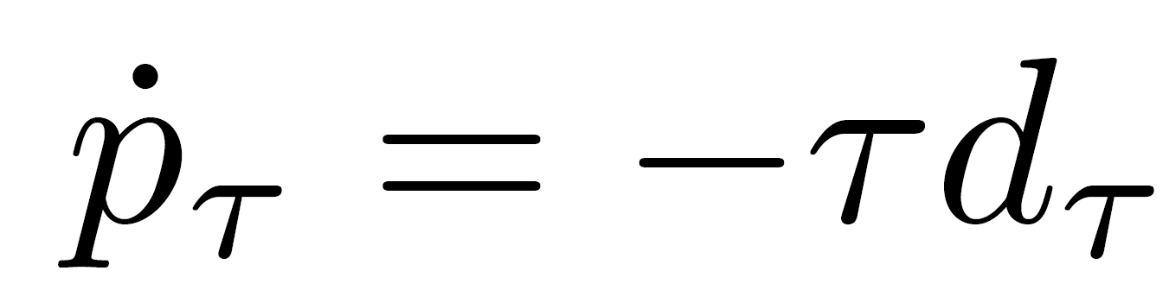
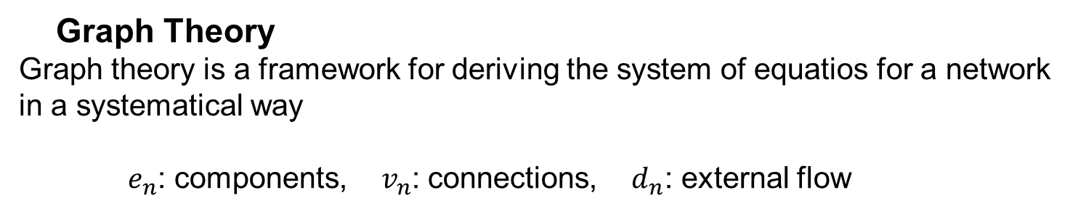
MODELLING AND NETWORKED CONTROL OF WATER DISTRIBUTION NETWORKS
AUTHORS: L. Andersen, M. Frederiksen, C. Jensen, J. Jensen,
R. Kristiansen, K. Laustsen and M. Therkildsen GROUP NO.: 733
Introduction and System Abstraction
Motivation
A reliable Water Distribution Network (WDN) is a pivotal part of any developed society. The objective of this project is, firstly, to both optimize the WDN control resulting in improvement in consumer experience and decreased strain on WDN components. Secondly leakage detection is introduced.
Problem Formulation
How can a reliable networked controller for the WDN be implemented that delivers constant level control?
Graph Theory
Graph theory is a framework for deriving the system of equatios for a network in a systematical way
$e_{n}$: components, $v_{n}$: connections, $d_{n}$: external flow
Modelling and Design
Controller Choices
LQR controller with integral action
Transfer matrix for the two pumps indicate low coupling, allowing for decentralized control.
Kalman Filter for Leakage Detection and Disturbance Estimation
Consumer flow is not realistically measured
Stiff kalman filtering allows for leakage detection and disturbance estimation
Input is based on mass conservation: What comes in must come out
Coupling between Controller and Estimator
LQR and Kalman needs to be decoupled in time otherwise -> coupled oscillators
We discovered this the hard way:
Root Locus Method
Identical controller for both pumps
Implemented as PI
Designed with root locus
Time delay modelled w. Padé approximation
Model was inaccurate -> manual tuning in lab
Reliability of Networked Control
Decentralised controller not impacted by network problems
LQR controller with Try-Once-Discard Protocol enables marginally stable system for arbitrary amount of package loss. The system may oscillate but the mean of the oscillations will be the reference.
Results
After 4h system leakage is simulated. After 8h 50% packet loss is introduced in outer loop
Outer Loop LQR Control
Follows constant tank level reference, starting 15 mm below reference.
Leakage Detection
Difference between measured consumer flow and estimate indicates leakage
Consumer Flow (disturbance) Estimation
The Kalman filter tracking based on harmonic model and flow measurement data
Inner Loop Pump Control
Pumps attempt to follow their reference, but oscillate around it
Discussion
Conclusions
Disturbance estimation with Kalman filter for feedforward to LQR requires increase of controller bandwidth to avoid synchronisation.
Kalman filter has to be stiff/slow to allow for leakage detection – limits disturbance estimation.
A leakage has to be sudden and large relative to consumer demand to be detectable.
Increased LQR bandwidth decreases the time separation between inner and outer loop, suggesting cascaded control may be worse off than intended.
Delay not in simulation – could partly cause oscillations in pump controllers. Coupling between pumps seen in lab must have been lost in linearisation.
Behaviour of system due to package loss suggests stability.
﻿A cascaded control structure consisting of an outer LQR and inner PI-controllers as well as leakage detection and disturbance estimation with Kalman filter, is proposed for regulation of level in an elevated water reservoir.
Despite model uncertainties and difficulties with the Lab WDN including pump delays, coupling, and slower dynamics, an efficient and stable controller was implemented.
References
[1] P. K. Swamee and A. K. Sharma, Design of Water Supply Pipe Networks. Wiley-Interscience, 2008.
[2] S. Skogestad and I. Postlethwaite, Multivariable Feedback Control: Analysis and Design, 2nd ed. John Wiley and Sons Ltd, 2005, vol. 1. [Online].
[3] G. Pannocchia, M. Gabiccini, and A. Artoni, Offset-free MPC explained: Novelties, subtleties, and applications, IFAC-PapersOnLine, vol. 48, no. 23, pp. 342–351, jan 2015.
[4] S. Hu and W. Y. Yan, Stability robustness of networked control systems with respect to packet loss, Automatica, vol. 43, no. 7, pp. 1243–1248, jul 2007.
Department of Electronic Systems, Aalborg University, Denmark

