Slide 1

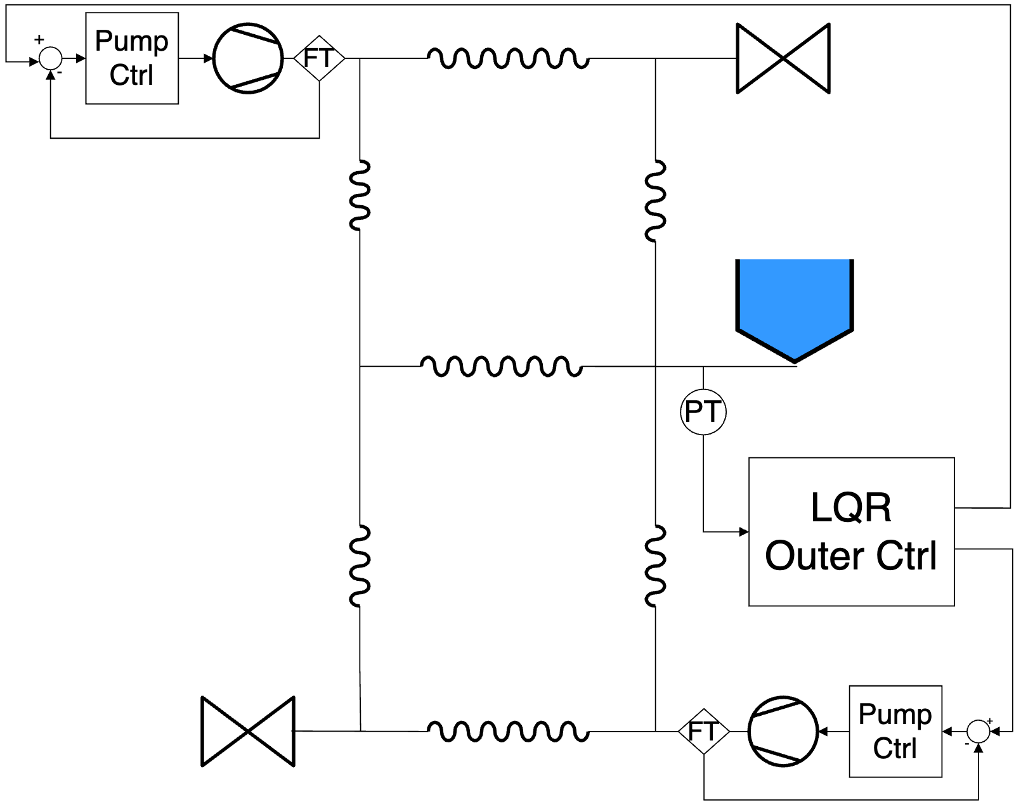
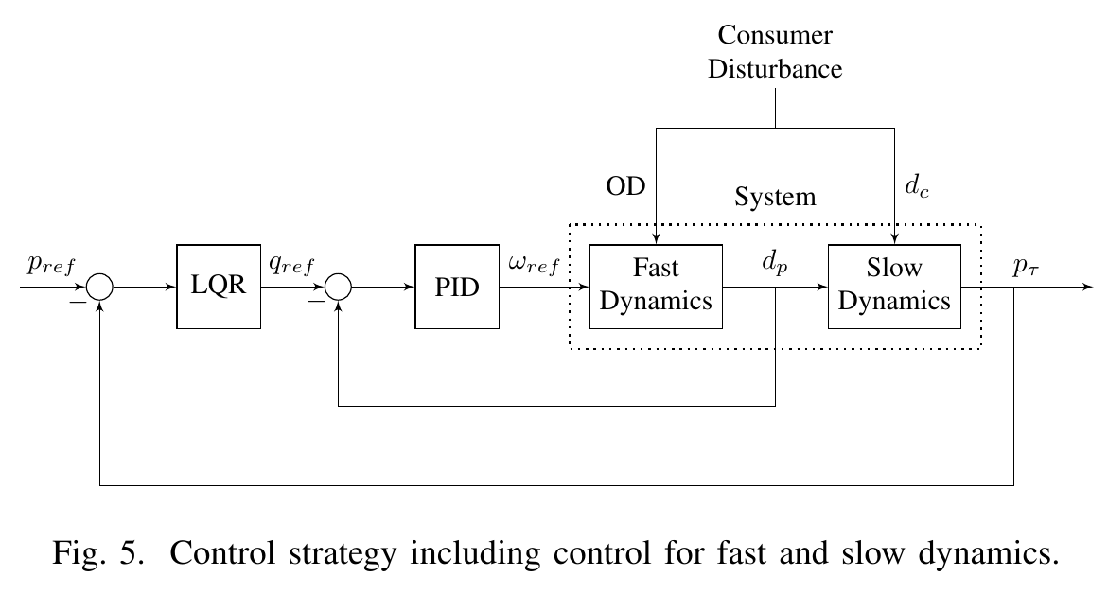
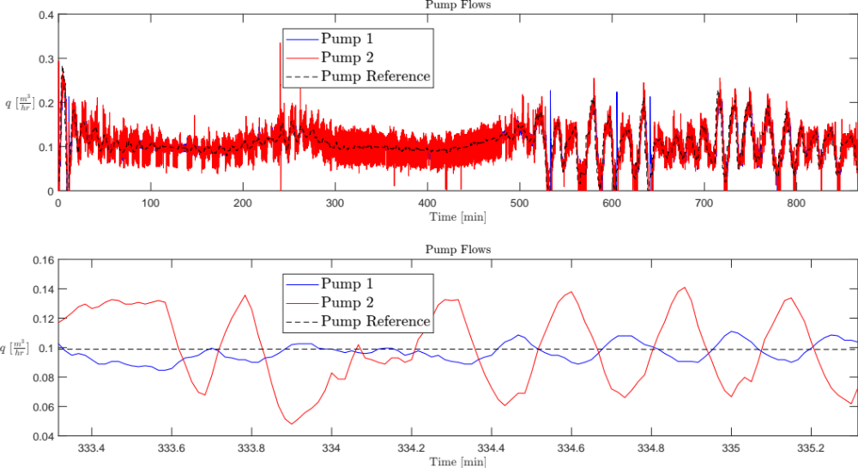
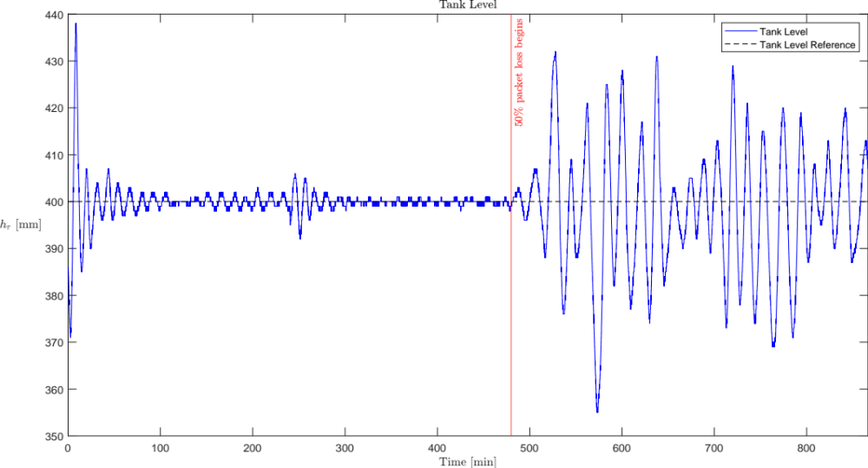
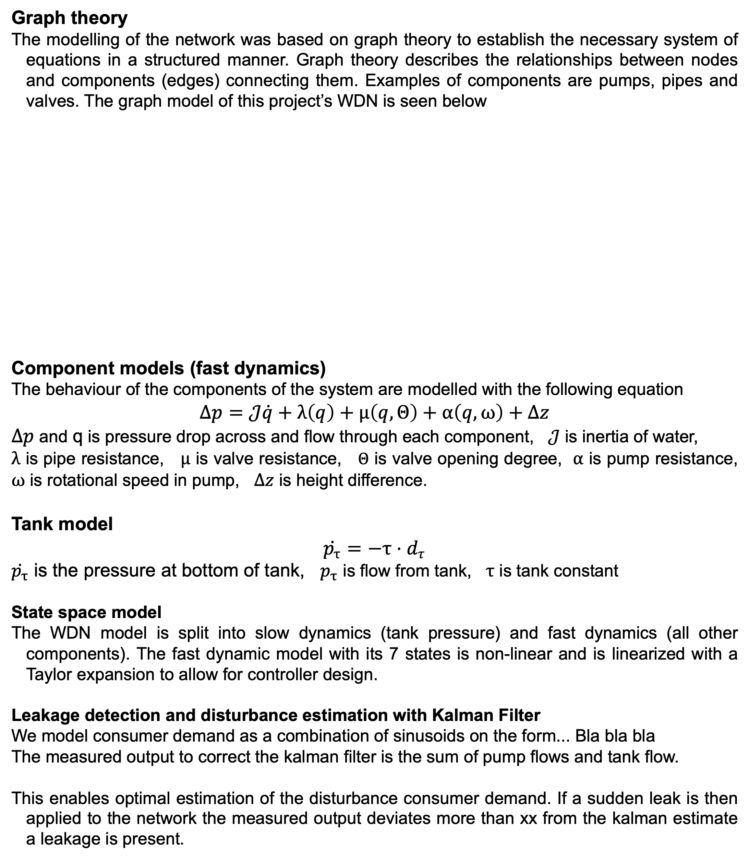
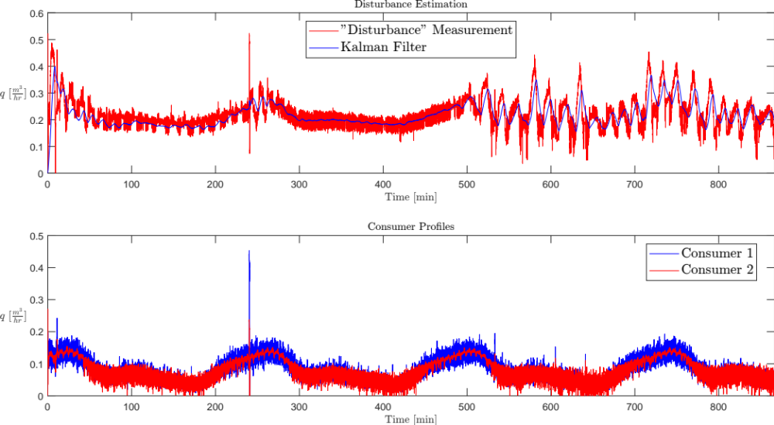
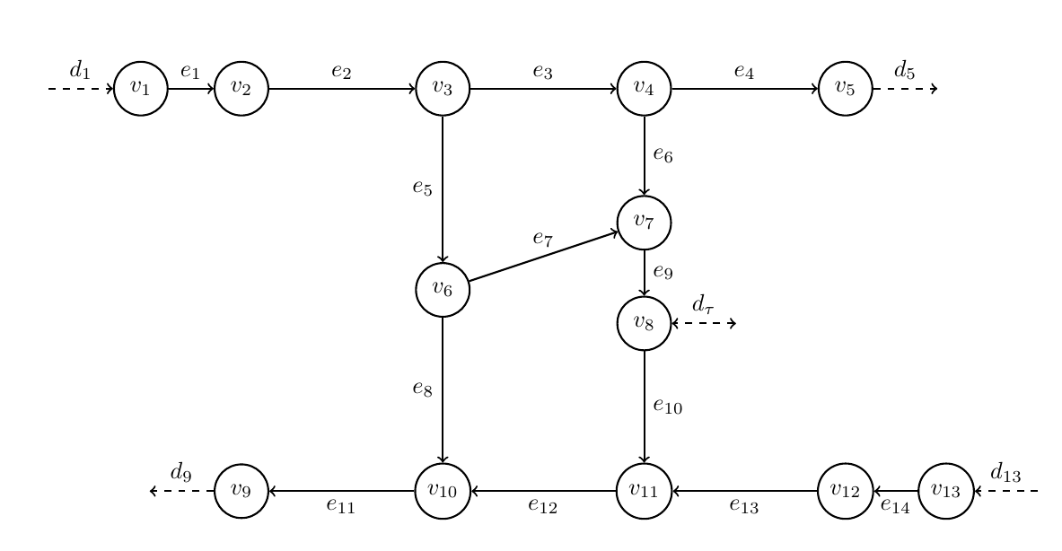
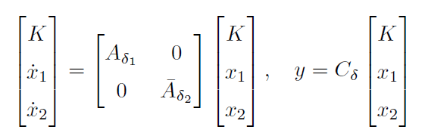
WDN …
Subtitle goes here
Continues if neccessary
Controller and filter design
The outer-loop tank pressure controller is implemented with a Velocity-Form Linear Quadratic Regulator (VF LQR). To achieve optimal control with integral action which insures no steady state error.
The root locus method was used for design of the inner-loop pump PI controllers. The transfer matrix of the linearized model indicated low coupling between the pumps enabling decentrailzed control.
The pumps have a four second time delay which was modeled with a second order padé approximation.
Kalman filter implementaion – stuff from jeppe and laurits
FFT on comsumer data for modelling consumer model
Iterative weights on covariances to tune to enable leakage detection
Consumer flow is feed forward to the LQR controller ☺
Oscillations in the tank pressure occured as a result of poor interaction between the outer-loop controller and the consumer flow estimated by the Kalman filter.
Author names
Address, Department of Electronic Systems, Aalborg University, Denmark
Introduction and System Abstraction
Motivation
A reliable Water Distribution Network (WDN) is a pivotal part of any developed society. The objective of this project is, firstly, to both optimize the WDN control resulting in improvement in consumer experience and decreased strain on WDN components. Secondly leakage detection is introduced.
Problem formulation
Water distribution network with high reliability
Constant pressure for consumers
Less strain on pipes (cost reductions in long term)
Leakage detection
Reliability (communication issues)
On figure xx the WDN network along with the proposed control structure is seen
Results
After 4h system leakage is simulated. After 8h 50% packet loss is introduced in outer loop
On figure xx the system control structure is seen
Inner Loop LQR control: The LQR controller follows constant tank pressure difference, starting 15 mm below reference.
Outer loop Pump control:
Modelling approach (methods)
Consumer flow (disturbance) estimation: The kalman filter
Vis at LQR virker –
Vis synkronisering mellem Kalman og LQR?
Vis at inner controllers virker ( kobling)
Vis at leakage detection virker
Discussion
May be some text in bullet form:
Disturbance estimation with Kalman filter (For feed-forward?)
Package loss simulation (sensitivity to packet losses)
Cascaded control!!!!!!! (slow and fast dynamics are separated)
Linearisation
Synchronisation between Kalman and LQR
Padé approximation influence on inner loop
Leakage detection limitations (leakage has to be sudden and large)
Diagonalized system when linearised but not so much in realitiy
Conclusions
Emphasize what is the main contribution of your work and it’s originality
References
TBD

