Slide 1

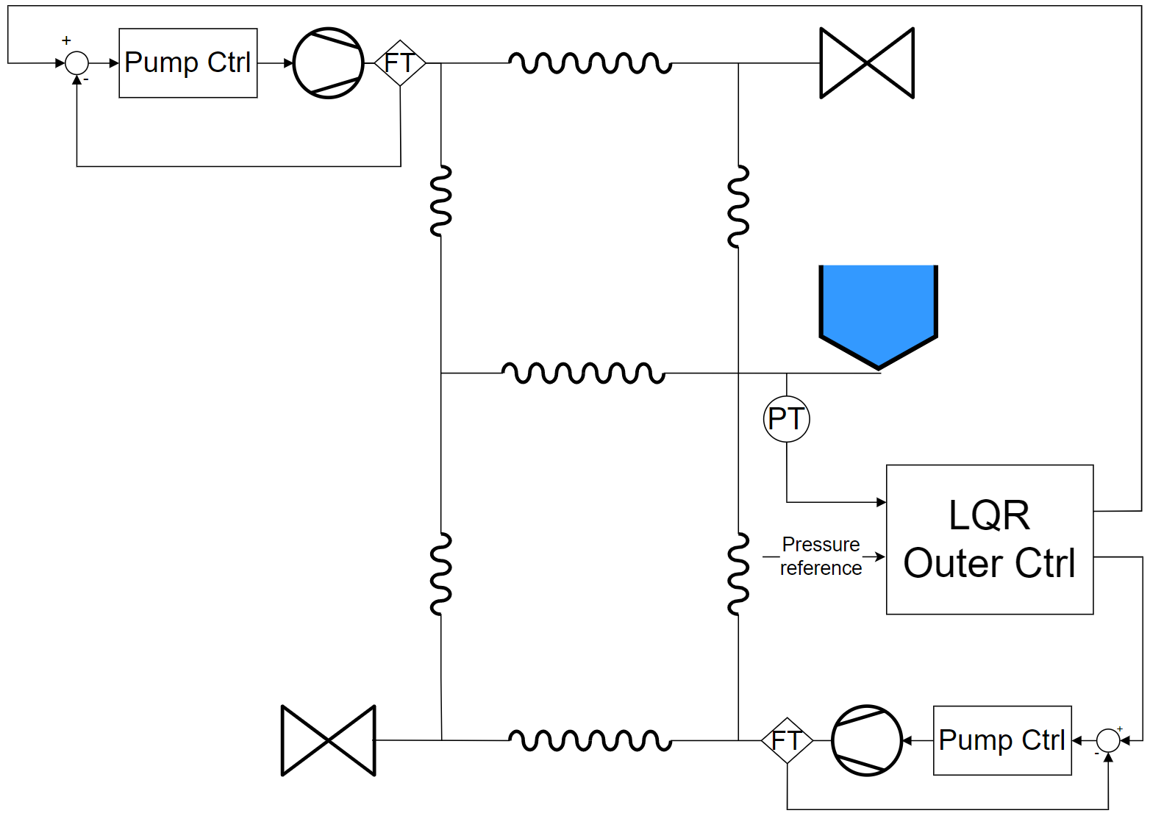
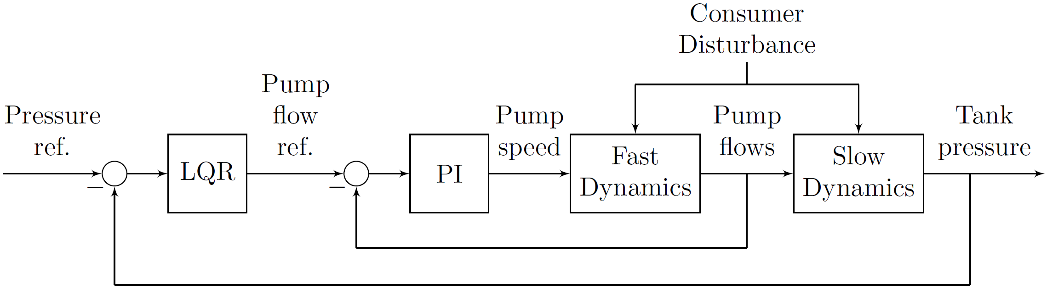
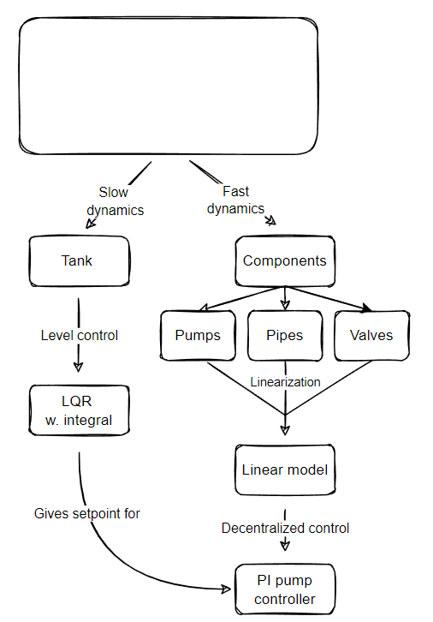
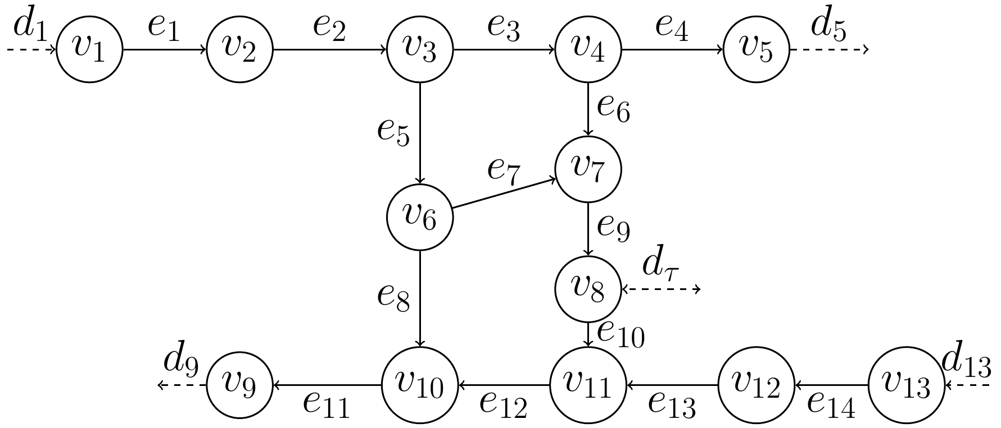
Author names
Address, Department of Electronic Systems, Aalborg University, Denmark
WDN …
Subtitle goes here
Controller and filter design
Introduction and System Abstraction
- Outer loop tank pressure control implemented with LQR with integral action
Inner loop pump controllers made with the Root Locus design method.
Linearized transfer matrix indicated low coupling between pumps
Plot of transfer matrix
- Four second time delay modelled with second order padé approximation
FFT of consumer data used to create model of consumption pattern for Kalman Filter
Estimated consumer flow is fed forward to LQR controller
- Interaction between (stiff) Kalman filter and slow LQR controller resulted oscillations:
- Plot of Kalman-LQR oscillations
Motivation
A reliable Water Distribution Network (WDN) is a pivotal part of any developed society. The objective of this project is, firstly, to both optimize the WDN control resulting in improvement in consumer experience and decreased strain on WDN components. Secondly leakage detection is introduced.
Problem formulation
How can a reliable networked controller for the WDN be
implemented that delivers constant pressure control?
Graph theory
Decentralized control
Here goes text
Bode plot
Kalman filter
FFT of consumer data
Root locus
Modelling approach (methods)
Oscillations
Here goes text
Syncronization
- Modeling of network was based on graph theory.
Slow and fast dynamics are separated for cascaded control
Slow dynamics from tank dynamics
Fast dynamics from pipe inertia
valves, pumps and pipes includes static resistances
Model is non-linear.
Linearised with Taylor expansion
Leakage detection and disturbance estimation with Kalman filter.
Consumer flow is not realisticly measured
Stiff kalman filter allows for leakage detection
Input is based on mass conservation – what comes in and must come out
Results
After 4h system leakage is simulated. After 8h 50% packet loss is introduced in outer loop
Inner Loop LQR control: The LQR controller follows constant tank pressure difference, starting 15 mm below reference.
Outer loop Pump control:
Consumer flow (disturbance) estimation: The Kalman filter tracking based on model and measurement data
Leakage detection: The big difference between the measured consumer flow and the Kalman Filter esitmate indicates a leakage
- Insert Kalman filter and LQR controller oscillations from incorrect tuning
Discussion
Conclusions
Disturbance estimation with Kalman filter for feed forward to LQR requires increase of controller bandwidth to avoid synchronisation.
Kalman filter has to be stiff/slow to allow for leakage detection – limits disturbance estimation.
Increased LQR bandwidth decreases the time separation between inner and outer loop, suggesting cascaded control may be worse off than intended.
Delay not is in simulation – could be cause of oscillations in for pump controllers. Coupling lost between pumps seen in lab must have been lost in linearisation.
Reliability of system due to package loss suggests marginally stable system.
Emphasize what is the main contribution of your work and it’s originality
References
TBD

