Slide 1

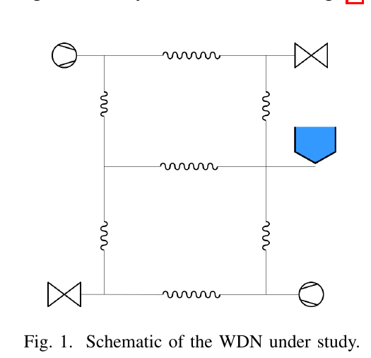
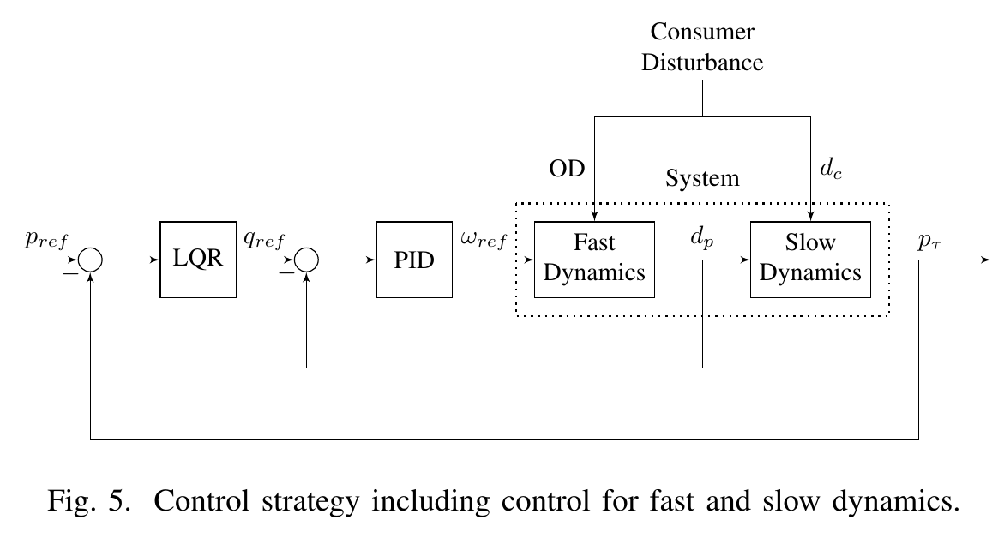
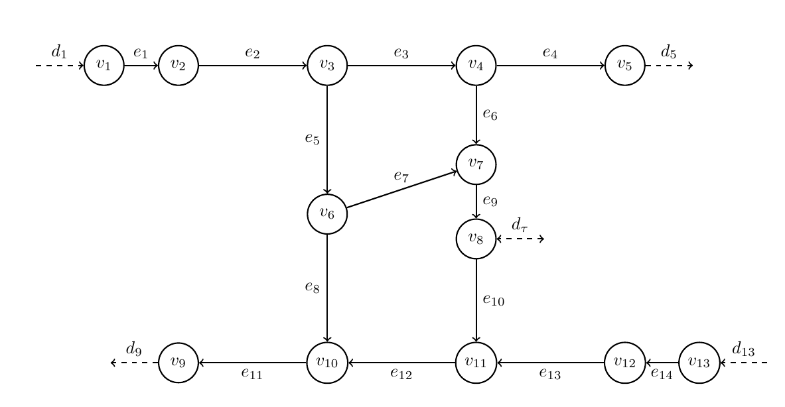

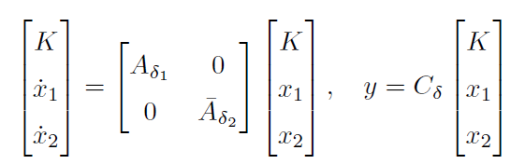
Controller and filter design
Title goes here
Subtitle goes here
Continues if neccessary
The outer-loop tank pressure controller is implemented with a Velocity-Form Linear Quadratic Regulator (VF LQR). To achieve optimal contorl with integral action which insures no steady state error.
The root locus method was used for design of the inner-loop pump PI controllers. The transfer matrix of the linearized model indicated low coupling between the pumps enabling decentrailzed control.
The pumps have a four second time delay which was modeled with a second order padé approximation.
Kalman filter implementaion – stuff from jeppe and laurits
FFT on comsumer data for modelling consumer model
Iterative weights on covariances to tune to enable leakage detection
Consumer flow is feed forward to the LQR controller ☺
Oscillations in the tank pressure occured as a result of poor interaction between the outer-loop controller and the consumer flow estimated by the Kalman filter.
Author names
Address, Department of Electronic Systems, Aalborg University, Denmark
Introduction and
System Abstraction
Motivation
A reliabile water distribution network (WDN) is a pivotal part of any developed society. This study aims to further develop upon the foundation of a WDN on several fronts. This is done by optimizing the controls of the WDN and by introducing detection of leakages. The aim is to improve consumer experience and decrease strains on WDN to reduce costs and there enable greater acces to clean water and sanitation (FNs verdensmål nr 17)
Problem formulation
Water distribution network with high reliability
Constant pressure for consumers
Less strain on pipes (cost reductions in long term)
Leakage detection
Reliability (communication issues)
Picture of system (ala graph, with illustration of components)
Illustration of controller structure.
Vis at LQR virker –
Vis synkronisering mellem Kalman og LQR?
Vis at inner controllers virker ( kobling)
Vis at leakage detection virker
Results
Further explanation, emphasizing focus of the paper
Modelling approach (methods)
Graph theory
Graph theory describes the relationships between
Nodes and components (edges) connecting them.
Examples of components are pumps, pipes
and valves.
The modelling of the network was based
on graph theory to establish the
necessary system of equations in a
structured manner (KVL and KCL)
Component models (fast dynamics)
The components of the system are modelled
with the following equation
Where J is pipe inertia , lambda is pipe resistance
Alpha is pump resistance, mu is valve resistance,
h is height difference. Delta p is pressure drop across
Each compoenent, q is flow in component, omega is
rotational speed in pump.
Tank model
d_tau is flow from tank, tau is tank constant, p_tau_dot is rate of change of pressure at tank bottom??
State space (splitting fast and slow dynamics)
The model ends up non-linear. Therefore it is linearised (using buullshit taylor) to enable a linear representation of the system to allow for controller design.
Bring more narrow graph model with bigger font/text
Leakage detection and disturbance estimation with Kalman Filter
We model consumer demand as a combination of sinusoids on the form... Bla bla bla
The measured output to correct the kalman filter is the sum of pump flows and tank flow.
This enables optimal estimation of the disturbance consumer demand. If a sudden leak is then applied to the network the measured output deviates more than xx from the kalman estimate a leakage is present.
Discussion
May be some text in bullet form:
Disturbance estimation with Kalman filter (For feed-forward?)
Package loss simulation (sensitivity to packet losses)
Cascaded control!!!!!!! (slow and fast dynamics are separated)
Linearisation
Synchronisation between Kalman and LQR
Padé approximation influence on inner loop
Leakage detection limitations (leakage has to be sudden and large)
Diagonalized system when linearised but not so much in realitiy
Conclusions
Emphasize what is the main contribution of your work and it’s originality
References
TBD

