Slide 1
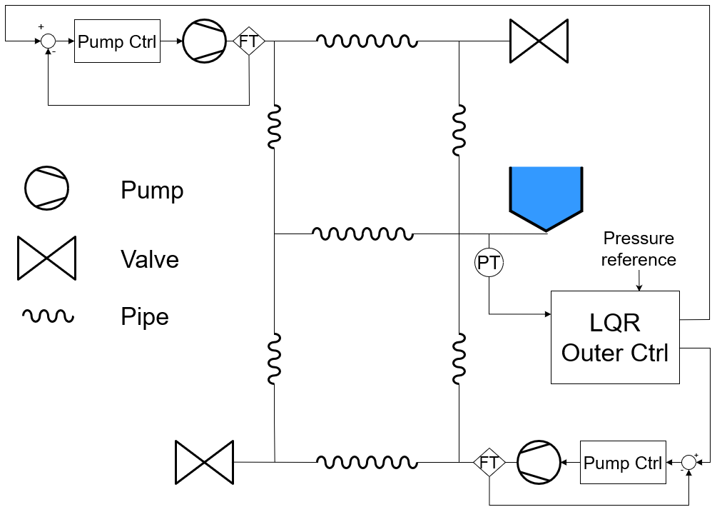
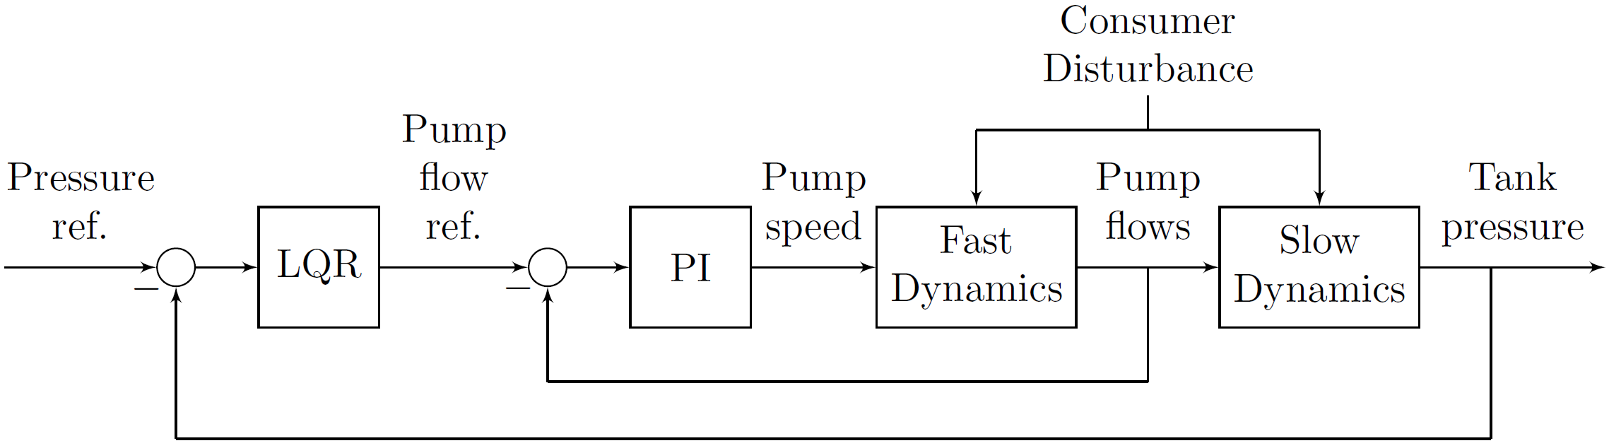
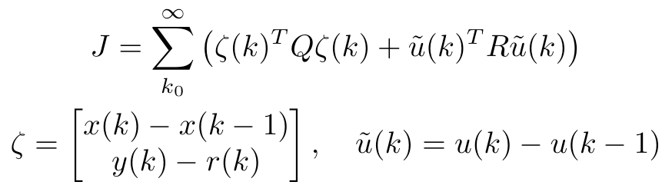
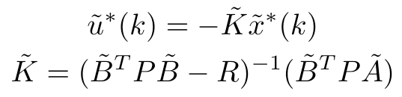
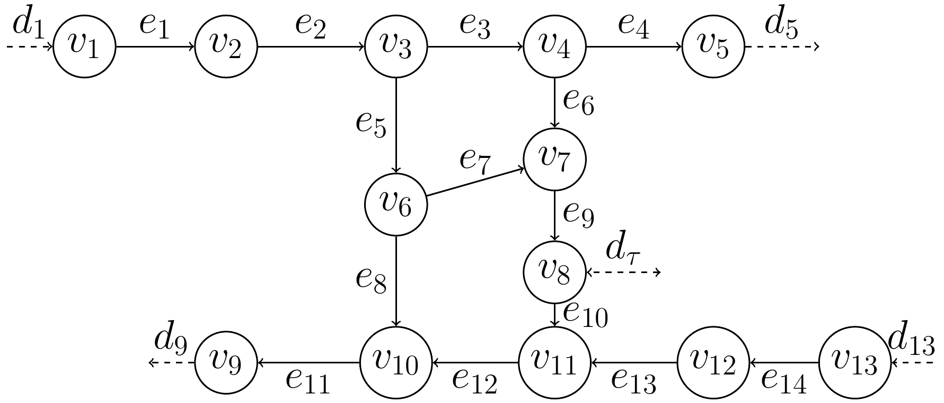
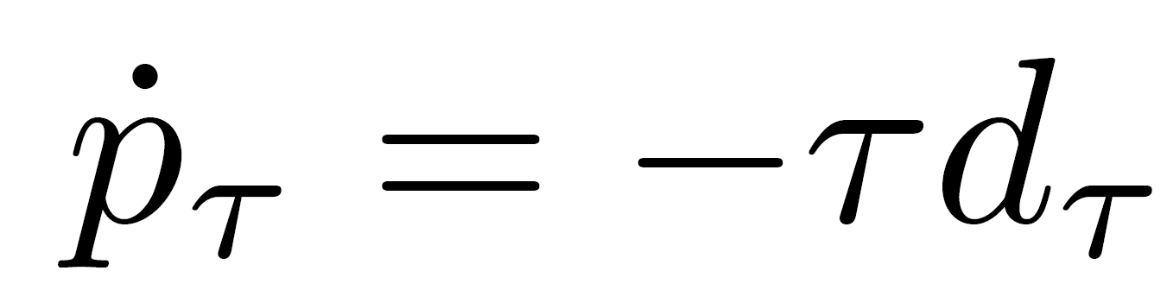
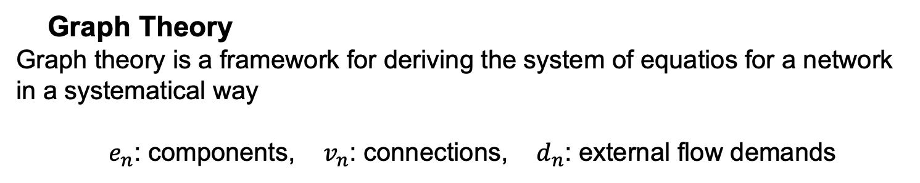
MODELLING AND NETWORKED CONTROL OF WATER DISTRIBUTION NETWORKS
Authors: L. H. Andersen, M. C. Frederiksen, C. M. Jensen, J. N. Jensen, R. L. Kristiansen, K. Laustsen and M. H. Therkildsen
GROUP NO.: 733
Department of Electronic Systems, Aalborg University, Denmark
Introduction and System Abstraction
Motivation
A reliable Water Distribution Network (WDN) is a pivotal part of any developed society. The objective of this project is, firstly, to both optimize the WDN control resulting in improvement in consumer experience and decreased strain on WDN components. Secondly leakage detection is introduced.
Problem formulation
How can a reliable networked controller for the WDN be implemented that delivers constant pressure control?
Graph Theory
Graph theory is a framework for deriving the system of equatios for a network in a systematical way
$e_{n}$: components, $v_{n}$: connections, $d_{n}$: external flow demands
Modelling, design
Controller choices
LQR controller with integral action
Transfer matrix for the two pumps indicate low coupling, allowing for decentralized control.
Kalman filter for leakage detection and disturbance estimation
Consumer flow is not realistically measured
Stiff kalman filtering allows forleakage detection and disturbance estimation
Input is based on mass conservation: What comes in must come out
Coupling between controller and estimator
LQR and Kalman needs to be decoupled in time otherwise -> coupled oscillators
We discovered this the hard way:
Root locus method
Identical controller for both pumps
Implemented as PI
Designed with root locus
Time delay modelled w. pade approximation
Model was inaccurate -> manual tuning in lab
Reliability of Networked control
Decentralised controller not impacted by network problems
LQR controller with Try-Once-Discard Protocol enables stable system for arbitrary amount of package loss in the mean square sense. The reference may oscillate but it the mean of the oscillations will be the reference.
Results
After 4h system leakage is simulated. After 8h 50% packet loss is introduced in outer loop
Outer Loop LQR control
Follows constant tank pressure difference, starting 15 mm below reference.
Leakage detection
Difference between measured consumer flow and estimate indicates leakage
Consumer flow (disturbance) estimation
The Kalman filter tracking based on model and measurement data
Inner loop Pump control
Pumps attempt to follow their reference
Discussion
Conclusions
Disturbance estimation with Kalman filter for feed forward to LQR requires increase of controller bandwidth to avoid synchronisation.
Kalman filter has to be stiff/slow to allow for leakage detection – limits disturbance estimation.
A leakage has to be sudden and large to be detectable.
Increased LQR bandwidth decreases the time separation between inner and outer loop, suggesting cascaded control may be worse off than intended.
Delay not is in simulation – could be cause of oscillations in for pump controllers. Coupling lost between pumps seen in lab must have been lost in linearisation.
Reliability of system due to package loss suggests marginally stable system.
﻿A cascaded control structure consisting of an outer LQR and inner PI-controllers as well as leakage detection and disturbance estimation with Kalman filter, is proposed for regulation of pressure.
Despite model uncertainties and difficulties with the WDN including pump delays and coupling and slower dynamics an efficient and stable controller was implemented.
References

