Slide 1

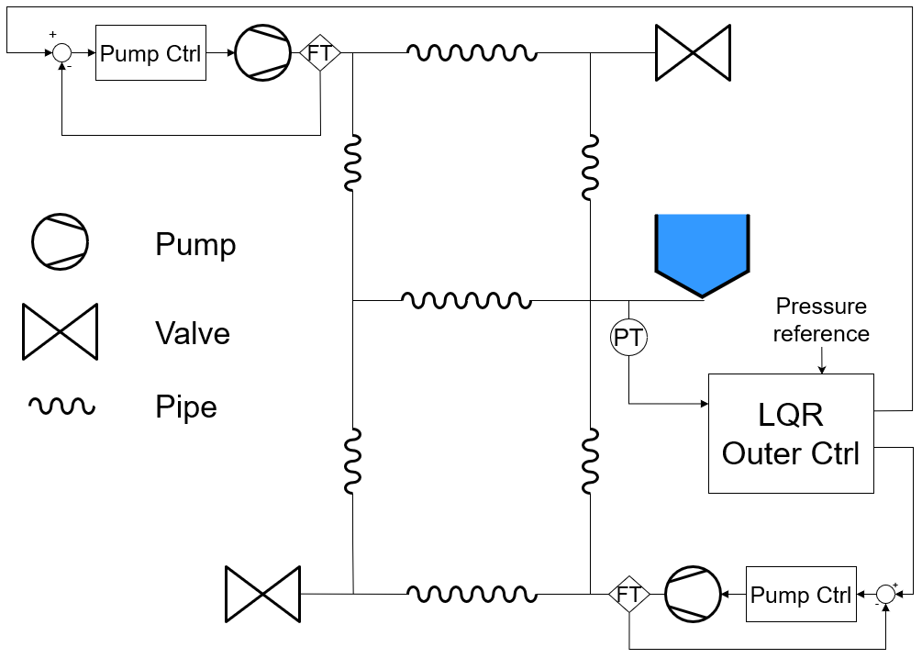
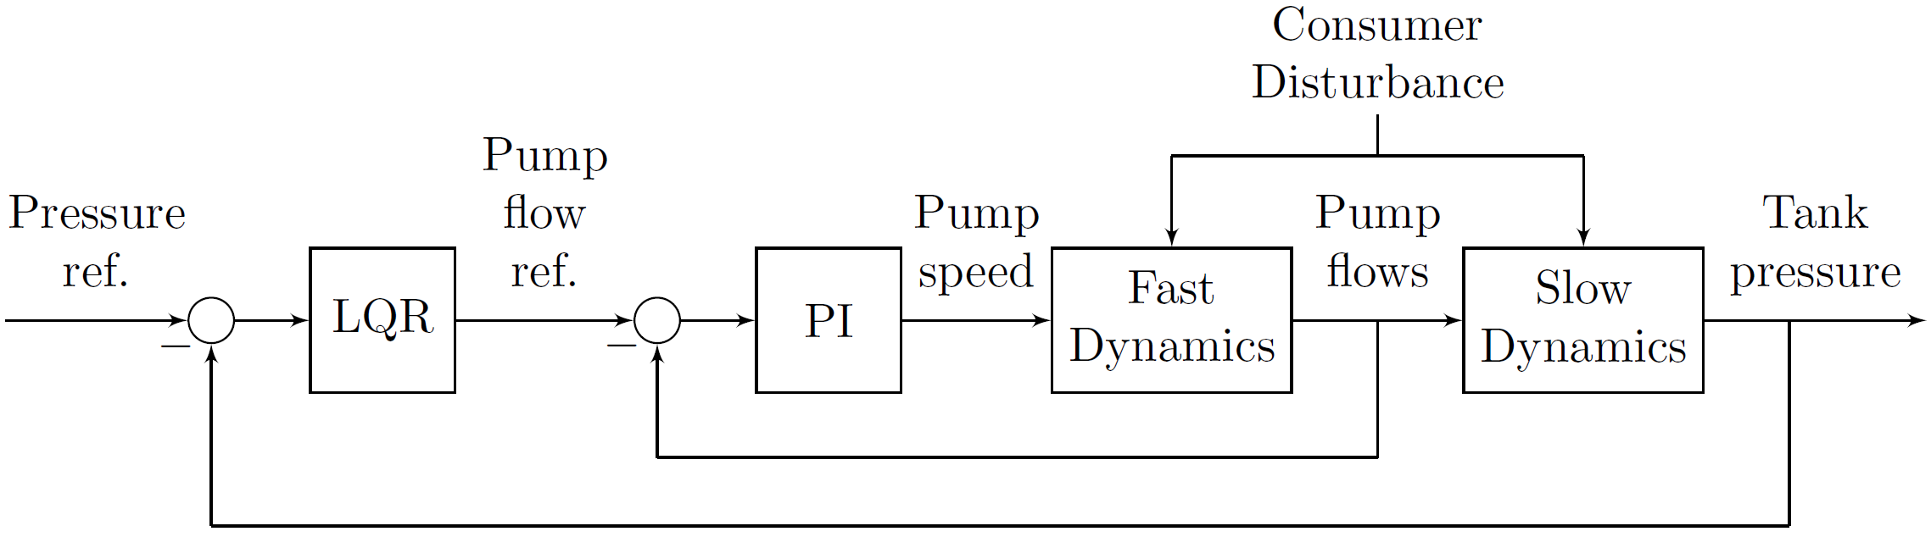
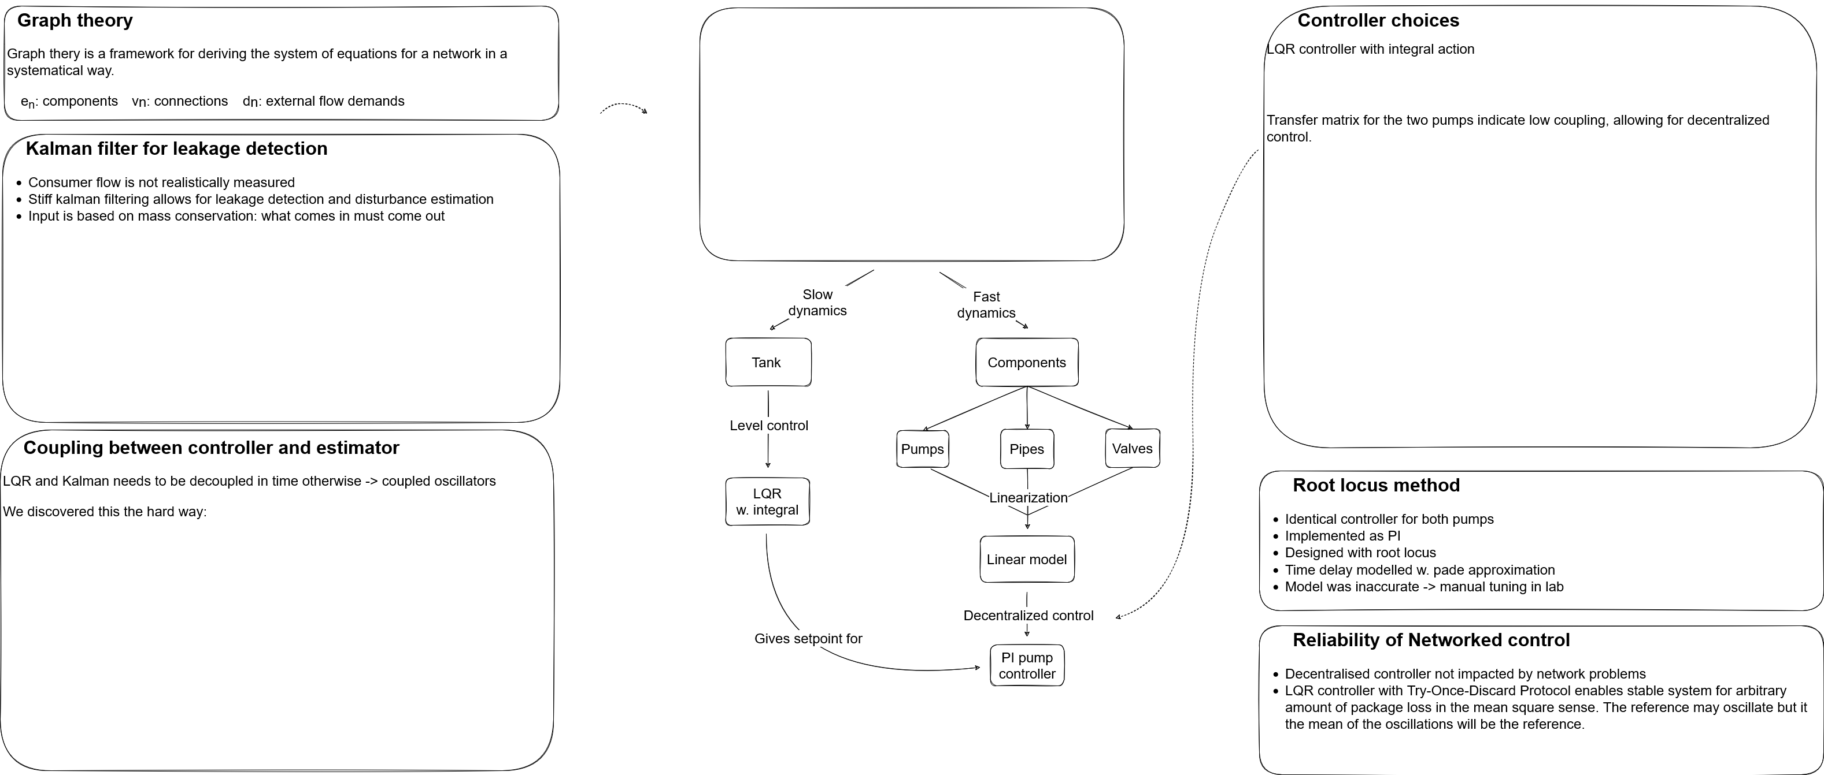
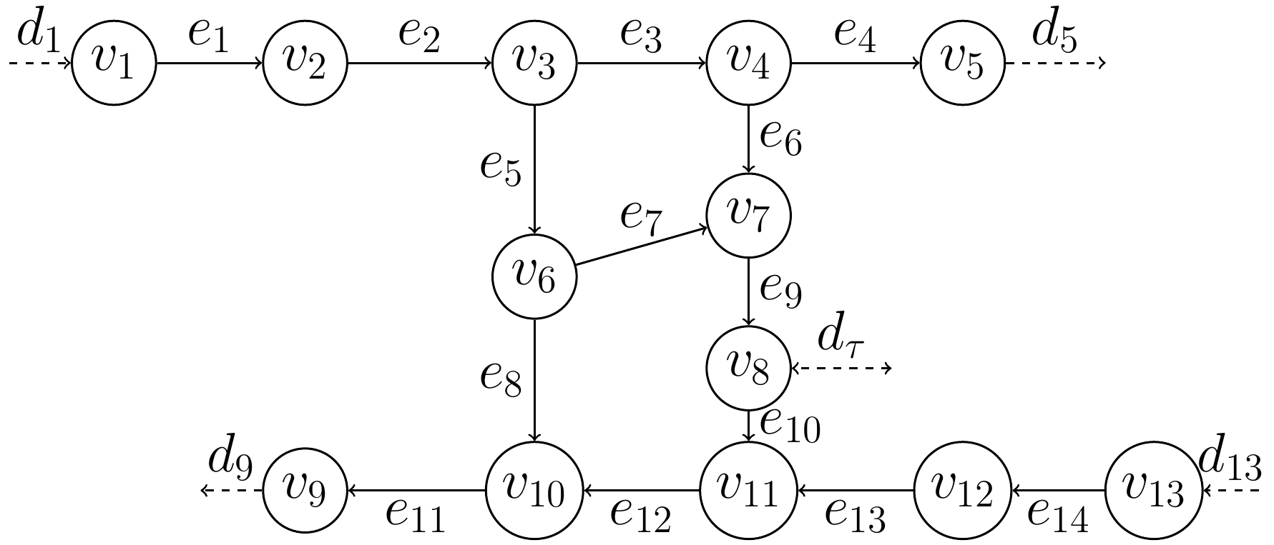
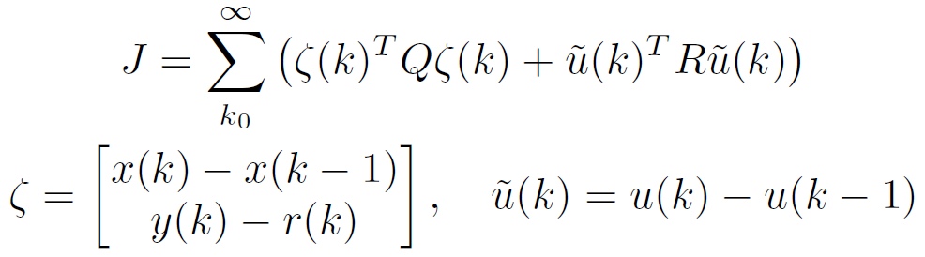
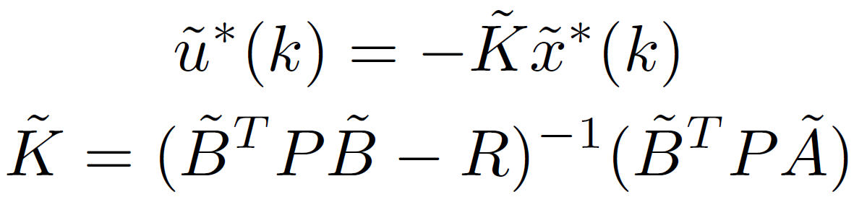
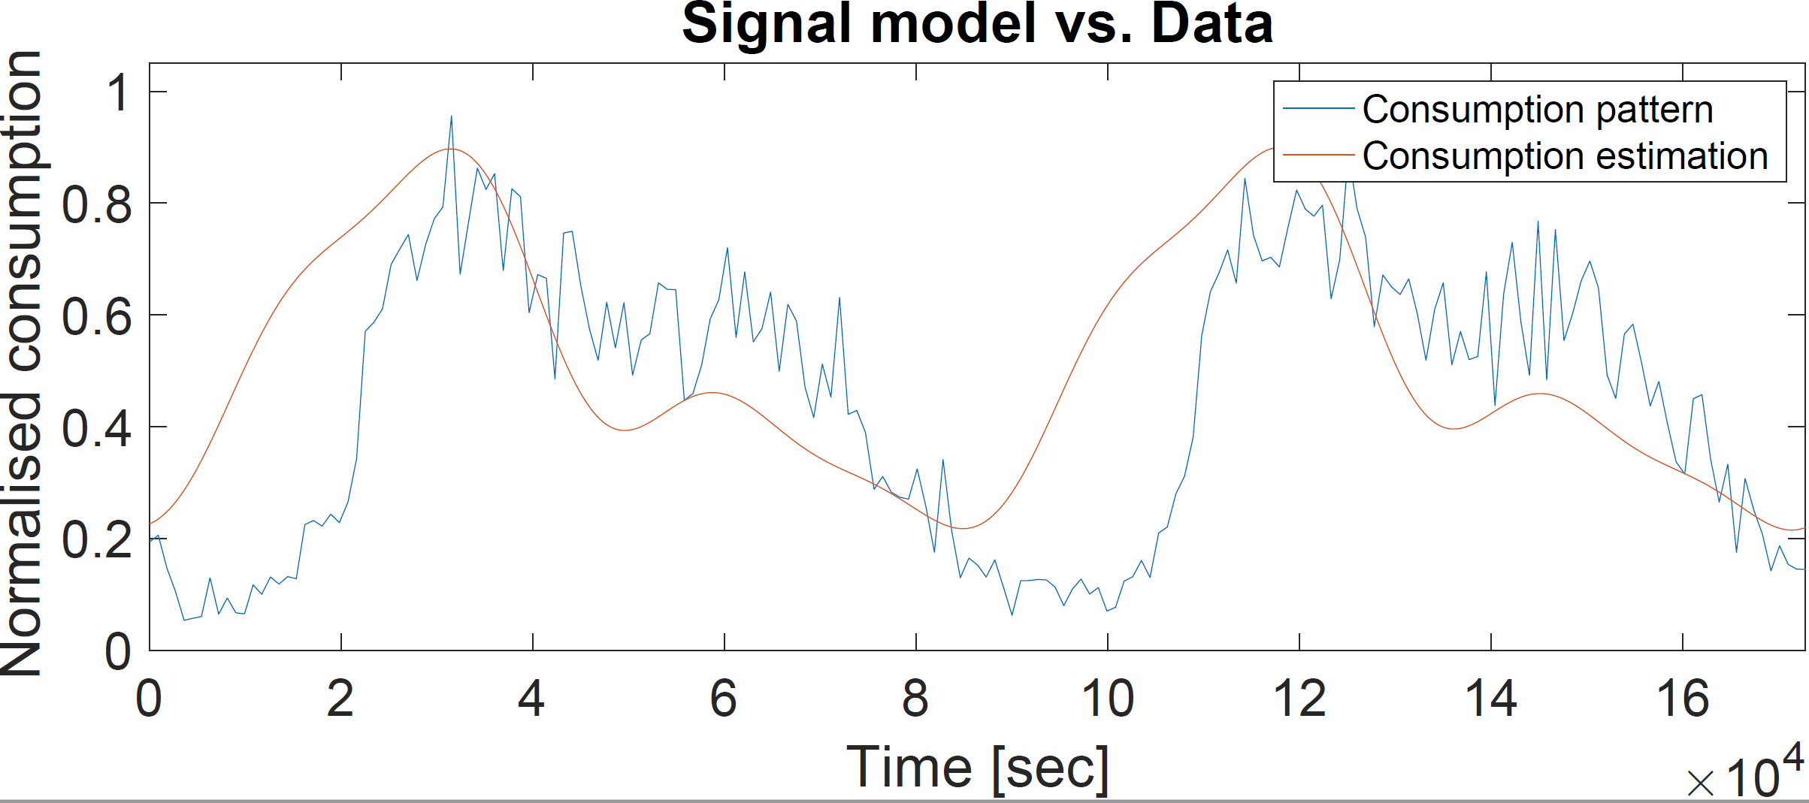
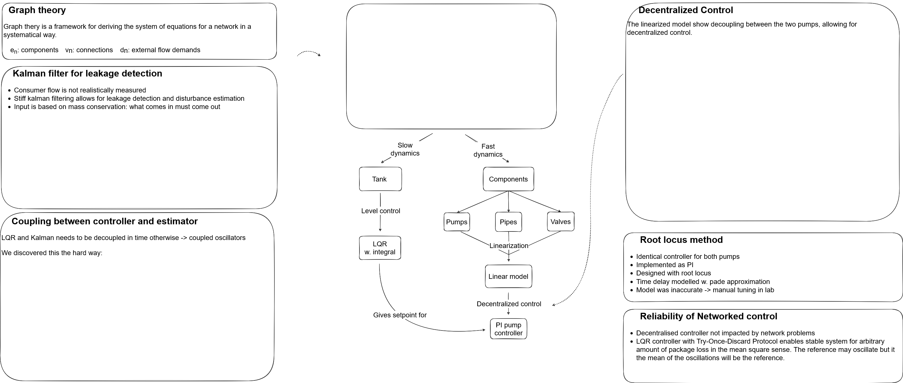
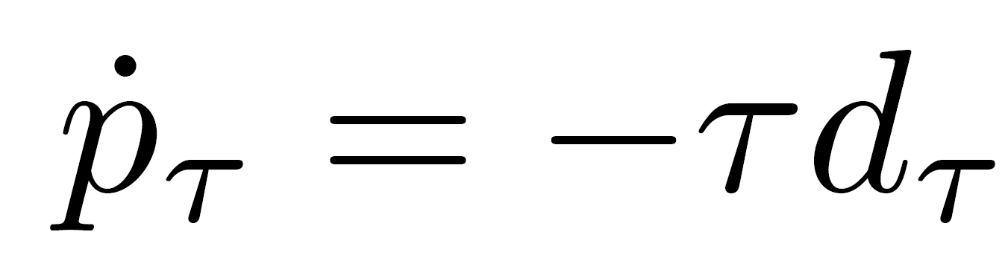
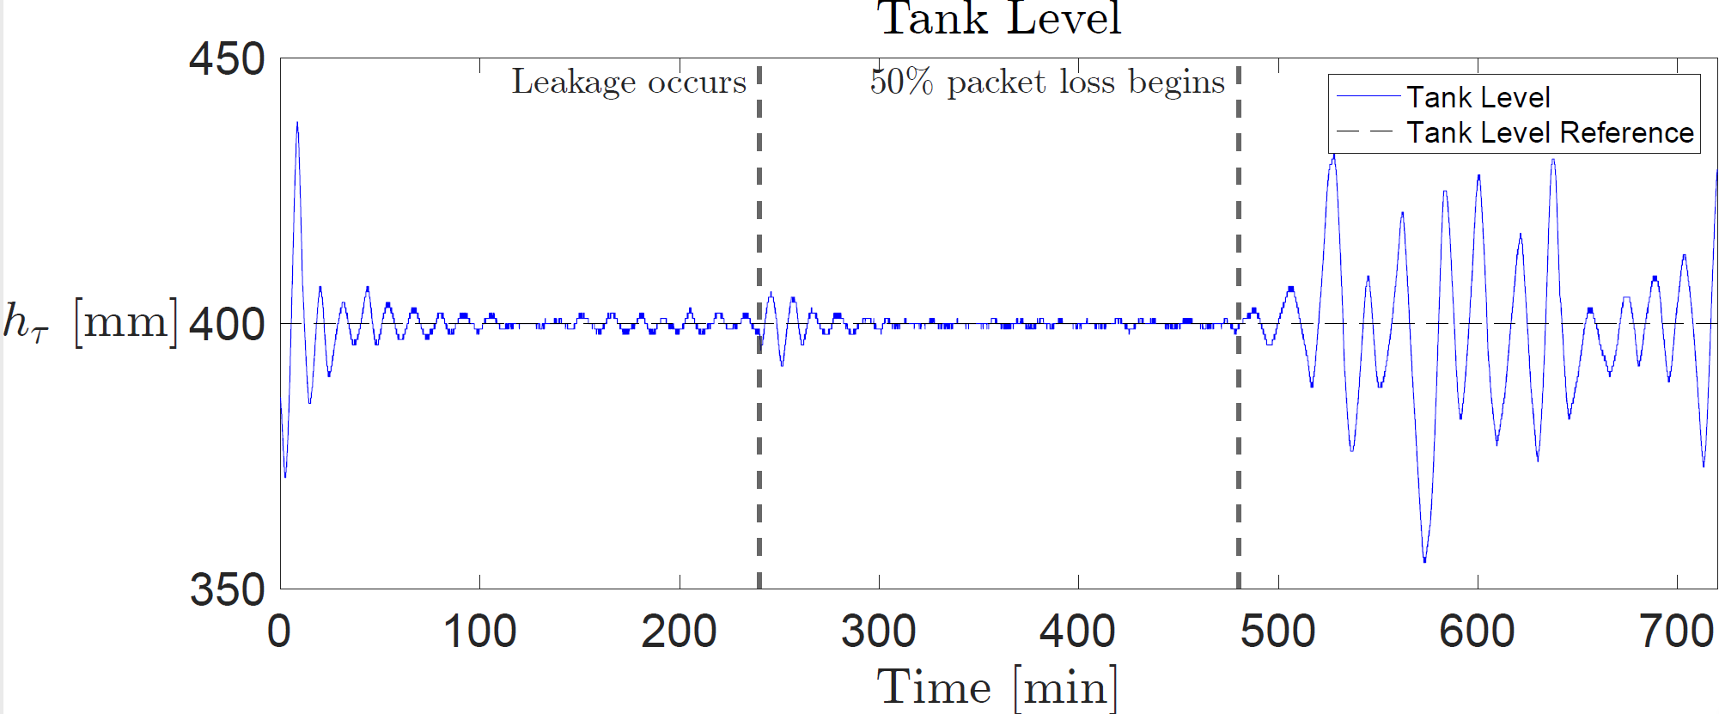
Author names
Address, Department of Electronic Systems, Aalborg University, Denmark
WDN …
Subtitle goes here
Controller and filter design
Introduction and System Abstraction
- Outer loop tank pressure control implemented with LQR with integral action
Inner loop pump controllers made with the Root Locus design method.
Linearized transfer matrix indicated low coupling between pumps
Plot of transfer matrix
- Four second time delay modelled with second order padé approximation
FFT of consumer data used to create model of consumption pattern for Kalman Filter
Estimated consumer flow is fed forward to LQR controller
- Interaction between (stiff) Kalman filter and slow LQR controller resulted oscillations:
- Plot of Kalman-LQR oscillations
Motivation
A reliable Water Distribution Network (WDN) is a pivotal part of any developed society. The objective of this project is, firstly, to both optimize the WDN control resulting in improvement in consumer experience and decreased strain on WDN components. Secondly leakage detection is introduced.
Problem formulation
How can a reliable networked controller for the WDN be
implemented that delivers constant pressure control?
Modelling, design
Modelling approach (methods)
- Modeling of network was based on graph theory.
Slow and fast dynamics are separated for cascaded control
Slow dynamics from tank dynamics
Fast dynamics from pipe inertia
valves, pumps and pipes includes static resistances
Model is non-linear.
Linearised with Taylor expansion
Leakage detection and disturbance estimation with Kalman filter.
Consumer flow is not realisticly measured
Stiff kalman filter allows for leakage detection
Input is based on mass conservation – what comes in and must come out
Results
After 4h system leakage is simulated. After 8h 50% packet loss is introduced in outer loop
Inner Loop LQR control: The LQR controller follows constant tank pressure difference, starting 15 mm below reference.
Outer loop Pump control:
Consumer flow (disturbance) estimation: The Kalman filter tracking based on model and measurement data
Leakage detection: The big difference between the measured consumer flow and the Kalman Filter esitmate indicates a leakage
- Insert Kalman filter and LQR controller oscillations from incorrect tuning
Discussion
Conclusions
May be some text in bullet form:
Disturbance estimation with Kalman filter (For feed-forward?)
Package loss simulation (sensitivity to packet losses)
Cascaded control!!!!!!! (slow and fast dynamics are separated)
Linearisation
Synchronisation between Kalman and LQR
Padé approximation influence on inner loop
Leakage detection limitations (leakage has to be sudden and large)
Diagonalized system when linearised but not so much in realitiy
Emphasize what is the main contribution of your work and it’s originality
References
TBD

