Slide 1
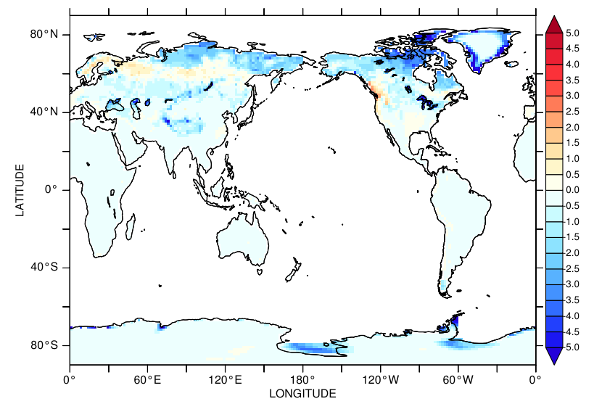
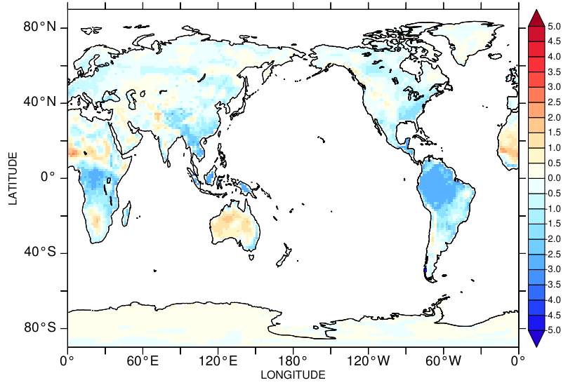
Surface energy budget
JULES 76 year average
Mean = -0.44
CABLE 40 year average
Mean = -0.47
Notes:
Now including melt terms

Slide 2
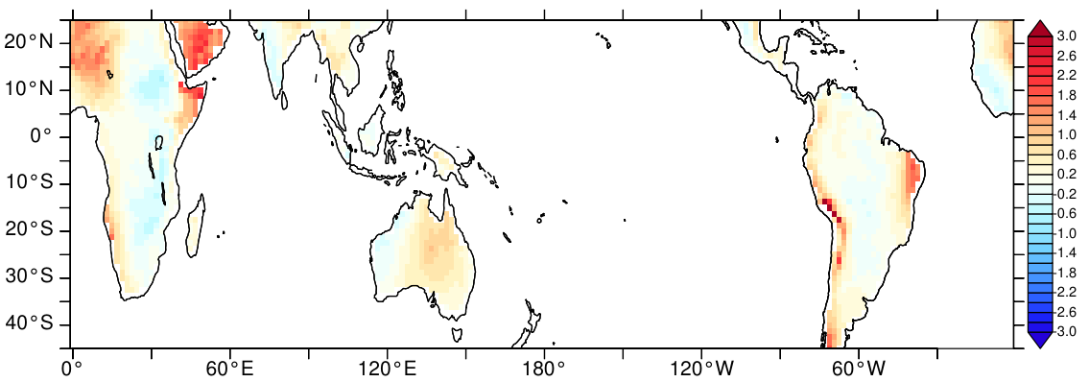
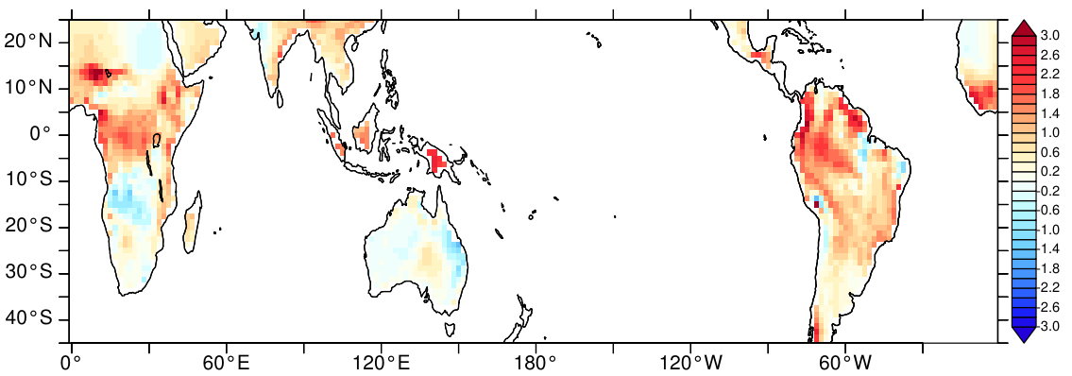
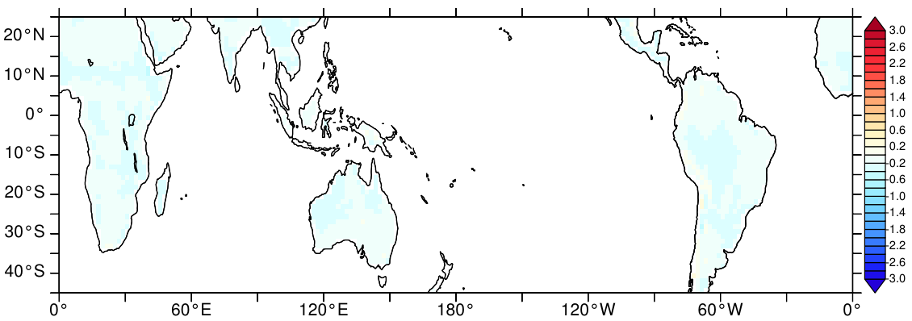
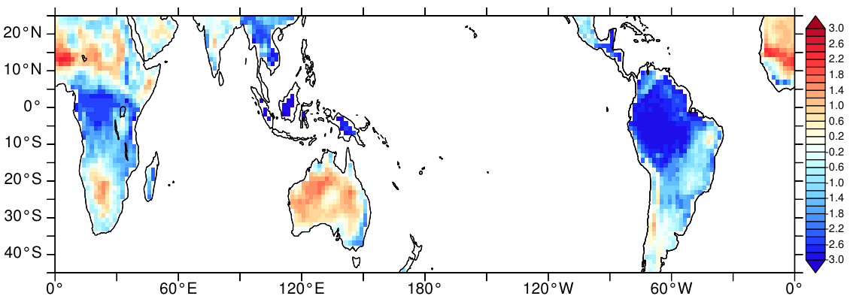
Surface energy budget: PiControl
MOSRS ACCESS-1.0: Mean 0.33, RMS 0.65
CABLE ACCESS-1.3: Mean 0.64, RMS 0.98
JULES ACCESS-CM2: Mean -0.17, RMS 0.19
CABLE ACCESS-CM2: Mean -0.79, RMS 1.57
Notes:
ACCESS CM2 includes snow melt, ACCESS 1.0 and 1.3 do not.

Slide 3
SCM experiments
10 day dry soil with relaxation to atmospheric profile
No cloud or evaporation
Bare soil, grass and forest
Compare CABLE net radiation to UM net radiation
Look at effect of albedo, time step, coupling corrections

Slide 4
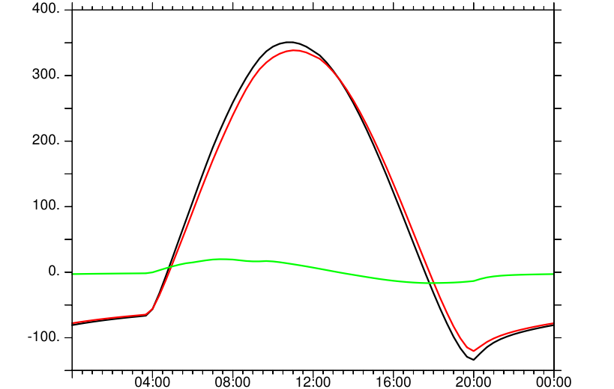
Net radiation
Mean diurnal cycle
UM radiation calculation uses previous step albedo and surface temperature
CABLE also calculates net radiation at end of step
Matches ground flux
Full model uses hourly radiation, but SCM calculates every step
UM net radiation, CABLE net radiation
Difference (UM-CABLE)

Slide 5
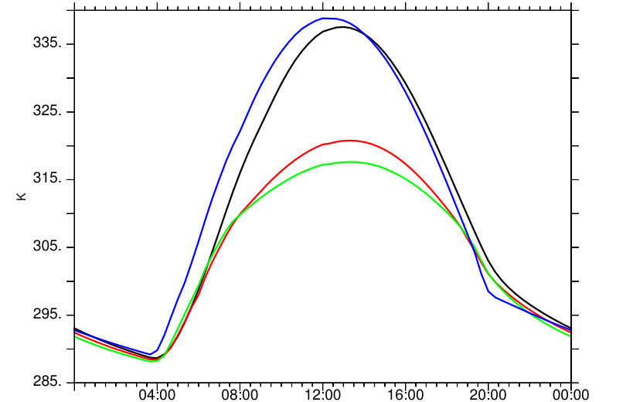
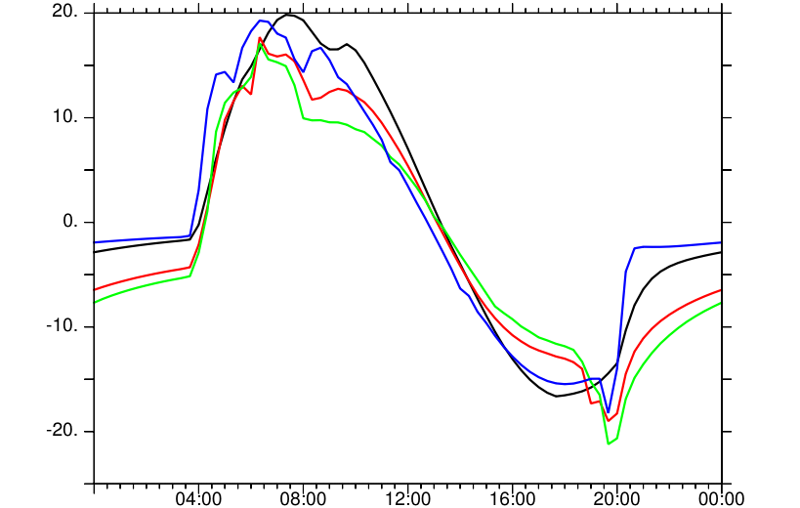
Mean diurnal cycles
Surface temperature
Net radiation error
CABLE bare soil, JULES bare soil
CABLE grass, CABLE forest

Slide 6
Net radiation error
Case | Time mean
CABLE bare soil | 0.25
CABLE grass | -1.66
CABLE forest | -2.32
JULES bare soil | 0.32
CABLE bare soil, JULES bare soil
CABLE grass, CABLE forest

Slide 7
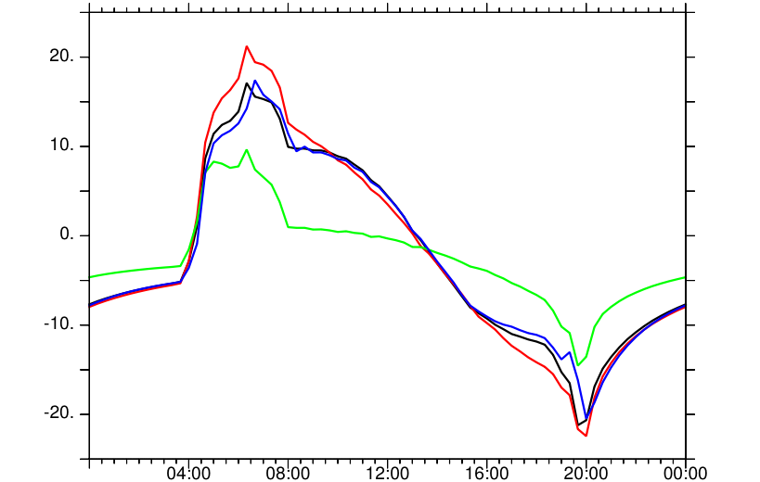
Net radiation error: CABLE forest case
Case | Time mean
Std | -2.32
Constant albedo | -2.24
l_rev_corr=F | -2.32
l_revised_coupling=F | -2.32
Std, constant albedo,
l_rev_corr=F, l_revised_coupling=F

Slide 8
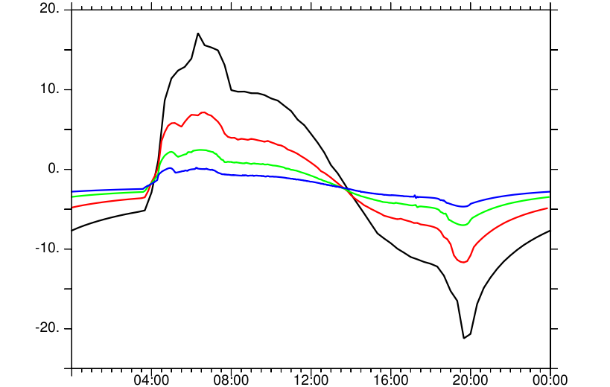
Net radiation error: CABLE forest case
Case | Time mean
Std (1200 s step) | -2.32
600 s step | -2.26
300 s step | -2.21
150 s step | -2.24
Std, 600 s, 300 s, 150 s

Slide 9
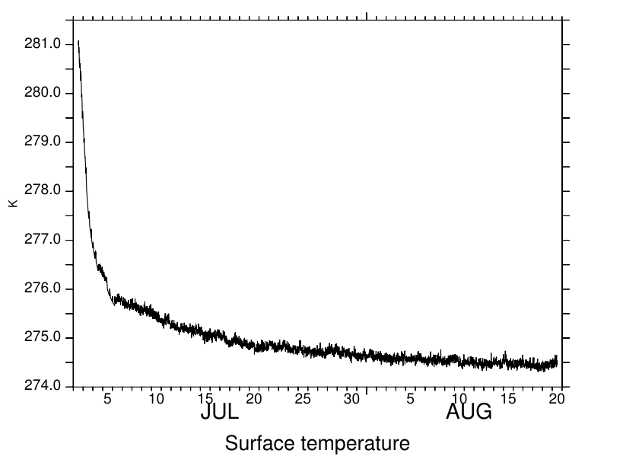
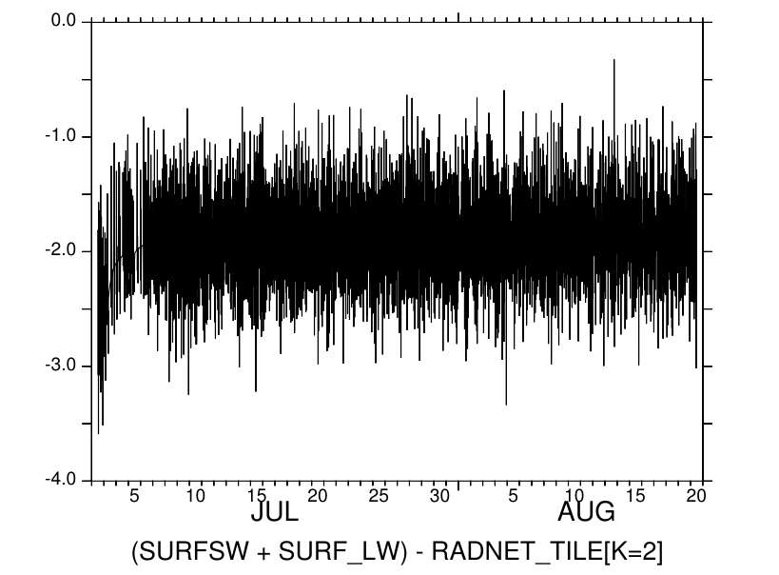
SCM experiments: no solar
Notes:
First day excluded from graphs

Slide 10
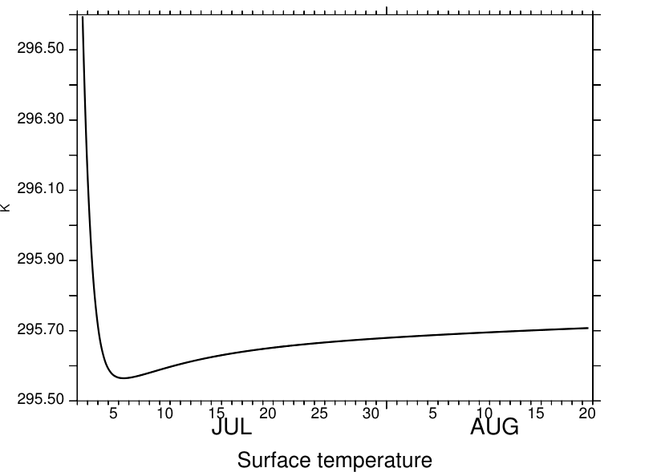
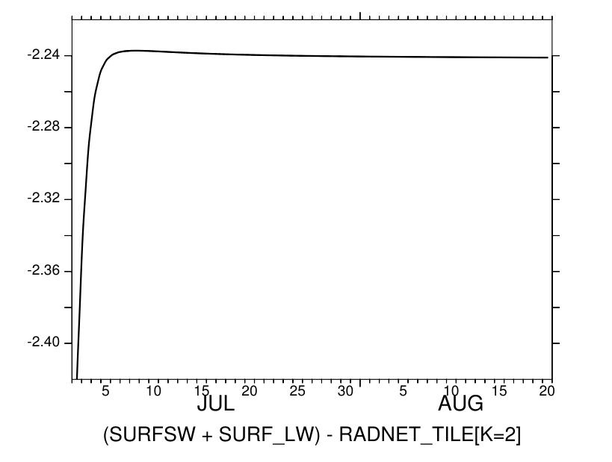
SCM experiments: fixed solar

Slide 11
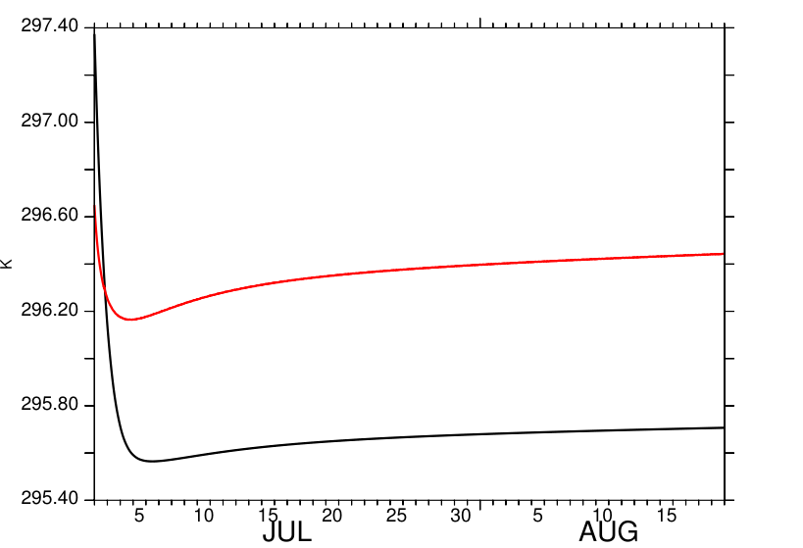
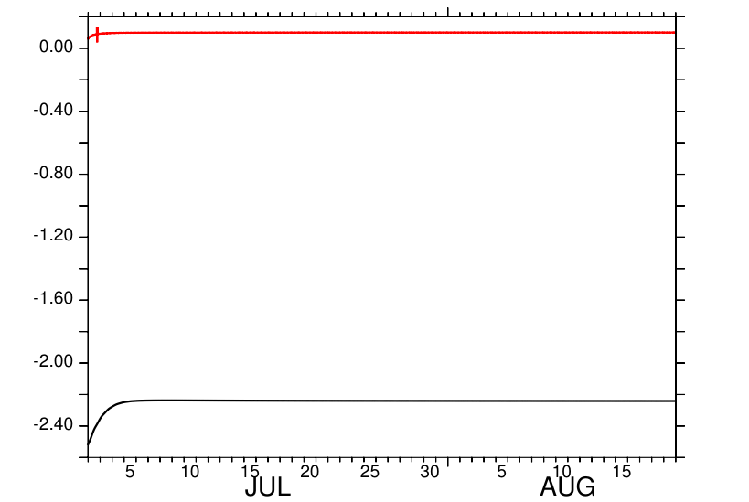
SCM experiments: fixed solar
Surface temperature
Net radiation error
10.6, 7.3

Slide 12
Potential temperature correction
met%tvrad = met%tk
met%tk = met%tk + C%grav/C%capp*(rough%zref_tq + 0.9*rough%z0m)
In SCM tests height term adjustment is 20 m and temperature adjustment is 0.2 K
4 σ T³ ΔT = 1.2 W/m^{2.} Flux change is twice this large because canopy radiates up and down.

Slide 13
Experiments with corrections
Standard code
Remove met%tk adjustment
IH changes to use met%tvrad in radiation calculations
Set met%tvrad = adjusted met%tk
Cases 2, 3, 4 all reduce radiation error to ~ 0.1 W/m²

Slide 14
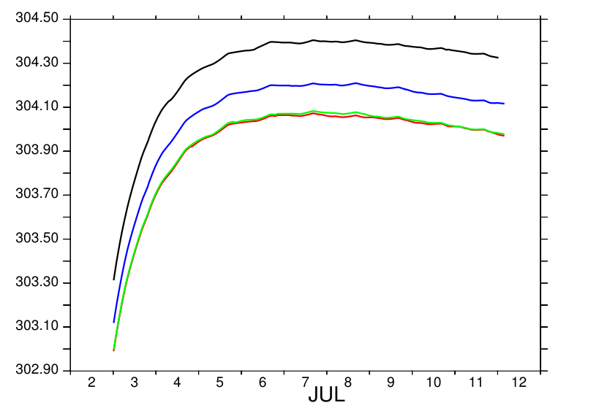
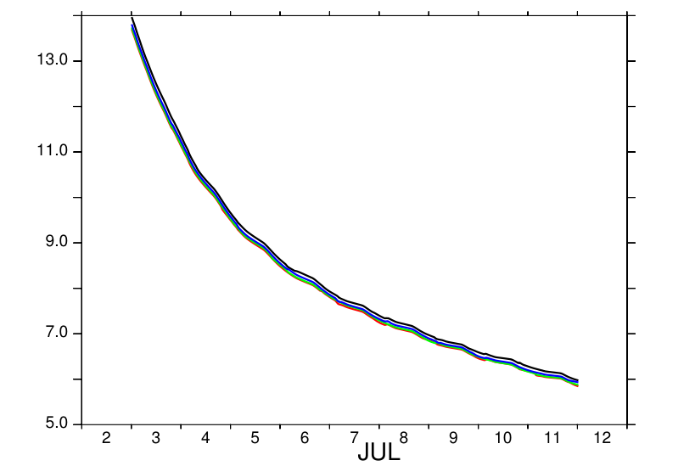
SCM with relaxation to initial profile
Dry soil with no latent heat flux and no cloud, forest with LAI=4
Daily mean surface temperature
Daily mean heat flux to ground
Standard, no correction, IH, adjusted tvrad

Slide 15
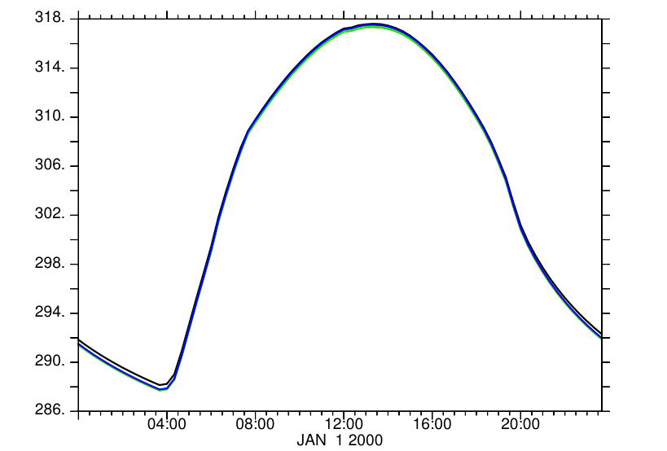
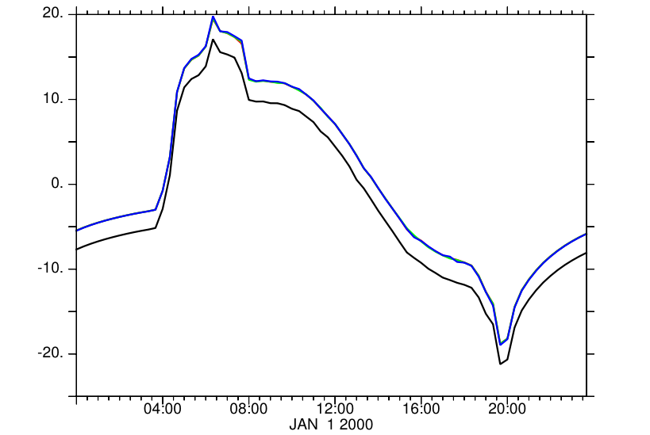
SCM with relaxation to initial profile
Dry soil with no latent heat flux and no cloud, forest with LAI=4
Mean diurnal cycle of surface temperature
Mean diurnal cycle of net radiation error (CABLE-UM)
Standard, no correction, IH, adjusted tvrad

Slide 16
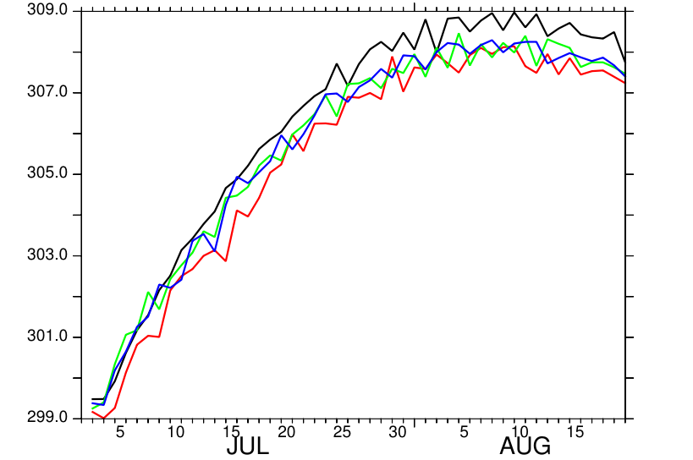
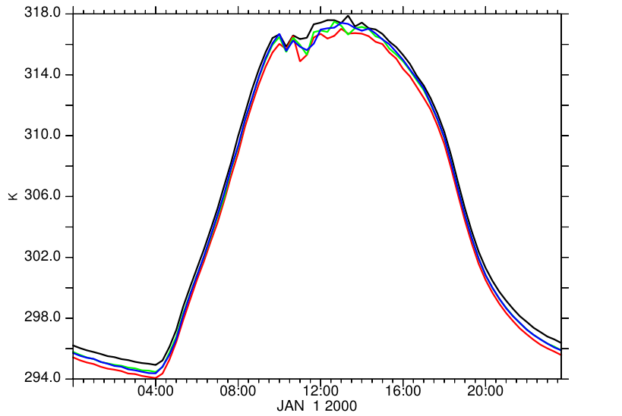
SCM with cyclic forcing
Forest with LAI=4, non-zero latent heat flux and clouds
Daily mean surface temperature
Mean diurnal cycle of surface temperature
Standard, no correction, IH, adjusted tvrad

Slide 17
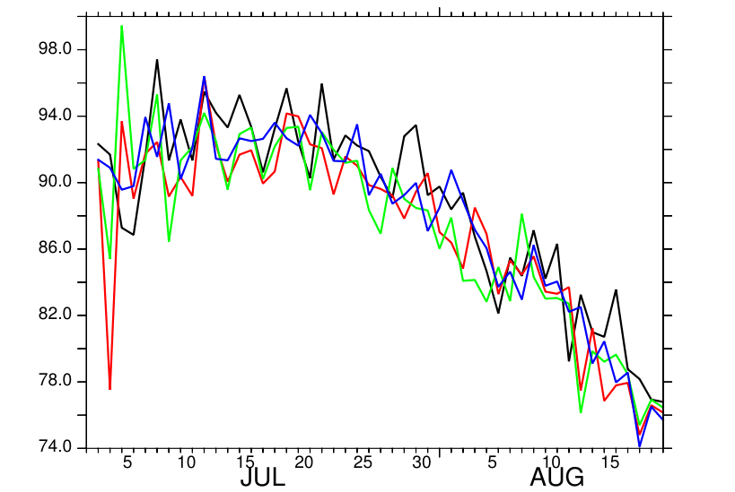
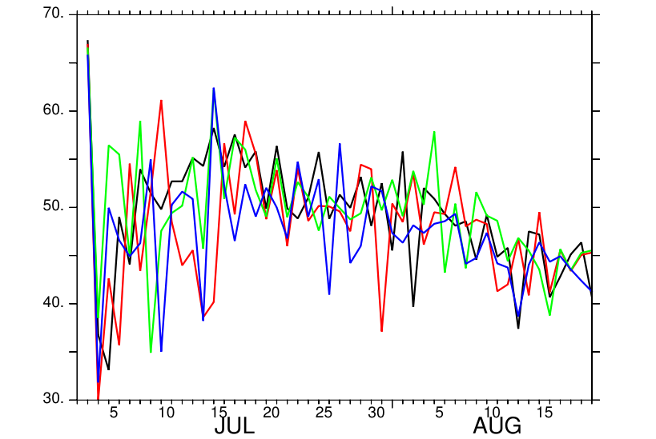
SCM with cyclic forcing
Forest with LAI=4, non-zero latent heat flux and clouds
Daily mean latent heat flux
Daily mean sensible heat flux
Standard, no correction, IH, adjusted tvrad

Slide 18
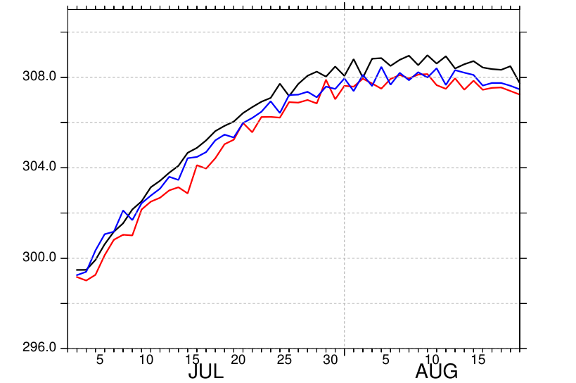
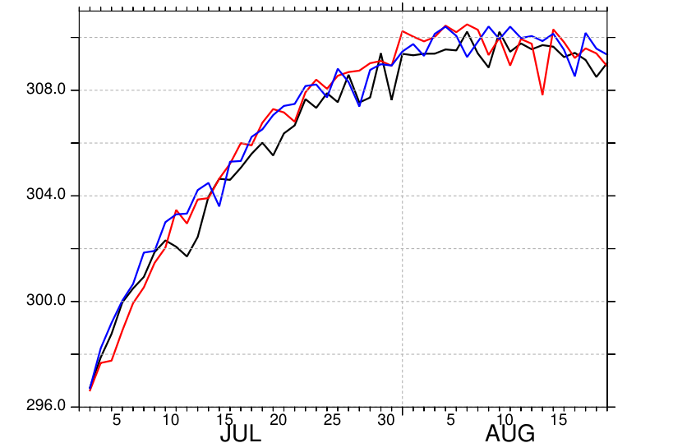
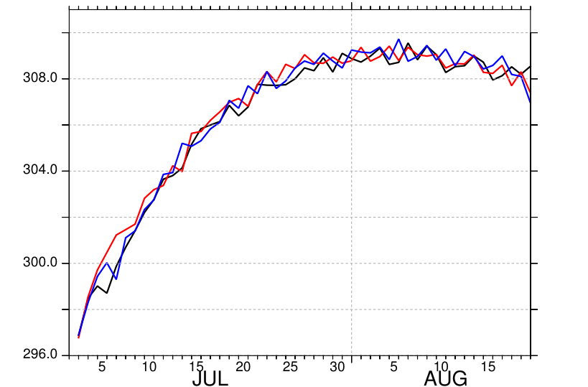
SCM with cyclic forcing: Forest
Daily mean surface temperature
LAI=4
LAI=1
LAI=0.1
Standard, no correction, IH

